Slide 1
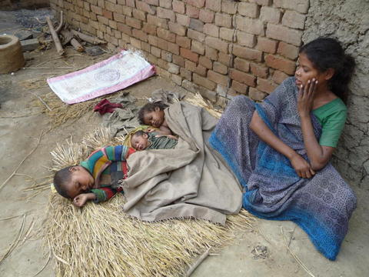


Sharpening the Focus on
Research & Innovation to Support Health Systems
Soumya Swaminathan, MD
DG, Indian Council of Medical Research, and Secretary, Dept of Health Research, MOH

Slide 2
ICMR Strategic Plan
Better Health through Research

Slide 3
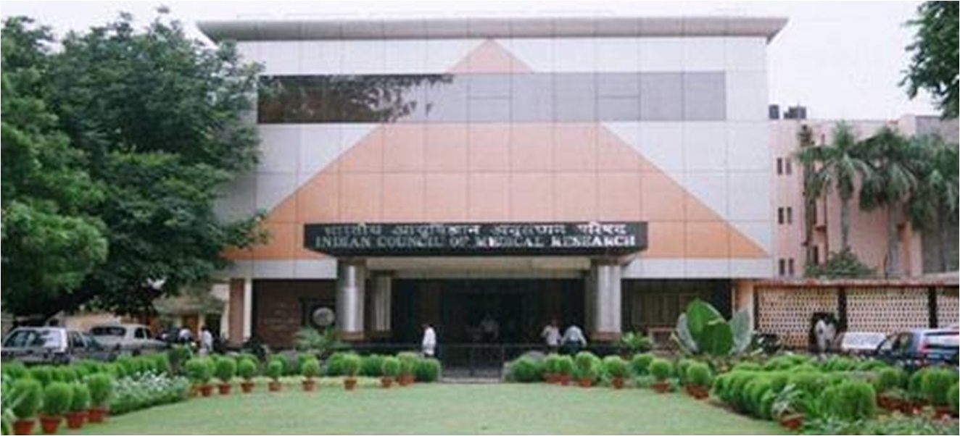
Indian Council of Medical Research
Founded in 1911 as Indian Research Fund Association; Renamed Indian Council of Medical Research (ICMR) in 1949
Apex organization to formulate, conduct, coordinate, fund and promote biomedical research
Autonomous organization under MoHFW, GoI
Intramural: High quality research through network of ~25 Institutes and field units
Extramural: Funding research in medical colleges, universities, institutions - ~ Rs 200 crore annually
Human Resource Development:
  1200-1500 fellowships/year including medical studentships, graduate scholarships and postdocs
  Adjunct Professor, Emeritus Professor and ICMR Distinguished Chairs

Slide 4
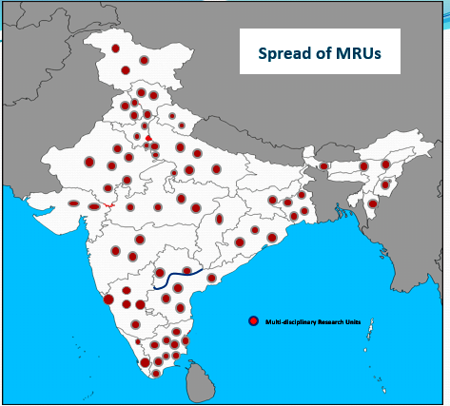
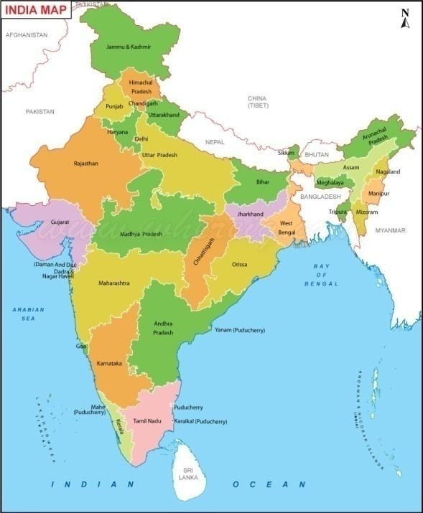
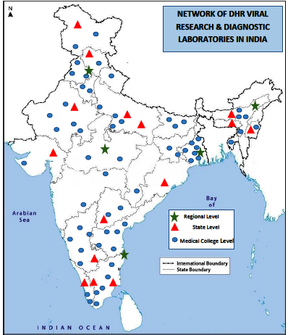
Infrastructure Development
Department of Health Research
Multi-disciplinary Research Units
Strengthen research environment in medical colleges and encourage faculty to undertake health research
Model Rural Health Research Units
Create infrastructure at primary health centres for transfer of technology to improve quality of health services and conduct research relevant for rural populations
Viral Diagnostic & Research Laboratories
Develop capacity for diagnostics, and undertake epidemiologic research for identification of new and unknown organisms & emerging/ re-emerging viruses

Slide 5
Vision 2030
Translating research into action for improving the health of the population
  achieve universal health coverage by developing indigenous, cost effective technologies and innovations in health care delivery
To make India a leader in health research
  Develop a cadre of clinician scientists
  Focus research on our health problems

Slide 6
Mission
GENERATE, manage and disseminate new knowledge.
INCREASE focus on research on the health problems of the vulnerable, the disadvantaged and marginalized section of the society.
HARNESS and encourage the use of modern biology tools in addressing health concerns of the country.
ENCOURAGE innovations and translation related to diagnostics, treatment, methods/ vaccines for prevention.
INCULCATE a culture of research in academia especially medical colleges and other health research institutions by strengthening infrastructure and human resource.
INTEGRATE research in different systems of medicine.

Slide 7
Strategic Framework
Pillar-1
Strengthen Health Research Capacity
Pillar-2
Organize Data Systems and Research Platforms
Pillar-3
Leverage Traditional Medicine
Pillar-4
Pillar-5
Enable Evidence to Policy Translation
Strengthen Program Implementation through Research

Slide 8
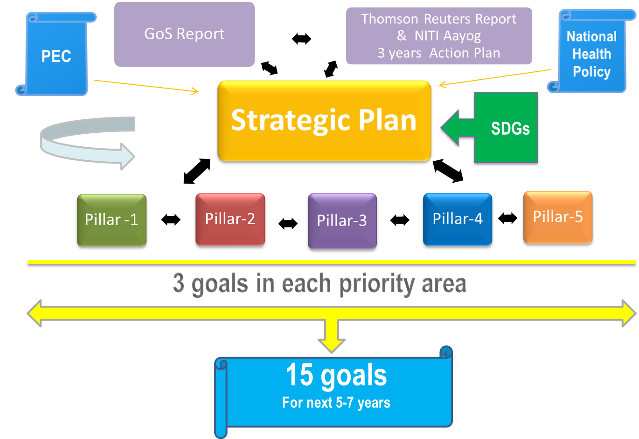
Roadmap to Better Health

Slide 9
Innovation for Health Systems

Slide 10
Connecting with Flagship Programmes
Vector Borne Diseases
Dengue, CHIKV national serosurvey
Triple drug therapy for filariasis elimination
Surveillance for Zika virus
Malaria elimination project in Madhya Pradesh in PPP mode
Wolbachia in Aedes mosquito to prevent viral infections
India TB Research Consortium
Support TB elimination by developing novel tools (diagnostics, vaccines and new regimens) through partnerships
Tribal Health Research Forum
Network of 16 ICMR Institutes
Research on Sickle cell anemia, Nutrition and TB
Non Communicable Diseases
A network of 27 centres for undertaking clinical trials in stroke
Improve hypertension management
Model of STEMI Care Pathway
Transfats estimation, strategy for reduction
Vaccine Preventable Diseases
Community based serosurvey to assess protection
Support measles elimination

Slide 11
Recent ICMR Technologies
MAC ELISA Kit for diagnosis of JE, dengue and WNV
Redesigned model of Cycle Rickshaw
Magnivisualizer for detection of pre-cancerous and cancerous lesion of uterine cervix
Fertility Assessment Kits

Slide 12
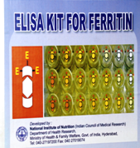
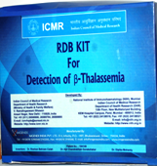


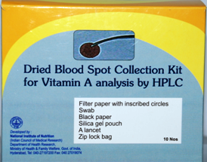
Nurturing Affordable
Indigenous Technologies - 1
Vaccines
JENVAC for Japanese Encephalitis (JE) in PPP mode with Bharat Biotech
Vaccine for H1N1
Occupational Health
Nylon knitted seamless gloves for tobacco harvesters
Cancer
AV Magnivisualizer, a magnifying device for screening cervical cancer
Diabetes
Strips and detection system(s) for Diabetes Mellitus
Nutrition
Technologies for Vitamin A and Ferritin estimations

Slide 13
Nurturing Affordable
Indigenous Technologies - 2
Blood disorders
Reverse dot blot hybridization diagnostic kit for detecting β-thalassemia syndromes and inherited blood disorders
Diagnostics for Infectious diseases
ELISA for detection of JE virus from mosquito
Assay for diagnosis of Hepatitis E, anti Crimean Congo Hemorrhagic Fever Virus antibodies in sheep and goat; anti CCHFV antibodies in Bovine; anti Kyasanur Forest disease virus antibodies; and anti Chandipura virus antibodies
Diagnosis of visceral Leishmaniasis from urine or saliva
Detection of pathogenic bacteria in food

Slide 14
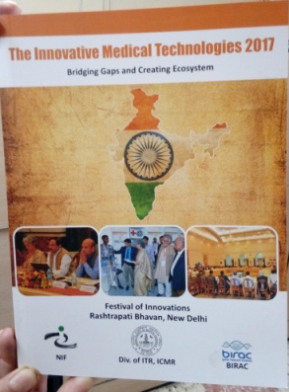

Showcasing Novel Indigenous Technologies
Festival of Innovations Exhibition at the Rashtrapati Bhavan
Exhibition
of Medical Technologies at the ‘Indo Africa
Health Science Summit’

Slide 15
Technologies Displayed
Diagnostics for NCDs
Labike Mobile lab : for providing quality diagnostic tests at low cost at doorstep of rural parts of country
Infectious diseases
Cilika - portable digital microscope
Truenat ® MTB - a molecular diagnostic test for detection of Mycobacterium Tuberculosis (MTB) in < 1 hour in near-patient settings
Others
Qora Stool Management Kit: FDA approved
Cardiovascular Diseases
MIRCaM – A mobile intelligent remote cardiac monitor provides real-time analysis in ambulatory ECG mode and connects to consultatnts through Cloud
Cardiac Patch/ (SYNKROSCAFF)
Neonatal Health
NeoBreathe – A foot operated newborn resuscitation system
Neonatal Resuscitation trolley with delayed cord clamping
BEMPU Bracelet -detects and alerts in the event of hypothermia in newborns
Drinking Water
Low cost laterite based filter for arsenic removal

Slide 16
Reproductive,
Maternal & Child Health

Slide 17
Aligning to National RMNCH+A Goals
Reducing Maternal /Perinatal
Morbidity and Mortality
Promoting Sexual and Reproductive Health
Addressing pregnancy complications
Addressing foetal & perinatal health, teenage pregnancy
Implementing safe birth practices
Fertility regulation, contraception
RTI/STI/FGTB/HIV prevention
Strengthening linkages between SRH and HIV
SRH of persons with disability RH of Tribal population
Gynaecological morbidities
Notes:
The focus of our research has been to provide evidence to policy makers to devise policies which would help in achieving the National goals and the MDGs/SDGs.
RMNCH+A = Reproductive, Maternal, Newborn, Child Health and Adolescent health

Slide 18
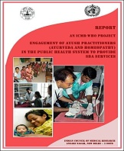
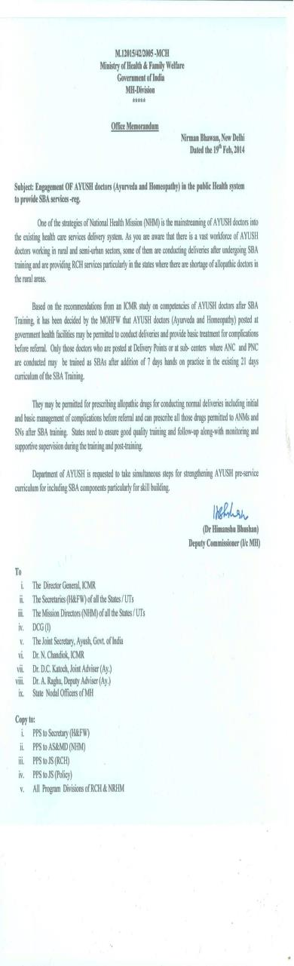
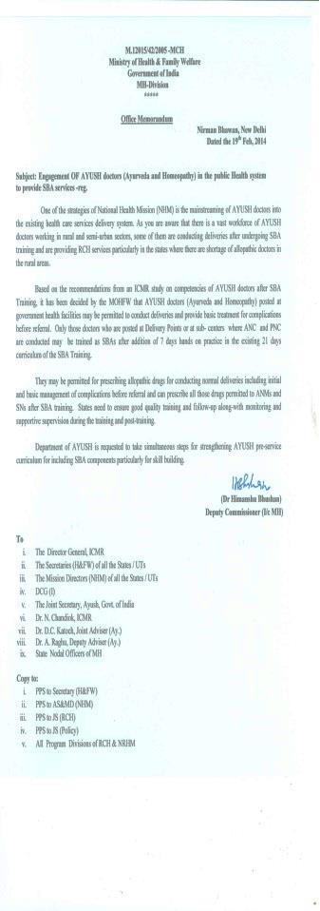
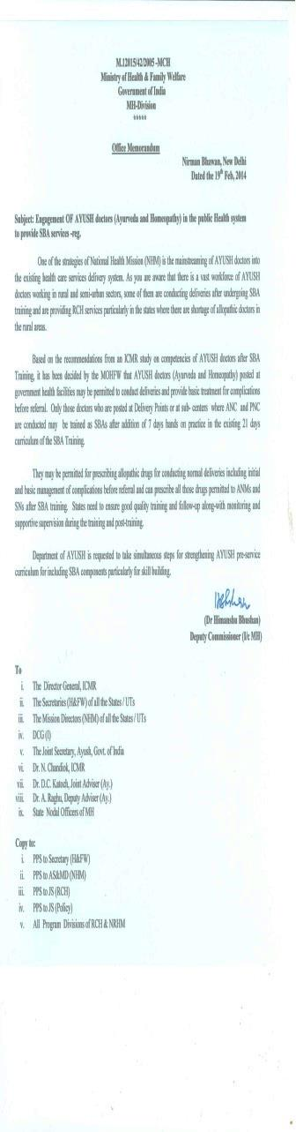
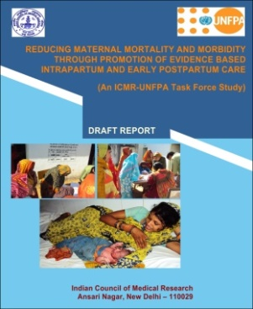
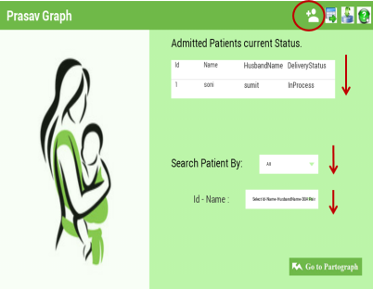
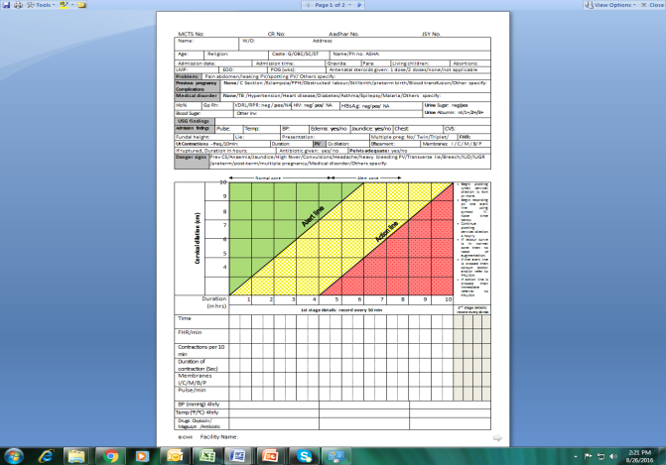
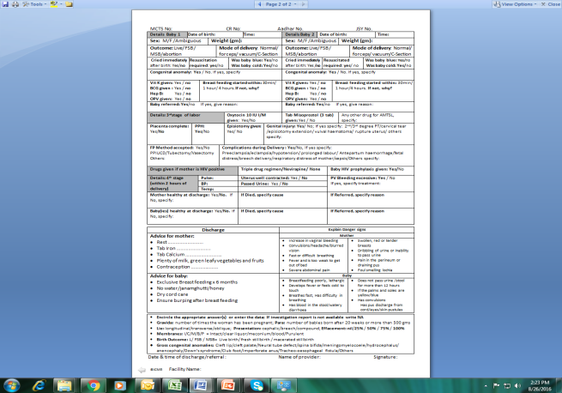
Reducing Maternal/Perinatal
Morbidity and Mortality
Health Systems Research
Engagement of AYUSH providers for Skilled Birth Attendance (SBA) – ICMR – WHO TF study
Implementing evidence based practices
Provider adherence to SBA guidelines, barriers
and challenges – ICMR – UNFPA study
Development of e-partograph/PrasavGraph - ICMR-IIT Delhi collaboration
Designing of Prasav Sheet
PrasavGraph
Addressing Pregnancy & Perinatal Complications
Task Force on Perinatal health, Preterm Birth, Stillbirths, Quality of Care
Center for Advance Research on Preeclampsia
PrasavSheet
Notes:
Engagement of AYUSH providers for Skilled Birth Attendance (SBA)- ICMR-WHO TF study was carried out in 6 districts of the country (Ajmer, Pali in Rajasthan; Nasik, Thane in Maharashtra and Mayurbhanj, Dhenkenal in Odisha) provided evidence that the graduate course curriculum of Ayurvedic & Homeopathic doctors provides them with basic knowledge of childbirth and with a short term training in skilled birth attendance their services could be used by the States to enhance the number of skilled workforce in maternity care. This was accepted as a policy by the Ministry. Appropriate amendments were made such that AYUSH providers were permitted to use essential allopathic drugs during delivery, such as misoprostol and oxytocin etc. It is expected that with this effort, AYUSH providers could fill in about half of the nearly 26,000 shortage of skilled birth attendants.
Provider adherence to SBA guidelines, barriers and challenges- ICMR-UNFPA study -The GoI issued guidelines on SBA in 2005 and trained maternity care providers accordingly. We evaluated the providers’ adherence to these guidelines in 5 districts of the country (Allahabad, Baroda, Cuttack, Jaipur and Thiruvallur) covering 5 medical colleges, 5 district hospitals and 46 CHCs/PHcs. Our findings indicated that the provider practices and processes were not aligned with the guidelines even in the medical colleges. Obsolete practices which can cause harm or strain time and resources need to be discontinued. In-depth interviews of 125 providers (doctors, nurses & ANMs were analyzed. The major barriers in adherence to the guidelines were grouped under 4 themes: -poor awareness and training; organizational & managerial barriers- lack of manpower, supplies; poor infrastructure and attitudinal barriers. Findings informed the Government to focus attention on wider dissemination of guidelines and training, focus on pre-service and in-service training of providers – Nurse Mentor programme and Dakshata program was initiated, Kayakalp programme to improve infrastructure of hospitals; central procurement of supplies has been initiated, display of protocols in labour rooms has been initiated, and birth companionship programme has been initiated. Further the government is focusing on improving documentation, and greater involvement of medical colleges in the programme.
Development of e-partograph - ICMR-IIT Delhi collaboration- Plotting of partograph which is recommended for every delivery in the SBA guidelines is <15%. Skills of providers are poor and plotting is often retrospective and incorrect thus rendering it not useful for diagnosing prolonged labour. E-partograph/prasavGraph ia an android based software which runs in real time with facility for offline recording and opportunistic upload, raising alerts for timely examination of patient or when the reading is abnormal, can send sms to specialist who is away from the facility. Work is being done for creating the platform for operationalizing the e-partograph. States of AP and MP have approached ICMR for initiating e-partograph.
PrasavSheet is a simple to use labour room case sheet which will provide a uniform database for collection of data in peripheral health facilities. Most entries in this need to be encircled with very little requirement of hand written text. This has been adapted by GoI for use in peripheral health facilities.
CAR on Preeclampsia has been supported to investigate the mechanisms leading to PE especially the role of LCPUFA and micronutrients. A bio-repository will also be created.
Leads from Adhoc projects:
Development of First trimester reference centiles of fetal biometry, Reference centile charts of first trimester aneuploidy screening and Doppler parameters for Indian Population.
Effect of tobacco exposure status on intra-uterine growth, birth weight (BW) and fetal outcome in bidi rollers by serial fetal biometry and cotinine assays indicated that Bidi-rolling results in nicotine exposure with nearly 4 times higher chances of developing gestational hypertension and oligohydramnios, and nearly two times higher risk of preterm and low birth weight.
The role of organo-chlorine pesticides (OCPs) as endocrine disrupter in causing PTB was investigated and indicates that high levels may be associated with PTB.

Slide 19
Promoting Sexual & Reproductive Health
Adolescent Health
Preparedness for marriage
Menstrual hygiene
Reproductive morbidities
SRH
(Sexual & Reproductive Health)
Female genital fistula in tertiary care hospitals- distribution, risk factors, success of repair, psychosocial-economic effects
Evaluation of molecular
methods (PCR, IHC) against conventional methods (HPE, culture, AFB staining) and laparoscopy in detection of FGTB
Task Force on Reproductive health issues among Tribal population- service utilization, male involvement
Task Force on Sexual & reproductive health of persons with disability
Contraception
Female condom
PPIUCD expulsion
Recombinant vaccine against B-hCG
Gynaecological morbidities
Pelvic floor dysfunction, CVD risk among PCOS, Genetic & biochemical
markers in metabolic syndrome, endometrial receptivity in infertility, Role of ATT in endometrial DNA-PCR +ve infertile women
,
Ethical Guidelines for Tribal health research

Slide 20
ICMR Studies on Expanding
Contraceptive Choices
CuT 380A
NET-EN-200mg
EC- Levonorgestrel 1.5mg
Medical Abortion regimen
Implanon subdermal single rod etonogestrel
Progesterone vaginal ring for lactating mothers
Notes:
Rationale: Use of contraceptives and appropriate use of its back-up methods for spacing or limiting births ensures better health for mother and child. Expanding contraceptives choices helps to meet some of the contraceptive unmet need of couples since reproductive desires differ in different people and in different periods of reproductive life.
ICMR studies on contraceptives include the following:
Long acting non-hormonal Contraceptive CuT 380A was introduced in the Family Welfare Prog in 2002 based on ICMR studies
ICMR studies in the 80’s and early 90’s led to the availability of NET-EN-200mg as a two monthly contraceptive injection in the country since 1994.
ICMR studies on back-up methods to contraceptives viz. Levonorgestrel 1.5mg resulted in the availability of emergency contraceptive (EC) pill in the Programme in 2002
Oral Mefipristone 200mg +misoprostol 400/600mcg is available in the country for safe early abortion since early 2000.
ICMR recently completed a large multicentre study with subdermal contraceptive single rod etonogestrel -68mg implant for safety, efficacy and acceptability of the 3 year contraceptive device on 3161 women enrolled at 22 participating sites (medical colleges and hospitals) in the country . The results led to the marketing of the product in 2017.
ICMR is completing a comparative study with progesterone vaginal ring (PVR) as a three monthly user-controlled vaginal contraceptive device compared to long acting (10 Yrs) , provider-controlled IUD CuT 380A available in the NFWP for post-partum women continuing with lactation for one year. The study carried out on 789 women (459-PVR and 330-IUD users) at 20 participating sites (medical colleges and hospitals) indicated that PVR is comparable to CuT 380A in terms of safety efficacy and acceptability of the method indicating that PVR could be made available to women in the country as an additional contraceptive choice for post-partum

Slide 21
What Next (2017-22)
Respectful Maternity Care Initiative (WRAI)
Operationalization of
e-partograph
(State Govts.)
Operationalization of Cancer screening guidelines (TATA, RMRC,
NICPR, State Govts.)
Building Research capacity
Information, Education
Implementation Research (IR)
Collaborations
Evidence to Policy
Data repository & Gap Analysis
PrasavSheet for improving labour documentation-Feasibility study (RMRC, KIIT)
Stillbirth burden & causes in district health system
Hysterectomy – causes, routes, complications
DBT- placenta research, Preeclampsia
CaRe-GAP- Perinatal Institute, Birmingham
Vaccine-B hCG
Rep health-Tribal population/NER
Notes:
Respectful Maternity Care Initiative -To review available standards for Respectful Maternity Care (RMC) and adapt them in the Indian context, Engage maternity care stakeholders to create awareness, recognize and report on deficits in RMC , Document challenges, barriers and facilitators in implementing RMC standards in facilities and Develop intervention model for implementing RMC in facility births. Will be carried out in 25 tertiary care medical colleges.
Training of providers for screening of oral, breast and cervical cancer in tea gardens of Dibrugarh – collaboration with TATA
tea, RMRC Dibrugarh and NICPR
PrasavSheet for improving labour documentation-Feasibility study – will be carried out in Mayurbhanj and Kandamal districts
of Odisha , in collaboration with RMRC Bhubaneshwar and KIIT University
Stillbirth burden & causes in Haryana – will test the application of a simple stillbirth tool to identify burden of stillbirth & early neonatal deaths and their risk factors in public health facilities of two districts in Haryana, in collaboration with PGIMER
Hysterectomy – causes, routes, complications. Study will bring out research needs in the management of common gynaecologic conditions leading to hysterectomy and its complications
Case Review and Growth Assessment in Pregnancy (CaRe-GAP): In collaboration with Perinatal Institute, Birmingham
Capacity building to improve perinatal outcome through use of
(a)Standardised case reviews which will help to recognise antenatal and intrapartum care factors for stillbirth and facilitate development of learning points and action plans to address them and,
(b). Fetal growth assessment: a comprehensive ‘train the trainer’ and e-learning programme to ensure standardised assessment and recording of measurements throughout pregnancy, and appropriate protocols for referral. This is supported by a rolling review to assess antenatal detection rates of ‘at-risk’ pregnancies and identify service gaps leading to missed opportunities

Slide 22
Major Focus of Newborn and Child Health Research
Addressing new born and child survival
  Home based newborn care
  Neonatal infections
  Low birth weight
  Prematurity- prevention and management
  Childhood pneumonia
Addressing childhood morbidity
  Paediatric kidney diseases
  Childhood cancers
  Paediatric HIV
  Childhood injuries
  Children in difficult circumstances
  Probiotics in women’s and child health
Health system research & Programme evaluation
Technology for health

Slide 23
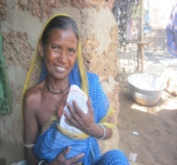
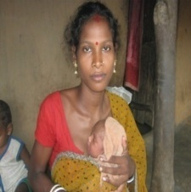
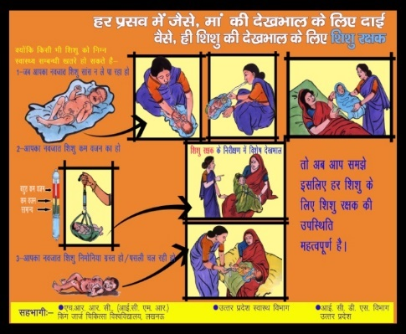
Reducing Neonatal Morbidity and Mortality
Home Based Management of Young Infants: tested effectiveness of home based newborn care at 5 sites
  Significant reduction in ENMR, NMR, young infant mortality rate, PNMR, IMR observed in intervention arm
  Results translated into policy home based newborn care in ASHA module
  Authorised injection genatmicin by ANM in special situation
A pilot study feasibility and acceptability of Kangaroo mother care initiated at home for Low birth weight babies(3 sites-rural, rural tribal and urban population) demonstrated
--method was acceptable to most mothers
--possible to promote KMC using the existing infrastructure

Slide 24
Surveillance for Neonatal Infections
Multi center study at 6 sites at secondary level hospitals to identify organism causing sepsis in neonates and their antimicrobial susceptibility showed
Culture positivity in 12.3% suspected cases. Early onset sepsis is more common
Kleibsiella spp and Staph aureaus- major pathogens causing sepsis in neonates in secondary level facilities
Need for implementation of infection control practices highlighted
Resistance pattern: Gram negative
bacilli(n=191) Resistance pattern: Gram negative cocci(n=134)

Slide 25
Effect of Probiotics VSL#3 on Prevention of Suspected Sepsis in LBW 0-2 month Old Infants in India: RCT
Low birth weight (LBW) neonates are at high risk for infections, including neonatal sepsis. Probiotics are effective in preventing necrotising enterocolitis and nosocomial infections in preterm LBW babies.
A significant effect was observed among infants weighing 1.5-1.9 kg & Median days of hospitalization with daily supplementation of probiotics VSL#3 (10 billion colony forming units (cfu)) for 30 days and 15 day delay in the onset of sepsis in the intervention arm in a multicentre pilot study.
A larger study is warranted

Slide 26
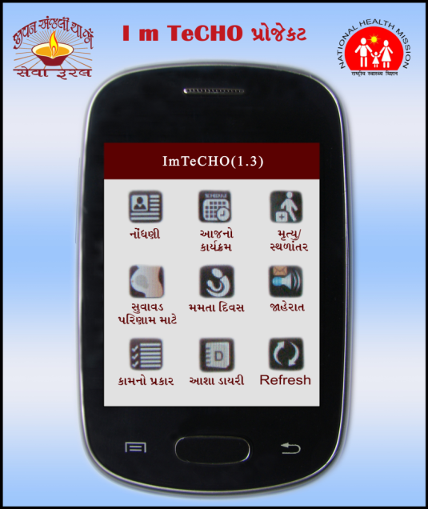
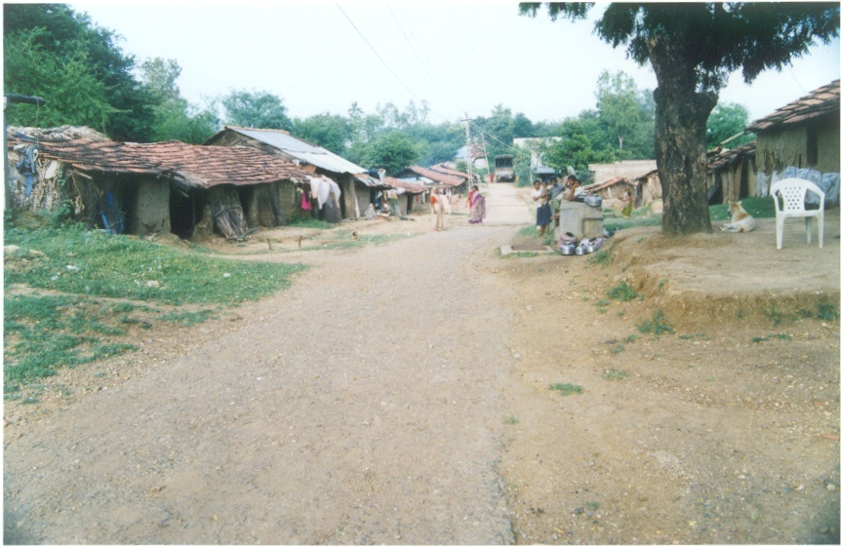
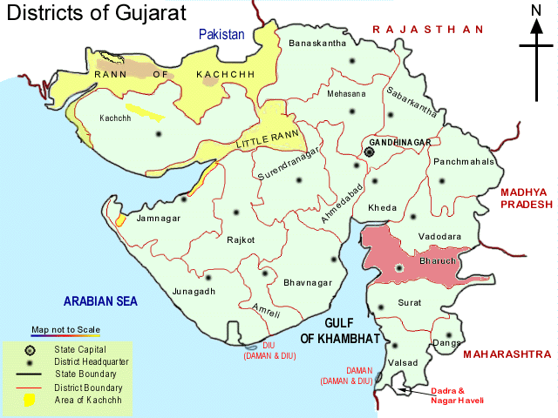
ICMR-WHO Implementation Research Study
An innovative intervention based on mobile-phone technology to improve coverage of proven community-based MNCH interventions to be delivered by ASHAs and PHC staff in tribal and rural communities of Gujarat
IMR & NMR
Implemented by NGO Sewa Rural

Slide 27
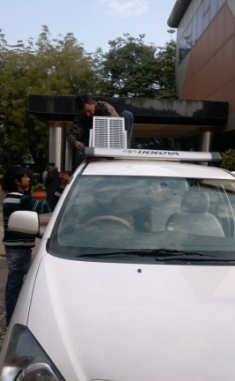
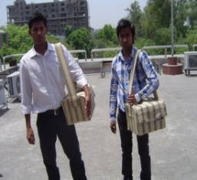
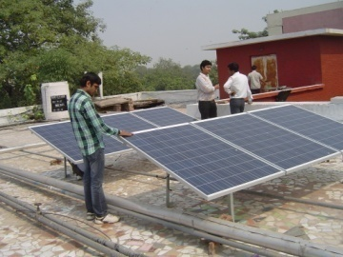
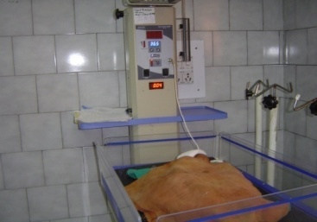
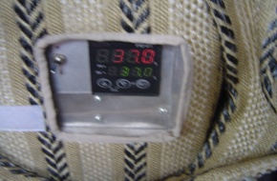
Solar Innovations in Healthcare of Newborns, Infants and Children - PHASE I
Solar Radiant warmer in operation since 10-12-2012 in LNJP Hospital
Solar portable culture Incubator
Selected in the i3 regional fair-northern region 30 Sept., 2013
Ranked 7th at the National i3fair held on
17 Oct. 2013
Awarded in the "Innovations in Medical Science and Biotechnology” on 11th March 2015 at Rashtrapati Bhavan
Manuscript submitted for publication in the “international J of clinical Neonatology”
Solar Powered Portable Culture Incubator: Annals of Pediatrics & Child Health 2015;3:1063

Slide 28
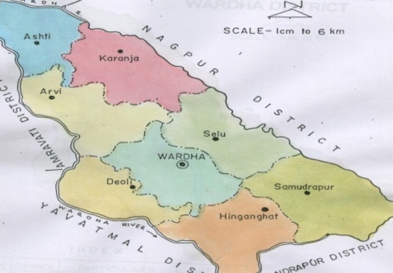
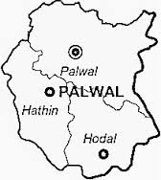
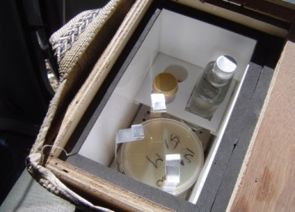
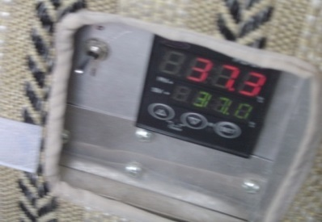
Solar Model District – in the Care of New Borns, Infants Phase II
Solar Radiant warmer
Wardha, Palwal
Solar portable culture incubator
Initial Feasibility study
Individual doctors were made aware of this innovation
Samples were requested from them
Brought samples of blood agar plates smeared with Pus, Throat swab etc kept in the solar portable culture incubator
Van was made available
AIIMS Microbiology did the culture and provided the Blood Agar culture plates
Reports were emailed to the Civil Surgeon
Where do we propose to use the solar powered radiant warmer:
Special Care Newborn Unit (SCNU): that provides
care to all sick newborns (except for those requiring assisted ventilation or major surgery)
Neonatal stabilization Unit
New born care corner

Slide 29
National Severe Acute Malnutrition Alliance
RCT to evaluate three feeding regimens on the recovery of children from uncomplicated severe acute malnutrition evidence to inform national policy (Inter ministerial SAM Alliance)
Recovery rate 43% in augmented home prepared food (AHPF) 48% in commercially procured ready to use therapeutic food (RUTF-C)
57% in locally prepared ready to use therapeutic food (RUTF-L)
Study 2 assessed MUAC at different cutoffs
Cut-off of 13.4cms would identify around 80% of all target children in the community
MUAC <11.5cms (Recommended by WHO) only identifies about a third of the children

Slide 30
Impact evaluation of a Screen Test and Treat approach for reducing prevalence of anaemia: a multi-centric cluster randomized trial among vulnerable groups from rural population
Possible reasons for low impact of the anemia control programs:
Supply chain problems
Poor compliance
Untargeted IFA supplementation in vulnerable groups
Multiple micronutrient deficiencies
Hypothesis
Adopting a ‘screen, test to diagnose & treat’ approach at community level will result in greater reduction in prevalence of anaemia among vulnerable rural population groups compared to the current practice of universal iron folate supplementation.
Study design: Community based cluster-randomized open labelled trial in four centres from the country
Unit of randomization: village
Selected villages: randomly allocated to one of the two arms:
Intervention arm: public health approach to screen, grade & treat anaemia
Control arm: existing practice of universal IFA supplementation under the anemia control program
Duration of follow up: one year
Primary outcome: (to be assessed at the end of one year)
Prevalence of anaemia in the different age & physiological groups
Secondary outcome measures:
Validated point of care diagnostic method for Hb estimation
Information on the causes of anemia in non-responders to IFA treatment

Slide 31
Surveillance

Slide 32
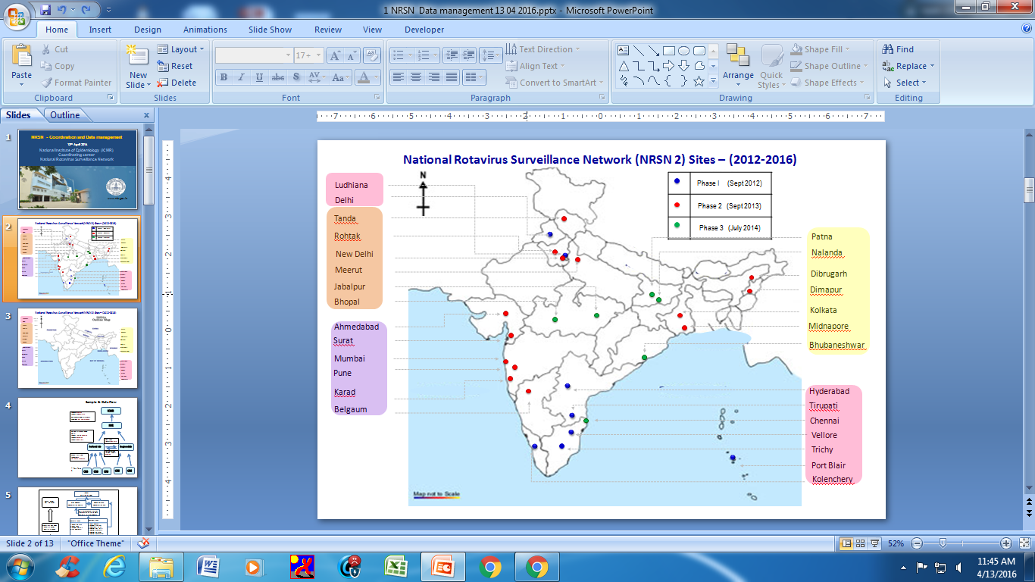
National Rotavirus Surveillance Network: 2012-2016
National hospital based surveillance to examine long term trends and pattern of diarrhea attributable to rotavirus among children < 5 years
To investigate the molecular epidemiology of rotavirus in India by typing the G and P proteins.
NRSN Sites – (2012-2016)

Slide 33
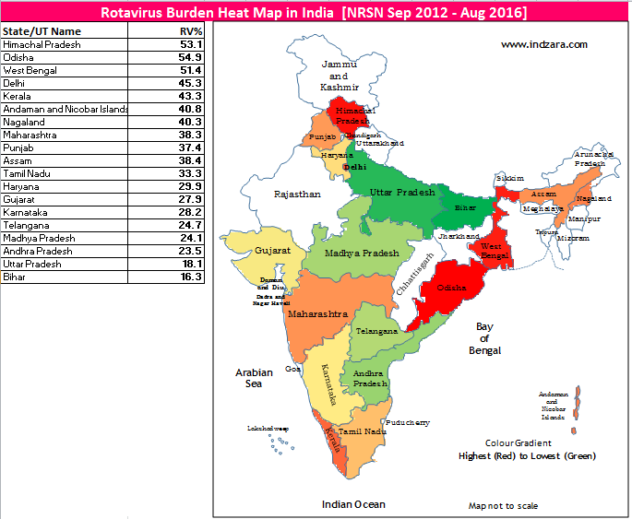

NRSN - Key findings
Rotavirus detected in 36% of children with AGE
Highest positivity (43%) among children aged 12 - 23 months
40% children with severe to very severe diarrhea were rotavirus positive.
Rotavirus infections occurred more commonly during the cooler months of December – February,followed by September – November
G1P[8] strains (52.9%) was the top strain followed by G9P[4] strains (8.7%) across the country
RV positivity Heat map

Slide 34
Informing vaccine policy
Surveillance data from National Rotavirus Surveillance Network (NRSN) highlights the high rotavirus disease burden in India
The age related data showed that Highest positivity (43.1%) was among children aged 12 -23 months; children aged 6-11 months had positivity of 40.7%
Infections occurred more commonly during Dec. – Feb
Data available with NTAGI and Immunization Division, MOHFW contributed to the decision on rotavirus vaccine introduction in UIP
With Phased roll out of the rotavirus vaccine in the UIP, ICMR in partnership with CMC Vellore and other agencies are continuing surveillance of rotavirus disease burden in the vaccine introducer states towards the assessment of the rotavirus vaccine impact

Slide 35
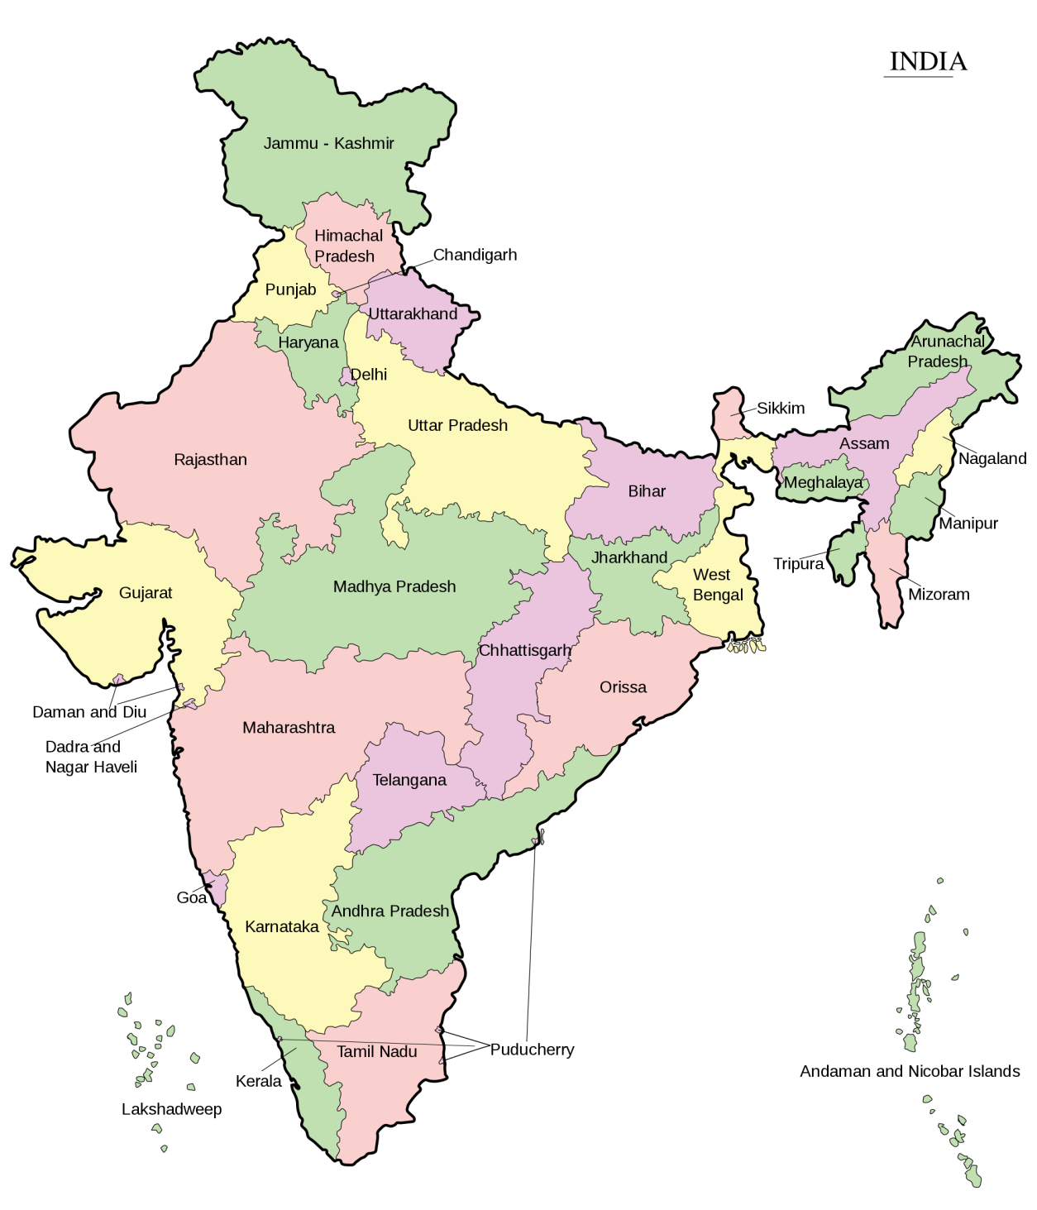
Rotavirus Vaccine Impact Assessment Study
Phase 1 - 14 hospitals in 4 states and 1 UT
Surveillance started before or with vaccine introduction in April 2016 in 4 states
Case-control design for vaccine effectiveness being undertaken .
Intussusception monitoring in 9 hospitals
Tanda, Shimla, Chandigarh (3 hospitals)
Rohtak, Mewat, Sonepat,
Chandigarh (4 hospitals)
Bhubaneshwar, Cuttack (4 hospitals)
Kurnool, Vizag,
Tirupathi (3 hospitals)

Slide 36
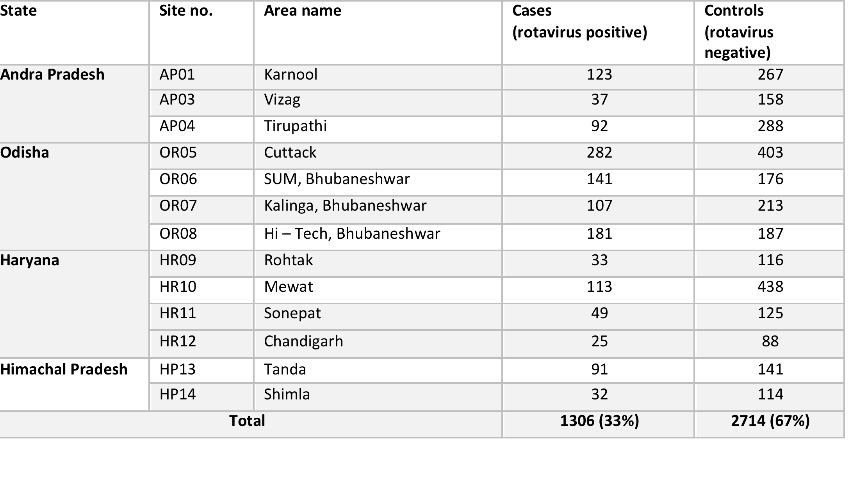
Current Status of Enrollment
Children admitted with gastroenteritis and tested for rotavirus (positive- potential cases if age eligible, negative-potential controls if age eligible)
Age eligibility will be determined and interim analysis conducted in Q4 2017
190 cases of intussusception identified, mostly not vaccinated with rotavirus vaccine. Analysis planned for 2018

Slide 37
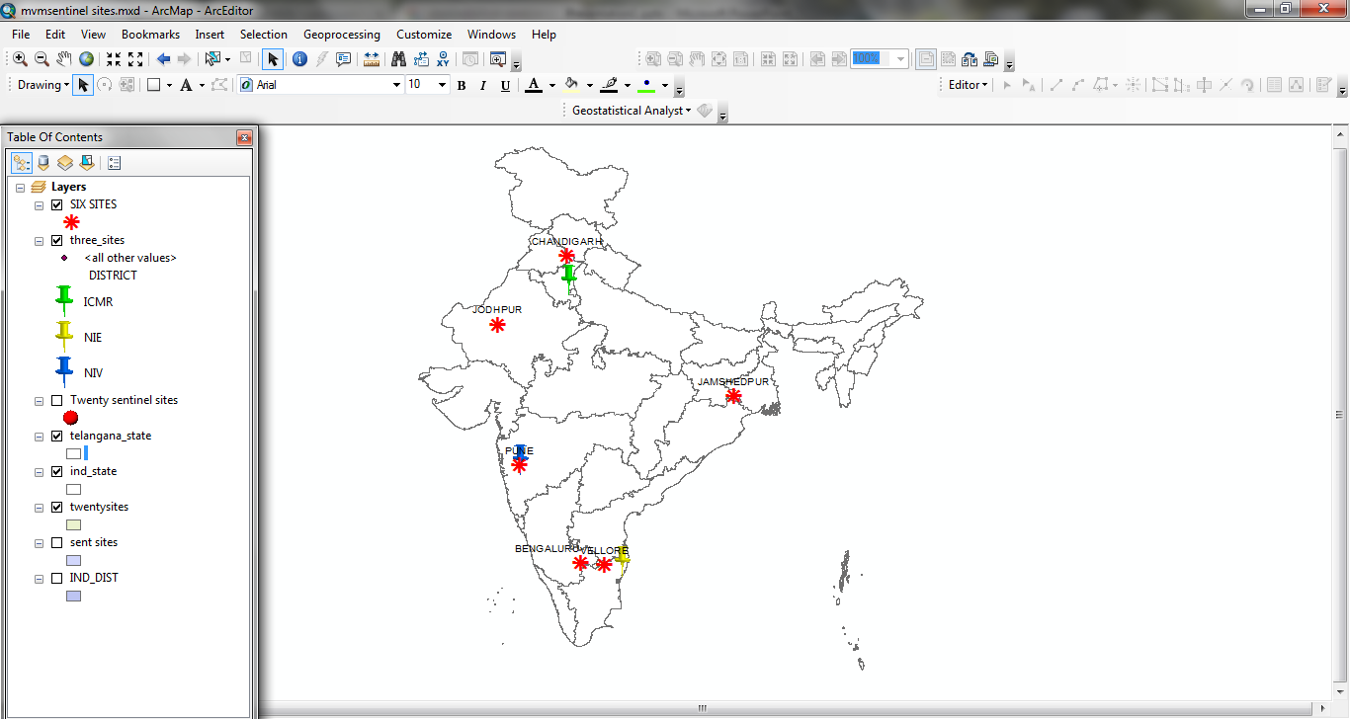
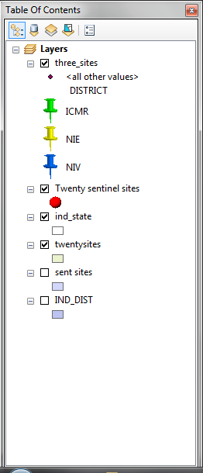
Congenital Rubella Syndrome Surveillance
CRS Surveillance – is strategic objectives for rubella/CRS control by 2020 (WHO SEARO)
ICMR initiated CRS surveillance in 2016 in six sentinel sites (Phase-1)
  Generate estimates of disease burden
  Monitor progress made by rubella control program
  Generate data about rubella serotype
ICMR, DELHI: OVERALL COORDINATION
NIE, CHENNAI: EPIDEMIOLOGIC COORDINATOR
NIV, PUNE: LAB COORDINATOR
Notes:
CRS sites in Phase 1: CMC Vellore; IGICH, Bengaluru; KEM, Pune; AIIMS, Jodhpur; PGIMER, Chandigarh; TMH, Jamshedpur

Slide 38
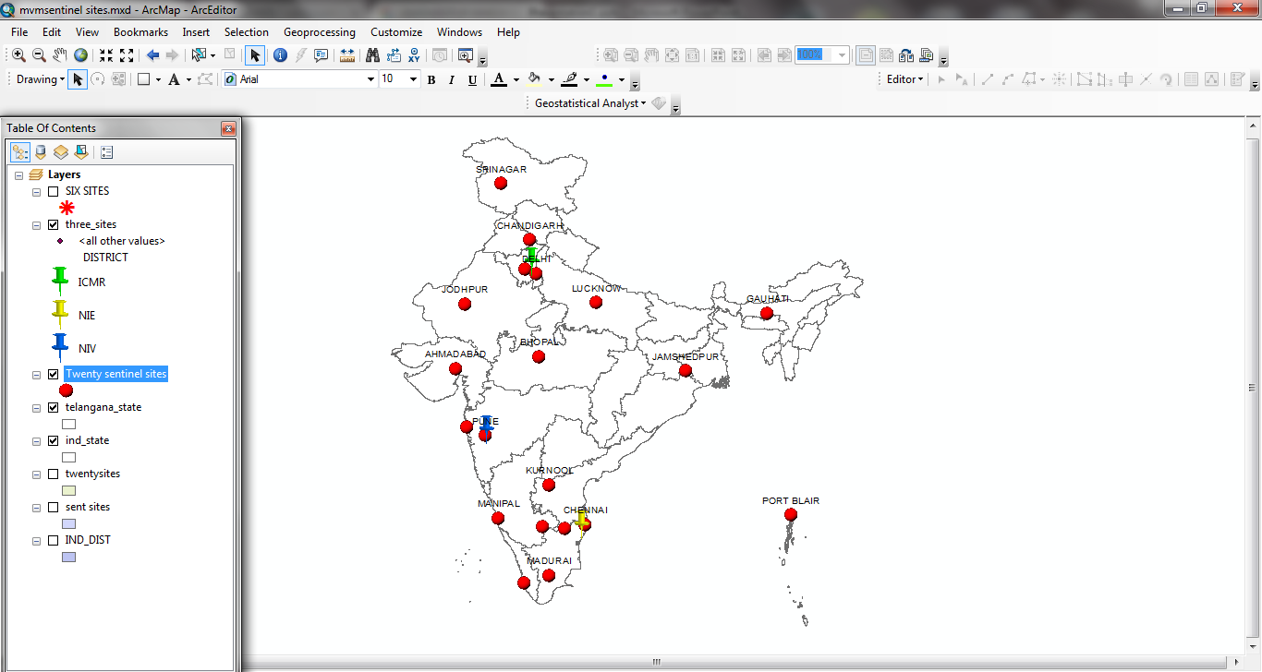
CRS Surveillance (Dec. 2016 – June 2017)
Suspected patients enrolled: 186
Proposed expansion: 20 sites
CRI, 2.2%
Clinically compatible, 5.9%

Slide 39
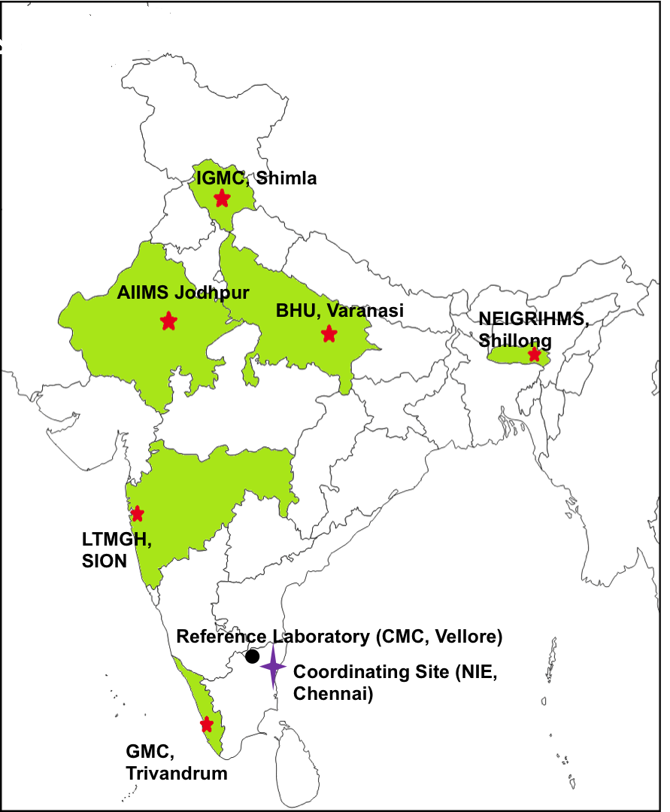
Surveillance of S. pneumoniae and other Invasive Bacterial Diseases
Objectives
  Estimate burden and distribution S. pneumoniae
  Determine the serotype profile and subsequent replacement of serotypes of S. pneumoniae in children with pneumonia and invasive bacterial diseases.
Recruited 1082 suspected pneumonia cases
  X-ray confirmed pneumonia: 876
  Blood culture positives for S. pneumoniae: 8

Slide 40
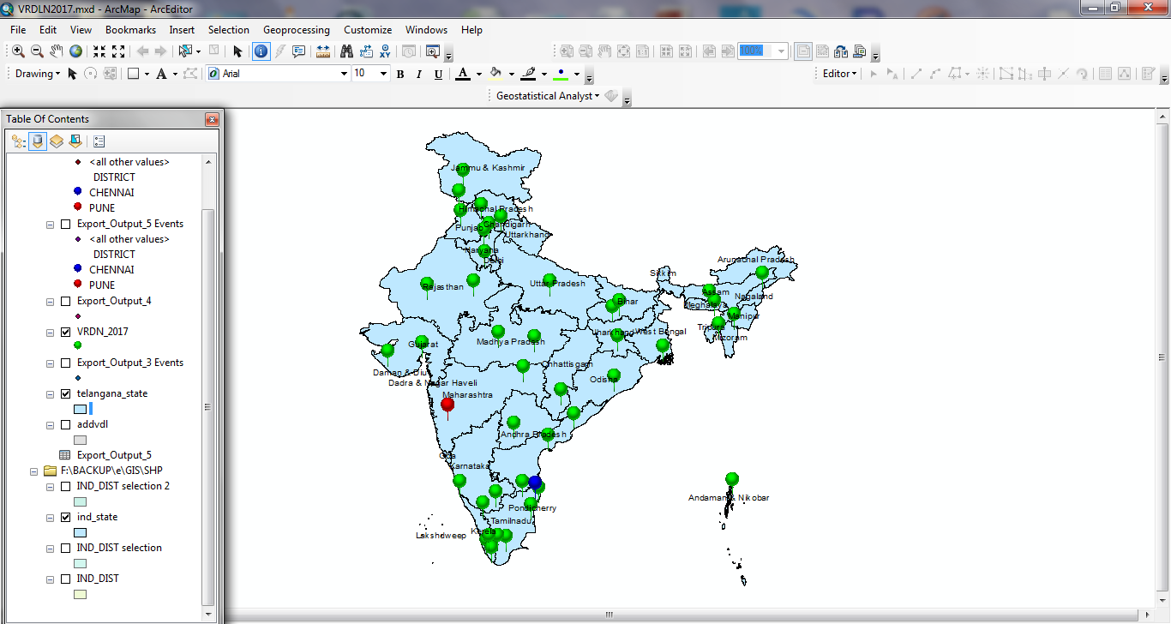
Virus Research and Diagnostic
Lab (VRDL) Network
Objectives:
  Strengthen laboratory capacity in country
  Provide early diagnosis to viral outbreaks
Structure
  Regional, State and District level labs

Slide 41
Disease clusters diagnosed by VRDLs during 2016-17 (n=307)

Slide 42
Cancer

Slide 43
Cancer Research Priorities
Training and implementation of cancer screening guidelines at Cachar Cancer Unit at Silchar in Assam
National ECHO hub for cancer prevention, empowering paramedical and medical workers in cancer control methodology, thus demonopolizing specialty knowledge in underserved areas
WHO - FCTC Global Hub on smokeless tobacco – undertaking policy and intervention studies to control this problem
Evaluating feasible and cost effective indigenous technologies for Human papilloma virus testing (eg HPV DNA test)
Supporting states with HPV vaccine introduction in schools

Slide 44
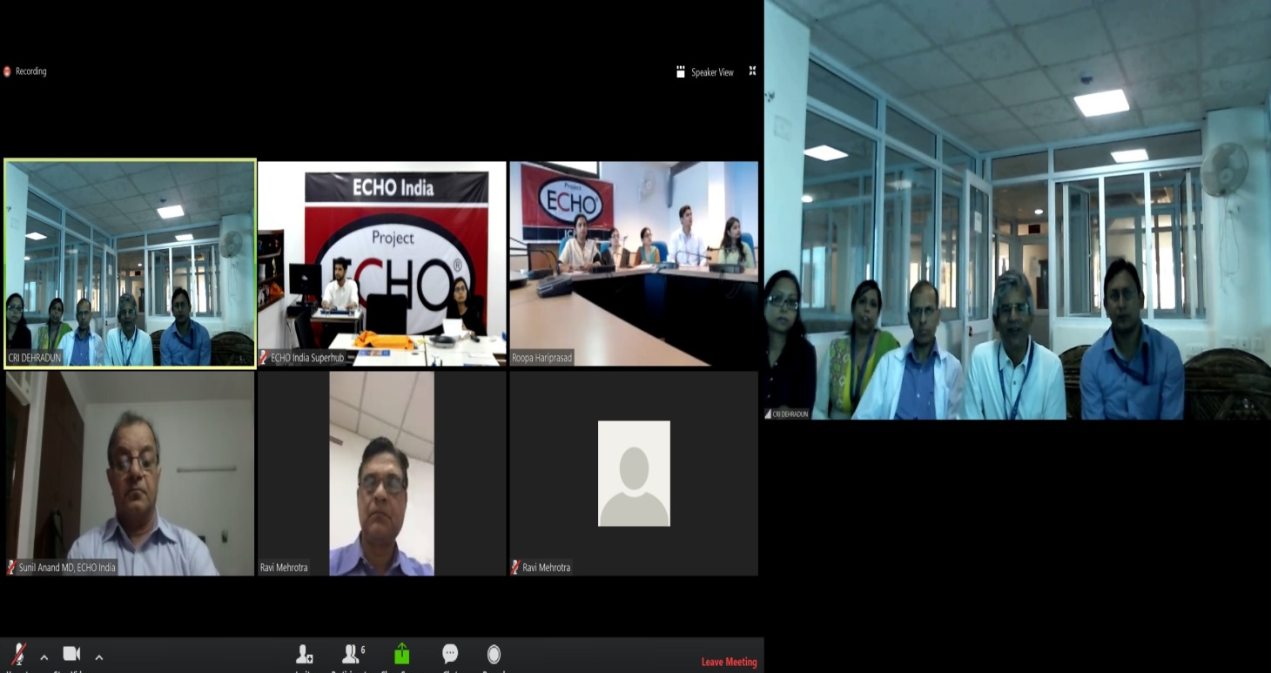
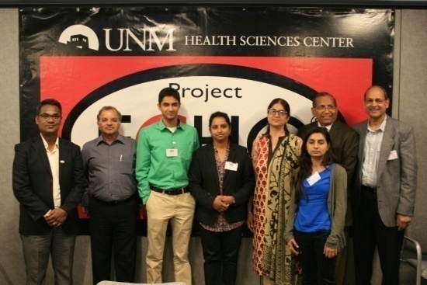

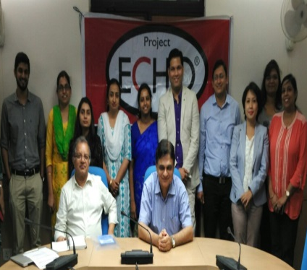
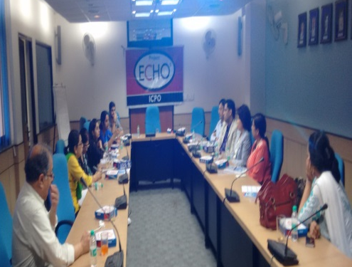
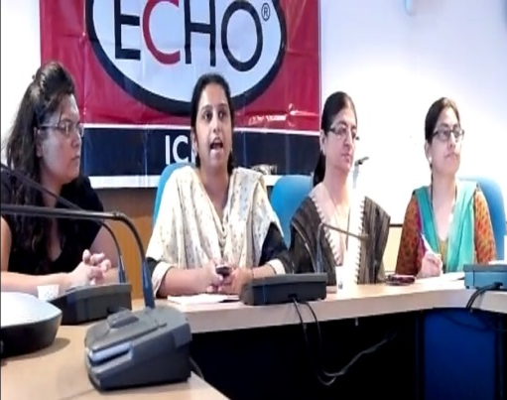
USING ECHO TECHNOLOGY for DISTANCE TRAINING IN CANCER SCREENING

Slide 45
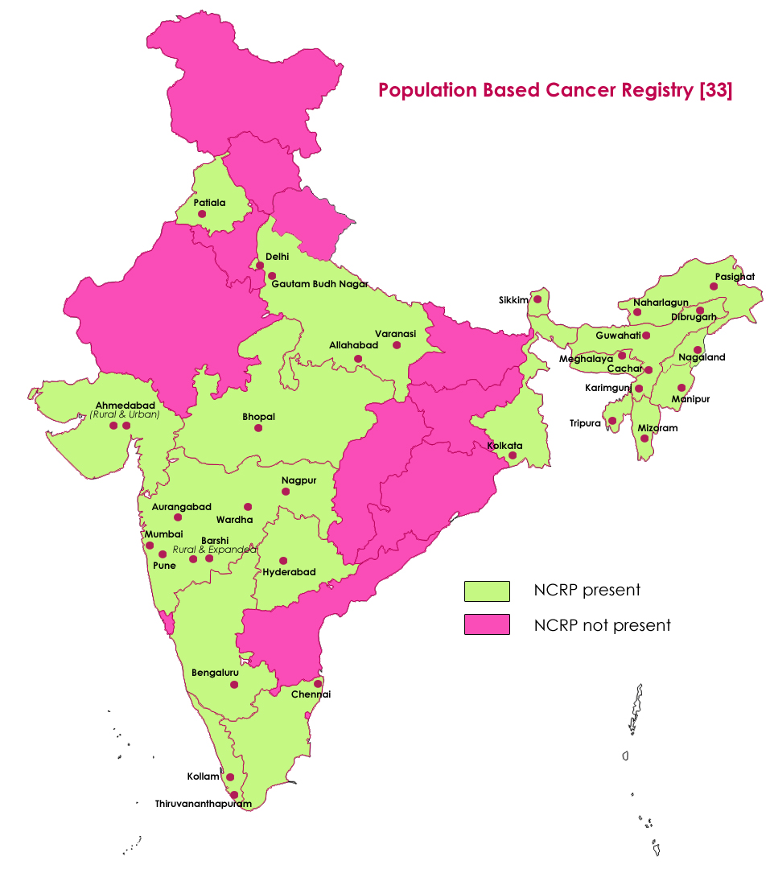
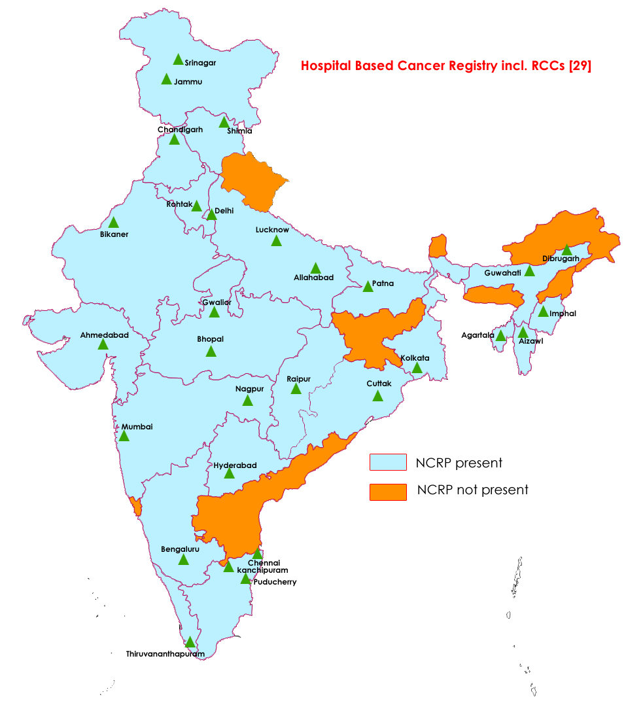
Cancers Registries under NCRP network
in India (1981-2017)

Slide 46
Change in Pattern of Leading Sites over Time Period* in India
Males
2005-2009 |  |  | 2010-2014
Rank | Site (Relative proportion) |  | Rank | Site (Relative proportion)
1 | Oesophagus (10.4) |  | 1 | Lung etc. (9.8)
2 | Lung etc. (9.4) |  | 2 | Oesophagus (8.6)
3 | Stomach (7.2) |  | 3 | Stomach (7.9)
4 | Mouth (6.2) |  | 4 | Mouth (7.1)
5 | Hypopharynx (4.9) |  | 5 | Tongue (5)
6 | Larynx (4.8) |  | 6 | Liver (4.7)
7 | Tongue (4.6) |  | 7 | Larynx (4.2)
8 | Prostate (4.2) |  | 8 | Hypopharynx (4.0)
9 | Liver (3.5) |  | 9 | Prostate (3.8)
10 | NHL (3.0) |  | 10 | Rectum (2.8)
11 | Bladder (2.9) |  | 11 | NHL (2.7)
12 | Brain, Nervous System (2.5) |  | 12 | Colon (2.5)
13 | Rectum (2.5) |  | 13 | Bladder (2.3)
14 | Colon (2.3) |  | 14 | Brain,Nervous System (2.2)
15 | Nasopharynx (2.1) |  | 15 | Other Skin (2.0)
16 | Myeloid Leukaemia (2.0) |  | 16 | Myeloid Leukaemia (2.0)
17 | Other Skin (1.7) |  | 17 | Gallbladder etc. (1.9)
18 | Bone (1.6) |  | 18 | Lymphoid Leuk. (1.5)
19 | Gallbladder etc. (1.5) |  | 19 | Nasopharynx (1.3)
20 | Tonsil (1.4) |  | 20 | Kidney etc. (1.3)
21 | Lymphoid Leuk. (1.3) |  | 21 | Tonsil (1.3)
22 | Pancreas (1.1) |  | 22 | Pancreas (1.2)
23 | Kidney etc. (1.1) |  | 23 | Bone (1.2)
*ICMR,NCRP:2005-2009,2010-2014

Slide 47
Change in Pattern of Leading Sites over Time Period* in India
Females
2005-2009 |  |  | 2010-2014
Rank | Site (Relative proportion) |  | Rank | Site (Relative proportion)
1 | Breast (22.4) |  | 1 | Breast (21.2)
2 | Cervix Uteri (14.3) |  | 2 | Cervix Uteri (13.5)
3 | Oesophagus (5.7) |  | 3 | Ovary etc. (5.5)
4 | Ovary etc. (5.4) |  | 4 | Lung etc. (5.0)
5 | Lung etc. (4.7) |  | 5 | Oesophagus (5.0)
6 | Stomach (4.3) |  | 6 | Stomach (5.0)
7 | Gallbladder etc. (3.3) |  | 7 | Gallbladder etc. (3.8)
8 | Mouth (3.1) |  | 8 | Thyroid (3.3)
9 | Thyroid (2.7) |  | 9 | Mouth (3.2)
10 | Corpus Uteri (2.0) |  | 10 | Liver (2.1)
11 | NHL (1.9) |  | 11 | Corpus Uteri (2.1)
12 | Other Skin (1.9) |  | 12 | Rectum (1.9)
13 | Tongue (1.8) |  | 13 | Colon (1.8)
14 | Rectum (1.8) |  | 14 | Tongue (1.8)
15 | Colon (1.7) |  | 15 | Other Skin (1.7)
16 | Myeloid Leukaemia (1.6) |  | 16 | NHL (1.7)
17 | Liver (1.6) |  | 17 | Myeloid Leukaemia (1.4)
18 | Brain, Nervous System (1.4) |  | 18 | Brain, Nervous System (1.4)
19 | Hypopharynx (1.1) |  | 19 | Nasopharynx (1.1)
20 | Nasopharynx (1.0) |  | 20 | Hypopharynx (0.9)
*ICMR,NCRP:2005-2009,2010-2014

Slide 48
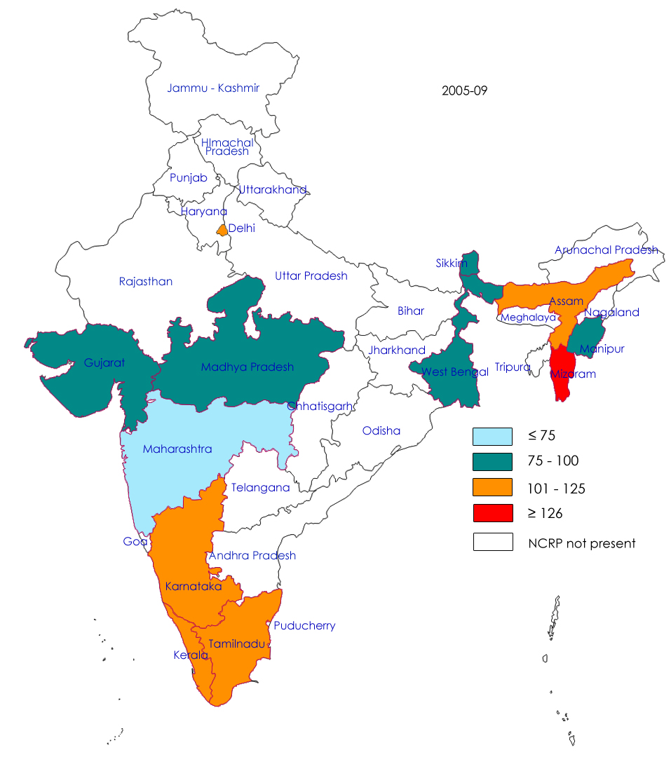

Estimated State Level Cancer Burden in India (All sites) - Males
Mean AAR per 1,00,000 population
Mean AAR per 1,00,000 population
2005-09
2010-14
AAR: Age Adjusted Incidence Rates

Slide 49


Estimated State Level Cancer Burden in India (All sites) - Females
Mean AAR per 1,00,000 population
Mean AAR per 1,00,000 population
2005-09
2010-14
AAR: Age Adjusted Incidence Rates

Slide 50
Burden of Cancer
(All sites) in India
Males
Females
114.6
(93.4 to 135.9)
(2012-2014)
129.9
(94.4 to 165.4)
118.0
(99.4 to136.5)
107.2
(93.1 to 121.4)
Mean incidence Rate AAR
(95% of CI) per lakh
231.4
(165.8 to 297.8)
195.4
(128.8 to 262.1)
179.1
(149.7 to 208.5)
172.0
(143.6 to 200.3)
Period Prevalence
proportion (95% of CI) per lakh
1.8
(0.52 to 3.1)
1.4
(0.38 to 2.44)
0.9
(-1.2 to 3.1)
Estimated CAGR
% (95% of CI) of Incidence
0.4
(-1.1 to1.9)
AAR: Age Adjusted Rates per 1,00,000 population
CAGR: Compound Annual Growth Rate
CI- Confidence Interval
India
North East
India
North East

Slide 51
Top seven leading sites of cancer among both sexes in India
India, 2012-14 Female
Relative proportion (%)
Relative proportion (%)
India, 2012-14 Male
Breast
Lung
Cervix Uteri
Oesophagus
Ovary
Stomach
Lung
Mouth
Oesophagus
Tongue
Gallbladder
Larynx
Stomach
Hypopharnx
Total proportion
58.9 %
57.3 %
Total proportion
53.0 %
41.6 %
North East
Remaining India
North East
Remaining India

Slide 52

Survival Analysis
(Hospital Based Cancer Registry)
Stage | North East | Rest of India
Head & Neck Cancer (Locally Advanced Stage) | 16.9% | 44.5%
Breast Cancer (Stage II) | 63.5% | 88.6%
Breast Cancer (Stage III) | 20.1% | 70.7%
Cervical Cancer (Stage IIB-IVA) | 33.9% | 62.9%
73.6 %
40.5 %

Slide 53


Comparison of Cancer Incidence and HDI
S.No | State | Mean Incidence CR (2012-14) |  |  | HDI 2007-08 / 2006 | HDI 2015
 |  | Male | Female | Both Sexes
1 | Arunachal pradesh | 77.3 | 78.3 | 77.8 | 0.652* | 0.616
2 | Assam | 104.4 | 90.1 | 97.3 | 0.444 | 0.556
3 | Delhi | 123.5 | 133.4 | 128.5 | 0.750 | NA
4 | Gujarat | 87.8 | 73.3 | 80.6 | 0.527 | 0.616
5 | Karnataka | 88.3 | 113.5 | 100.9 | 0.519 | 0.618
6 | Kerala | 156.4 | 143.5 | 150.0 | 0.79 | 0.712
7 | Madhya pradesh | 82.2 | 90.4 | 86.3 | 0.375 | 0.557
8 | Maharastra | 65.1 | 67.0 | 66.1 | 0.572 | 0.666
9 | Manipur | 59.4 | 73.3 | 66.4 | 0.702* | NA
10 | Meghalaya | 93.0 | 56.7 | 74.9 | 0.629* | NA
11 | Mizoram | 158.6 | 130.3 | 144.5 | 0.688* | NA
12 | Nagaland | 74.9 | 54.0 | 64.5 | 0.700* | NA
13 | Punjab | 91.1 | 112.8 | 102.0 | 0.605 | 0.661
14 | Sikkim | 70.8 | 76.0 | 73.4 | 0.665* | NA
15 | TamilNadu | 115.5 | 132.5 | 124.0 | 0.570 | 0.666
16 | Tripura | 62.4 | 48.2 | 55.3 | 0.663* | NA
17 | West Bengal | 118.8 | 120.8 | 119.8 | 0.492 | 0.604
*-2016 ; CR-Crude Rate; NA- Not Available
Source: http://www.in.undp.org;
http://hdr.undp.org/en/composite/trends
https://www.sikkim.gov.in/stateportal/Link/Sikkim%20Human%20Developent%20Report%202014.pdf
https://en.wikipedia.org/wiki/List_of_Indian_states_and_territories_by_Human_Development_Index
Fidler et al. A global view on cancer incidence and national levels of the human development index. International Journal of Cancer, Int. J. Cancer: 139, 2436–2446 (2016).

Slide 54
Cancer as a Notifiable Disease
The following States have gazetted Cancer as a Notifiable Disease.
1. Karnataka on 25 July 2015
2. Haryana on 29th October 2014
The following States have issued Administrative order for compulsory notification of cancer cases
1. Manipur on 22nd February 2017
2. Gujarat on 20th May 2016
3. Arunachal Pradesh on 29th July 2015
4. Assam on 9th Dec. 2013 (Kamrup district)
5. Punjab 18th Oct. 2011
6. West Bengal on 20th Dec. 2010
7. Tripura 24th Sept. 2008
Cancer Notification will help:
Provide complete data on cancer incidence and mortality
Plan strategy by taking policy decisions
Provide regional break-up for regional prioritization in regards to cancer burden
Planning Cancer control activities
Monitoring trends and patterns
Challenges are still there in implementation and monitoring even after notification

Slide 55
Phases of the ICMR-INDIAB Study
Phase I – Completed
(Chandigarh, Jharkhand, Maharashta, Tamil Nadu )
Phase II
Five states completed
(Andhra Pradesh, Bihar, Gujarat, Karnataka & Punjab)
North East - ongoing
Six states completed
(Arunachal Pradesh, Assam, Manipur, Meghalaya, Mizoram & Tripura)
PHASE I
NE COMPONENT
PHASE II
Total sample size n= 59,992 till date
Anjana RM et al for ICMR – INDIAB Study Group, Journal of Diabetes Science and Technology, 2011 ; 5: 906 - 914

Slide 56
Prevalence of Diabetes, Prediabetes and Hypertension

Slide 57
Prevalence of Generalised and
Abdominal Obesity

Slide 58

Prevalence of Diabetes & GDP per capita by State
Prevalence of Diabetes & GDP
per capita by State

Slide 59
Top 5 Causes of Death in India: Rural and Urban, 2013

Slide 60

Health Systems Preparedness for Interventions for NCDs and Cause of Death among the Tribal population in India (2014- 2016)
Study sites : 12 districts (1 district per state with > 50% tribal population)
Phase I completed in 7 states
Cause of Death
Estimate the contribution of NCD to the deaths in 12 predominantly tribal districts in India
Facility survey
Describe the infrastructure (including drugs and diagnostics) available for management of hypertension, diabetes, chronic respiratory disease and cardiovascular diseases in the primary and secondary care facilities
Provider survey
Describe the knowledge and prescription practices of doctors for above mentioned NCD
Patient survey
Estimate level of adherence among patients with above mentioned Non communicable diseases (NCDs)
Identify the challenges in seeking care for patients
ICMR collaboration;
National Institute of Epidemiology, Chennai
Regional Medical Research Center, Dibrugarh

Slide 61
Contribution of NCDs as cause of death

Slide 62
Public Health Facility Survey Screening and Outpatient Services in Phase I States
 | Type of facility
 | PHC/CHC (N=65) |  | Sub district/DH (N=15)
 | n | % (n/N) | n |  | % (n/N)
Screening services
HT | 26 | 40 |  | 8 | 53
DM | 26 | 40 |  | 7 | 47
Cervical cancer | 6 | 9 |  | 5 | 33
Breast cancer | 6 | 9 |  | 3 | 20
Oral cancer | 6 | 9 |  | 3 | 20
Out patient treatment services
HT | 50 | 77 |  | 15 | 100
DM | 47 | 72 |  | 8 | 53
 | Type of facility
 | PHC/CHC (N=65) |  | Sub district/DH (N=15)
 | n | % | n | %
Hypertension drugs
Atenolol | 43 | 66 | 13 | 87
Amlodipine | 53 | 82 | 11 | 73
Nifedipine | 10 | 15 | 4 | 27
Diabetes drugs
Metformin | 16 | 25 | 6 | 40
Glibenclamide | 13 | 20 | 3 | 20
Glipizide | 9 | 14 | 3 | 20
Glimepride | 6 | 9 | 2 | 13

Slide 63
Patient survey: Lack of regular treatment and poor blood pressure control among hypertension patients in Phase I states
Poor availability of drugs in health facilities as reported by Hypertension patients in Phase I states
Health services delivery
  Lack of standard protocols and guidelines for managing various NCD
Poor utilization of health facilities by NCD patients
  Very low PHC utilization except Sikkim
  Variable utilization of district/sub district hospitals
Financing
  Delayed release of funds
  Inadequate funds

Slide 64
Future Challenges
Integrated Surveillance systems for infectious diseases
Using Data to Inform Programs – reverse data flow to field level workers
Management of chronic diseases - hypertension, diabetes and mental health
Providing high quality care at PHC and below: focus on preventive and promotive health, including diet and nutrition

Slide 65


