Slide 1

RESPECTFUL MATERNITY CARE
Bringing about changes in clinical practices
Dr. Shrinivas Gadappa
Professor & HOD
Department of OBGY
GMCH, Aurangabad.
Mobile no. 9822441553
Email :gadappashrinivas@gmail.com
31st October2018
Respectful Maternity Care
Birth Companion
Birthing Position

Slide 2
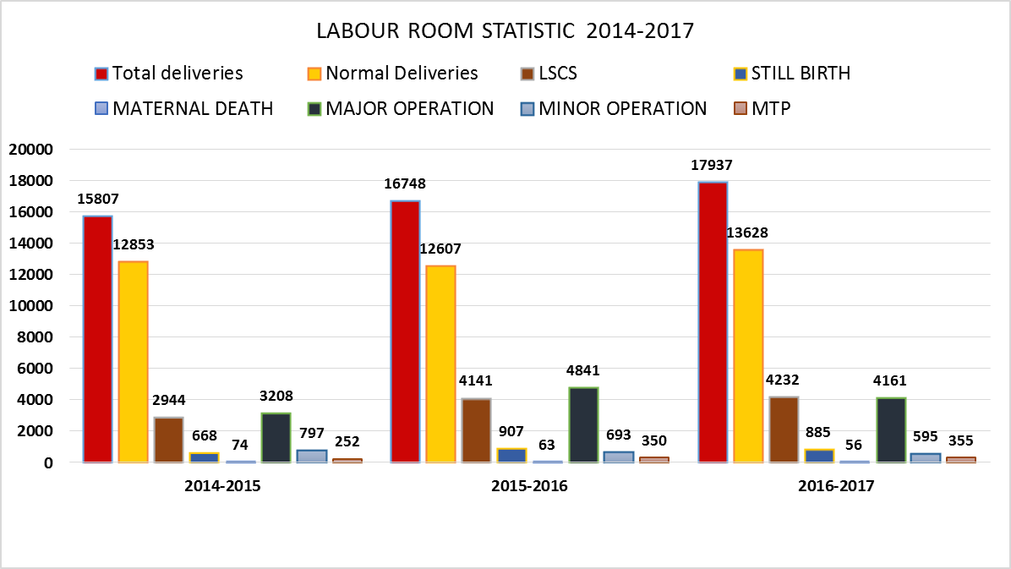
GMCH,Aurangabad Statistics

Slide 3
Respectful Maternity care
Respectful Maternity care
OBJECTIVES
Need
Rights of clients
Process to ensure RMC
Take home message

Slide 4



Slide 5
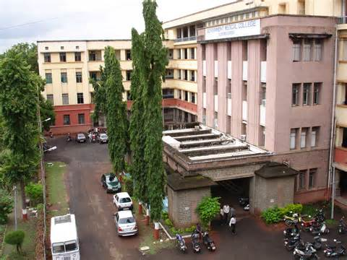
Why is GMC Aurangabad promoting RMC?
Restricting ambulation/different positions during labor and choice of birth position
Lack of companion/family during labor
Over-use of anesthesia/analgesia
Administration of oxytocin at any time before delivery in such a way that the effect cannot be controlled
Restricting food and fluids
Separation of mother and baby
Early cord clamping
Routine episiotomy
Enema
Shaving
Common Medicalised Practices that Are Harmful

Slide 6
Bringing about changes in clinical practices

Slide 7
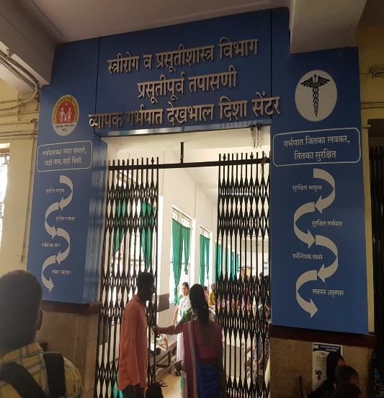

OBGY OPD Entrance Gate
Before
After

Slide 8
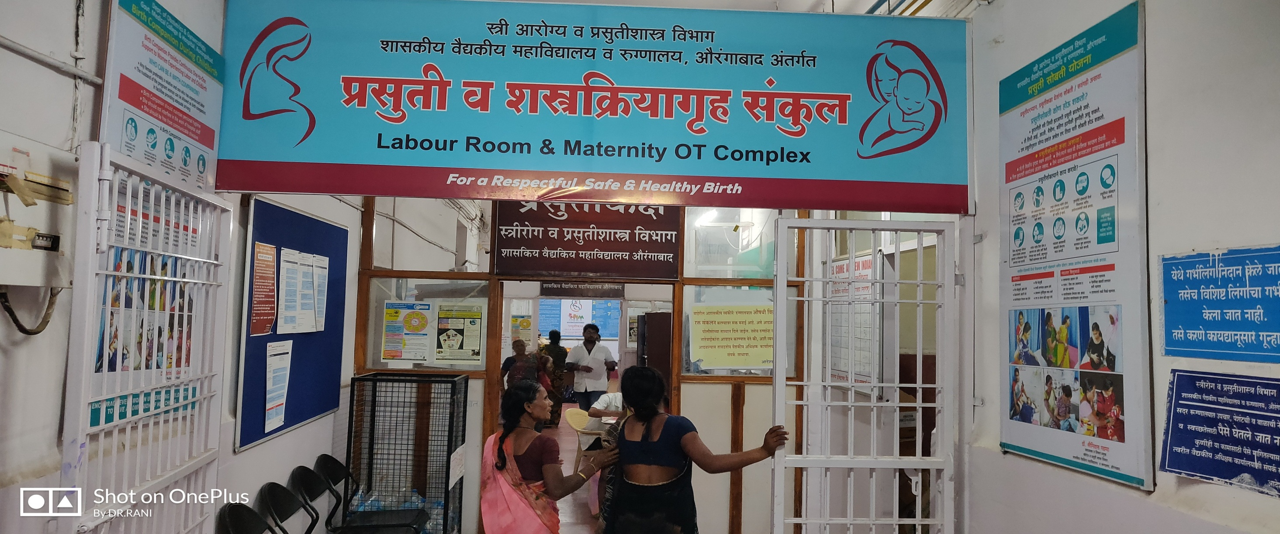
Labour room

Slide 9
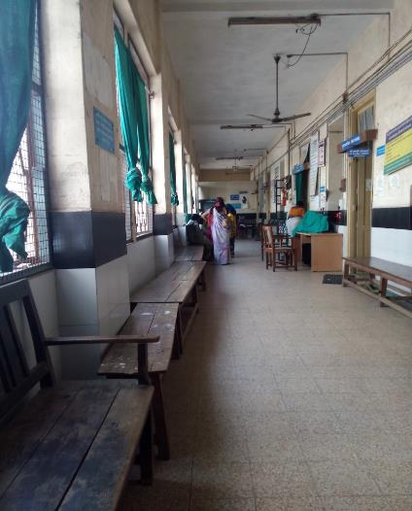
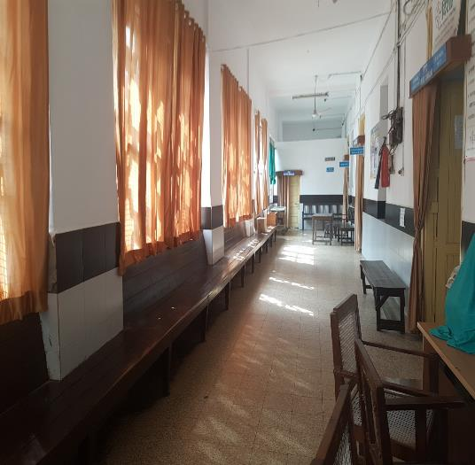
ANC Clinic

Slide 10
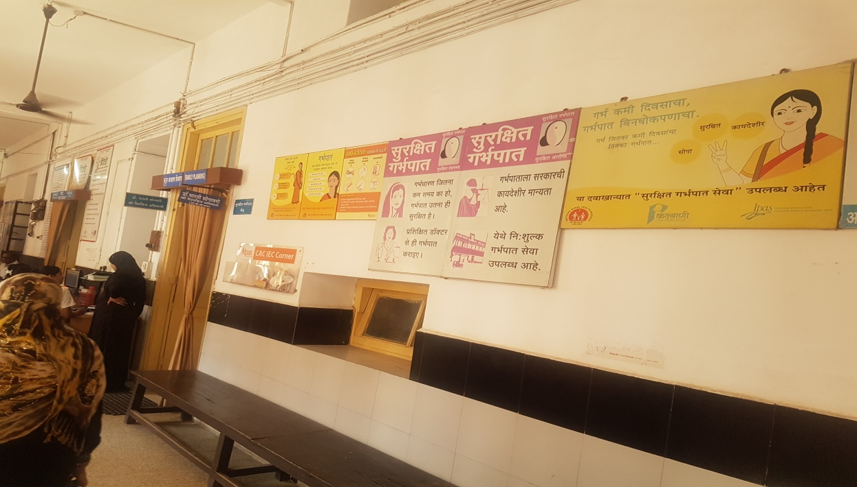
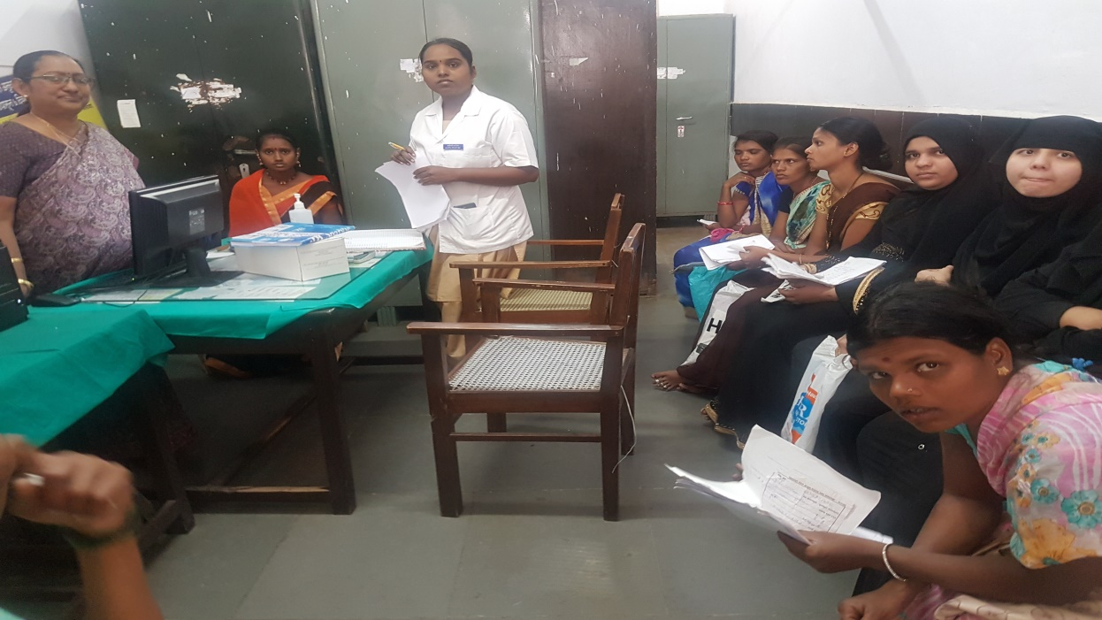
Wanted OR Unwanted Pregnancy
COMPHRENSIVE “Abortion CARE ‘’Under MTP Act

Slide 11
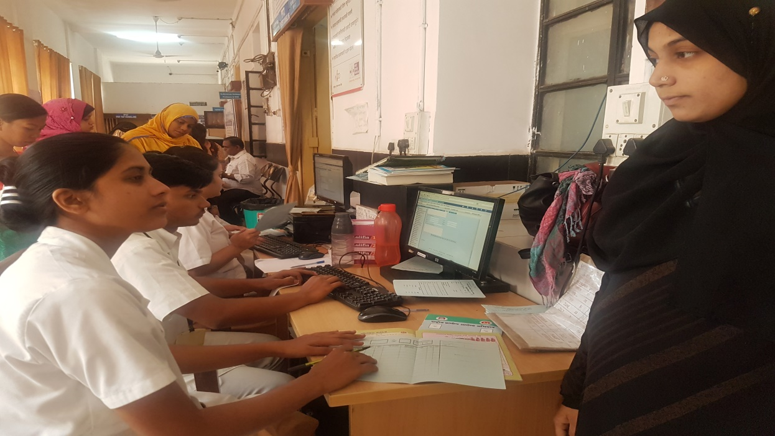
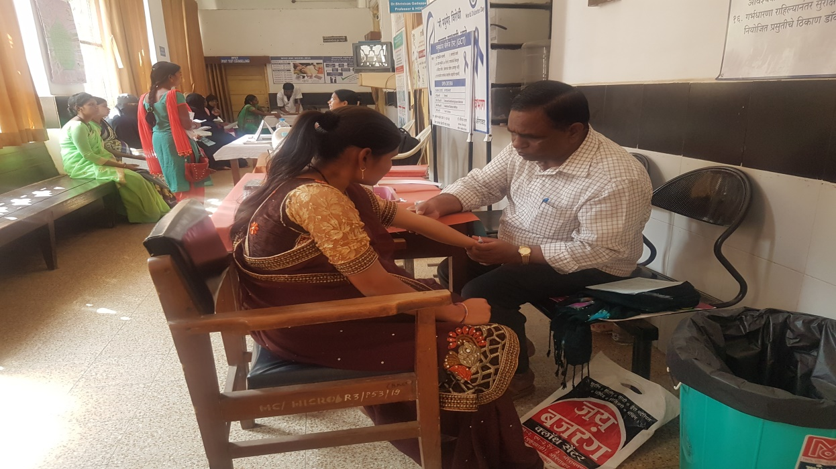
Registration, consent &one prick test…..

Slide 12
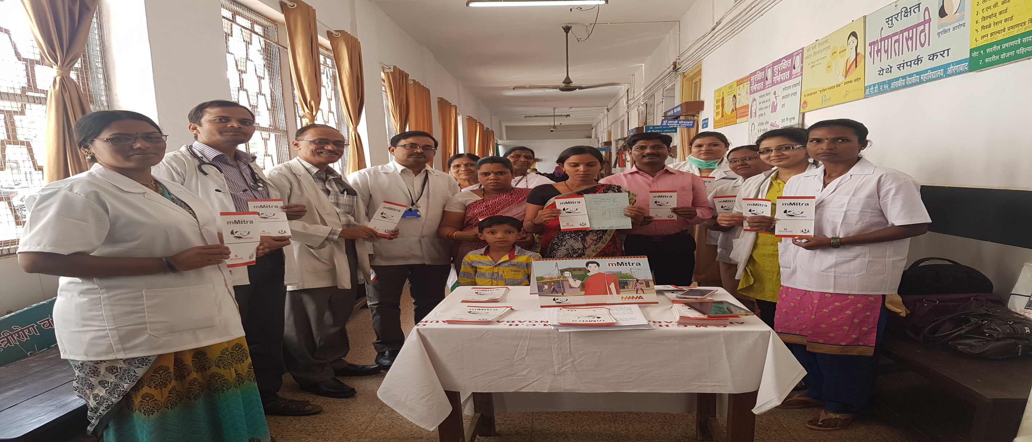
Free voice message services……

Slide 13

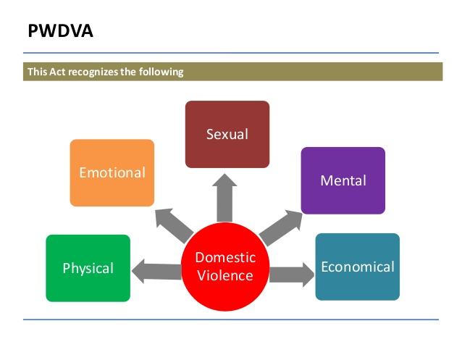

INTIMATE PARTNER VIOLENCE
VIOLENCE AGAINST WOMEN
From 1% to 28% of women report they were physically abused during pregnancy, by an intimate partner.

Slide 14

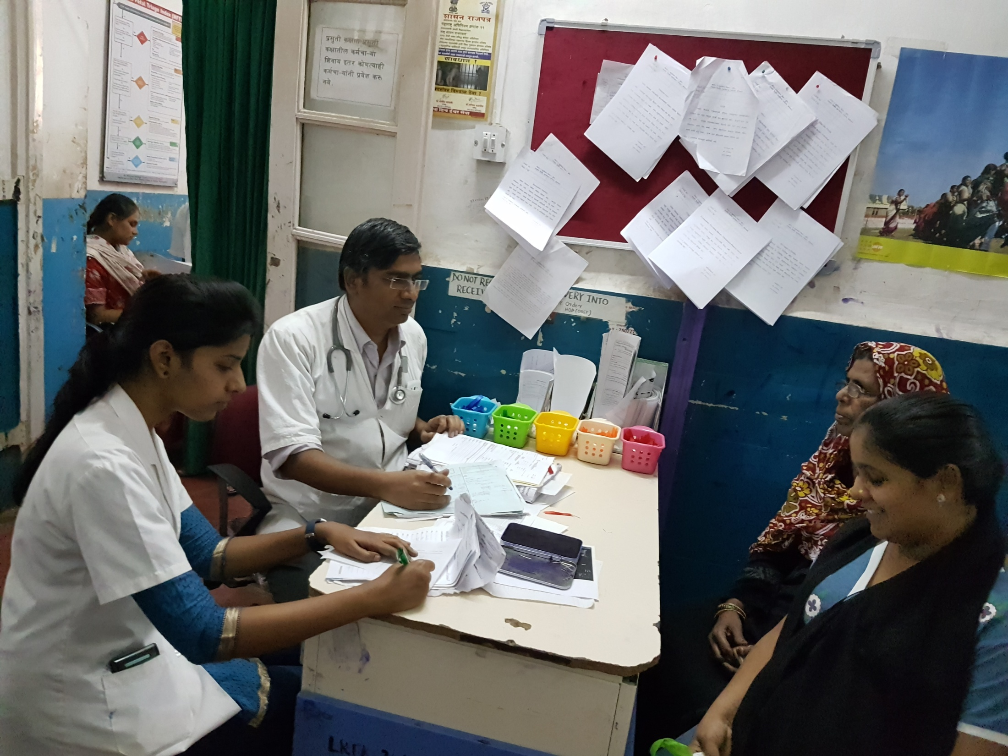
INFORMED CONSENT

Slide 15
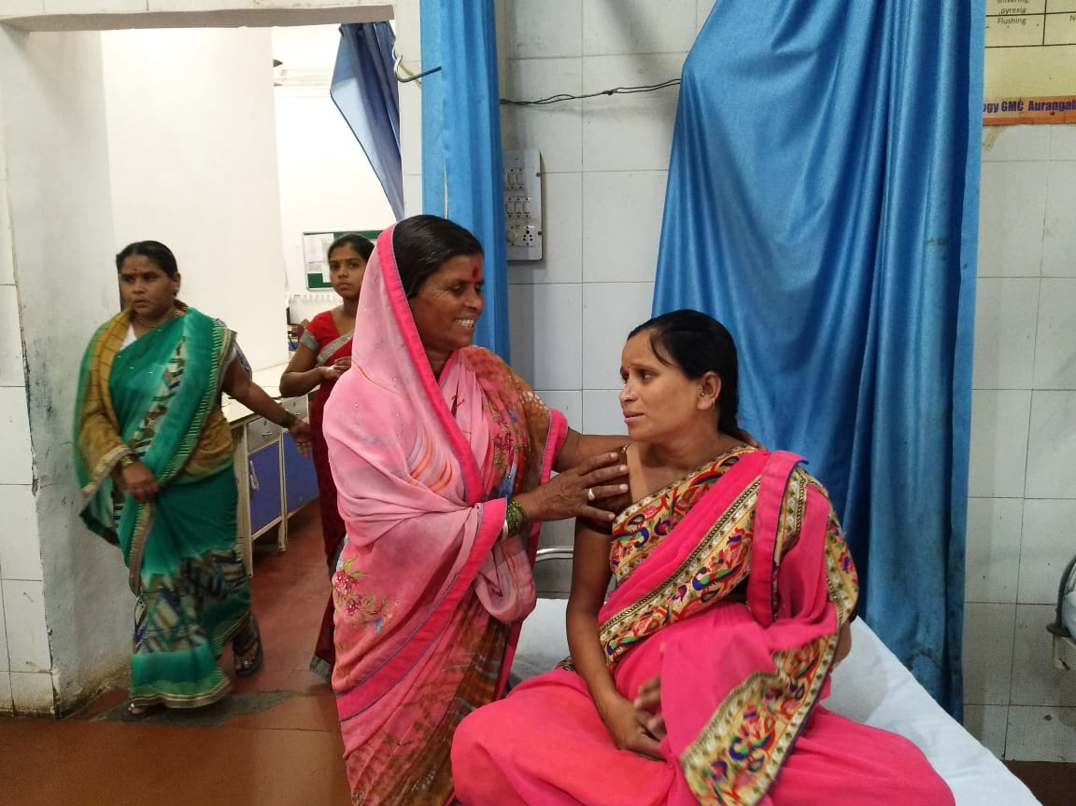
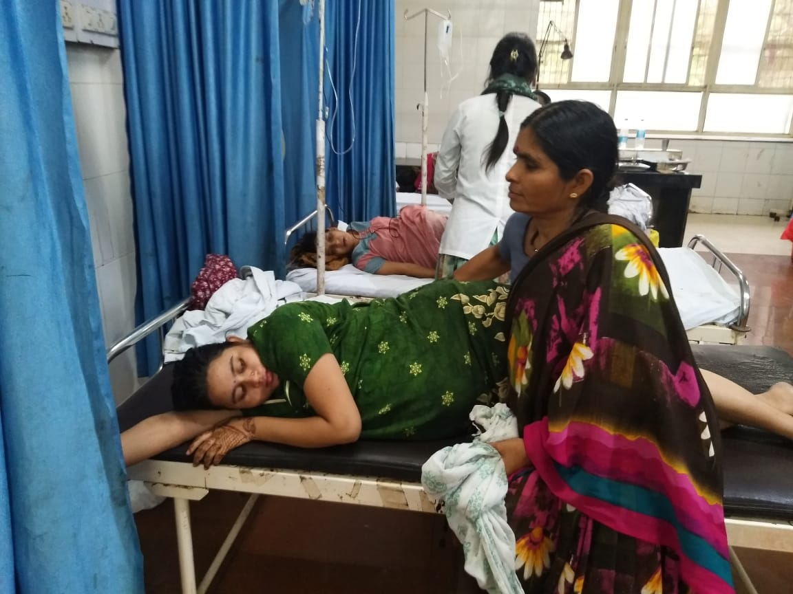
Birth Companion (Doula)
Policy in GMCH, Aurangabad

Slide 16
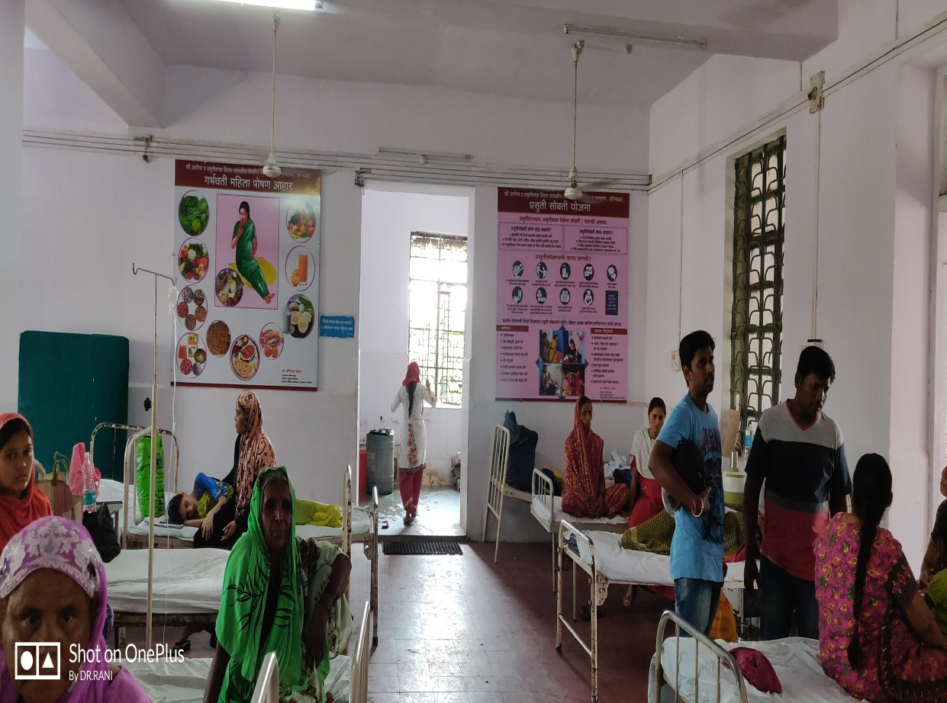
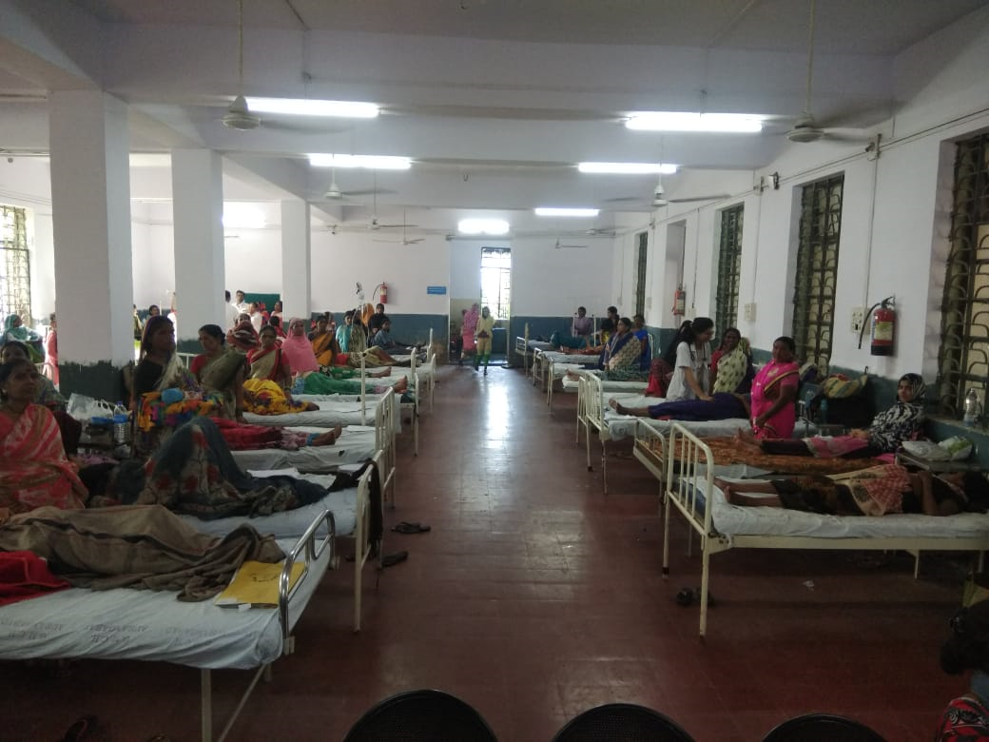
ANC WARD
Birth Companion (Doula)
Birth Companion (Doula)

Slide 17
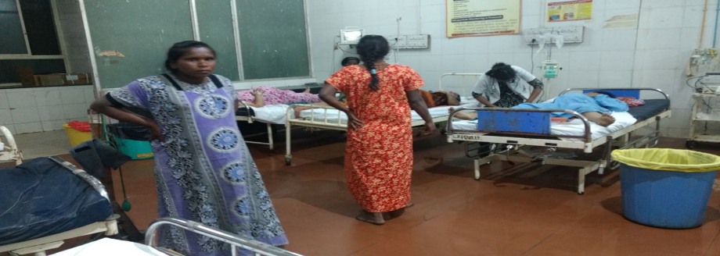
Right 5 - Equality, freedom from discrimination, equitable care
Right to liberty, autonomy, self-determination
Freedom to move around during labor
Infrastructure such as holding bars, bricks , sitting Labor tables to be made available for using position of choice
Use of traditional knowledge especially in tribal areas
No coercion for a particular method of Family Planning

Slide 18
Advantages of upright position in first & second stage of labour
Help birthing woman to distract her from labour.
Give her self control.
Strengthen uterine contraction.
Fasten progress of labour.
Reduces need of Oxytocin.
Stronger and more efficient uterine contractions.
Aiding cervical dilatation.
Reduced risk of labour dystocia .
Utilization of gravity may improve fetal descent.
Effective bearing down effects.
Improved fetal positioning.
Reduced risk of aorta caval compression and therefore improved acid base outcomes in the newborns .
Increased diameters of the pelvis.
Psychological benefits include reduced pain/backache, increased feeling of being in control and more effective communication with health professionals.
Small reduction in assisted deliveries
Decreased episiotomy rate

Slide 19
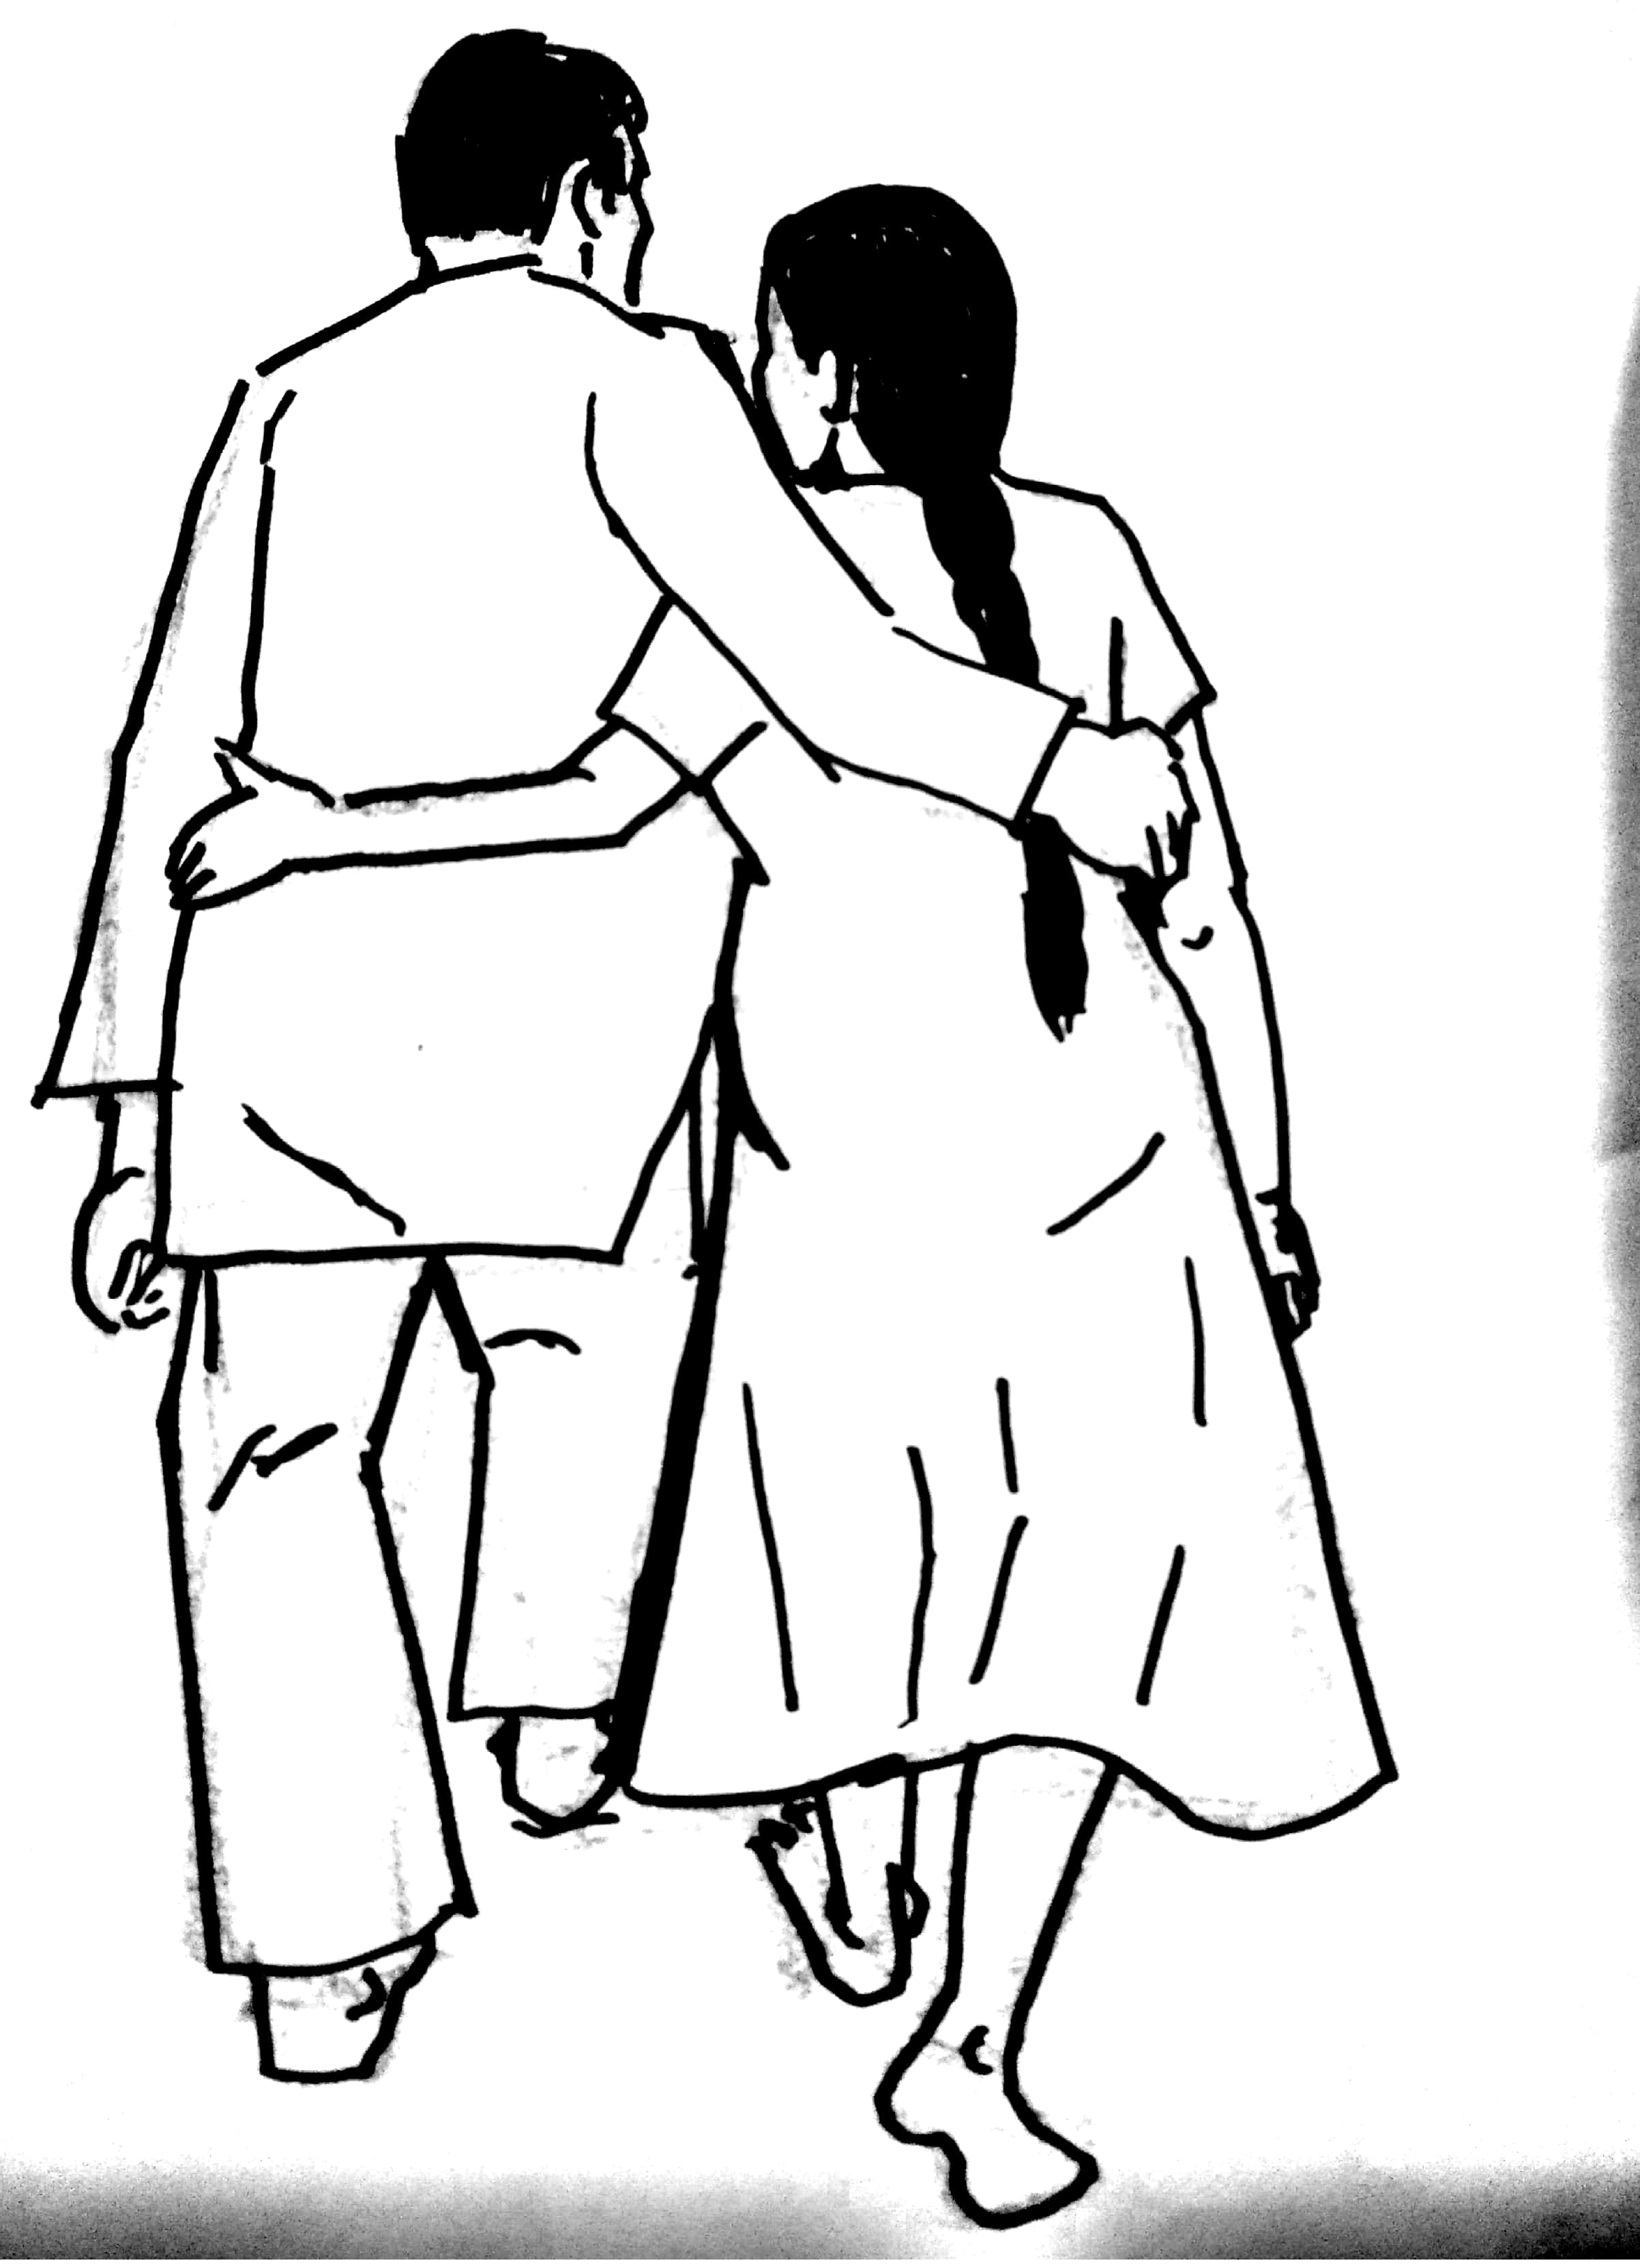
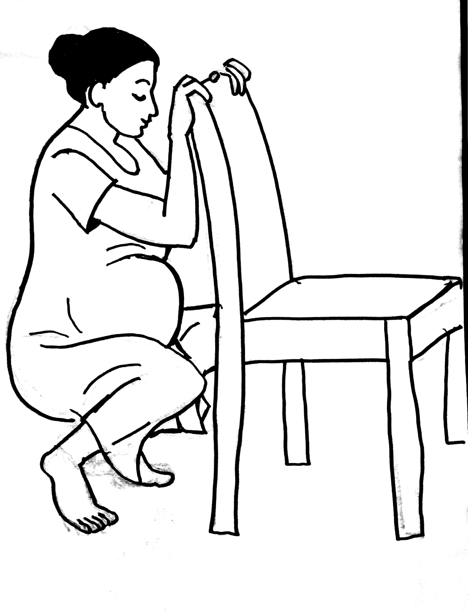
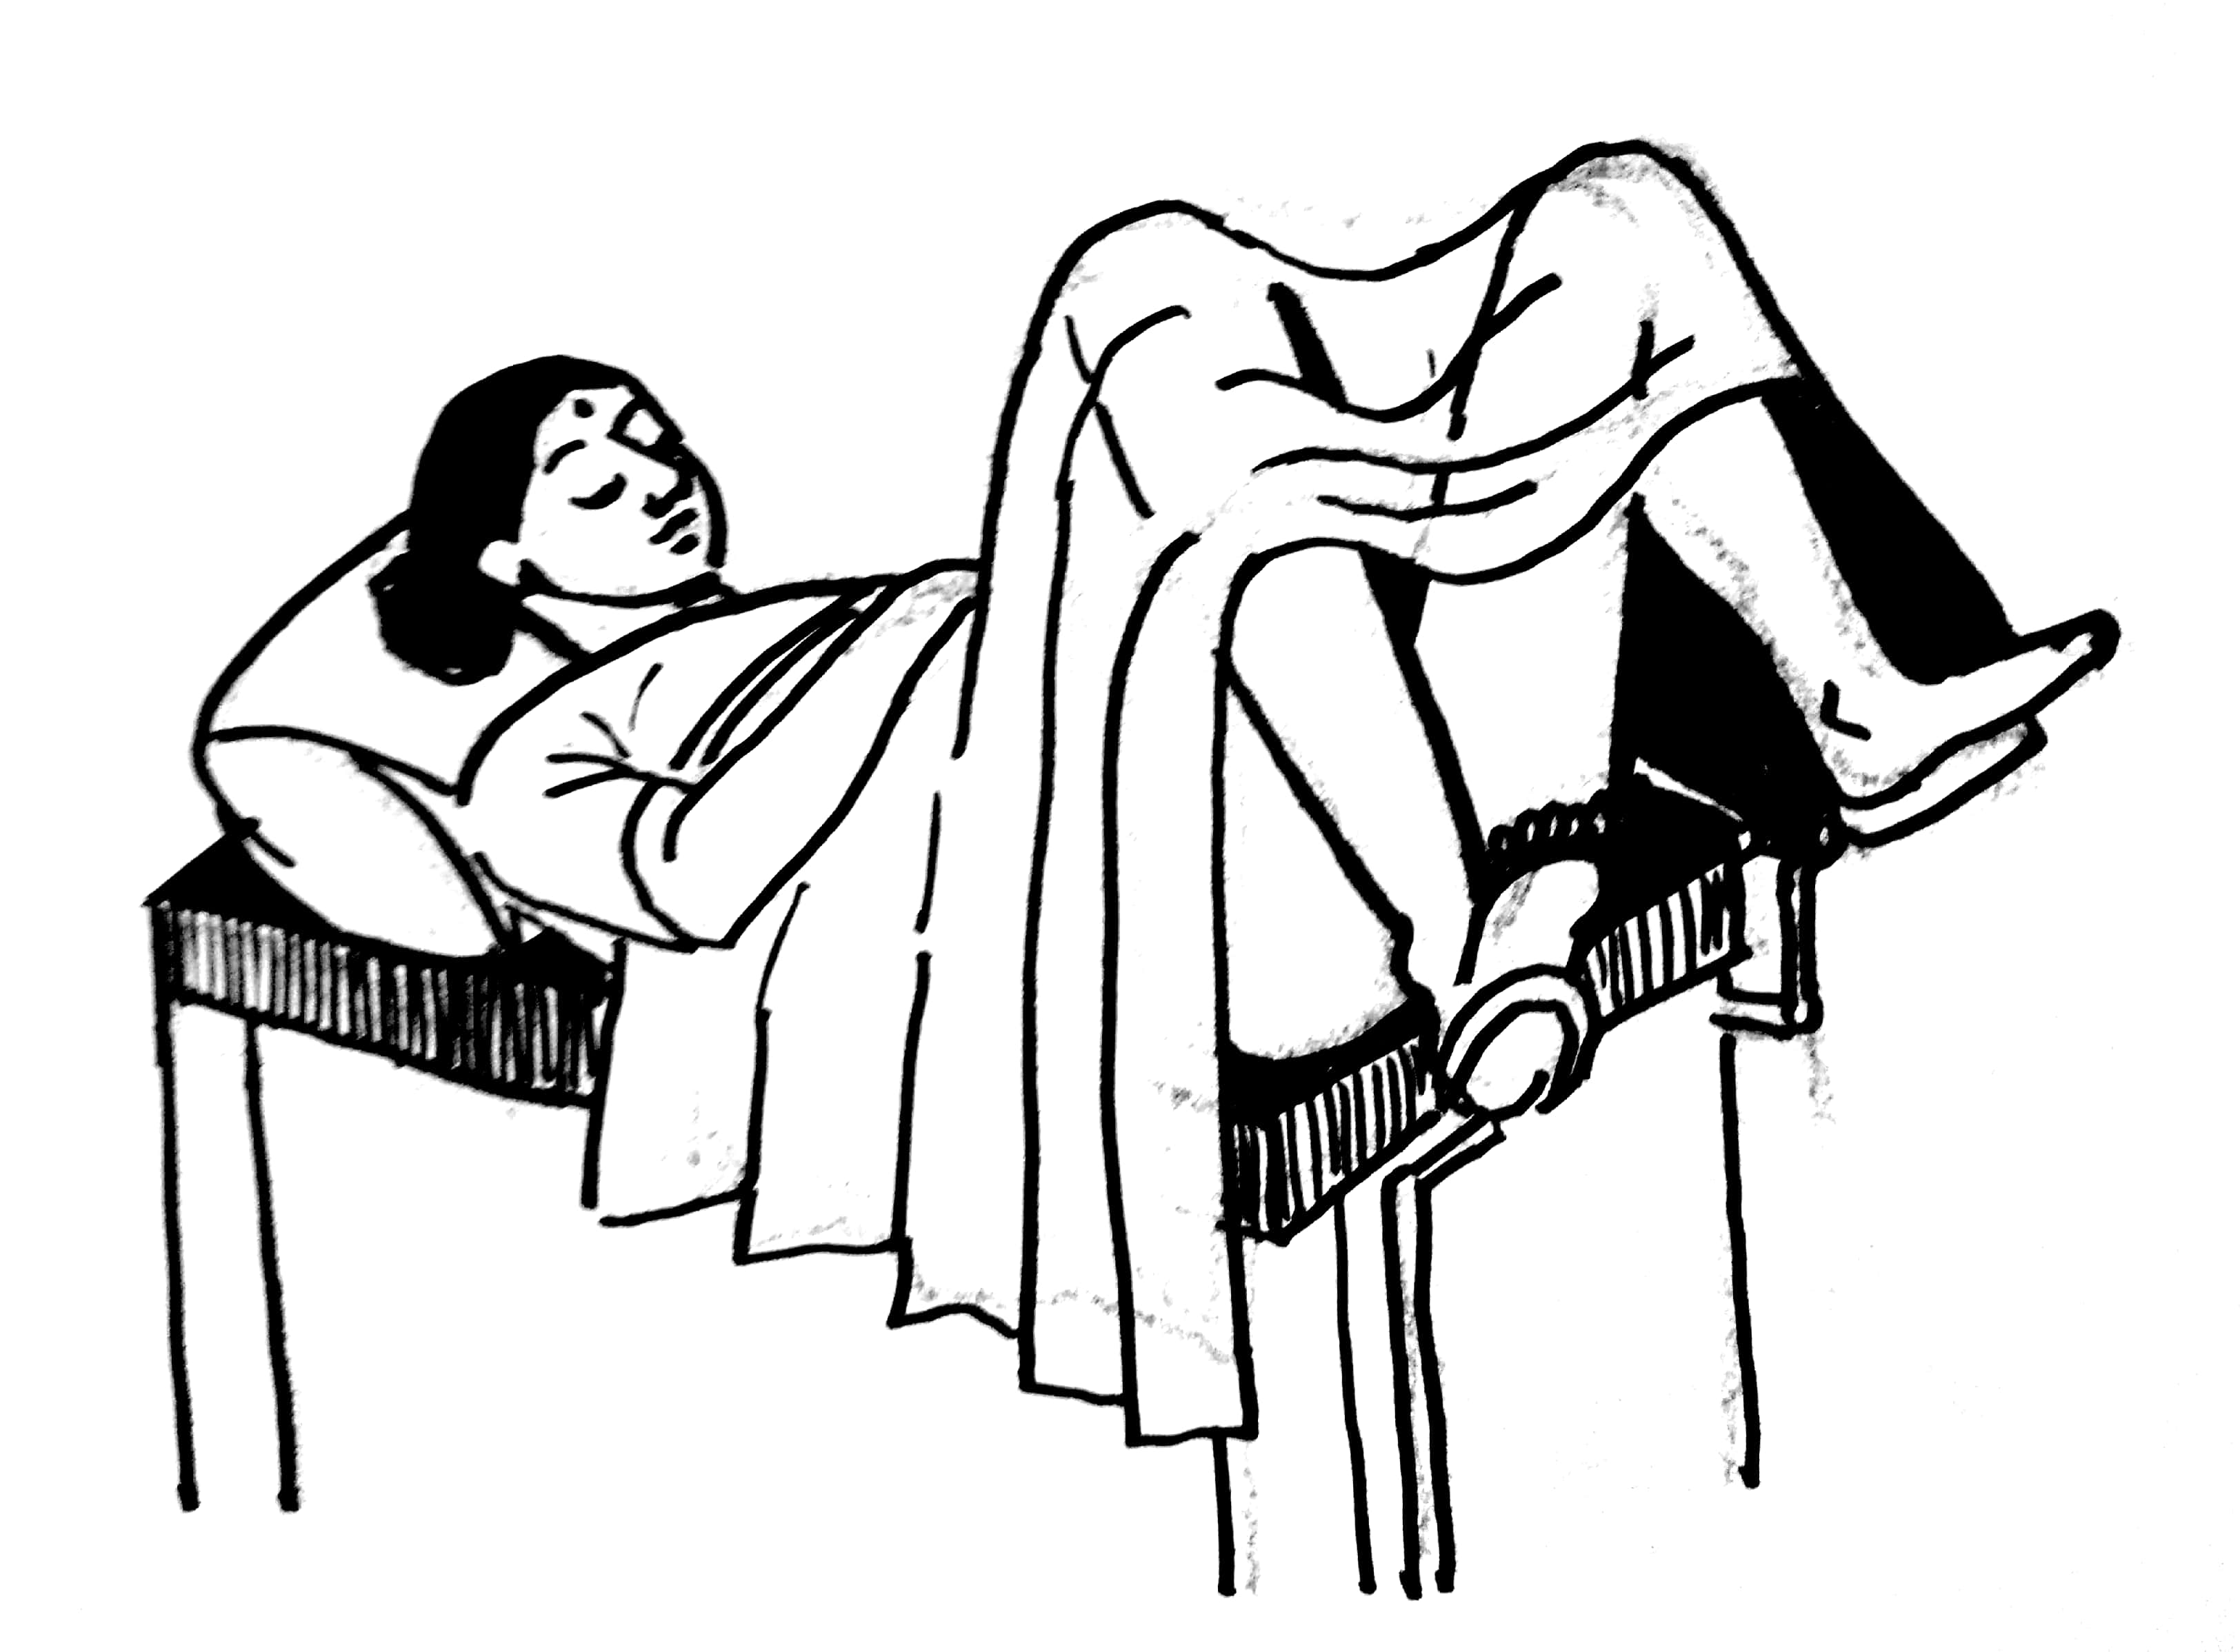
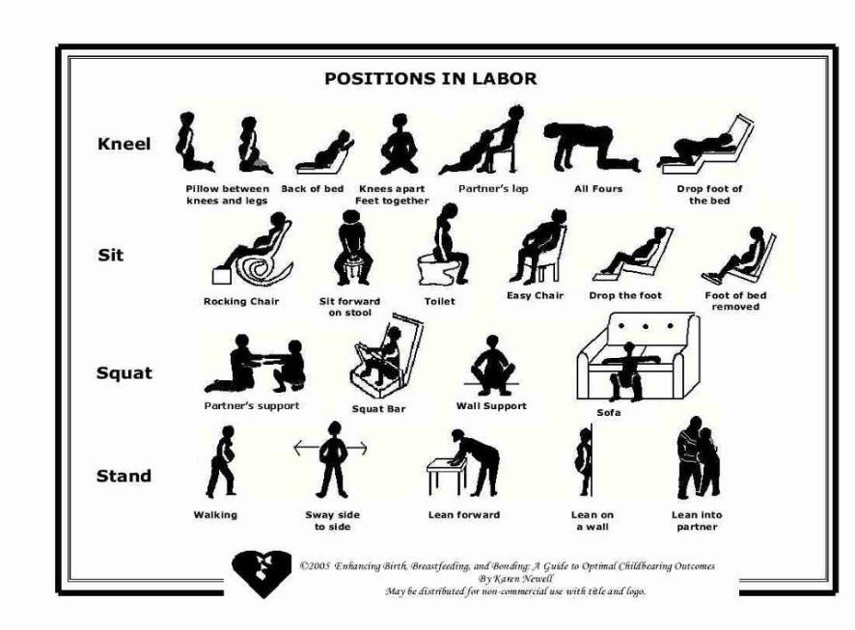
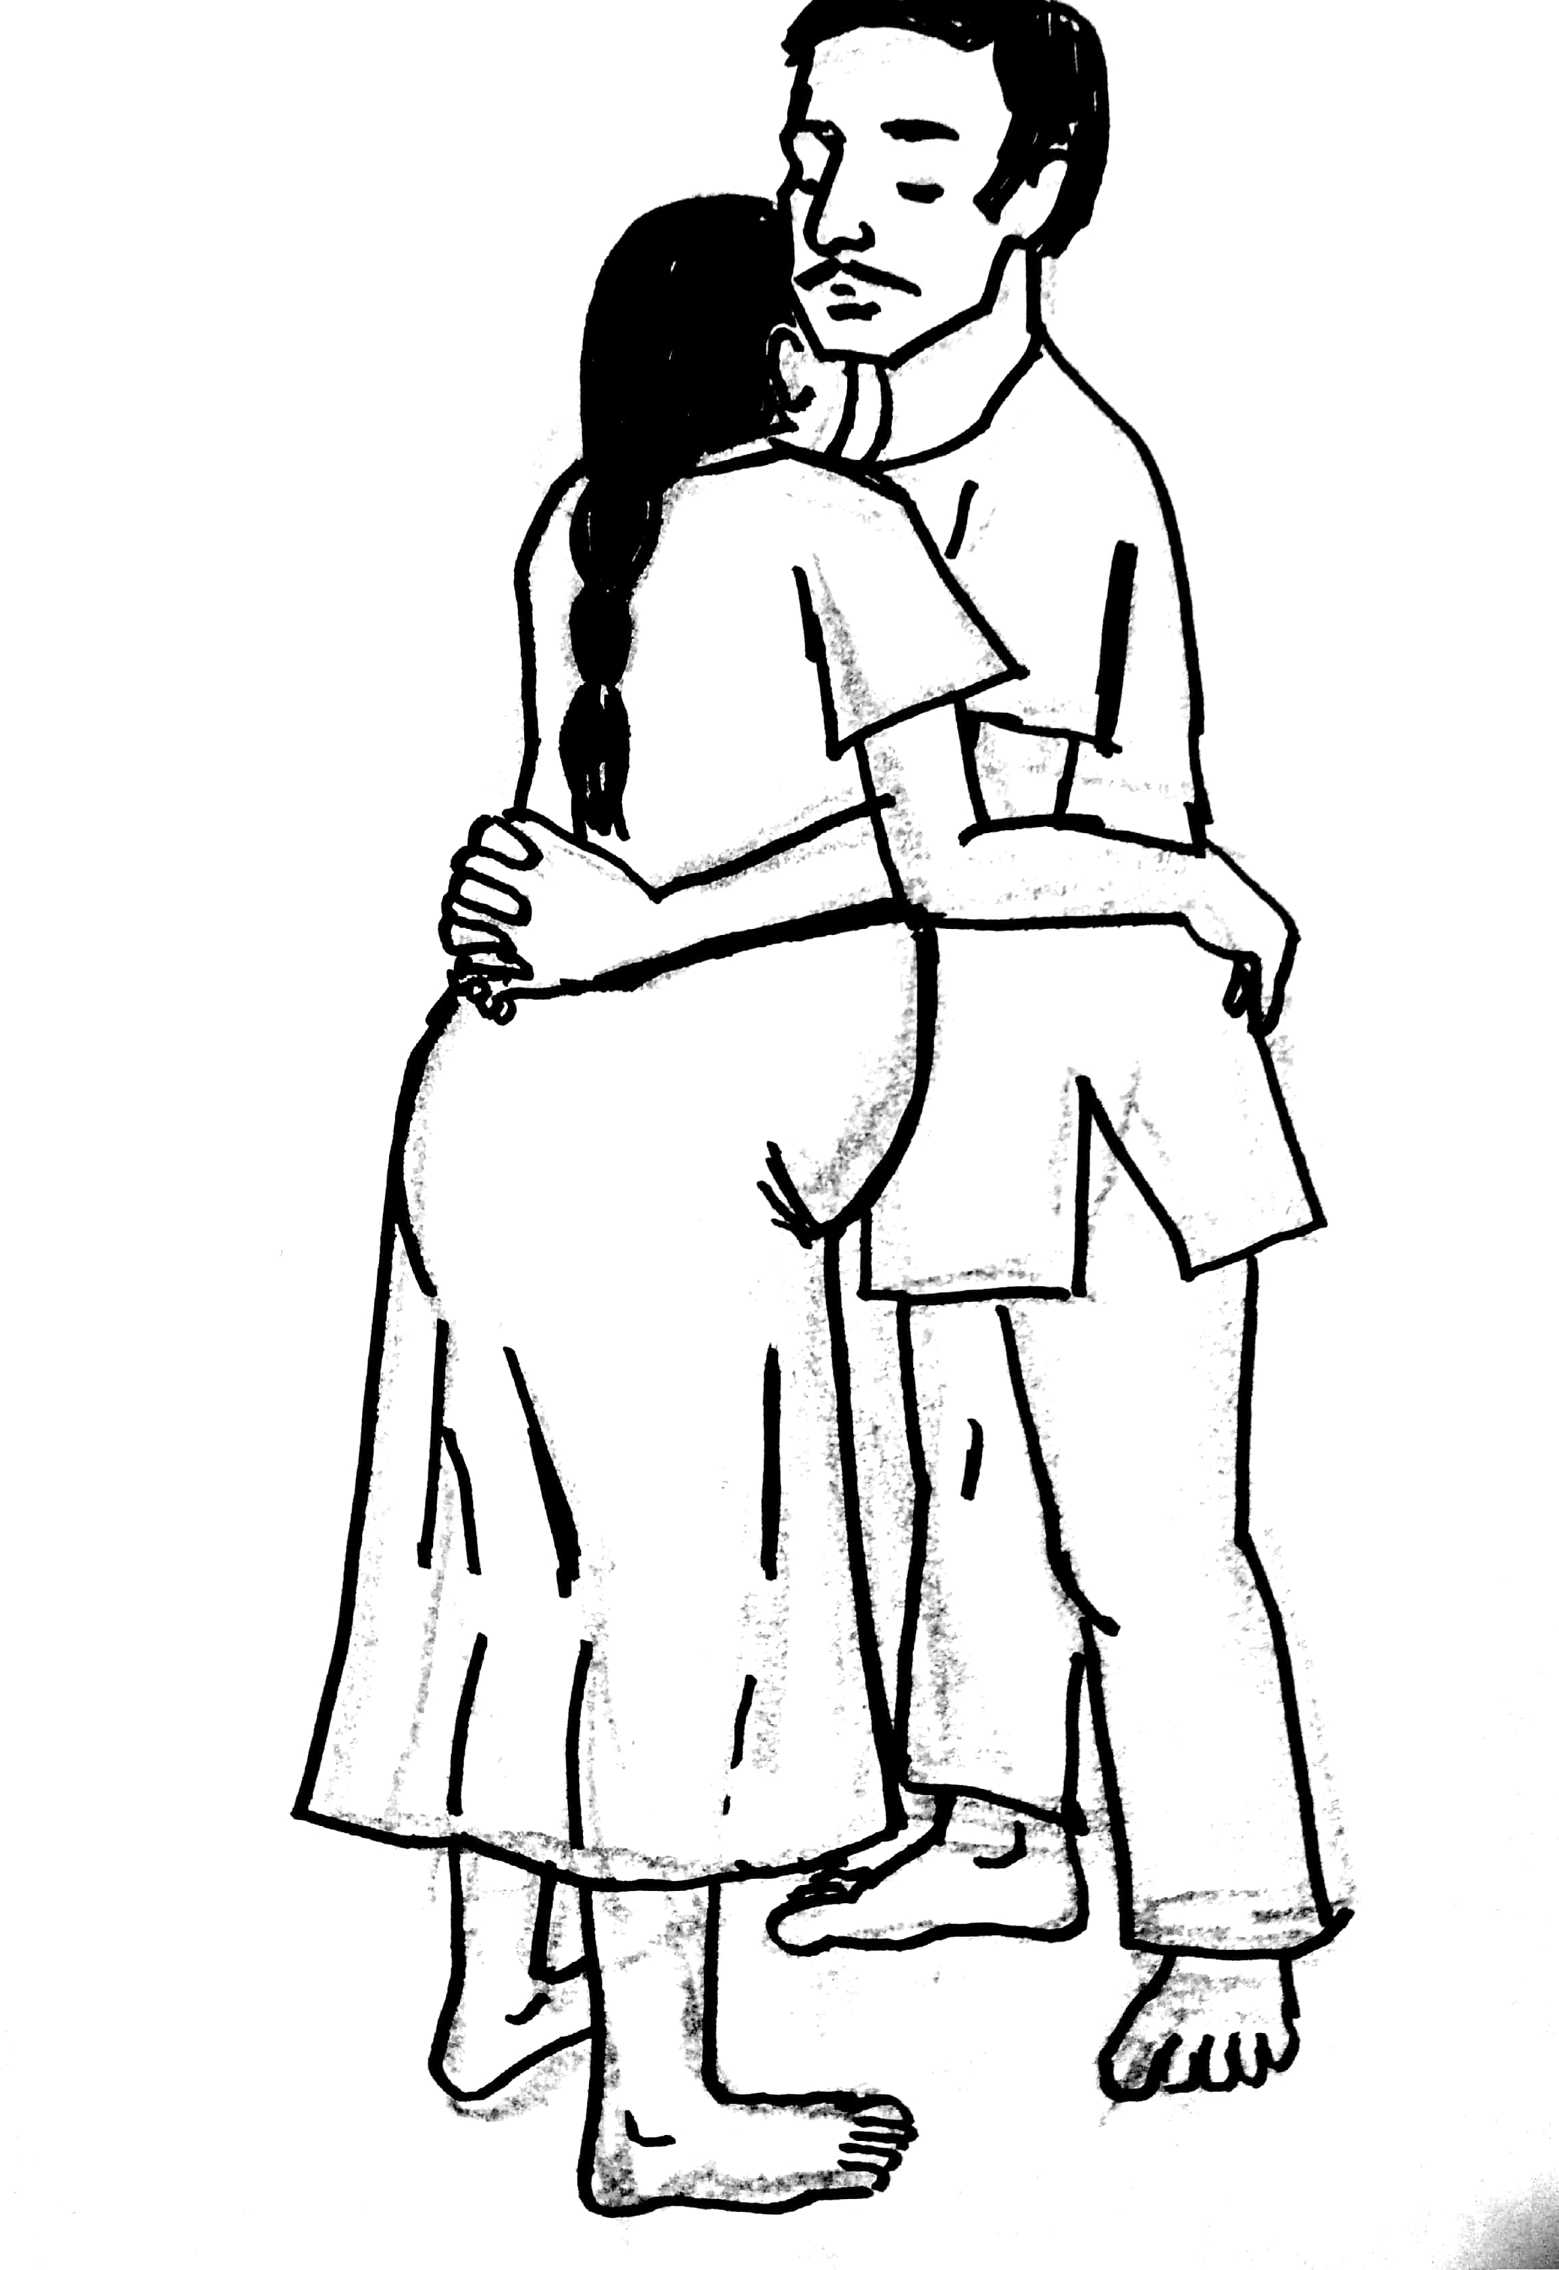
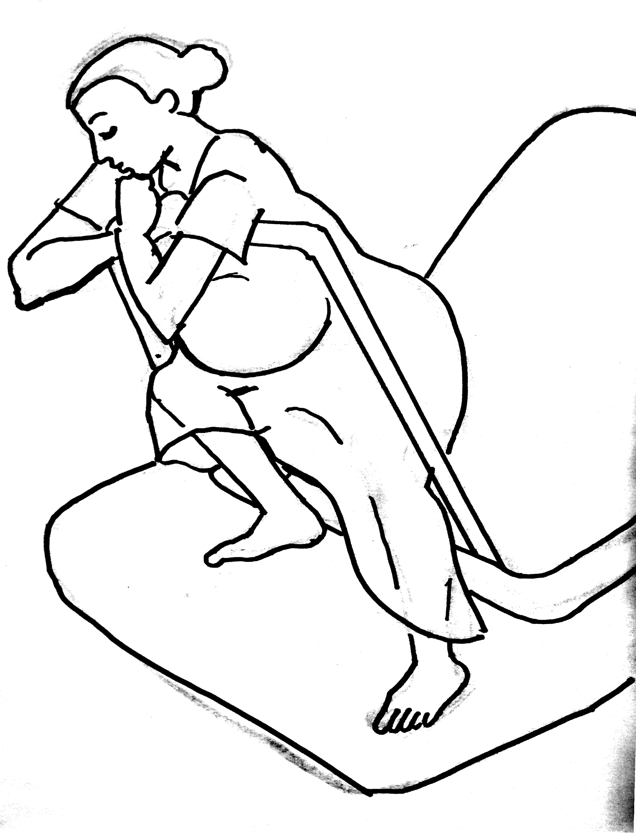
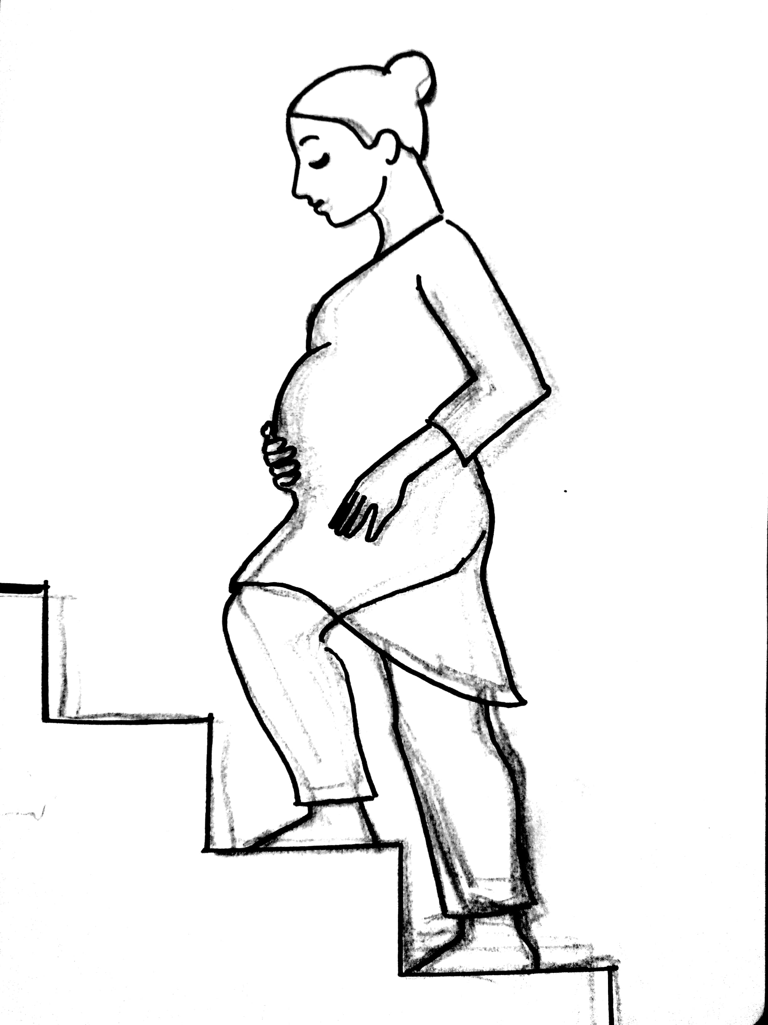
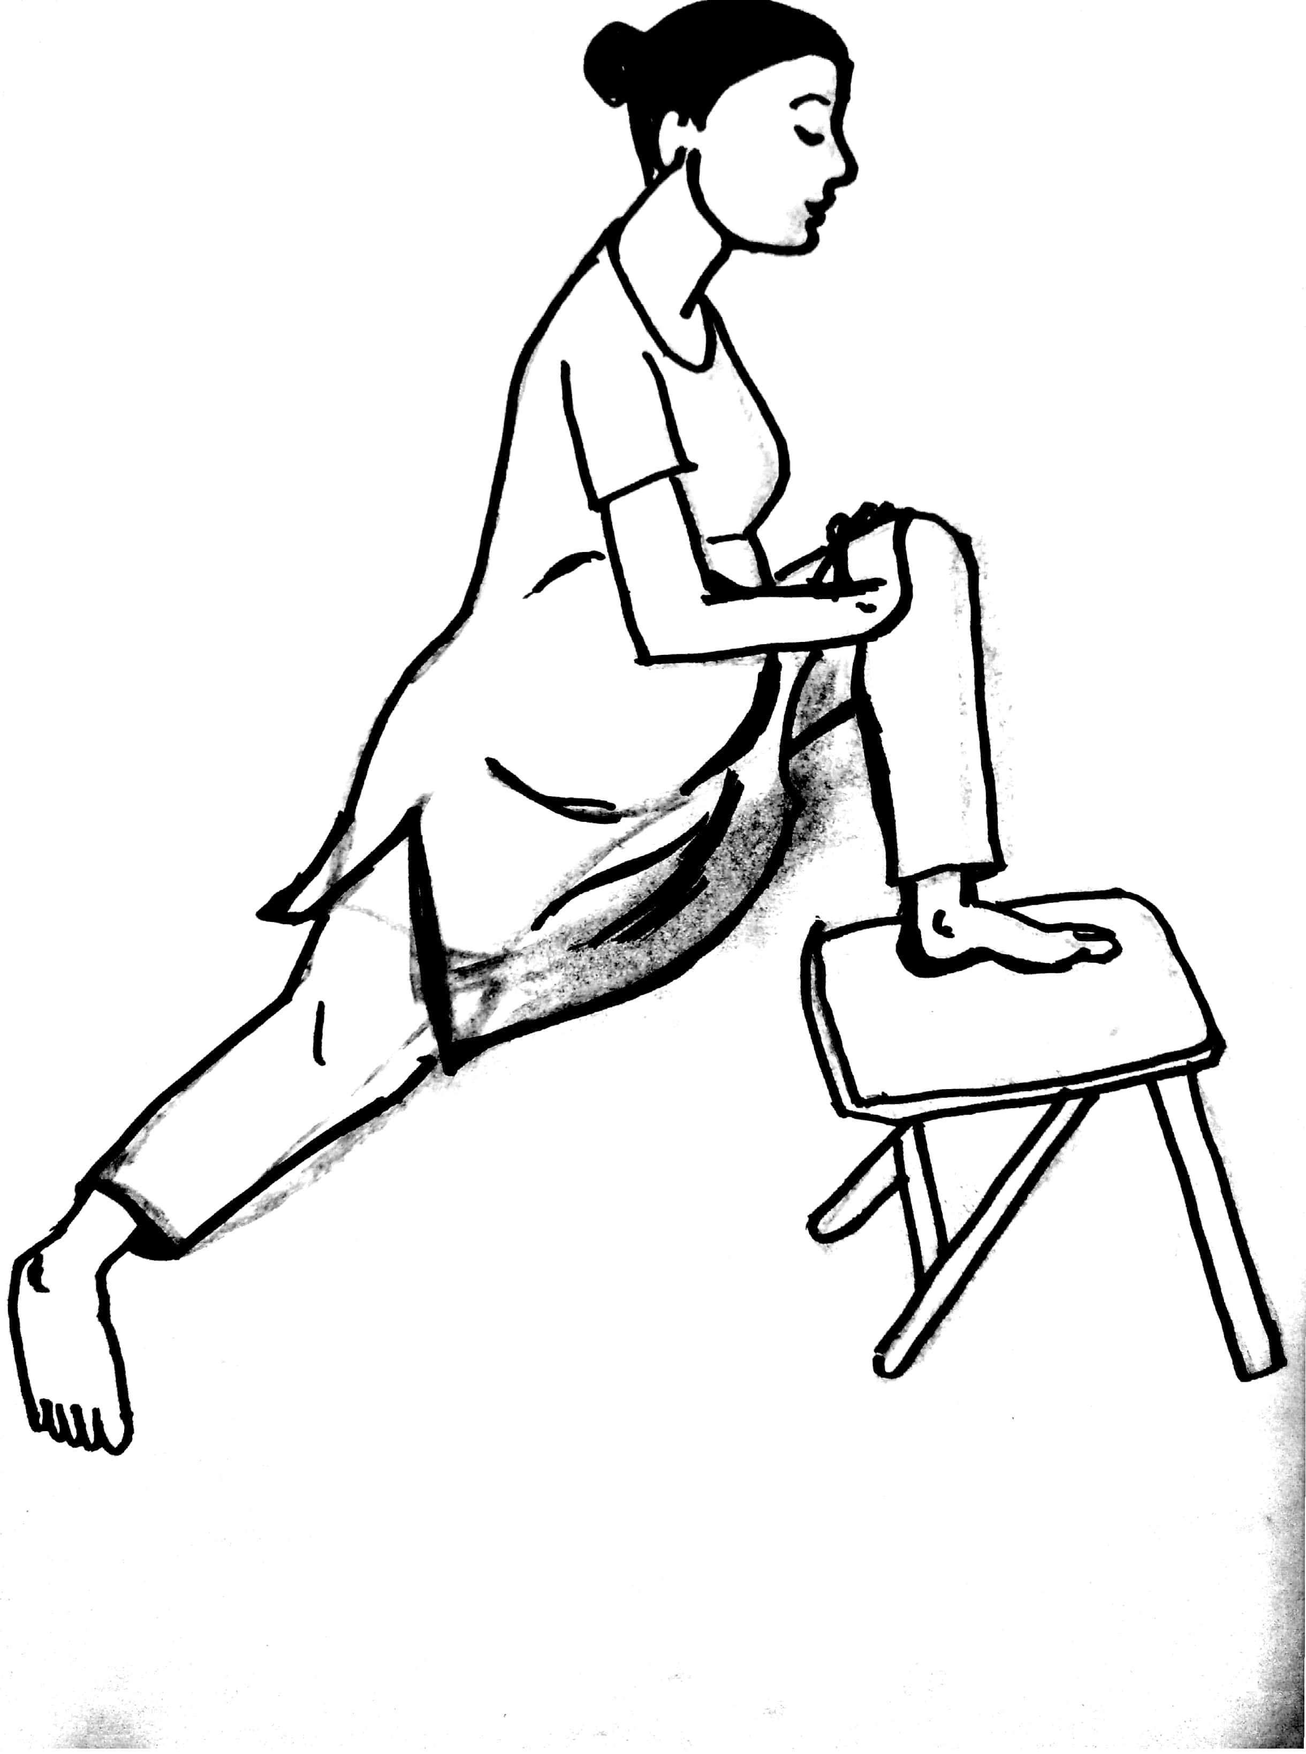
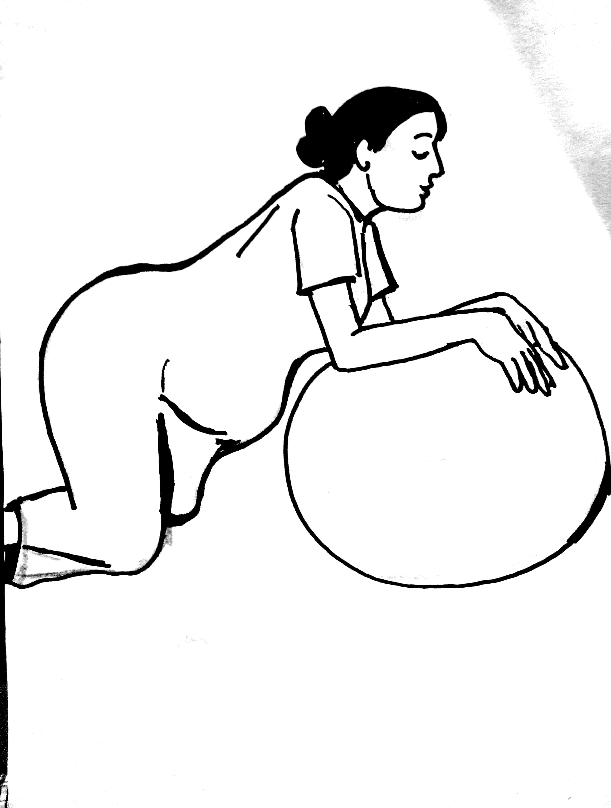
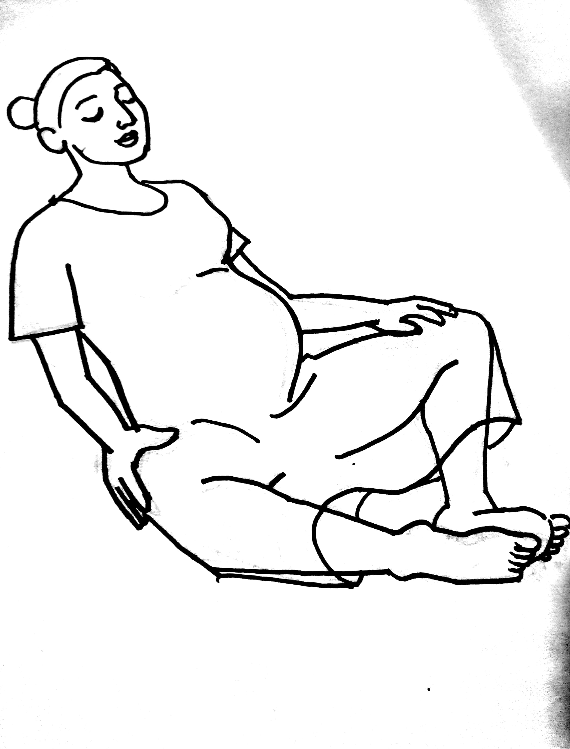
POSITION OF CHOICE FOR BIRTHING

Slide 20
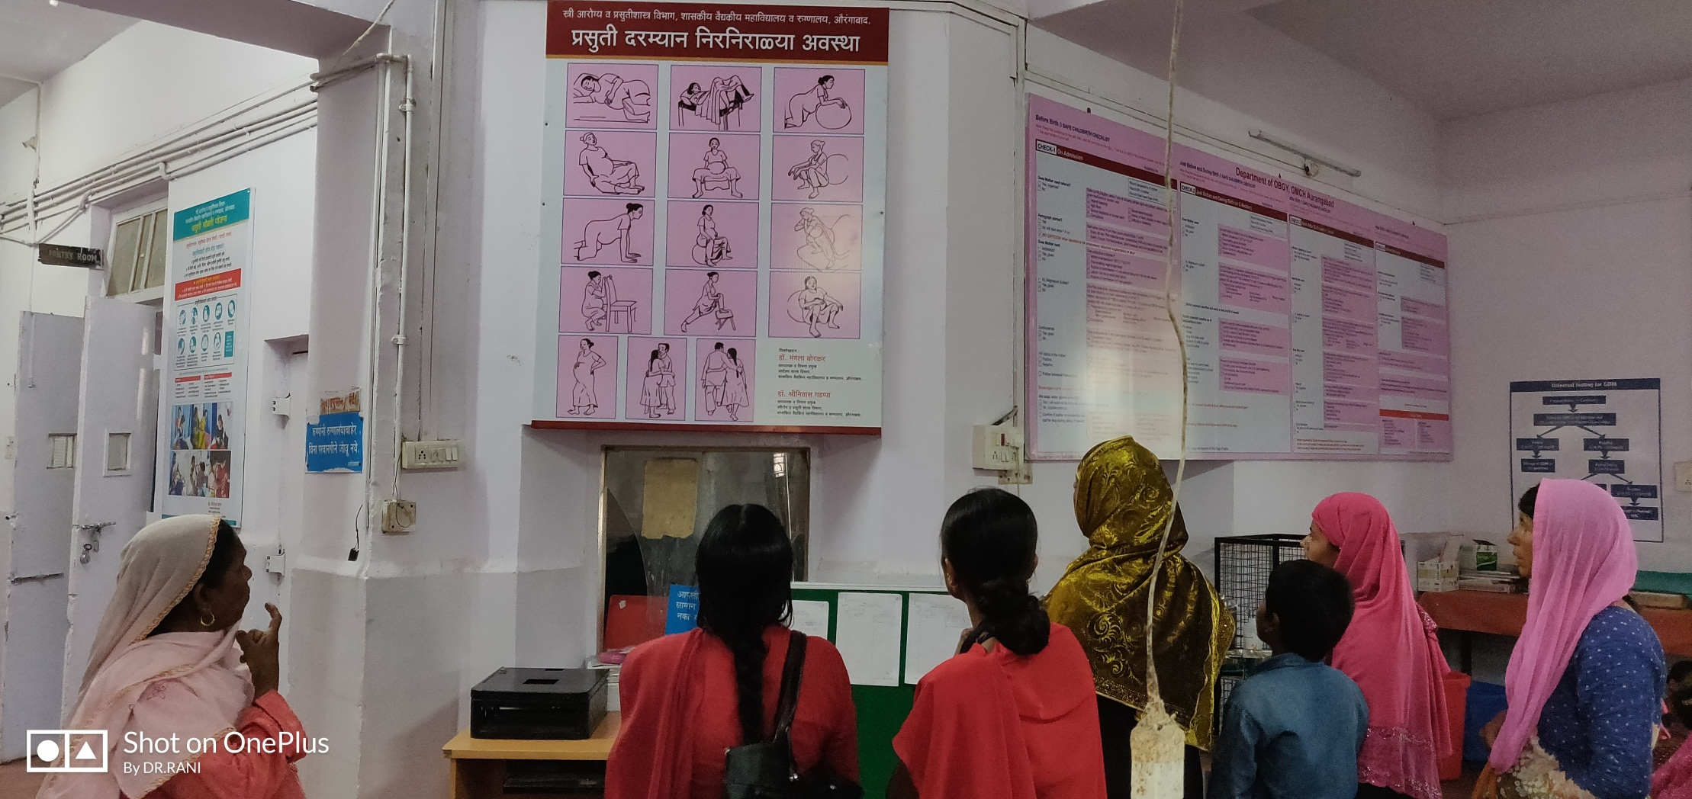
Learning & Understanding

Slide 21
“obstetric chute”

Slide 22
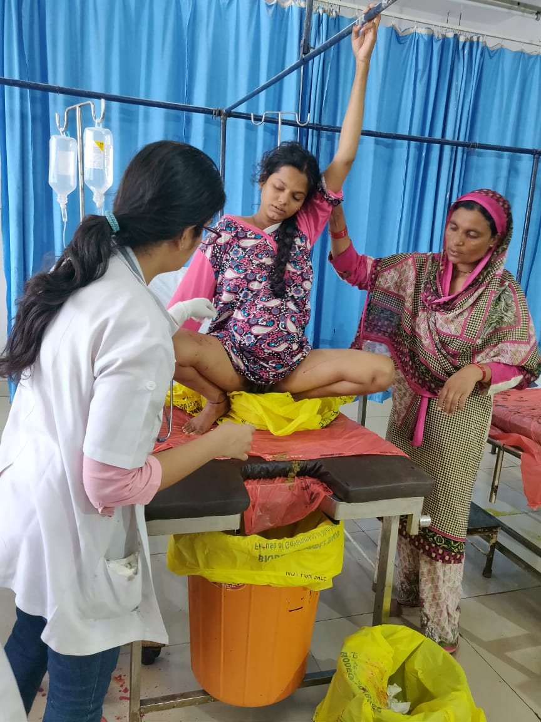
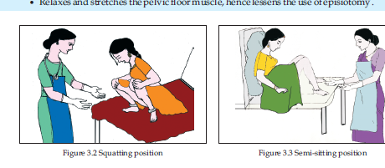
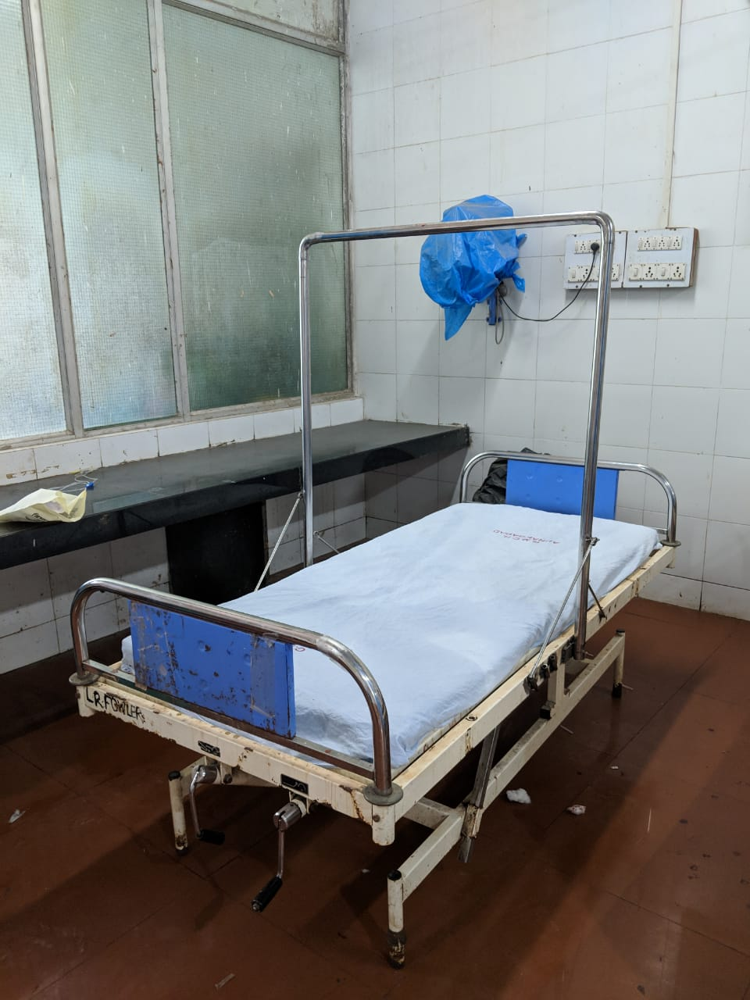
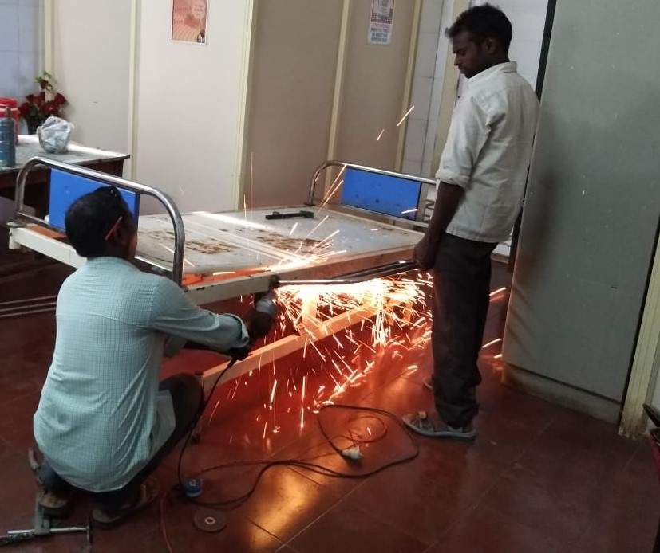
No Need for extra Infrastructure

Slide 23
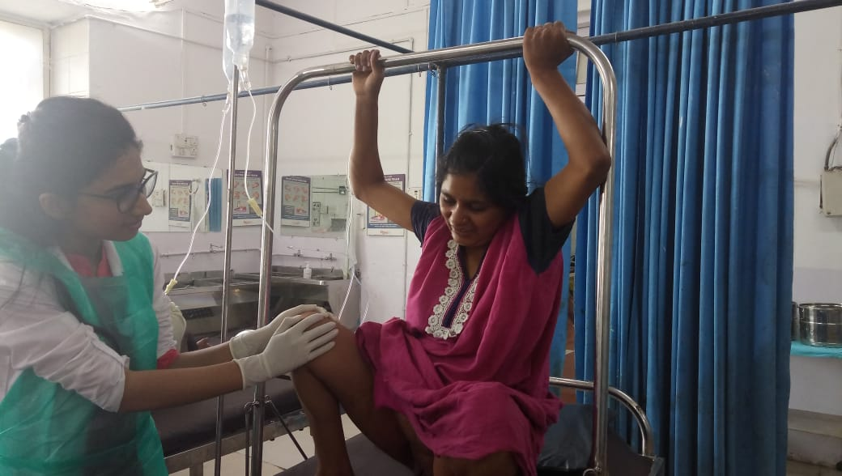
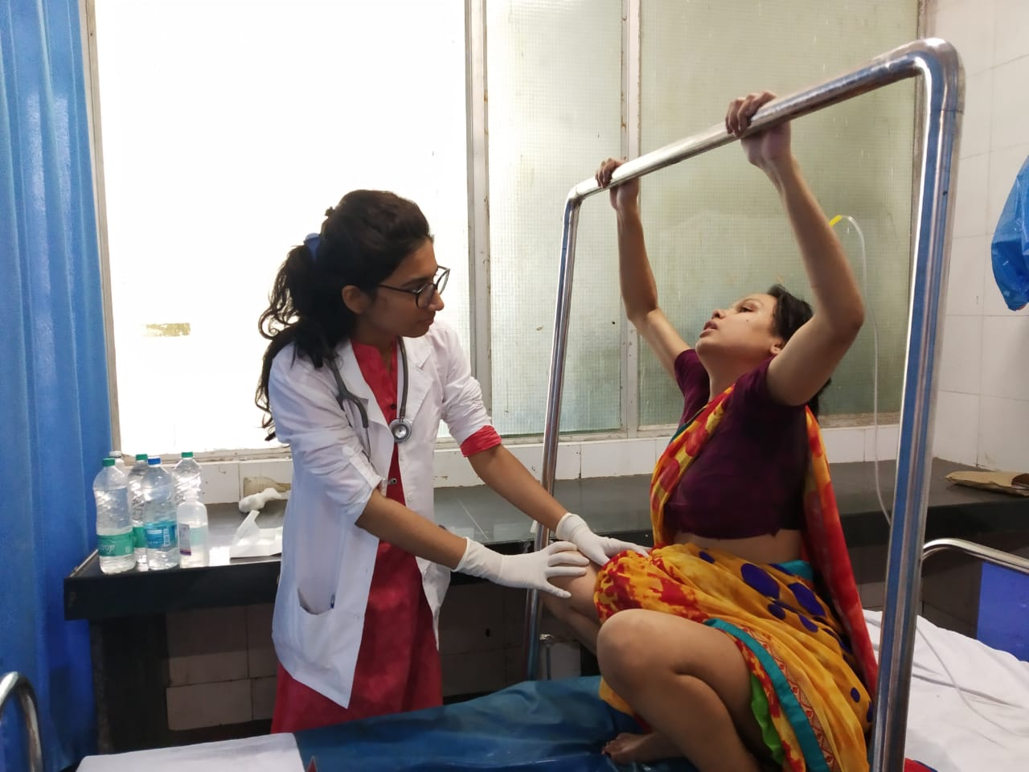
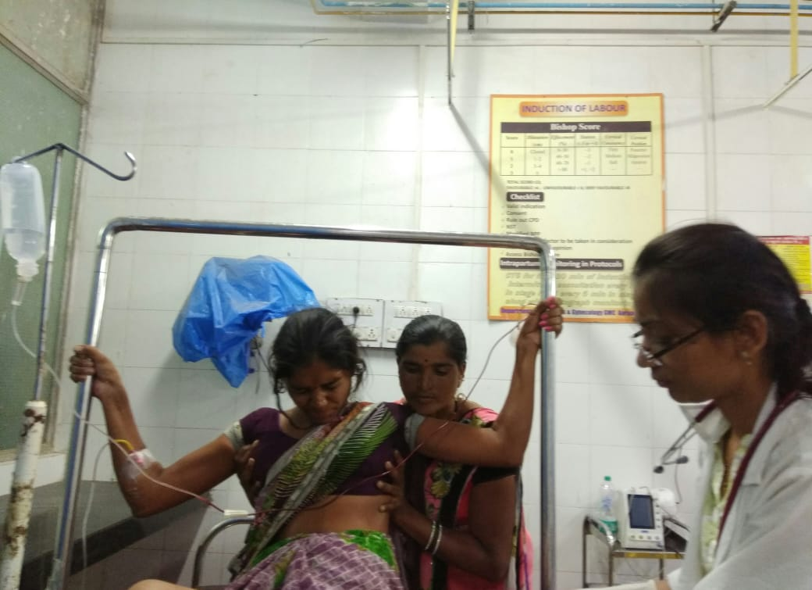
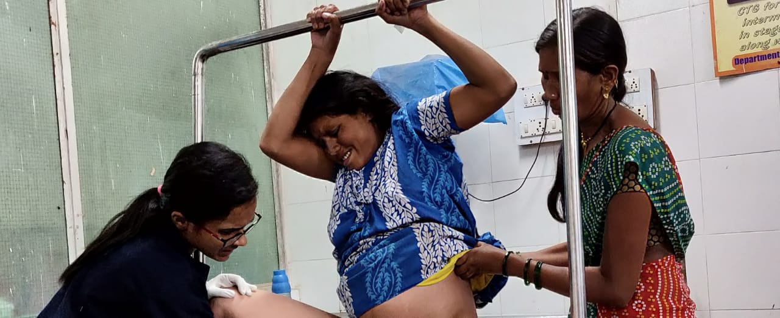
Squatting Bar

Slide 24
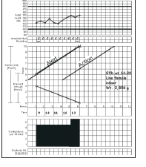
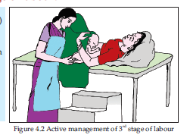
Active Management of
Third Stage of Labour
Partograph

Slide 25
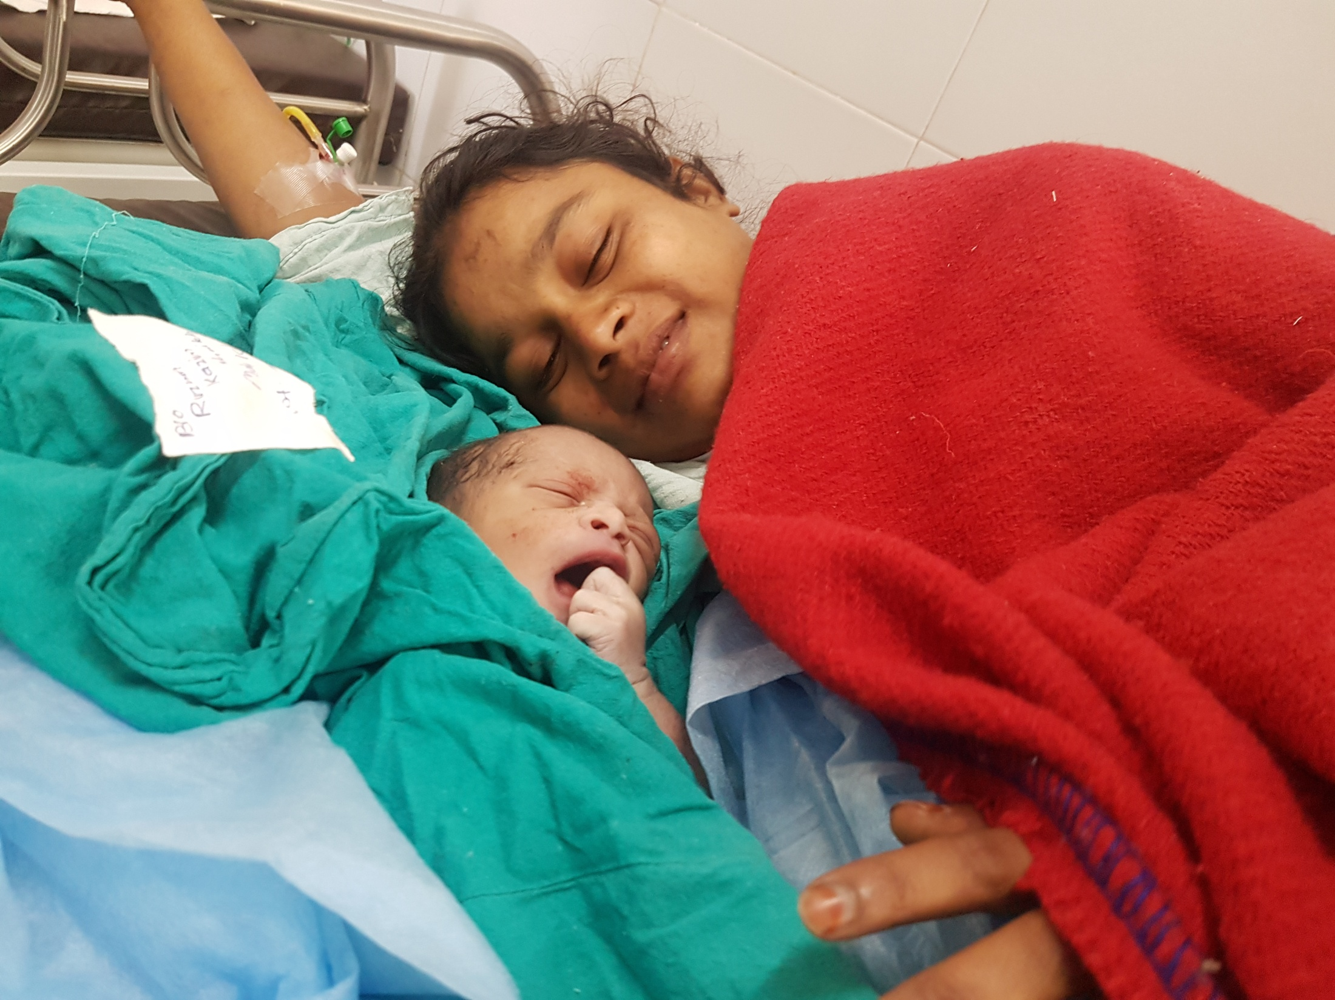
Keep Mother and Baby Together
The day of birth is the most dangerous day for mother and baby
State of the World’s Mothers Report, SC 2013
Promote warming with ‘skin-to-skin’ after birth
Promote early and exclusive breastfeeding
Ensure mother counselled on danger signs

Slide 26
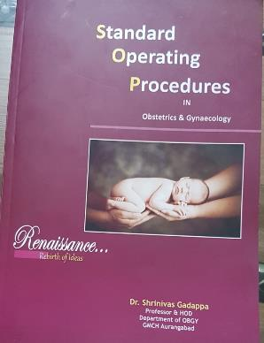
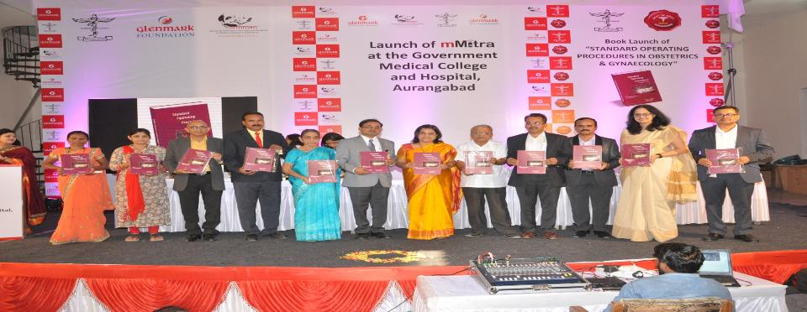
PROUD MOMENT FOR TEAM OBGY

Slide 27
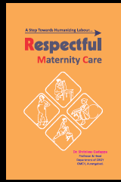
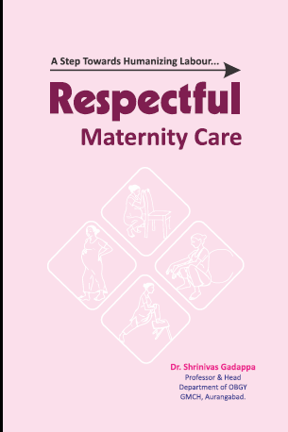

Guidelines from GMCH,Aurangabad

Slide 28
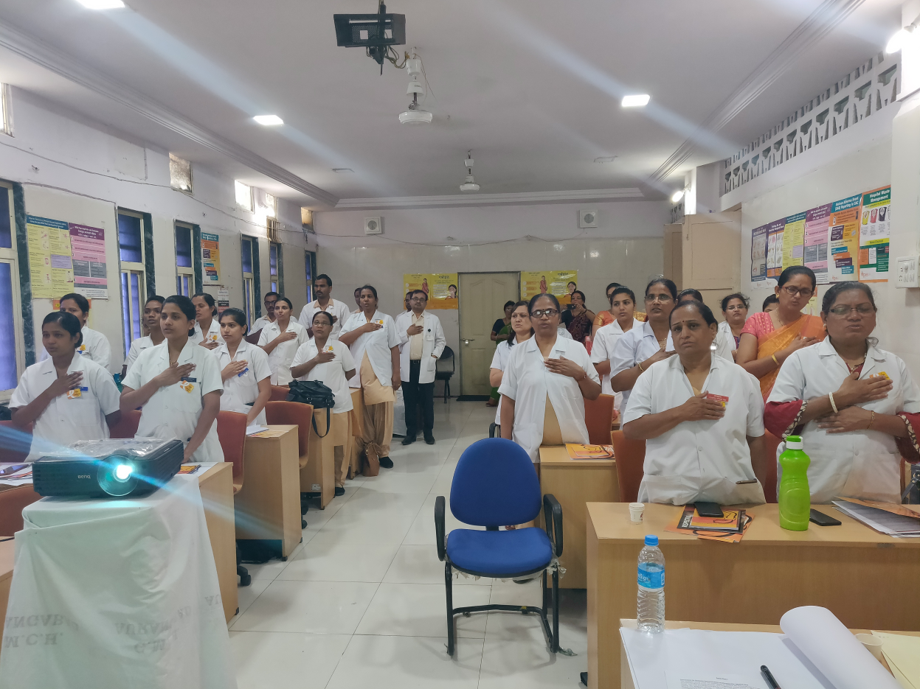
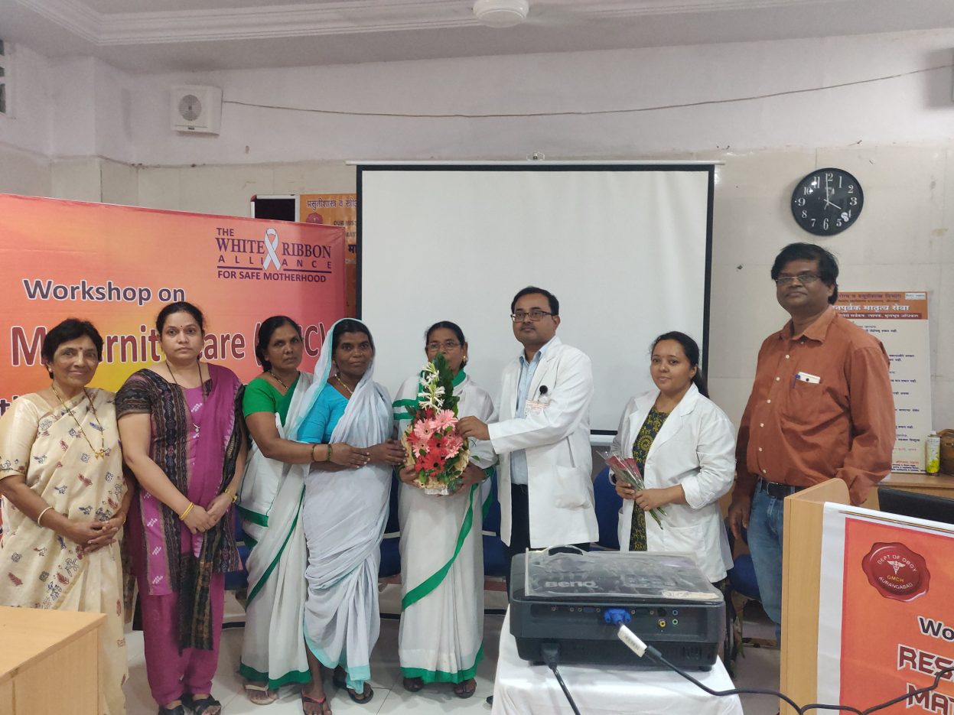
Training SERVICE PROVIDERS on interpersonal skills, behaviour and clinical empathy.

Slide 29
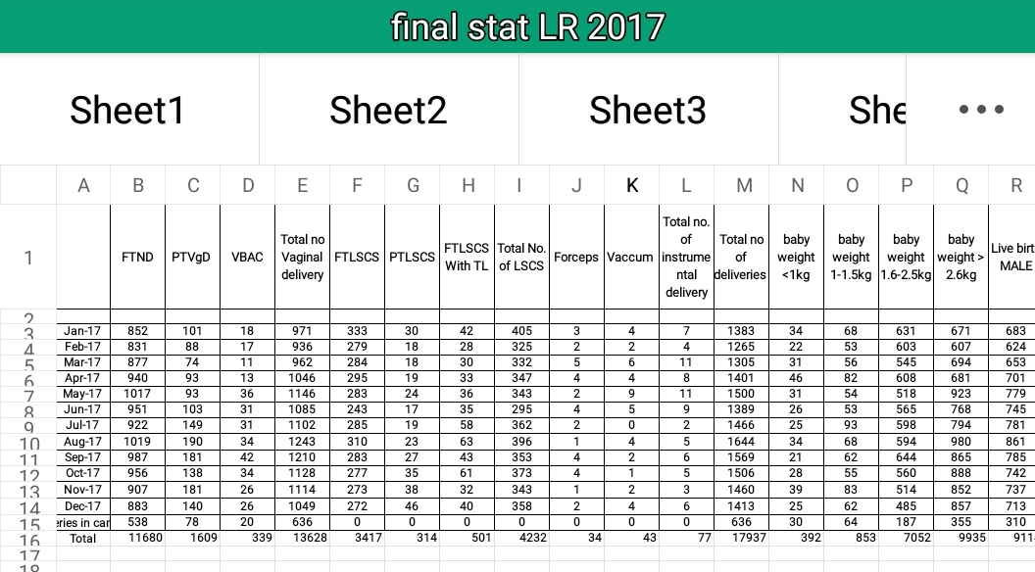
Accountability

Slide 30


PPH workshop : SAVE MOTHERS GROUP
Warm referrals……

Slide 31
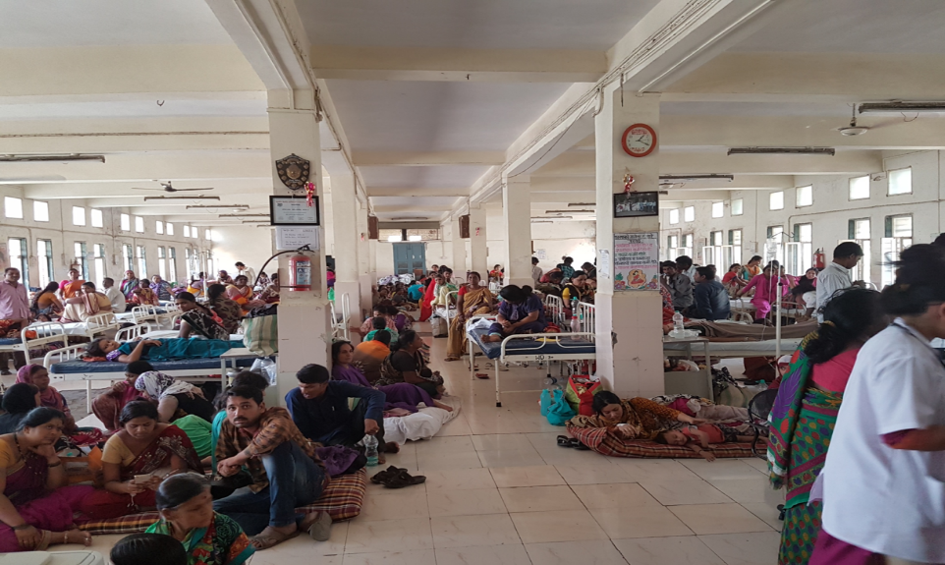
IS IT POSSIBLE TO GIVE RESPECTFUL CARE WITH SUCH A WORKLOAD ??????

Slide 32

Challenges
Strength
SOPS
Willingness to work
smart work plans
dissertation on Birth Position & Doula
Number of deliveries more than 18000/year
Only three units
Human resource
supplies
Funds
Time for training
Study

Slide 33
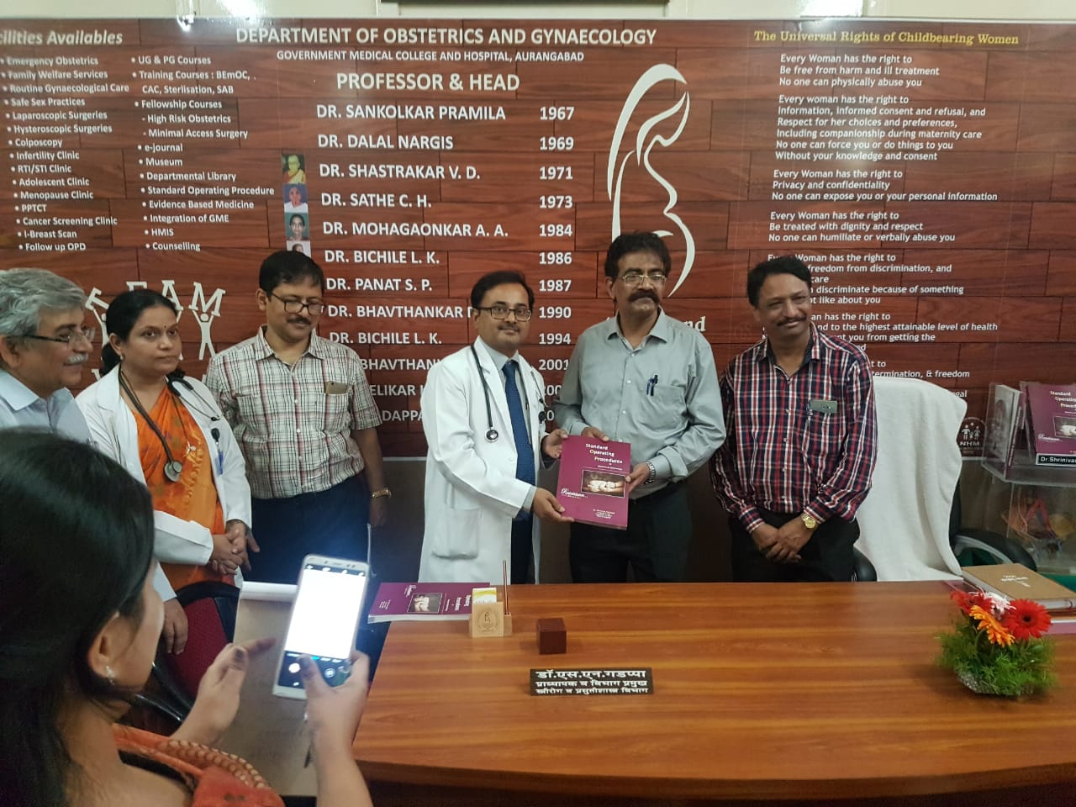
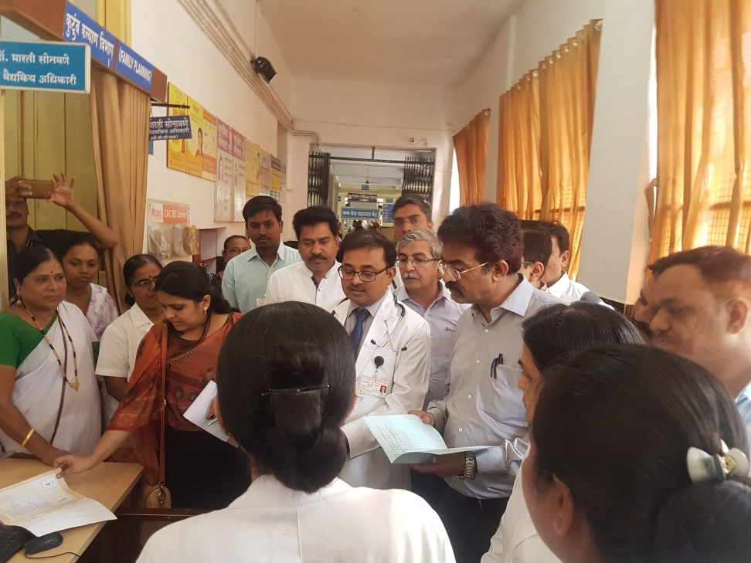
Big moment…Dr Dinesh Baswal sir,
Deputy Commissioner , N H M New Delhi
{30 May 2018}

Slide 34
RECOMMENDING THIS FACILITY – ANC EXIT INTERVIEWS
33% of the clients visited the ANC clinic based on the positive recommendation of their friends/relatives.. 56% of the clients reported that the y would recommend the clinic because of the good behavior of the healthcare workers.

Slide 35
WAITING TIME AND PROVISION OF ESSENTIAL ANC SERVICES – ANC EXIT INTERVIEWS
Only 5% of the clients reported having to wait for more than 2-3 hours for services at the ANC clinic. Similarly, receipt of all essential ANC services (except glucose) ranged from 81-100%

Slide 36
PHYSICAL HARM AND ILL TREATMENT – ANC EXIT INTERVIEWS
95 out of 100 women interviewed did not experience any form of ill treatment from health care providers.

Slide 37

PROVISION OF EQUITABLE CARE– FINDINGS FROM EXIT INTERVIEWS
97% of the clients reported that healthcare providers did not discriminate with them because of their age, marital/health or multipara status.
90% of the clients had reported that they had not witnessed other women being treated poorly because of age/marital status or multipara.

Slide 38
LEFT WITHOUT CARE– FINDINGS FROM EXIT INTERVIEWS
93% of the clients reported that healthcare providers did not ignore or abandon them when they were in need or called for help.

Slide 39
BIRTHING POSITION

Slide 40
DISTRIBUTION OF EPISIOTOMY IN BOTH GROUPS
This table shows that need of episiotomy was more in recumbent group as compared to upright group and the result was significant statistically
22.5% woman needed episiotomy in dorsal lithotomy position whereas 7.2 percent needed episiotomy in upright position.

Slide 41
BIRTHING POSITION STATISTICS
The birthing position statistics In months of June 2018 to September 2018 were recorded
Squatting postion was most favoured by patients with around 766 deliveries conducted in this position
154 woman were delivered in reclining position
308 woman delivered in other postions like semisitting,standing kneeling etc
Dorsal position still most common with 1443 deliveries
Total vaginal deliveries conducted during this period were 4071,with 2671 birthing positions recorded statistically.

Slide 42


Slide 43


Slide 44


Slide 45



Impact of
Respectful Maternity Care

Slide 46




Slide 47
TAKE HOME MESSAGE
Respectful Maternity Care is a universal human right
It includes respect for women’s autonomy, dignity, feelings, privacy, choices, freedom from ill treatment and coercion and consideration for personal preferences including option for companionship…….
RMC is an attitude that permeates each word, action, thought, and non-verbal communication

Slide 48
We all have a role in assuring that women have respectful maternity care!
THANK YOU!

Slide 49






Acknowledgement
INTEGRATING GME IN MBBS CURRICULUM
JDF

