Slide 1

Treating heart attacks in India
What is the optimal approach?
G Karthikeyan, MD, DM, MSc
Professor of Cardiology
All India Institute of Medical Sciences
New Delhi, India
PHRI International Fellow
McMaster University, Canada
Editor-in-Chief BMJ Heart Asia

Slide 2
What is the best approach to treat heart attacks in India?
How is a heart attack caused?
How is it treated?
Determining the best approach for India (local experiences, and insights from other countries)

Slide 3
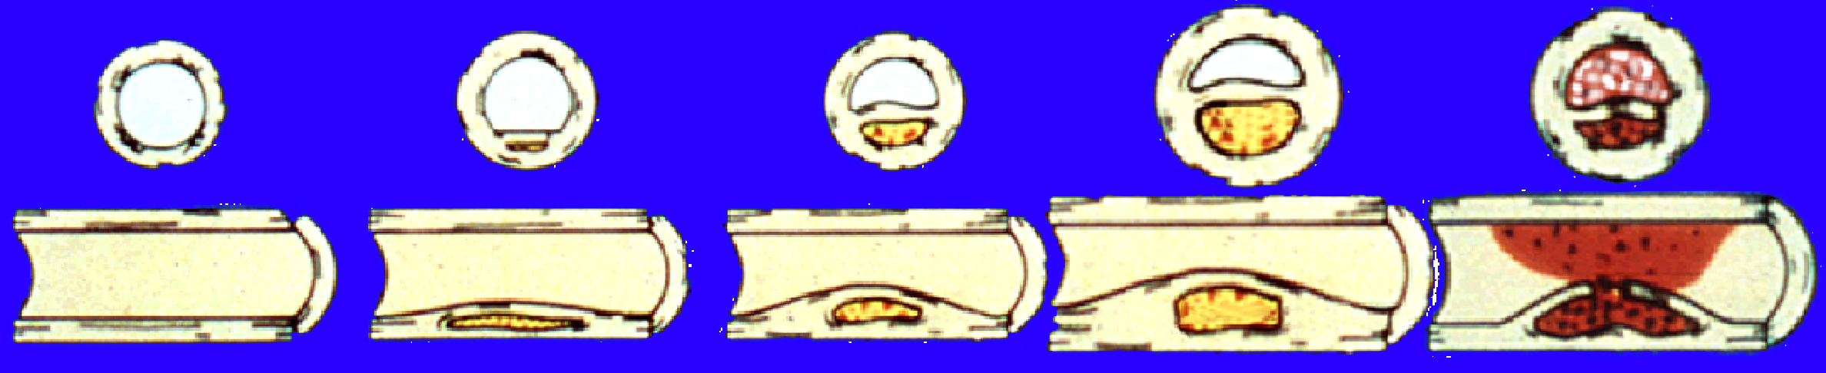
How heart disease happens
Plaque
Rupture/
Fissure &
Thrombosis
Occlusive
Atherosclerotic
Plaque
Fatty
Streak
Fibrous
Plaque
Normal
Unstable
Angina
MI
(“Heart attack”)
Death
Effort Angina
Clinically Silent

Slide 4
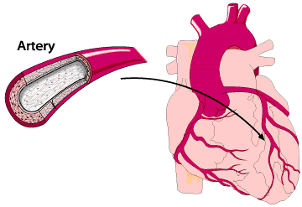
How a heart attack occurs

Slide 5
How to treat heart attacks?
The purpose of any treatment is to open the blocked artery as soon as possible
“Clot-busting” medicines (thrombolytic therapy)
Primary angioplasty (primary PCI)
A combination of the two

Slide 6
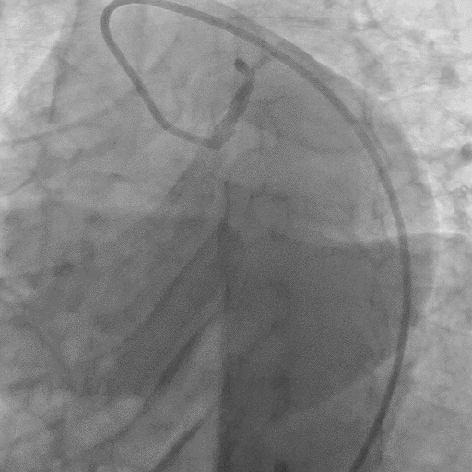
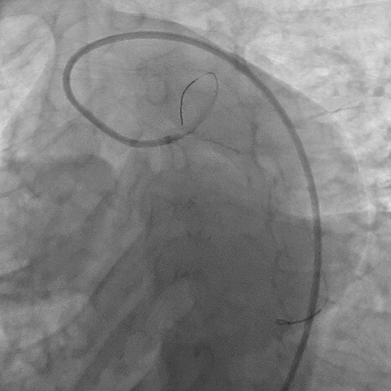
Treating heart attacks: Primary angioplasty

Slide 7
Which is the better treatment?
When performed in a timely manner, primary angioplasty is better than thrombolytic therapy
Treating 100 heart attacks with primary angioplasty, instead of “clot-busting” drugs will save 2 additional lives
So should we provide for facilities to do primary angioplasty for all patients with heart attack in India?

Slide 8
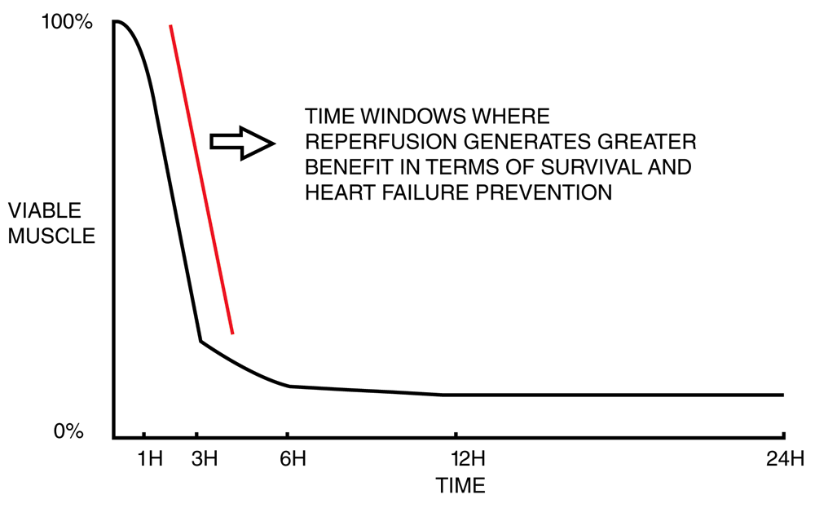
The importance of timely treatment
Time is muscle
The “Golden Hour”

Slide 9
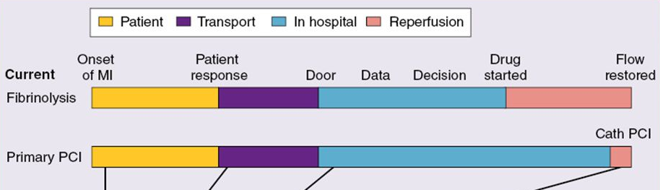
The anatomy of time to treatment
Patient delay
System delay
Door-to-needle, and Door-to-balloon times

Slide 10
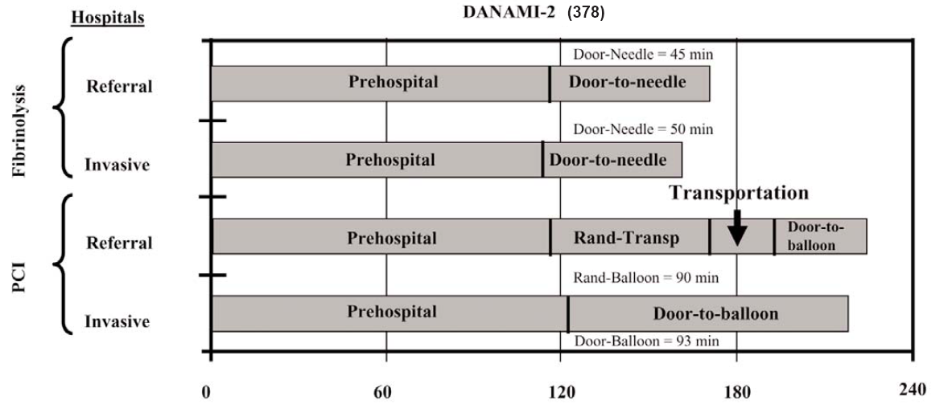
The anatomy of time to treatment
Patient delay

Slide 11
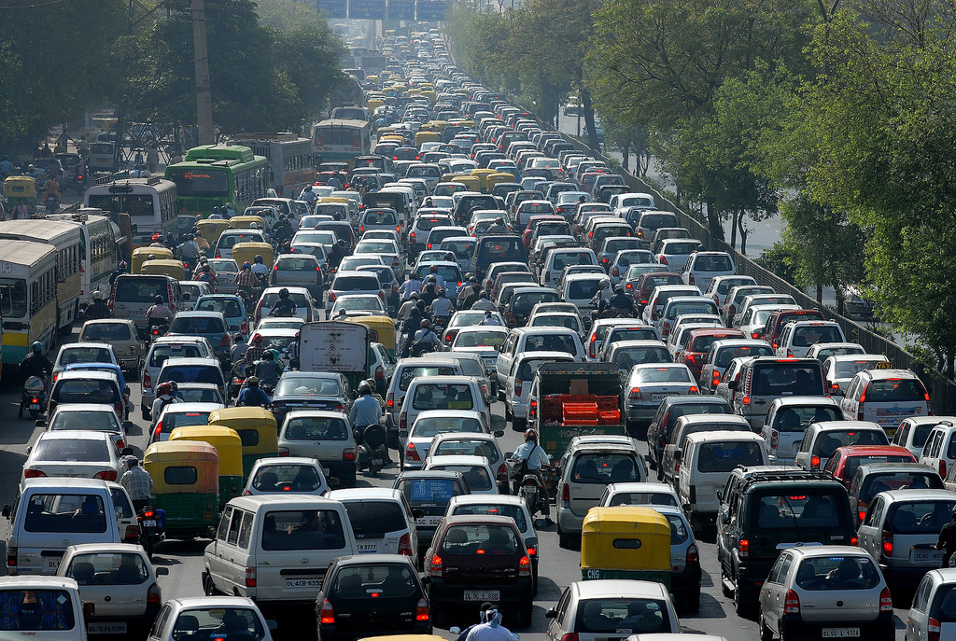
How long does it take to get to hospital in India?

Slide 12
How long does it take to get to hospital in India?
Location, year | Time to first medical contact (hrs)
Karnataka, 2001 | 12
Tamilnadu, 2001 | 10.9
Multiple hospitals, 2001 | 10.8
Delhi, 2003 | 8.5
Multiple hospitals, 2008 | 6 (median)
Kerala, 2013 | 4.5 (median)
North-Eastern states, 2013 | 10
Himachal Pradesh, 2015 | 13

Slide 13
How long does it take to get to hospital in India?
Treating on time is a more critical issue than the modality of treatment

Slide 14
Can we provide timely primary angioplasty in India?

Slide 15
Timely primary PCI: Lessons from the USA
  There were 630 cath labs in India in 2015
  But most located in and around major cities
  Only about 10% of patients are treated by primary angioplasty
  The US has >4 times as many cath labs as India has
  84% of Americans live within a 1-hour drive of a cath lab
  Timely primary angioplasty can be provided only if labs are operational 24/7

Slide 16
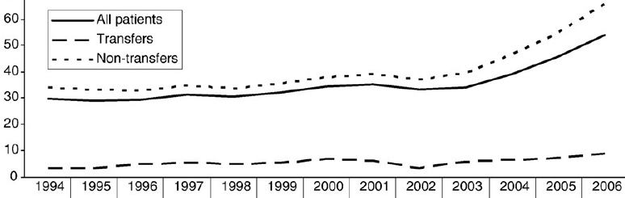

Timely primary PCI: Lessons from the USA
Proportion of patients ≤90 minutes from presentation

Slide 17
Timely primary PCI: Lessons from the USA
Increasing the number of cath labs to improve timely access

Slide 18
Can we provide timely thrombolytic therapy in India?

Slide 19
Can we provide timely thrombolytic therapy in India?
Only 40-60% of people with heart attack receive thrombolytic therapy
Many of them beyond 6 hours after onset of chest pain
30-40% of patients present beyond 12 hours
Main reasons for delay:
Consulting a local practitioner (who does not thrombolyse)
Delay in transportation
Private - 63%, Public - 33%, Ambulance - 5%

Slide 20
Can we provide timely thrombolytic therapy in India?
≈ 3 hrs
Adequately staffed peripheral hospitals/clinics
Practitioners willing to thrombolyse

Slide 21
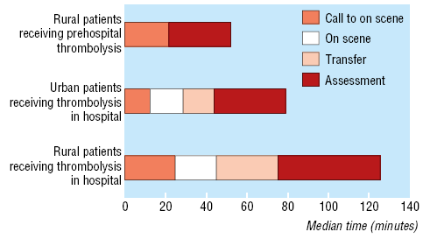
Timely thrombolytic therapy: Lessons from rural Scotland
Saving time by paramedic administered pre-hospital thrombolysis

Slide 22
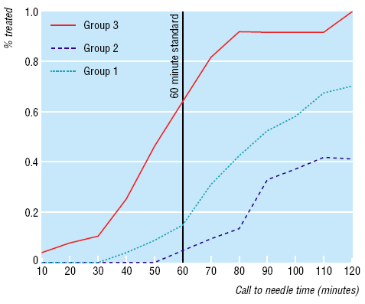
Timely thrombolytic therapy: Lessons from rural Scotland
Patients receiving thrombolysis within 60 minutes

Slide 23
Conclusions
Patients with heart attacks in India present 4-11 hours later than in developed countries
This is overwhelmingly due to prehospital delay
Reducing time to treatment will yield the greatest benefits, and should be the objective of any policy level interventions
This can be achieved by encouraging thrombolytic therapy in peripheral hospitals, and by pre-hospital thrombolysis
Providing primary angioplasty should not be a priority at this time, as it will be costly and impractical

Slide 24
Time is muscle
The “Golden Hour”

