Slide 1

-an innovative STEP for engaging private sector to End TB in Kerala

Slide 2
Background
Approximately half of the TB patients in India seek care from private sector.
Concerted efforts by the National TB Program are going on to get all these cases notified. Leaks in TB care cascade were identified in the country.
Standards of TB Care in India envisions all patients to receive 26 standards irrespective of place of treatment
Kerala Government has declared its commitment to End TB by 2025 and envisions Public and Private to work together for the benefit of the society.

Slide 3
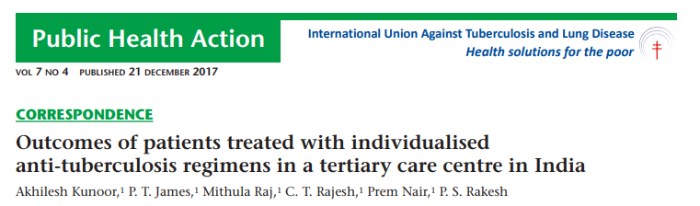
Among the patients initiated on private regimen, the success rate was 70.4% among PTB and 76.1% among EPTB cases.
Details for 21% patients undergoing a private anti-tuberculosis regimen could not be obtained and were considered as Lost to Follow Up
The leak in cascade of care was identified as a major issue in private hospitals as there was no system there to identify the leaks, follow up the patient and ensure public health actions.

Slide 4
System for TB Elimination in Private Sector
STEPS centres
Single window system in private hospital
Ensuring all Public Health Actions to all
Private Hospital Consortium
Consortium of Hospital Managements
Establishing STEPS, policy support & Review
Coalition of Professional Medical Association
To sensitise and support specialists
To advocate with doctors for following STCI

Slide 5
STEPS Centre Model
A nodal person (STEPS lead) at the centre and contact persons (STEPS link) in each in-house unit are linked in a hub and spoke model.
Patients are counselled and supported during test, diagnosis, treatment initiation and ensuring all public health actions.
STEPS Lead notifies cases to Nikshay and update information.
Specimen collection and transportation for cost-free CBNAAT test, Anti-tuberculosis drugs, domestic Airborne infection control kits, patient incentives and ICT based treatment monitoring are provided by RNTCP at the private hospital.

Slide 6
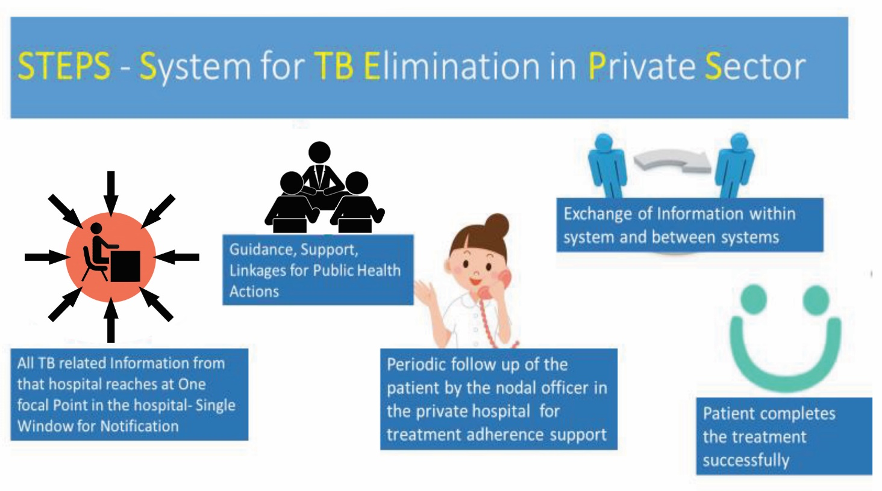

Slide 7
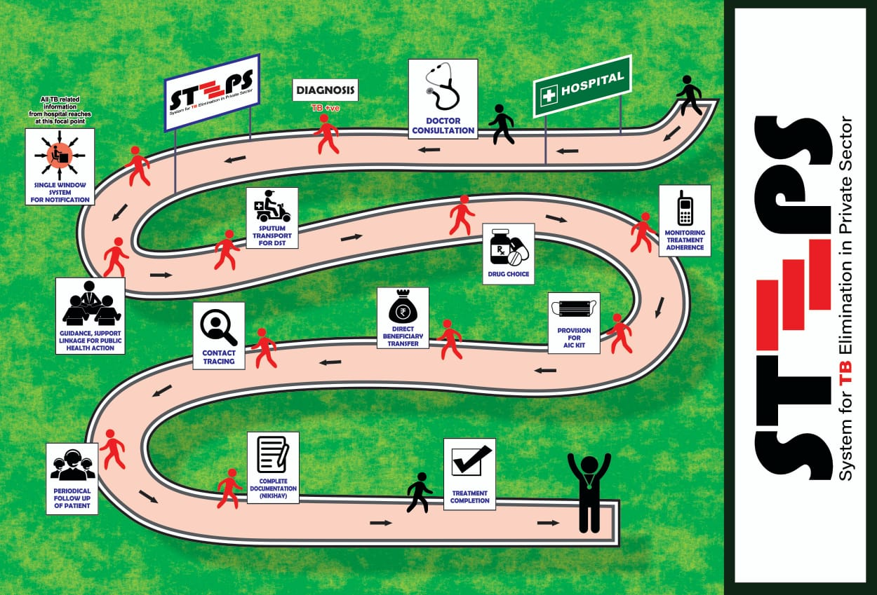

Slide 8
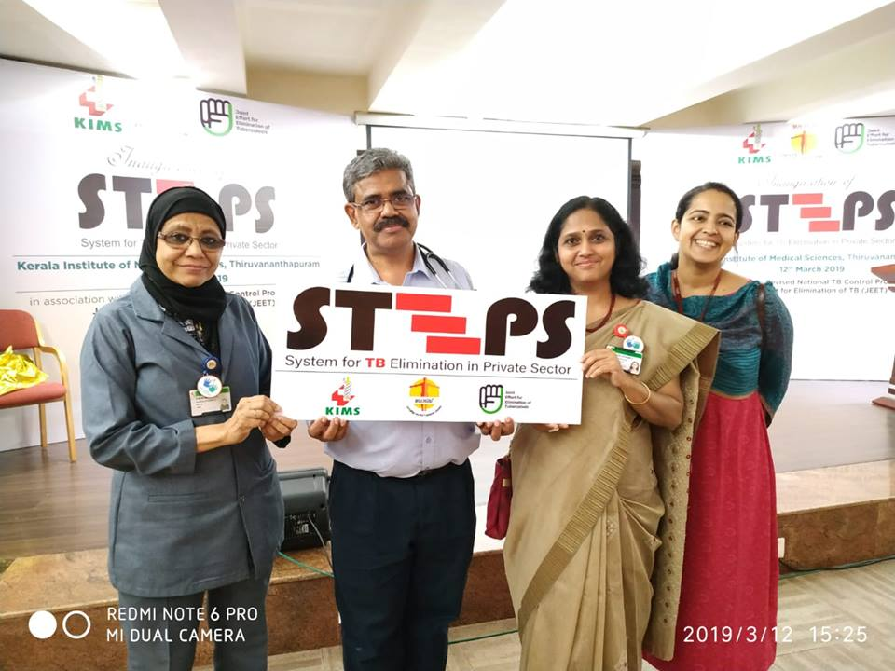
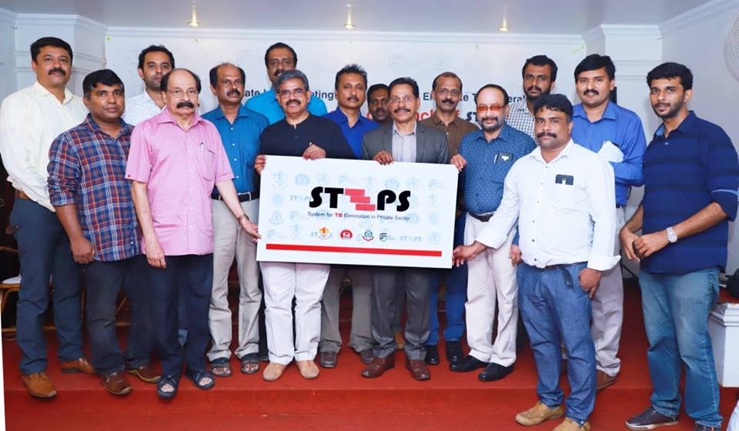
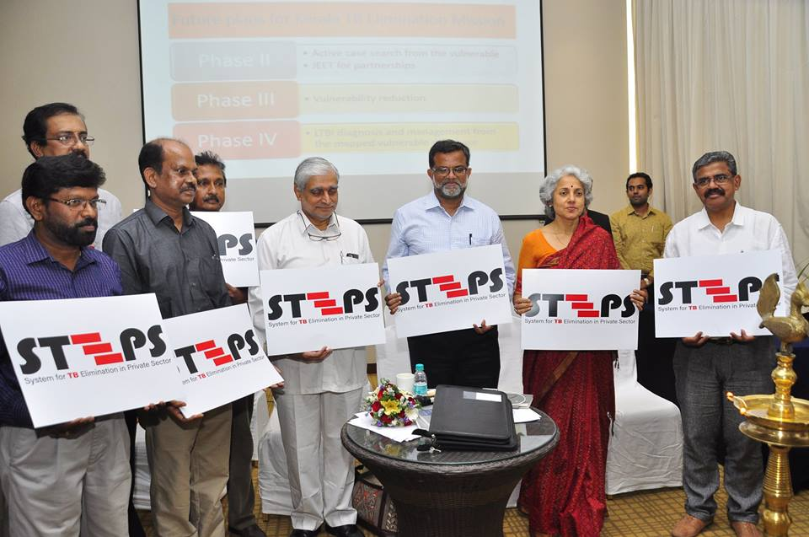
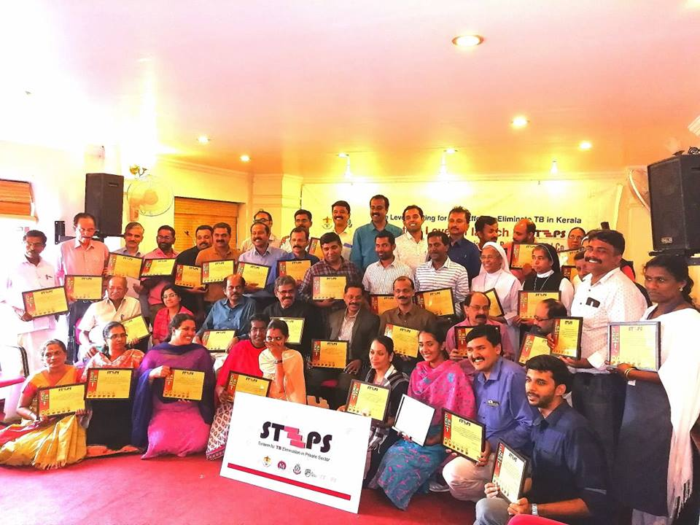
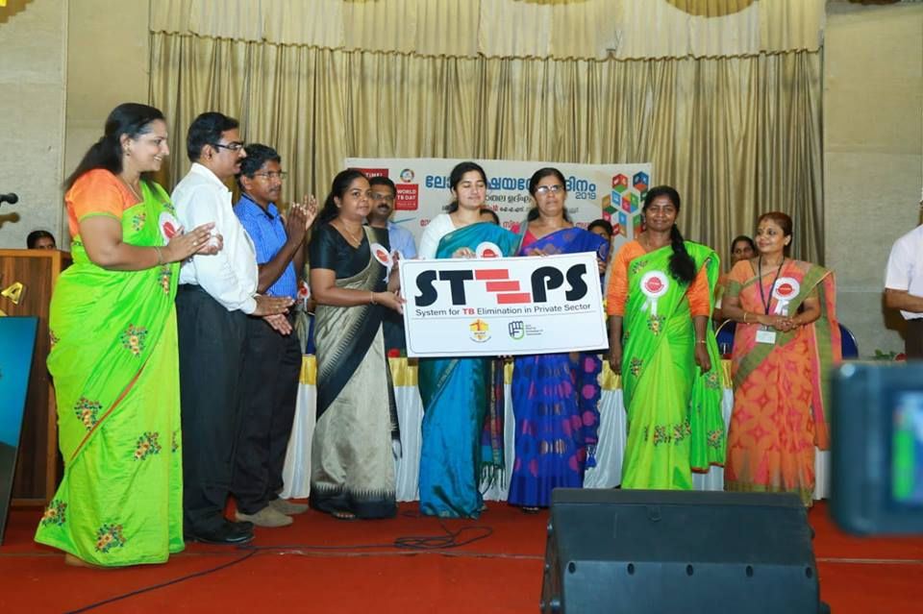
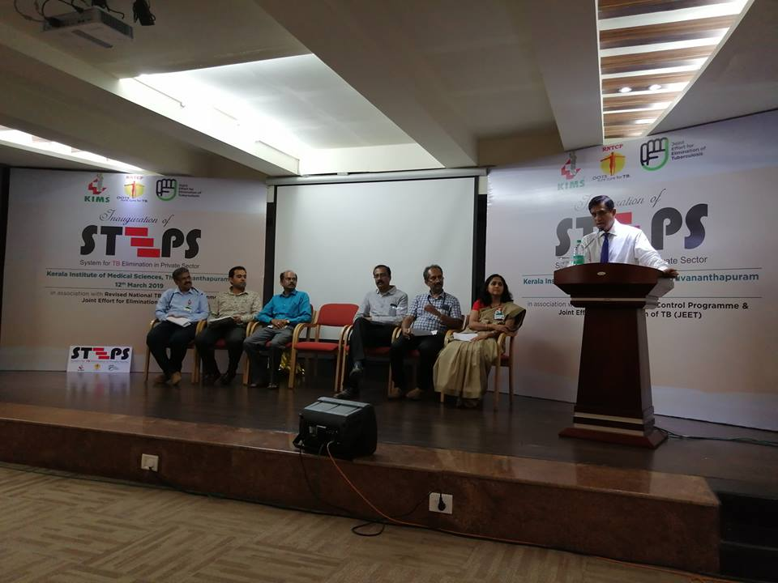

Slide 9
Private Sector Cases- Comparison between 2018 and 2019
 | 2018 (JAN-SEP) | 2019 (JAN-SEP) | Remarks
Notification (Enrolment/Diagnosis at a private facility) | 3829 | 5040 | 31% increase in private Notification as compared to 2018
Microbiological Confirmation | 35% | 40%
Universal DST | 16% | 39%
DBT Account Entry | 51% | 66%
HIV Status | 42% | 70%

Slide 10
Trend of Adult Rifampicin containing Products Sales (2015-2018)
Data Source: Annual TB drug Sales Information of Lupin, Cadila, Concept, Macleods officially collected by Drugs Controller of Kerala as part of TB surveillance

Slide 11
Sustainability, Scalability, Replicability
The model has no additional financial or human resource implications. It fosters customer loyalty between patient and private hospital without interfering in business. So, itself it is sustainable.
It relies on social responsibility of private sector blended with profitable customer care services and self realisation of the Government about its actual role to serve the entire citizens.
The model could be locally customised to any setting.
It is a win-win-win scenario for Public, Private and Society, so itself easily replicable.

Slide 12
Conclusion
Low cost locally customised private sector engagement models with good administrative commitment is feasible and is beneficial to the society.
STEPS is a patient centric strategy by Government which helped to (i) Improve Standards of Care among patients reaching private sector, (ii)Reduce Out of Pocket Expenditure to patients reaching private & (iii) Strengthen the system to ensure Universal access to TB care.
STEPS will also lead the way for establishing ‘System for Total Engagement of Private Sector’ for all National Health Programs other than TB.

Slide 13
Thank You

