Slide 1




Comprehensive Women Health Care Screening and Treatment Program

Slide 2
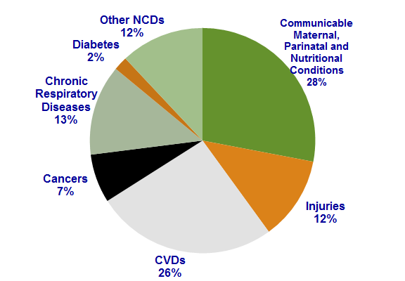
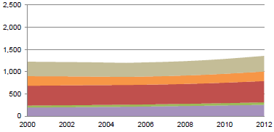
Disease Burden
NCDs are estimated to account for 60% of total death
Mortality under 70 years due to 4 major NCDs: Cancer, Diabetes, CVD and COPD
Institute of cytology and preventive oncology, India:
Cancer is the second most common cause of death in India (after cardiovascular disease).
More women in India die from cervical cancer than in any other country. One woman dies of cervical cancer every 8 minutes in India.
Breast cancer is the most common cancer in women in India and accounts for about a quarter of all cancers in women in Indian cities.
Probability of dying between ages 30 and 70 years from 4 main NCDs is 26%
Source: 1. WHO – NCD Profiles, 2014: http://www.who.int/nmh/countries/ind_en.pdf?ua=1, 2. Institute of cytology and preventive oncology, India

Slide 3

Evolution of the program
Comprehensive women health care screening & treatment Program
Vision
Empower women to become aware and take care of their own health by providing them access to knowledge and preventive health care services.
Mission
Motivate women to seek knowledge about their own health, to provide them access to screening services for Non Communicable diseases, appropriate counseling and management, so that they can get screened themselves before occurrence of diseases. This will benefit not only women but also families and community enlarge for achieving health and reducing expenditure on health care.
NHM
(NPCDCS)
PSI India
(Sankalp)
- NCD clinics established
in District Male
hospitals which lack -
Privacy and Belongingness
for women
Women specific services
+ Was Working for
cervical cancer in 3
districts with private
providers only
+ Screening of women
aged 30-59 years
through VIA & treatment
through Cryotherapy
(WHO guidelines)
- Limited Funds for large
scale implementation

Slide 4

Key Features
Implementation Plan
Preventive Approach to Non Communicable Diseases – Early detection and Management
Screening every woman between 30- 60 years for -
  Obesity
  Hypertension Cardiovascular Diseases
  Diabetes
  Cervix Examination through VIA
  Breast Cancer
  Anemia
Appropriate management (Counselling/Treatment/Referral/Follow up)
Personalized Record & regular health follow-up of clients
Geographical coverage
  Phase I-5 Districts
  Phase II- 28 Districts
  Phase III- 75 Districts (Whole State)
Location with in the districts-
  DWH & 2 CHCs
Mode of Service Delivery-
  Daily OPD at District Women Hospital
  Fixed Day Service at CHC

Slide 5
Institutional Mechanism
NHM
(Overall Rollout/Funding
SIFPSA
(Implementation)
PSI
(TA)
    NHM-
    Financial Support to the Program
    Regular monitoring and supervision
    Organising TAG for any technical decision
SIFPSA-
Coordinate trainings
Provide HR in DWH after 6 months for 6 months for districts of phase 1
PSI-
Technical Support
Providing district level HR for DWH (1doctor, 1 nurse & 1 support staff) for initial 6 months for the districts of phase 1
Development of training sites at Medical colleges
Training & Capacity building of service providers
Development of IEC Prototypes and other communication materials
Development of Community Mobilization Strategy
Development of MIS System for program clients follow up
Tripartite MoU has been signed between NHM, SIFPSA and PSI for Roll out of the project
Technical Advisory Group – Chaired by Mission Director.
Steering committee – Chaired by Mission Director

Slide 6
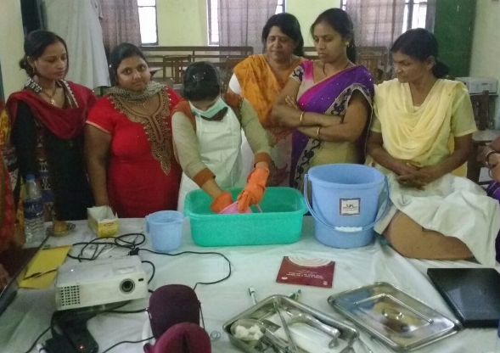
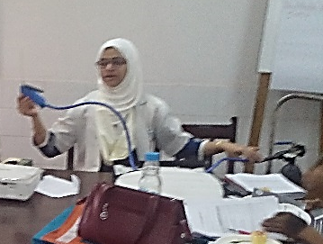
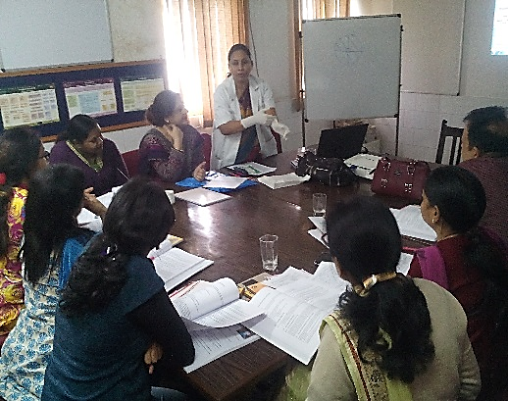
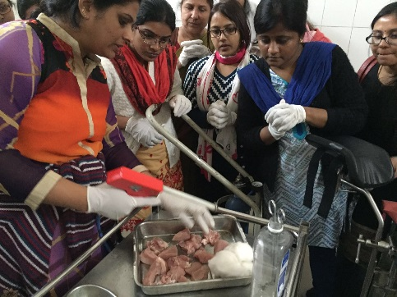
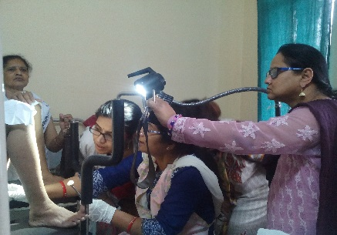
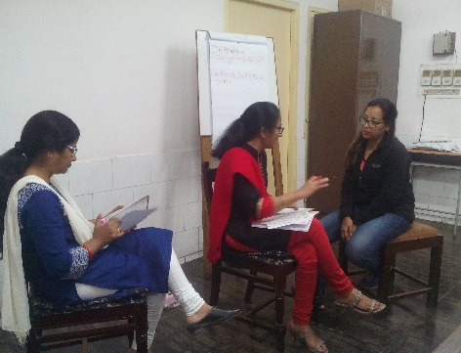
Training
Sites
  TOT- 3 Medical Colleges
  Training of SAs - DWH
Reference Material
  Training Manuals for Doctors & Screening Assistants
  Standard Operating Procedures for smooth operations of Clinic
Orientation- All CMS and NCD nodal of 28 districts
were oriented for the program
State Plans to involve more Medical colleges in
training and Supportive Supervision

Slide 7
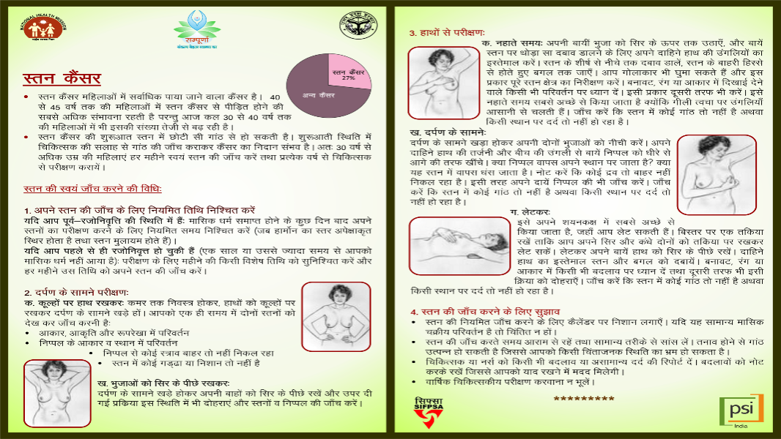
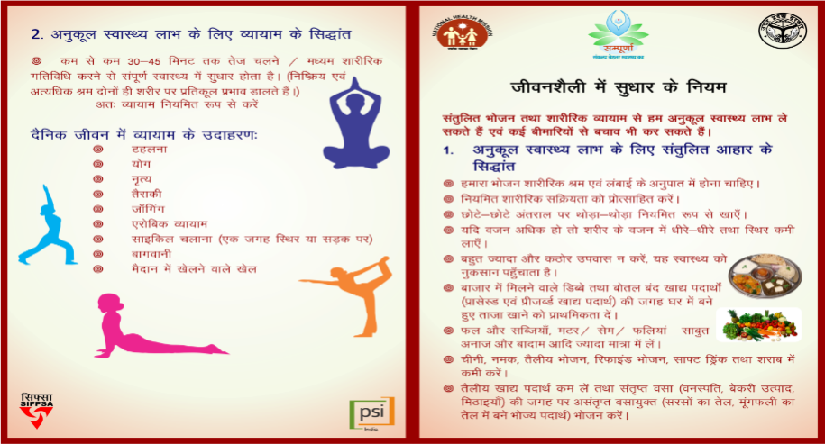
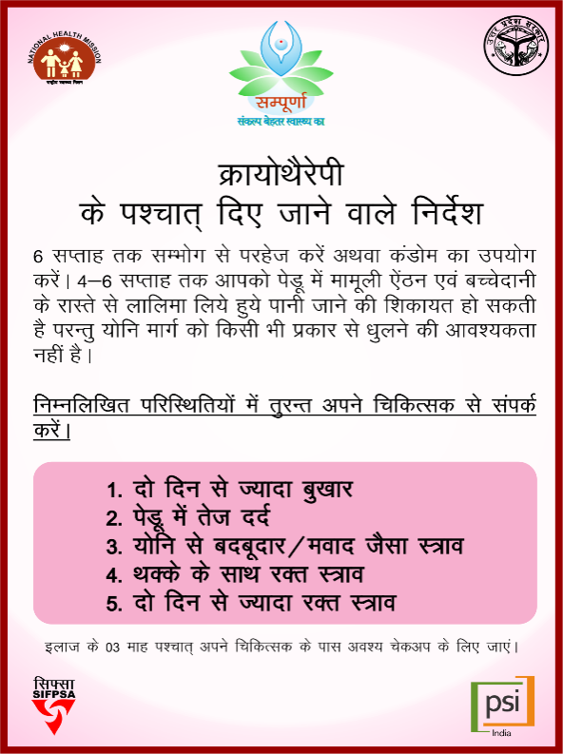
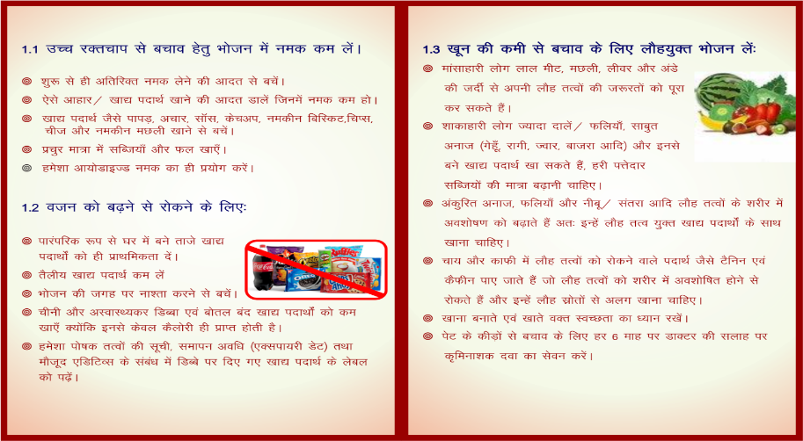
Educational Material
1. Principals for Life Style Management
2. Community Awareness leaflet
3. Leaflet for self examination of Breast

Slide 8
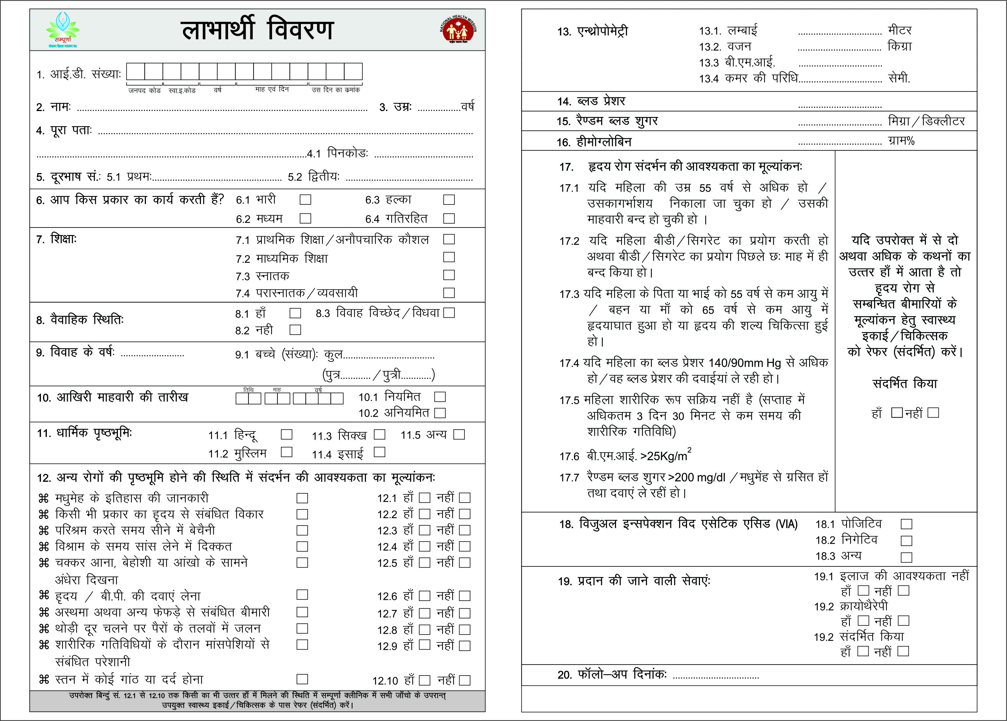
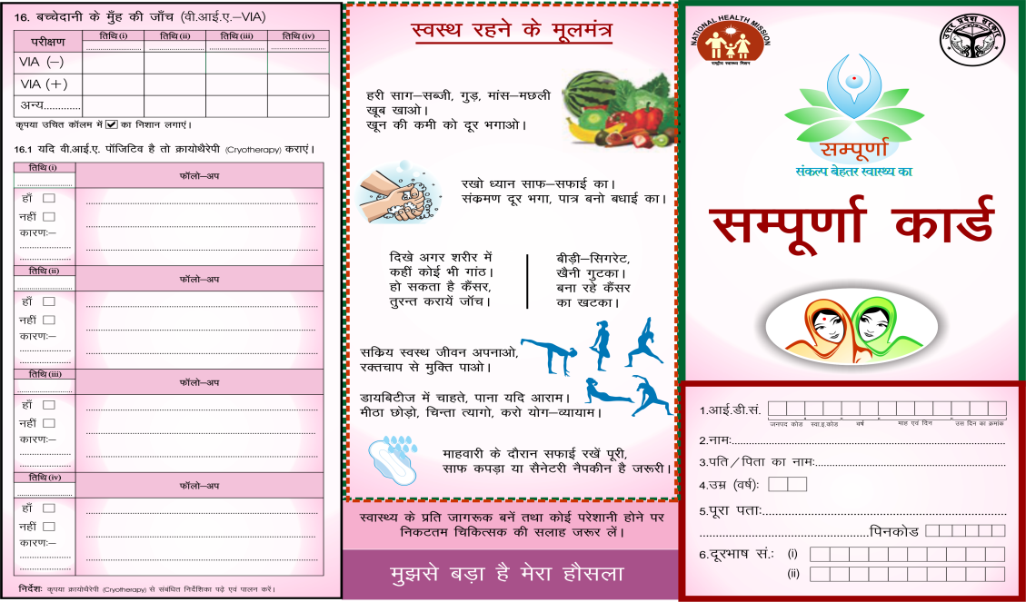
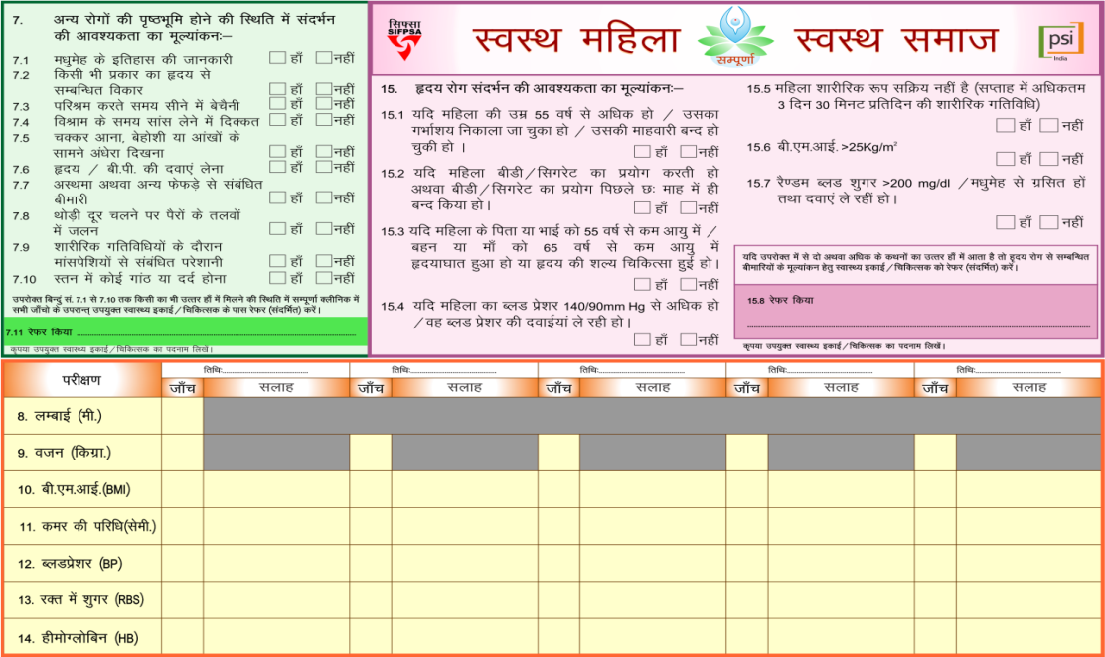
Beneficiaries Records
Sampoorna Card- for Beneficiaries
Beneficiary record- for Clinic

Slide 9
Sampoorna -Total Achievement Since Inception (Sept 2015) to June 2016 (Till 20th Jun)
Indicators | Sampoorna
No of women aged 30-59 screened for Cervical Cancer | 21387
No of women screened VIA positive | 674
Positivity Rate (in %) | 3.2%
No of VIA screened positive eligible women treated with Cryotherapy | 319
Treatment Rate (in %)* | 63%
No of VIA screened positive women referred for advance treatment/investigation | 168 (25%)
No of women referred for advance treatment for NCDs (other than CaCx) | 6620
*Note: In calculating treatment rate the number of women referred for advance treatment/investigation have deducted from the number of screened positive women.
Screening Start Month & Year- September 2015

Slide 10
Blood Pressure
Diabetes
N=11268
N=10877
227 records discarded from analysis due to incomplete/missing/wrong data
618 records discarded from analysis due to incomplete/missing/wrong data

Slide 11
Challenges
Limitations in Massive Screening
Though project aims to screen maximum number of women only a limited number of women can be screened in the clinic in a day which is less desired number and does not cover a significant part of the population.
Finding space among the other priorities
Mother & Newborn Health is still a priority.
Shifting of thought process from curative care to preventive care is time taking process.
.
Skill Development
Decision of positivity after VIA is subjective and even after a very good training doctors may require hand holding.
As the positivity rate of VIA is 7%, large number of clients are required for practicing Cryotherapy during training of doctors.
Skill development for decision making after VIAis a major barrier in shifting screening task from doctors to nurses
Client Mobilisation
In absence of the perceived need and lack of awareness, women don’t turn up for the check up in the clinic if they do not have any symptoms.
Human Resource
There is dearth of doctors.
Existing staff is overloaded with MNH work.
Technology : Treatment with Cryogun
Cryotherapy requires regular supply of N2O which is difficult to maintain due to limited number of plants in UP.

