Slide 1



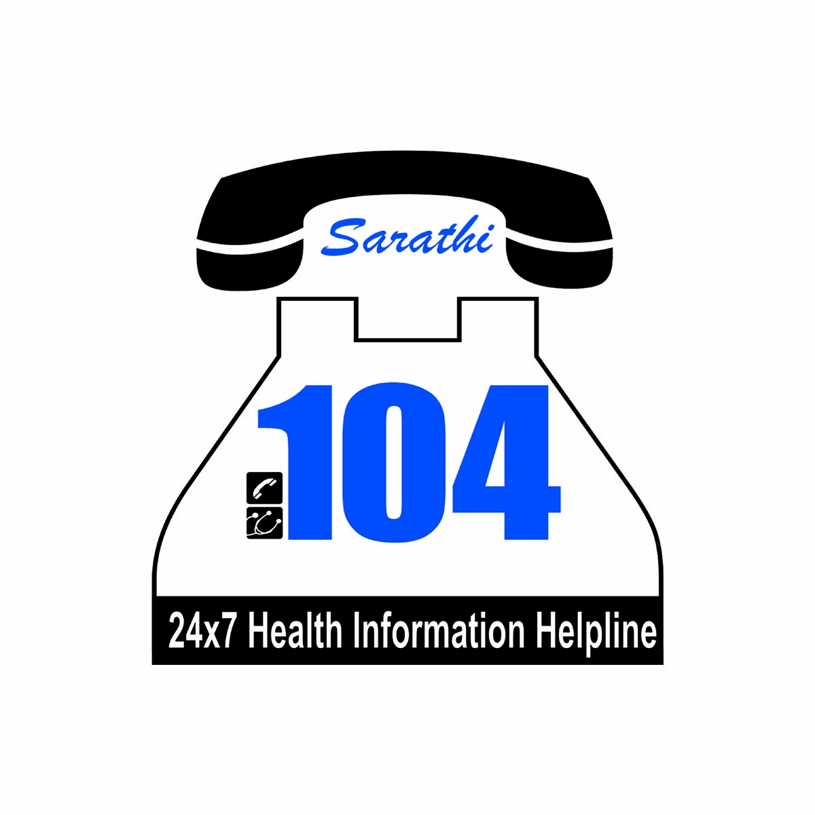
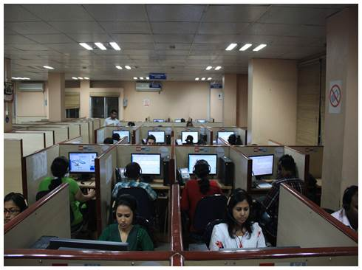
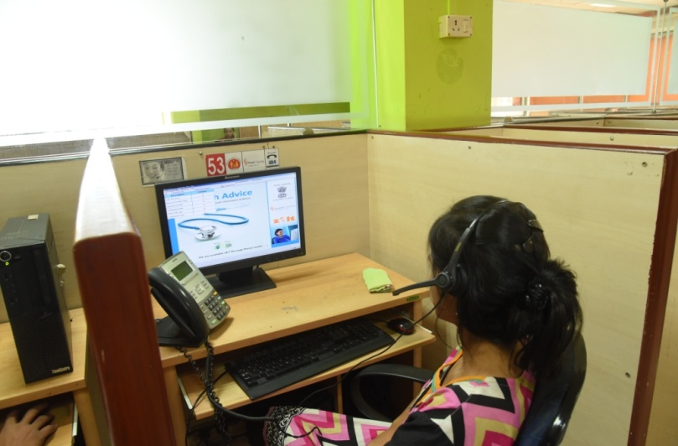
Sarathi 104 Health Information Helpline with Grievance Redressal System
National Health Mission, Assam
Health & Family Welfare Department
Government of Assam

Slide 2
Situation Analysis
Areas of concern
There was no single window system to provide health information in the State.
For small medical advices, people have to visit Doctor. For that many health issues remain unattended.
People hesitate to visit doctor for certain health issues specially sex related issues.
Adolescents neither consult with doctor nor with parent for their health issues (specially sexual and psychological related issues) which remain unattended.
There was no structured mechanism to redress the grievances of public related to health facilities, services etc
There was no structured mechanism to address the information of epidemic outbreak from public.

Slide 3
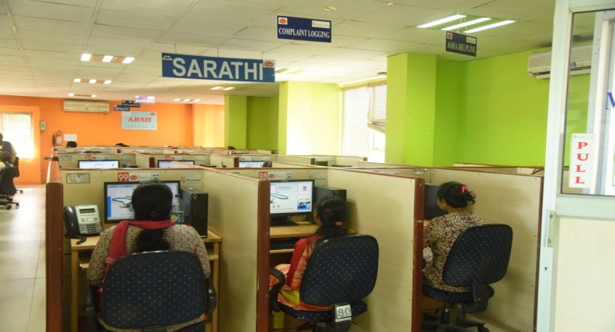
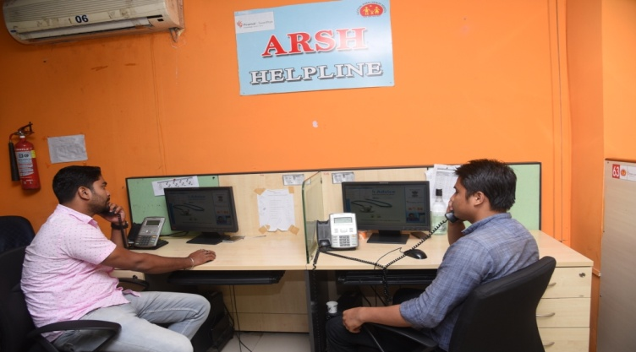
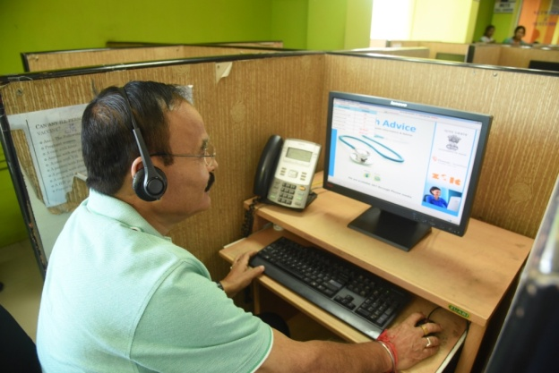
Single Window System for Help information and Grievance
Services under Sarathi 104
Health Advice
Counseling
Health Information Helpline
Grievance Redressal
Epidemic Helpline
RSBY Helpline
ASHA Helpline

Slide 4
Salient Points of Sarathi 104
Salient points
Caller can directly call in the 104 Toll Free No
Services are available on 24X7 basis for 365 days a year
State of the Art Software Technology
Manned by trained Paramedical Staff, Counselors and Doctor
Provides Health Care personnel with Timely Referral & appropriate intervention. Integration with 108 services.
Validated Algorithm & Treatment Protocols
Services offered in Hindi , English , Assamese and Bengali
Started on 20th July 2010 with 50 Seats

Slide 5
Technology
Technology used in Sarathi 104
Automated Diagnosis: Clinical Decision Support System (CDSS) tools enable diagnosis of minor ailments by paramedics allowing doctors to focus on complex cases only.
800 algorithms are used for automated diagnosis of minor ailments.
650+ Disease Summaries are used to provide advice over the phone
New Disease information are updated regularly

Slide 6
Call Flow in Sarathi 104
Emergency Transport
Exchange
Switching Server
Health Advisory officer
Medical Officer
Caller
Counseling
Officer
Complaint Logging/Directory Information/Complaint Redressal

Slide 7
Achievements of Sarathi 104
Sarathi 104 has received more than 1 Crore Calls.
On an average 6500 calls received per day.

Slide 8
Steps for Online eCRS System
NHM Assam has developed online electronic complaint Redressal system (eCRS) for quick redressal of the complaints.
Complaints received from 104 imported in eCRS
Authorized officer of NHM segregate the complaints and forwarded to respective District/ Directorate. Forwarding letter along with complaint detail auto generated.
District / Directorate user update action taken report
State level user verifies the action taken report and send to 104 to inform the caller about the action taken. If action take not satisfied then return to District.
Callers are informed about action taken from 104.
If Caller satisfied then call closed.
If caller not satisfied, then call again forwarded to District.

Slide 9
Process Flow for Electronic Grievances Redressal System (eCRS)
Receive data from 104 Call Center
No
Checking of Information
(Check whether information is specific or non specific)
Call the caller to get required information
Segregation
(Administrative process to set Priority & Category)
Generate order
Send SMS
Forward to District/ Directorate
Receive Action Taken report from District/ Directorate
Generate Reminder
Inform Caller through 104
No
Yes
If Satisfied
Close the Case

Slide 10
Category wise Complaints
Total 6682 complaints received out of which 4738 (71%) complaints readdressed from 17th August 2011 to 25th August 2016.

Slide 11
Integration of eCRS with Assam MCTS Call Centre
Assam MCTS Call Centre
Assam MCTS Call Centre inaugurated on 1st September 2013
Phone Calls are made to Pregnant Women and parent of Children regarding due date of services and information about various health schemes.
During interaction with beneficiaries actual status of implementation of programmes collected by asking simple question whether the benefits has been received or not.
All negative feedback received from beneficiaries are treated as complaint and also readdressed through Complaint Redressal System.
Total 86,487 negative feedback collected through Assam MCTS Call Centre from 1st September 2013 to 25th August 2016

Slide 12
Thank You

