Slide 1
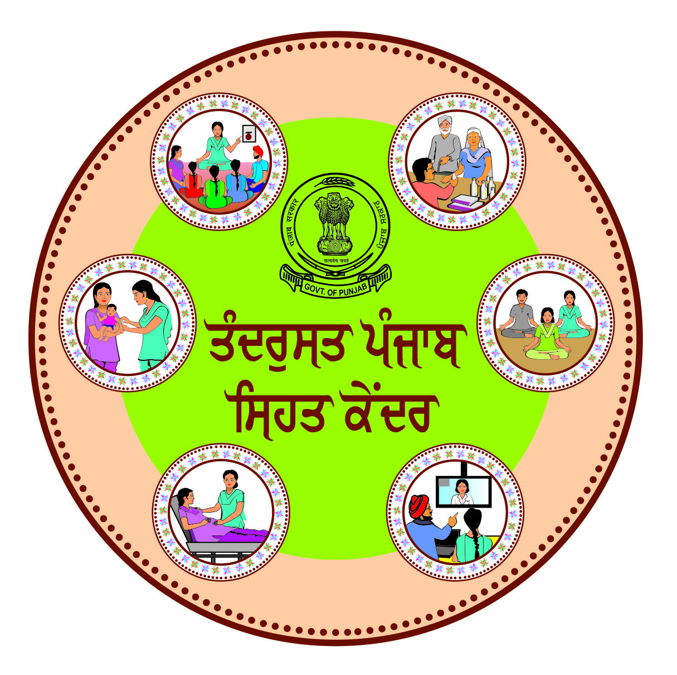
Screening, Detection and Management of Diabetic retinopathy through Health & Wellness centers in Punjab

Slide 2
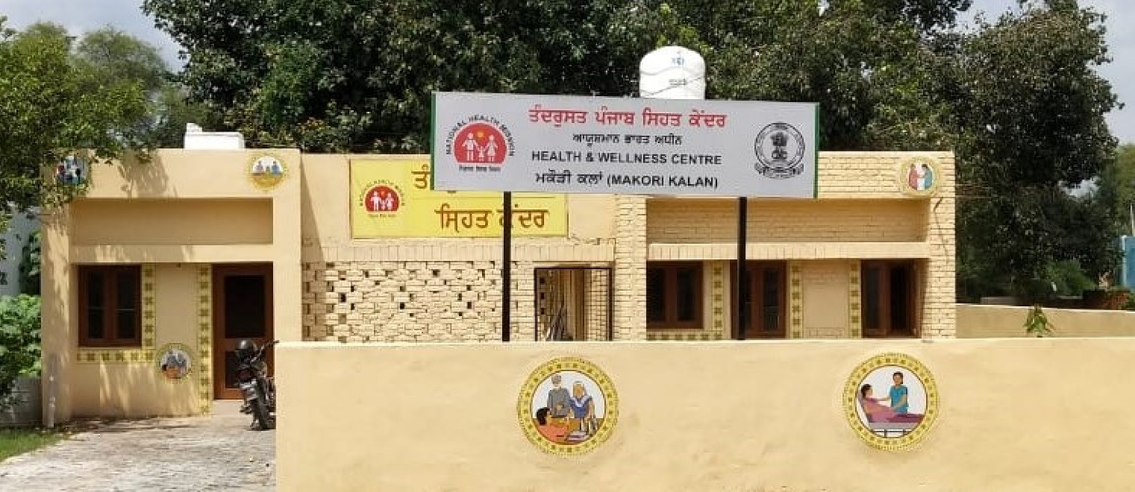
Health & Wellness Centers, Punjab
Launched in 2019
2046 HWCs operational till date
1600 CHOs have been recruited
Footfall – 60.5 lakhs
Over 22 lakh Individuals screened for NCDs
51 lakh patients have received medicines
20 lakh diagnostic tests done

Slide 3
Burden in India & Punjab
72 million diabetics amongst 1.3 billion population
Estimated to rise to 135 million by 2045
Prevalence > 20 years: 7.3% (Punjab 10 %)
One in eight persons >50 years in India is a diabetic
Prevalence in 21 districts among > 50 yrs is 11.8 %
Kapurthala in Punjab has diabetes prevalence as 22 %

Slide 4
Burden in India & Punjab
Among diabetics
Prevalence of blindness 2.1%
Visual impairment 13.7%
10-20 % diabetic patients suffer from complications
16.9% had diabetic retinopathy or damage to retina,
7% had diabetic maculopathy or damage to macula
3.6 % per cent had sight-threatening diabetic retinopathy

Slide 5
Introduction
60.5% had poor control of sugar
Majority of the diabetics had never sought an eye check-up
Poor awareness regarding the health, 90 % of known diabetics had never gone for fundus evaluation for diabetic retinopathy

Slide 6
National Efforts
Population-based screening for hypertension, diabetes and common cancers*
Premature mortality from cardiovascular diseases, cancer, diabetes or chronic respiratory diseases to be reduced by 25% by 2025**
Special focus on non-communicable disease***
Health insurance and health and wellness centres
* National Program for Prevention and Control of Cancer, Diabetes, CVD and Stroke
* National Health Policy 2017
**Ayushman Bharat

Slide 7
Rationale for the Project
NPCDCS and NPCB & VI are being implemented
Lack of integrated community-based DM & DR screening programme
Opportunity to strengthen the health system in three different areas
Sensitization of the key stake holders & policy makers

Slide 8
Introduction
Health & Wellness Centre (HWC) are to provide primary health care facilities to entire population.
Health and wellness centers also provide an opportunity for primary eye care and strengthening referral networks to eliminate avoidable blindness

Slide 9
Diabetic Retinopathy Screening through H&WCs
Project started in 5 districts in 2019-20:- Amritsar, Kapurthala, Mohali, Faridkot & Patiala
Now rolled out in all the districts
The specific aims of the project were to:-
Development of Training protocols to implement Diabetic Retinopathy early screening and grading
Capacity Building of the health care staff at HWCs and higher facilities
Establishment of a satellite centre at District hospitals to provide comprehensive DR services
Organization of Screening Camps and Awareness Campaigns
IEC material developed in local language:- Punjabi

Slide 10
Flow of Diabetic Eye Care from HWC to Tertiary Care Centre
CBAC form filled by ASHA/ANM to prioritize at risk population
Community mobilization by ASHA/ANM to nearest HWC on specified day for blood sugar testing
Consultation & back referral to linked HWC with notes for further follow up by CHO
Diabetics
Non Diabetics
Medication started at HWC thru Teleconsultation or by MO at PHC /CHC/SDH
Health promotion activities by ASHA/ANM on risk factors & prevention from NCDs
Referred to Ophthalmic officer at PHC/CHC for screening visual acuity, cataract & refractive errors
***Referral card to be developed for DR referral & back referral
DR screening at DH by Ophthalmologist

Slide 11
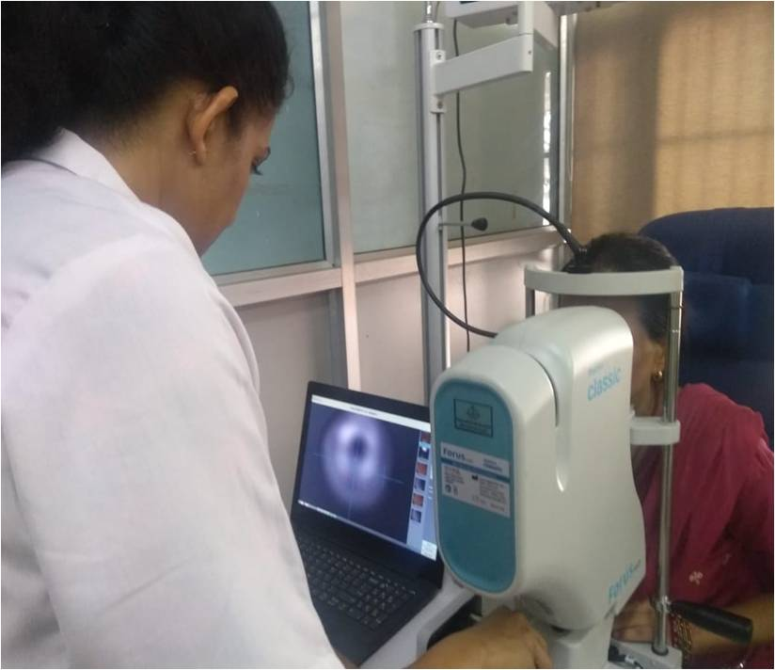
Portable non mydriatic fundus camera

Slide 12
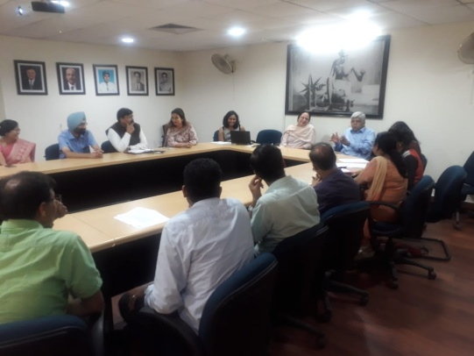
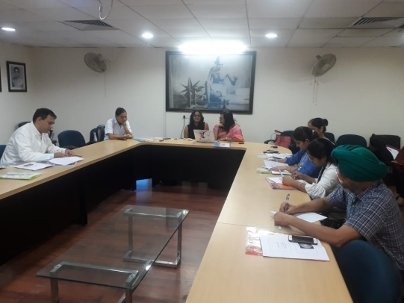
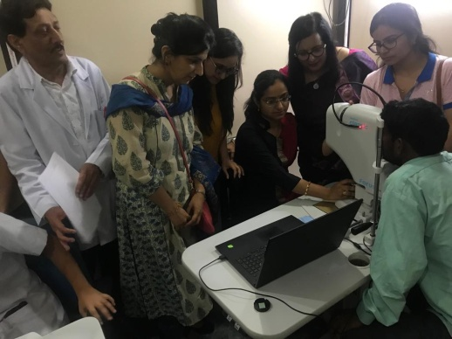
Capacity Building
Key stakeholder meeting:
A meeting was organized with key stakeholders in PGIMER (July 24-08-2019)
Training (25-26 July 2019)
Training of nurses, optometrist, ophthalmologist

Slide 13
Diabetic Retinopathy Referral card
Health & Wellness Centre (To be filled by CHO) | Date:
Registration no
Name of the patient
Age in years
Gender of the patient (Male/Female/Others)
Address
Phone number
Screening for diabetes
Blood sugar level
Referred to

Slide 14
PHC/CHC/SDH…………………
To be filled by Medical Officer | Date:
Type of Diabetes (Type I/Type II/Others)
Duration of Diabetes (Years)
Treatment for diabetes if yes medicine details else NA
Duration of starting treatment
Any other co morbidity | HTN (Yes No)
 | Raised Cholesterol (Yes No)
 | Kidney disease (Yes No)
 | CVD (Yes No)
 | Others
To be filled by ophthalmic officer
Vision acuity | R/L
Any other observations

Slide 15
District Hospital………
To be filled by Ophthalmologist | Date:
 | Right Eye | Left Eye
IOP
DR grading (R0 R1 R2 R3 M0 M1 P0 P1 U)

Slide 16
Referral Decision……
Referral | Very Urgent Urgent
Co morbidities | Cataract Glaucoma
Referred to (Facility)
Follow up due

Slide 17
Reporting Requirement at different facilities: Reporting of diabetic patients at different levels of health care system should follow as given below: HWC → On the HWC portal CHC/PHC → Number of diabetic patients in the OPD → Number of patients reporting to ophthalmic officer → Number of patients referred to higher facility

Slide 18
District Hospital → Number of diabetic patients in the Medicine OPD
→ Number of patients screened for diabetes in the Eye OPD
Diabetic Retinopathy
Screening done Referred to higher facility Number of Follow up patients

Slide 19
Follow-up of Patients: - CHO of respective Health wellness center has to ensure follow-up of all the cases - Record of follow-up after treatment is to be maintained by CHO

Slide 20
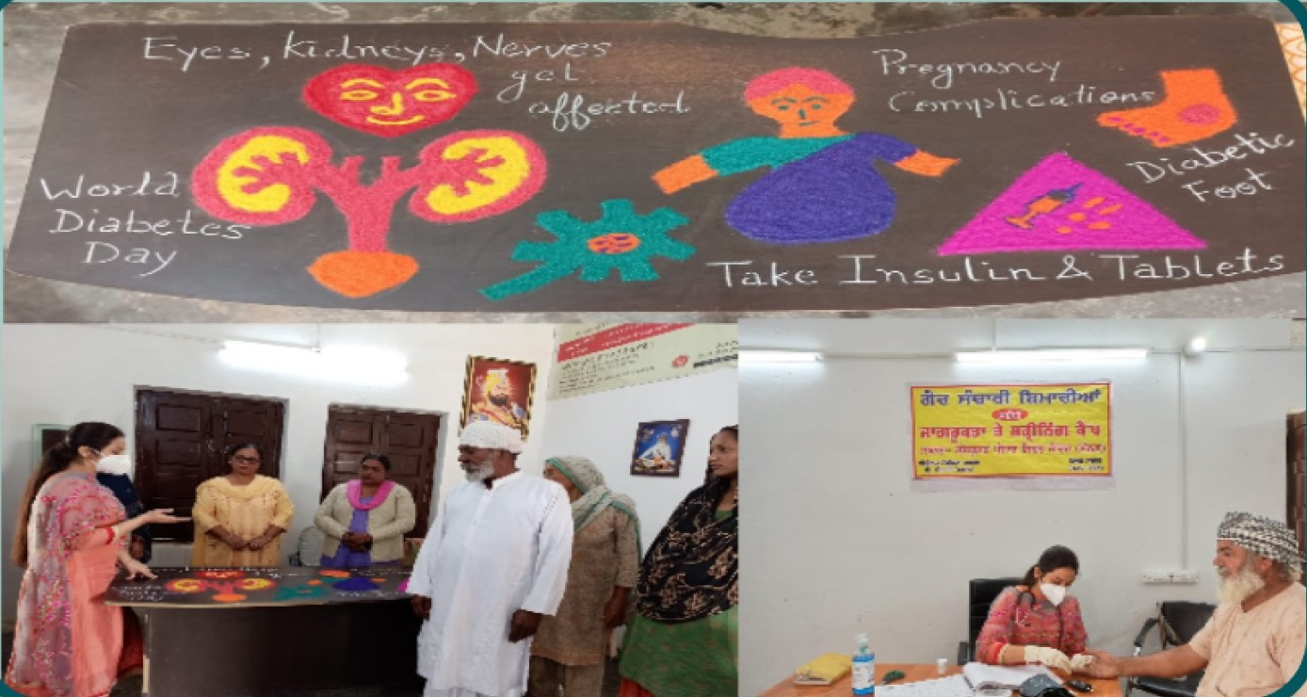
Management of Diabetes
Screening of diabetes and diabetic retinopathy cases
Diet
Exercise
To be suggested by CHOs to the patients

Slide 21
How to plan diet and exercise for an Individual with diabetes?
1) Existing weight : Ideal body weight
2) Life style: Sedentary, Moderate activity, Strenuous
physical activity
3) Duration of diabetes and associated complications

Slide 22
Ideal body weight = height in cm-100
e.g. height is 154, then
ideal body weight is = 154-100=54kgs
Healthy Eating
Eat regular meals, include a starchy carbohydrate food such as bread, cereal, potato, rice (eat the appropriate portion) at each meal.
Limit your intake of sweet and sugary foods.
Reduce your fat intake and change the type of fat you eat-avoid high-fat dairy products and animal proteins such as butter, beef, coconut and palm oils, processed snacks, baked goods.

Slide 23
Eat fruit and vegetables regularly
Eat fish twice a week
Cut down salt to food, trans fats and processed foods.
Avoid tobacco use: smoking increases the risk of diabetes and cardiovascular diseases.

Slide 24
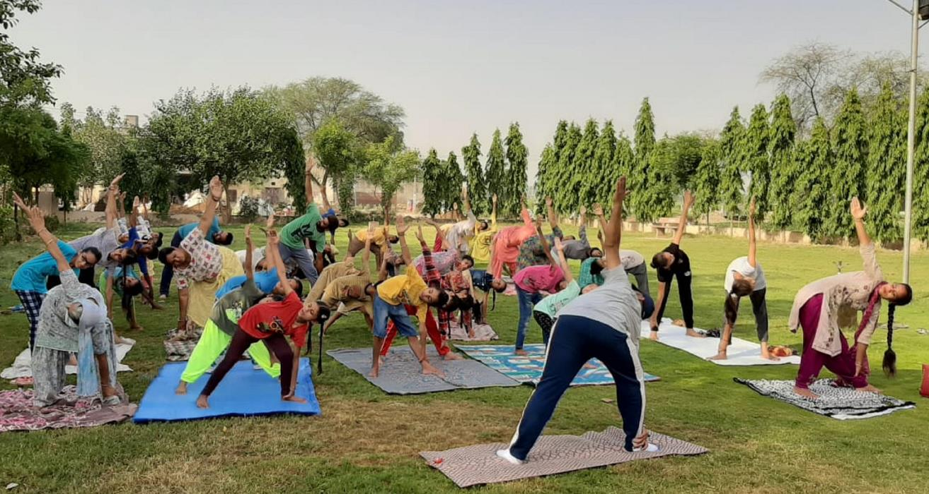
Be physically active:
Physical activity for at least 30 minutes regularly of moderate-intensity that includes brisk walking, Yoga, swimming, or jogging.
No more than two days in a row without physical activity.
Breaking up sitting time every 30 minutes during the day.
Incorporate flexibility exercises, like stretching or yoga into your weekly routine.

Slide 25
Evidence of effectiveness
The prevalence of Diabetes among the patients screened at Health and wellness centres is 12.6%
The prevalence of Diabetic retinopathy among the diabetic patients is 13%
Out of total DR patient, 30% patients were referred to medical colleges for the laser treatment.

Slide 26
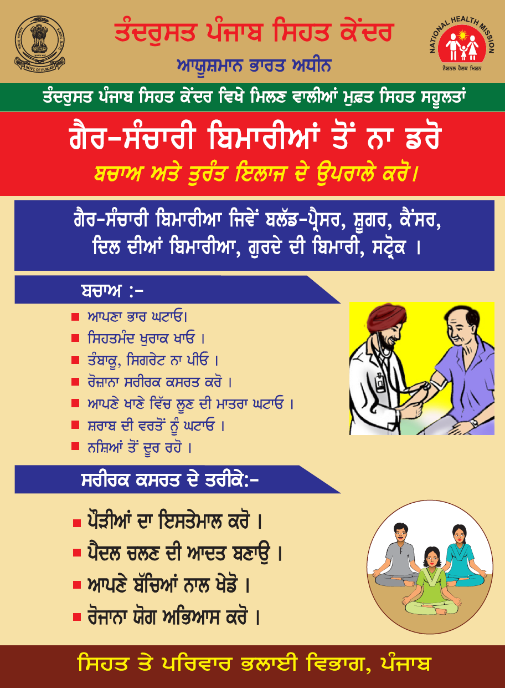
IEC for HWCs
IEC Posters and Booklet to be developed in the local language.
Purpose is to create health awareness among community about health and service delivery at HWCs.

Slide 28
Potential for scale
Around 10 lakh population of the state will be benefitted
Help in reducing the out of pocket expenditure (OOPE) of the patients who are suffering from diabetes and diabetic Retinopathy
If the screening and detection programme is implemented, the damage to the eye due to diabetes can be prevented.

Slide 29
Thanks

