Slide 1



SHALABHAM-
COMPREHENSIVE NEWBORN SCREENING
PROGRAM IN KERALA
KESHVENDRAKUMAR IAS
STATE MISSION DIRECTOR
NATIONAL HEALTH MISSION, KERALA
arogyakeralam.gov.in

Slide 2


Welcome!!
A Life Saving Innovation with country wide
relevance to improve
Quality of Survival

Slide 3
THIS FOLLOWS..
1
Problem Statement & Background Information
2
Comprehensive Newborn screening Program components
3
Results, Scope & Challenges
4
Hridyam for Little Hearts as a successful model of intervention
5
Results and achievements
6
Uniqueness, Scope & Challenges

Slide 4

INFANT MORTALITY TREND
A Focused intervention Model based on evidences
India has succeeded in reducing
neonatal mortality from 57 per 1000
births in 1990 to 24 per thousand
births in 2017, a very substantial and
significant achievement.
Kerala has the lowest Infant Mortality rates among the larger States of
10/1000 live births in the country.

Slide 5
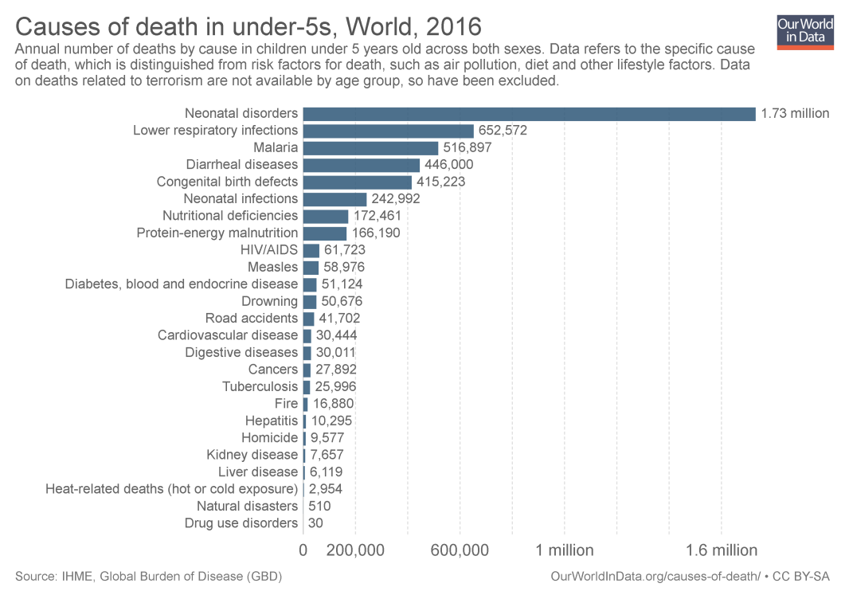
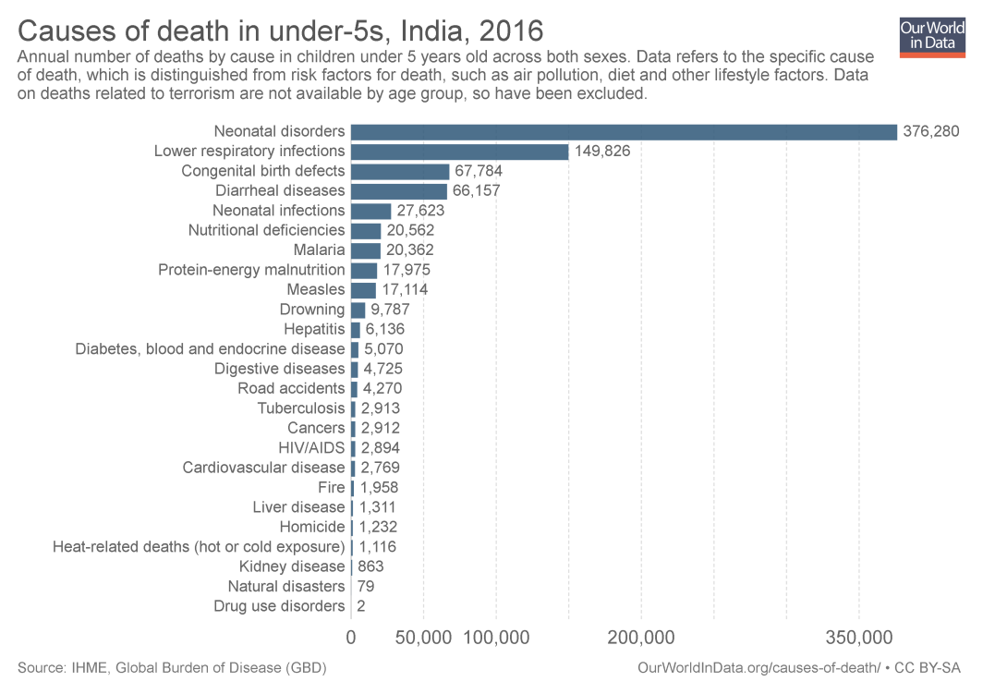
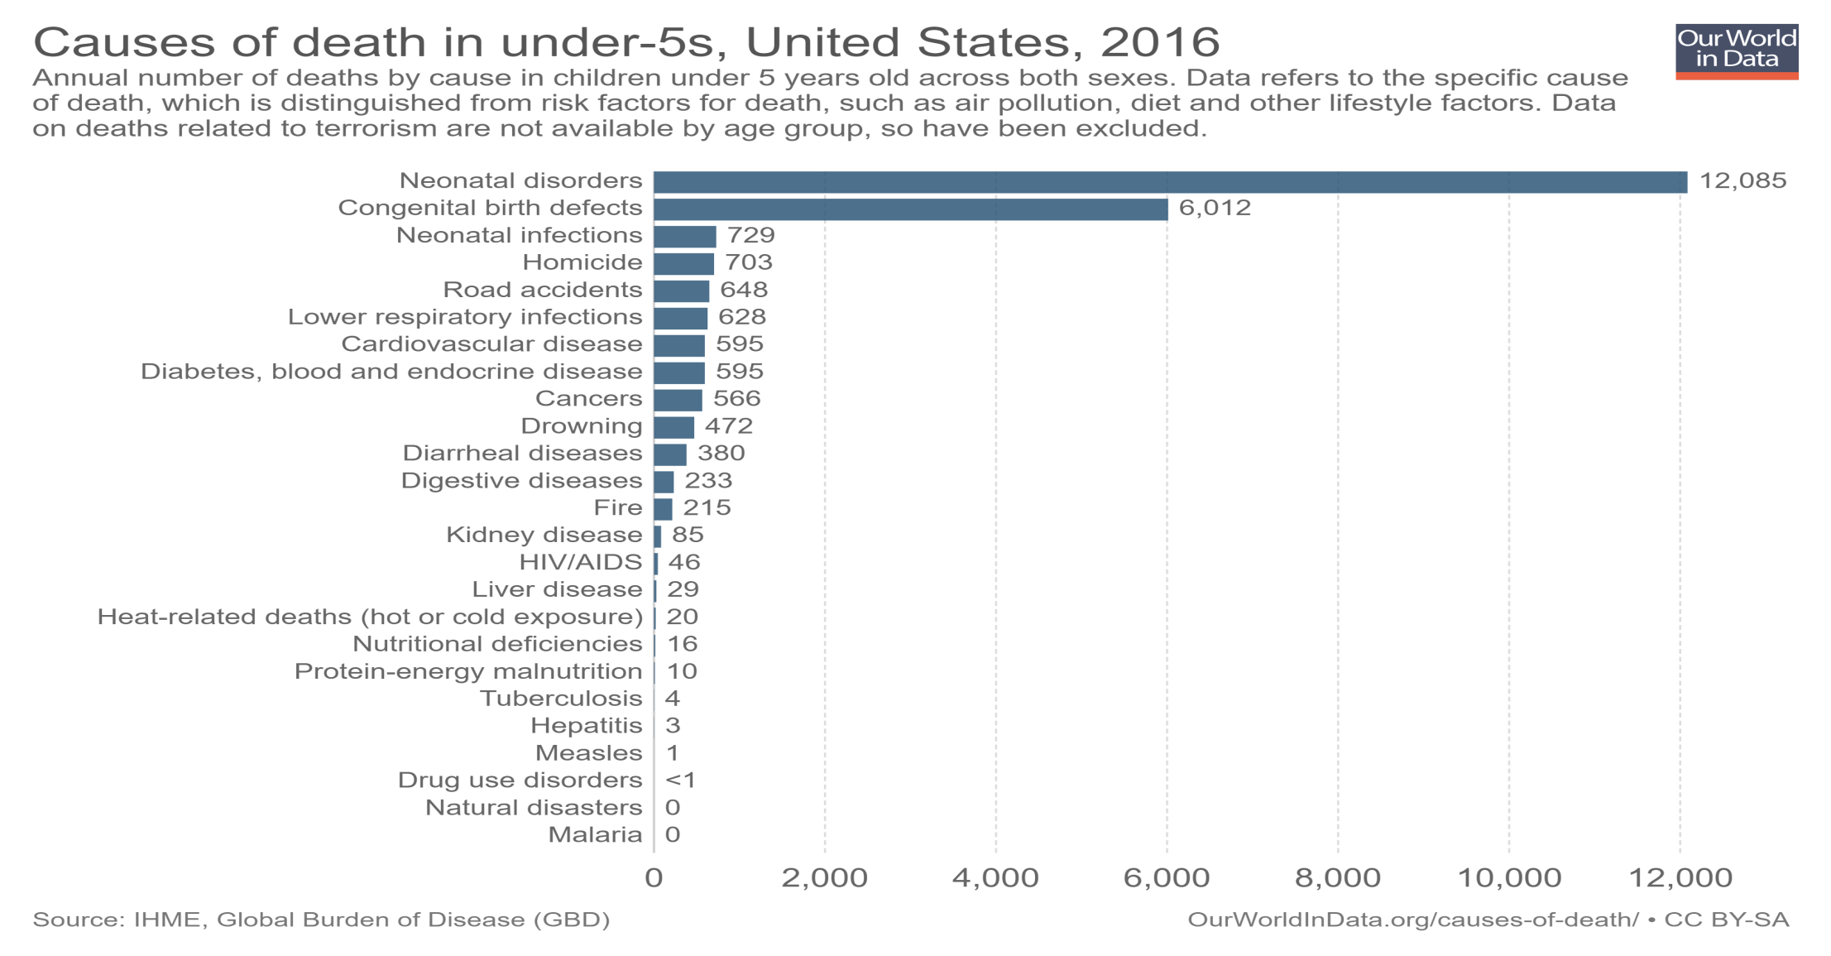


Worldmap CAUSE OF DEATH

Slide 6
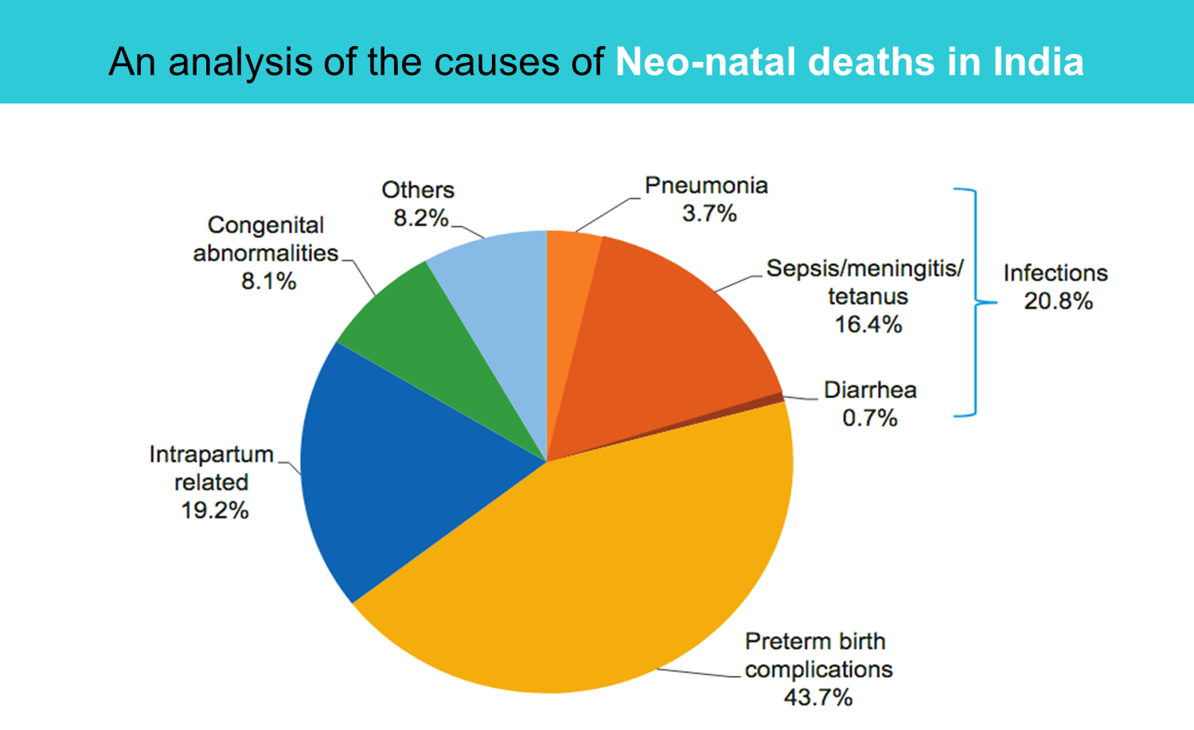
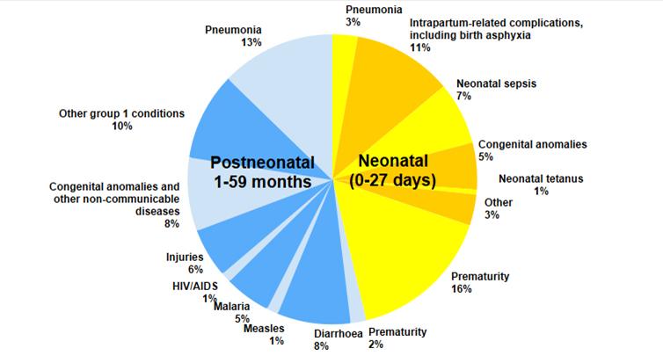
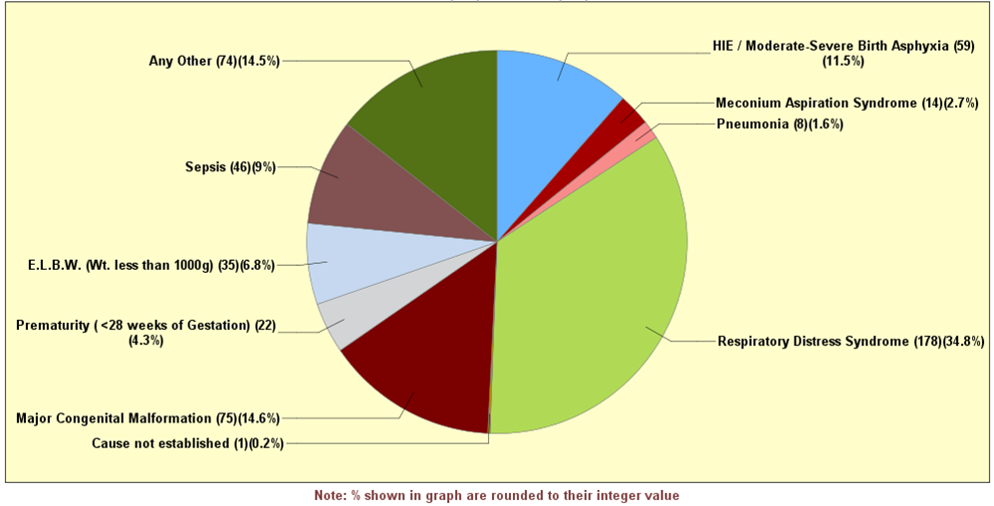
Causes of deaths among children under 5 Years, 2016
Cause of Death profile : Kerala, India
Total Death: 512 | Duration 01/01/2017 to 31/12/2017

Slide 7
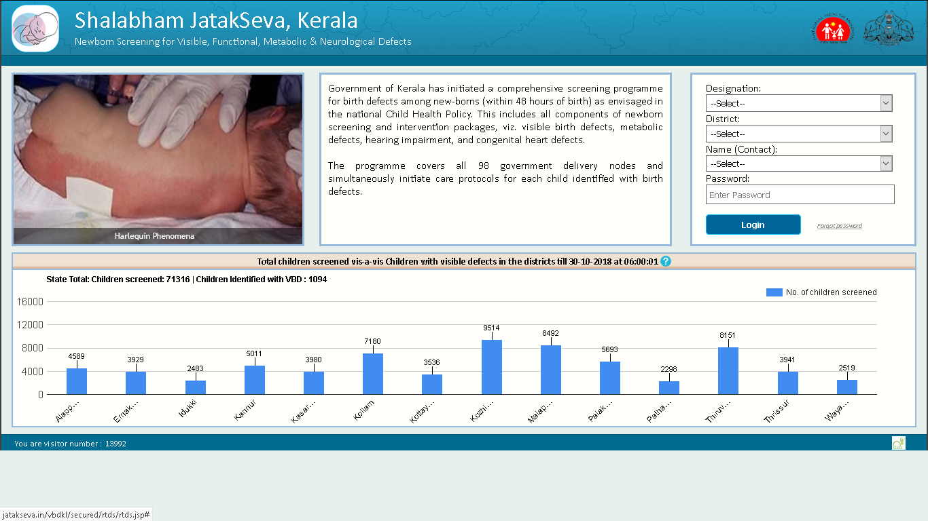
COMPREHENSIVE NEWBORN SCREENING PROGRAM
A Focused intervention Model based on evidences

Slide 8
MILE STONES..
Metabolic Screening
VBD screening as part of RBSK
ROP Screening for High Risk Preterm
Started as a special initiative in selected delivery points
As part of rolling out RBSK, documenting Newborn Birth defect screening in delivery points were initiated
Screening for Retinopathy of Prematurity started in 7 Tertiary Care Special Newborn Care Units
2014
2012
2016
2018
2018
Hearing (OAE) Screening
Pulse Oximetry Screening
OAE Screening program started with the support of KSSM, Presently, extended to all Delivery points with more than 50 delivery per month
Started in selected 54 delivery points (with more than 100 delivery per month) for early detection of cCHD

Slide 9
COURSE OF SCREENING
VBD Screening
Pulse Oximetry
OAE Screening
Metabolic Screening
Within 24 Hours
24-48 Hours
Near 48 Hours
After 48 Hours
Newborn Screened by Delivery point Staff Nurse or RBSK Nurse & seen by Pediatrician. Being documented using the Jatakseva android app
Pulse Oximetry is recorded for Newborn using specific PO machine with in-built Software which record, interpret & transmit the readings
Hearing Screening is done by trained Nurses at around 48 hours post partum using OAE machine. Referred cases are followed up at DEICs or NPCD level.
Blood sample collected by heel pricking and on blotting paper, dried samples transported to PH and RPH Labs. Reports captured in Jatak Seva online from the Labs.

Slide 10
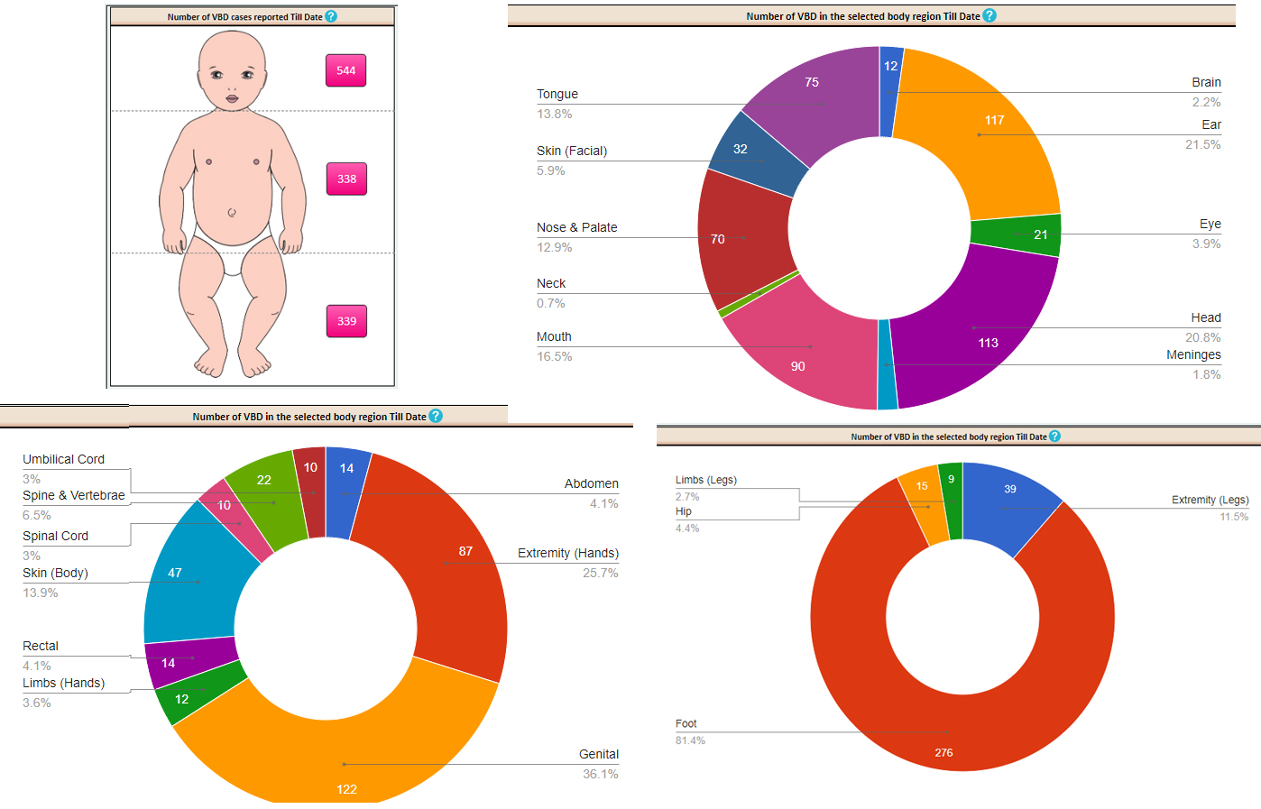
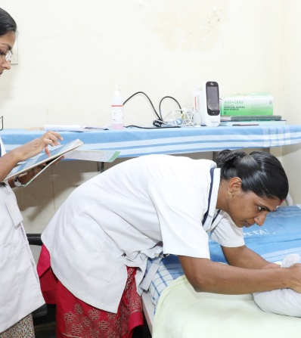
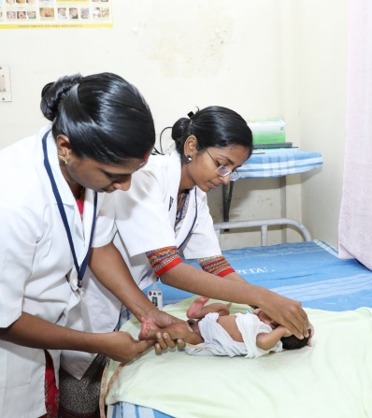
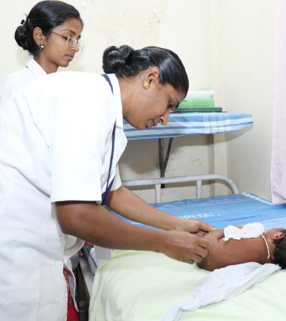
VISIBLE BIRTH DEFECT SCREENING
From all 99 Public Delivery points
Data Capturing
Head to Foot Examination
Examining back & Genitalia
Information after examination using RBSK Protocol will be entered into Jatakseva Android App developed by NHM Kerala
Head to Foot examination as prescribed under RBSK is done including anthropometry
Head & Neck, Abdomen & Back including Genitalia and Lower limb is examined using RBSK Job Aid
Insert Your Image
Insert Your Image
Insert Your Image

Slide 11
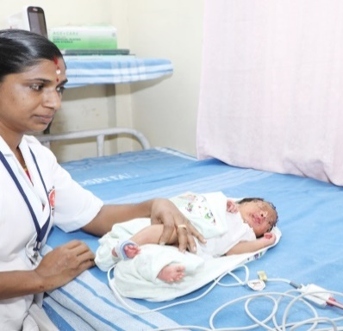
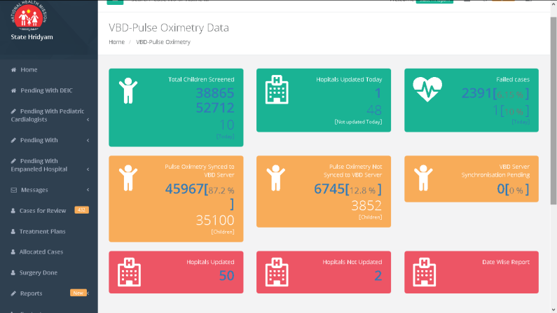
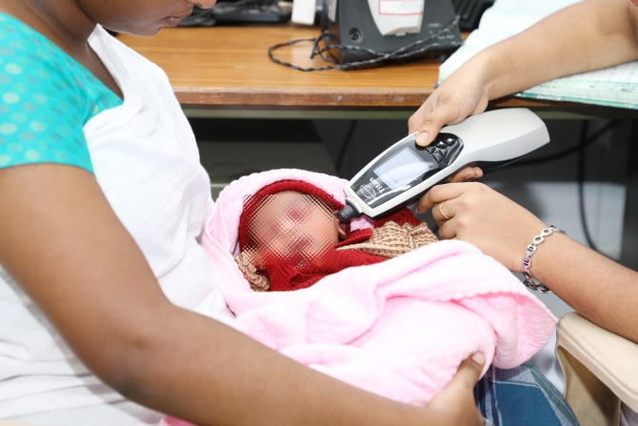
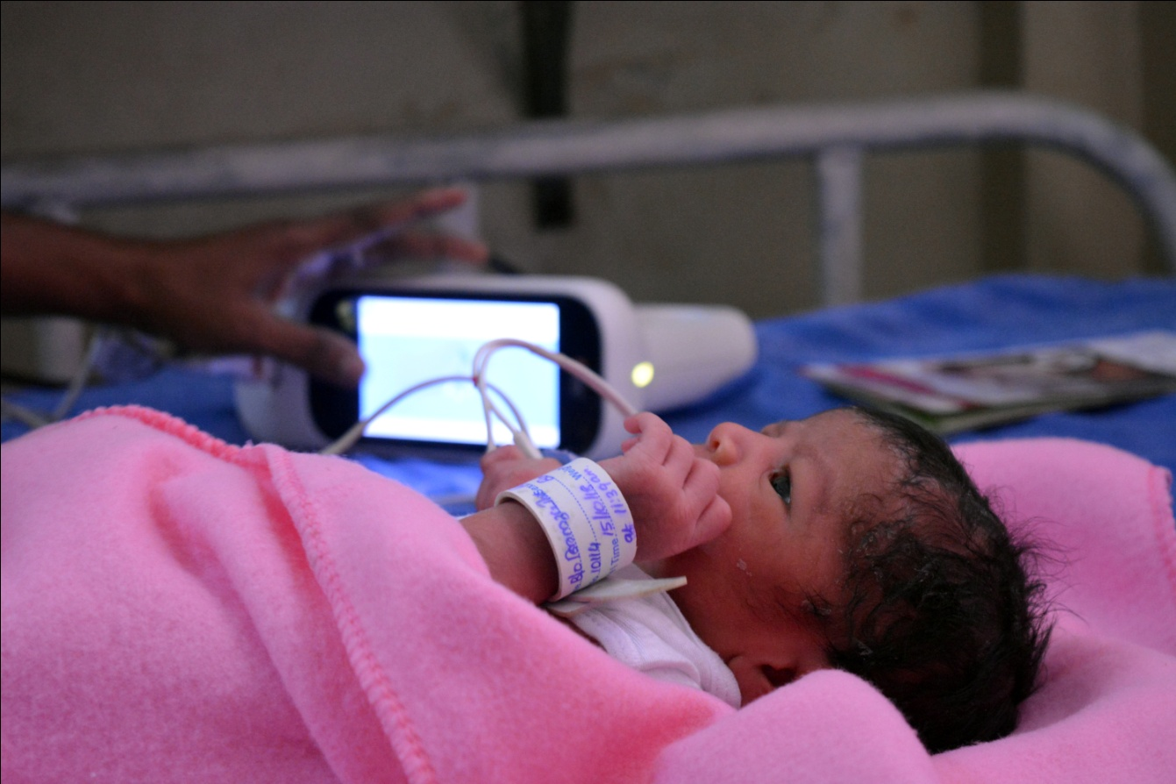
FUNCTIONAL BIRTH DEFECT SCREENING
For Hearing OAE, PO for CHD & ROP in selected high volume delivery points
Pulse Oximetry Screening for CHD
PO Results to Hridyam portal
OAE Screening
ROP Screening
Machine while connected to local computer with Internet Connectivity PO results against each child get updated in Hridyam & VBD portal
Testing using OAE machine around 48 hours of birth & data uploaded to UHS server & VBD server.
Screening for Retinopathy of Prematurity is done to all High Risk Newborn, Preterm with very Low Birth Weight & Suuscptible
PO Screening at 24 -48 Hours after birth & the set algorithm in machine detects PO passed/failed
.
Insert Your Image
Insert Your Image
Insert Your Image
Insert Your Image

Slide 12
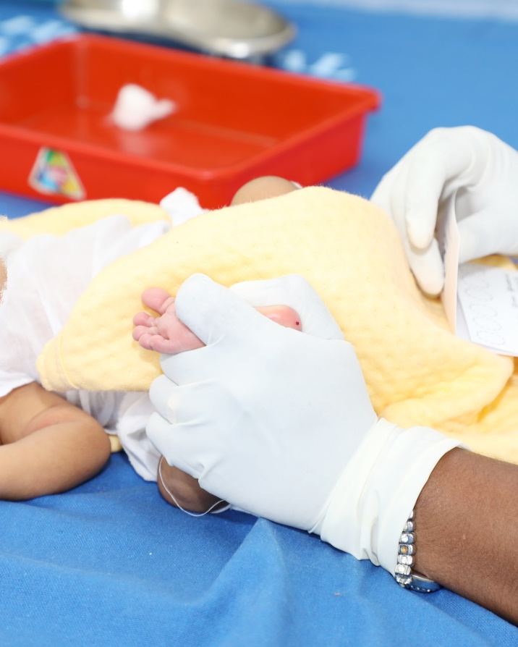
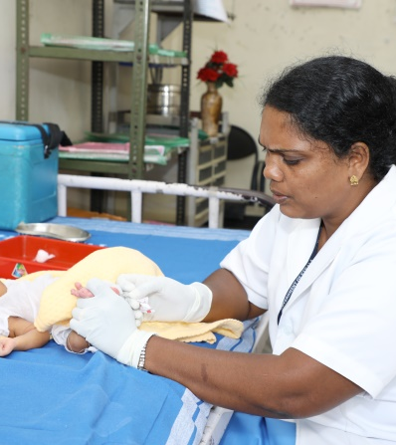
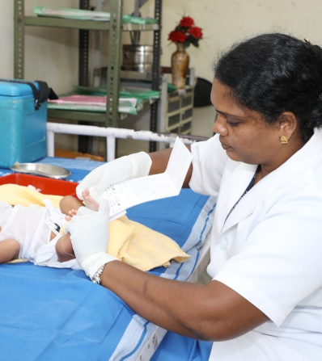
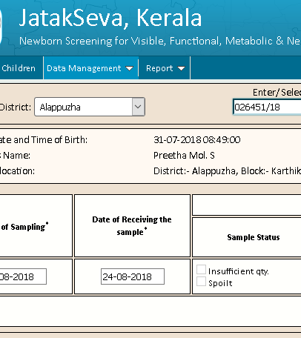
METABOLIC SCREENING PROGRAM
Testing at State & 3 Regional Public Health Labs
Heal Prick
Sample taken on Filter Paper
Online data reporting
Sample taken on filter paper is dried & transported under strict cold chain (2-8 degree)
Test results are entered online against each child using the VBD unique Number generated
Sample taken after 48 hours by heal prick.

Slide 13
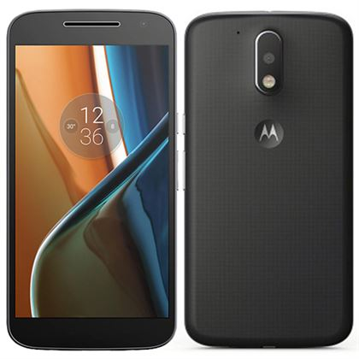
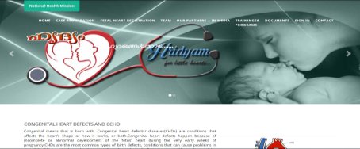
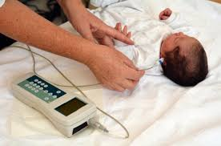

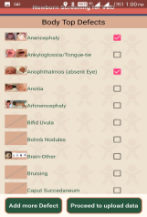

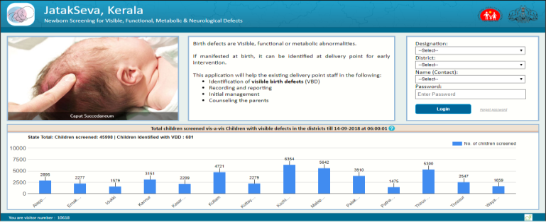
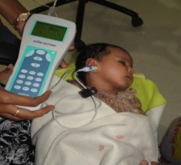
Newborn Screening - Data Flow
Visible Birth Defect Data on Real-time
Hridyam Portal
Newborn Screening with
Pulse Oximeter
RBSK/ Staff Nurse,
Doctors
JatakSeva
Mobile App
Web Service
1
2
3
4
UHSP Server
Web Service
Blood samples collected from Newborns and sent to PH Labs
PH Labs test and enters the result in the JatakSeva web portal
JatakSeva Web Portal
Data Entry form
Newborn Screening for hearing with
Otoacoustic emissions (OAE)

Slide 14
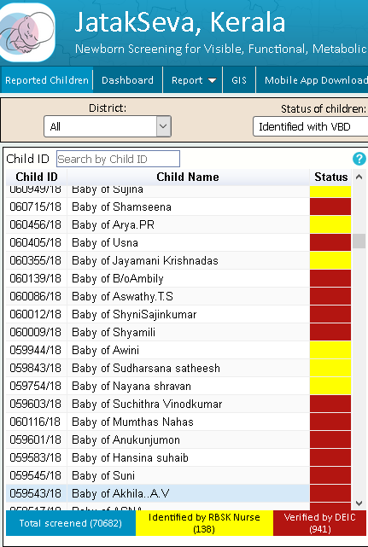
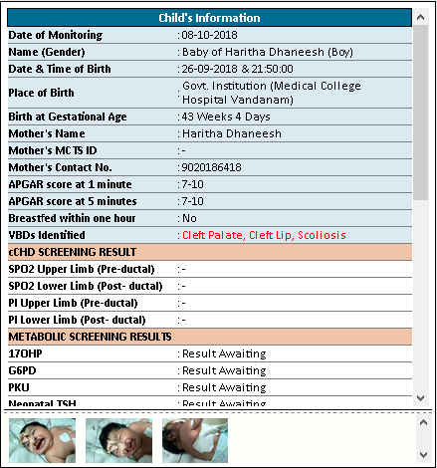

EVERY CHILD WITH UNIQUE ID
Color coded for immediate attention
Child Information Corner
Locates any child
Shows Child with VBD as screened by Nurse
After confirmation by DEIC, color coding changes
Details of each child is available in one place
All test results are viewed by experts

Slide 15
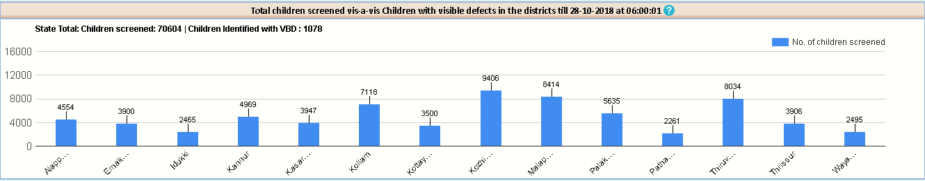
RESULTS
Screening Results Reported | Month | June | July | August | September | October Till 29th Oct 11 am
 | VBD Screened | 11147 | 14716 | 13771 | 15054 | 16181
 | PO screened | 3907 | 7890 | 7950 | 8350 | 8107
 | OAE Screened | 136 | 2515 | 5979 | 6661 | 3946
 | Metabolic reported | 2253 | 6482 | 7247 | 6727 | 1747
VBD screening by Jatakseva Android app
OAE & Metabolic Screening
Started on 1st June 2018 in all delivery points and PO screening in 48 delivery points, used the VBD unique number as the trailer for identification of child in the whole system.018
OAE screening information captured by UHS server and data shared with VBD server against the unique number.
Metabolic screening test results entered against the unique Number by each lab after testing the sample send from delivery points

Slide 16

Hridyam for Little Hearts
A Successful model of intervention after screening for Congenital Heart Disease (CHD) using Pulse Oximetry from all public health delivery points and those case identified from other locations in Kerala.

Slide 17

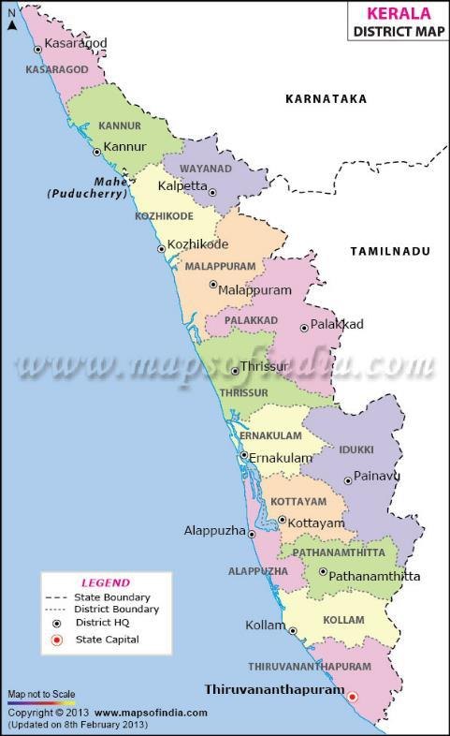
KERALA Pediatric Cardiac Care : Situation Analysis
CHD Demographics in Kerala
33 Million | Population
0.5 Million | Children Born/year
10 | Mortality Rate, per 1000 live births (IMR)
5032 | Infant deaths/year
8 per 1000 est. | CHD prevalence
4,092 est. | New CHD/year
1,023-1,364 est. | New Critical CHD/year (25-30% of all new CHD)
780 est. | Deaths from CHD/year
550-700 est. | Infant CHD Surgeries performed
34% est. | Estimated Surgical Treatment Coverage
60% of children born with Critical CHD will die before 1st birthday ; 90% will die before reaching 5th birthday
Kerala Capacity to Address CHD
14 | Administrative Units (districts)
2 | Existing Pediatric CHD Surgery Centers, Public
4 | Existing Pediatric CHD Surgery Centers, Private
978 | Total Annual Pediatric Open Heart Surgeries, (Kerala patients )
552 | Annual Pediatric Surgeries performed among infants Kerala patients
660 | Annual Cath Interventions, Kerala patients
7 | Needed Pediatric CHD Surgery Centers, distributed based on geography and population density
1 | Existing Pediatric CHD Cath Labs, Public
6 | Existing Pediatric CHD Cath Labs, Private
12 | Pediatric Cardiologists
24 | Needed Pediatric Cardiologists
10 | Pediatric Cardiac Surgeons
12 | Needed Pediatric Cardiac Surgeons
Private Pediatric Cardiac Program
Public Pediatric Cardiac Program
New Public Pediatric Cardiac

Slide 18

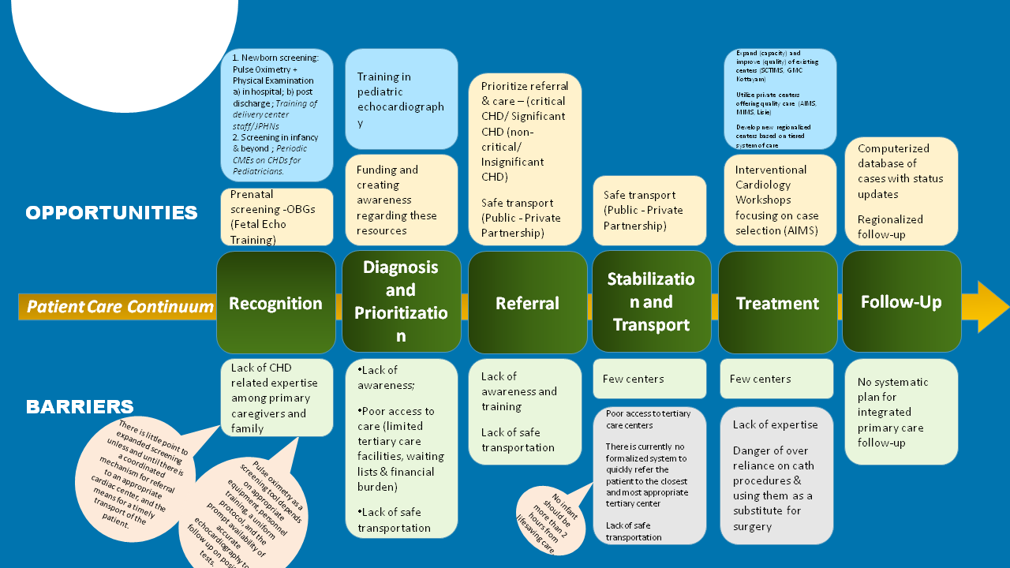



Slide 19


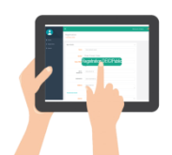




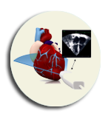
















Registration
DEIC/Public
Case Registration from
Public / Hospitals / DEIC
DEIC
Add more Information Verify and transfer to Paediatric cardiologist
Consent
Follow up
Pediatric cardiologist
If No
If Yes
Information adequate to Categorize
Categorize
Public Hospitals
Public Hospital
Treatment plan
If No
If Yes
HridyamAdmin
Treatment plan within
tentative date
Allot to Public
Hospital
Allot to Empd.
Hospital
Treatment
Empanelled Hospitals
Case refer to Empanelled hospitals
Treatment plan

Slide 20

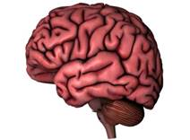
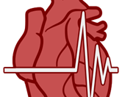

UNIQUENESS & ADVANTAGES
State is having Newborn
Transport System with
fully equipped Ambulances and Trained Staff.
Multiple models(PPP, MPLADs, etc.) involving different stakeholders (Professional bodies NNF) are under
consideration for
expansion
.
Cognitive & Neurodevelopment tracking of children with CHD and post-operative cases for early stimulation in case of Development delay
Transportation
Neurodevelopmental Outcome
Complex CHDs with combinations of anomalies which are not included
under model costing of
RBSK & high value cases are offered services
under the scheme
through state plan fund support.
Capacity building for Early Diagnosis including prenatal,, Doing more surgeries in public health
facilities, preoperative stabilization, Timely referral &
Transportation, etc.
Complex CHDs
Capacity Building

Slide 21
July August
September
Focus is on Infant Cases/ Neonates with complex diseases as a life saving program.
10%
 | July | August | September
Cases Registered <1 year | 110 | 85 | 110
Operated | 38 | 35 | 34
Cases Registered >1 year-5 Years | 26 | 27 | 32
Operated | 7 | 14 | 7
20%
70%
Cases registered in percentage

Slide 22
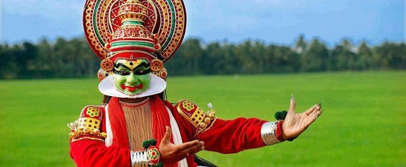
Thank you
RBSK Supported Model

