Slide 1
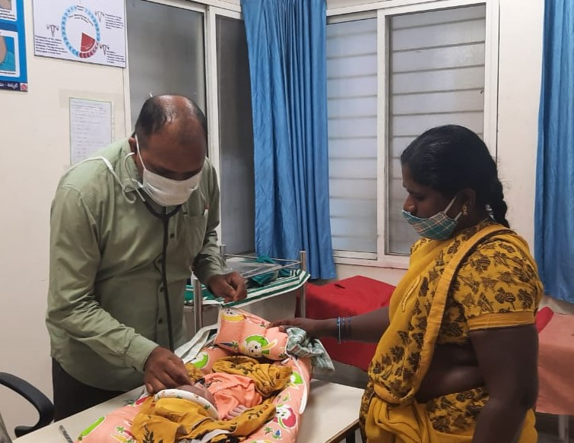
Specialist Evening Clinics
National urban health mission
Government of Telangana

Slide 2
Background
Sl No | Particulars | Metro | Non-Metro | Total
1 | NUHM ULBs | 1 | 41 | 42
2 | UPHCs | 133 | 99 | 232
3 | Basthi Dawakhanas | 225 | - | 225
4 | Population (2011 Census) | 67,31,790 | 51,84,501 | 1,19,16,291
5 | Slum Population (2011 Census) | 22,87,174 (34%) | 21,88,685 (42%) | 44,75,859 (38%)
6 | Vulnerable Groups in Urban Area | Homeless, rag-pickers, street children, rickshaw pullers, construction, brick kiln workers, sex workers and other temporary migrants

Slide 3
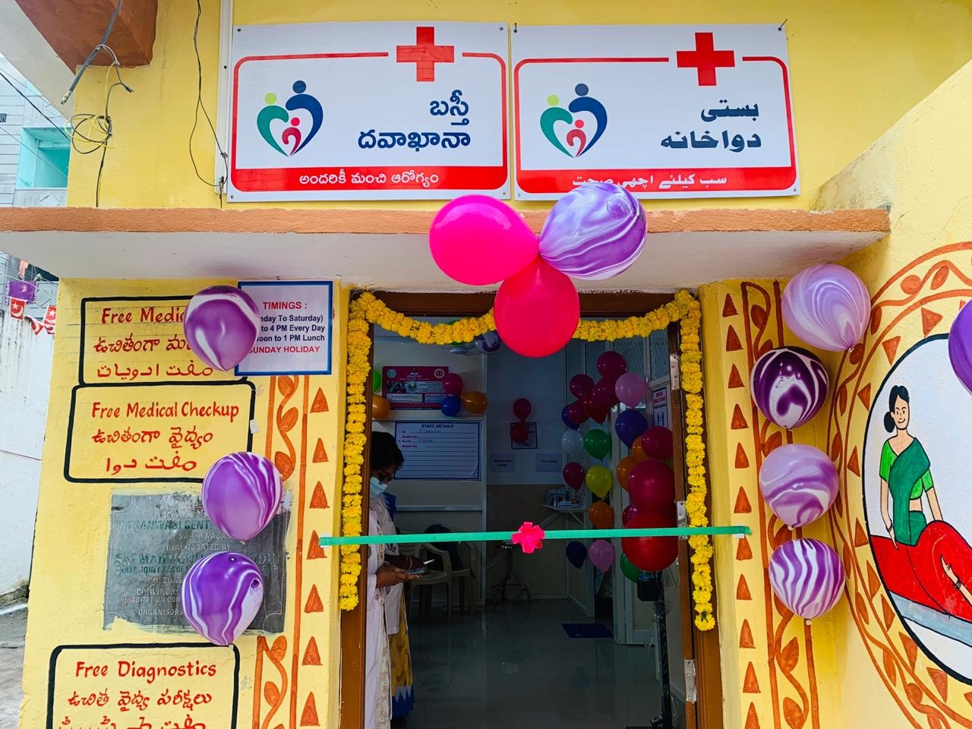
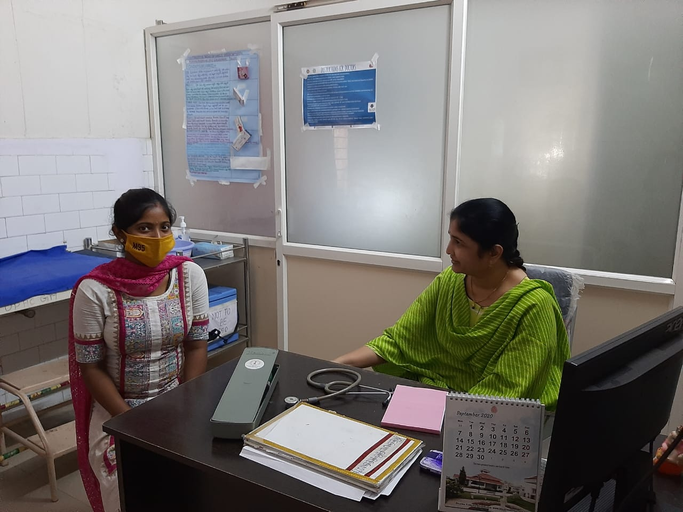
Basthi Dawakhanas in GHMC

Slide 4
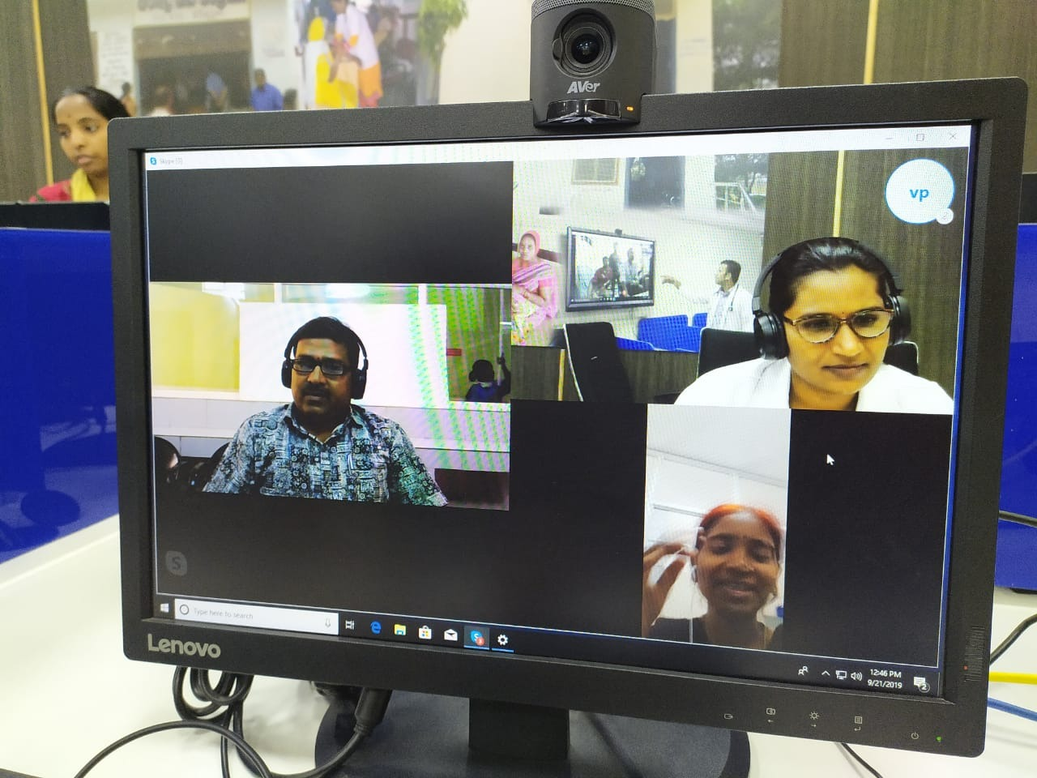
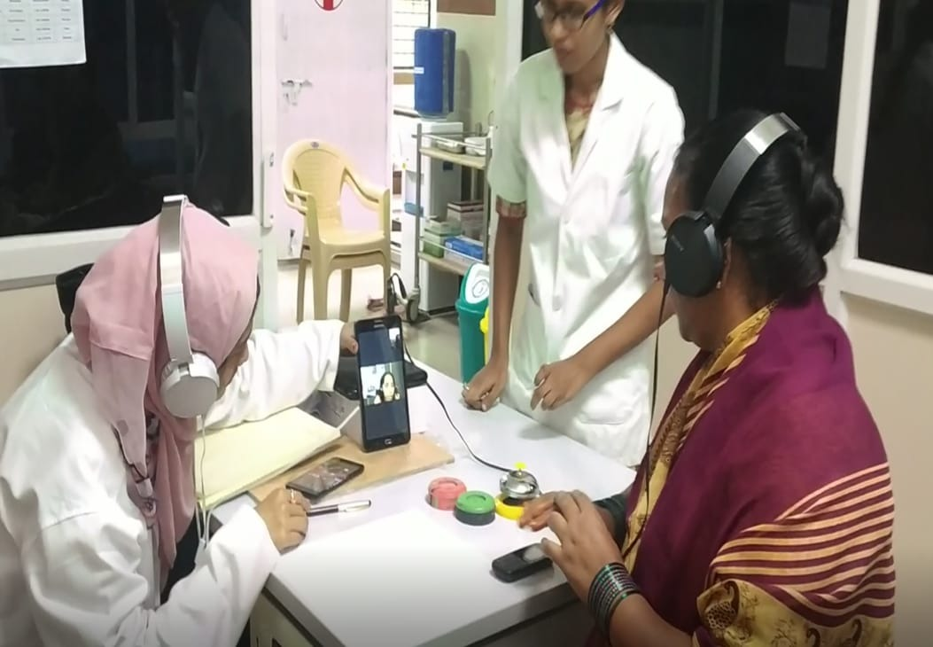
Teleconsultation in UPHCs & BDKs
Teleconsultation started in all UPHCs of GHMC
Started in 50 Basthi Dawakhanas

Slide 5
Specialist Evening Clinics -Objective
To improve the health access to speciality / tertiary level care of the urban poor particularly the slum dwellers and other disadvantaged / vulnerable sections.
To provide curative, preventive and promotive services
To reduce the out of expenditure of the poor
To reduce load on tertiary care hospitals

Slide 6
Specialist Evening Clinics - Advantages
Convenient for the people who return in evening after work
Rather than medical officers referring patients to tertiary care hospitals, specialists will check patients under the same roof
Need not wait in long queues for consultation, to collect medicines or for diagnostic tests.
People don’t have to travel far distances to consult specialists

Slide 7
Services Included:
Consultation with Specialist doctors
Free diagnostics under Telangana Diagnostics – blood tests, ECG, X Ray & USG
Drugs prescribed by Specialists are provided free; Drugs supplied by TSMSIDC
Clinics started from 1st February 2019

Slide 8
Specialities included:
Currently 4 specialities are being implemented in 75 clinics in the state:
  General Medicine
  Paediatrics
  Obstetrics & Gynaecology
  Orthopaedics
Timings: 5 PM to 8 PM | 5 Days a week

Slide 9
Current Status
Sl No | Region | No of Specialist Evening Clinics | Remarks
1 | Metro – GHMC | 50 | Hyderabad – 24; Medchal Malkajgiri – 15, Ranga Reddy – 10, Sanga Reddy – 1
2 | Non Metro | 25 | 25 clinics in 15 districts
TOTAL |  | 75

Slide 10
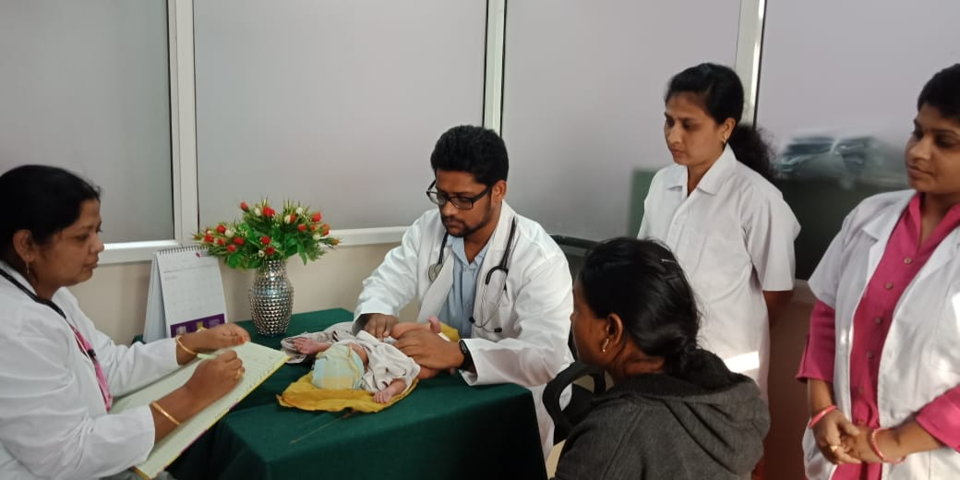
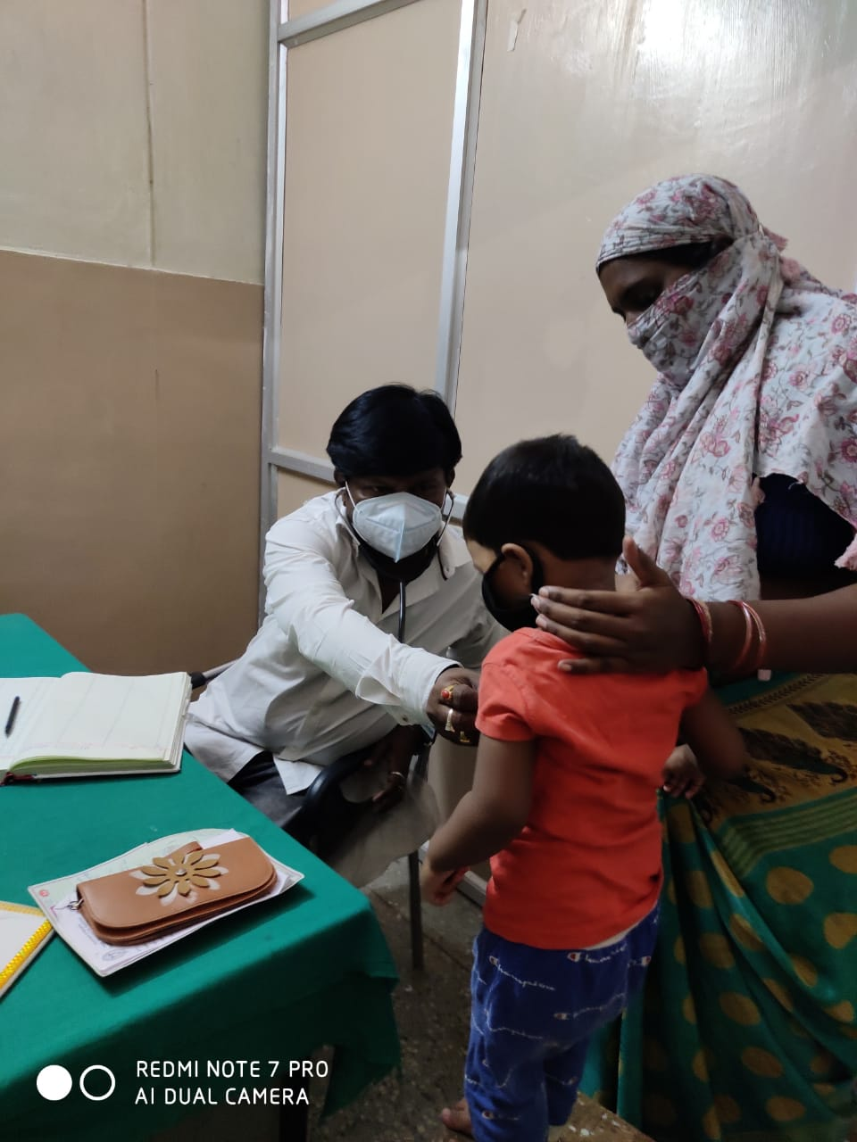
Paediatrics speciality clinic

Slide 11
Staffing:
Specialist clinics are manned by 1-Specialist, 1-Staff Nurse & 1-Support Staff
Hiring of Staff:
Specialists are hired from Government secondary / tertiary level hospitals or from open market
Preference for Staff Nurse & Support Staff of the UPHC / Basthi Dawakhanas are allowed to work in the clinics.

Slide 12
Incentives
Sl No | Type of Staff | Metro Areas | Non Metro Areas
1 | Specialist Doctors | Rs 3500 / day | Rs 3000 / day
2 | Staff Nurse | Rs 300 / day | Rs 300 / day
3 | Support Staff | Rs 200 / day | Rs 200 / day
4 | Performance based incentive – Rs 8000 / month
5 | Cost of Contingency - Rs 2000 / month

Slide 13
Performance
Sl No | District / Region | Number of Clinics operational | Average OPD / month in 2019 | Average OPD / month in 2020
1 | Hyderabad | 20 | 612 | 410
2 | Ranga Reddy | 15 | 90 | 105
3 | Medchal Malkajgiri | 4 | 664 | 502
4 | Non Metro Areas | Started in Jan-2021 | 0 | 0
Number of Specialist Doctors:
1. Paediatrics: 18
2. Obstetrics and Gynaecology: 15
3. General Medicine: 4
4. Orthopaedics: 2

Slide 14
Budget (Rs Crores)
Sl No | RoP Year | Approved Budget | Expenditure
1 | 2019-20 | 8.06 | 2.04
2 | 2020-21 | 4.80 | 0.00
3 | 2021-22 (Proposed) | 6.90 | NA

Slide 15
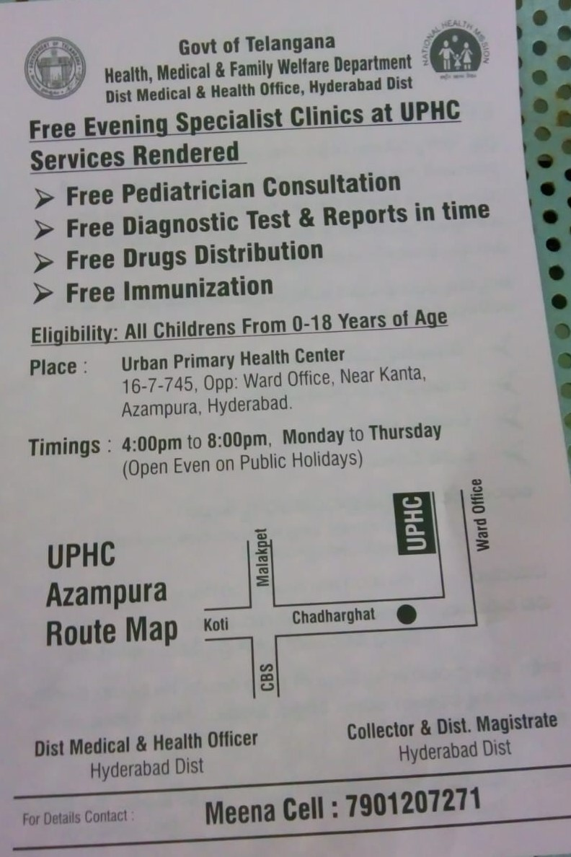
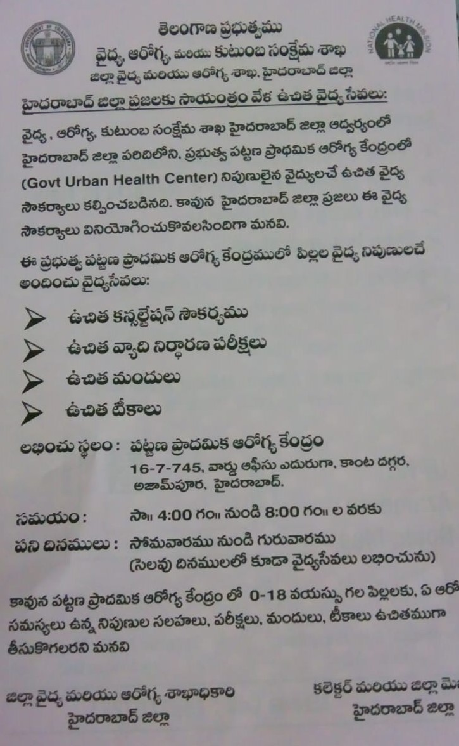
IEC

Slide 16
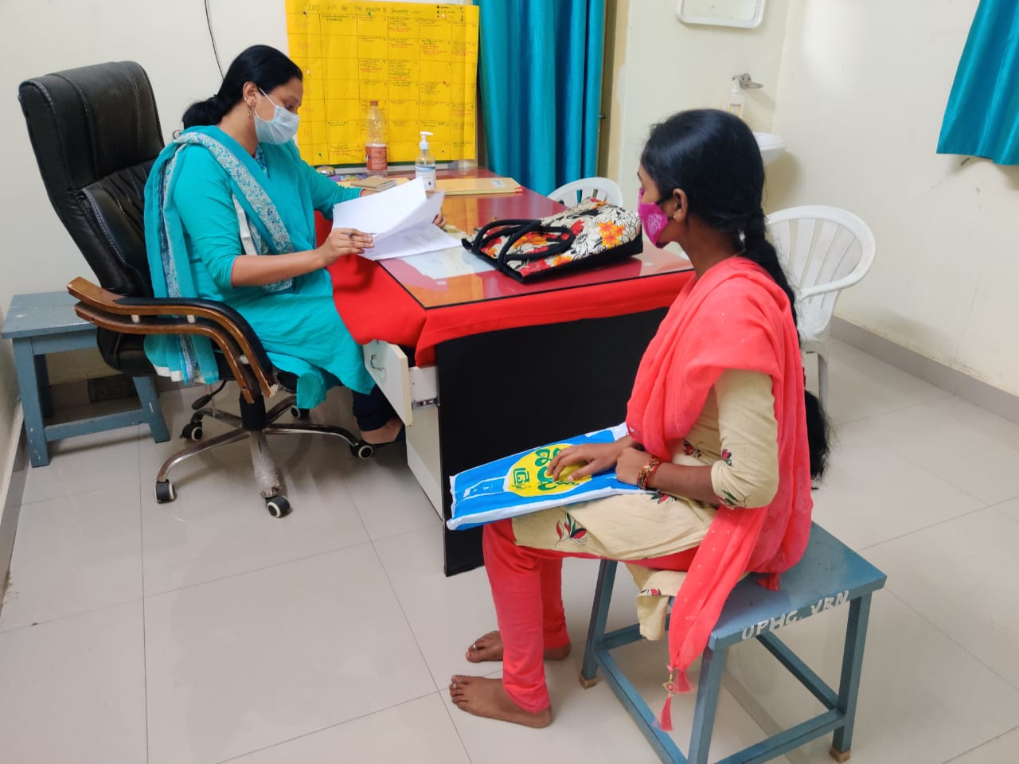
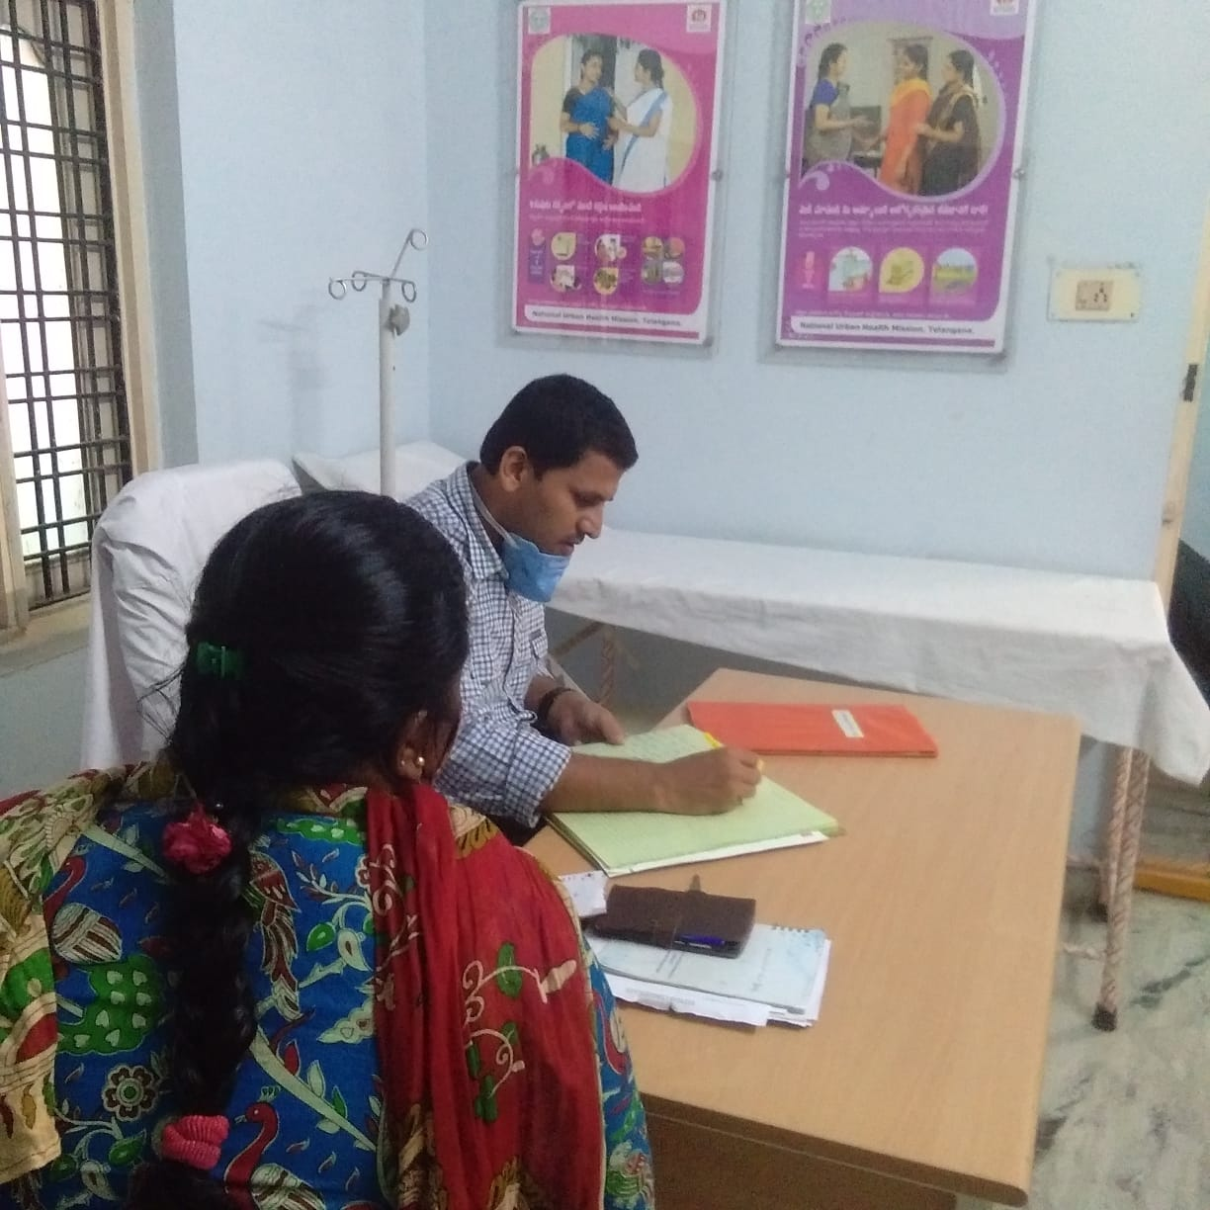
Gynec & Ortho clinics

Slide 17
Thank you.!!

