Slide 1



SURAKSHIT MATRITVA AASHWASAN
(SUMAN)
Making every effort to realize the aspirations and dreams of each and every mother in the country

Slide 2
Maternal Mortality Ratio
11 States have achieved the NHP Goal of MMR less than 100/ lakh live births
Between 1990 and 2015-17
India MMR Decline
Global MMR Decline
Global
India
78%
45%
Notes:
Between 1990 to 2015

Slide 3
MMR Status.
Increase :-Uttar Pradesh, Madhya Pradesh
No Change- Punjab , Andhra Pradesh, Bihar
Highest Decline- Karnataka, Maharashtra , Kerala and Rajasthan

Slide 4
National Health Policy 2017 & SDG: Commitment for RMNCHA
India on track to achieve SDG Goals 2030
: Target 3
MMR -70/ lakh live births
U5MR: 25/ 1000 live births
National Health Policy:
Maternal Mortality Ratio – 100 by 2020
Neonatal Mortality Rate – 16 by 2025
Under 5 Mortality Rate – 23 by 2025

Slide 5
Key Challenges
Several programmes exist but Assured Service Delivery is an issue
Respectful and Quality healthcare
Reporting and Reviewing of each and every Maternal Death
Involvement and Community Engagement

Slide 6
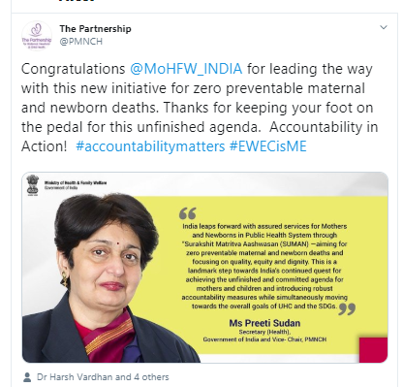
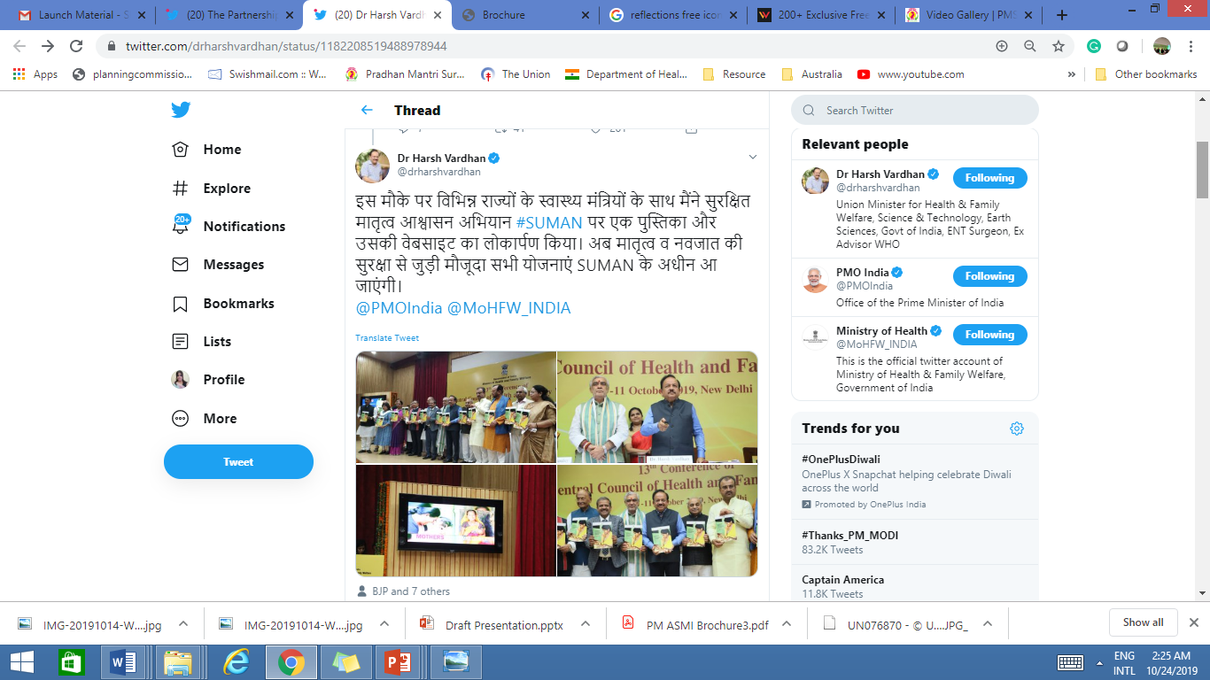
LAUNCH OF SURAKSHIT MATRITVA AASHWASAN (SUMAN)
10th October 2019

Slide 7
SURAKSHIT MATRITVA AASHWASAN (SUMAN)
Initiative for Zero Preventable Maternal and Newborn Deaths
AIM:
Assured, dignified, respectful and quality healthcare,
at no cost and zero tolerance for denial of services,
for every woman and newborn
visiting the public health facility
in order to end all preventable maternal and newborn deaths and morbidities
and provide a positive birthing experience.

Slide 8
OBJECTIVES
Create a responsive health care system
Provide an interdepartmental platform for convergent action plans.
Use institutional and other community-based platforms to spread awareness, mobilize community and facilitate 100% reporting & review of Maternal Deaths
Develop and establish a system of continuous client feedback and redressal of grievances
Provide high quality medical and emergency services and referrals
Effective governance including formulating strategies, supervision and review of the program for corrective actions.

Slide 9
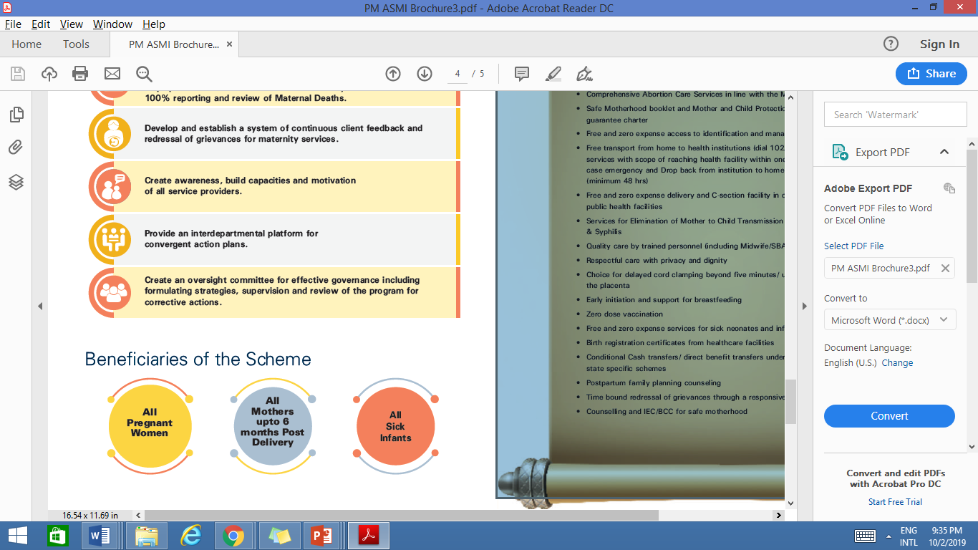
Beneficiaries of the Scheme

Slide 10
CONCEPTUAL FRAMEWORK
Zero Tolerance for Any Negligence
Respect For Women’s Autonomy, Dignity , Feelings And Choices
100% Maternal Death Registration And Reviews
Community level Maternal Death Reporting
Client Feedback Mechanism
Awards To Community Champions
Community Engagement & Mega IEC/BCC
Intersectoral Convergence
Integrates existing Initiatives like JSSK, PMSMA, LaQshya , FRUs etc
Grievance Redressal
Zero Preventable Maternal and Newborn Deaths and high quality of maternity care delivered with dignity and respect.
SERVICE GUARANTEE

Slide 11
ENTITLEMENTS UNDER THE INITIATIVE
Provision of at-least 4 ANC checkups, one PMSMA checkup & six HBNC visits
Free transport from home to health institution
dial 102(108)
Assured referral services with scope of reaching health facility within 1 hour of any critical case emergency.
Deliveries by trained personnel (including
Midwife/SBA)
Elimination of Mother to Child Transmission (EMTCT) of HIV, HBV & Syphilis
Choice for Delayed Cord Clamping upto delivery of placenta in uncomplicated deliveries
Post partum FP counseling & IEC/BCC for safe motherhood
Respectful Care with privacy and dignity

Slide 12
ENTITLEMENTS UNDER THE INITIATIVE
Early Initiation and support for Breastfeeding
Management of sick neonates
Zero dose vaccination
Birth registration certificates from healthcare facilities.
Conditional cash transfers/direct benefit transfer under various schemes
Drop back from institution to home after due discharge (minimum 48 hrs)
Free and zero expense delivery and C-section facility in case of complications at public health facilities
Time bound redressal of grievances including through a responsive call center/helpline.

Slide 13
BROAD PILLARS OF THE INITIATIVE
SERVICE GUARANTEE
    COMMUNITY AWARENESS
JSSK, JSY, PMSMA, LaQshya, MAA, care for sick & small babies, Home based care for mothers & newborn
    HEALTH SYSTEM STRENGTHENING
Involving VHSNC and SHGs, Community Champions
    MONITORING & REPORTING
Infrastructure- LDR, OT, Obstetric HDU/ICU,NBCC,NBSU, SNCU, Human resource, Drugs and diagnostics, Referral systems, Creating centres of excellence
    INCENTIVES AND AWARDS
Service Guarantee Charter, Grievance redressal including responsive call center for better redressal, ensured availability of MCP card and Safe motherhood booklet
    IEC/BCC
Awards and recognition to performers
First responder of maternal death to get 1000/-.
Identifications and felicitation of champions
Mega IEC/BCC activities promoting "zero preventable maternal & newborn deaths"

Slide 14
Notification of Facilities under SUMAN by Jan 2020
Step-1 &2
Identification of Facilities under SUMAN.
Step-3 & 4
Notification of the SUMAN facilities either by the district authority or by the state authority.
District Administration to ensure facilities provide SUMAN Service packages.
Step-5 ,6 & 7
List of SUMAN Facilities to be shared officially at Panchayat, Zilla Parisad, WCD, NRLM, Health facility In-charge including AB-HWC.
Monitor and review every six months and accordingly notify the revised list of facilities.
Self-Assessment by the facilities.
Link SUMAN identified facilities through online and IT enabled system.
SUMAN Service Guarantee
Basic Package
SUMAN Service Guarantee
BEmONC Package
SUMAN Service Guarantee
CEmONC Package
Initial Prioritization in identification of Facilities
All LaQshya and NQAS certified facilities
All Medical Colleges , District Hospital for delivering CEmONC package
All SDH for either BEmONC or CEmONC package

Slide 15
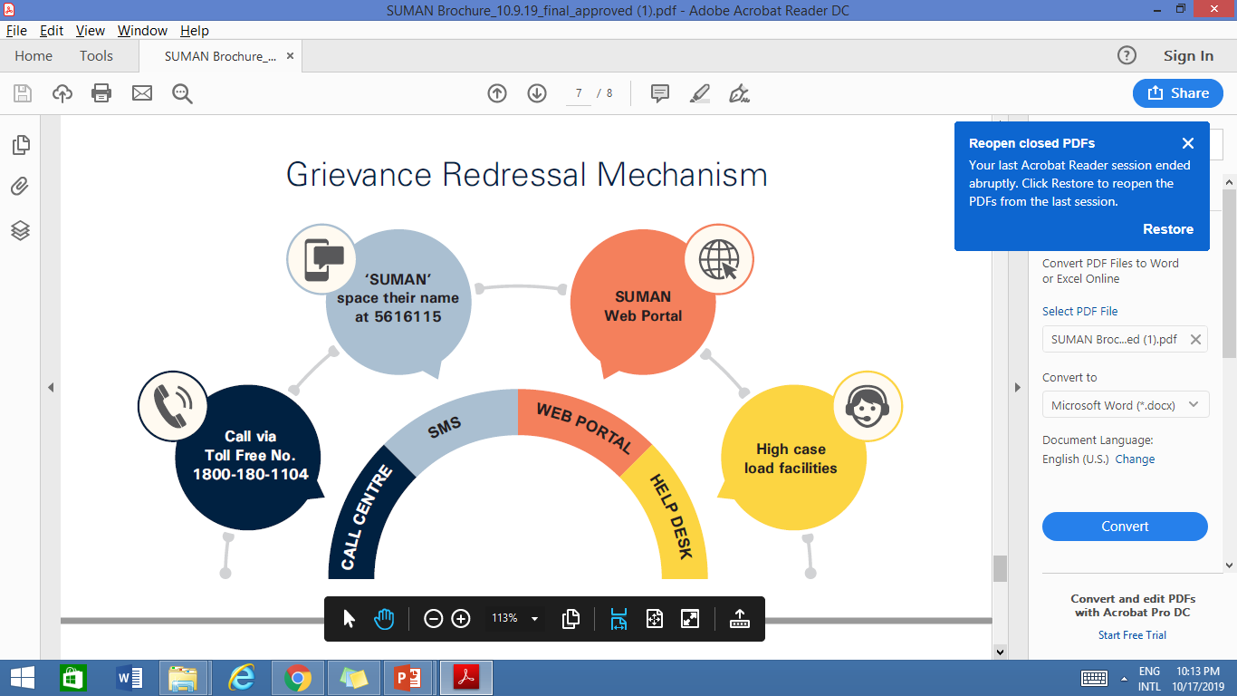
Grievance Redressal
Grievance Redressal Mechanisms
Client
Registration
Triaging
SMS-Automatically generated
Facility/ District/ State
Client
Higher Authority

Slide 16
Escalation of Grievances from Facility to State Level
At Facility/ Block
Up to 7 days
At District Level
Up to 14 days
At State Level Up to 21 days
Up to 28 Days
Facility Quality team-
MOIC In-Charge/ GR Officer
District Quality Assurance Unit
CMO / GR Officer
State Quality
Assurance Unit
MD-NHM
PS Health/ GR Officer
State Health Minister
All real time and urgent grievances need to be resolved immediately and certainly within 24 hours
If a facility cannot resolve a grievance it would be escalated to District and State levels
Synopsis of Grievances to be presented before the SUMAN committees

Slide 17
Community Engagement Under SUMAN
Volunteer Engagement Under SUMAN
1. Jankari (Information)
2. Bhagidari (Involvement and participation of citizens)
3. Karyawahi (Time bound action)
4. Suraksha (Protection of citizens from punitive actions by the government in response to raising questions)
5. Sunwai (Citizen’s right to be heard)
6. Janta ka manch (Collective platform)
7. Prasar (Report Dissemination)
SUMAN volunteers can be anyone either a male or female who volunteers himself or herself to associate with SUMAN initiative of GOI
Role of SUMAN Volunteers
Ensure uptake of SUMAN entitlements
Ensure 100% maternal death reporting
Ensure awareness of grievance redressal mechanism

Slide 18
Maternal Death Reporting under SUMAN
Report every Maternal Death on Centralized Toll Free Number
- 1800-180-1104
  Who can report?
  PRI
  Male MPHWs
  ANM
  ASHA
  AWW
  Any other common person from the community.
Name to be shared with District CMO
Verification by District i.e. through Block Medical Officer
If verified – First Responder to receive Rs. 1000

Slide 19
Way Forward
Notification of SUMAN facilities:
  Identification of public health facilities providing services as per SUMAN Packages (operational guidelines)
  Notification of facilities providing SUMAN Basic, BEmOC and CEmOC packages by Jan 2020
GR Mechanisms
  Nominate State, District and facility GR officers and update Information of GR officers on SUMAN portal
  Monitor GR systems
  Prepare long term plan for State specific GR mechanism as per GR guidelines
Community Engagement
  Prepare a State –specific plan to engage with self help groups, PRI departments
Advocacy Campaigns
  Plan for advocacy campaigns for raising awareness regarding entitlements under SUMAN, GR Mechanisms, maternal death reporting etc

Slide 20


