Slide 1
Systematic Active Case Finding Efforts in Tribal TB Units of Visakhapatnam, Andhra Pradesh
Implementing partners:
State National Health Mission, State Revised National TB Control Programme, District Revised National TB Control Programme, Integrated Tribal Development Agency (ITDA), Local Community Leaders

Slide 2
Introduction
Burden of TB is high in Tribal population
  Difficult geographic terrain makes it difficult for them to approach Health facilities frequently.
  Transmission is likely to be higher because of
    Their living habits in close clusters or huddled together in small huts
    Malnourishment and lowered immunity
  Passive case finding approach may miss many TB cases or diagnose them late.

Slide 3
TB BURDEN IN TRIBAL TUs - VISAKHAPATNAM
 | 2015(Jan-Dec) |  | 2016(Jan-Dec) |  | 2017(Jan-June)
 | Total Cases | Cases/ lakh/annum | Total Cases | Cases/ lakh/annum | Total Cases | Cases/ lakh/annum
District | 6076 | 133 | 6086 | 137 | 2901 | 130
Tribal | 1106 | 169 | 1172 | 175 | 562 | 170

Slide 4
Program Description:
India mainly uses passive case finding to detect tuberculosis (TB) patients through the Revised National Tuberculosis Control Programme (RNTCP).
Systematic Active case finding activities can bring TB services closer to the Tribal community.
The Tribal communities gather in large numbers at certain specific places like weekly markets, Bus stations, patient-health care provider meetings, Gram sabhas, monthly religious rituals etc.
Eight Tribal TB Units having 14 Designated Microscopy Centers with a population of 686846 (15.36% of total District population of 4470909) were selected to conduct ‘Active TB case finding ‘activities.
Since March 2015 Health camps to screen patients with symptoms of TB are being organized systematically once every month on fixed day at one of the specific places.
Medical Officer, PHC STS ( Senior Treatment Supervisor) , Laboratory Technician and a paramedical staff participate in setting up Sputum Collection Centers in the “Shandy camps”
Patients with symptoms are encouraged to give spot sputum sample at these centres and asked to report with early morning sample at the nearest Health facility
If the patient does not reach the health facility with second sample, health workers will visit the home of the patient to ensure his sample is collected.
IEC activities & House to house awareness is carried out throughout the year by the Health staff about these camps

Slide 5

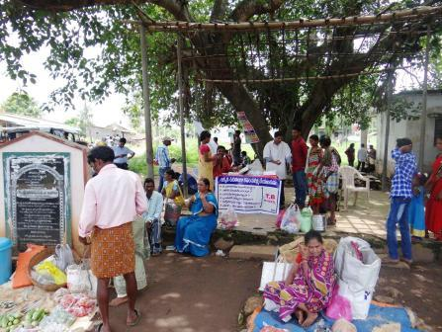
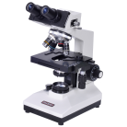
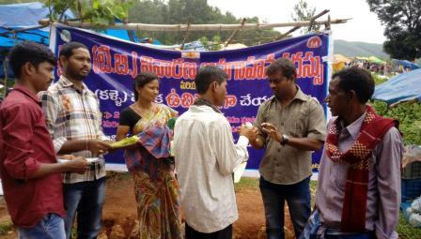
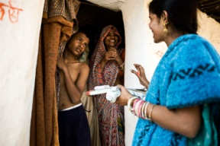
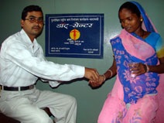
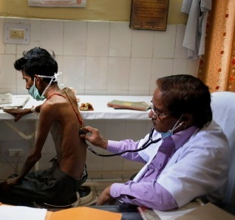

SPUTUM COLLECTION AT SHANDY CAMPS
MO/LT/ Parameidcal attend health camps organized in these Shandy Camps every month
PHI/DMC
Shandy Camp
Spot sample taken to
STS attend one of these camps selected randomly every month as prescheduled
Patients attending these camps are screened for TB symptoms
Spot sputum samples are collected from the symptomatics .
Patient asked to report to nearest health facility with early morning sputum sample the next day
Morning sample
House to house awareness and IEC activities conducted through out the year by health staff
If patient does not bring
early morning sample
DOTS
Doctor examines patient
Health staff visit patients
home and collect sample
LT examined
TB Confirmed
LT examines
samples

Slide 6
STATISTICAL INFORMATION
S.No | TU Name | 2015-16 ( 8 Sputum Collection Camps) |  | 2016-17 (8 Sputum Collection Camps) |  | 2017-18(Apr-June 17)
 |  |  |  |  |  | ( 2 Sputum Collection Camps)
 |  | No. of Sputum samples collected | Positives identified | No. of Sputum samples collected | Positives identified | No. of Sputum samples collected | Positives identified
1 | Paderu | 52 | 4 | 92 | 8 | 24 | 1
2 | Hukumpeta | 41 | 3 | 65 | 6 | 15 | 0
3 | Munchingput | 47 | 3 | 58 | 7 | 13 | 0
4 | GK Veedhi | 27 | 2 | 45 | 4 | 10 | 0
5 | Araku | 40 | 3 | 79 | 9 | 31 | 7
6 | Ananthagiri | 35 | 3 | 54 | 6 | 13 | 3
7 | KD Peta | 54 | 5 | 72 | 7 | 37 | 0
8 | Chinthapalli | 60 | 5 | 81 | 7 | 49 | 4
 | Total | 356 | 28 (Cat I – 24 Cat II – 04) | 546 | 54 (Cat I – 47 Cat II – 07) | 192 | 15 (Cat 1 – 15)
Indicator | Year 2014 (Jan-Dec)Before Sputum Collection Camps were held | Year 2015(Jan-Dec) After Sputum Collection Camps were held] (A) | Of (A) Number of cases from the Camps | Year 2016(Jan-Dec) After Sputum Collection Camps were held (B) | Of (B) Number of cases from the Camps | Year 2017(Jan-June) After Sputum Collection Camps were held (C) | Of (C) Number of cases from the Camps
Persons with TB symptoms tested in all Microscopy centres in the District | 37750 | 38864 | 356 | 44807 | 546 | 16180 | 192
TB cases confirmed in the District | 4025 | 4063 | 28 | 4258 | 54 | 1842 | 15

Slide 7
Programme Outcome
  TB case detection rates are moderately increased.
  The number of sputum samples collected and sputum positive TB cases detected amongst them are increasing steadily every month as is seen in the table and have nearly doubled in 2016-17 as compared with cases in 2015-16.
  The Shandy camps have also spread awareness and more patients with TB symptoms (Presumptive TB cases) are attending the Health facility to confirm TB diagnosis

Slide 8
Financial Implications
  There are no additional financial implications.
  Programme budget for IEC activities are used for the awareness campaigns and for organizing the camps.
Scalability
    This can be scaled up to include all Tribal /agency areas in the State or Nation since data shows that such efforts incur no additional expenses and can contribute towards a moderate increase in TB cases. The existing health system and programme staff with support of ITDA can implement this.
    Budget plan for ITDA may include this head of expenses specifically to improve supporting activities, strengthen and ensure that this scheme is continued without interruptions as a part of tribal area financial plan
    NSP 2017-25 also highlights the importance of Active Case Finding

Slide 9
Concluding Remarks
  This programme activity shows that an innovative, community-based, education/case finding intervention increased the number of TB cases detected and treated
  TB diagnostic and treatment services are brought closer to vulnerable communities
  Boosted awareness about RNTCP services.
  More frequent camps regularly at all Shandy Camps can increase TB case detection

Slide 10
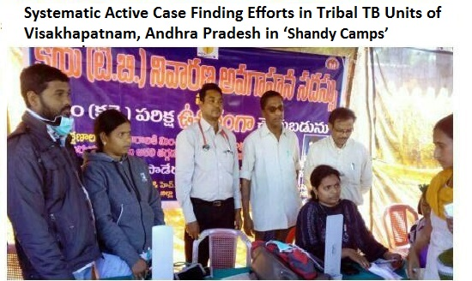

Slide 11
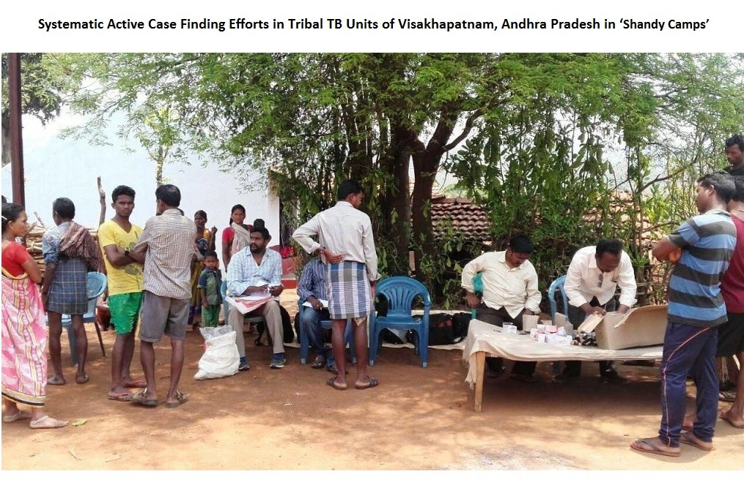

Slide 12
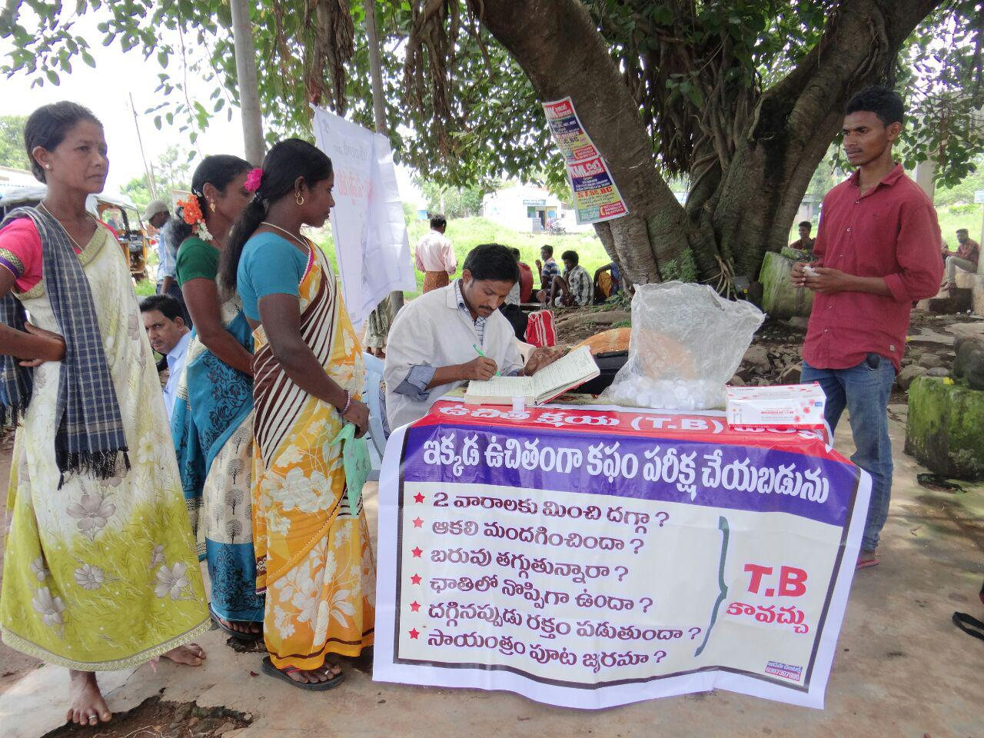
SPUTUM COLLECTION CAMP IN PROGRESS

Slide 13
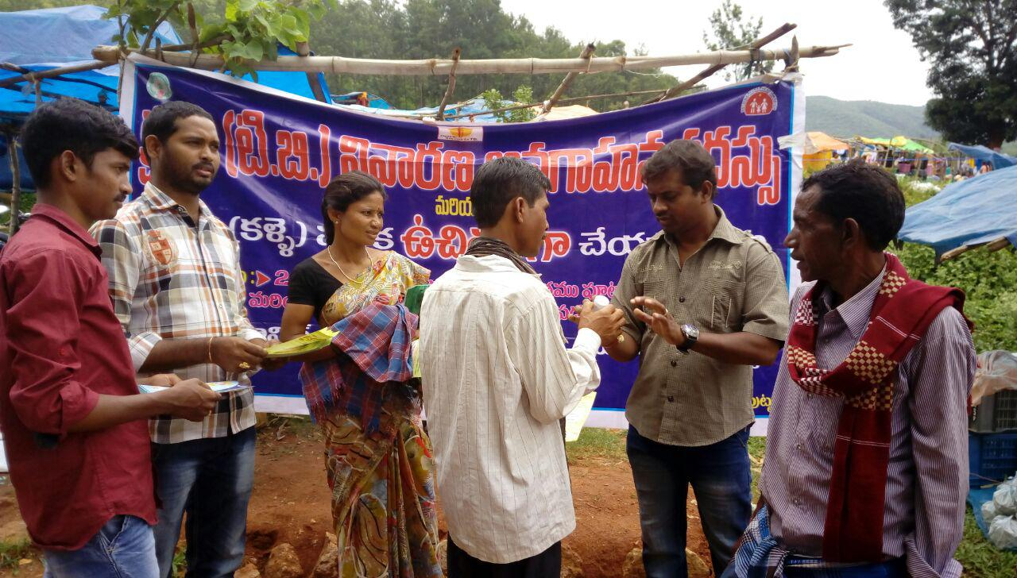
SPREADING AWARENESS ABOUT TB IN SHANDY CAMPS

Slide 14
Thank You

