Slide 1
Treatment Support Group the promising solution to end loss to follow up
Kerala

Slide 2
This presentation will highlight
Decreasing trend of LFU in Kerala
Pathanamthitta district reporting zero default
Reengineering of DOTS to ‘DOTS Triad’
Concept and functioning of Treatment Support Group [TSG] strategy

Slide 4
Number of TUs reporting Zero LFU among NSP in Kerala
Quarter Yr | Number of TUs with Zero LFU | Proportion of TUs with zero LFU | Proportion of population with zero LFU
1q14 | 14 | 19.2% | 18.3%
2q14 | 25 | 34.2% | 29.0%

Slide 5
Annual trends of Loss to Follow Up in Pathanamthitta district, Kerala

Slide 6
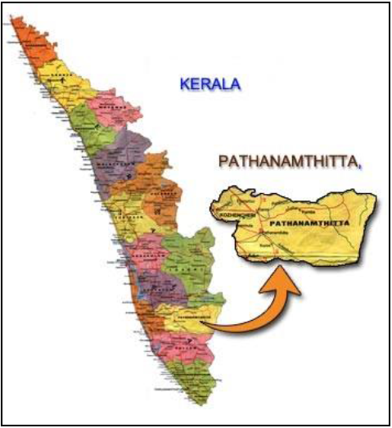
Background of LFU in Pathanamthitta
Implementing RNTCP as a pioneer district since 1993.
Moderately hilly district that nests 1.2 million population with a density of 452/sq.km, Urban segment is 11% and adult literacy rate is 97%.
Reasonable access to health care services including TB care.
Quarterly they test 4000 presumptive TB cases, diagnose175 smear positive cases, register 300 TB cases of which 150 are NSP.
3.5% of diagnosed S+ are ILFU and 6% of NSP are LFU during treatment.
Attempts based on reengineering of DOTS resulted in considerable reduction in LFU; however, the last mile remained to be highly challenging

Slide 7
Re-engineering DOTS [1/2]
Re-engineering DOTS was based on a concept called DOTS triad.
A DOTS triad is a three way transaction among the patient, DOT provider and a representative of health system, who is a multipurpose health worker [MPHW] at PHC for every 5,000 population.
Patient
DOT Provider
DOTS Triad
MPHW

Slide 8
DOTS Triad functioning
Operational since 4q11. MPHW (not STS) is primarily accountable for each case in his jurisdiction.
Most of the DOT providers are community volunteers (ASHA, SHG, next door neighbours)
MPHW does the initial home visit, counselling and contact tracing. MPHWs are trained in counselling (Axshaya)
Fortnightly follow up visit to patient & DP. Updating cards follows.
Early detection of ADRs and retrieval of interrupters.
MPHS (not STS) supervises and the designated block MO (not MOTC) reviews the process fortnightly.
DMO (assisted by DTO) reviews PHC wise monthly on every 5th working day.

Slide 9
Advantages over classic RNTCP DOT
Absolute integration with general health system at the most peripheral level
Vertical HR (MOTC, STS) are freed for focussed activities (trainings, migrants, anti-tobacco, PPM, QA of DOT, notification…)

Slide 10
The last mile sprint
Though DOTS Triad reduced LFU to a great extend, a small proportion did not adhere to treatment.
Reasons were alcohol/drug addiction, broken family, destitute, difficult access to DOT centre, inadequate food, lack of sense of social inclusion.
DOTS triad had casual relationship with initial loss since its function commences with treatment initiation
A new concept, the Treatment Support Group (TSG) was implemented to mop the floor clean

Slide 11
Concept of TSG
A treatment support group [TSG] is a non-statutory body of socially responsible citizens and volunteers to provide social support to each needy TB patient safeguarding his dignity and confidentiality by ensuring access to information, free and quality services and social welfare programs, empowering the patient for making decision to complete the treatment successfully.

Slide 12
Organization of TSG
The group is usually chaired by the president of Gram Panchayat, its health standing committee chairperson or a local opinion leader.
Members of the group are the MO, MPHW, community DOT provider, experienced informal counsellors, CBO or FBO members, Janamythri police (citizen-friendly police), local philanthropists and other community volunteers.
The group supports all the DOTS triads in its sphere of influence.
Though this is an informal group, they have started formal meetings and documentation recently.

Slide 13
Formation of TSG
MO/MPHS meets potential members
One opening meeting of all members
Linkage of patient with TSG is through MPHW
Documentation by MPHW
Conveniently held TSG meetings approximately once in a quarter

Slide 14

TSG: The protective hands
Patient
DOT Provider
DOTS Triad
MPHW

Slide 15
Functioning of TSG
Functional since 1q13.
Dignity and confidentiality of the patient rank high in priority
Hence only needy patients are linked to TSG through MPHW.
This linkage is with patients’ consent.
Examples of linkages
  TB pension from revenue department
  Food support to the family by gram panchayat
  Travel support by gram panchayat/ philanthropist
  House visit by FBO member
  House visit by counsellor
  Retrieval of interrupters
  Friendly house visit by a Janamythri police
  Palliative care to seriously ill TB/DRTB patients

Slide 16
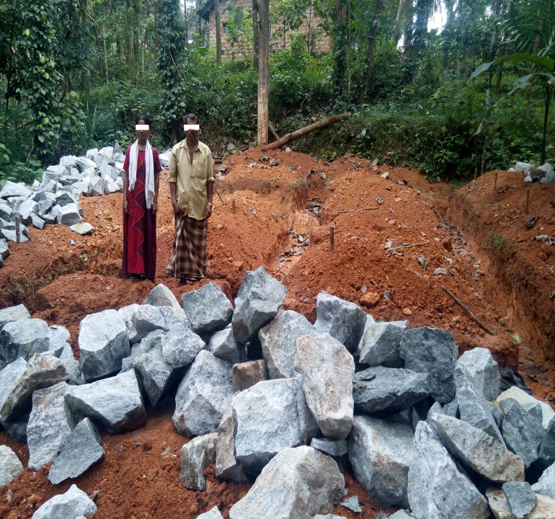
Resources for TSG
The model does not burden the health system for additional resources.
Camaraderie, the most valuable resource, is the cheapest and most universal.
Nutritional support through the district Panchayat’s project [LSG dept].
A TB pension is provided at Rs 1000 per month till the completion of treatment [Revenue dept]
Hospital expenditures through RSBY.
Travel to DOT centre through local resources
Travel to DRTB centre [taxi/ambulance] by LSG
In rare occasions, LSG has adopted family of TB patient

Slide 17
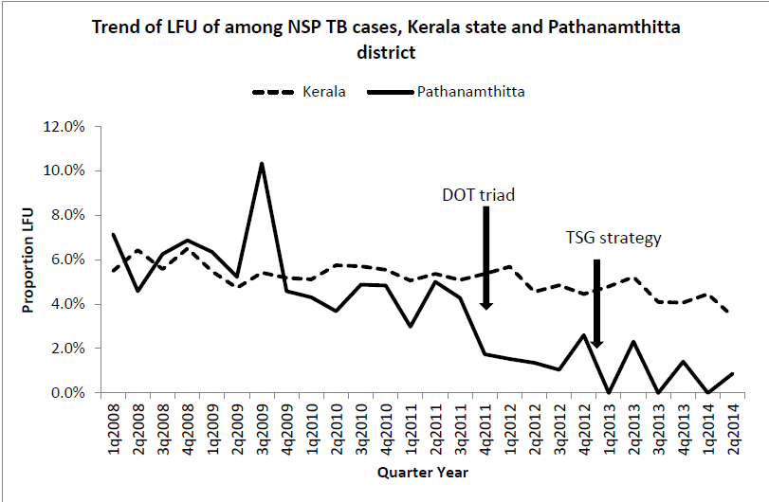
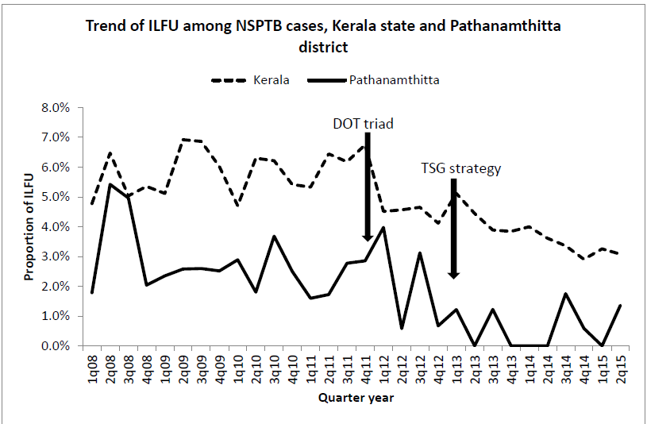
Impact of TSG on LFU

Slide 18
Thanks

