Slide 1
A Digital Health Revolution
(Technology Enabled Community Health Operations)
Jai Prakash Shivahare, IAS
Commissioner of Health,
Government of Gujarat
Notes:
Respected Chair for the session Vandana Maam, Co-chair, colleagues on the dias and all the participants. Its my privilege to present before you a very important IT application, which is bringing a revolution in Gujarat in health indicators because it has emerged as a wonderful management tool in the hands of State’s political leadership, health team and common citizens to bring transparency and make targeted interventions to improve our health indicators. This we call Technology enabled community health operations.

Slide 2
Goals
Inputs and Processes
Reduce IMR/ MMR
Sex Ratio
100% Immunization
Reduce Malnutrition
Number of machines sealed
Number of visits to PHCs
Infrastructure/ Medicines
Staff
Number of review meetings
Notes:
!. Thanks to adequate budget allocation by the state Government and support from National Health Mission, we have adequate finances to take care of staff requirement and create good infrastructure. We have all the resources to make a difference in these indicators.
2. However, there are two important ingredients to achieve a quantum jump in these indicators; as were rightly flagged by H’ble Health Minister Dr Harsh Vardhan in his speech yesterday. One; passion and commitment from entire health team, starting from Top political leadership to Principal secretary right upto ANM and Asha and involvement of common people to achieve these goals.
3. I will describe in a minute how TECHO has become a management tool to achieve both the things and has started giving wonderful results. Not too long ago, when I was in the field as collector or DDO,

Slide 3
Data Sources for Health Indicators
Data on Health indicators
Census
NFHS
SRS

Slide 4
Current Challenges in health Data management
Data Integrity
Sample data
Multiplicity of reports
Lag in data
Census
NFHS
Data Analysis
District/ Taluka/ Village
Data visualization

Slide 6
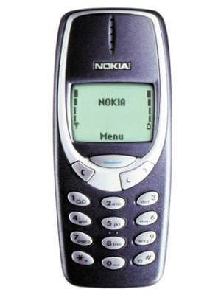
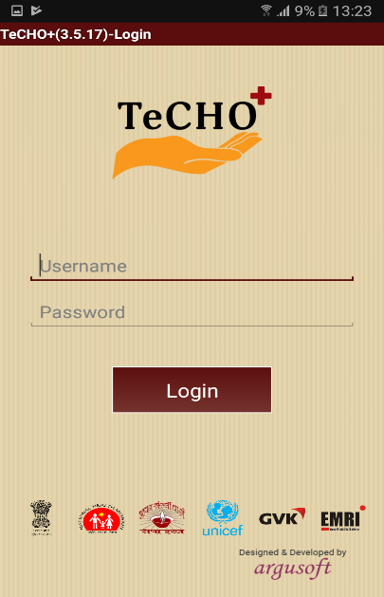
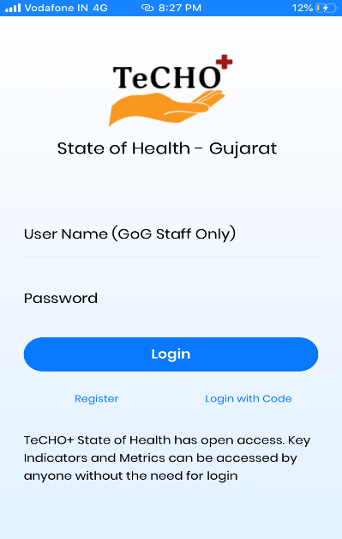
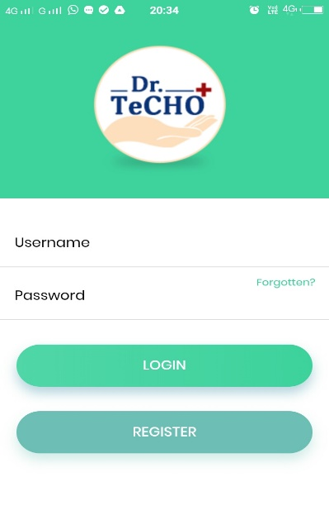
Journey of TeCHO+ program in Gujarat
2013
ImTeCHO
October 2017
TeCHO+
Apr 2019
State of Health
Nov 2019
My TeCHO
Coming Soon…
Dr. TeCHO
2009
Janani Program

Slide 7
TeCHO+: a digital health data transformation in making . . .
E-Mamta
IM TECHO
TeCHO
TeCHO+

Slide 8
Features of TeCHO+
Geo Tagging enabled
Tracking of time spend in visit
Geo Fencing enabled
Big Data Analysis &Visualization

Slide 9
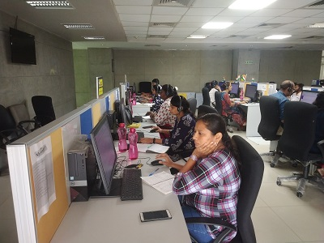
Health Nurturance & Transformation Hub
Assuring Data Quality and Quantity management
Beneficiary level verification
High Risk Pregnancy Tracking and Management
Ensuring accountability through geo tagging
Ensuring Appropriate and informed Referral
Health worker skills assessment

Slide 10
Successful Roll out in entire state
Front line workers
10,793 FHWs (100%)
Health Facilities
2219 Health facilities (100%)
Coverage
CHOs (100%)
ASHAs (100%)
Daily 2987/3389 Deliveries registered (88.2%)
99.3% of population (6.53 Cr.)
7,46,551 pregnancy registration (89.4%)

Slide 11
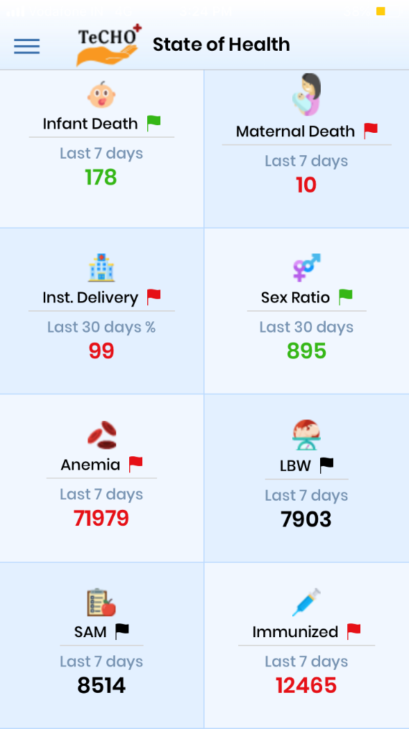
State of Health: A giant leap towards data transparency
Health data is made available in public domain
Can be accessed and used by every citizen without restriction up to last granularity
Beneficiary details not made available to ensure confidentiality

Slide 12
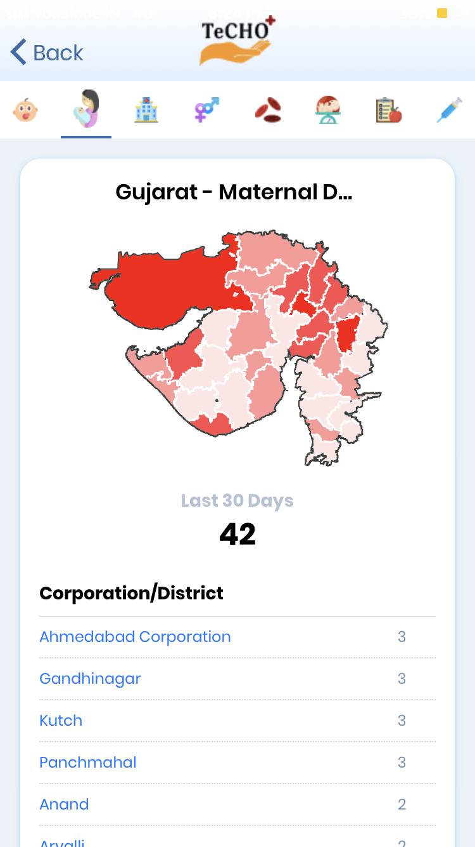

Slide 13
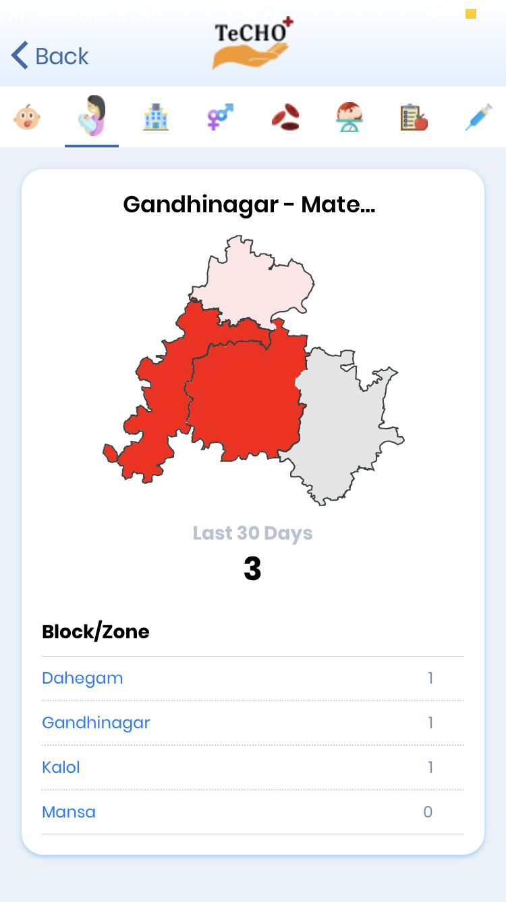
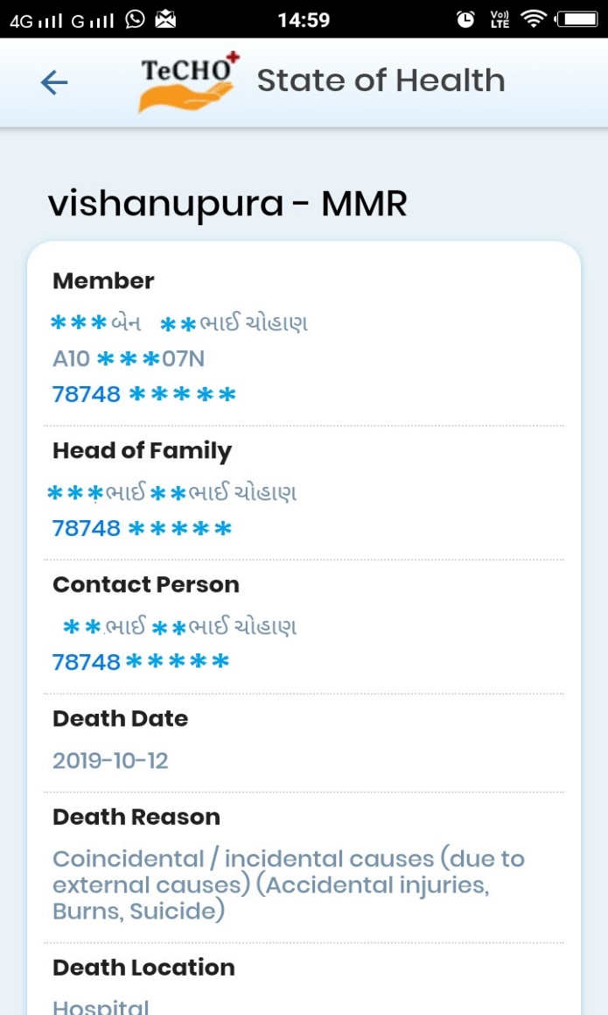
IF LOGGED
IN

Slide 14
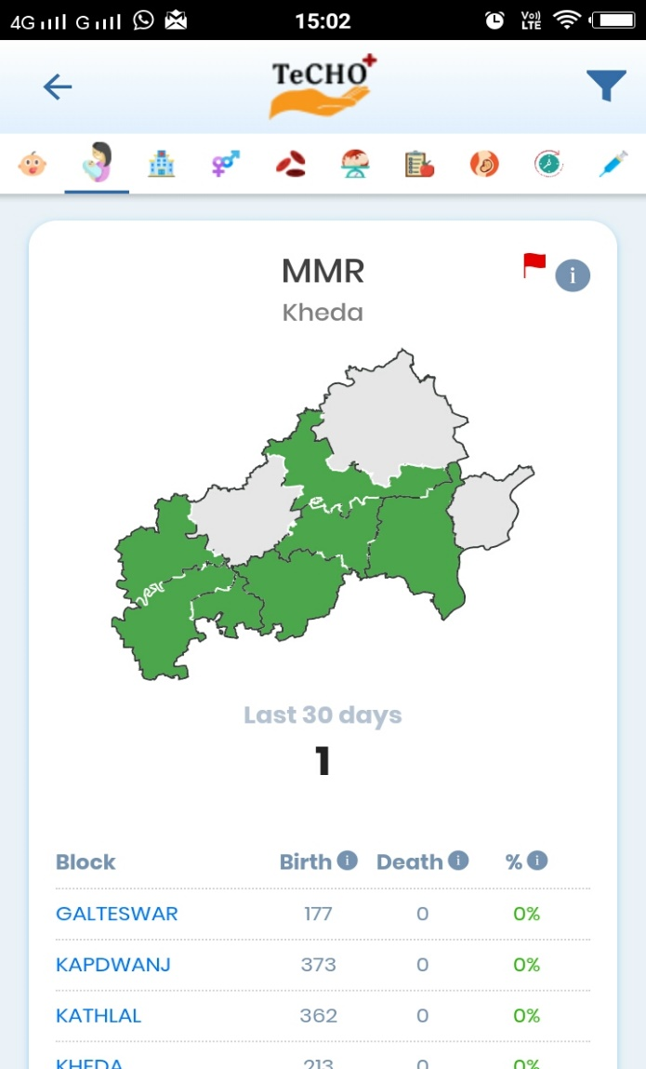
Tracking of MMR
IF LOGGED
IN

Slide 15
Continuum of Care using TeCHO+
> 30 years
15-49 Years
Non communicable disease screening – HT, DM, Caner (Oral, Breast, Cervical)
Eligible Couple tracking, ANC/PNC services, Family planning services
0-5 Years
> 40 years
Child registration, Immunization and nutrition & Cerebral Palsy screening
National Program for Control of blindness
Population Enumeration
Notes:
© Copyright PresentationGO.com – The free PowerPoint template library

Slide 16
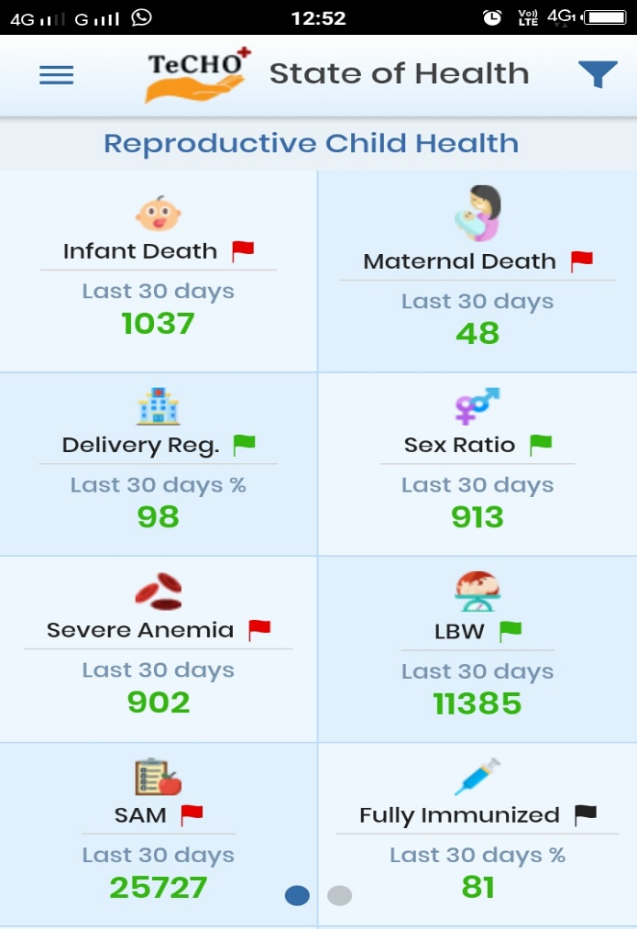
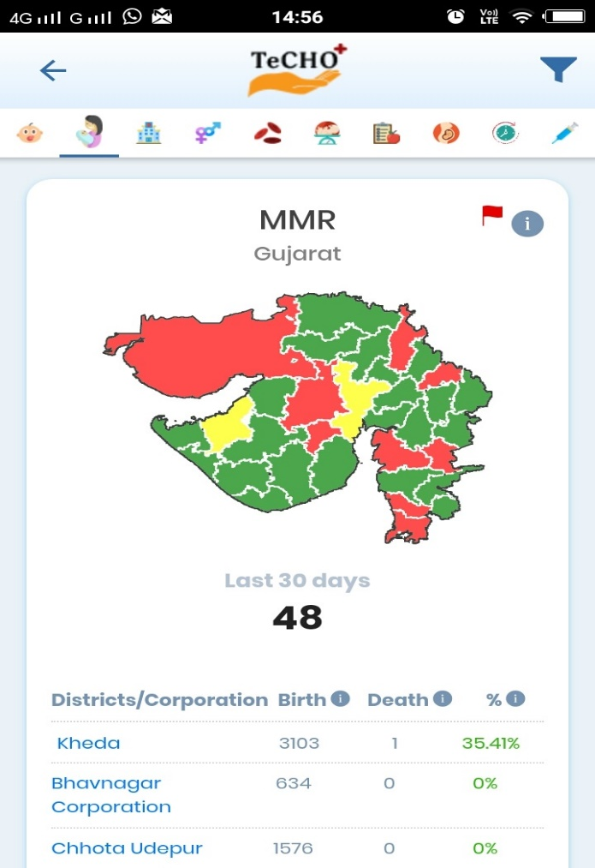
Comprehensive 7/11 approach for RMNCH+A and beyond
Already being monitored using TeCHO+
Soon to be added
Notes:
Mission Niramaya is an extension of 7X11 approach and implementation framework for the comprehensive approach.

Slide 17
Big Data
Data Analytics
Use of Data
=> TECHO Provides actionable points

Slide 18
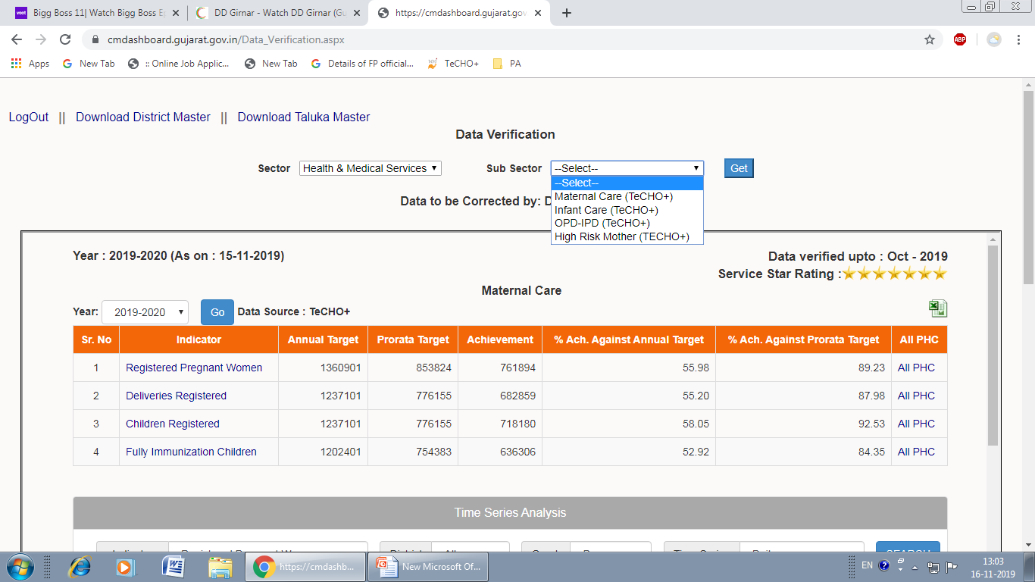
CM Dashboard ( 11 indicators from TeCHO+)

Slide 19
One Stop Health IT solution
Real time-real place-real person data entry for 7+4 indicators
Third generation health data revolution digital real time decision support system
First step in direction of e Health Records

Slide 20
One Stop Solution for
Front line workers
Public & Private Health Facilities
Beneficiaries
Citizens & PRI members
Health managers
CM Dashboard for review

Slide 21
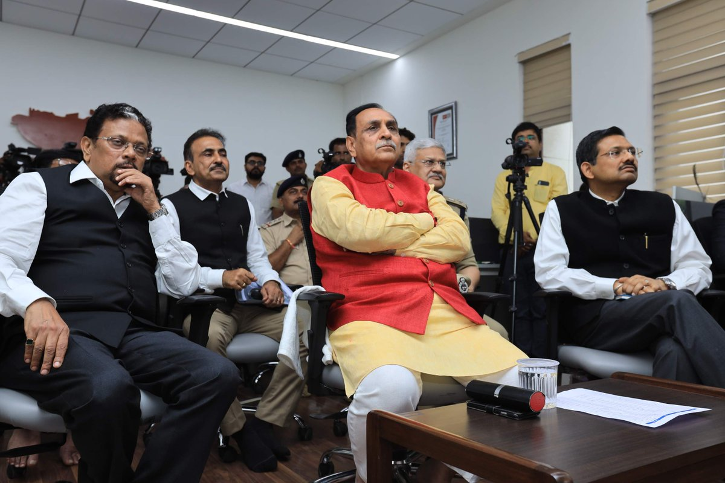
One vision, One mission
Team Gujarat

Slide 23
Ranking of Departments/ Districts
November 2018
November 2019
Remarkable improvement in Health indicators
Full immunization
Sex ratio
IMR
MMR
Notes:
Red flag shows either improper reporting or decrease in performance

Slide 24
Partners
SEWA Rural, Jhagadia- Training and technical guidance
Argusoft India Ltd - Software
GVK EMRI - call center support
UNICEF - technical support

Slide 25
Way Forward
Work in progress to include mental health, RBSK, Blindness Control Program
Integration with Birth Registration System and CAS-ICDS
Linkages and support to other departments such as Education/ WCD
Linkages with Aadhar for improving accuracy of TeCHO+ Data
Will be happy to help other states implement TeCHO

Slide 26
Thank You

