Slide 1
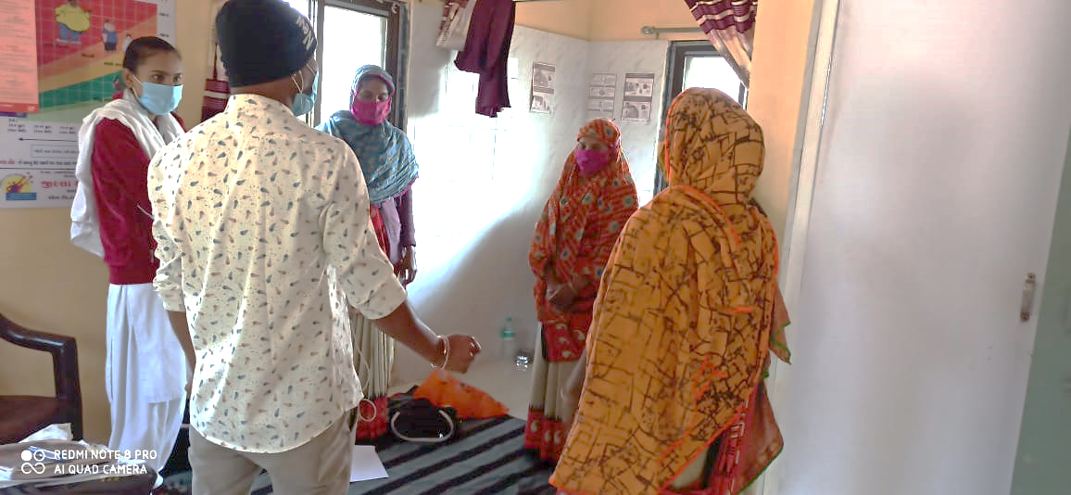
Team huddle Meetings
Innovation and Learning Centre (ILC)- Dahod
Charutar Arogya Mandal
Karamsad, Anand
Gujarat

Slide 2
Problem Description
CHOs: Team leader, newly formed cadre, relatively very young
MPHWs: experienced, permanent staff, pay scale higher (seniors)
Rift between CHOs and MPHWs
MPHW-M and ASHAs listen to MPHW-F (earlier looking after the centre)
Hampering work at the community level and centre level adversely affecting the delivery of services

Slide 3
Possible solution
Intervention- to promote a positive team spirit
Simple
Cost effective
User friendly
Team huddles
Energizing meetings
Each member tries to fit in each other shoes
To understand the experiences and generate
empathy towards each member
Build a support system for everyone
Applied in sports- in the beginning and at end

Slide 4
Why do a daily team huddle?
Increase focus
Remove roadblocks
Team morale
Facilitate communication
Promote accountability

Slide 5
Team huddle meetings Versus review meetings
Team Huddle meetings | Review meetings
Short, brief, regular meetings | Can be lengthy one with a set agenda
Informal and relaxed environment | Formal and strict environment
To communicate about day to day activities and hurdles | To take reviews and focus on reports/ data
Strong sense of belonging | Do not provide a sense of belonging
Based on providing support and boost morale | Based on monitoring the junior cadres
No target based approach | Target based approach
No records to be kept for these meetings | Records and minutes of the meetings to be maintained
All are in relaxed mood | All are in tensed mood except the senior most cadre

Slide 6
Benefits of team huddle
Sense of unity
Opportunity to discuss about the problems, new projects idea and initiatives
Support-seeking and alleviate confusions
Glimpse of what is expected of the team (today and near future)
Rejuvenate for the work day
Platform of sharing one’s experience (positive or negative)

Slide 7
Process
Gather the team and start with informal greetings
What he/she expects to accomplish today and what is needed to be focussed on
Stand up during the entire meeting
for breaking the chain of hierarchy
ending the meeting in a short period of time
Stand in a circle- proper eye contact
Decide the name of member to initiate the meeting (by some fun activities)

Slide 8
(contd.)
Every team member (including the leader) briefs everyone about 3 things:
What have we accomplished so far?
What do we need to focus on next?
What support do I need from other team members?
Great platform to praise an employee for something recently achieved (motivational)
End with important updates, if any
Separate conventional meeting for individual problems or queries

Slide 9
Facilitation by Innovation and Learning Centre (CAM)
Training the ILC team members on Team huddles
Conducted a pilot round at Extension Programmes Department in Shree Krishna Hospital (Charutar Arogya Mandal)
Incorporated in our system and conducting each day without fail at CAM till date

Slide 10
(contd.)
At HWC level
Orientation of the 100 CHOs at the “CHO induction training program”
10 interested CHOs selected and entire 10 HWC team briefed about the process
Started since last week of November and still on-going
Tool for monitoring and feedback designed
Each centre visited at least twice a week
Whatsapp group formed for coordination and resolving issues

Slide 11
Feedback from the HWC team members
Community Health Officers
“We get the relevant data and information that is required, without even asking for it. The ASHAs and FHWs provide the details without prompting now.”
“With the help of team huddle meetings, the team members can be brought on one platform and the job chart can be followed easily.”
“Other team members accepted us as their team member, as we discuss our work and activities together, they think we are one of them.” “We can describe the activities of other team members as well. Earlier it was not possible, and we used to call frantically about the whereabouts of other team members.”
“Duplication of work has lessened as compared to earlier because a brief planning is done during the huddle itself”

Slide 12
MPHW-Female
“It used to be awkward for me to report to CHO as she is very younger to me and I had to report to her. Now in the huddle meeting where we all stand up and discuss the day’s activities, it has become quite easier for me.”
MPHW-Male
“We come to know what other members doing through the huddle. Every member starts to come on time”
“It helps us in planning our work better by interacting with the FHW and the CHO”
“It is good, we get a chance to meet every member of the center together, at least once in a day”

Slide 13
ASHAs
“Through these meetings, we can share our activities and boost up our self-confidence, morale as well as self-respect. Now, after some of these meetings, the CHO praises us about our activities”
“We have to plan our activities beforehand. Earlier we were conducting the activities on ad hoc basis”
Most of the ASHAs were hesitant to speak in front of everyone about their activities and find it a difficult task for them, but they can be accustomed to it after sometime, once they gain confidence.

Slide 14
Challenges
CHOs are posted at other place for COVID-19 pandemic duty.
As ASHAs are honorarium based volunteer she can not be forced to remain present daily at fix time. We are not providing incentive for the huddle meeting.
This innovation based on the behavioural change so it will take time to streamline.
To sustain this innovation and enthusiasm new ideas to be added at interval.

Slide 15
Scalability
Zero-cost activity
Less time required daily- around 15-20 minutes
Minimum training- team training approach
Effective in addressing several issues related to team work, hierarchy, communication
Needs a paradigm shift in the work culture of the current healthcare system
Should not be seen as a target to be achieved but a “work culture to be adopted”
No reports or numbers to be reported for this activity

Slide 16
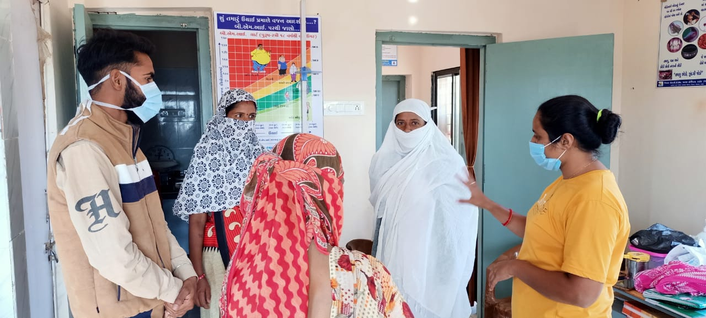

Slide 17
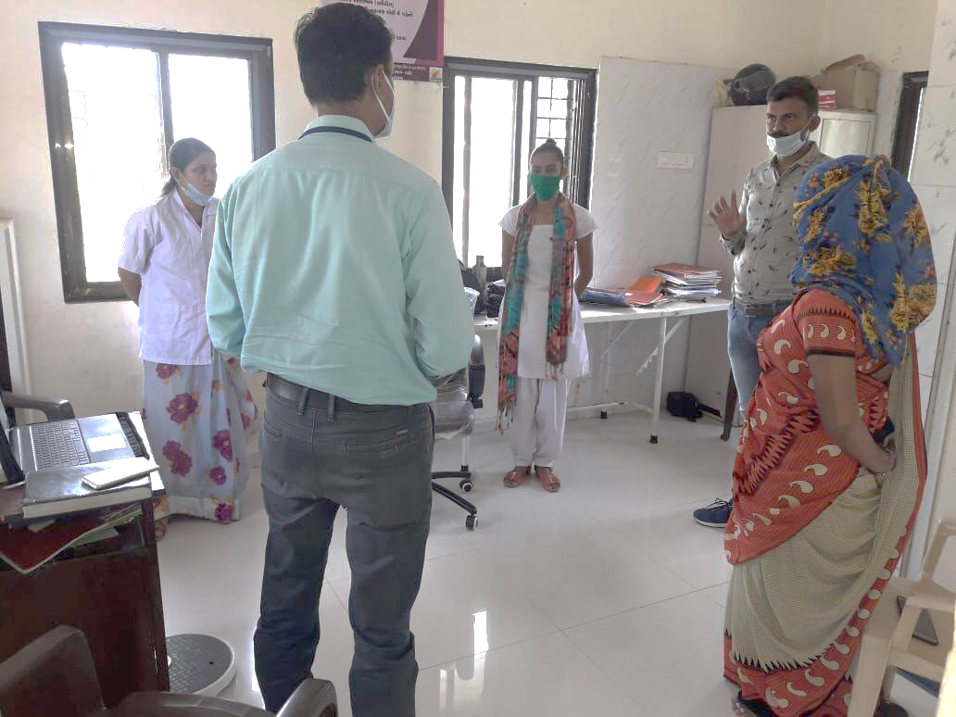
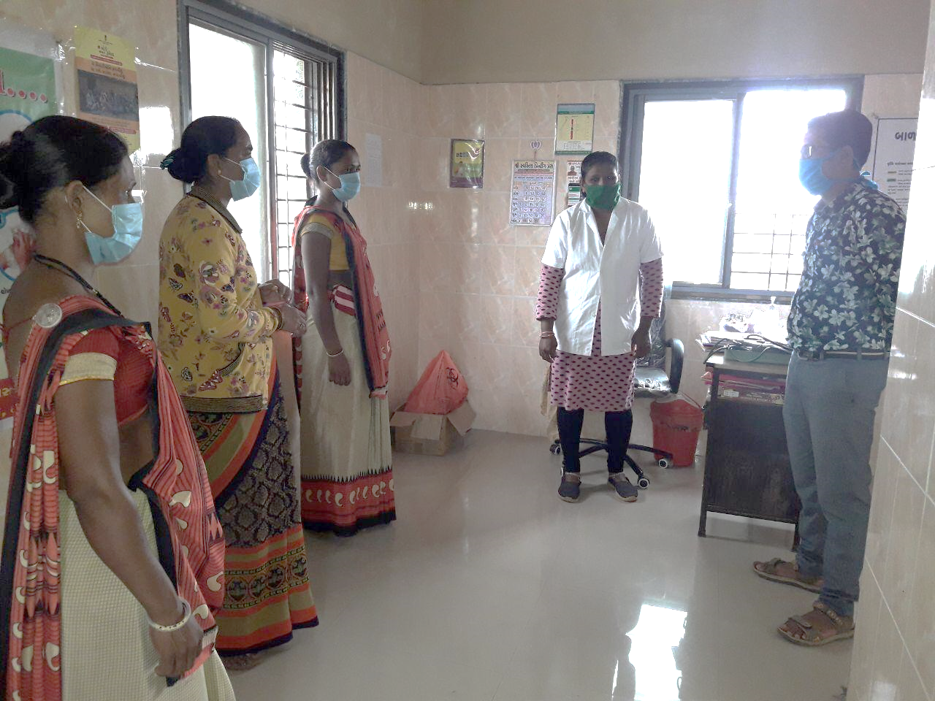

Slide 18
Thank you

