Slide 1


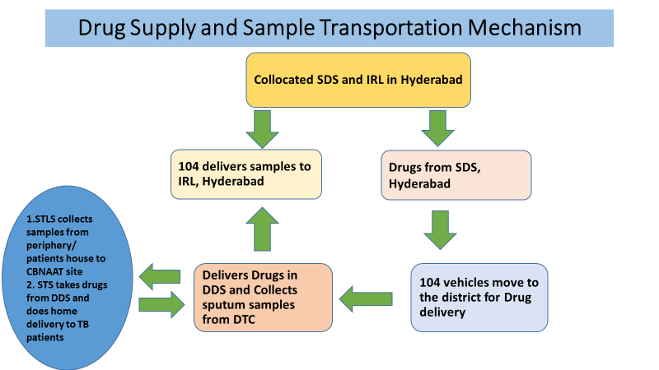
Ensuring uninterrupted sample transportation and home delivery of Anti TB Drugs to TB patients amidst lockdown
Rationale- Telangana
Rationale-
Covid-19, has been a major public health concern worldwide. India announced lockdown on 23rd March 2020, which led to halt of all the outpatient services, sample transportation and Anti TB drug delivery. In order to continue the TB services TS implemented a plan utilizing the available resources.
Description of the Model and Action Plan
Use of 104 Vehicles from NCD programme to be used for TB Drug and sample Transportation
Action Plan and route map prepared for sample transportation from the districts to state lab and drug delivery from State drug store to the districts
Forecasting of monthly utilization of drugs to the districts done by state team
Districts informed well in advance about the arrival of 104 vehicles
Collection of samples from patients house by the supervisors, packed and kept the at the District HQ for the collection on arrival of 104 Vehicle
Drug delivery done to the District HQ by 104 vehicles. Then, patient wise home delivery of TB drugs done by TB Supervisors
Both the activities were implemented during lockdown period i.e March to June 2020. The data for specific time for both the activities is shown below -
Number of districts | % of Number of Patients on treatment who received home delivery of anti TB drugs
10 | 100%
9 | 90-99%
14 | 80- 80%
Total districts -33 | 90% (State average)
Potential Scale-up-
The model showcase that there are resources available within the system. Inter department coordination and support can result in successful outcomes.

