Slide 1
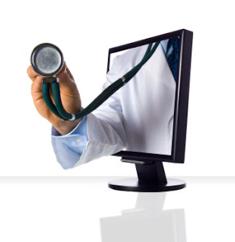
“Telemedicine Project Maharashtra”
National Summit on Good, Replicable and Innovative practices
29th – 31st August 2016

Slide 2
Concept of Telemedicine
Telemedicine is the use of telecommunication and information technology to provide clinical health care through transmission of medical, imaging and health informatics data via telephone, Internet or other means from remote & rural areas to specialist nodes
Objectives
To provide expert consultation to patients in remote areas overcoming distance barrier and specialist gaps.
Video conferencing facility for online consultation
To provide Continuing Medical Education(CME) for Medical and Para Medical staff

Slide 3
Need of Telemedicine
Availability of specialists is major concern (Vacancy of various specialists between 50-70%)
Difficulty in availing medical facility by patients from tribal, rural and remote areas
Distance and time required to avail health facility is major hurdle.
Specialist advice required by general duty medical officers who are working in rural areas.

Slide 4
Salient features
Telemedicine facility is available in District Hospital as well as some of the RH and SDH.
Tribal area is also covered.
For specialist modes, both Government as well as private hospitals empanelled.
Facility to transmit soft copies of reports, images X Ray
One to one communication also possible.
Offline as well as online mode for consultation available.

Slide 5
Evolution of Telemedicine Program in Maharashtra
1
2
3
4
Year 2006- Pilot Project in collaboration with ISRO in KEM Hospital Mumbai, District Hospital Latur, Beed, Nandurbar, Sindhudurg and Karad
Year 2007-2008 - Expanded to additional 20 Districts hospitals, 2 Sub-districts hospitals and 4 Govt. Medical Colleges
Feb 2011- Telemedicine Network Shifted from ISRO Bandwidth to BSNL/MTNL Broadband
Year 2011-2012- Telemedicine Network Expanded to 30 Sub-district Hospitals

Slide 6
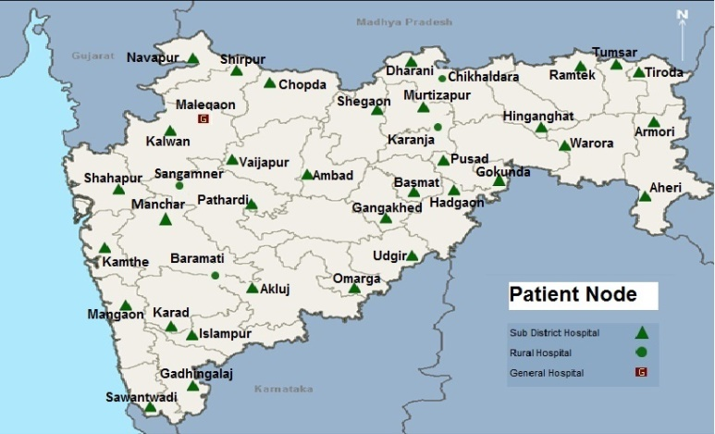
Area Covered
Telemedicine Centres in Maharashtra under NHM – 62 Patient Node
23 District Hospitals and 39 CHCs

Slide 7
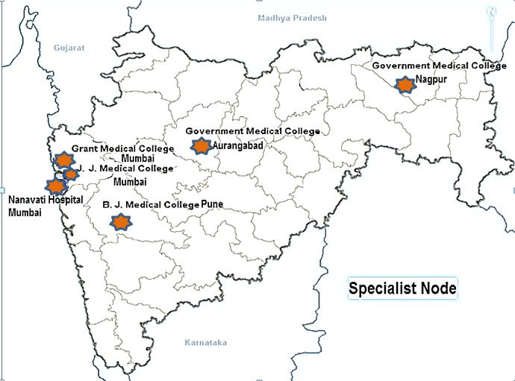
Area Covered (Contd.)
Six Specialist centers
K.E.M. Hospital Mumbai
Sir J.J. Hospital Mumbai
Government Medical College, Nagpur.
B.J. Medical College, Pune
Government Medical College, Aurangabad
Nanavati Hospital, Mumbai.

Slide 8
Benefits of Telemedicine
Diagnostic & Therapeutic facility where local expertise is not available or consensus on diagnosis is not reached
Continuous Medical Education - for medical/ para medical staff and awareness generation in community during special campaigns
Expert/ Second opinion with more than one doctor for diagnostic and therapeutic purpose in atypical cases
Psychological and financial benefit to patients
Availability of Expert consultation at the door step of patient
1.
2.
3.
4.
5.

Slide 9
Number of Telemedicine Consultations Over 2009-16

Slide 10
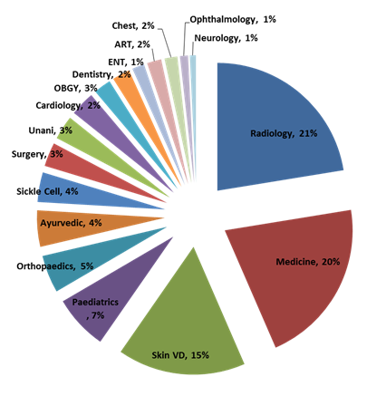
Specialty wise % utilization
Percentage of Offline Consultation - 58% (Within 24 hours)
Percentage of Online Consultation - 42%

Slide 11
Average utilization per node
Average utilization of Telemedicine for Patient Nodes in 15 - Tribal Districts (33 -Patient Nodes)
Avg.Case Referred - Per Patient Node/Year Uptake
Average utilization of Telemedicine
for 6 Specialist Nodes
Avg. Opinion Given - Per Specialist Centre/Year Uptake

Slide 12
E-PHC (Primary Health Centre)

Slide 13
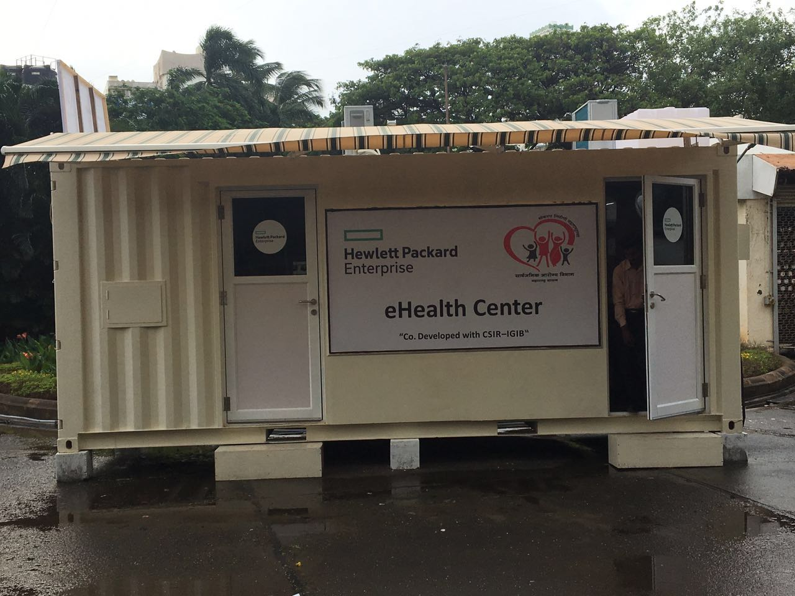
E-PHC (Primary Health Centre)
E-PHCs are being set in collaboration with MNC Hewlett Packard (HP)
in remote tribal locations of Maharashtra.
1) Harisal in Amravati
2) Gora in Palghar
3) Potegaon in Gadchiroli
4) Khapar in Nandurbar
5) Gopinath gad in Beed
Tele-consulting
HPE health cloud
Dashboard
Medical equipment
Shipping Container

Slide 14
E-PHC continued..
Shipping Container:
Standardized shipping container
Low cost investment
Easy to transport
Rapid to deploy
Medical Equipment:
Semi-autoanalyzer
ECG
Spirometer
Digital Thermometer
Glucometer
Stethoscope
Telemedicine:
Consultation at secondary care hospital
Super-specialist consultation at tertiary care hospital
Remote health worker training
Health Cloud:
Web based Medical Records
Automated health data upload
Remote monitoring of equipment and workforce
Dashboard:
Analytics
Early epidemic detection
Preventive healthcare and intervention
Disease surveillance in real time

Slide 15
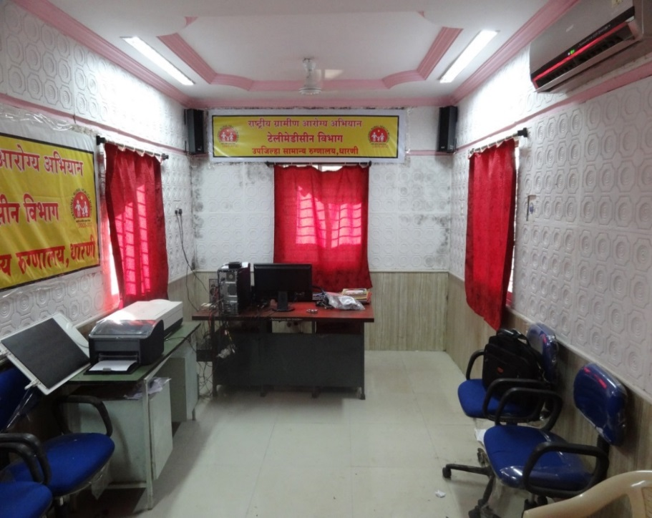
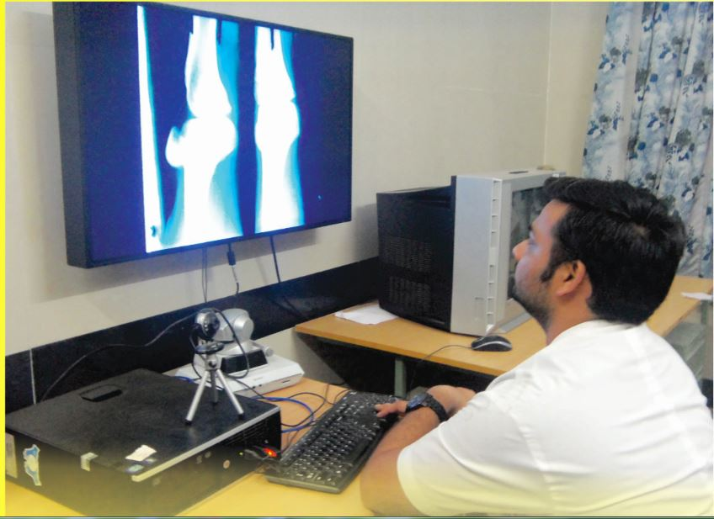
Telemedicine Nodes
Sub District Hospital, Dharni (Amravati, Melghat)
Patient Node
Government Medical College, Aurangabad
Specialist Node

Slide 16
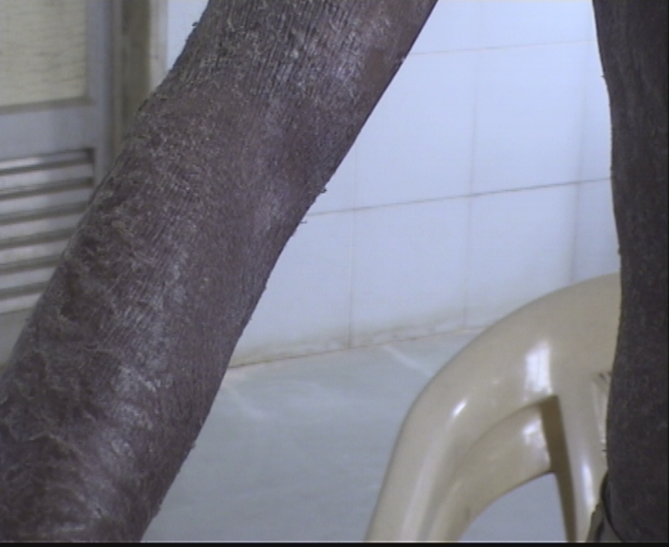
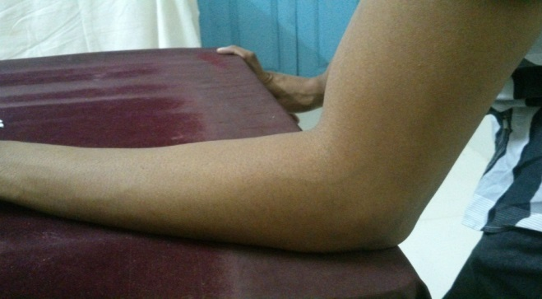
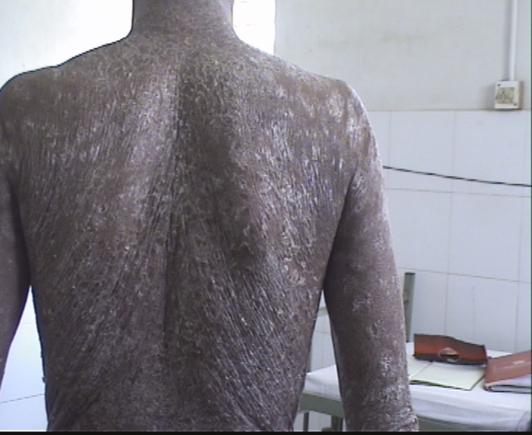
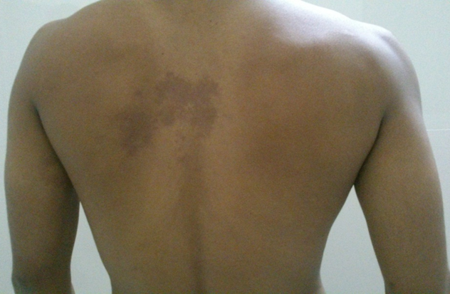
Patient Name: Mr. Chandar Koli (30yrs/M)
Diagnosis : Exfoliative Dermatitis
Patient Node: Mangaon Telemedicine center, Raigad.
Specialist Node: Nanavati hospital, Mumbai
Before Treatment
After Treatment (After 4 Months)

Slide 17
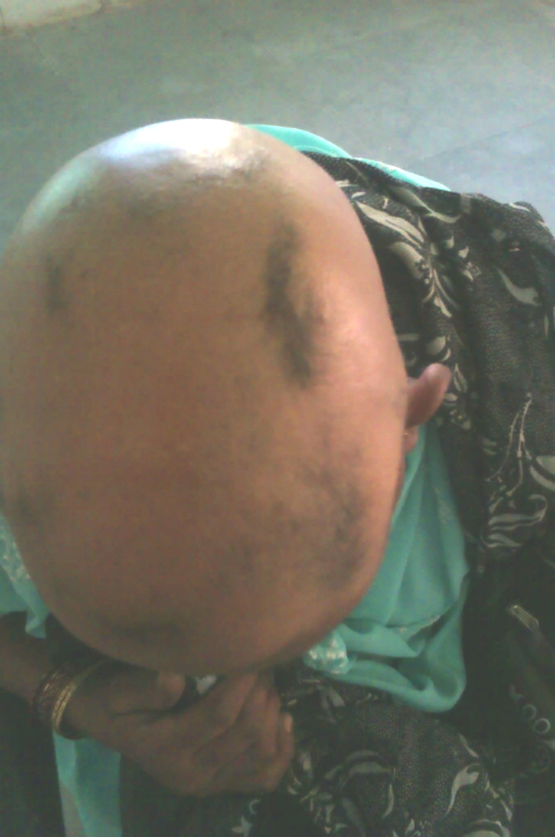
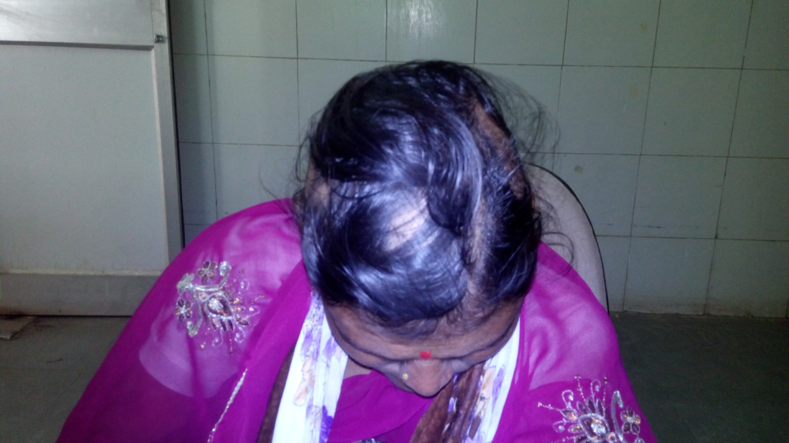
Patient Name: Smt. Asha Dhakane (40yrs/F)
Diagnosis : Alopecia Areata
Patient Node: Pathardi Telemedicine center, Ahmednagar.
Specialist Node: B J Medical college, Pune
Before Treatment
After Treatment (After 12 Months)

Slide 18
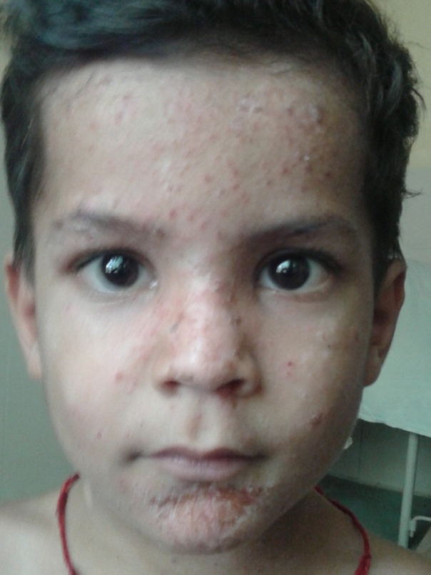
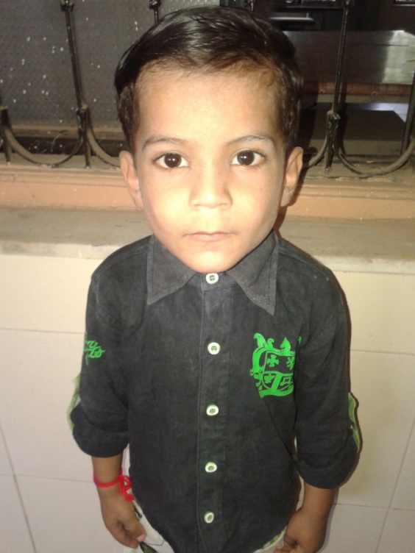
Patient Name:. Master. Rohit Jadhav (4 yrs/M)
Diagnosis : Impetigo
Patient Node: Shirpur Telemedicine center, Dhule.
Specialist Node: KEM hospital, Mumbai
Before Treatment
After Treatment

Slide 19
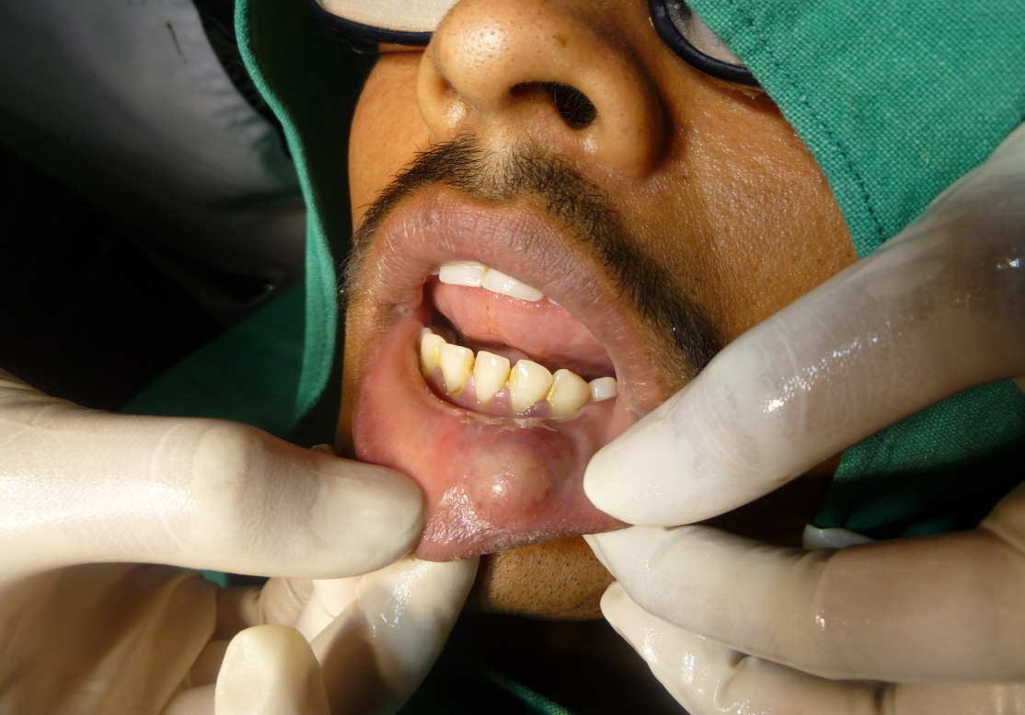
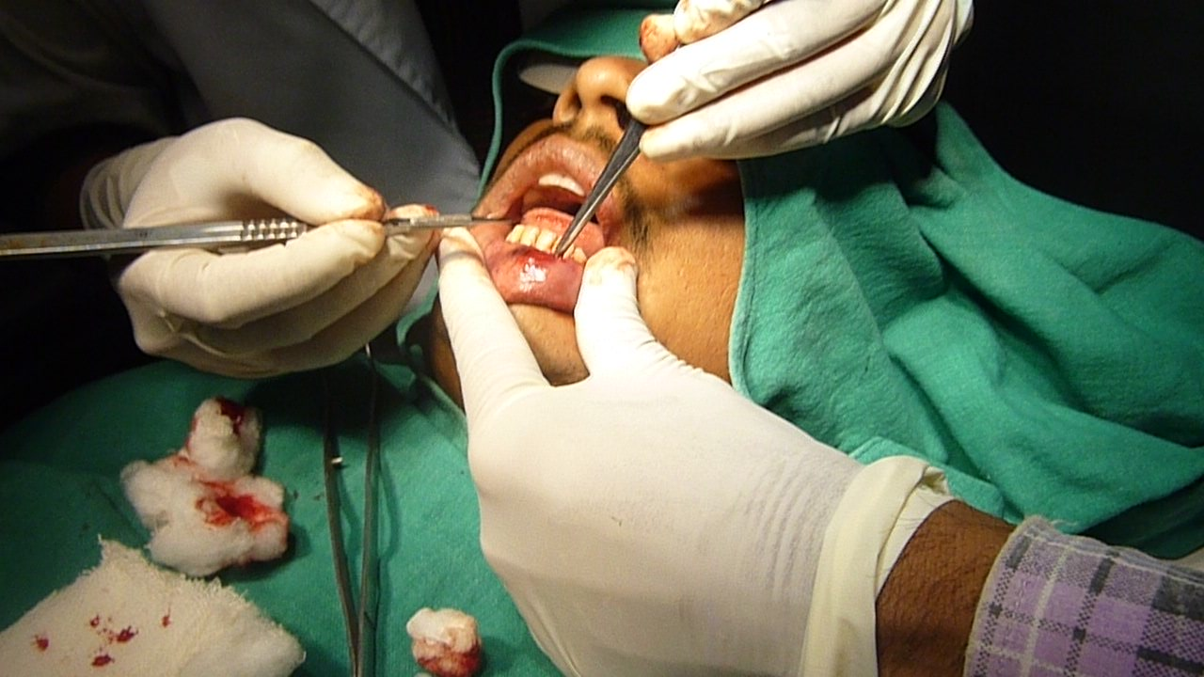
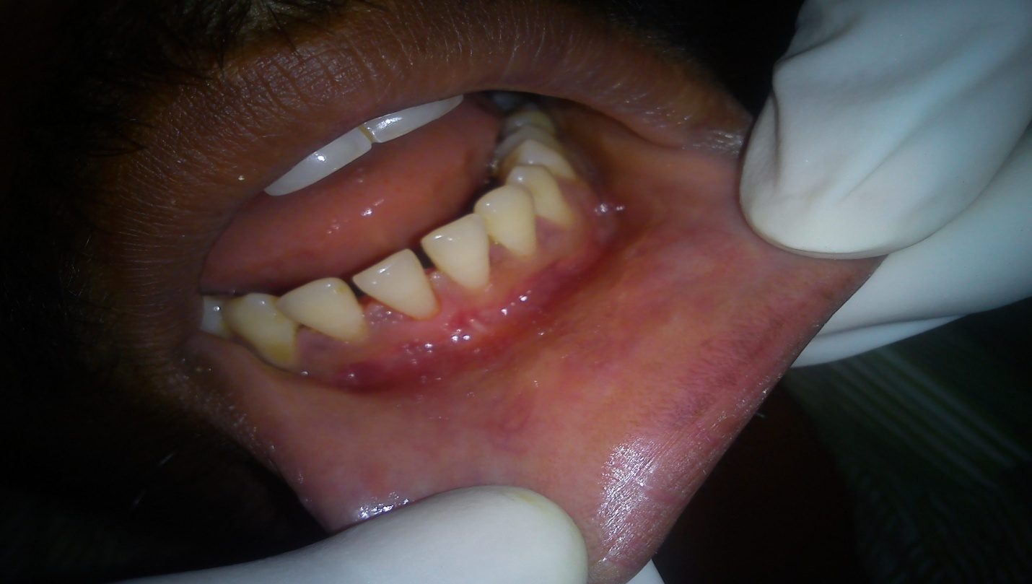
Patient Name:. Mr. Rahul Gawande (23 yrs /M)
Diagnosis : Mucocele
Patient Node: Karanja Telemedicine center, Washim.
Specialist Node: Sir JJ hospital, Pune
Before Treatment
During Treatment
After Treatment
Dental patients’ operation in OT at Washim District under guidance of HOD of Dental department, Sir JJ Hospital Mumbai through telemedicine facility.

Slide 20
Thank you
National Health Mission,
Public Health Department of Maharashtra,
Govt. Of Maharashtra

