Slide 1
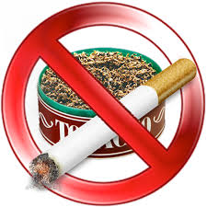
Tobacco Free Villages
4th National Summit on Good and Replicable Practices and Innovations in Public Health Care System
A Leap forward for Tobacco free Punjab
Department of Health & Family Welfare Punjab

Slide 2
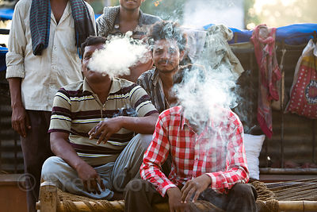
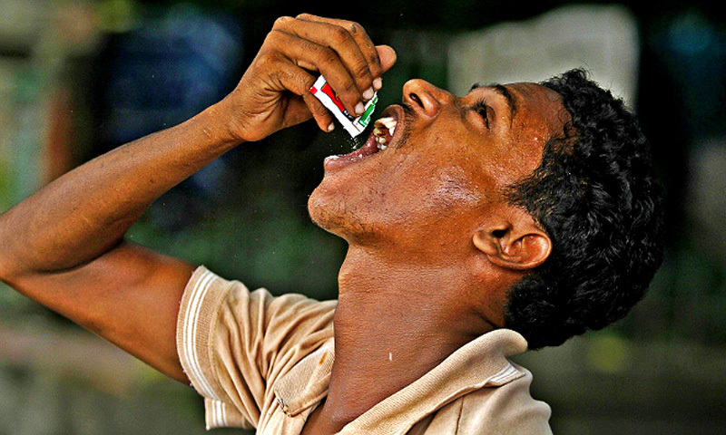
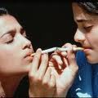
Prevalence of Tobacco use in Punjab
(GATS 2010)
    About 25 lakh adult population in Punjab uses Tobacco in one form or the other
    About 75-80 persons die due to Tobacco use in Punjab every day out of more than 3500/ day in India
Type | Punjab
Tobacco users | 11.7%
Smokers | 6.9%
Smokeless | 6.5%

Slide 3
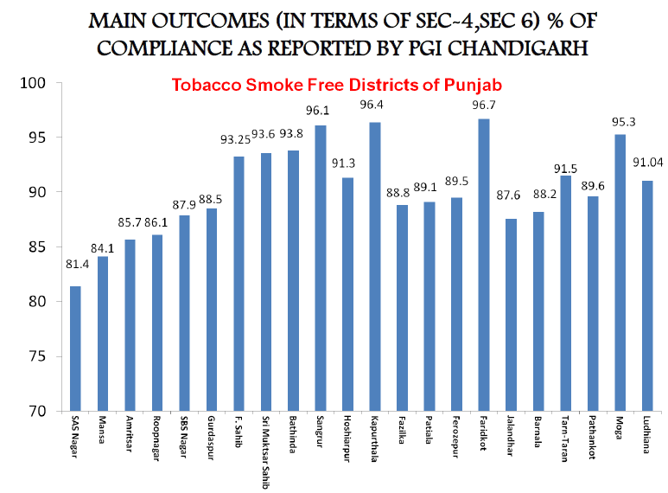
Background
All the 22 districts of Punjab declared Tobacco Smoke Free (TSF) on the basis of Compliance Studies conducted by School of Public Health, PGIMER, Chandigarh

Slide 4
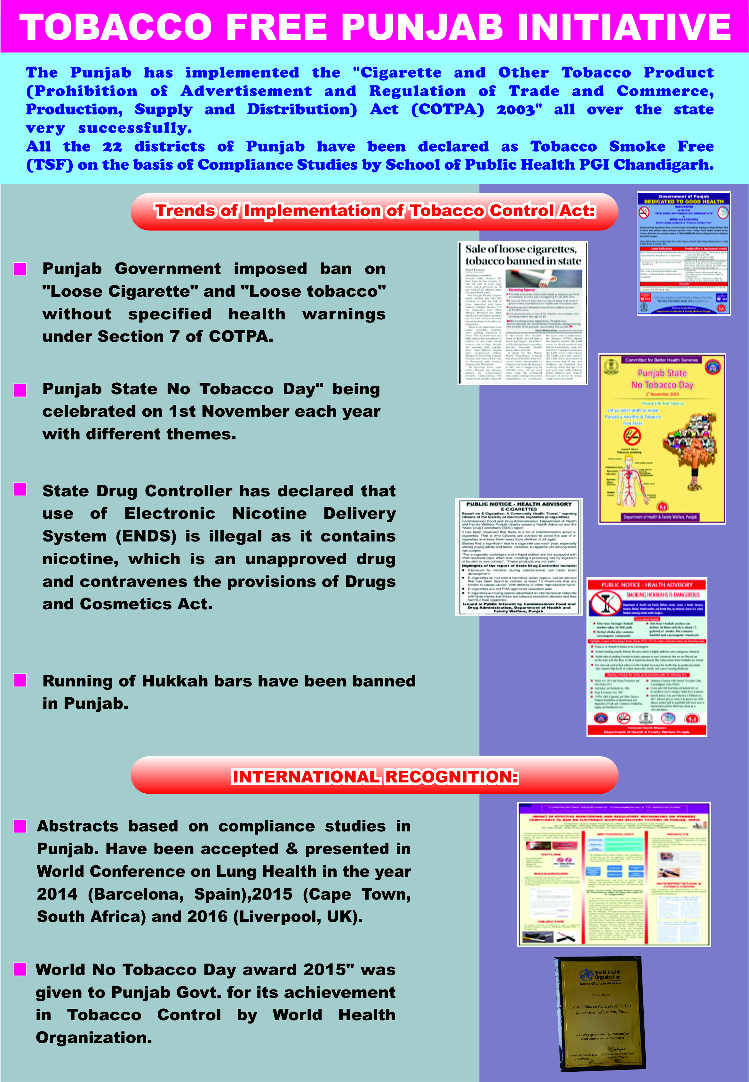

Slide 5
Steps taken so far
Ban on Chewable Tobacco Products: Notification issued regarding Prohibition on Manufacture, Storage, Sale or Distribution of "Gutkha", "Pan Masala", processed/ flavored/ scented chewing tobacco and any other Food products, containing Tobacco or Nicotine as ingredients by whatsoever name available in the market
Ban on e-Cigarettes: Use of Electronic Nicotine Delivery System (ENDS) DECLARED illegal (as it contains Nicotine, which is an unapproved drug & contravenes the provisions of Drugs & Cosmetics Act) – State Drug Controller
Ban on Loose Cigarette/ Tobacco: Notification issued - Ban on Loose Cigarettes and Loose Tobacco without specified health warnings in compliance of Section 7 of COTPA Act

Slide 6
Steps taken so far
Tobacco free health institutions: All District & Sub-divisional Hospitals declared as Tobacco Free
  A box placed at the entrance of the hospital to put tobacco products in it before entering hospital
Punjab State “No Tobacco Day”: Observed on 1st November which is also “Punjab Day” with different THEME every year
Screening for Oral Cancer and Pre-cancerous lesions: In Dental OPDs during the month of February and March 2017
  50,427 patients examined; 4682 patients (9.28%) were smokers/smokeless tobacco users
  Oral lesions detected in 2075 tobacco users (44.3%)
  37 (0.79%) had oral cancer
  168 (8.09%) suspected patients referred to higher centers for comprehensive evaluation and treatment22

Slide 7
Steps taken so far
WORLD NO TOBACCO DAY 31st May 2017: Month long "Tobacco free Punjab Campaign" launched by Hon’ble Health Minister, Punjab, by Flagging off the Publicity Van - visited all 22 Districts; more than 110 cities; 200 schools - to create awareness among the people especially youth about the ill effects of tobacco through Posters, Audio and Video clips
Tobacco Vendor hauled under Juvenile Justice Act for selling cigarettes to a minor: Teams constituted to conduct enforcement drive in the state
  FIR was lodged against a mobile vendor under section 77 of Juvenile Justice Act for selling tobacco products to minors (Jalandhar)

Slide 8
State Target - End Tobacco by 2025
  State Level Coordination Committee/ Task Force: (SLCC/SLTF) Quarterly meeting under the chairpersonship of Principal Secretary Health to review the performance of all departments regarding the Anti Tobacco laws
  District Level Coordination Committee/ Distt. Level Task Force: (DLCC/DLTF) monthly meetings under the chairpersonship of Deputy Commissioner
  Block Level Coordination Committee/ Block Level Task Force: Under the Chairpersonship of Sub Divisional Magistrate.
  Enforcement Drives - regularly by District Level Task Force and Block Level Task Force in all districts of Punjab under all sections of COTPA, 2003
    Total 26,909 Challans have been done against the violators from April 2016 to Mar 2017 and the money collected from the challans is used for IEC activities under COTPA
  COTPA Compliance study (Compliance to all sections of COTPA 2003) - 8 districts in Punjab have been declared as Total COTPA Compliant on the basis of compliance study by PGIMER, Chandigarh

Slide 9
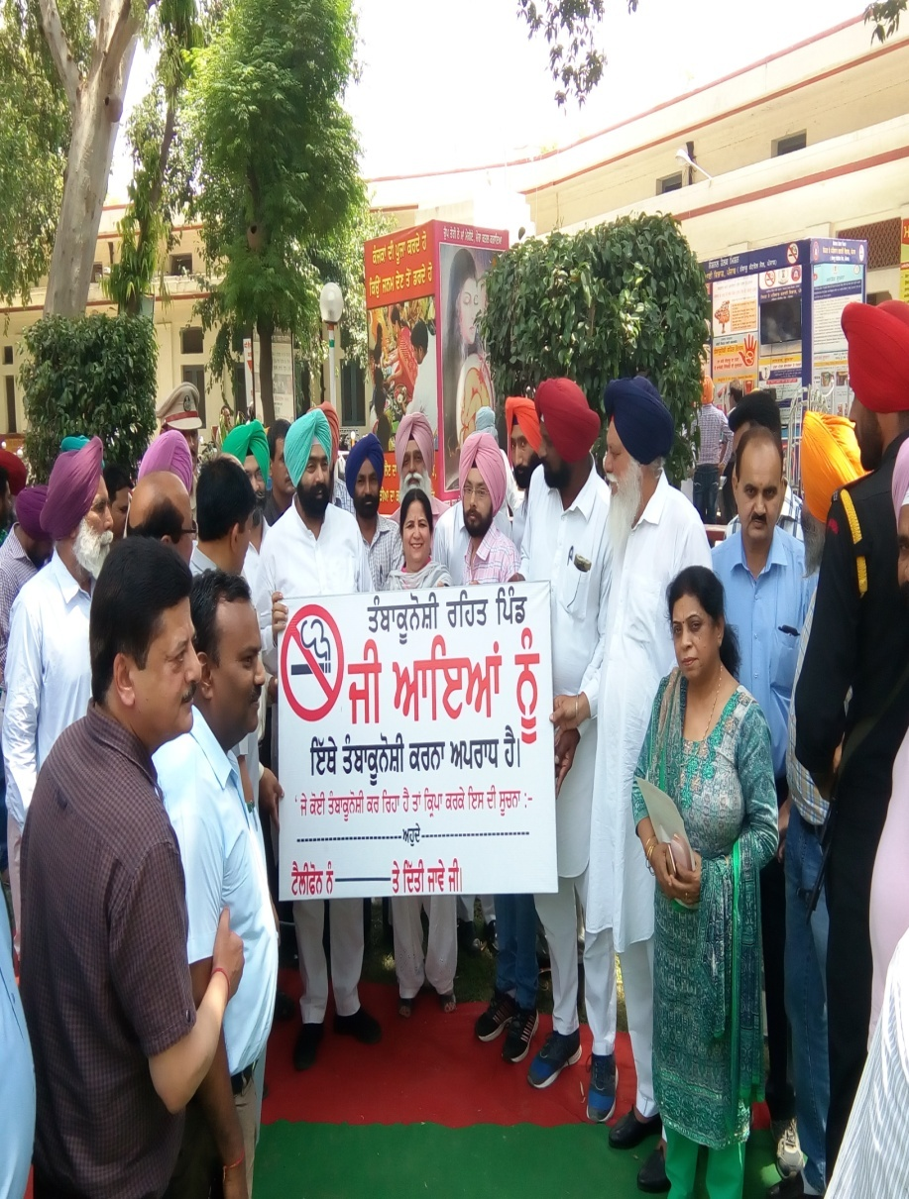
Tobacco Free Villages
Rural Punjab - 62.5% of the total population
Poor awareness regarding ill effects of the tobacco
Tobacco sold at shops along with the food items which is against the Food Safety and Standards Act, 2006
Important to focus at the village level to tackle this problem

Slide 10
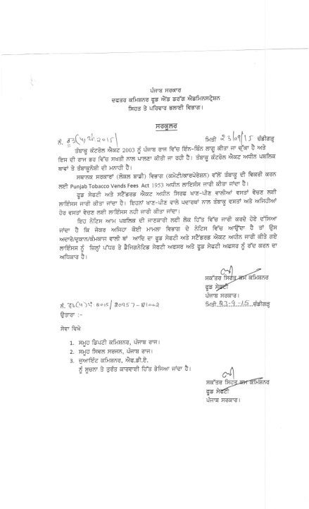
Circular issued by Food & Drug Administration that in case of sale of tobacco products by food vendors/ shopkeepers license can be cancelled under Food Safety & Standards Act

Slide 11
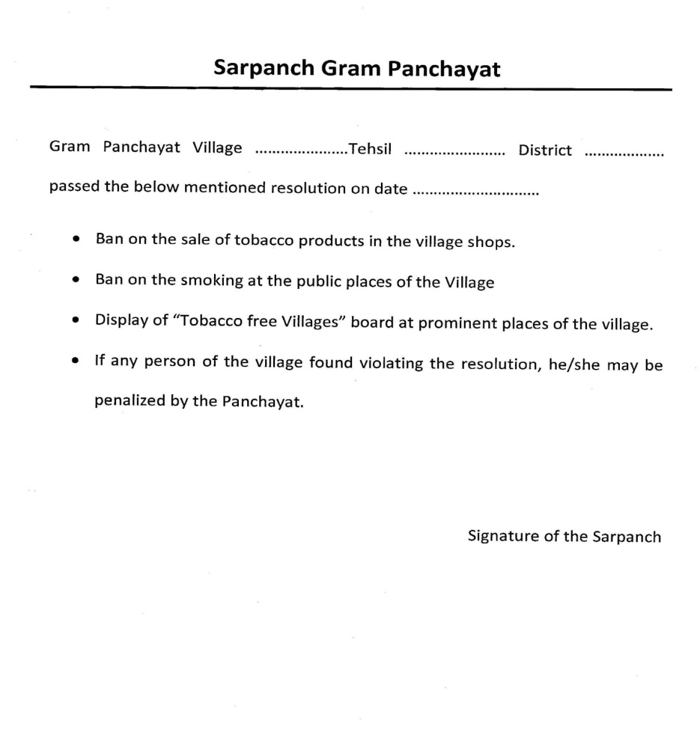
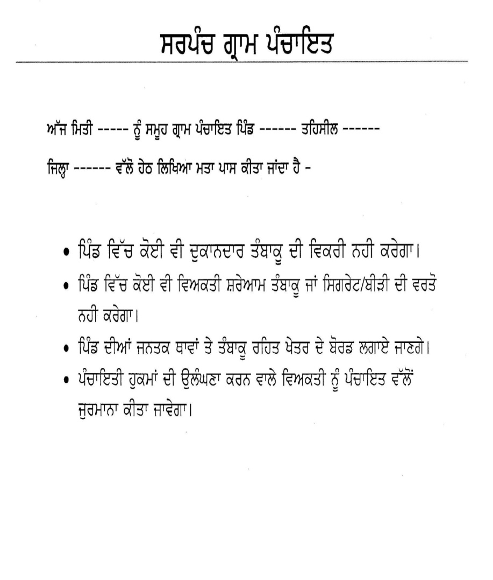
Methodology
1st Phase: Sensitisation of Panchayats by Health Department about the ill effects of the tobacco and motivated to put up a resolution to declare their village as Tobacco free

Slide 12
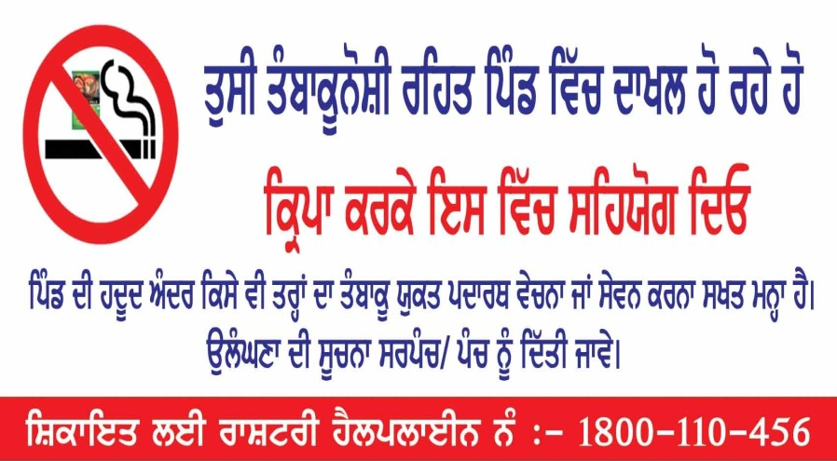
Methodology
2nd Phase: Village level Committee formed and resolutions submitted to Deputy Commissioner to declare themselves as Tobacco Free Villages
3rd Phase: Regular follow up of villages by District Level Task Force

Slide 13
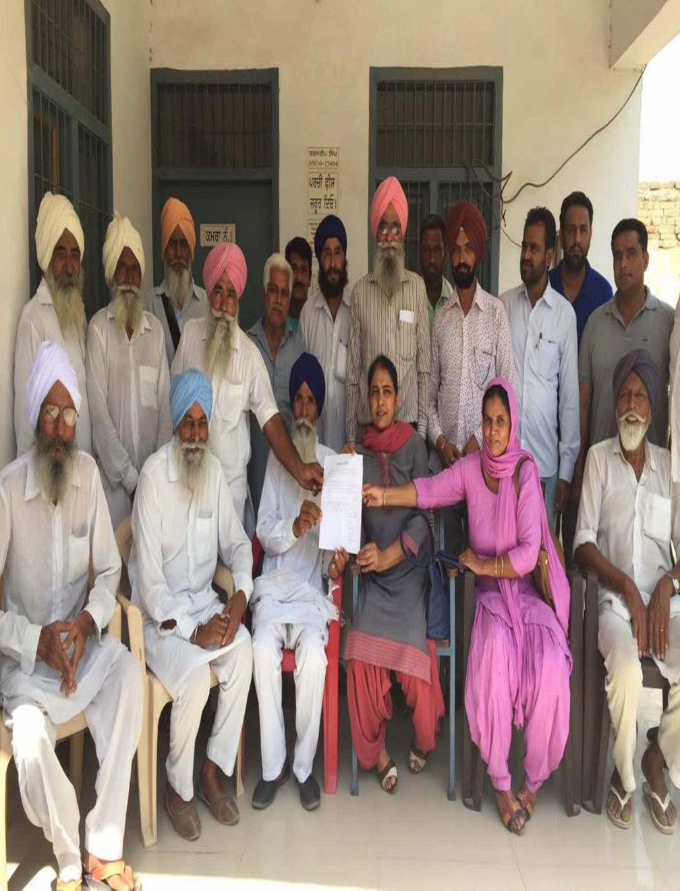
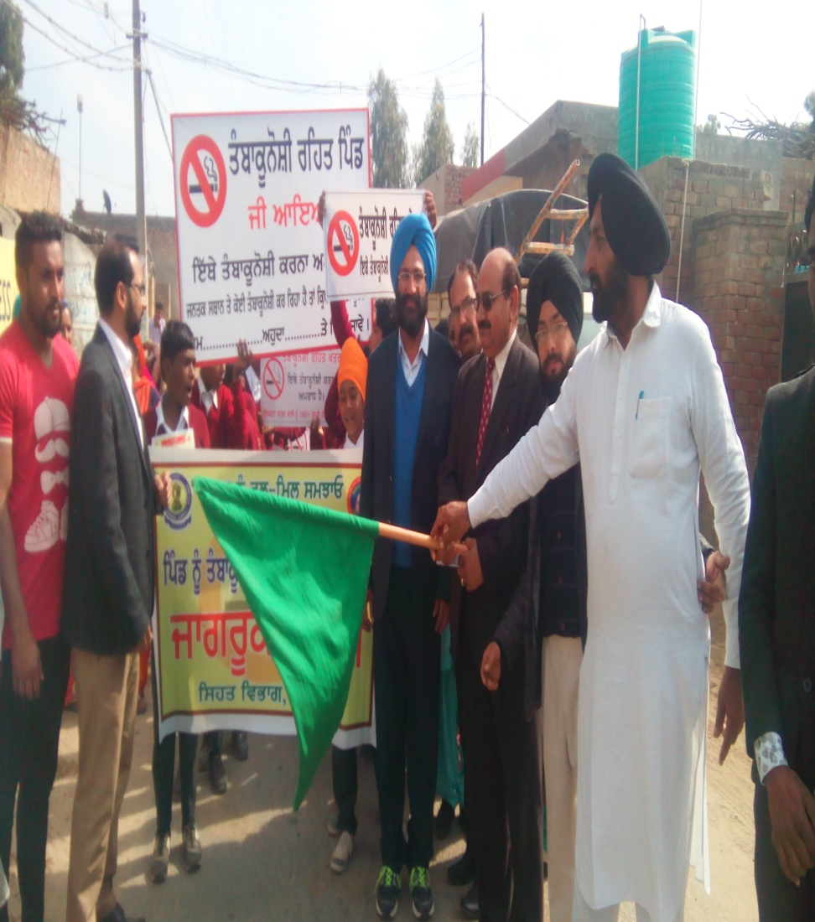
Results
Total 352 villages in the state of Punjab covering a total population of 5.32 lakh declared themselves Tobacco Free by passing the resolution
Tobacco Free Village boards displayed at the prominent places of all the villages
No sale of tobacco products in the villages

Slide 14
District wise list of Villages
District | Total No. of Villages
Amritsar | 4
Barnala | 2
Bathinda | 14
Fatehgarh Sahib | 5
Faridkot | 16
Ferozpur | 32
Gurdaspur | 5
Hoshiarpur | 45
Jalandhar | 2
Kapurthula | 19
Ludhiana | 5
Mansa | 12
Moga | 2
Sri Muktsar Sahib | 6
Roopnagar | 31
Sahibzada Ajit Singh Nagar | 1
Sangrur | 2
Tarn-Taran | 144
Total | 352

Slide 15
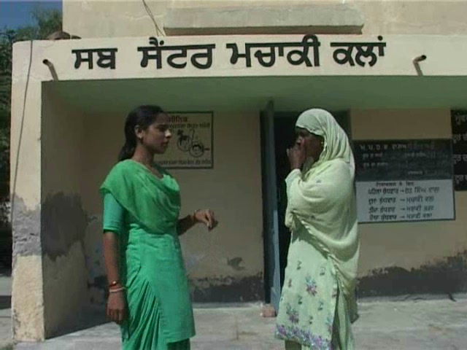
First Tobacco Free Village - Machaki

Slide 16
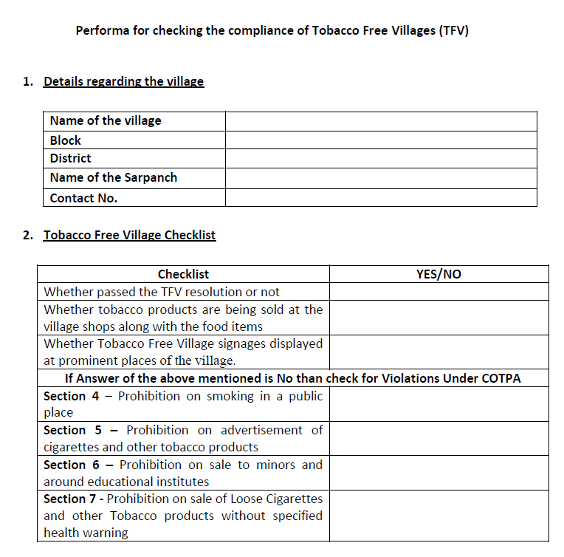
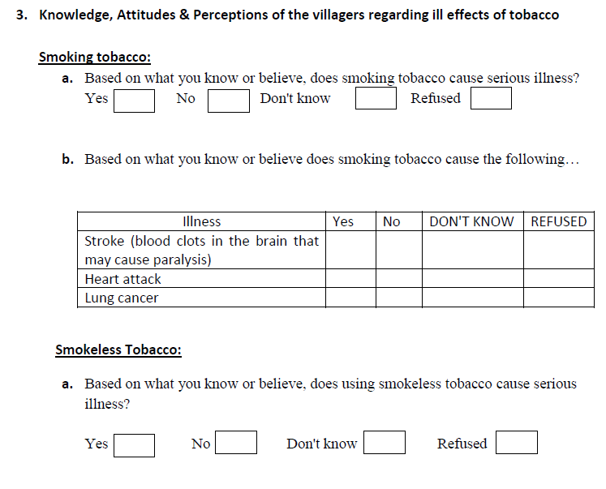
Compliance Study for Tobacco Free Villages
To be done by PGIMER, Chandigarh

Slide 17
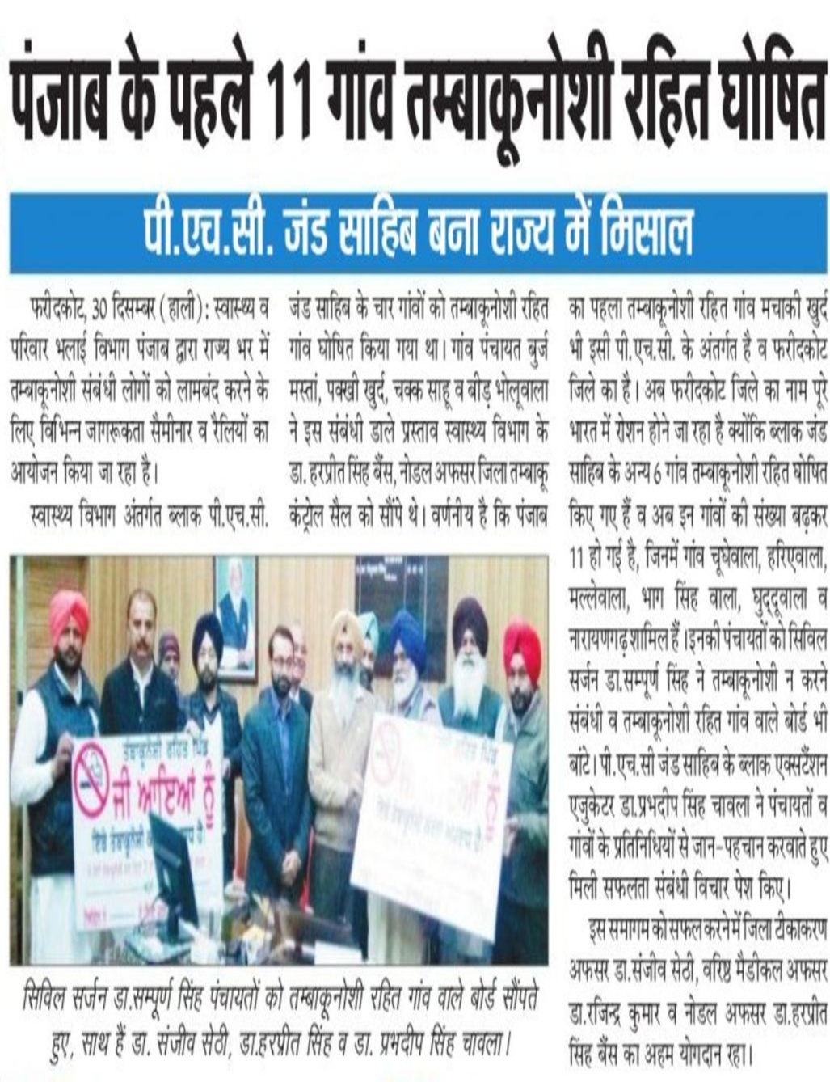
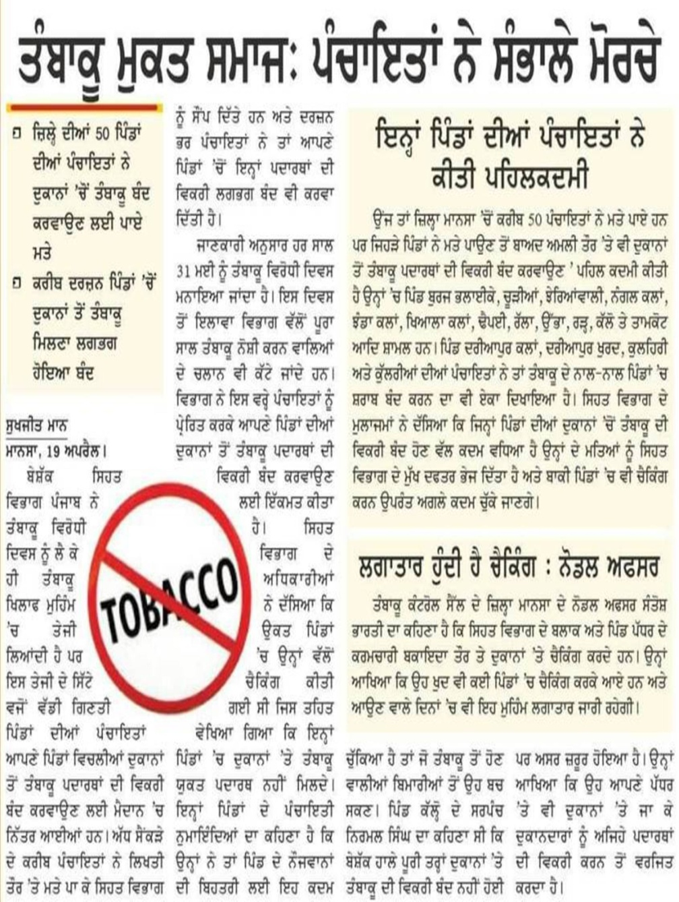
Conclusions
Very good initiative to control the menace of Tobacco use at grass root level
Will help to create awareness about the ill effects of tobacco and improve the knowledge of people regarding the Tobacco related diseases and Anti Tobacco Laws at village level

Slide 18

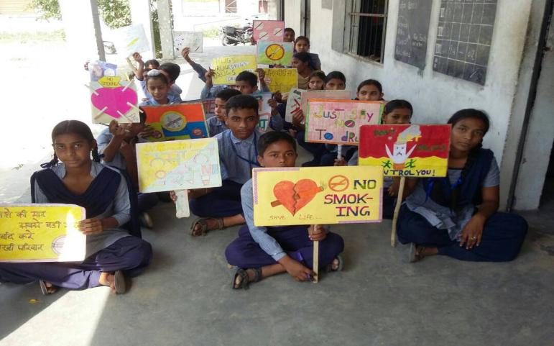
Partnering together to fulfill the vision of tobacco free Punjab
THANK YOU

Slide 19
Compiled list of Villages
Sr. No. | Districts | Villages
1 | Faridkot | Chak Sahu, Pakhi Khurd, Machaki Khurd, Buraj Mastan, Beerh, Bholuwala, Narayan Garh, Mallewala, Hariyewala, Bhag Singh Wala, Ghudduwala, Chuggewala, Kothe bhag singh, Guru ki dhaab, Kothe Kehar Singh, Sibian and Kothe Mahla Singh (16)
2 | Sri Muktsar Sahib | Shekh, Sahib Chand, Dhoolkot, Dashmesh Nagar, Nanakpura and Urang (6)
3 | Hoshiarpur | Bering, Haler, Narnol, Sunehda, Nagar, Gurdaspur, Manjhpur, Chant, Thura, Talubal, Jakobal , Kotli Khurd, Lameen, Pandori Arayia, Himmatpur, Rasoolpur, Thakri, Ibrahimpur, Bastibodh, Kotli, Lehra, Kokowaal, Gogo, Rurki Khaas, Adarsh Nagar, Behbalpur, Noragabad, Haripur, Bassi Daud Khan, Bajrawar, Marnian Kalan, Mokha, Jallowal, Dhollowal, Shekhupur Kalan , Chak Khella, Chaidha,Tohliyan, Sarhalakhurd, Kandowal, Chak Naryal , Muradpur Guru Ka, Dhalamwal, Mundian Rangran, Bains Khurd and Sada Ariyan (45)

Slide 20
Compiled list of Villages
Sr. | Districts | Villages
4 | Bathinda | GulabGarh, Kothe lal singh, Khemuana, Mehma Bhagwana, Kothe Lakhi Jungal, Baho Sivian, Tahla Sahib, Bagair Mohabat, Jaatri, Gattawali, Maari, Kanakwal, Jai Singh Wala and Shergarh (14)
5 | Sahibzada Ajit Singh Nagar | Chatt (1)
6 | Ferozepur | Mehma, Malluwala, Rorawala, Chuhar Khilchian, Joggewala, Jamali Wala, Limbri Wala, Ahemad Wala, Behbal Wala, Behak Fattu, Gatta Dalair, Sudhian, Chaggian, Behak Wallayat Shah, Maujgarh, Basti Boote Wale, Kili Bodla, Saddarwala, Wariah, Chak Mehrana , Navan Mehrana, Nubarewala, Mithe , Gama Murade wala, Sukhewala, Jhanda Bagga Nawan, Beri Quarder, Chabb, Basti Punjab Singh, Arian Wala, Malog Shah Wala , Bugele Wala, Baggi Patri, Tega Singh Wala, Hassan Dhut and Wagha (32)
7 | Amritsar | Kathunangal, Variam Nangal, Abdal and Maan (4)
8 | Mansa | Rarh, Kalloh, Tamkot, Khiala Kalan, Dhaipi, Ralla, Ubha, Jhanda Kalan, Burj Bhalaike, Chuhran, Jharianwalia and Nanagale Kalan (12)

Slide 21
Compiled list of Villages
Sr | Districts | Villages
9 | Gurdaspur | Kala Nagal, Nano Harni, Agwan, Singpura and Ratar Shatar (5)
10 | Sangrur | Bakho peer and Mullowal (2)
11 | Jalandhar | Kala Bakra and Bhogpur Khalsa (2)
12 | Barnala | Pandher and Rajiya (2)
13 | Ludhiana | Jallah Majra, Nelon kalan, Rohle, Dhande and Bharthala (5)
14 | Fatehgarh Sahib | Dhangeriyan, Khera, Hindupur, Tarkhan Majra and Sherpur (5)
15 | Kapurthala | Desal, Fatehpur, Mittha, Kothe Chatha Singh, Kothe Kla Singh, KaulTalwandi, Wadala Khurd, Bibri, Jawahar Nagar, Beeja, Mugal Chakk, Valni, Bheelawala, Amarkot, Gandha Singh Wala, Shikarpur, Chann Chakk, Shadi pur and Bholath Ward No. 1 Mohalla Santsar (19)
16 | Roopnagar | Ballan Kalan, Amrali, Bangiya, Khanpur, Dangrali, Ghardram Khurd, Udampur, Samana Khurd, Mundiya, Doholan Majra, Dhumma, Bhamnada, Nathmalpur, Saheri, Khairpur, Paprali, Charhadi, Badhali, Rampur Mukda, Rampur Mehrav, Boothgarh, Sangat Pura, Nurpur Bedi, Sangat pur, Kubbewal, Lakhno, Majri Gujra, Inderpura, Bikko, Thalikalan and Saini Majra Dhaki (31)
17 | Moga | Jogewala and Badhni Khurd (2)

Slide 22
Compiled list of Villages
Sr. | Districts | Villages
18 | Tarn Taran | Bhojran wala, Jhabal Khan, Jhabhal Pakhota, Padri Kalan, Jeobala, Bakipur, Bath, Kaler, Bhullar, Bath Khurd, Jawand Khurd, Gohal, Kot Dasondhi Mal, Bala Chak, Adda Jhabhat, Behla, Kabba Kandiala, Mughal Chak, Thathi, Bachre, Kazikot, Alawalpur, Pandori Gola, Sanghe, Allahdinpur, Norangabad, Bagariyan, Khabe Dogran, Jodhpur, Mano Chahal Kalan, Mano Chahal Khurd, Maini, Manan, Jhabhal Khurd, Pandori Tabhat Mal, Pandori Ram Singh, Pandori Hussan, Johal Raju Singh, Ram Rawni, Aima Malhan, Sarai Dwana, Nurpur, Sheikh, Bhojhan, Palasaur, Bhuge, Shahbaz pur Khurd, Shahbazpur Kalan, Wan, Gwlalipur, Mananke Khurd, Mamanke, Kalan, Deal Rajpuran, Gorkha, Dallebe, Nava Pind Dalleba, Rataul, Kothi, Daburji, Molowal, Jhamke Khurd, Rabhoke, None, Rajewala, Doe, Chappa, Kalas, Bagaria, Gago Bua, Mahna, Chhichhre Wal, Mari gor Singh, Mari Samran, Patti Punjab, Mari Theh, Colon, Cheela, Colony Cheela, Chella, Mari Sant pura, Pahuwand, Puhla, Maurhi Kambobe, Mughal Chak, Dhum, Khalra, Theh Kala, Theh, Nanshera, Kale, Sandpur, Sandhran, B lair, Kothi Sur Singh, Jati Umra, Dera Johel, Alia, Khadur Sahib, Bahadur pur, Rampur, Gharaba, Rureasal, Tabhtu chak, Joneke, Mugal Chakk, Sarhali Khurd, Lalpur, Loheke Khurd, Shingarpur, Pualdi, Sankhchak, Rai Shiana, Chatala, Rasul pur, Kabbe Rajpura, Sarhali Khurd, Dial, Shehabpur, Gopala, Jaura, Duggalwala, Nandpur, Jhandher, Dhattal, Shakri, Khara, Suhawa, Gurjarpur, Karmuwala, Chamba Kalan, Kambo Dhayewala, Munda Pind, Bharam Pura, Raniwalah, Jhander Muhapurbha, Dhundha, Jeoneke, Jamarai, Dhum Dhaliwala, Bhail Dhawala, Bhoian, Bhail Dhaiwala Kaler, Bhathal Sahijth Singh, Waring, Billian Wala and Johal Dhaliwala (144)

Slide 23
Management of Hepatitis C
under
Mukh Mantri Punjab Hepatitis-C Relief Fund (MMPHCRF)
Department of Health & Family Welfare
Punjab
23

Slide 24
Prevalence of HCV Infection
India
  Estimated prevalence of HCV infection in India is about 0.5-1.5% - approx. 12 – 18 million
  Estimated viremic rate of about 80%, corresponds to a viremic prevalence of about 0.68% - 8 – 9 million
Punjab
  Exact magnitude was not known
  Certain studies had highlighted high burden
  PSACS data was indicative of high prevalence in certain areas

Slide 25
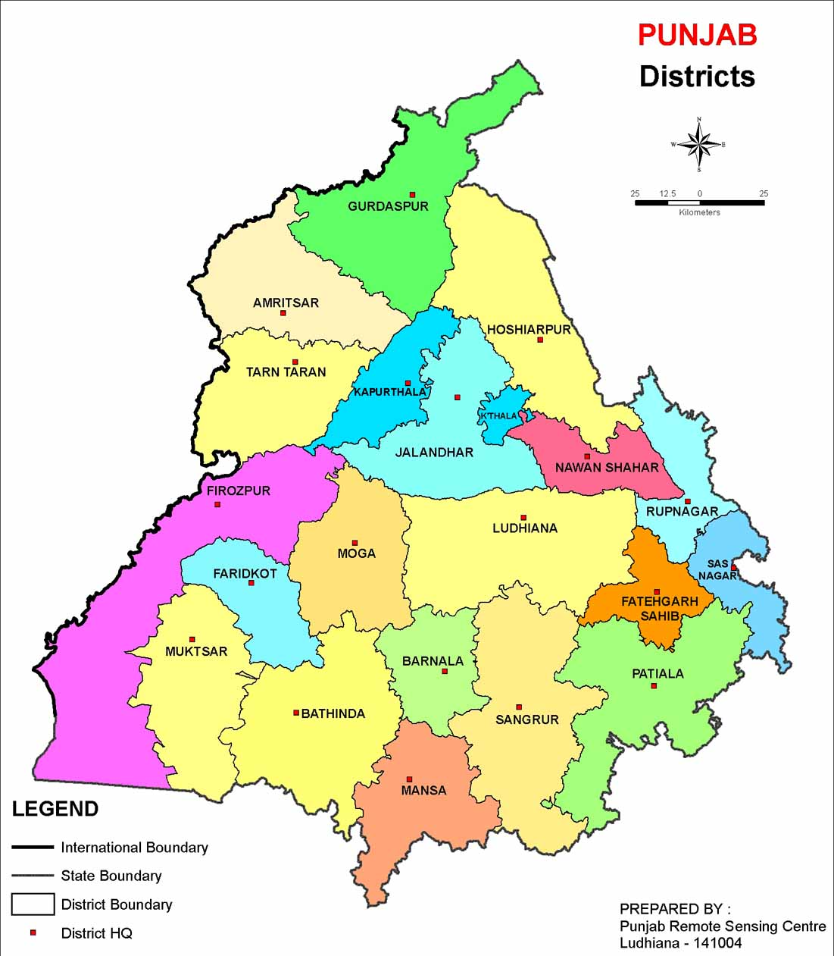
Urban%- 3.09
Rural%- 3.38
Total%-3.29
HCV Prevalence in Surveyed Districts
3.15
0.28
2.05
0.63
0.39
0.46
0.00
3.82
1.79
0.00
0.64
0.5
0.0
4.11
4.11
Sood A et al, Unpublished
0.2
2.16
1.11
0.00
8.86
8.86
12.45
3.26
5.83
2.83
5.73
4.84
13.64
2.95
5.22
High Prevalence

Slide 26
Basis for State Initiative
Study by Dr Ajit Sood indicated higher prevalence of Hepatitis C in certain parts of the State
  Hot Spots
Higher prevalence of Hepatitis C in blood donors more than the national average (Blood Bank data for 3 years)
These were indicators to plan a programme for management of Hepatitis C

Slide 27
Rate Contract for HCV Testing and Treatment
Provide subsidized treatment to patients
  Rate Contract for injectable drugs (Interferons) in 2014-15
  Injection available through Jan Aushadhi Stores
  Available to the patients at subsidized rates per injection
    Self funded as patient was supposed to bear the cost
Drawbacks
  > Rs 80,000/ for treatment for 24 weeks
  > Rs 1,60,000/ for treatment for 48 weeks
  Price was still high for some groups
  No mechanism of track and record of the patients
  No mechanism of standardized follow up
27
Notes:
PHSC did the rate contract after calling tenders. The injections were made available at Jan Aushadhi Stores from where patients used to buy the injections

Slide 28
Mukh Mantri Punjab Hepatitis-C Relief Fund (MMPHCRF)
A State Initiative: Based on findings of studies and Blood bank data, State prepared Programme for management of Hepatitis C cases
PGIMER prepared the SOPs for the programme (available on website of Department - http:pbhealth.gov.in/mmphcrf.htm)
Launched in June 2016
  free treatment of Hepatitis-C to all residents of Punjab
  Funds provided by State Government for procurement of drugs for management of Hepatitis-C
28

Slide 29
Goal of the Therapy
To eradicate HCV infection to prevent
  liver cirrhosis
  HCC (Hepatocellular Carcinoma) and
  death
End point of the therapy
  Undetectable HCV RNA in a sensitive assay, 12 weeks after the end of treatment - Sustained Viral Response (SVR)

Slide 30
Decentralized mode
  Decentralized Hepatitis C Treatment
    Treatment made available at
    22 District Hospitals and
    3 Government Medical Colleges
Sensitization of Medical and Paramedical personnel involved in examining, diagnosing and providing treatment
    Regimens, Follow ups and Testing
    Co-morbid conditions
    Special circumstances

Slide 31
Testing for Hepatitis C
Baseline testing - standardized
  Anti HCV-ELISA Free in 25 centers
  CBC (Complete Blood Count) Free in 25 centers
  LFT (Liver Function Tests) Free in 25 centers
  RFT (Kidney/Renal Function tests) Free in 25 centers
  Tenders for baseline and follow up testing (Viral Load and Genotype)
      Dr Lal Path Laboratories
    Viral Load: Rs 2200/ per test (Initial test is charged from patient and last test for SVR is done free of cost)
    Genotype: Rs 3000/ per test (Test charged from patient- Required for cirrhotic patients only)
31

Slide 32
Rate Contract for Drugs (DAAs) for HCV
Standardized procurement
  PHSC: Rate Contract (RC) done
  Drugs worth Rs. 58 crore procured in 2016-17
  Drugs worth Rs. 3.6 Crore procured in 2017-18 from State Budget
Regimen | Drugs | For 12 weeks (1st tender) | For 12 weeks (2nd tender)
Regimen 1 | Sofosbuvir + Ledipasvir | Rs 21,420/ | Rs 13,388/
Regimen 2 | Sofosbuvir + Ledipasvir + Ribavirin | Rs 23,184/ | Rs 15,026/
Regimen 3 | Sofosbuvir + Daclatasvir | Re 18,711/ | Rs 7340/
Regimen 4 | Sofosbuvir + Daclatasvir + Ribavirin | Re 19,624/ | Rs 8974/
32

Slide 33
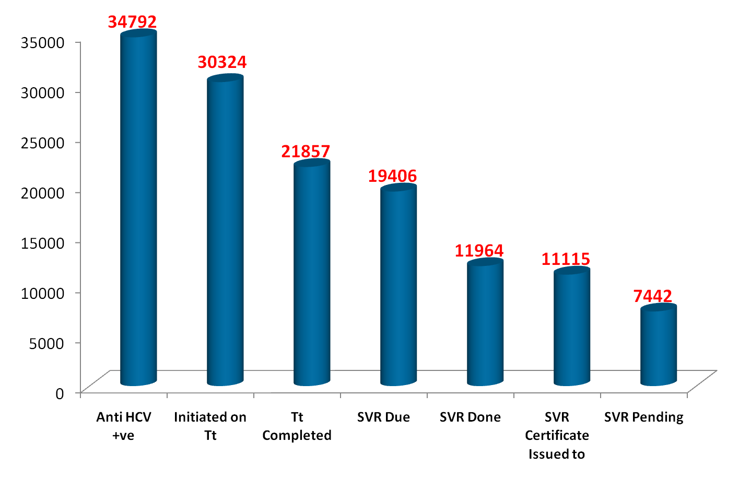
MMPHCRF Patient Cascade
(18.6.16 to 28.06.2017)
33

Slide 34
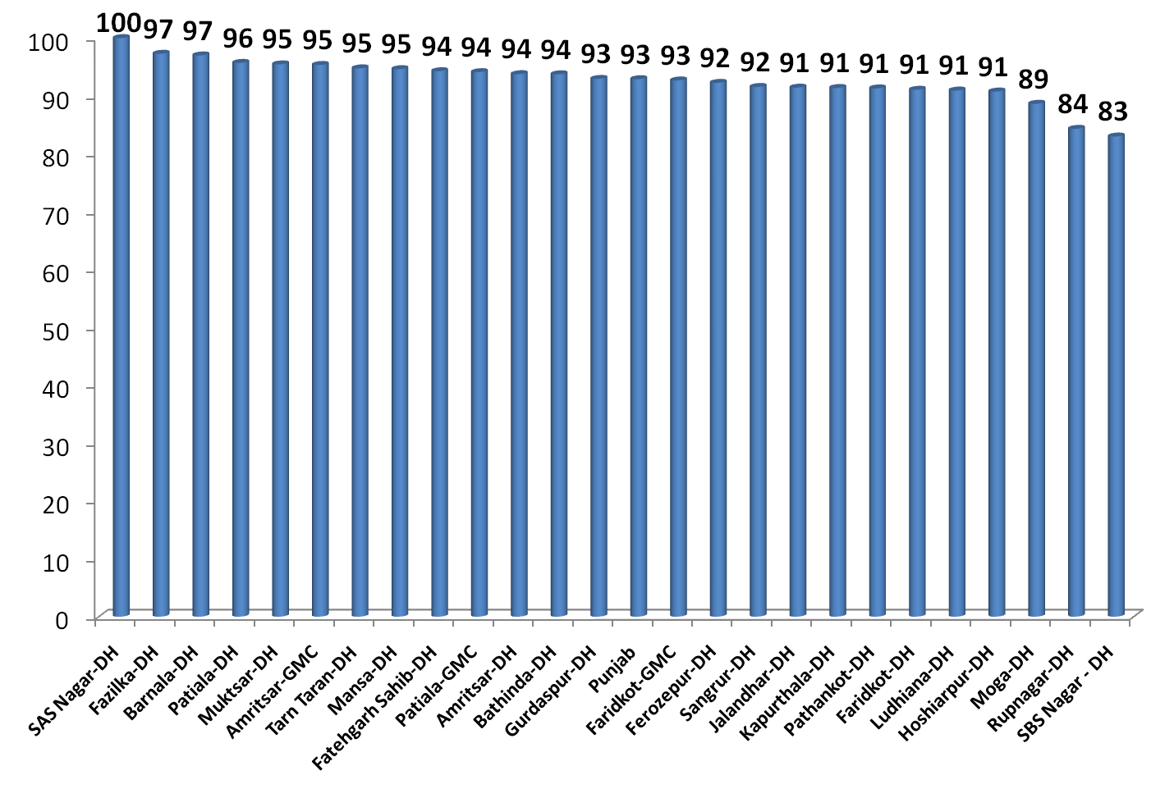
SVR (Sustained Viral Response) Outcome
34
Notes:
State has cure rates (SVR Rate) of appx 93%

Slide 35
Prevention of HCV in Punjab
Injection safety
  Punjab is the first state selected by WHO for injection safety project
  TEG (Technical Expert Group) constituted in collaboration with WHO for injection safety
    Policy for shift to RUPs in Public and Private hospitals
    Waste Management
  WHO - Collaborating with Punjab for technical inputs in implementation of the program
35

Slide 36
Active Interventions
Phase I:
HIV +ve patients attending ICTC
Intravenous Drug Users (IDUs) at OST centres
IDUs at Target Intervention Projects under PSACS
These High Risk Groups are screened with Rapid Tests
CBC/ LFT/ RFT are already free
Viral load with gene Xpert
Treatment by Govt. of Punjab
Phase II:
All Health Care Providers will be covered under FAPHC+
  Free Annual Preventive Health Check up with HBV & HCV
Pregnant females attending antenatal clinics
36

Slide 37
Thanks

