Slide 1



UNIQUE INSTITUTIONALIZATION OF ASHA PROGRAMME IN THE STATE OF JAMMU & KASHMIR
NATIONAL HEALTH MISSION, JAMMU & KASHMIR

Slide 2
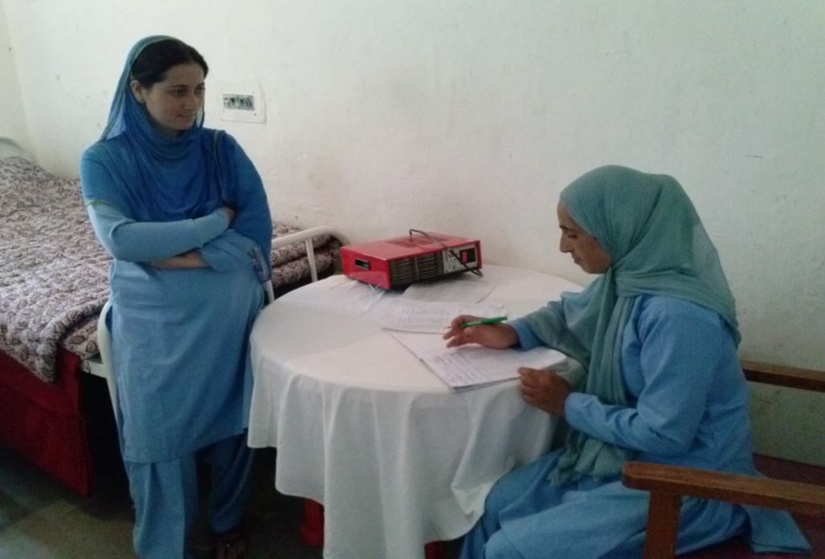
PLAN OF PRESENTATION
SWOT ANALYSIS
INTERVENTIONS UNDERTAKEN
INSTITUTIONALIZATION of ASHA
PROGRAMME
ASHA CADRES- STRUCTURAL
HIERARCHY
ASHA SUPPORT STRUCTURE IN J&K
STRENGTHENING MEASURES
BENEFITS REAPED

Slide 3
SWOT ANALYSIS
AVAILABLITY OF TRAINED WORKFORCE AND CONGRUENCE OF OBJECTIVES: Implementation of various National Health Programmes.
Health promotion, education and protection against various diseases.
In congruence with the 34 activities as envisaged in ASHA programme.
MANAGEMENT OF ASHA PROGRAMME OPERATIONS AT THE DISPOSAL OF PMUs: Directly under the ambit of District/ Block Programme Management Units.
Around 12000 ASHAs needed systematic mentoring and monitoring at various levels.
NEED FOR SYSTEMS APPROACH FOR MANAGEMENT OF THE PROGRAM:
The job work perennial in nature.
Attrition has a potential of destabilizing.
CONVERGENCE FOR EFFICIENCY AND EFFECTIVENESS:
Conflicts among ANMs, ASHAs, AWWs (the Triple ‘A’ structure)
Need for absolute integration and coordination for efficient operations.

Slide 4
INTERVENTIONS UNDERTAKEN
Additional assignment to the permanent health cadres as per the criteria
CHOs/LHVs/HEs/ANMs etc.
Decided to be utilised as the District ASHA Coordinators, Block ASHA
Coordinators & ASHA Facilitators respectively.
Trained as DRPs (District TOTs).
Financial Consideration
From the existing health system and getting salary from the parent department.
Decided to provide only the support in terms of mobility & office expenses for
mentoring and monitoring activities.
AFs: Rs. 600/pm, BACs:1800/pm, DAC: 3200/pm (FY 2015-16).

Slide 5
INSTITUTIONALISATION OF ASHA SUPPORT MECHANISM
Selection of ASHA Cadres
Criteria setting
Addl. Assignment of existing CHO/LHV/ ANM/ HE etc based on criteria.
ORIENTATION OF ASHA CADRES
Training of ASHA Cadres upto module 1-7
IMPLEMENTATION
Meeting-VHSNC monthly
Guidelines of ASHA Incentives
Meetings at various levels for close coordination
Meeting & subsequent mentoring and monitoring - At Cluster level(monthly) -At Block level-BAC to review AFs (monthly) -At District level-DAC to review functioning of BACs (monthly) -At State level- SPMU to review District ASHA Functionality (quarterly)
Community process guidelines & ASHA Facilitator’s Handbook
VHND/VHSNC guidelines
VHND monthly

Slide 6
ASHA CADRE -STRUCTURAL HIERARCHY:
DAC
BAC
AF
ASHA
One District ASHA Coordinator (DAC) for each District (22)
One Block ASHA Coordinator (BAC) for each Block (117)
  1 AF caters to 20 ASHAs in non- HTR (Hard to Reach) Blocks and 10 in HTR (Hard to Reach) Blocks
11873 ASHAs ( One ASHA per 1000/500 population)

Slide 7
ASHA SUPPORT STRUCTURE IN JAMMU & KASHMIR
STATE TRAINERS (11)
DISTT RESOURSE PERSONS (180)
AF Trg. (816)
ASHAs (12000)
PROGRAMME MANAGER (1)
MISSION DIRECTOR
ASHA CADRES (TRAININGS)
ASST. PROGRAMME MANAGER (1)
DAC(22)
BAC (117)
AF (816)
ASHAs (12000)
PROGRAMME MANAGER (1)
MISSION DIRECTOR
ASHA CADRES (EXECUTIVE)
ASST.PROGRAMME MANAGER (2)
Dy. CMO

Slide 8
STRENGTHENING MEASURES
Compensation and Incentive Delivery
Prompt DBT mechanism for timely monthly incentivisation of ASHAs based on ASHA diaries.
ASHA Grievance Redressal Mechanism
(i) Divisional level help line established to immediately redress ASHA Grievances within 24hrs. (ii) Monthly DAGC/BAGC meetings.
ASHA Communication Management
State / District / Block ASHA Whatsapp Group for immediate information transfer to most peripheral level in the state without an additional investment as in other technologies.

Slide 9
BENEFITS REAPED
Economic model to enhance community outreach services:
Trained Human Resource was already available.
Cost and time of hiring large numbers (955) of supervisory and managerial staff (DAC/BAC/AFs) saved.
Only the mobility support and OE given to DAC/BAC/AFs.
Approximately Rs. 404.34 lakh saved annually.
Stable Model:
Attrition issue addressed.
Continuity assured.

Slide 10
BENEFITS REAPED…
Effective Functional Integration & inter-sectoral co-ordination of existing Health HR with ASHA Programme at all levels.
Conflict free Smooth Operations:
Placement based on seniority and merits cum suitability. Employees of the Health department itself.
Better sense of ownership.
Less attrition, more efficiency and accountability.
Contributed to maximum budget utilization (91%) under the ASHA incentives during FY 2015-16.

Slide 11

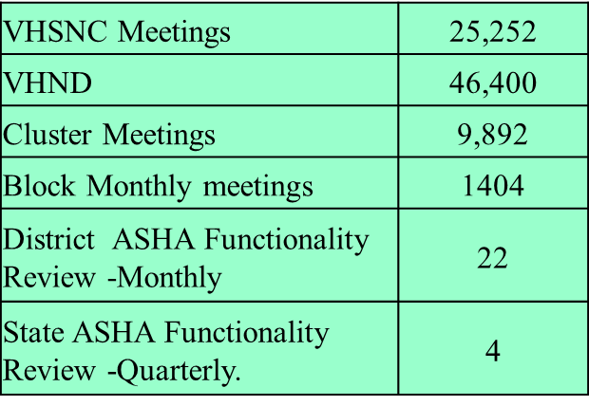
Indicator | FY 2012-13 | FY 2015-16
ASHA escorted PW* ( out of total institutional deliveries) | 68840 ( 44% ) | 97547 (61%)
Expenditure under ASHA Incentives | Rs. 596.98 lakh | Rs. 841.74 lakh
Expenditure under HBNC | Rs.0.53 lakh | Rs. 146.36 lakh

Slide 12
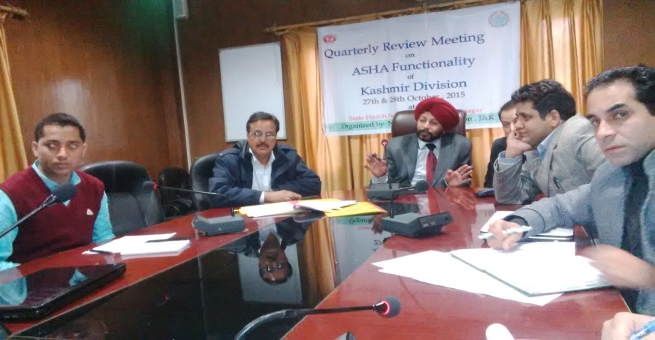
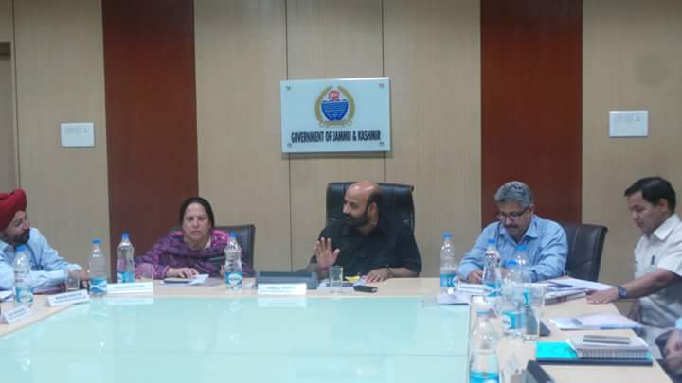
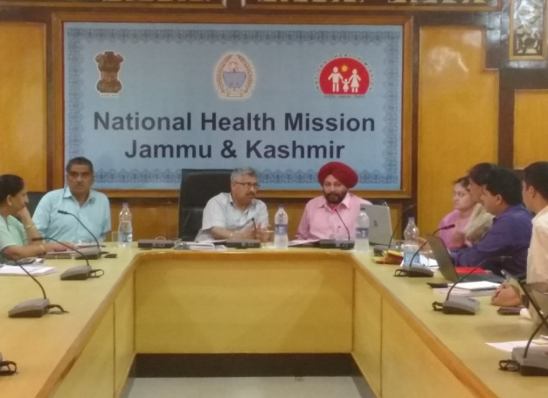

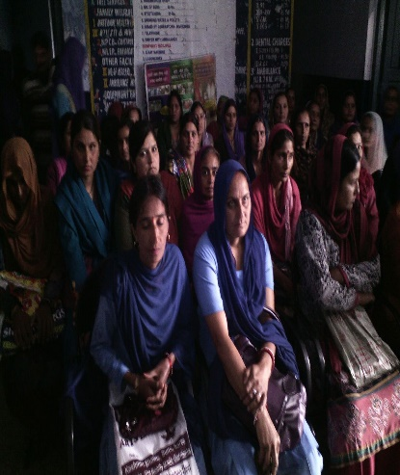
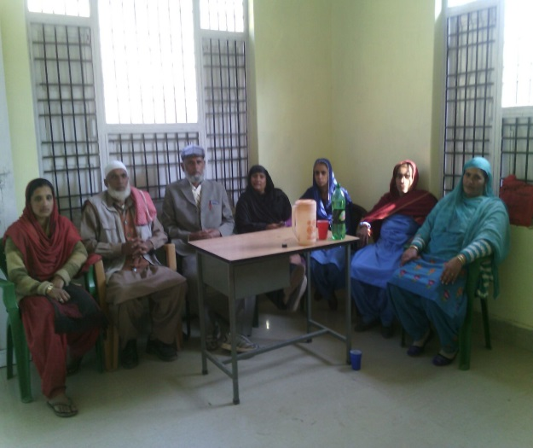
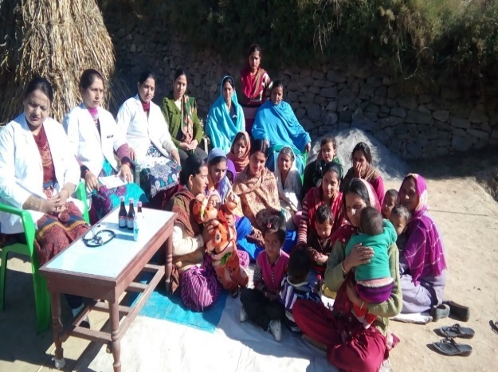
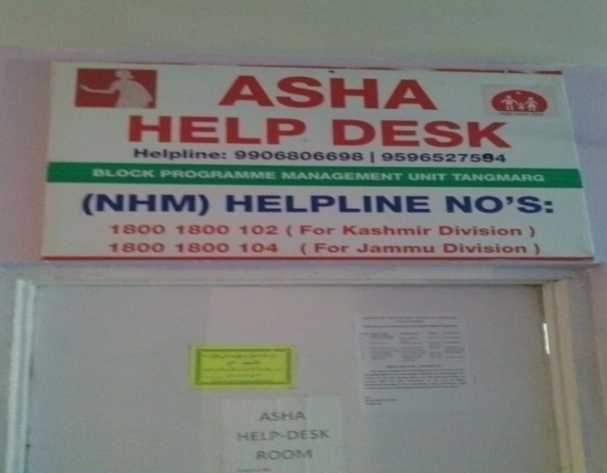

THANK YOU

