Slide 1



Urban surveillance under IDSP -Bangalore Model-KARNATAKA
State Surveillance Officer
State Surveillance Unit
DH & FWS Bangalore

Slide 2
Overview
BBMP – Bangalore Municipal Corporation covering 800 Sq Km area with over 10 Million population.
About 4000 Health Facilities – Govt, Private Hospitals, Labs & Clinics.
Over 3000 Health facilities are GIS mapped
Provision to update Hospital details.

Slide 3
PHIEC-Disease Surveillance system
Online reporting from Hospitals and Labs
Communicable Diseases & Non- communicable diseases
11A , 11B ,11A1 and S Forms – IPHS based templates
11B Confirmed cases – Line listing with patients contact details with geo coordinates
Preventive Community Health Strategy Enabled with
Dashboards ,Statistical views
Trends and Area impacted for preventive measures
Govt. and Private Hospitals as well as Laboratories onboard.
Created Logins, provided training and followed up for initial period.
Receiving data weekly from about 500 Hospitals
Monitoring and action updates by Rapid Response Team.

Slide 4
PHIEC-Features
Hospitals to report on Monday or latest by Tuesday for previous week
High Alert feature (Real time basis – as and when happens )
Reminder SMS alerts sent for non-submission.
On select confirmed cases – ex: Dengue - ELISA IgM (MAC) – automated SMS and e-mail sent to concerned Public health officials for preventive & control measures.

Slide 5
Cont..
Health Centers/ Health Inspectors update preventive and control actions using Mobile app – with Geo location & Photo of action
Dashboards to track actions across officers on confirmed cases.
Dashboards with various filters for trend analysis.
Disease wise, zone wise, range wise, hospital wise, date range etc.

Slide 6
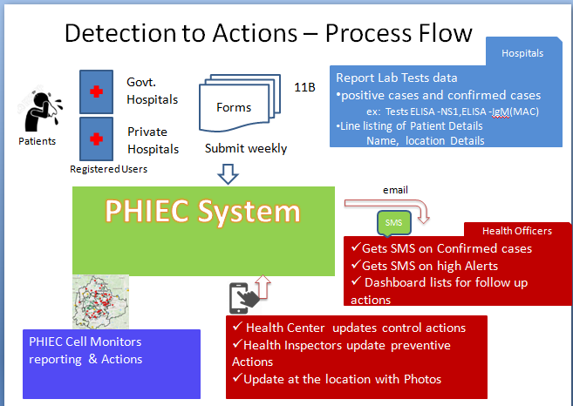
PHIEC-Features Summary

Slide 7
Thank You

