Slide 1
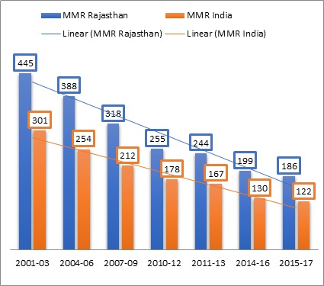
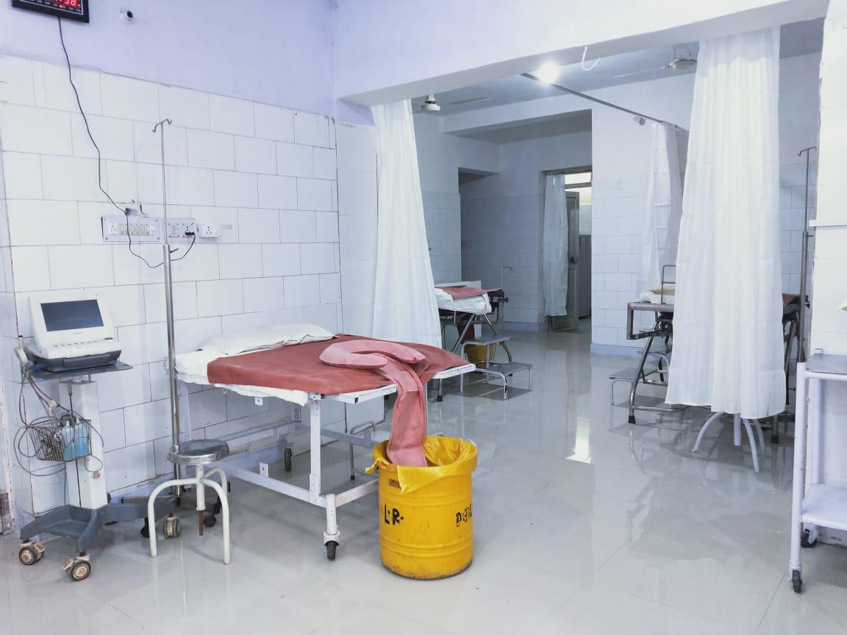
Use of Technology for
Better Data Visualization and Informed Decision-Making:
MWMIS
By:
Team Maternal Health
Rajasthan

Slide 2
Existing Paper Based System
Huge volume of non-analyzed data (in paper formats)
Inadequate recording of data for maternal & new born care
Data recording in Multiple Registers
Manual collation of Data
Delay in availability of data for decision making
Admission
Labour Room
Post-natal ward
Discharge
Admission
LR Reg
Discharge
IUD
High Risk Pregnancy
Refer in
Refer out
HIV
Enter primary detail in case Sheet
Enter intra partum & immediate post partum notes in case sheets
Enter post natal care notes in case sheets
Enter discharge notes /discharge slip
Case Sheet Jan-16
Case Sheet Feb-16

Slide 3
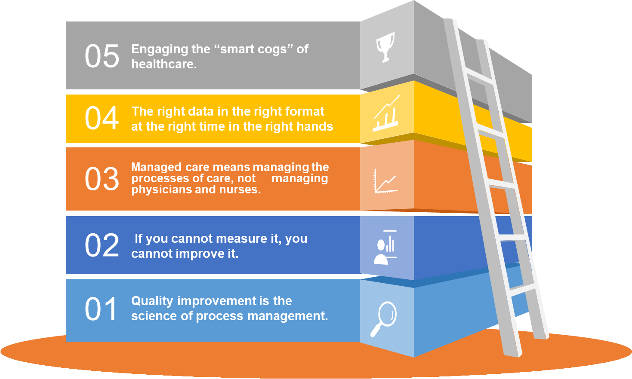
Need for Collection and Utilization of Data from LR
Five Deming Principles that Help Healthcare Process Improvement
Notes:
We already have idea competency development and QI. Here I am going to talk Jhpiego’s innovative approach to add technology for betterment of QoC. Basicallay it is a technology driven improvement.

Slide 4
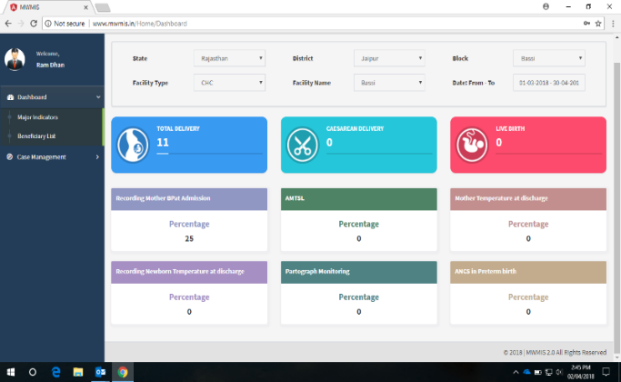
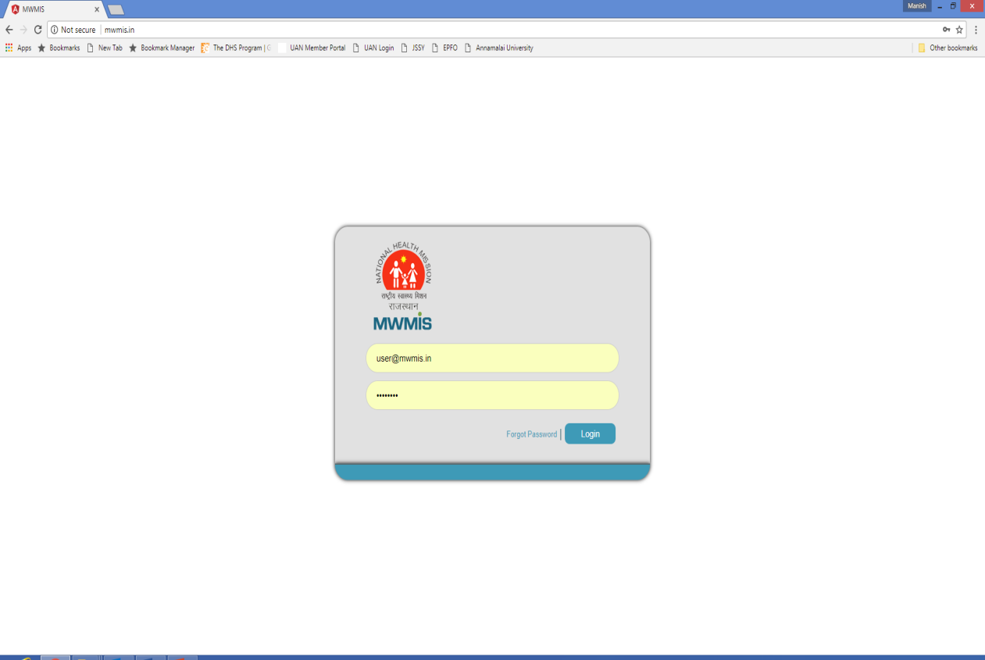
Case sheet Digitalization
Hands-on training of data entry operators in Rajasthan
Labor room case sheet digitization and Maternity Wing Management Information System (MW MIS) software
112453 cases registered out of 1.3 lakh deliveries across 21 districts by 202 facilities .
Enables monitoring of provider practices in labour room for improving facility level accountability and planning of corrective actions.
Facility, district and state level dashboards developed for key process and outcome indicators of Dakshata program.
Hands-on training of DEOs OF Dakshata facilities conducted in SIHFW.
In order to ensure good quality of MWMIS data, state is reviewing facilities on the basis of :
% cases entered (vis-à-vis total deliveries)
% completeness of casesheets.
Enables monitoring of provider practices in labor room for improving facility level accountability and planning of corrective actions

Slide 5
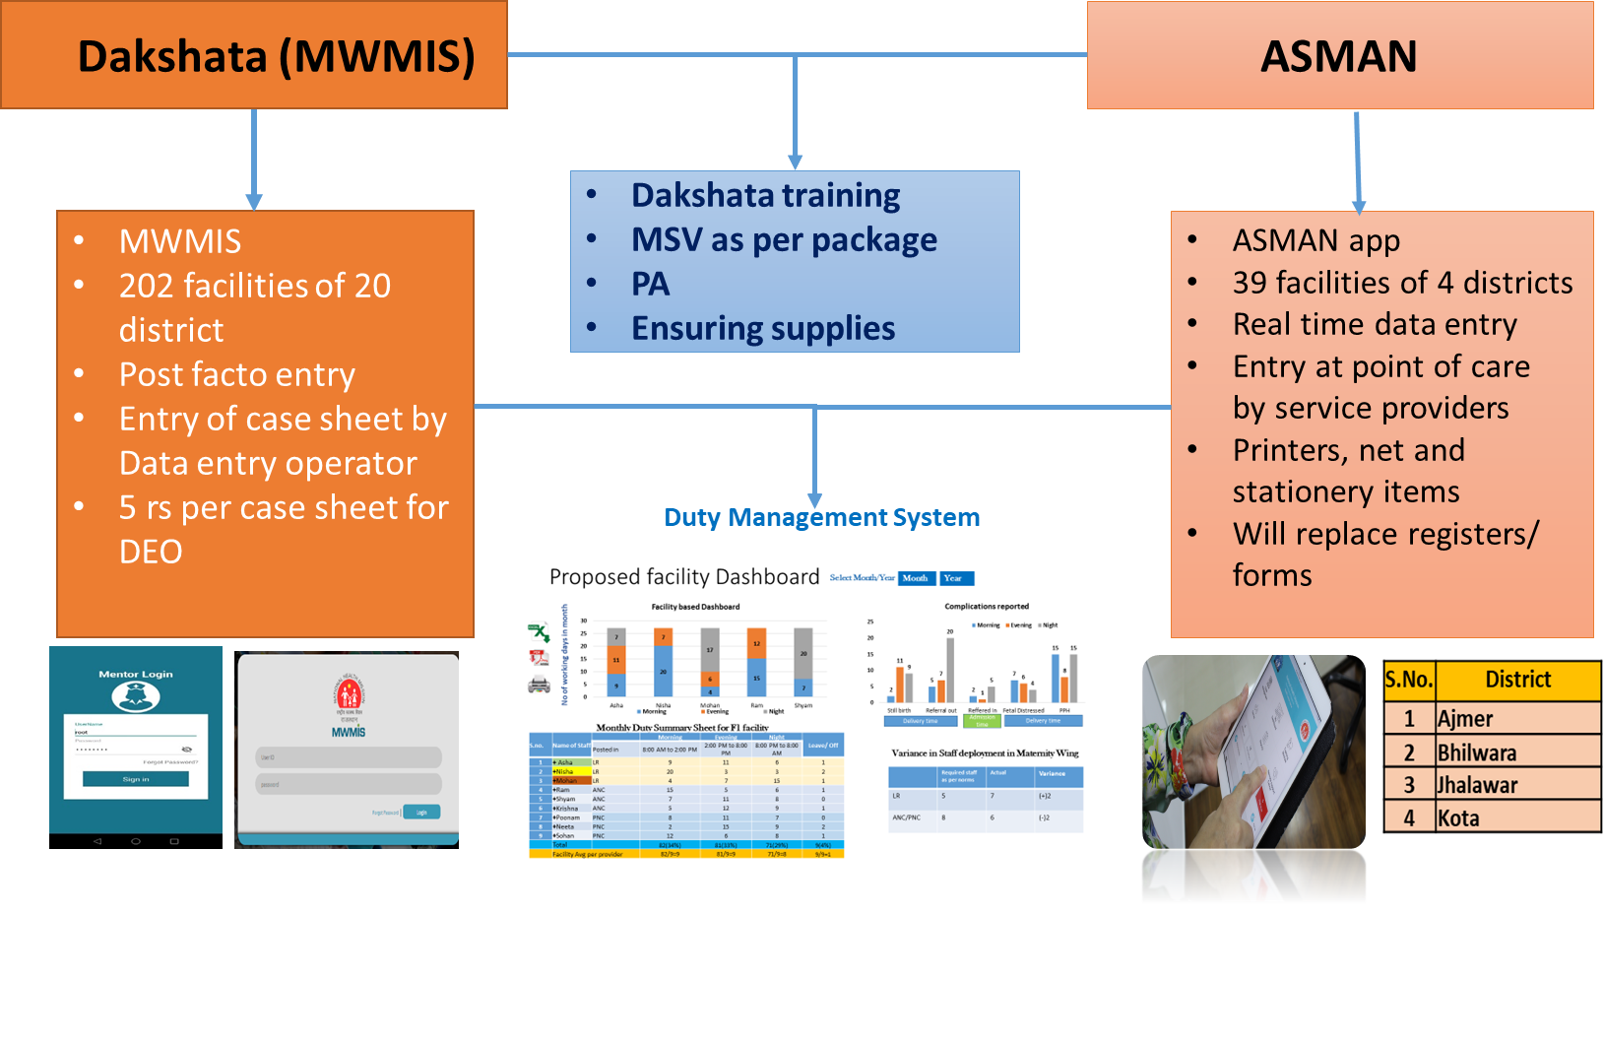
MWMIS and ASMAN: How They are Different
Way Forward:
Gradually state will shift from offsite data entry (MWMIS) to Onsite entry (ASMAN)
Explore possibility to link ASMAN with other similar platform like Ojas
Hosting of these applications on Govt Approved Server

Slide 6
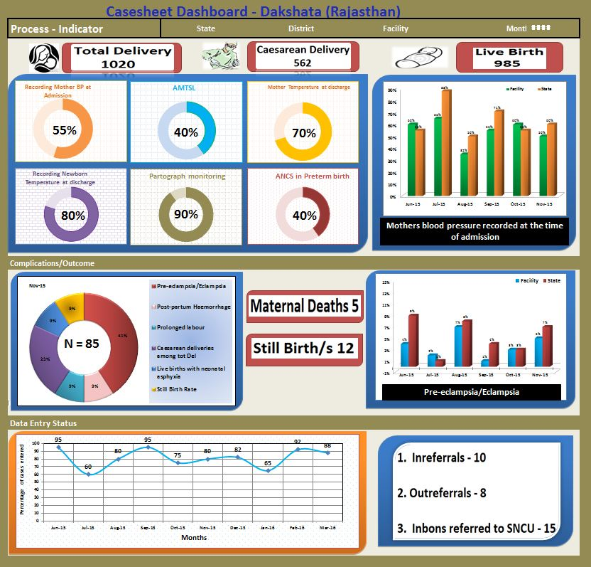



Digitalization to Process Information Onsite (ASMAN) and
Offsite (MWMIS)
Admission
Labour Room
Post-natal ward
Discharge
Facility
District
State
Enter primary detail in app
Enter intra partum & immediate post partum notes in app
Enter post natal care notes in app
Auto generate discharge slip

Slide 7
Tracking Outcome Indicators – Stillbirth Rate (SBR)
Source: PCTS data
4073 stillbirths averted in intervention facilities
Dakshata facilities showed almost 24% reduction of SBR in Phase-I facilities and 21% reduction in Phase II facilities in comparison to 13% reduction in other facilities.

Slide 8
Tracking Outcome Indicators - Inborn SNCU Admissions with Neonatal Asphyxia
58% SNCUs (15/26) reported decline in inborn admissions with neonatal asphyxia in Phase I & II districts.
Overall, 3.4% decline reported in inborn admissions from 17.9% (2015-16) to 14.5% (2018-19)
% Inborn Admissions
% Change in Inborn Admissions
Source: SNCU Online data

Slide 9
Improved Management of Pregnant Women with Hypertension (BP>140/90)
Source: PCTS data

Slide 10
Identification and appropriate referral of PE/ cases
PE/E referral decreased by 6% (from 40% to 36%)
Contextualization-PE/E referral trend at different level to facilities
Source: Facility Complication data

Slide 11
Identification and appropriate referral of PE/E cases
Contextualization- SN Work Load
Contextualization- HR adequacy
A=<20 del/month/SN
B=21-40 del/month/SN
C=>40 del/ month/SN
Source: Facility Complication data

Slide 12
Identification and appropriate referral of PPH cases
PPH referral decreased by 8% (from 27.8% to 19.4%)
Contextualization-PPH referral trend at different level to facilities
Source: Facility Complication data

Slide 13
Identification and appropriate referral of PPH cases
Contextualization- SN Work Load
Contextualization- HR adequacy
A=<20 del/month/SN
B=21-40 del/month/SN
C=>40 del/ month/SN
Source: Facility Complication data

Slide 14
Dakshata Third Party evaluation by PHFI Hyderabad
Activity | Initial | Interim
P/V examination | - | 97%
Hand Hygiene | 24% | 26%
Measuring temperature improved. | 8% | 23%
During childbirth, Injection oxytocin administration within 5 minutes of birth improved | 74% | 85%
Use of clean cord cut (almost universal), keeping bag and mask ready | - | 90% above
Pre-filled oxytocin | 75% | 78%
Hand wash before delivery | 52% | 59%
Induction of labor using oxytocin | 28% | 21%
Drying & weighing the baby & initiating breast feeding within one hour improved over time but assessment of uterine tone and mother’s vitals | 41% | 11%
Vitamin K administration | - | 75%
Care immediately after childbirth. | - | 6%

Slide 15
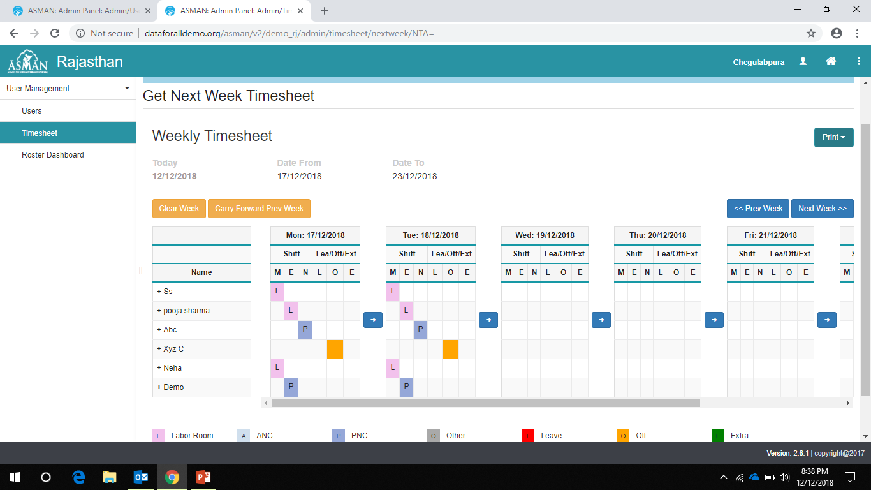
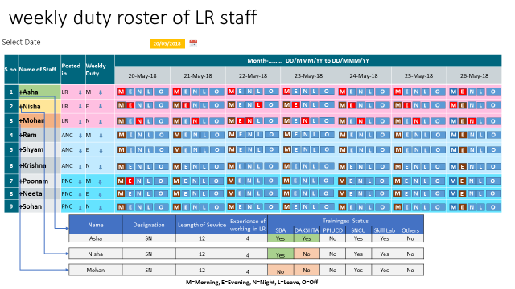
What we derived from data ?
Staff Nurse duty roster in MWMIS
MWMIS has found place on LaQshya GOI portal.

Slide 16
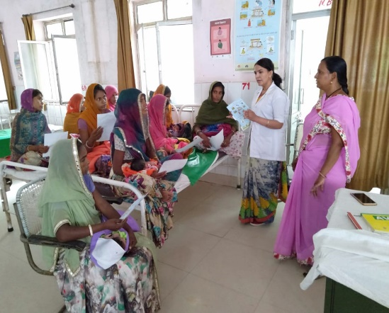
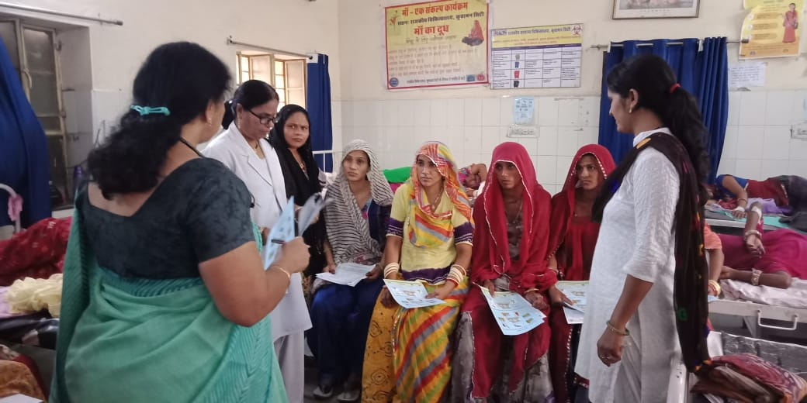
Group PNC or Discharge Counselling: Initial Results
- Group counselling sessions in PNC ward on key messages
- Development and printing of a leaflet of pictorial messages which are attached along with discharge ticket.
Display posters on danger signs, breastfeeding in the ANC/PNC wards
Bulk of Women can get the common health promotive messages
SDH Kuchaman , nagaur
Dr.kalpana
CHC bhindar , udaipur
Sn- smt. meena
Result:
Source Periodic Assessment, Client feedback form

Slide 17
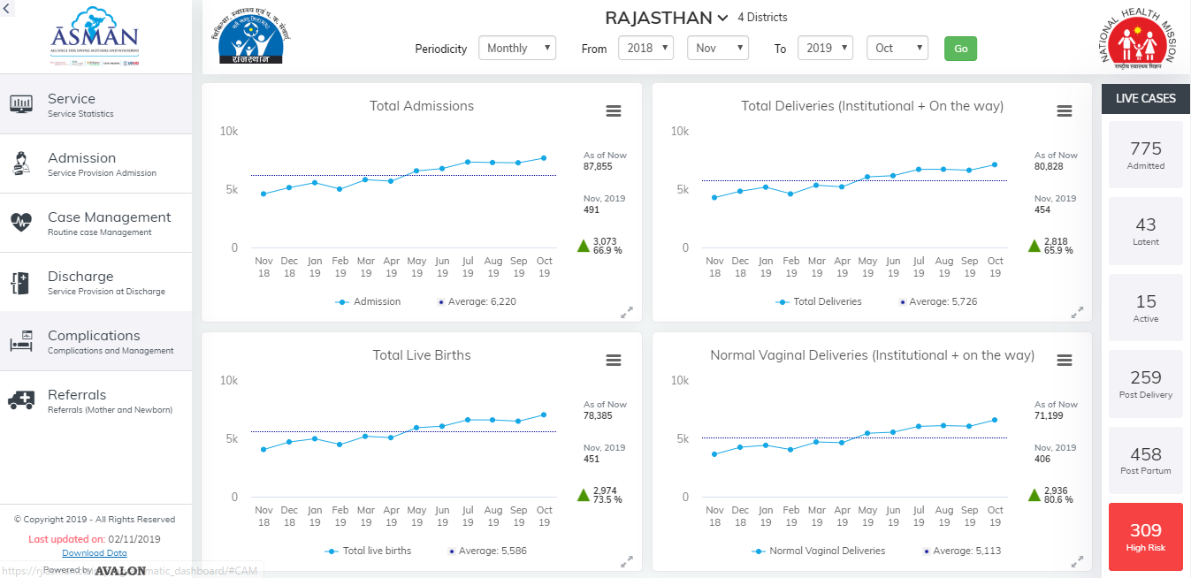
ASMAN Application Dashboard

Slide 18

Thank You…

