Slide 1
Using multipronged strategy for improving facility-based management of Low Birth Weight (LBW) babies including ECD in Haryana
Ms. Amneet P Kumar
Secretary Health and MD NHM
Haryana

Slide 2
Haryana Childhood Mortality Indicators Trends (SRS data)
Annual Rate of reduction
Annual Rate of reduction
Annual Rate of reduction
Annual Rate of reduction
AAR for (2005-10)
IMR 4%
NMR 0.6%
AAR for (2010 -15)
IMR 5%
NMR 5.5%
AAR for (2015 -17)
IMR 8.3%
NMR 6.3%
Notes:
Overall Average Annual Rate of Reduction (AAR) from 2001 to 2017 are U5MR (4%), IMR (3%), NMR (3%), ENMR (3%). Haryana has observed stagnancy in NMR since 2001 to 2010 after that NMR reduction was expedited. After 2010 Haryana has witnessed higher institutional deliveries and efforts were made to improve Intra and immediate postpartum care (IPC and IPPC). Efforts were done to improve infrastructure and processes in Labour Room premises in district hospitals and other high delivery load facilities. Haryana conducted multiple rounds of RAPID in majority of its Districts. Recently under LaQshay 48 health facilities are identified including all district hospitals of the state.

Slide 3
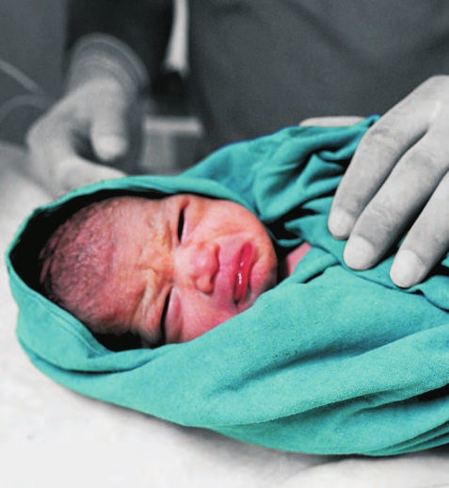
Low Birth Weight (< 2.5 kg) Burden in Haryana
Neonatal disorders contribute to 8% of the total Disability Adjusted Life Years (DALYs) in Haryana
Low Birth Weight (LBW), the largest contributor to the malnutrition Disability-Adjusted Life Year (DALY) in India, has a prevalence of 22.3% in Haryana
With a birth cohort of over 500,000 annually, there are an estimated 10- 15000 newborns with birth weight < 2000 gm (2-3%)
(Source: Global Burden of Disease 2017)
https://tinyurl.com/y655b3cb
Notes:
DALYs - The disability-adjusted life year is a measure of overall disease burden, expressed as the number of years lost due to ill-health, disability or early death.
Place the web link: GBD 2017: https://tinyurl.com/y655b3cb
According to Care Around Birth Data. 14% of total live births are LBW babies and 3% of total live births are having <2 KG birth weight.
18% of LBW babies are having <2 KG birth weight. (107646 LB, 14931 LBW, 2727 <2KG. Period Oct 2015 to Nov 2017, for 31 health facilities of 5 HPDs)

Slide 4
Multipronged Strategy for Improving Facility Based management of LBW
1
2
3
4
5
Identification of hidden low birth weight babies - Replacement of all conventional manual weighing scales with digital scales
Improving access to care of small and sick newborns - Upgradation of 5 NBSUs into SNCUs and Strengthening of NBSUs
Kangaroo Mother Care (KMC) for all LBWs - KMC units in all SNCUs
Family Participatory Care for Continuum of care: at SNCUs, NBSUs and at home after discharge
Initiate Early Childhood Development (ECD)/ Developmentally Supportive Care (DSC) in SNCUs and continued in community through HBYC
Low Birth Weight Babies (LBWs), Newborn Stabilization Units (NBSUs), Sick Newborn Care Unit (SNCU), Home Based Care for Young Child (HBYC)
Notes:
NHM Haryana has identified 5 strategies for LBW babies covering identification of LBWs and then providing care at facility and community level. We are using new technology (digital weighing machines) to identify newborns and utilizing strong network of SNCUs in Haryana, encouraging practice of evidence based interventions to provide appropriate care to the vulnerable newborns and also strengthening NBSUs and Front Line Workers by using latest training modules released by GoI. Out 5 strategies are displayed in this slide.

Slide 5
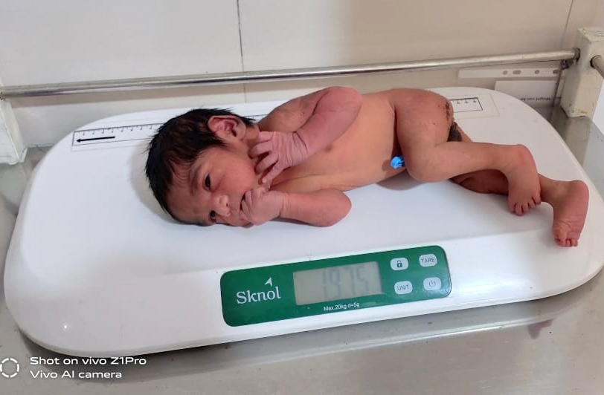
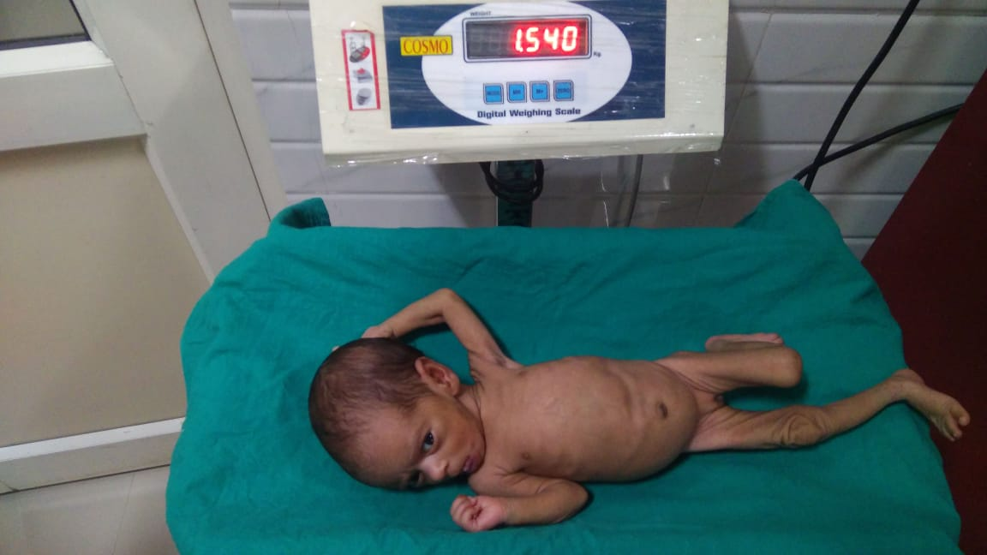
Identification and management of hidden low birth weight babies
1

Slide 6
Use of Digital Weighing Scale at all NBCCs at Delivery Points
High Priority Districts – HPDs
Source: HMIS
Notes:
With the use of digital weighing machines which have been bought from the NHM operationalization budget of NBCCs/SNCUs/NBSUs, the identification of LBW increased from 10% in 2017-18 to 18% in 2018-19 in the government hospitals. The digital machines are easier to operate and give more accurate readings. In our Aspirational distrikct Mewat it has increased from 3% to 14%.

Slide 7
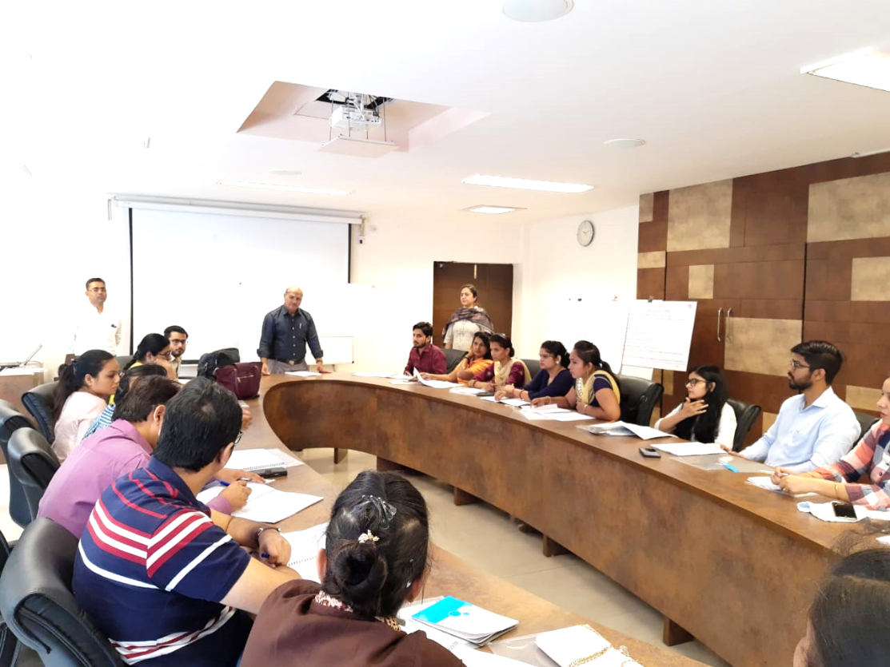
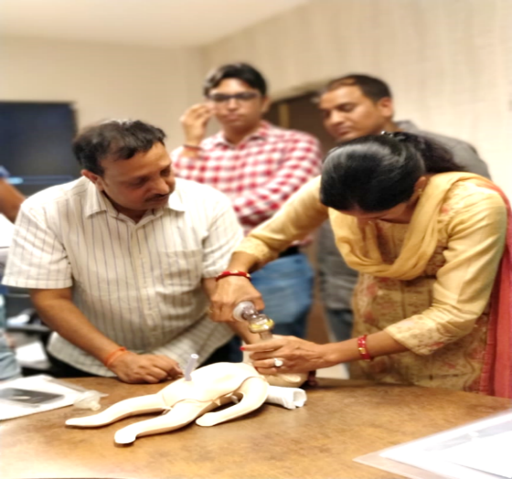
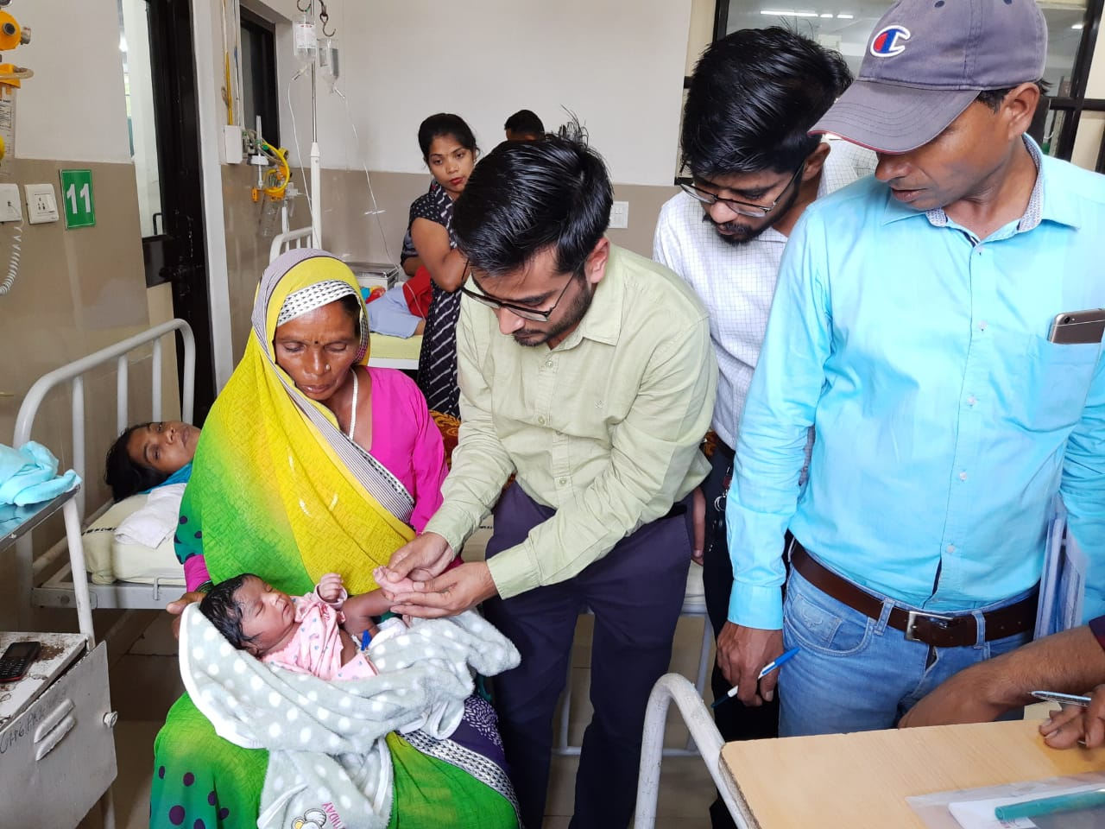
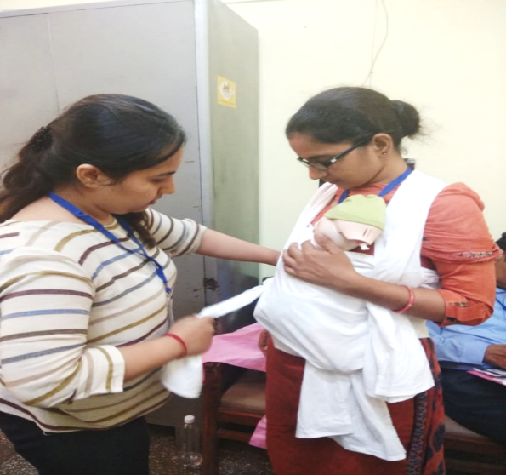
Improving access to Care of Small and Sick babies
2

Slide 8
Haryana Newborn Action Plan (HNAP)
Data analysis of 12000 Newborn Deaths from IDR showed that nearly 80% deaths were happening at home
Improving access to Facility Based Newborn Services through Regional SNCUs: Strengthening of selected SNCUs and NICU of government medical colleges (Rohtak and Hisar)
Establish Step Down Neonatal Care Model: to provide quality services to back referrals from premier institutes (PGI Chandigarh, PGI Rohtak, GMCH 32)
Mentoring of NBSU staff by SNCUs
Fixed staff in Labour Room
Development of SOPs for referral linkages
Notes:
Haryana Newborn Action Plan developed with the support of USAID supported Vriddhi Project aims to reduce NMR to single digit by 2025
Key recommendations from HNAP for improving facility based care of newborns that the state is in the process of implementation are:

Slide 9
Upgraded SNCUs at high case load SDH/FRUs
23 functional SNCUs and 66 NBSUs across 22 districts
393 neonatal beds in SNCUs
Upgradation of NBSUs to SNCUs
SDH Ambala (functional)
4 more planned
Notes:
4 more planned : Gohana -Sonipat, Ballabhgarh-Faridabad, CHC Hathin-Palwal, SDH Jagadhari-Yamuna Nagar

Slide 10
Strengthening operationalization of NBSUs
Prioritization
Phase wise for existing 66 NBSUs, focus on AD Mewat in phase 1
Human Recourse
Ensuring dedicated 4 staff nurses and designated medical officer
Infrastructure and Equipment
Gap analysis conducted for Infrastructure and equipment
Recording & Reporting
Standardized case sheet with daily monitoring, discharge and referral slip; NBSU admission register and monthly reporting formats printed
Clinical protocol posters, recording and reporting register provided
Gaps are being filled through operationalization cost of NBSU
3 days NBSU Training done for 24 staff nurses and MOs from 5 NBSUs in Oct 19
4 new NBSUs will be started by Mar-20

Slide 11
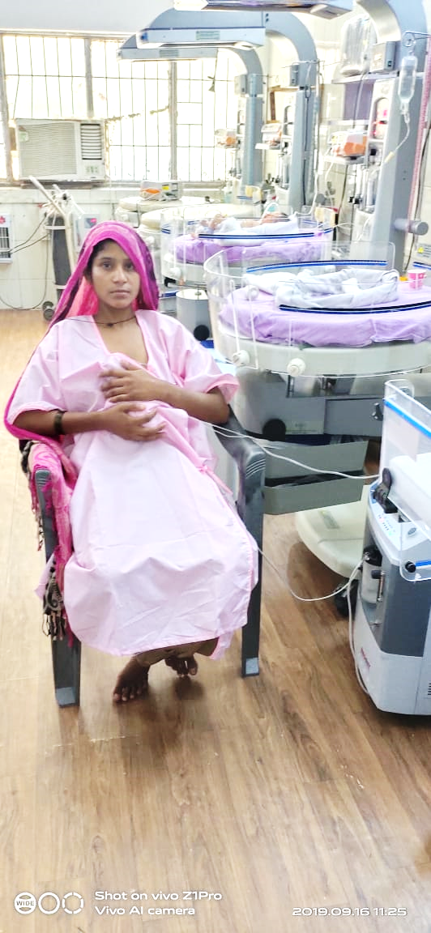
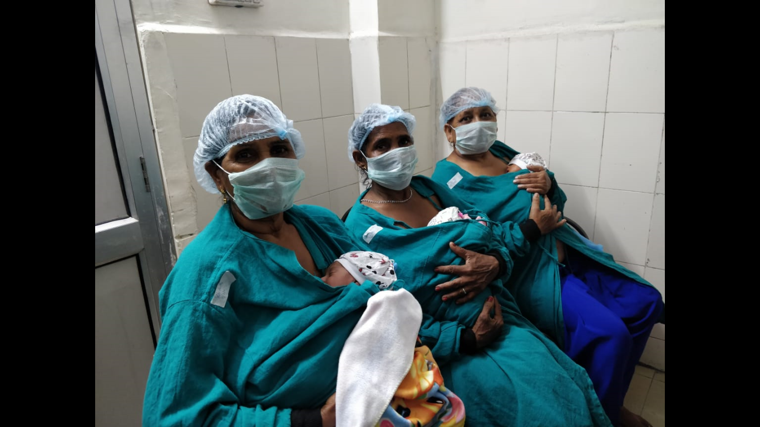
Kangaroo Mother Care for all LBWs
3

Slide 12
Demystifying KMC - Pilot initiatives of KMC in PNC wards in 5 HPDs (31 health facilities) now extended to all districts
Baseline Assessment conducted in 31 facilities of 5 HPDs
254 trained
Training conducted on IPC and IPPC in 5 HPDs Apr – May 2016
Facility Readiness assessment (n=31) conducted in 5 HPDs
152 trained
Formal KMC Training conducted in 5 HPDs May to July 2017
% of Health Facilities provided KMC
0% | 0% | 0% | 20% | 30% | 18% | 21% | 16% | 24% | 14% | 40% | 43% | 52% | 68% | 68% | 62% | 68% | 67% | 53% | 71% | 80% | 74% | 85% | 90%
In 2016 (Jan to Dec) 29% (363/1231) and in 2017 (Jan to Sep) 53% (462/736) received KMC Source: Vriddhi Project data
Notes:
Demystifying of KMC – An important evidence based intervention for improving breast feeding, weight gain, reducing hypothermia and sepsis. Does not require much resources of equipment and can be done in post natal wards. This model shows that with quality training at district level and “low dose high frequency training and mentoring” at facility level KMC can be ensured in post natal wards of district and sub-district hospitals including non-FRU CHCs and 24*7 PHCs.

Slide 13
Kangaroo Mother Care Units in all SNCUs
Well equipped KMC units are established in all 23 SNCUs of Haryana,
KMC is also initiated in NBSUs and postnatal wards,
KMC session for mothers also a part of FPC,
*April to Sep-2019
Notes:
Implementation of KMC in all the SNCUs of Haryana is being done. During 2016-17 only 20% newborns received KMC, coverage of KMC increased to 32% in 2017-18 and 36% in 2018-19. During the last 6 months of 2019-20 about 42% of LBWs have received KMC in SNCUs. Haryana deeply recognizes the importance of KMC for newborns and sincerely promoting the same in SNCUs, NBSUs and postnatal wards. As you can see in the pictures that we are also encouraging participation of grandparents and other relatives to provide KMC so baby can received KMC for extended hours. We have also involved fathers and other health male adults to provide KMC. NHM Haryana has ensured that there will be no budget constraint in KMC implementation.

Slide 14
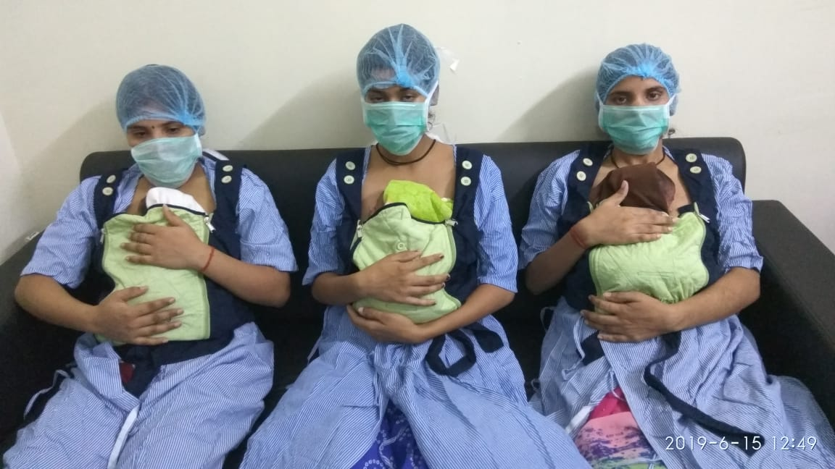
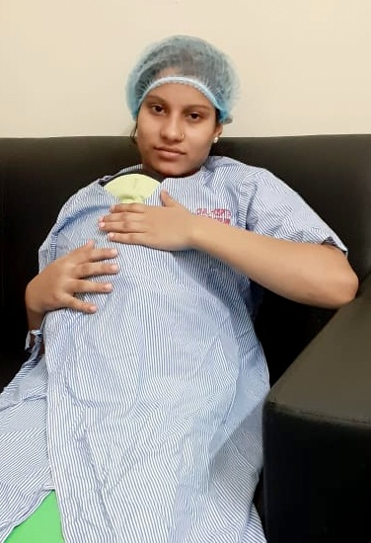
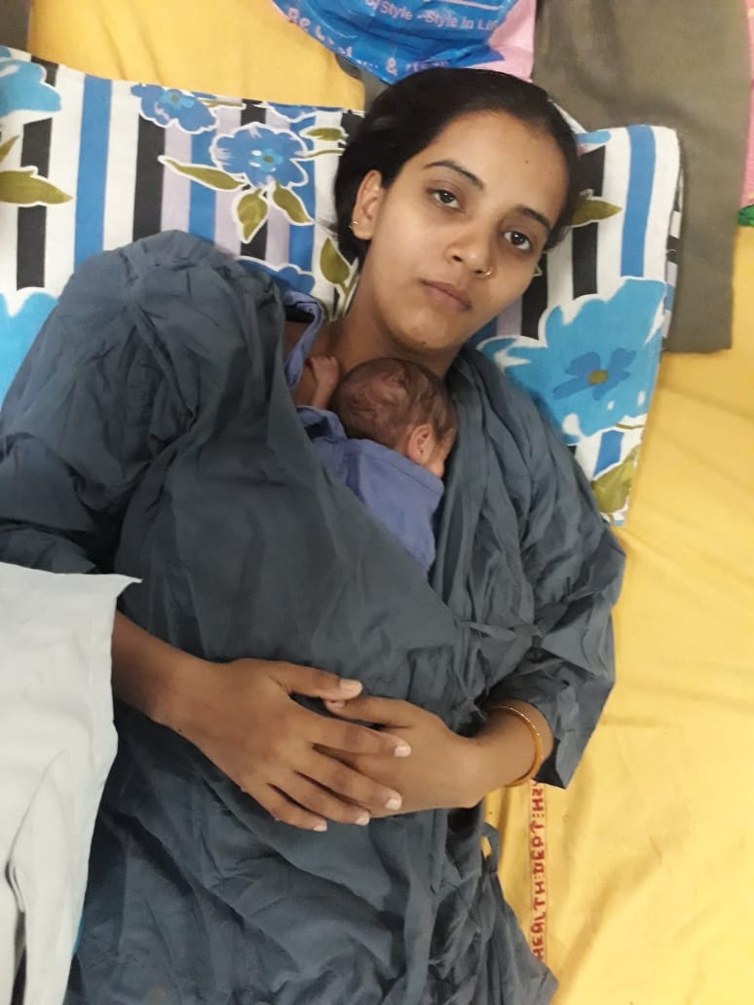
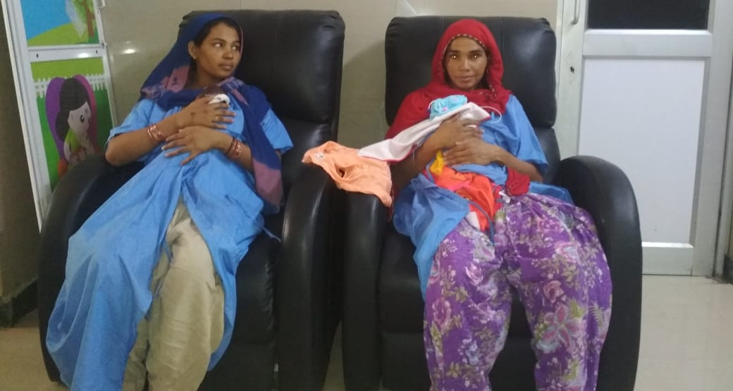
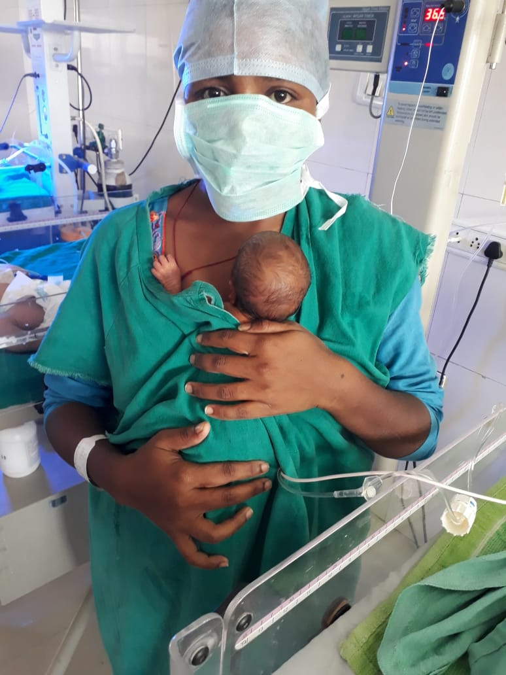
KMC given
KMC Given
SNCU: Bhiwani
SNCU: Yamunanagar
Notes:
KMC Given

Slide 15
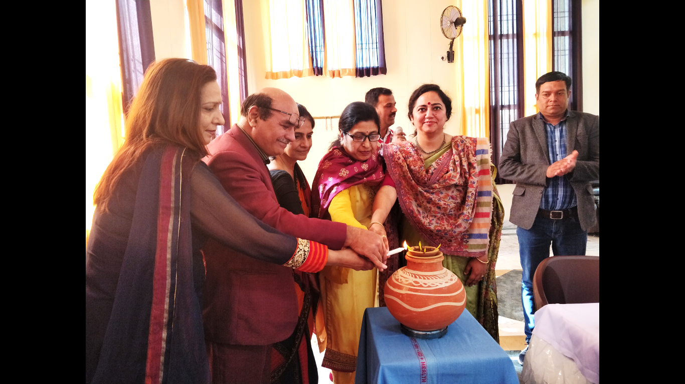
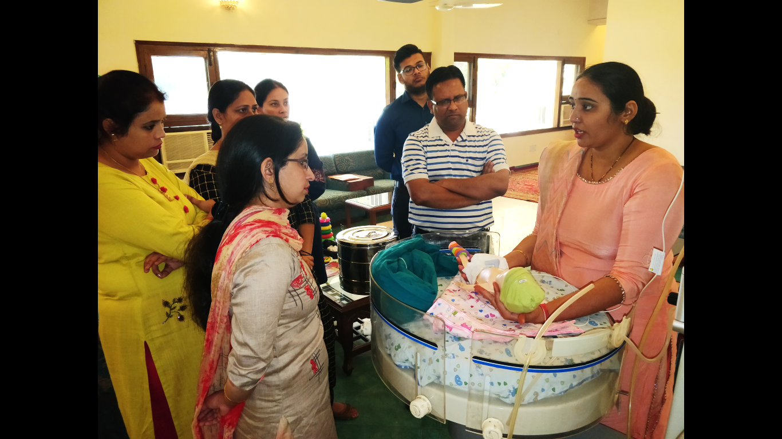
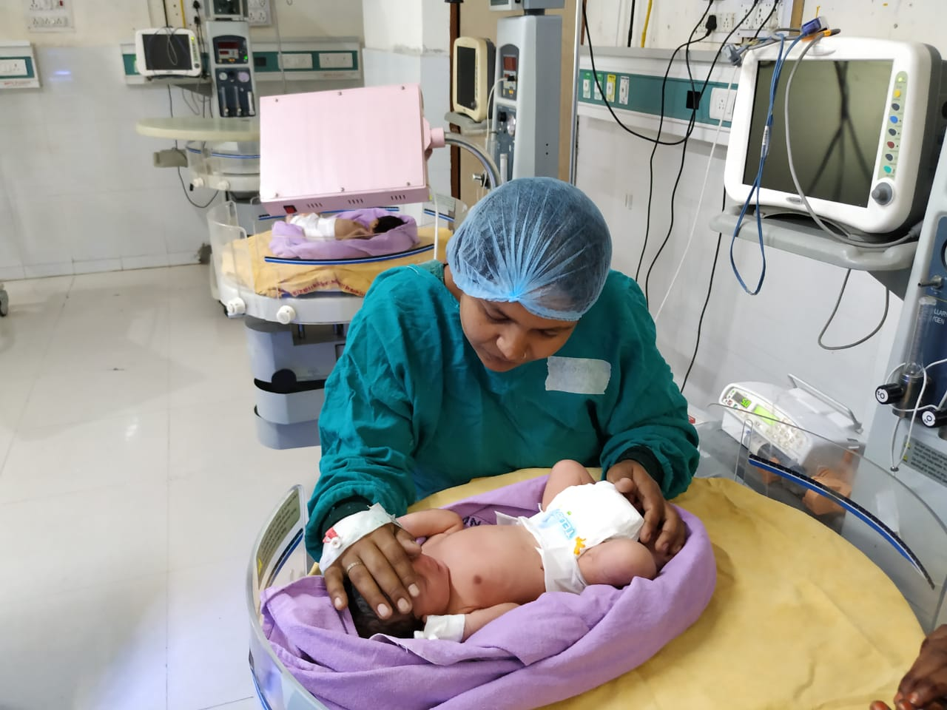
Family Participatory Care for Continuum of care
4
Notes:
Family Participatory Care is a unique approach to involve families by educating and empowering them in baby care during admission of their baby in SNCUs. USAID-Vriddhi project supported state in envisaging ideal if FPC implementation in the state and also provided technical supports in its implementation. Total of state ToTs were completed in Haryana covering all of its SNCUs and selected NBSUs and NICUs of 2 government medical colleges. Haryana trained total of 104 health personal in FPC including 16 paediatricians.

Slide 16
Family Participatory Care (FPC) approach
FPC imparts skills and education to family care providers, using standardized videos, demonstration and practice, on;
Routine care of newborn,
Infection preventions,
Developmentally Supportive care (DSC), Kangaroo Mother Care (KMC) and
Identification of danger signs of newborn
Empowerment of parents / families of newborn (admitted in SNCUs) to take care of their babies not only in SNCUs but also at home after discharge
Notes:
We want to use every opportunity in our facility to improve the quality of care for mother and babies. FPC is one of those examples. Recently we have conducted 4 state ToTs in Haryana and covered all 23 SNCUs, 6 NBSUs and 2 Government Medical Colleges in Haryana. As it is shown in research conducted in other states that FPC empowered care givers / family members continue to practice the skills (which they have learned in SNCUs) of newborn care at home after discharge from SNCU. It also improves KMC practices at home and facility level follow of newborn.

Slide 17
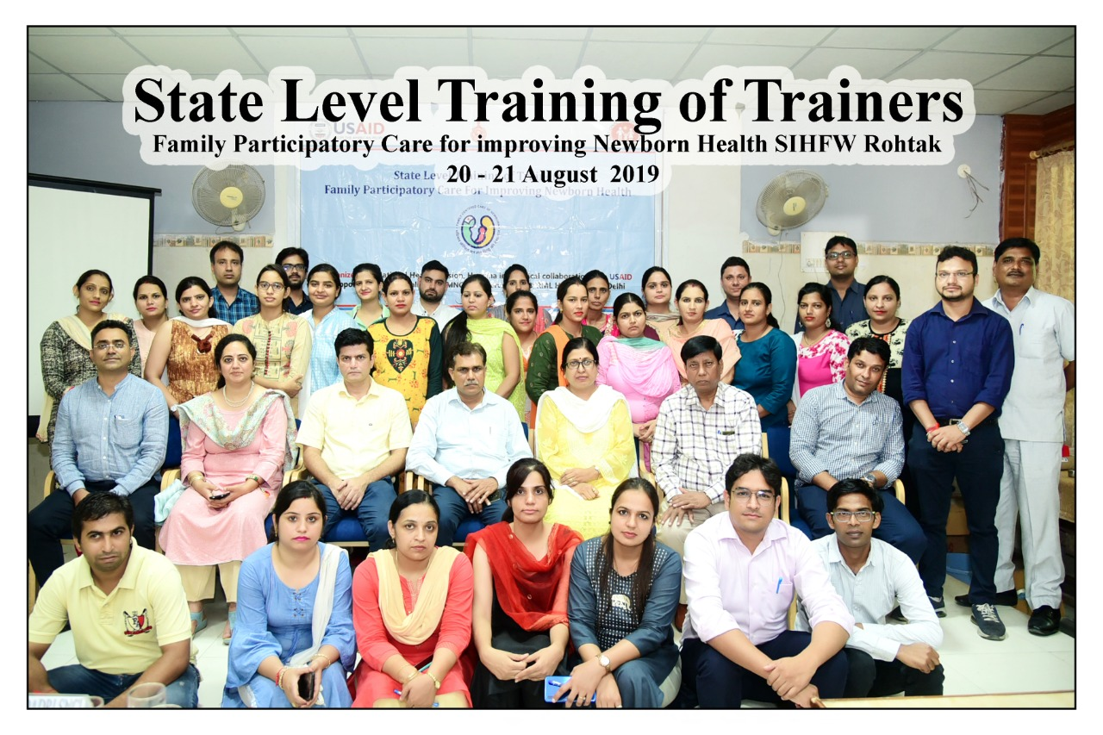
4 Regional ToTs of FPC
104 Participants trained
Paediatrician, MO, Staff Nurses and NHM Consultants)
Facilities:
2 Government Medical Colleges
23 SNCUs
5 NBSUs
2922 FPC sessions held and 68% of care givers attended at least any FPC sessions (Apr-Oct 19)

Slide 18
NBSU Jagadhari, Haryana
India’s first NBSU to implement FPC!
1
Mothers giving KMC for LBW babies
2
Video teaching session facilitated by staff nurse
3
Hand hygiene by mothers
4
Gowns with name label for mothers
5
Grooming kit – nail cutter, nail polish remover comb
6
Mothers inside NBSU providing routine care
7
Mother comforting baby – singing lori
8
Containment to calm the baby
Notes:
Haryana is the first state in entire country which involves NBSUs in FPC implementation to increase the coverage of this life saving approach. All 3 NBSUs of an aspirational district were covered and 3 other NBSUs were selected. NBSU Jagadhari in district Yamuna Nagar is the first NBSU in the country where FPC implementation was started. We are thankful of USAID-Vriddhi Project in helping us in this endeavor to save the lives of newborns. These are the few pictures from NBSU Jagadhari. We observed in Jagadhari that after FPC implementation;
Antibiotic use decreased
Crowd due to attendants and parents decreased significantly,
Trust between staff and parents increased.

Slide 19
FPC Practices in Aspirational District of Haryana
Nesting of babies for comfort
2
Hand hygiene of mothers- cutting nails
3
Mother cleaning the baby
9
4
5
6
7
8
Information about radiant warmer and machines
Positioning of baby- flexed
KMC given for twins
Hand washing
Training session for mothers
Respectful maternal and newborn care
1
Notes:
These are the similar pictures like NBSU Jagadhari and provides glimpse of FPC implementation at SNCU of our Only Aspirational District Mewat.

Slide 20
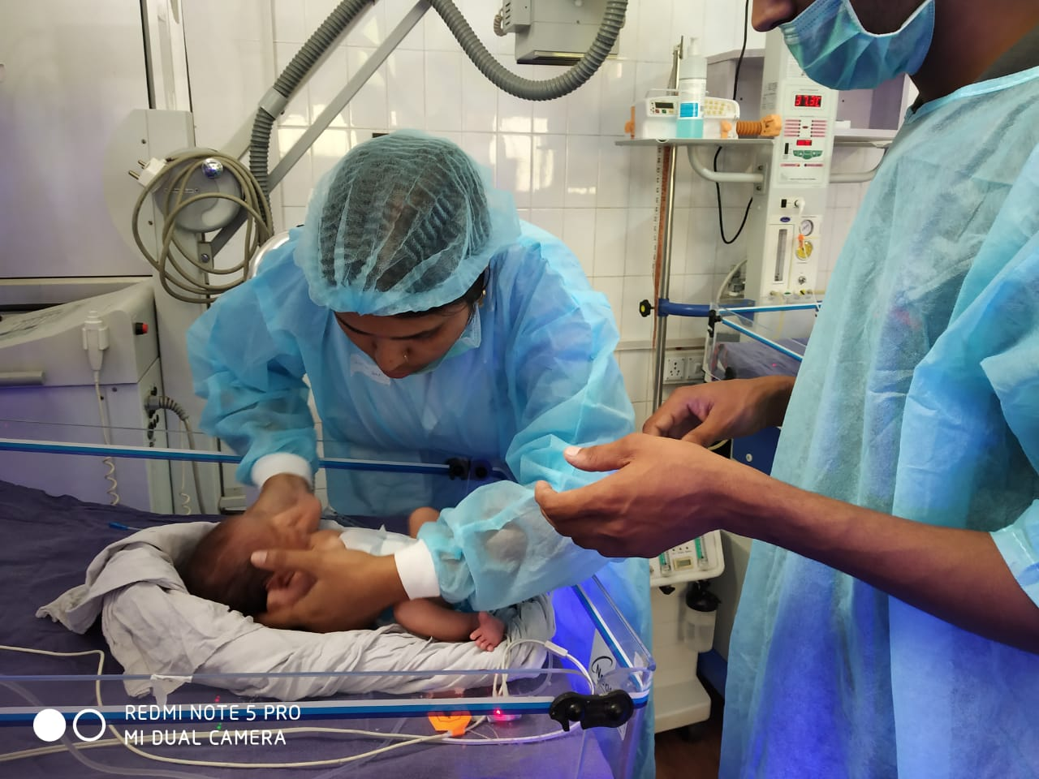
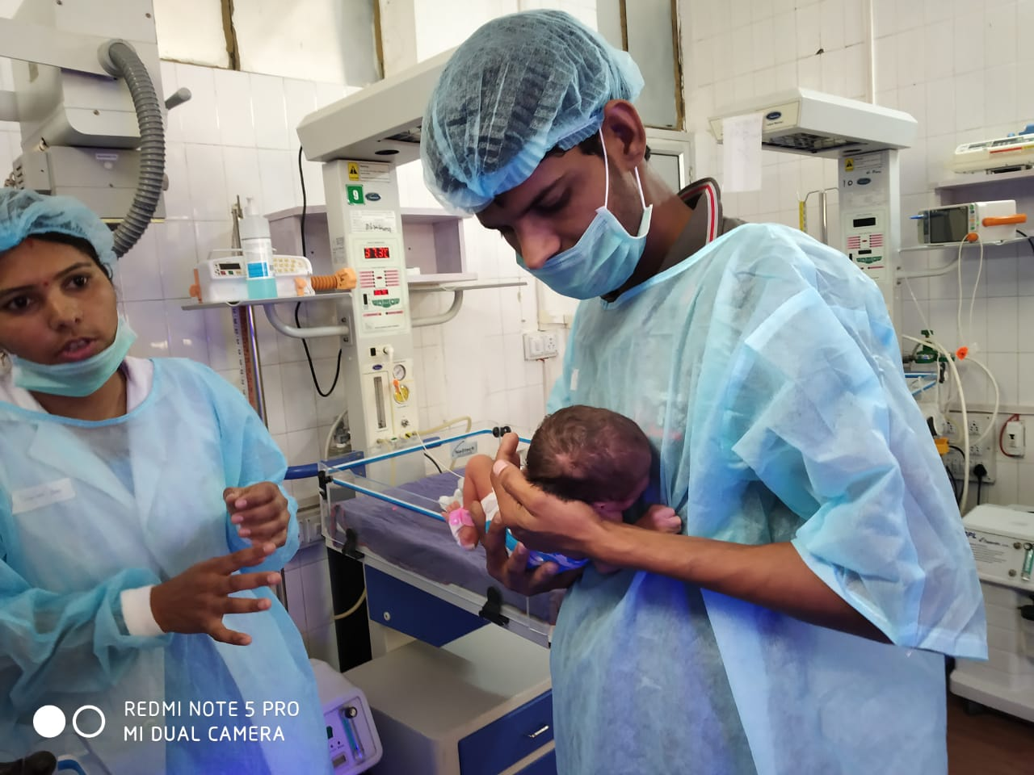
4
Early Childhood Development (ECD)
Notes:
We are also sincerely implementing Early Childhood Development (ECD) in our state. Currently we are doing to important things in this regards. First at facility level, session 2 (Developmentally Supportive Care) is directly related to ECD for newborn admitted in SNCUs. We educate and impart skills in parents for newborn care under FPC including ECD, research in other states indicates that parents tend to practice the important skills of newborn care at home. We are positive that same will happen in Haryana. Second at facility level, by providing useful information in MCP cards and conducting ToTs on HBYC. These are helpful for frontline health workers (FLWs) and parents. During VHND meetings and immunizations days and in AWCs FLWs discuss it with the parents.

Slide 21
Early Childhood Development (ECD) in Haryana
Facility Level
Developmentally Supportive Care (DSC) is a part of Family Participatory Care (FPC)
Age appropriate stimulation is given – Audio- mother’s soft voice, Visual – parents face, colour balls, Smell - mother’s smell, Touch – parents holding baby gently, stroking, Taste – breast milk
Negative stimulus like excessive light and noise and unpleasant strong smells are reduced
It is being implemented in all 23 SNCUs and selected NBSUs of Haryana
Community Level
Home Based care for Young Child (HBYC) program is being implemented in the state through ASHAs
ECD messages are published on MCP card

Slide 22
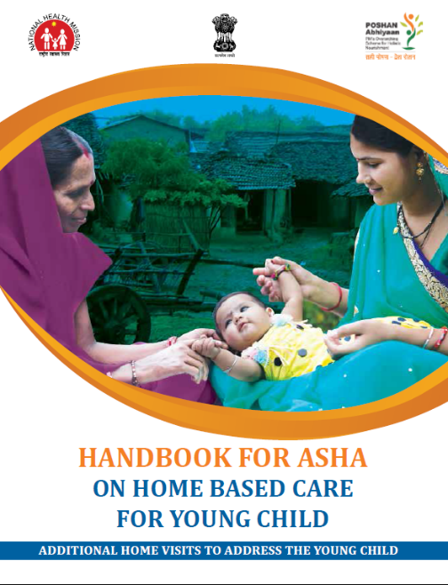
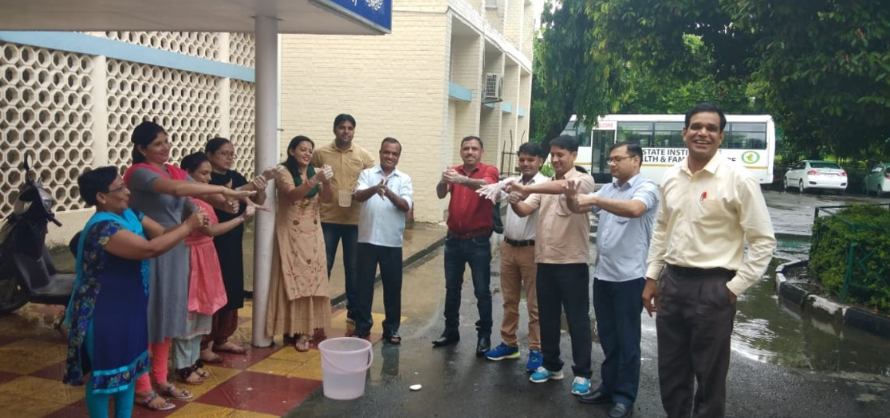
Home based care for Young Child (HBYC): Haryana
12 batches of HBYC Training of Trainers completed
345 participant trained

Slide 23
Way Forward
Disintegrated analysis – Sub District facility wise analysis of LBW identification
Completion of Strengthening of Regional SNCUs in Rohtak and Hisar
Upgrading NBSUs in SNCUs in a phased by manner,
Continue to leverage newer training packages by GoI (FPC and NBSU) to provide better care in SNCUS and NBSUs,
More focus on KMC in NBSUs and postnatal wards,
Implementation of FPC in all NBSUs of Haryana,
Completion of ToTs of HBYC and conduction of further trainings at district and sub-district levels

Slide 24
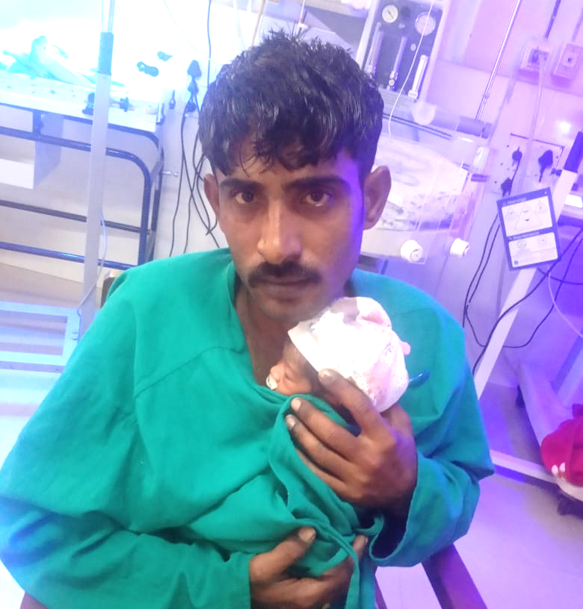
Change Leaders in Haryana
This is the photo of a premature baby 35 weeks, who was delivered at home, baby brought to SNCU. “FPC empowered” father has been providing Kangaroo Mother Care (KMC) to his baby in SNCU.
Father and other family members of this baby are trained in routine care, infection prevention, Developmentally Supportive Care (DSC), Kangaroo Mother Care (KMC) and identification of danger signs under FPC program at SNCU Karnal, Haryana
FPC not only empowers mothers and family members for the best possible care of a newborn but also ensures Respectful Maternal and Newborn Care.
Notes:
FPC not only empowers mothers for the best possible care of a newborn but also empowers other family members to provide motherly care.

Slide 25
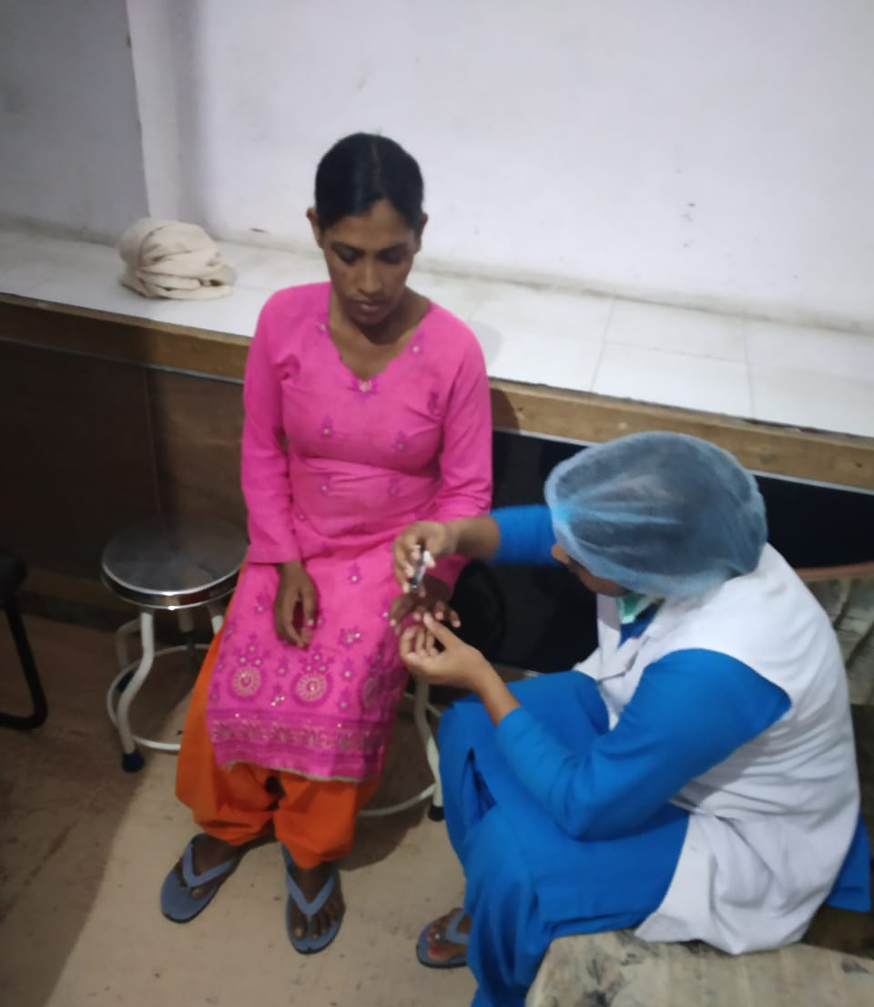
SNCU Staff Nurse from Aspirational District Mewat is assisting one of the mothers at SNCU Mewat to prepare her for entry in SNCU so she take care of her baby under FPC program
We Care for you
Thank You
Notes:
We Care for you As I have told earlier that FPC has 4 components, and in first components SNCU staff helps parents in infection prevention practices including hand washing and personal hygiene. In this picture SNCU staff nurse cutting the nail of a proud mother so she can go inside SNCU (in Mewat) and join SNCU staff in taking care of her baby.

