Slide 1



Overcoming vaccine hesitancy in MR campaign
Karnataka
(7th February to 19th March 2017)
Measles-Rubella Vaccination Campaign February 2017 Karnataka

Slide 2
MR campaign: Vaccination strategy
Target age group: 9 months to <15 years
To cover one school in one day; one village in one day
Average Campaign duration: ~ 3+ 1 weeks = ~16-20 working days
  1st week: School based campaign
  2nd and 3rd weeks: Community based campaign
  4th week: sweeping activity
National MR vaccine Launch in Bangalore on 5th February 2017
Target Children = 160,32,635
State Achievement = 158,45,040 (98.83%)
Measles-Rubella Vaccination Campaign February 2017 Karnataka

Slide 3
Challenges: Vaccine Hesitancy
Large private schools not allowing vaccination in schools
Rumours from Tamilnadu and Kerala that MR vaccine causes adverse reactions - rumour of MR causing infertility, Correlation between MR and autism etc.
Community resistance from Muslim minority community leading to Schools and madrasas refusals
Some Private practitioners advocated against MR campaign citing their clients have received 3 doses of MMR
Measles-Rubella Vaccination Campaign February 2017 Karnataka

Slide 4
Innovative Communication Strategies
Big FM radio channel roped in as official radio partner
Radio Jockey along with team of experts- Health department, Unicef and WHO addressed concerns of parents and teachers in prominent large schools.
Expert’s interaction and motivational messages by teachers and students aired live on radio
Motivated other large chain of schools to come forward for MR vaccination clearing many of their apprehensions and hesitancy
Measles-Rubella Vaccination Campaign February 2017 Karnataka

Slide 5
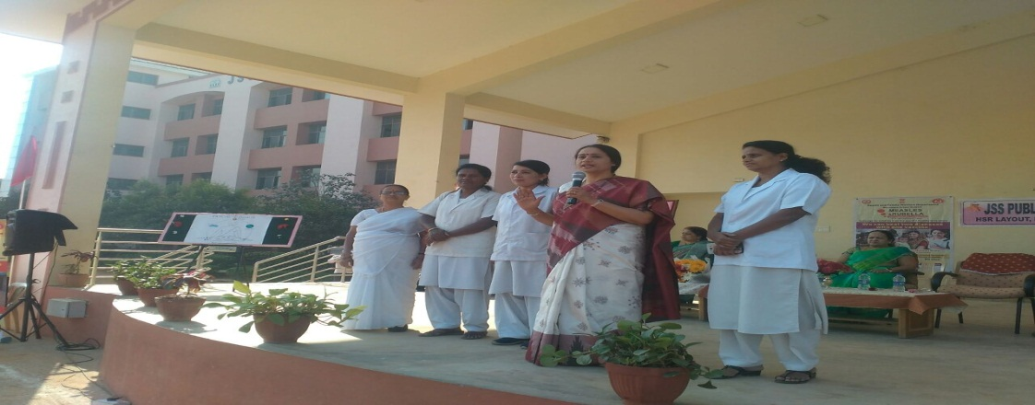
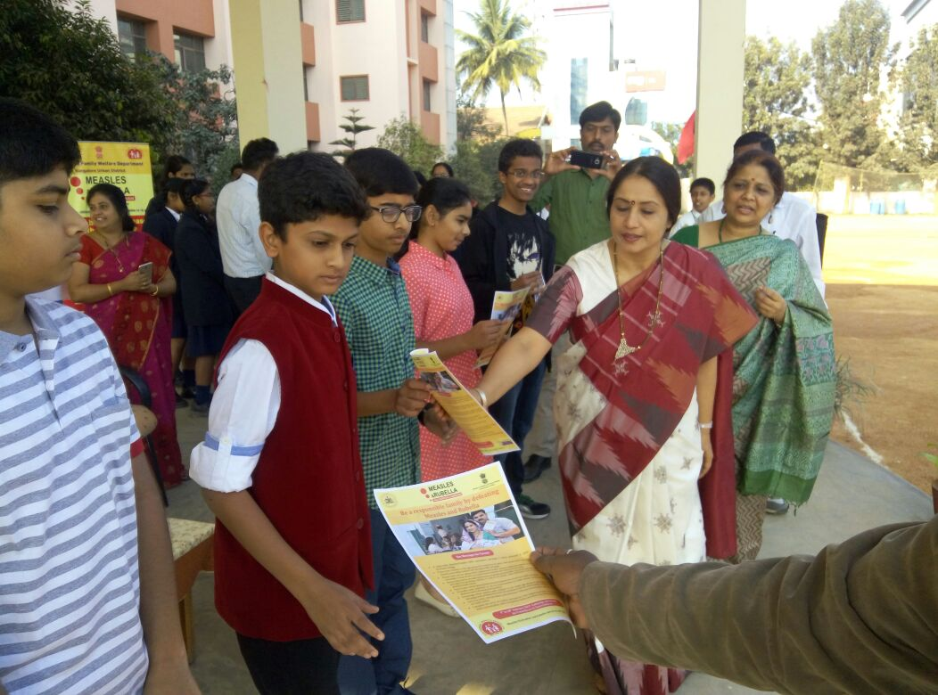
MR campaign awareness for schools Children
Principal Secretary- HFW with RJ team along with District DIO, Unicef and WHO
Measles-Rubella Vaccination Campaign February 2017 Karnataka

Slide 6
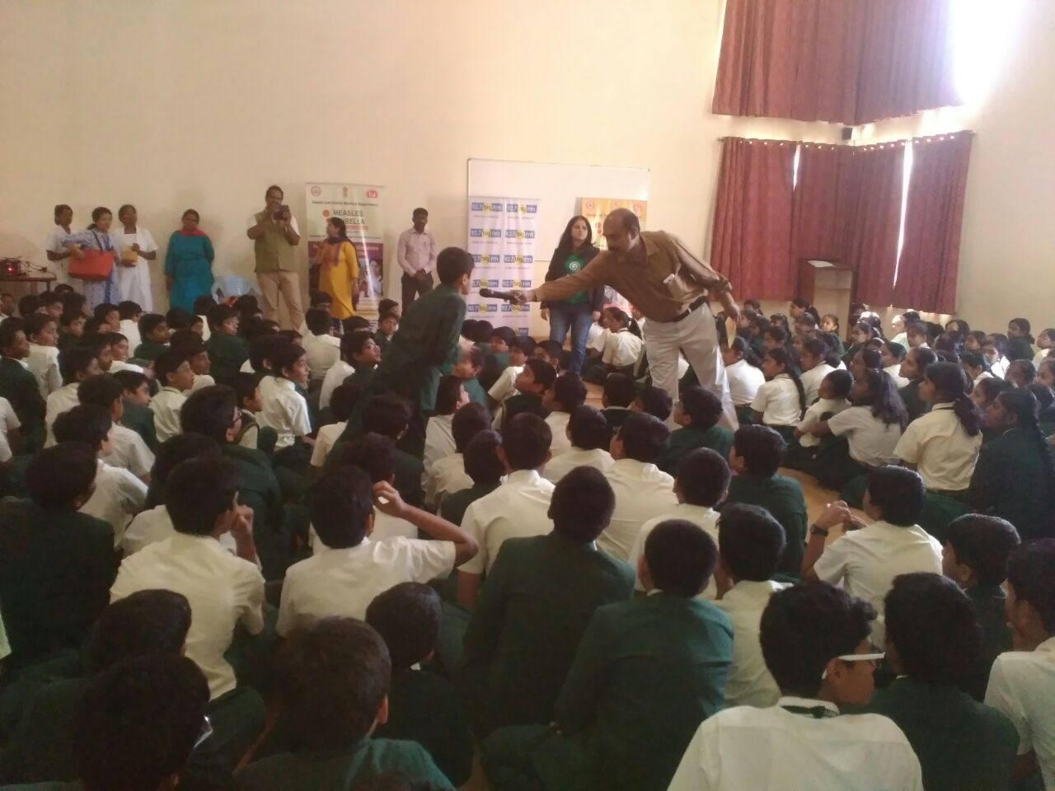
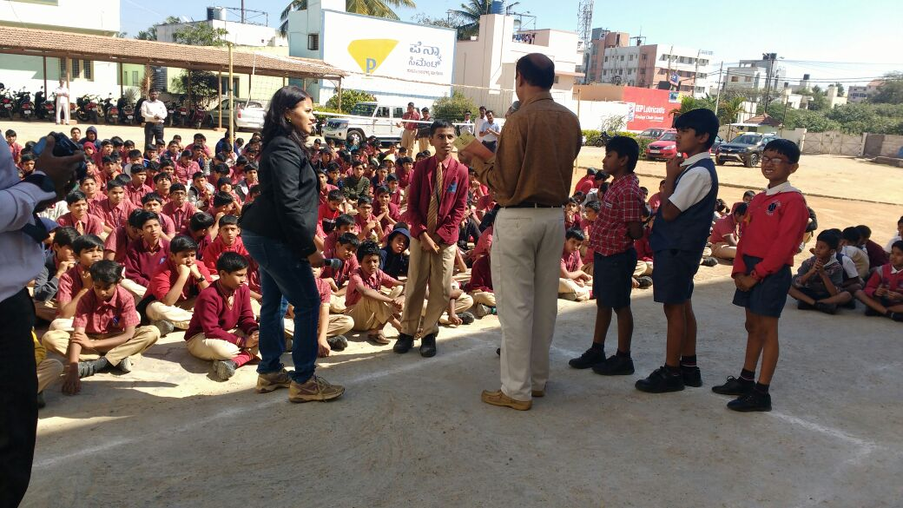
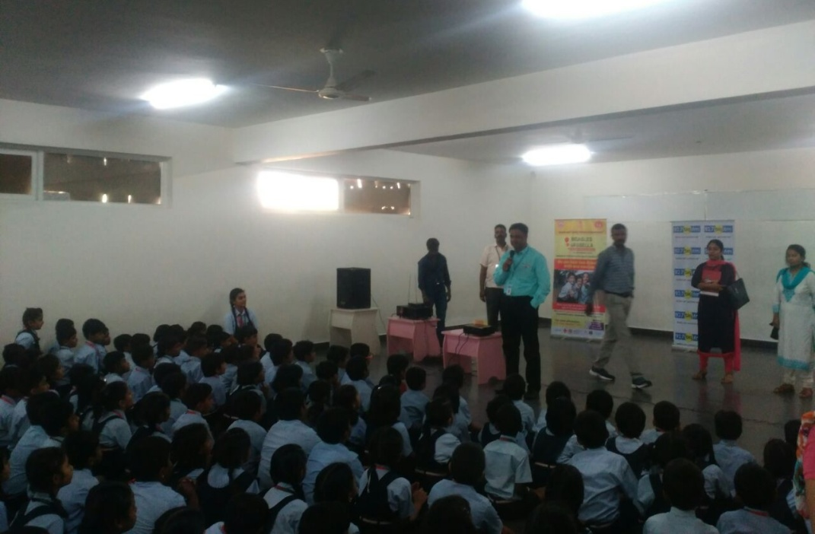
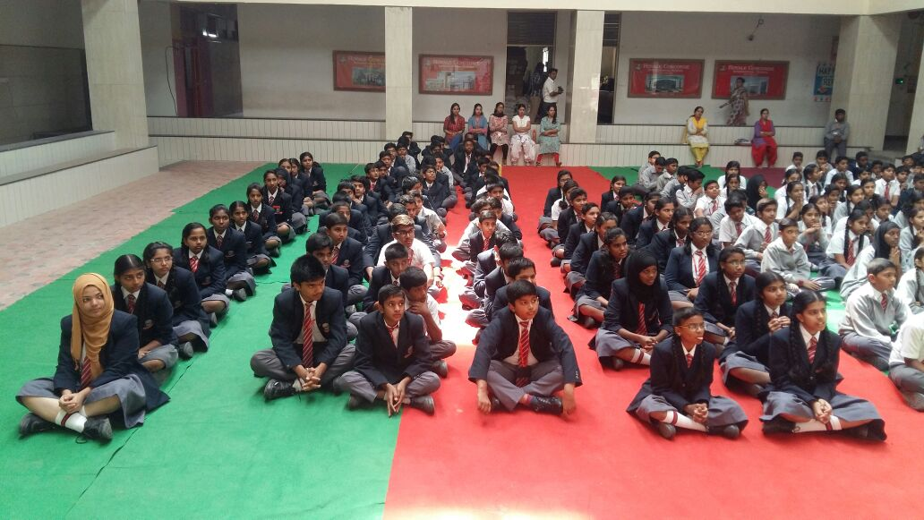
MR campaign awareness at Reluctant schools by BIG FM RJs
Chaitanya School
BGS Nobel School
Thathva School
At Mysore
Measles-Rubella Vaccination Campaign February 2017 Karnataka

Slide 7
Programme Outcome
128 hesitant schools visited and all got convinced and many other schools too came forward for MR vaccination listening to live radio motivation.
Yielded 100% positive results in three major cities of Karnataka- Bengaluru, Mysuru, and Mangalore.
Implementing partners: Government of Karnataka, Big FM, Unicef, WHO
Financial Implications: Big FM sponsorship supported by Unicef and Government of Karnataka
Scalability: Feasible in all major cities where there will be challenge of large school hesitancy
Measles-Rubella Vaccination Campaign February 2017 Karnataka

Slide 8
Innovation: State Media Whatsapp Group
Whatsapp group consisting of all major health reporters in the state and moderated by JD-IEC along with Principal Secretary-HFW, MD-NHM and Commssioner-HFW
Sent out positive messages and latest information updates regarding campaign
Queries on all rumours answered timely to media from the health department avoiding negative rumours to spread
Financial implication: Nil
Programmatic outcome- helps avoid hesitancy by timely addressing media concerns through proper communication
Measles-Rubella Vaccination Campaign February 2017 Karnataka

Slide 9
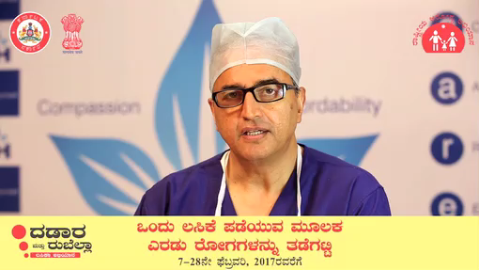
Video Appeals from Celebrities, Medical Fraternity, Scientists & Religious Leaders
Measles-Rubella Vaccination Campaign February 2017 Karnataka

Slide 10
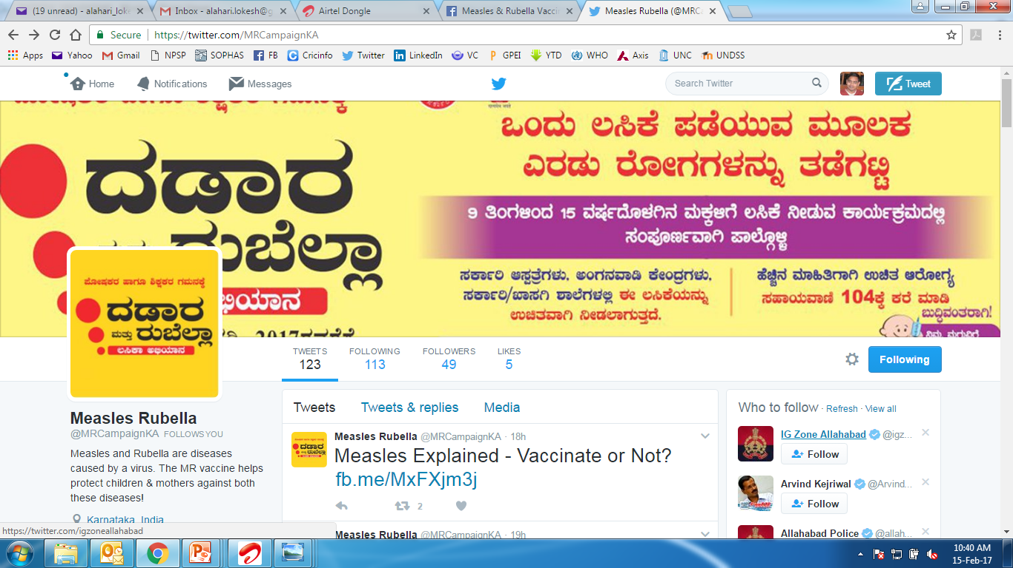
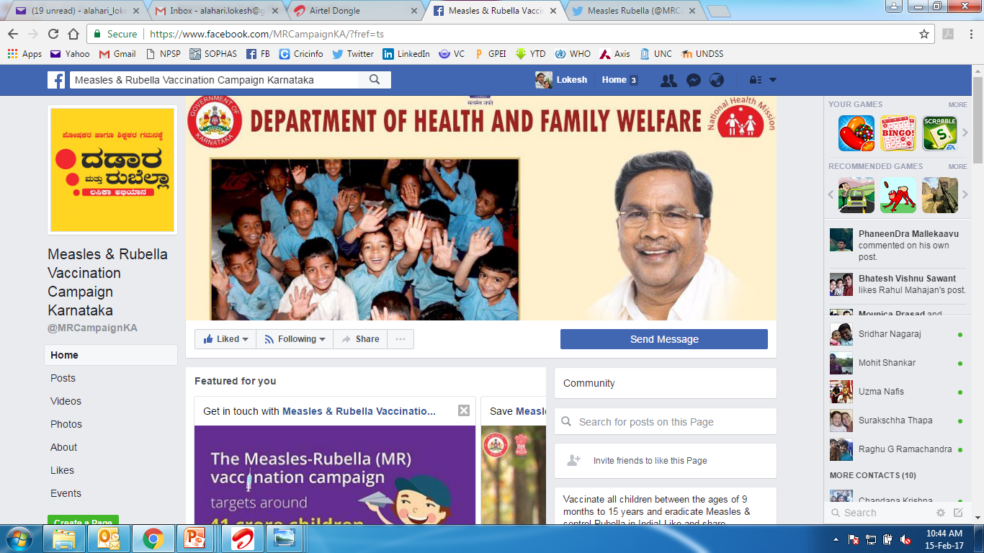
  Dedicated facebook page and twitter handle
  Regular updates, answering questions of hesitant parents by experts,
  Facebook live chats with experts
Measles-Rubella Vaccination Campaign February 2017 Karnataka

Slide 11
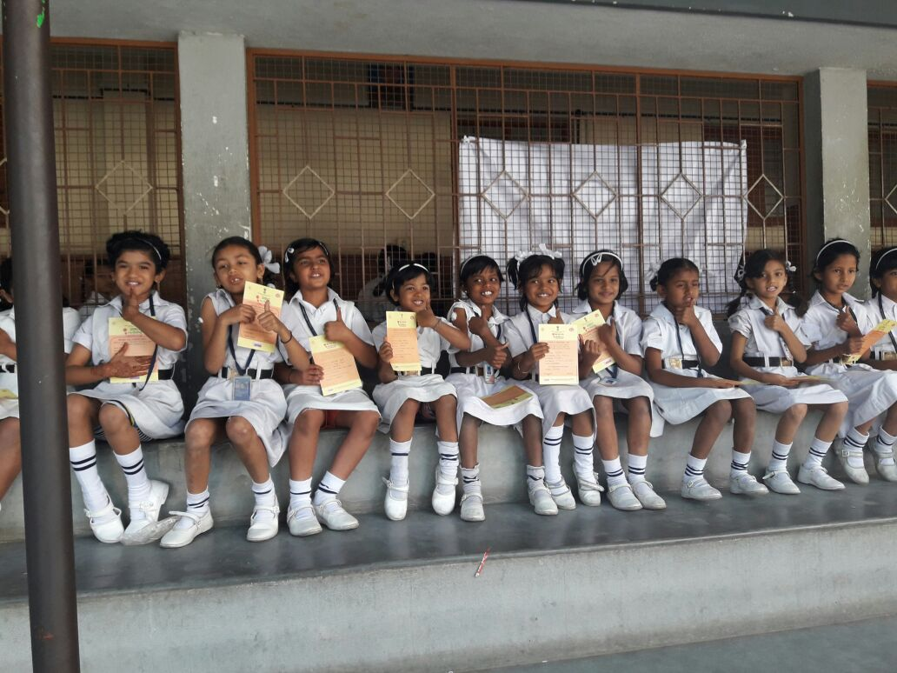
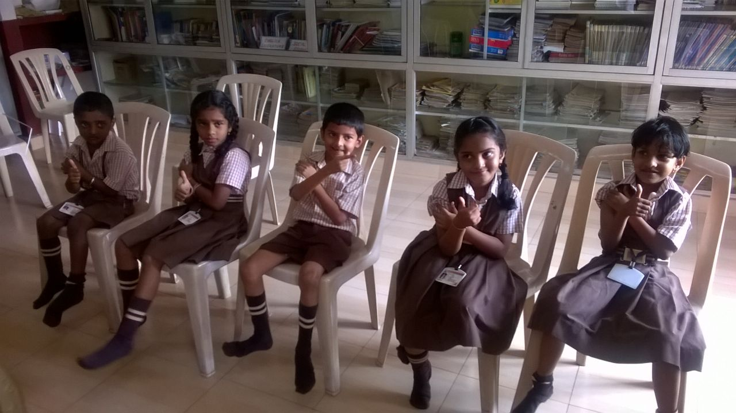
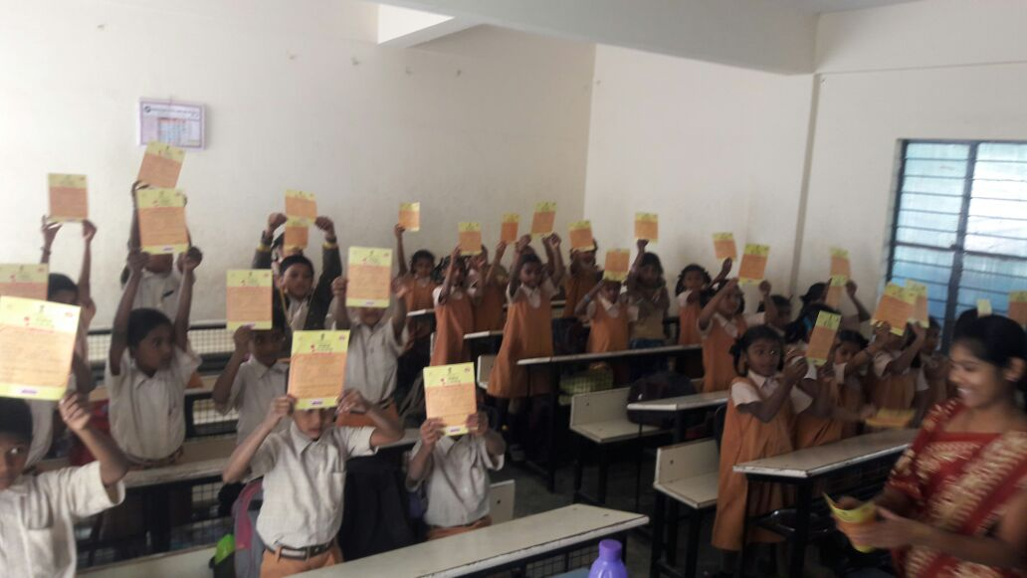
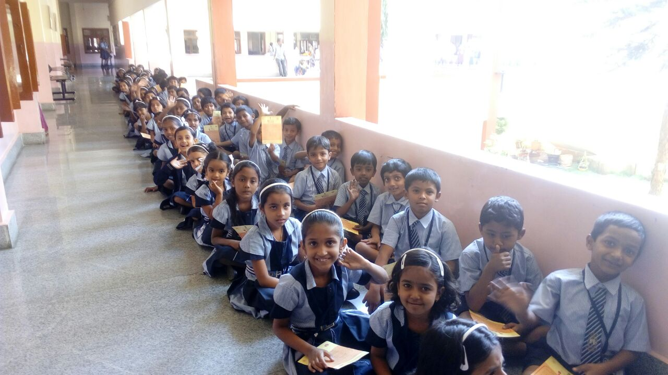
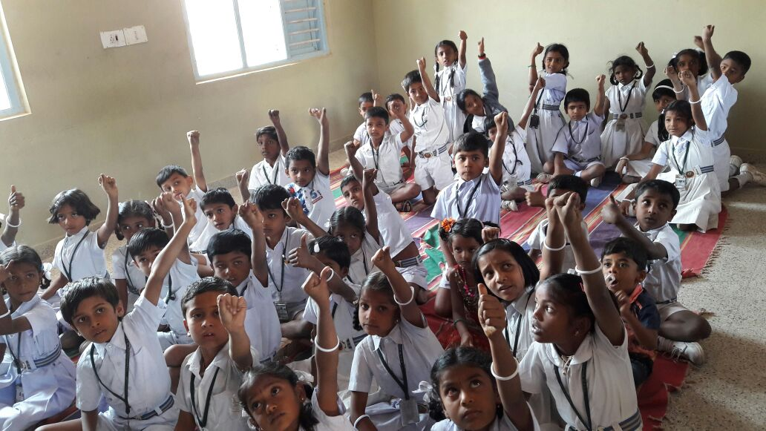
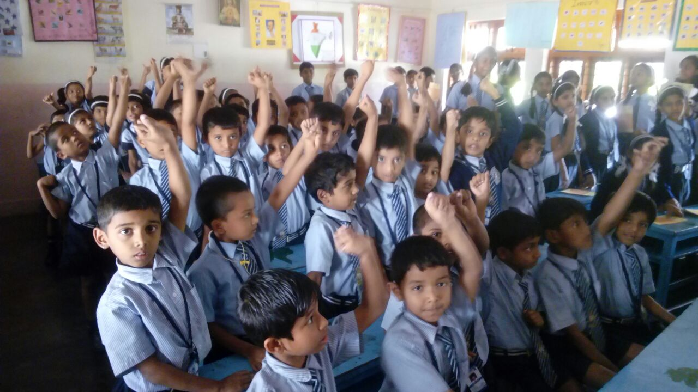
Thank you

Slide 12
Other Innovations – MR Communication
Posters/Banners/ Hoardings
Videos and audio messages, jingles from celebrities
Television- Ads, Panel discussions, live phone-in programs
Radio- Multiple channels
Metro stations
Bangalore Airport
Bus branding- Buses-outside, inside, tickets
Facebook/Twitter/You tube page
Newspapers ads- State and regional multiple languages
School Rallies
Appeal from Chief Minister/ Health minister
Movie Theatres ad screening
Milk packets branded
Big FM School mobilization
India- England T20 match
Train announcements- stations and inside trains
Local cable channels across all districts
Folk artistes regional awareness events
Garbage van announcements
Measles-Rubella Vaccination Campaign February 2017 Karnataka

Slide 13
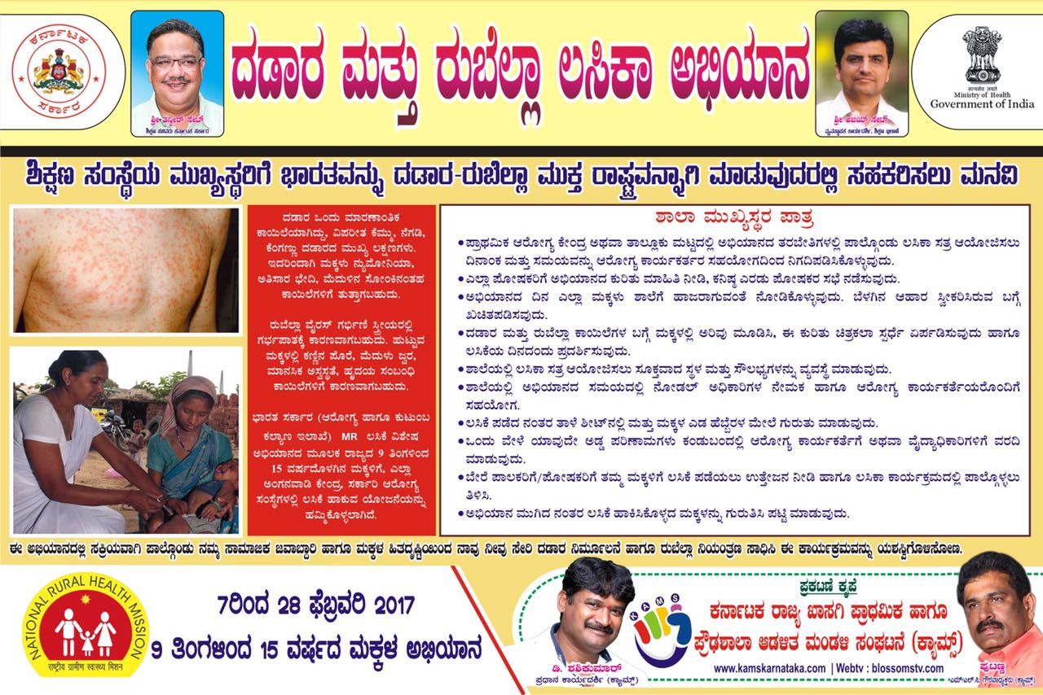
Posters printed by private schools management association and circulated to all schools in association to support MR vaccination campaign
Communication through Private school management associations to address Private schools hesitancy
NO Cost Implication
Good & Positive programmatic outcome
Measles-Rubella Vaccination Campaign February 2017 Karnataka

Slide 14
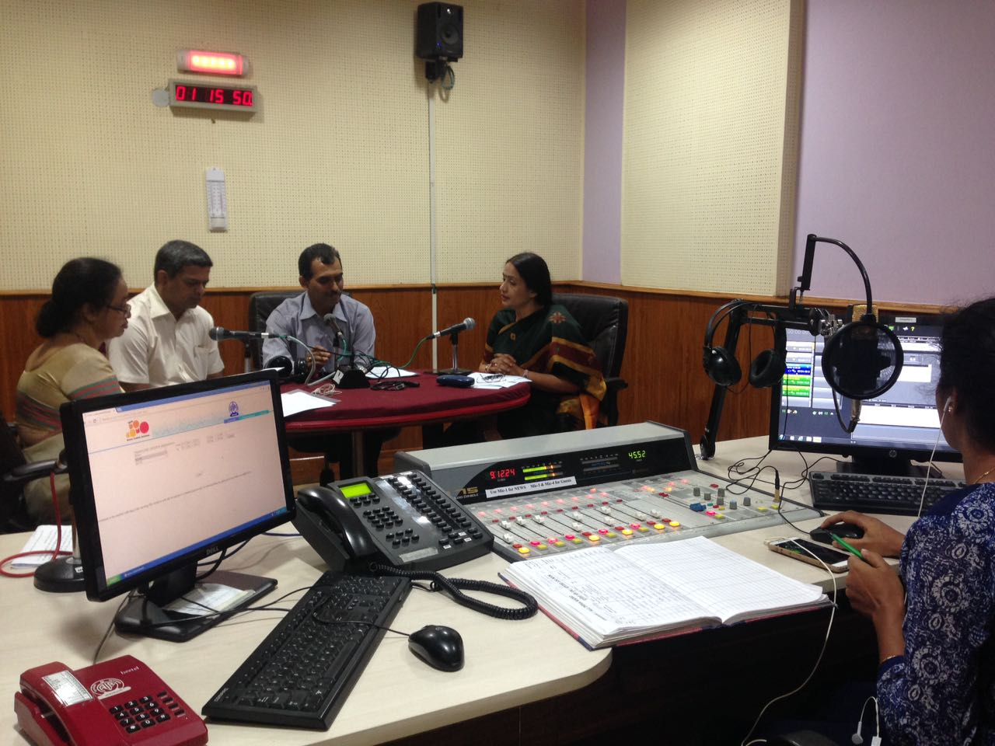
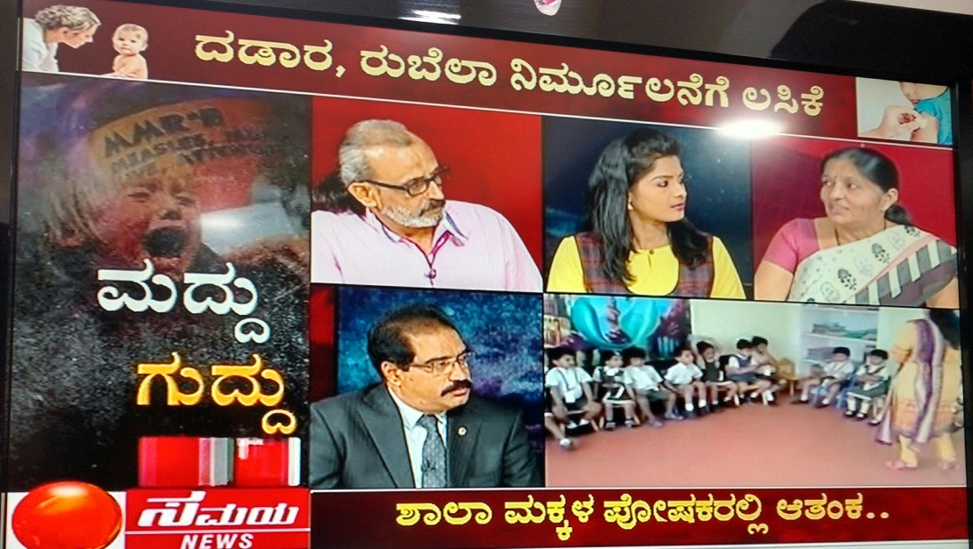
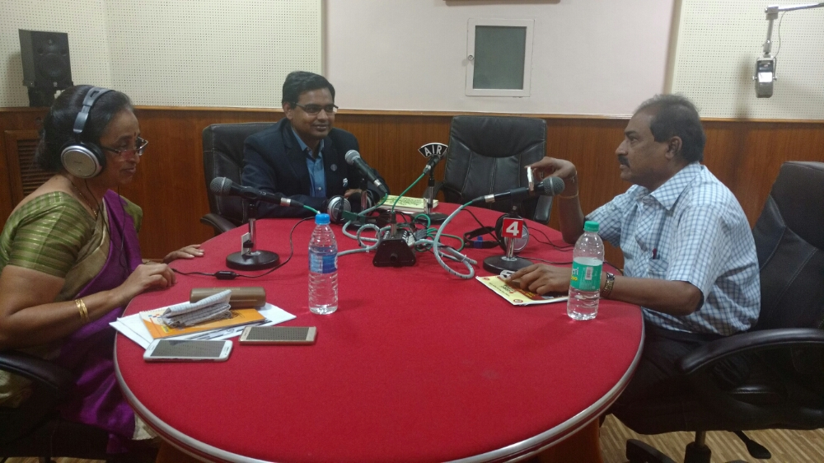
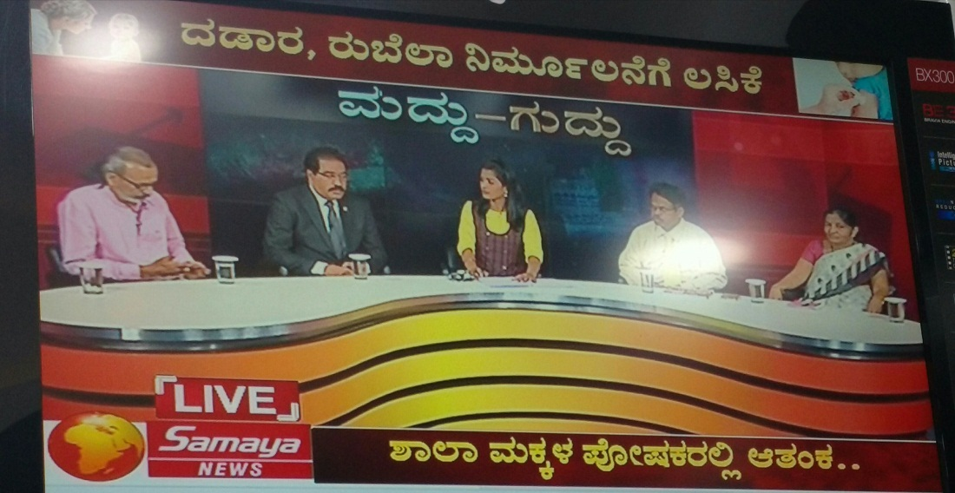
Awareness programs – Live Q & A with experts in Radio and TV Panel discussions
Measles-Rubella Vaccination Campaign February 2017 Karnataka

Slide 15
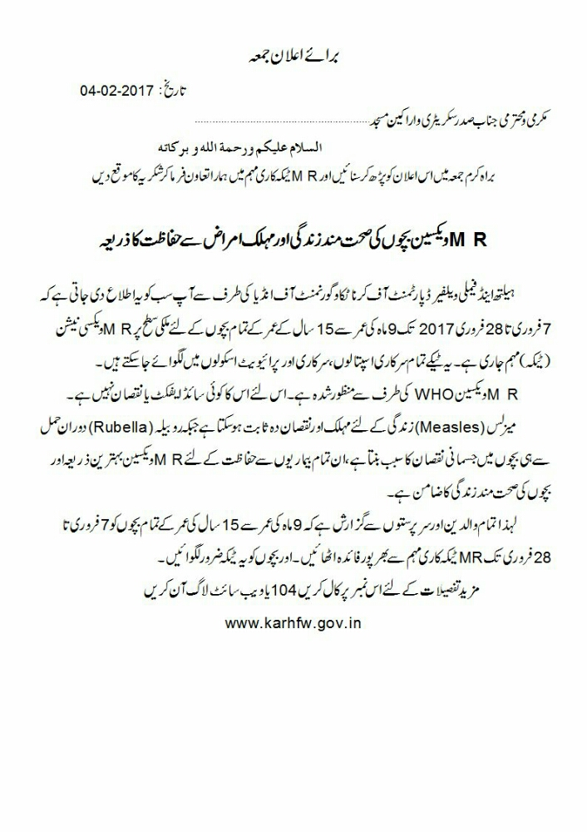
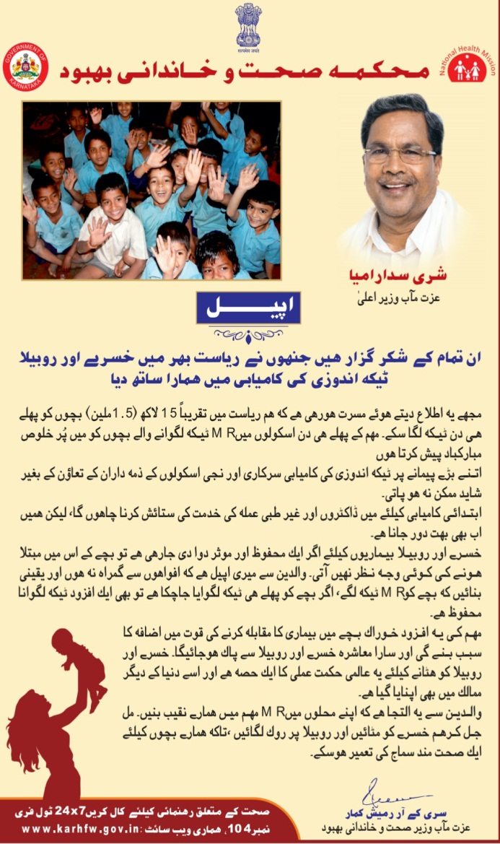
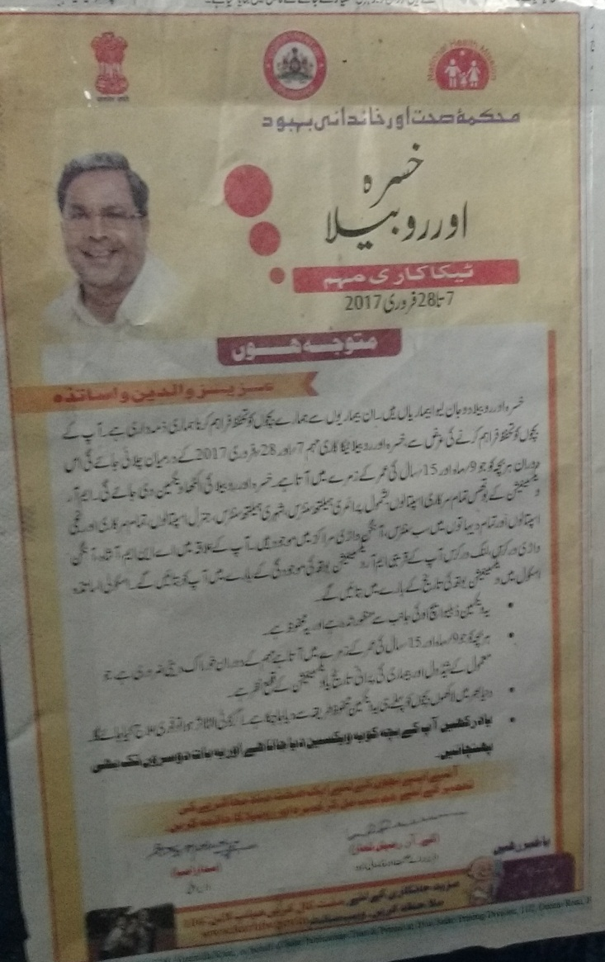
Letter from State Wakf Board and Urdu Appeals
- Not to believe in Rumours
Measles-Rubella Vaccination Campaign February 2017 Karnataka

Slide 16
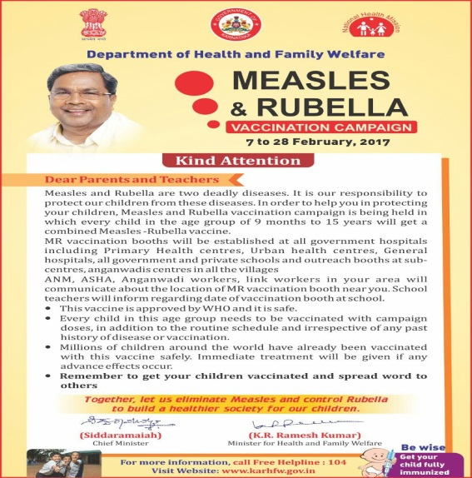
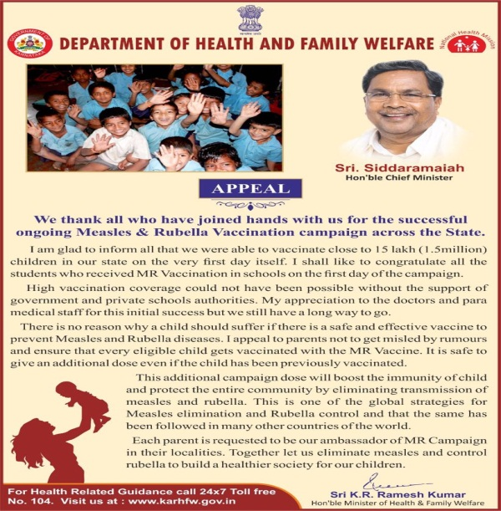
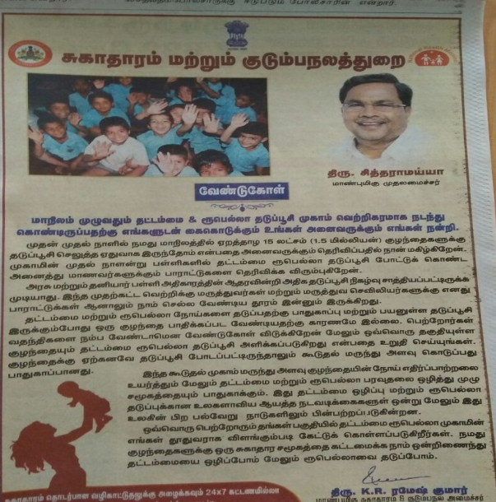
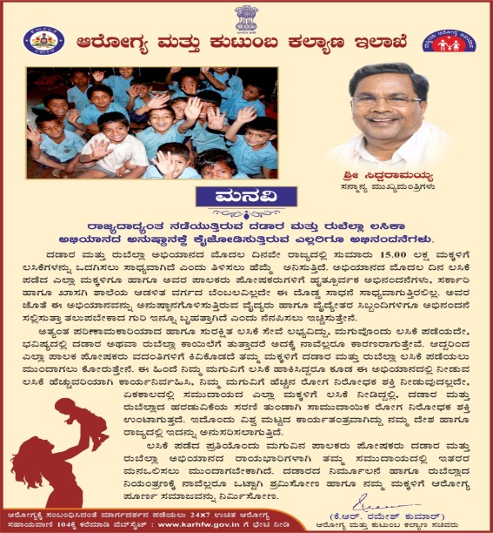
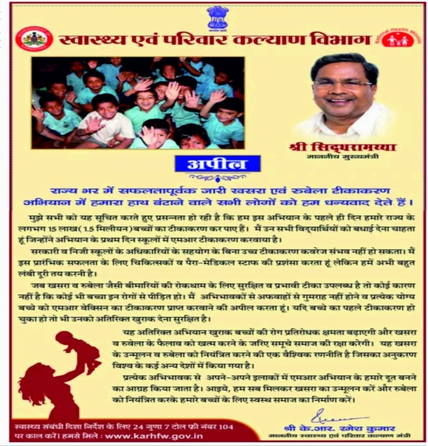
Appeals from Chief Minster & Health Minister
Published in 41 Newspapers in different languages
Kannada, English, Hindi, Urdu, Tamil, Marathi etc.
Measles-Rubella Vaccination Campaign February 2017 Karnataka

Slide 17
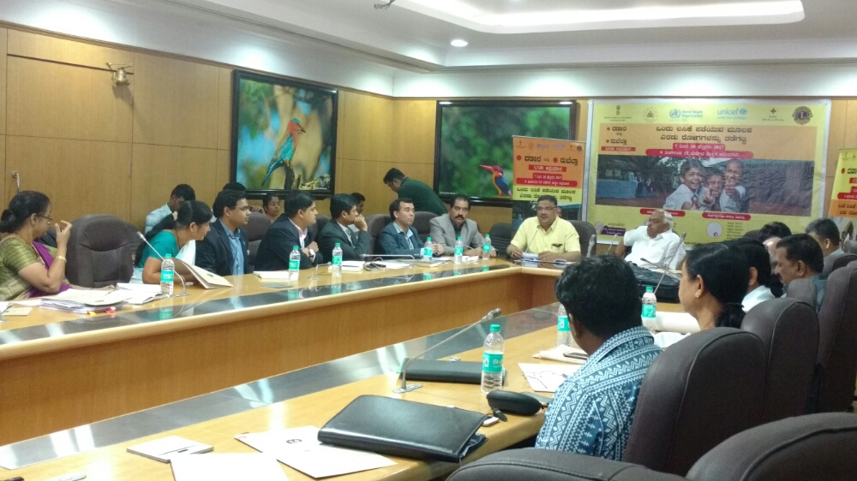
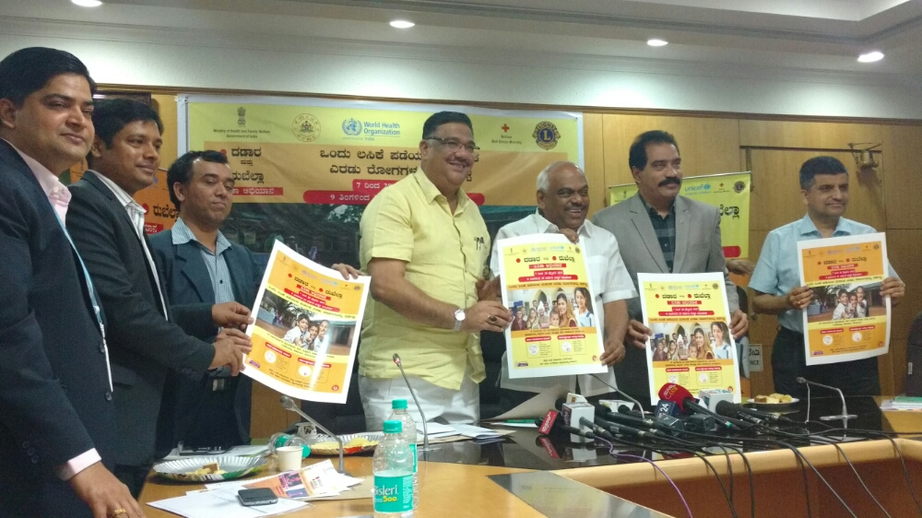
Joint Media briefing by Health Minister and Education Minister
Measles-Rubella Vaccination Campaign February 2017 Karnataka

Slide 18
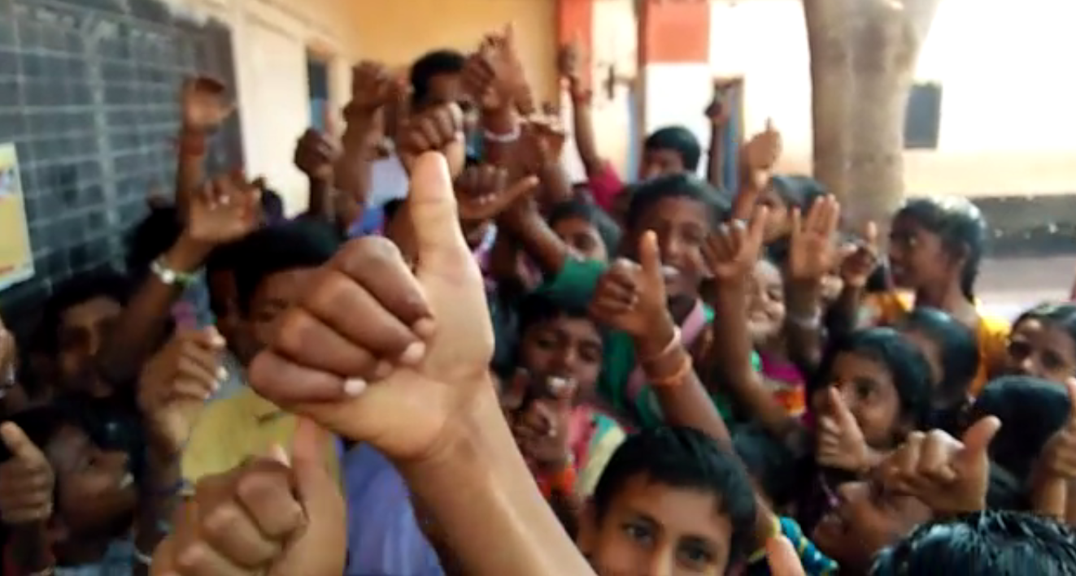
Positive video clips from vaccinated children circulated widely convinced many hesitant parents not to believe in rumours and vaccinate their children safely
Measles-Rubella Vaccination Campaign February 2017 Karnataka

Slide 19
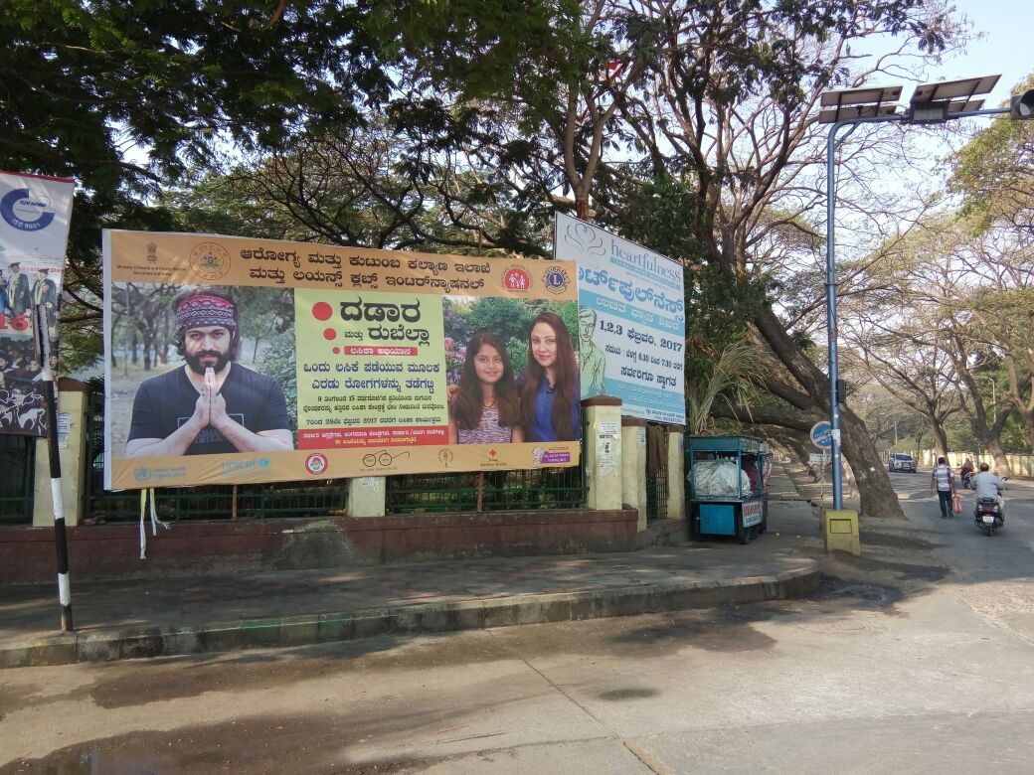
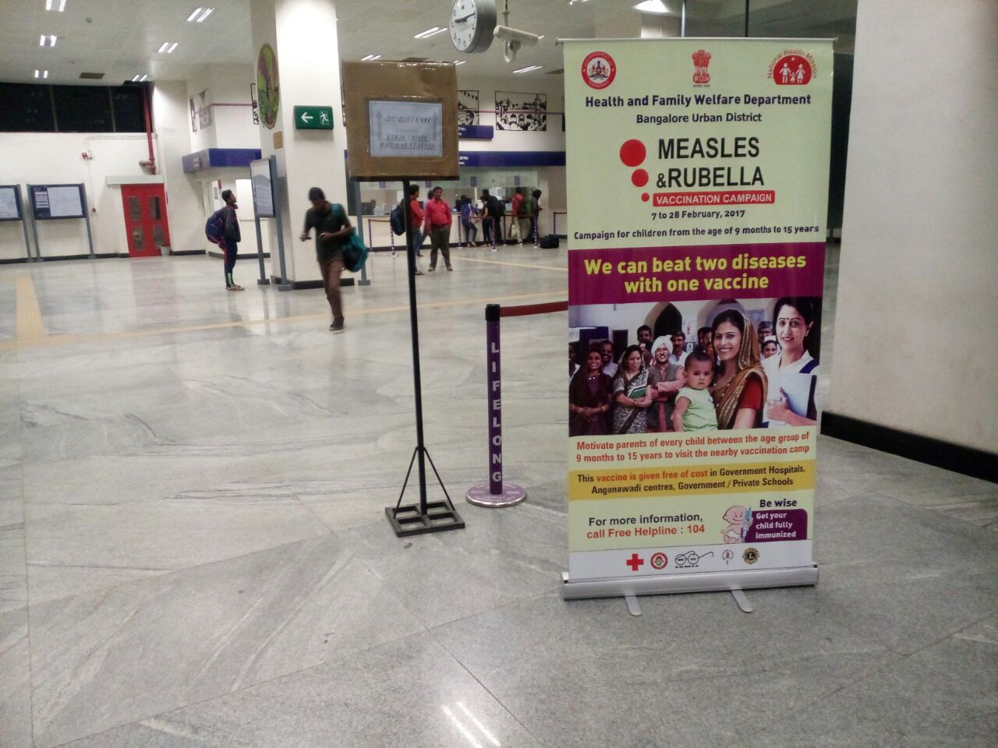
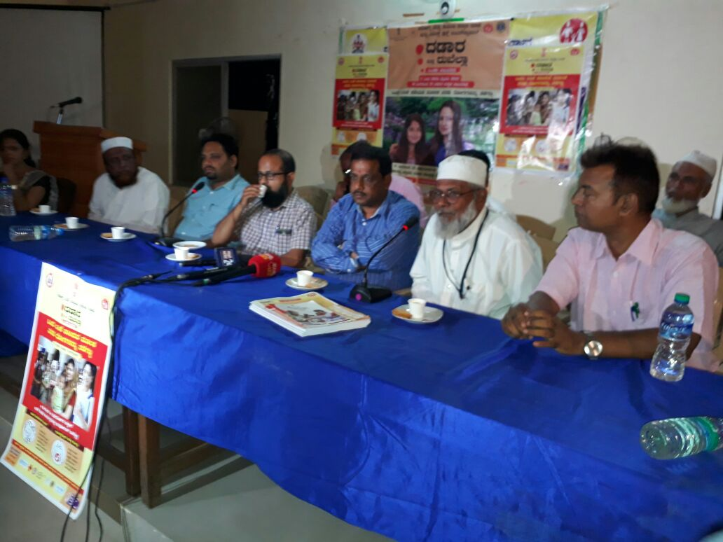
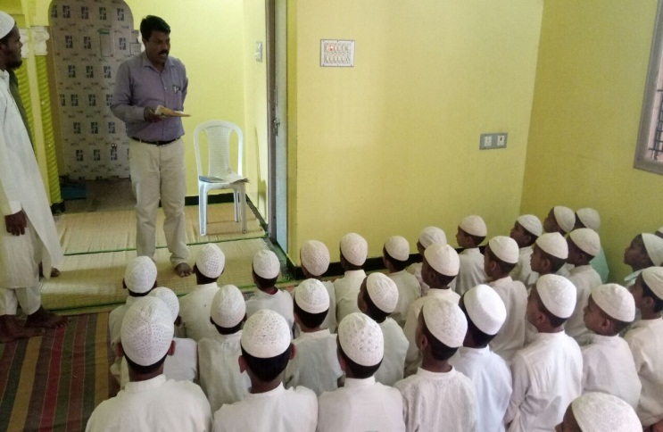
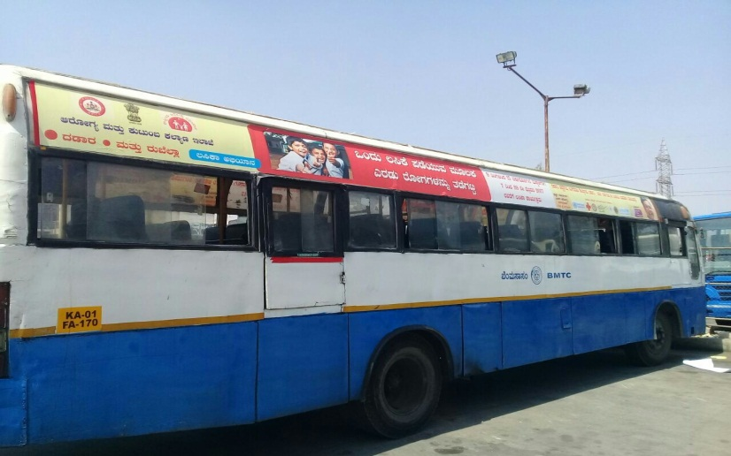
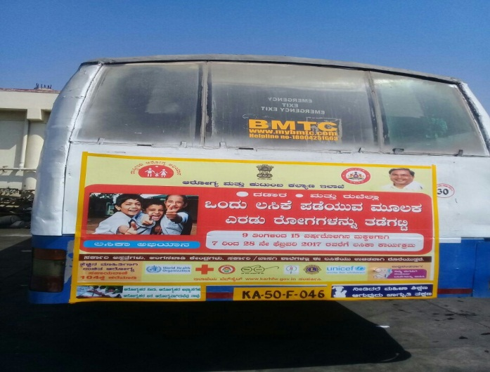
Reaching to all: Metro stations, Airport standees
Bus branding, Community leaders meetings, Hoardings,

Slide 20
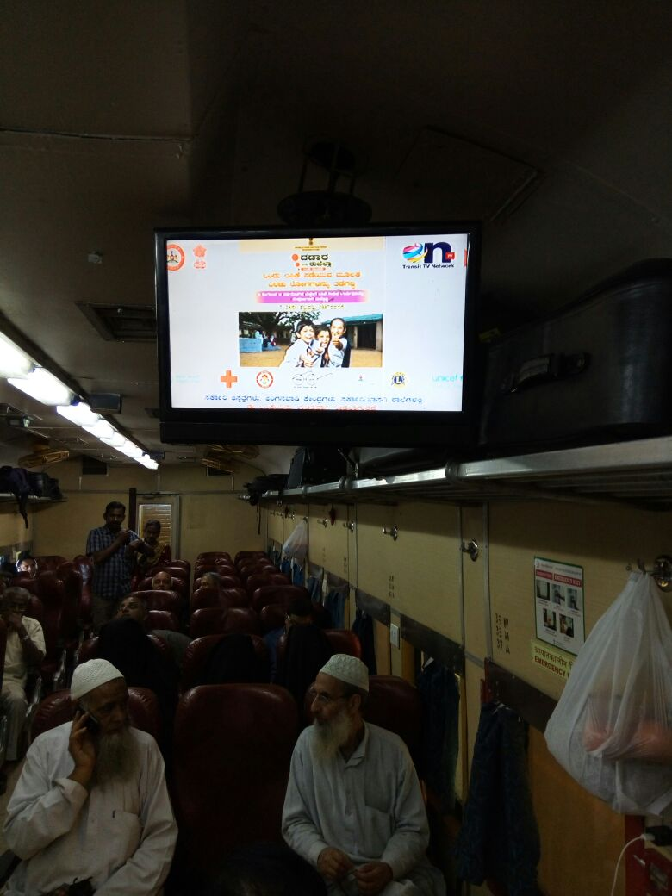
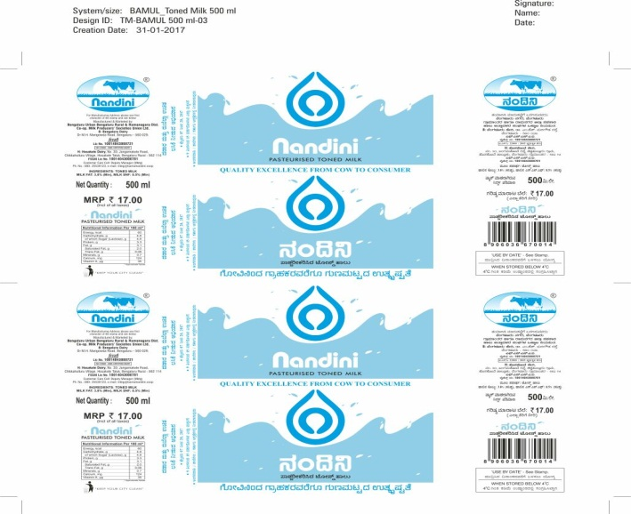
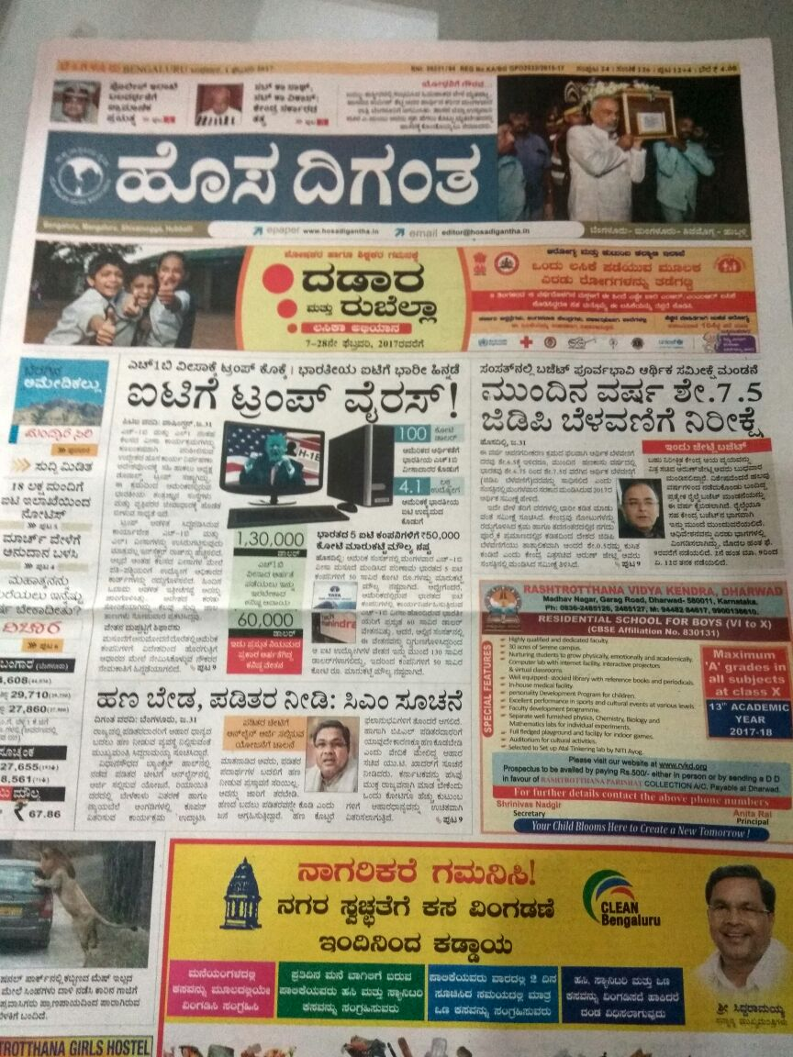
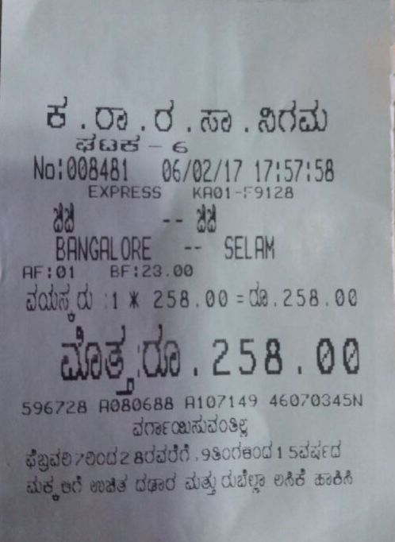
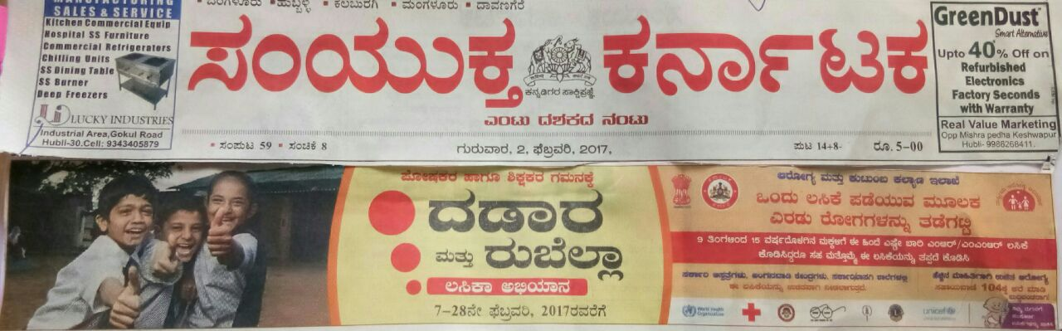
Reaching out to all: Announcements in Trains, Milk packets, Bus tickets, Newspaper skyber ads
Measles-Rubella Vaccination Campaign February 2017 Karnataka

Slide 21
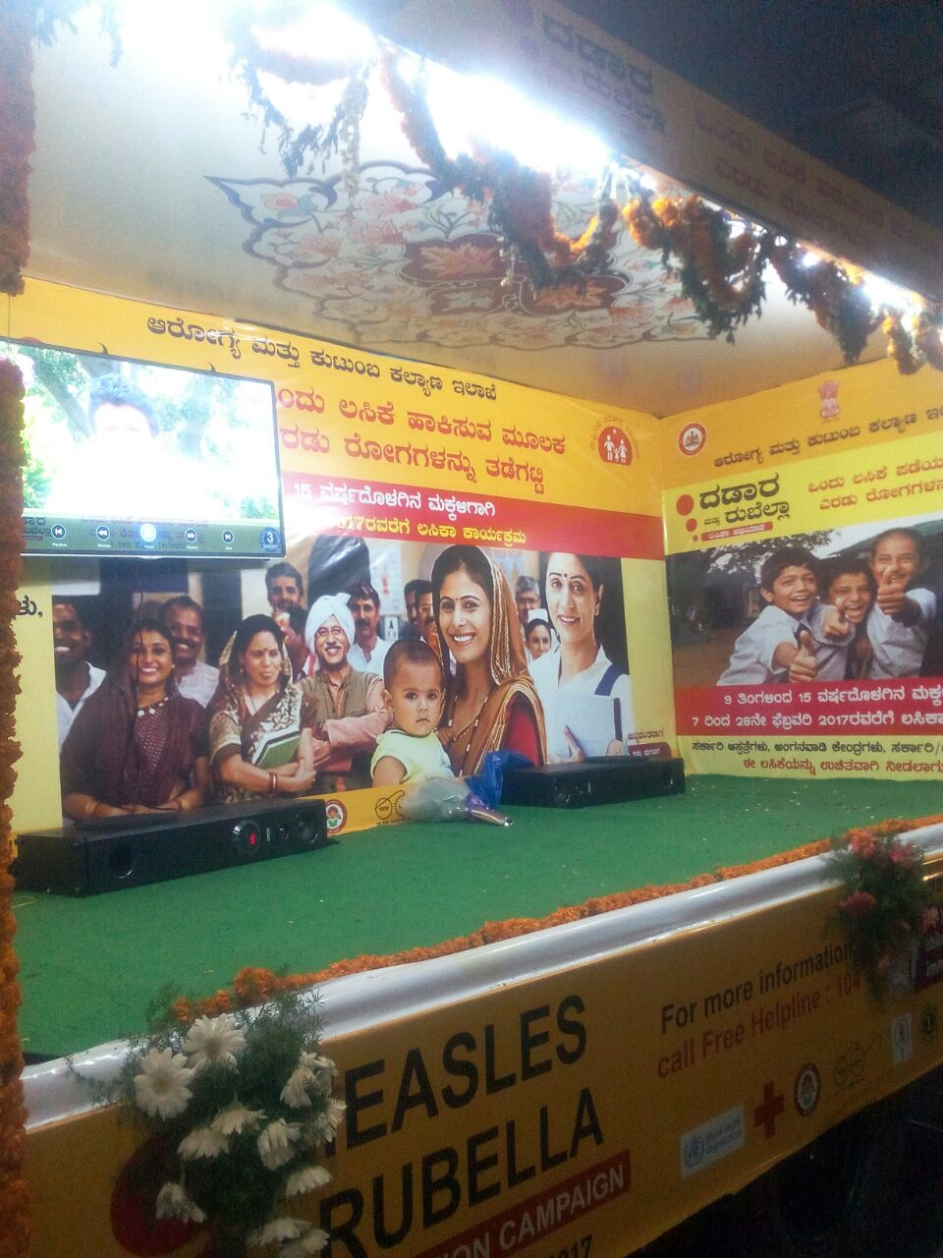
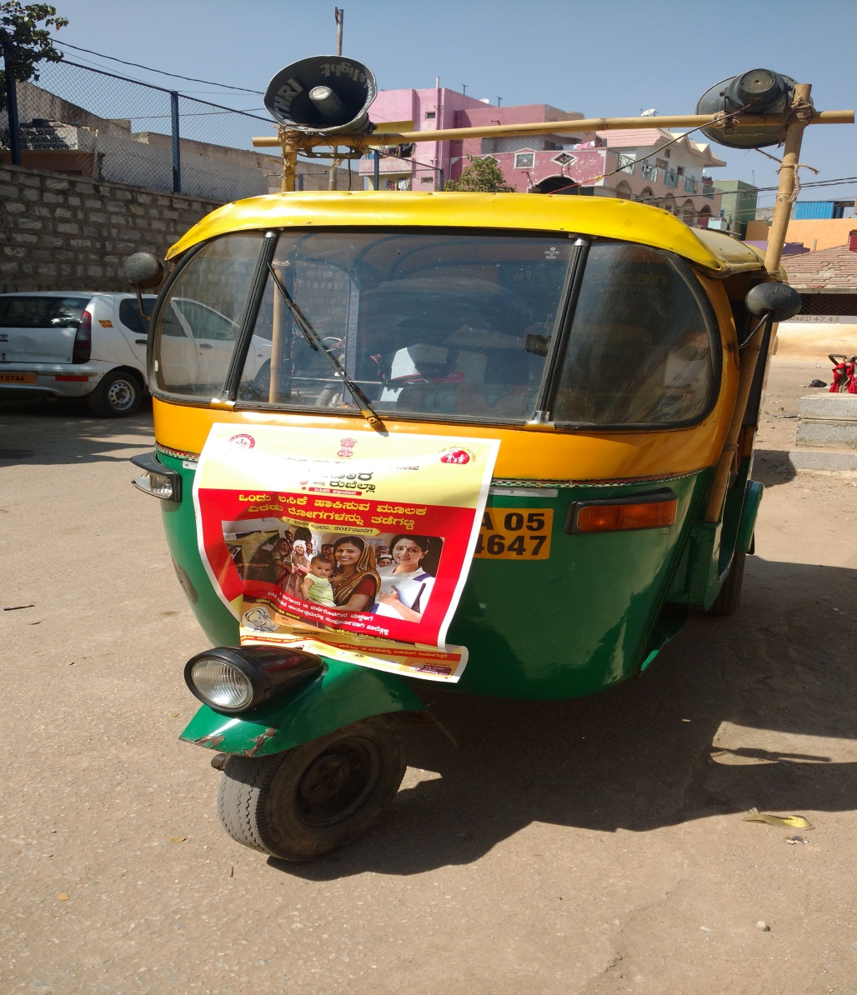
Kala Jatha Van
Dramas/Roleplays- Vaccination
Daily supervision autos with mike systems
Measles-Rubella Vaccination Campaign February 2017 Karnataka

Slide 22
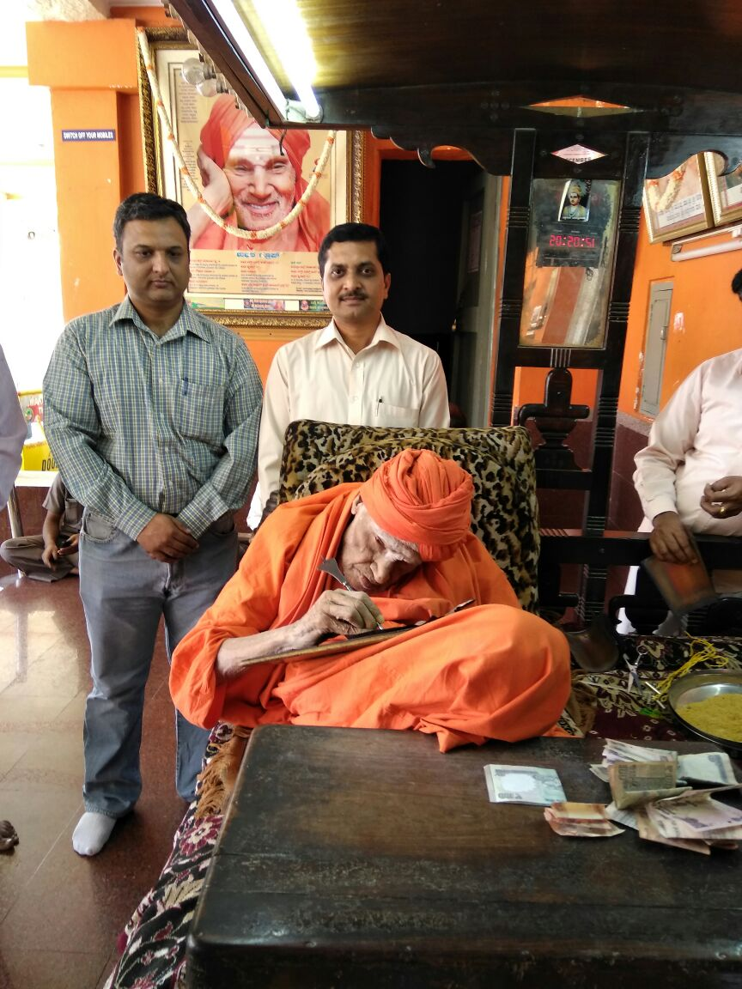
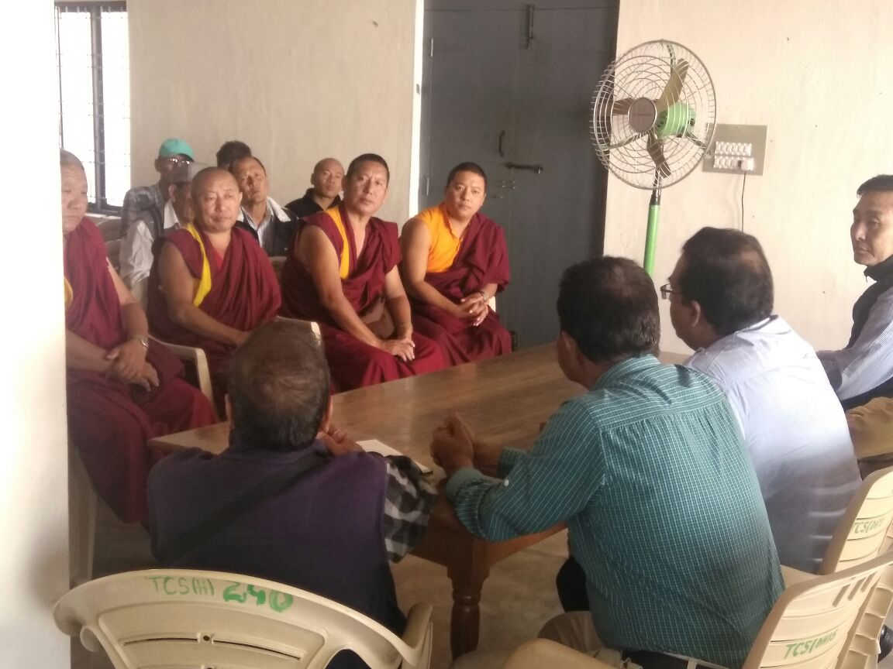
Support from Religious leaders
Measles-Rubella Vaccination Campaign February 2017 Karnataka

Slide 23
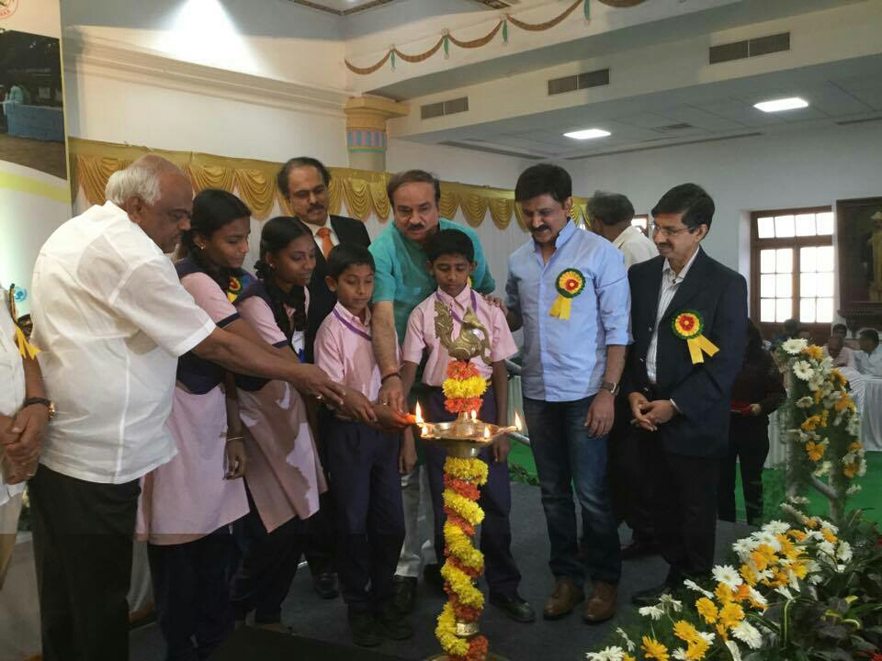
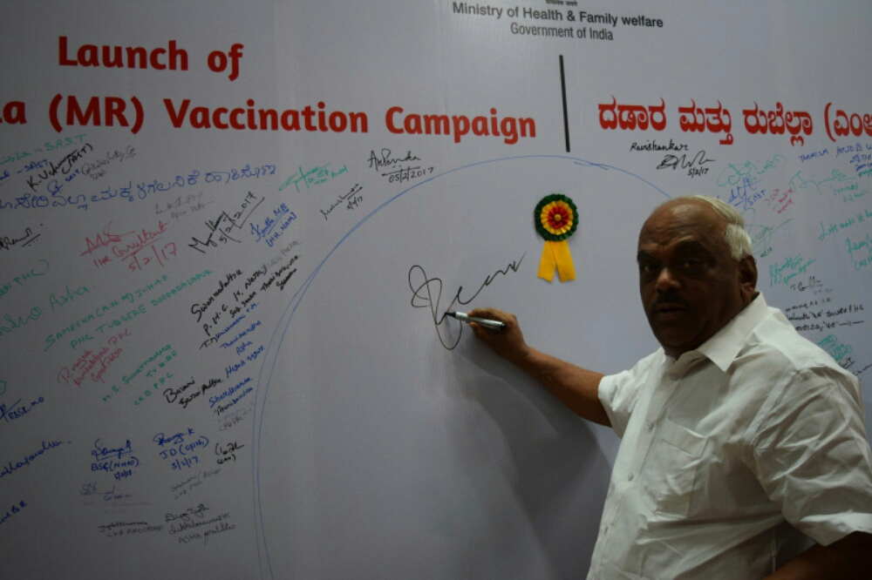
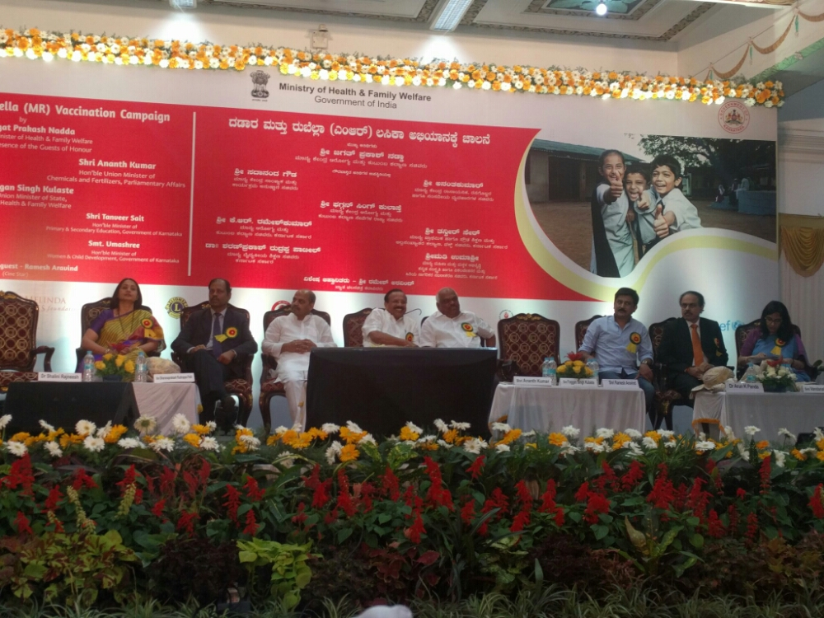
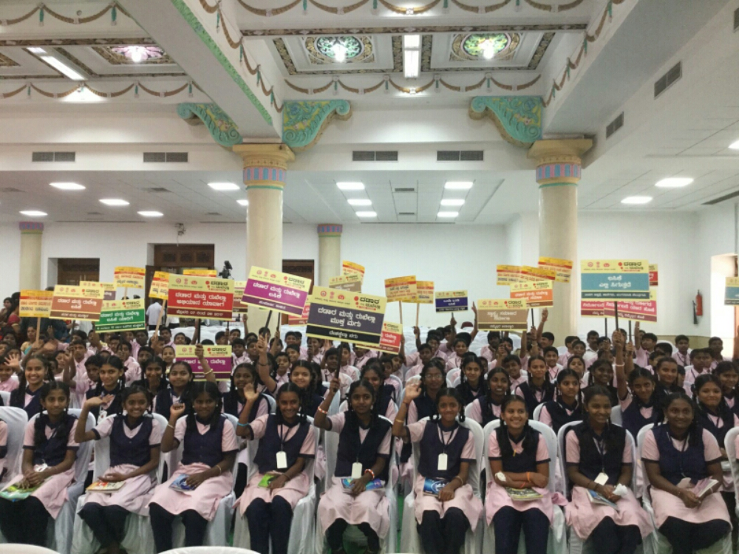
National Launch of MR campaign 5th Feb
Measles-Rubella Vaccination Campaign February 2017 Karnataka

Slide 24
Thank you

