Slide 1
Zone-wise categorization of essential services at HWCs during COVID times in Chhattisgarh
28 th December 2020

Slide 2
Background
Due to COVID-19 outbreak, health facilities and workforce overburdened
Major focus shifted towards controlling the pandemic
Essential health services at HWCs and other health facilities got compromised
Health seeking behavior of general population also affected because of :
  Lock down, Social / physical distancing requirements
  community perceptions that health facilities are infected
It was equally important to focus on non COVID activities and continue providing essential services,
State developed detailed operational framework for continuing essential services in HWCs located at different zones (Red/orange/green) with the technical support of Jhpiego / NISHTHA for implementation

Slide 3
Essential & Desirable Services
Essential services for all areas included:
  maternal, new born and child health,
  prevention and management of communicable and Non Communicable diseases,
  Continuum of care for NCDS/ chronic diseases to avoid complications
  addressing health emergencies.
  health promotion activities
Desirable Non-COVID-19 services were defined, which could be deferred and undertaken after lockdown/restrictions are lifted. These services included:
  IEC campaigns
  meetings of the Village Health Sanitation and Nutrition Committees /
  Mahila Arogya Samitis
  community based screening for chronic conditions, other screening programmes
  etc.

Slide 4
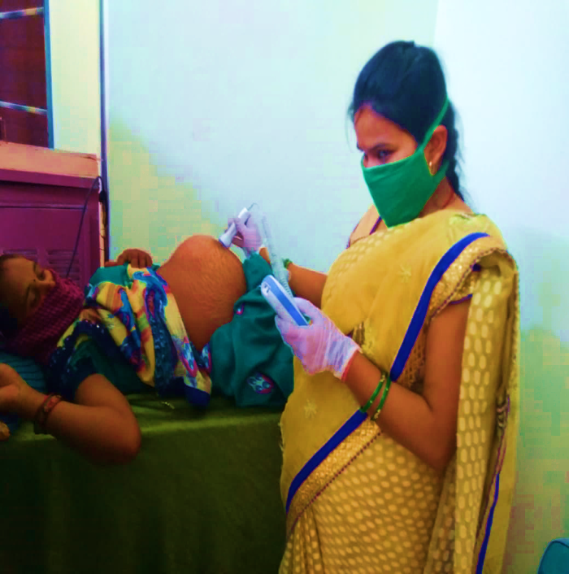
Ante-natal care services
ANC home visits by RHOs
Doorstep delivery of IFA, Cal. tablets.
telephonic follow-up if cannot do home visits. Consult PHC MO through telephone/ telemedicine, if needed
RHOs make a list of suspected/ confirmed COVID-19 PW & share with sector I/ C MO for birth preparedness
Quarantine facilities at nearest PHC/CHC for PW who were exposed to +ve cases
Special quarantine centers setup for pregnant women and children
Red zone
Orange zone
Follow up of ANCs/ PNC/HBNC through home visits by ANMs / ASHAs / CHO.
Telephonic follow-up / Tele medicine facilities at HWCs
Advance birth planning & counselling for deliveries at alternative CHC-FRU.
Mothers can visit the SHCs / HWCs/ PHCs only if required for ANC
Educate the pregnant women on COVID-19 infection prevention and control measures
Three months’ supply of IFA, Calcium tablets through home visits
Green zone

Slide 5
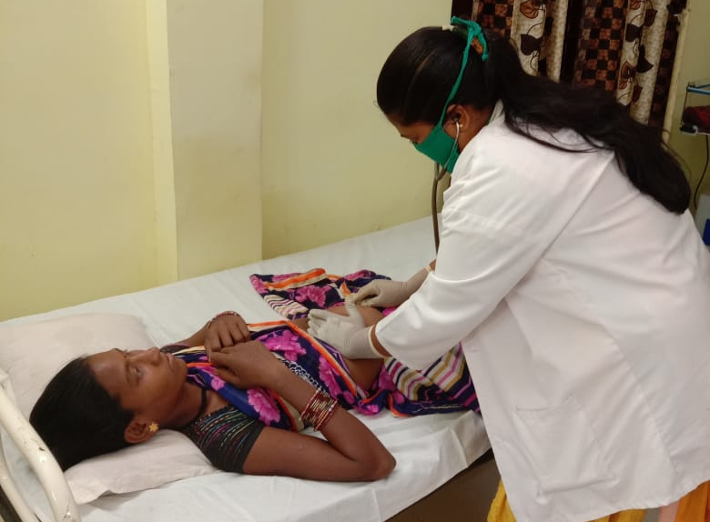
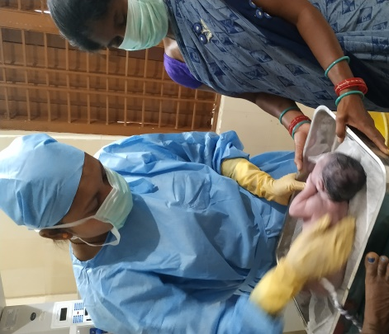
High-risk pregnancies
Line listing & follow-up - High risk pregnant women's.
Birth Planning - Identify delivery points in advance to prevent potential complications (CEmOC), referral care for newborns and children with serious diseases
Transport - Non COVID-19 ambulances are available for emergency . Advance arrangement of logistics and transport.
Ensured Facility preparedness -
  Full time Availability of MOs
  Availability of safe delivery kit at HWCs.
  Availability of essential drugs and logistics including adequate PPE, misoprostol etc.
  All Blood banks/Blood Storage Units are kept functional and ensured adequate stock.
All zones

Slide 6
Intra-partum services
For red zone/orange Zone
Ensured availability of transport for the COVID positive/suspected PW.
Took consent additionally to routine consent also taken at the time of admission including aspects related to COVID-19 infection
Restriction of entry of birth companion in LR.
Dedicated COVID labour rooms/ OTs for Covid Positive care established
Ensured adequate supply of safe delivery kits to all designated delivery points
Ensured availability of Misoprostol and disposable delivery kits with ANMs / CHOs for safe deliveries
Maintain unidirectional flow to enter the labor room after donning recommended PPE
Cleaning as per protocals
All Blood banks/Blood Storage Units need to be kept functional and should ensure adequate stock.
Labor room protocols to be made available at the health facility.
Orientation of MItanins to ensure enlisting of pregnant women with EDD up to next 3 months
All zones

Slide 7
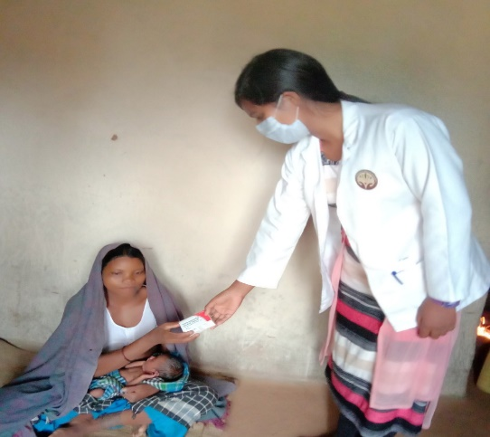
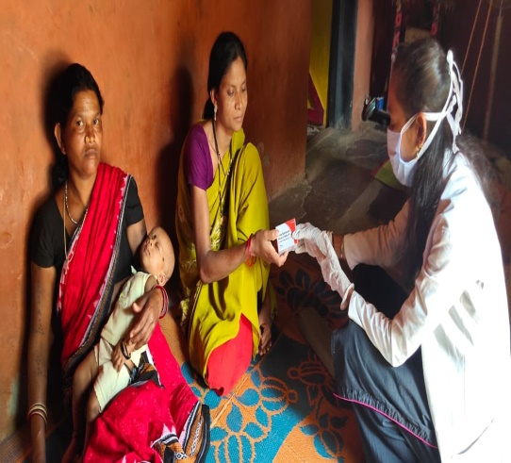
Post-partum & newborn care
Counseling of all mothers on HBNC & IPC measures.(danger signs for mothers & newborns. Let her breastfeed even if she is a suspected or confirmed case)
Telehealth/Telemedicine services
Three months supply of IFA, Calcium tablets can be ensured by Mitanins through home visits
The mother assured mask all the time and strictly followed all the IPC measures while feeding the new born.
All zones
Follow up post-natal mothers on telephone on day 1, 5 and 10 by CHOs / ANMs / Mitanins. Home visits for PNC services and newborn care can be done by ANMs/Mitanins, only if required
Red zone

Slide 8
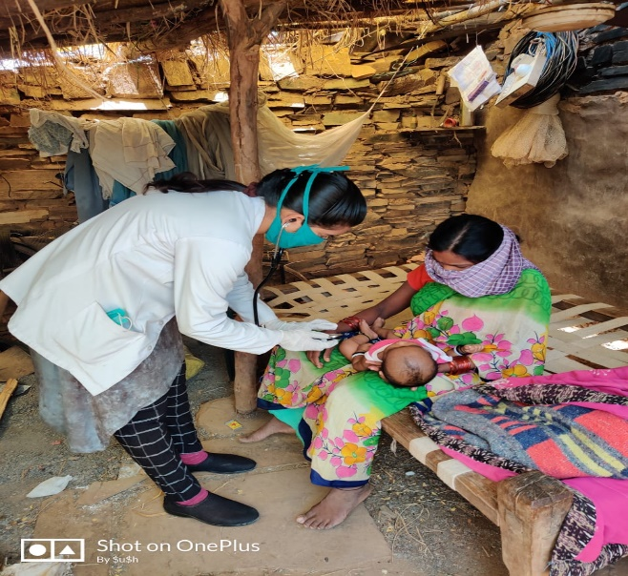
Immunization services
Red zone
Conducted only essential vaccination through house to house visits
Quarantined beneficiaries identified and vaccinated after the quarantine peried.
Immunization
Ms Sushma, CHO,HWC-Tekameta, Baster
Triple layer masks, gloves and proper hand hygiene to be maintained by HCW
List of all HCF having cold chain points must be updated
The name & contact details of HCW must be provided with beneficiary
Line listing of all beneficiaries’ facility wise for next 3 months
Adequate supply of PPE
Ensuring availability of vaccine logistics
All zones
Green/ Orange zone
Conduct vaccination at health facility maintaining social distance and proper use of mask by PW

Slide 9
New born care & childhood illnesses
Home visits by Mitanins with proper protection
Pre-counseled mothers before leaving the HCF for exclusive breast feeding, safe neonatal practices and KMC Continued admission to SNCU and NBSU as per existing guidelines
Mitanins contacted the family telephonically regarding Home Based Young Child Care. Discontinue home visits
In case of childhood illnesses, Mitanin / ANM / CHO did consultation with PHC MO telephonically for appropriate referral and management advice
Enlisting sick newborns and young children by Mitanin followed by rigorous follow-up through telephone
Use government non-COVID ambulances for transportation of sick newborns. Used private vehicles if required with due reimbursement.
Ensured adequate supply of ORS, Cotrimoxazole, Gentamycin, and Amoxicillin at the SHC / HWCs.
Calculated drug requirement by considering estimated number of cases. Relax norms for local purchase
Red / orange zone

Slide 10
Management of children with SAM
Red/ orange zone
Growth monitoring of children falling into severe & moderate category of malnutrition
SAM children or the accompanying mother /caregiver who are asymptomatic or with suspected or proven COVID 19 infection managed in separate isolation facility as per recommended COVID guidelines.
Previously admitted children who are stable and have entered rehabilitation phase can be discharged early with appropriate feeding advice and medication
Recommended SAM management protocols followed during the stay period.
ALL SAM Cases identified in the community can be referred by Mitanin/AWW to PHC, SHC or nearly HWC for follow up.
Telephonic follow-up of children discharged from NRCs
List of children discharged from NRC shared with AWC ,prioritized home-based delivery of Take Home Ration

Slide 11
Family Planning
Red zone
Distributed condoms/ OCPs/ Chhaya possibly for 3 months by trained Mitanin/ANM.
Delay IUCD, Antara, Sterilization. Opt for alternate appropriate spacing methods
PPIUCD is only recommended for institutional delivery cases. Medical/ surgical abortion & PPIUCD services s done only at those HCFs with proper IPC measures, including MTP Act registered pvt. hospitals. ANM identify and refer these cases.
HWC, block and district level microplanning used the line list of eligible couples.
Three monthly indenting through FPLMIS by looking into last three- month utilization.
Green/ orange zone
Facility/ VHND (not in orange zone) level counselling done by FP counsellor in designated Health facility
During house visit for COVID-19 surveillance, FP counselling for basket of choice provided by the Mitanin/MPWs

Slide 12
Disease control-Tuberculosis
Red zone
Digital IEC material for healthcare provider
Continue supply of DOTS ensured
Listed MOs for teleconsultation/ telemedicine support
Identified a nearby private provider near home for injections for MDR-TB patients who are on injectable regimen
Bi directional TB-Covid test initiated
All zones
Training of NTEP staff and RHOs on managing TB patients and community during COVID-19
Line-listing of all TB and MDR-TB patients maintained at the PHC/ SHC/ HWC level
Ensuring seamless functioning of TB toll free helpline numbers to avert any service interruption during lockdown
Catalyze NTEP team for DBT payments to private providers and TB patients
Green zone
Ensured routine screening/ diagnostic/ treatment as per std. NTEP guidelines
Collected sputum on home visits following SOPs by RHOs for suspected cases/ patients who can’t come to HCF
Involved youth runners for transport of sputum samples to the respective microscopic centers
Mapped of TB resources (city/ district/ block-wise facilities and services in public/not-for-profit/private sectors) in the catchment area
Equipped frontline health care providers with TB resources of the catchment area
Developed SOP for client flow of TB patients to avoid any contact with Covid-19 patients

Slide 13
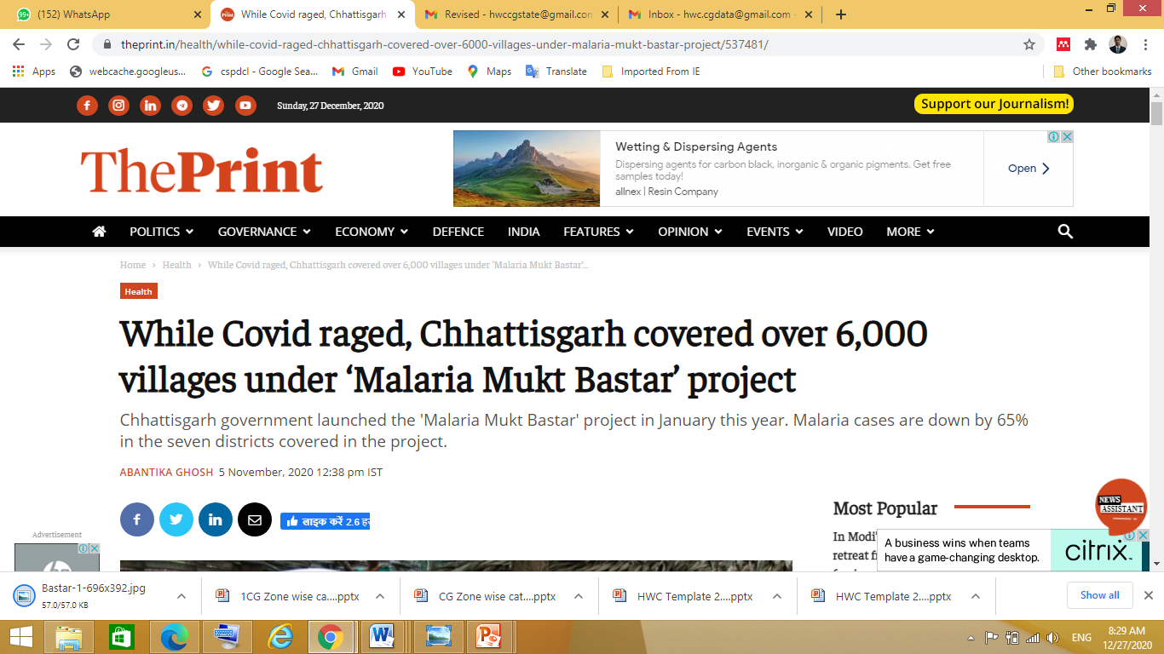
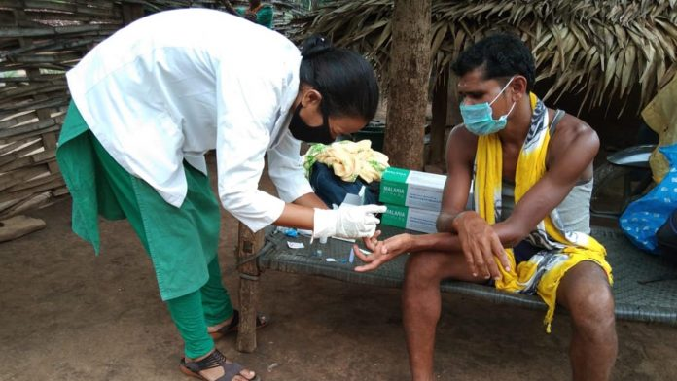
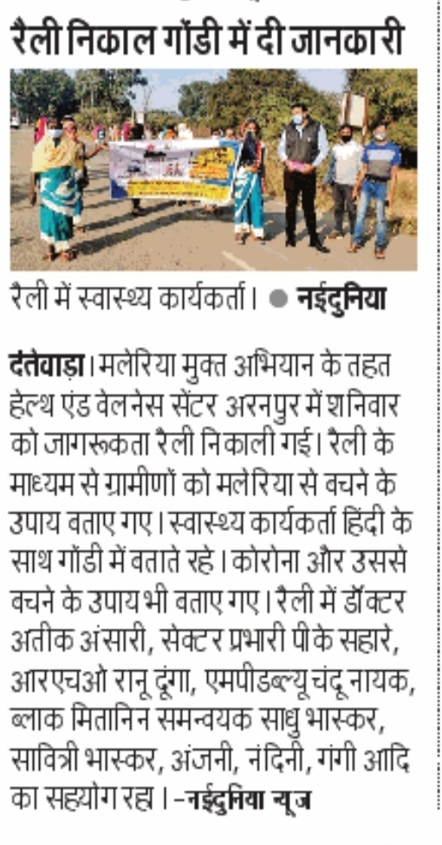
Disease control- Malaria
During COVID lock down period second phase of Malaria Mukt Bastar abhiyan was implemented Successfully and covered 6000 villages
Healthcare workers in Bastar region went door to door, testing people to achieve 100 percent coverage
About 10 months after the initiative was launched, the seven districts in Chhattisgarh have seen a 65.5 per cent year-on-year decline in the total cases of malaria recorded.
This year, the malaria mortality rate in the Bastar region also declined to 0.5 in the January to September period, compared to 0.39 last year. In Sukma, it is down from 1.5 to 0.37 and in Dantewada from 2.16 to 0.30.
The test positivity rate — the number of people testing positive — in the first round of the programme was 4.6 per cent while in the second phase, it was 1.27 per cent.
Due to the COVID situation, every survey team was provided with masks, gloves and sanitisers and they were instructed to maintain physical distance everywhere.
Supervising teams ensured that the teams that visited door-to-door, followed Covid appropriate behaviour

Slide 14
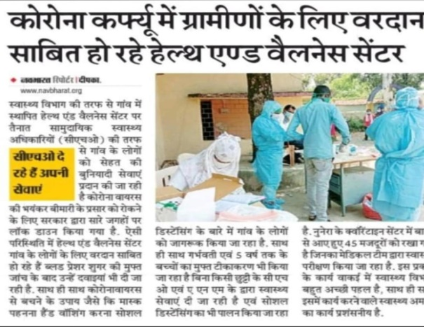
Non Communicable Disease control
Red zone
Line listed the Co-morbid patients and 60+ year of population at HWC Level
Ensured door step screening and follow at door step
Ensured continuous monitoring and uninterrupted delivery of essential medicine
Health education and IEC for prevention of COVID is been ensured
Maintenance of buffer stock of all essential medicine and consumable
Shielding of Co-Morbid and 60+ population at Home by HWC team
All zones
Ensured all the Healthcare staff should follow COVID –19 protocols while providing care at facility level
Instructed to use barrier cabinet in the OPD area
Only emergency cases/symptomatic cases are allowed to come in Health care facility, non emergent cases are treated at community level
For Symptomatic and suspected case fever clinic was being run so that healthcare worker and patient can be protected
Green zone
Ensured routine screening/ diagnostic/ treatment as per std. guidelines
Screening by home visits following SOPs by RHOs for suspected cases/ patients who can’t come to HCF
Equipped frontline health care providers with resources of the catchment area
In all HWCs annual Health Calendar is being followed

Slide 15
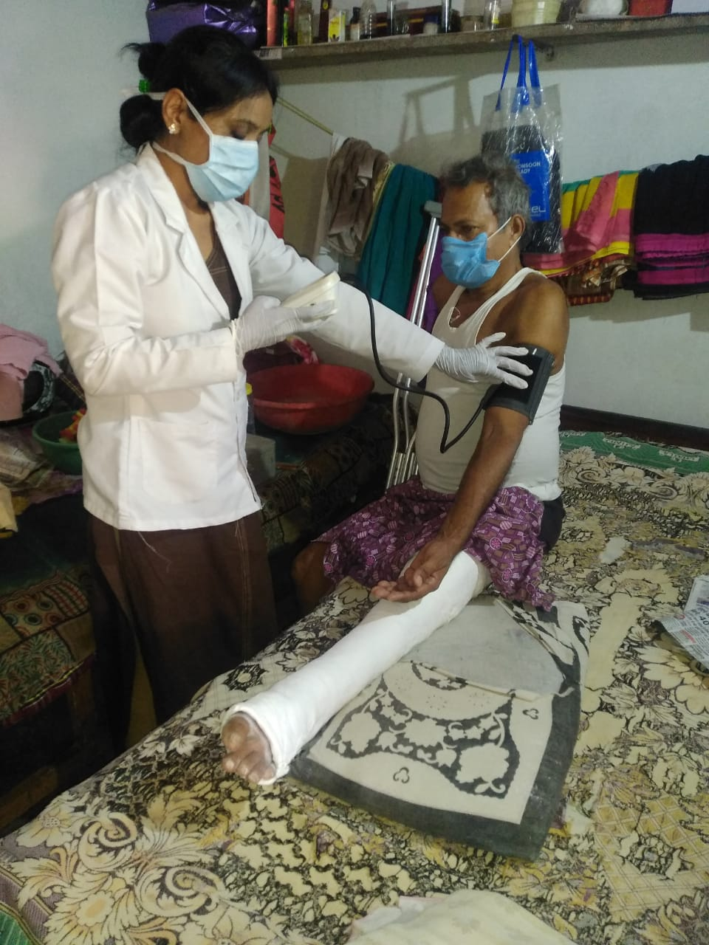
Overarching themes
Organized VHNDs only in the green zones and continue provision of services on MCH/ FP/ TB as usual
Continued essential activities with necessary precautions from COVID-19 in the green zone
Provision of Adequate supply of PPE to RHOs/ CHOs & other healthcare staff
RHOs trained on infection prevention and control measures and workers strictly followed IPC guidelines.
RHO trained in personal protection, use of PPE and hygiene practices
Social distancing and infection prevention practices followed at all levels by all health care staff during COVID-19.
Home based care for NCD
CHO Rasia HWC Bhaleshar, Mahasamund

Slide 16
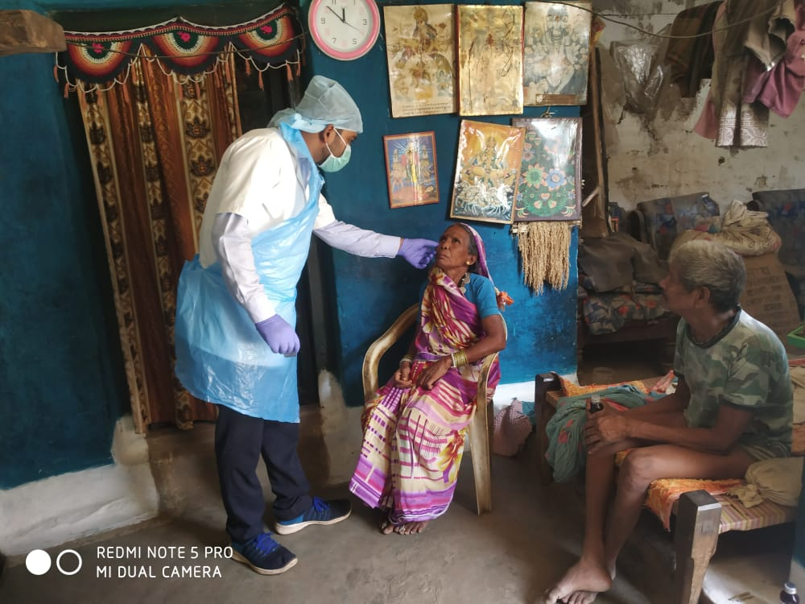
Overarching themes
Routine follow-up through WhatsApp or telephone for HRPs, sick newborns, NBSU / SNCU / NRC discharged infants and children, TB and NCD patients by CHO,s/ANMs/community volunteers, SHG members, retired / nurses / health providers, school teachers and NGOs.
Patient support groups for TB, NCD made on WhatsApp where follow-up and adherence ensured by health providers under supervision of PRI members
Private vehicle employed for transporting patients in the absence of government vehicles and reimbursed by district administration

Slide 17
Achievements
Door Step Delivery of Drugs During COVID-19 Pandemic (1 April to 30 November 2020)
(Reported by 1655 Health and Wellness Centers)
Total Number of Diabetes Patient Received Medicine at Home | 196375
Total Number of Hypertensive Patient Received Medicine at Home | 132330
Total Number of Tuberculosis Patient Received Medicine at Home | 5279
Total Number of Leprosy Patient Received Medicine at Home | 2727
Total Number of Pregnant Women Received Medicine at Home | 185470

Slide 18
Thank You

