Slide 1



Slide 2

Why a new fund management system?
Funds kept in large number of bank accounts at state, district and sub district levels making reconciliation difficult
Parking of funds and unused balances
Real time monitoring mechanism lacking
Expenditure not limited to the budget provided in PIP
Payment through PPA cumbersome
Artificial fund shortages

Slide 3
What is e-Vittapravaha
Single bank account at the state level
Web based application for management of NHM PIP/ Budget & Fund flow
Single window gateway for all payments
Real time information system of fund availability

Slide 4
PIP & FUND RELEASE PATTERN
PRE e-Vitta
POST e-Vitta
GoI
GoI
State Health Society (22 bank accounts)
State Health Society (single parent account)
51 Districts (568 bank accounts)
426 DDOs (child accounts)
313 Block (313 bank accounts)
PHC
SHC
VHSC

Slide 5
Modules of e-Vittapravaha
Activity Management
Budget Management
Manage Fund Disbursement
Reconciliation
Fund Release Management
Beneficiary/Vendor Management
Support Request

Slide 6
Users of e-Vitta
Policy Makers(4)
Finance(3)
State Level
Planning(2)
IT
(2)
Program Officer
(29)
AIIMS
(3)
Division Level
RJD
(21)
Training Institutes
(9)
Nursing Colleges(6)
District Level
CHMO
(153)
District Hospital
(153)
Medical Colleges
(36)
Block Level
BMO
(939)
Other Hospitals
(12)

Slide 7
Process Flow Of e-Vittapravaha
Planning/IT
NHM
State Parent A/C
Beneficiary/ Vendor Registration
Budget Head/Activity/Sub Activity Mapping
Program officers
Post DS request goes to parent account for credit the required amount to child account
DDO & Activity wise Budget Allocation
auto Swipe in
Maker
DDO Child A/C
Fund Disbursement
(Expenditure/Advance/DBT)
DDO (till block level)
Finance
Separate A/c for tax payments
Fund Release (Untied/beneficiary/NHM universal)
Excel Upload
Integration
(HRMIS,ASHA, RBSK, Tally, PFMS)
PFMS
Reverse MIS
Real time auto Swipe out..
Liability deductions file
Beneficiaries/ Vendors/Employee A/C
Tax payment using E-Net for 51 DHS Nodes
CBDT/EPF/OTHERS Tax Portal
Payments(Maker & Authorizer)
Acknowledgement of tax Payments

Slide 8
Implementation Support
Divisional Coordinators
Central Support Team
State officials
Technical Team
(Solution provider + Bank)

Slide 9
Systemic Impact
Ensures perpetual availability of funds till block level throughout the year
Limits expenditure against planned activities
Allows flexibility of budget allocation
Ensures improved implementation of beneficiary oriented schemes
Release of Untied funds directly from block level to VHSCs, SHC, PHC
Integration with program softwares like ASHA/HRMIS or RBSK etc. for calculation of payments

Slide 10
Process Reforms
e-request trail for additional budget/ fund
Program officer will be able to monitor the utilization of funds by all the DDOs through their logins
Fund provided up to the extent of fund utilized - solution for parking of funds
No delays due to PPA processing - Digital signature for high speed payment in PFMS
Minimal advances since nodes added as Vertical Departments like Medical colleges

Slide 11
Innovations
Linkage between activity wise approved budget of PIP & expenditure
Earmarking of fund – Beneficiary, Untied and NHM universal
Provision of Maker, Checker & Approver
Approval using Biometrics based Aadhar authentication
e-delegation for link officer
Mandatory upload of supporting documents for every transaction

Slide 12
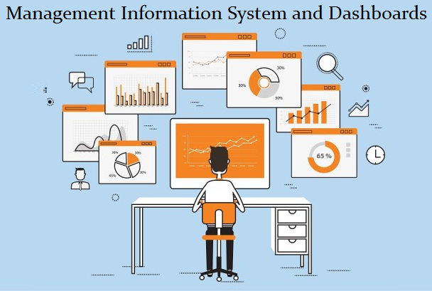
MIS & Dashboards
Budget Management
Budget Allocation Details
Activity Wise DDO Analysis
DDO wise Financial Analysis
Program wise Analysis
Fund Disbursement
Fund Disbursement Details
Payment Tracking Analysis
Reconciliation Analysis
Deduction Analysis
DDO wise Deduction Analysis
Dashboard
DDO Dashboard
Payment Tracking Analysis
Reconciliation Analysis

Slide 13

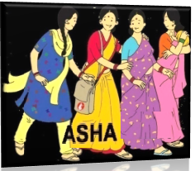



Integrating Program Applications
e-
Vittapravah

Slide 14
Challenges faced during---
Development
Synergy between PFMS codes and FMR codes
Matching the activities to the relevant outputs in PFMS
Matching the output template from e-Vittapravah with desired input form of PFMS
Load estimation for infra sizing
Categorising the activity types
Identifying designations for various roles
IT Infrastructure - State of the art State Data Centre

Slide 15
Challenges faced during…
Development
Dynamic nature of requirement - Flexibility of software adapted to dynamic nature of requirement
Financial statement & Ledger management – Integration with Tally in progress
Payment of taxes- Integration with dedicated tax paying portal.
Availability of need based hardware resources – SDC provides resources on the fly

Slide 16
Challenges faced during…
Roll Out
Training of users
Manual upload on PFMS & EP04 - Integration process with PFMS already initiated by MoHFW/CGA/NHM MP
Integration with program softwares like ASHA,
HRMIS- Process details of various activities is lacking
Connectivity at sub district level : Primary connectivity of SWAN & secondary connectivity
Mismatched timing between finalized PIP and go live of the software.
Closing of district level bank accounts
Network security management – Technical support by SDC

Slide 17
Daily payment Transactions(No.) – 8000 to 10000
Average daily Disbursement(Amt.) – 5 cr

Slide 18
Payments Made in e-Vitta

Slide 19
Payments Made by Direct Benefit Transfer
Others(1.6 cr)
Total Amount Disbursed -97.5 cr, As on 27/10/2018

Slide 20
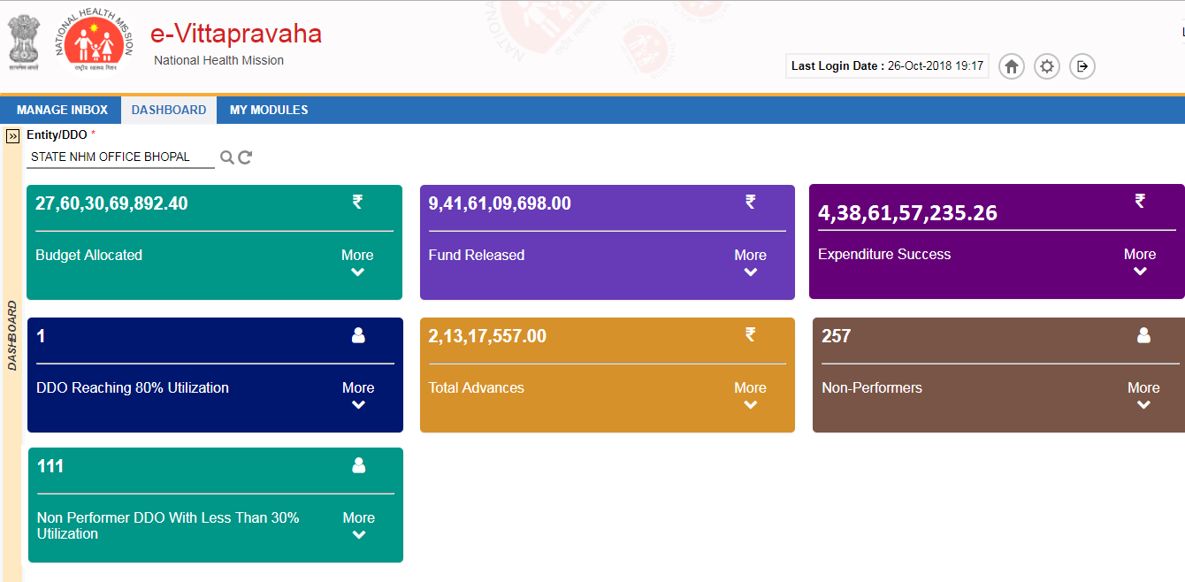
Management Dashboard

Slide 21
NEXT STEP -Integration with PFMS
State Parent A/C
Planning/IT
Beneficiary/ Vendor Registration
NHM
Budget Head/Activity/Sub Activity Mapping
Maker
PFMS Validation
Program officers
DDO & Activity wise Budget Allocation
Beneficiary/ Vendor Unique code generation
PFMS
Digitally signed
Approved File from SFTP to PFMS
Finance
DDO (till block level)
Fund Disbursement
Separate A/c for tax payments
Real time auto Swipe out..
Fund Release (Untied/beneficiary/NHM universal)
File Approver using Biometrics
SFTP Server
Reverse MIS
Integration
(HRMIS,ASHA, RBSK, Tally, PFMS)
Liability deductions file
Tax payment using E-Net for 51 DHS Nodes
CBDT/EPF/OTHERS Tax Portal
Beneficiaries/Vendors/Employee A/C
Payments(Maker & Authorizer)
Acknowledgement of tax Payments

Slide 22
Scalability
Adaptable to sudden increase in work load
Can work in both horizontal and vertical clustering mode
System can handle N number of users
Ease of adaptability, and plug and play configuration for new functionalities.

Slide 23
Sustainability
An end to end solution with a single window approach
Developed application is in lines with the GoI mandate
Serves as an umbrella platform for financial transactions of all other program applications
Best Practices in Process re-engineering
User friendly yet meeting all compliances of accounting (audit/taxation etc)
Usage of new techniques like aadhar based biometrics

Slide 24
THANK YOU

