Slide 1
STRENGTHENING OF DIAGNOSTIC NETWORK IN A DISTRICT
THROUGH XV-FC AND PM-ABHIM GIA & ANTICIPATED KEY CHALLENGES

Slide 2
Solutions - Out of the Box
AVAILABILITY OF DIAGNOSTICS AT PUBLIC HEALTH FACILITIES
INTEGRATED PUBLIC HEALTH LABORATORY
GAP ASSESSMENT
BLOCK PUBLIC HEALTH UNIT
DIAGNOSTIC INFRASTRUCTURE, PHYSICAL LAYOUT, IPC
EQUIPMENT MAINTENANCE, AMC/CAMC
SAMPLE COLLECTION, STORAGE, TRANSPORT, TURN AROUND TIME, QUALITY
QUALITY OF SERVICE, QUALITY OF REPORTS, EQUAS, IQAS, ILC
HUMAN RESOURCE OPTIMAL UTILIZATION, SKILLING, MOTIVATION
PRE-ANALYTICAL, ANALYTICAL & POST-ANALYTICAL VARIABLES
IT PLATFORM INTEGRATION (LIMS)

Slide 3
RESOURCES AVAILABLE XV FC AND PM-ABHIM (FY-2021-22 TO 2025-26)
XV-FC
Rural Component
Building-less SC, PHCs, CHCs (Rs. 7167 Cr)
Support for diagnostic infrastructure to the primary healthcare facilities (Rs. 16377 Cr)
HWCs in Rural (Rs. 15105 Cr)
For all other BPHUs (Rs. 5279 Cr)
Urban Component
Support for diagnostic infrastructure to the primary healthcare facilities (Rs. 2095 Cr)
HWCs in Urban (Rs. 24028 Cr)
PM-ABHIM
Centrally Sponsored Scheme (CSS) Components
AB-HWCs in Rural
17788 SHCs in 7 High Focus States + 3 NE States
(Rs. 9872.66 Cr)
AB-HWCs in Urban
11044 UHWCs in 11 HFS
(Rs. 19955 Cr)
IPHL in 730 Districts
(Rs. 1482.6 Cr)
3382 BPHUs in 11 High Focus States
(Rs. 3829.52 Cr)
Critical Care Hospital Blocks Population > 5 L
(Rs. 19064.8 Cr)
Central Sector (CS) Components
Critical Care Hospital Blocks in 12 Central Institutions
20 Metro Surveillance Units, 5 Regional NCDCs and implementation of IHIP
Strengthening surveillance capacities at 17 Points of Entry
Strengthening Disaster and Epidemic Preparedness 15 EOC & 2 Container based mobile hospitals
Bio-security preparedness & strengthening Pandemic Research, National Institution for One Health
The Units/Blocks under two different funding sources are required to be kept distant and separate for the support provided under each scheme

Slide 4
OBJECTIVES OF DIAGNOSTICS SUPPORT
XV-FC
1)Availability of min. set of diagnostics.
2)Availability & Training of HR
3) Early detection, prevention & containment of infectious disease.
4) Strengthening disease surveillance
5)Leverage technology for use of POC diagnostics
6)Universal health coverage
7) Reduce OOPE
BPHU
1) Strengthening disease surveillance
2)Act as hub in case of disaster & public health emergency
3) Integration and strengthening of comprehensive diagnostic facilities
IPHL
1) Build & expand IT enable disease surveillance system
2) Integration and strengthening of comprehensive diagnostic facilities at public health laboratories at district and sub-district level
UHC

Slide 5
INTEGRATION OF DIFFERENT SECTIONS OF THE DISTRICT HOSPITAL LABORATORY
Physical
Establishing a central sample collection facility in a patient friendly location
Data
Establish Laboratory Information management system
Functional
Merging the lab components of various vertical programs

Slide 6
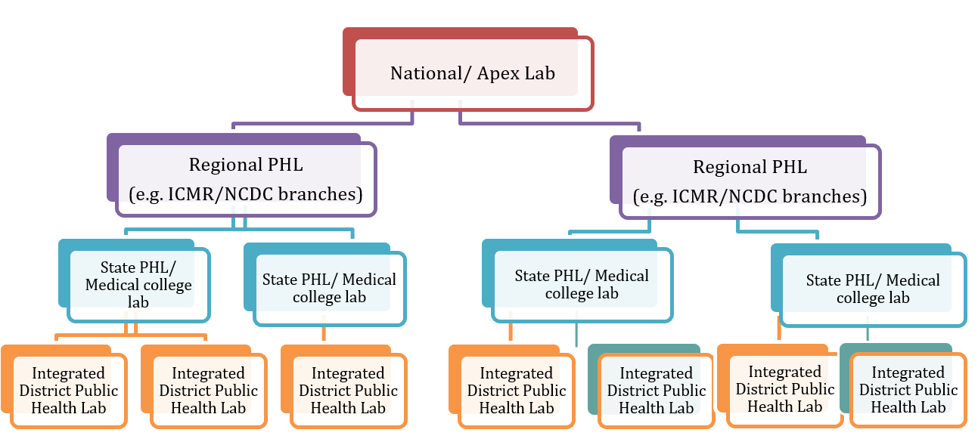
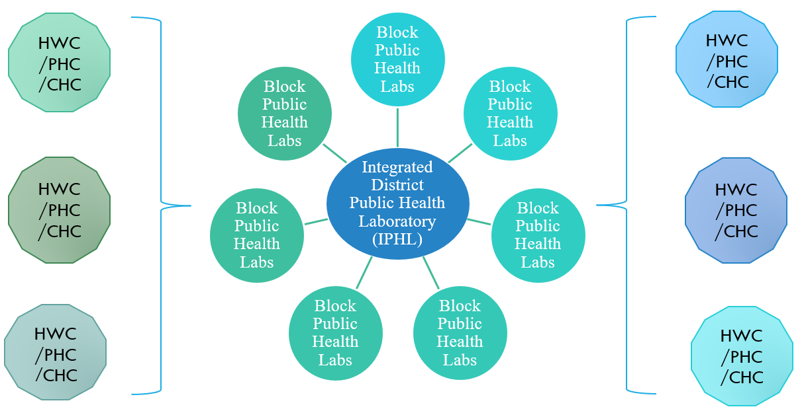
LABORATORY NETWORK AND LINKAGES
1)Downward linkage of 2) Upward linkages of IPHL
IPHL (Hub and Spoke model)

Slide 7
PHED
VET LAB
CPCB
FSSAI
INTEGRATED DISTRICT PUBLIC HEALTH LABORATORY (IPHL) & BLOCK PUBLIC HEALTH UNIT (BPHU)
WATER BOARD
WASH
ICDS
NDMA
NDRF
WCD

Slide 8
GAP ANALYSIS
Identifying & Mapping High Caseload Health Facilities
Availability of Infrastructure for providing diagnostic services as per IPHS
Availability of Human Resource for providing services as per IPHS
Diagnostic and Laboratory Equipment including storage
Reagents & Consumables Inventory Management
Supply Chain management
Equipment maintenance mechanism
Sample Transportation (Cost and Mode of sample transportation to hub – reducing the Turn Around Time)
IT Infrastructure (LIMS) Report generation

Slide 9
SERVICE DELIVERY OPTIONS
INHOUSE
PPP-HYBRID
PPP-Contract In
HUB & SPOKE (IN)
HUB & SPOKE (PPP)
RENTAL REAGENT

Slide 10
SAMPLE COLLECTION AND TRANSPORT
Sample vials and Virus Transport Medium (VTM)
Routine samples can be packed safely to avoid spillage. For Labelling, barcode labels should be utilized
WHO recommends basic triple packaging system for safe transportation of infectious substances and diagnostic specimen.
A suitable outer container (e.g., thermocol box, ice-box, hard-board box) for transportation by road, courier or State transport corporation
Hard-frozen Gel Packs

Slide 11
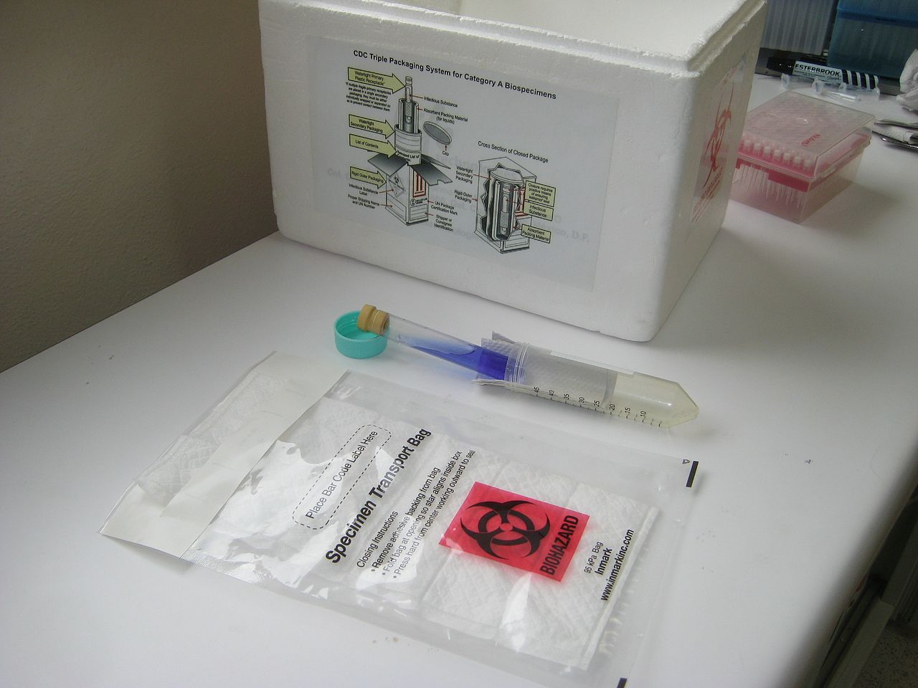
Sample Packaging
WHO recommends basic triple packaging system for safe transportation of infectious substances and diagnostic specimen.
Primary receptacle – A well labelled primary water-tight, leak-proof receptacle containing the specimen and wrapped with adequate absorbent material to absorb all fluid in case of breakages.
Secondary receptacle – A second durable, water-tight, leak-proof receptacle with enough absorbent material to enclose and protect the primary receptacle.
Outer shipping package

Slide 12
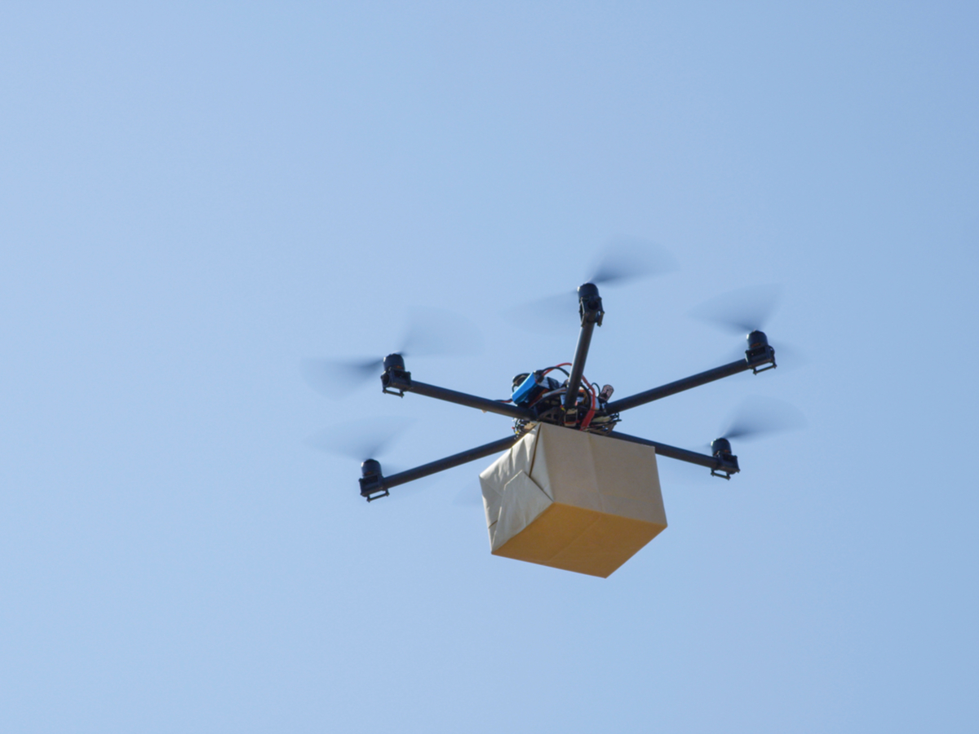
Sample Transportation
Sample integrity is dependent on accurate pre-analytical processes
Sample identification (Using barcode or QR code) at the facility prior to transportation must be ensured.
The three basic tenets of sample transportation are
Time
Temperature
Stability.
Needs good working relationship and communication amongst the sender at the spoke lab, the carrier and the receiver at the Hub lab

Slide 13
Common Errors Encountered in Pathological Laboratories
Error in identification of samples
Incorrect storage of kits/reagents/chemicals/consumables
Inappropriate use of reagents/chemicals
Equipment failure
Unsuitable environment
Untrained staff
Technical failure in preparing sample testing protocol
Inaccuracies in documentation
Misinterpretation of results

Slide 14
QUALITY INDICATORS
Pre-analytic Indicators:
% of unacceptable samples (samples rejected)
% of contaminated blood cultures
Analytic indicators:
EQAS score*/Inter laboratory comparisons (ILC)
No. of IQC failures
Results of competency assessment of the staff
Average downtime for hematology analyzer and biochemistry analyzer
Post-analytic indicators:
Turnaround times compliance (Percentage of results meeting turn-around-time)*
No. of missed critical alerts
Indicators for Public Health Functions:
No. of IPHS recommended parameters included in the scope of testing
No. of Tests being done by Labs
% of outbreaks detected by IPHL through routine lab-based surveillance
% of outbreaks investigated by IPHL in the district

Slide 15
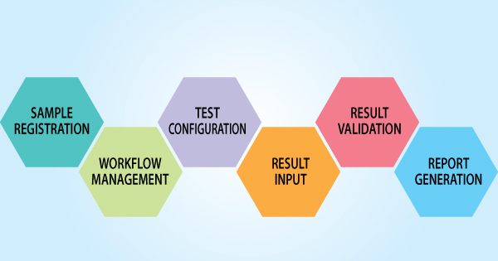
LABORATORY INFORMATION MANAGEMENT SYSTEM (LIMS)

Slide 16
STRENGTHNING OF DIAGNOSTIC NETWORK
Enhance Inhouse Capability
Human Resource Training, Motivation, Conducting Workshops
Equipment Procurement And Maintenance
Robust Sample Transportation System
A Good Supply Chain Method for getting the Reagents & Consumables
Good LIMS for Reporting
Good upward, downward and lateral linkages

Slide 17
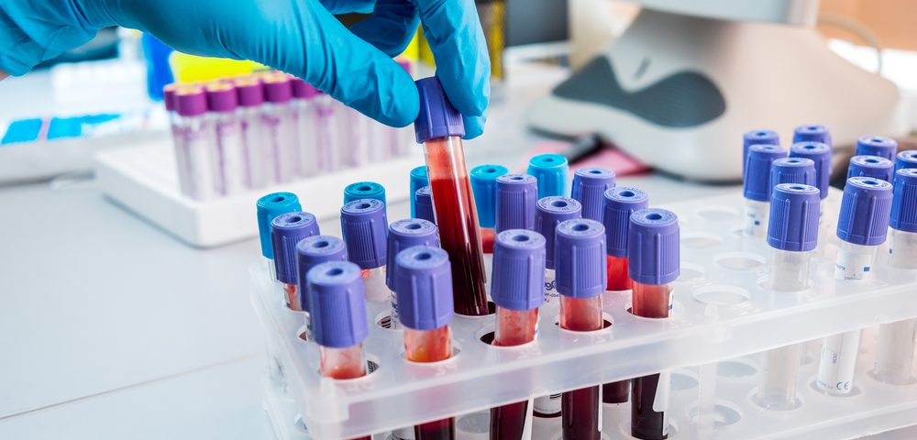
WAY FORWARD
Identify & Map existing DPHLs. Hold consultative meetings.
Networking with the various PHLs in the district/state and adopt the SOPs on sample collection, transport and reporting
IT integration with the DHs (IPHL) for standardization of reporting formats & data collection and analysis
Capacity building for the Lab Technicians in DPHL functioning

Slide 18
STATE BEST PRACTICES – EFFECTIVE DIAGNOSTIC SERVICE DELIVERY MODELS

Slide 19
Telangana Diagnostics
Hub & Spoke Model where a Central Laboratory (Hub) caters to all Health Facilities (DH/ SDH/ CHC/ PHC/ Basti Davakhana) (Spokes) that are in the vicinity of below 60 KMs.
Each district have at least 1 Diagnostic Hub based on OPD volume of connected spokes.
Distance between Hub and Connected Spokes is between 30-60 KMs. This prevents sample damage due to longer transportation time.
Telangana State Medical Services & Infrastructure Development Corporation (TSMSIDC) is the nodal agency for procurements
Supply Chain Management is through eAushadhi workflow
Started with 800 Samples collected from respective Spokes at Hyderabad Hub. Currently 17,000 samples are tested daily with Turn-Around-Time (TAT) of 24 Hours across the state

Slide 20
LIMS – SHARP (Science House Application for Remote Pathology)

Slide 21
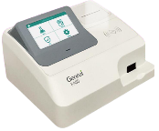

Slide 22
Currently 10 Hamar Labs functional (7 DHs & 3 CHCs)
Block Public Health Unit (BPHU) functional at CHC Patan Durg.
Number of tests performed : 120 tests in DH and 36 tests in CHCs.
Haematology (18 tests), Biochemistry (59 tests), Clinical Pathology (15 tests) , Serology & Immunology (16 tests) , Microbiology (12 Tests)
Sample collection and transportation is done through TB Runner (“ जांच मितान”)
सेवा प्रथम कर्तव्य

Slide 23
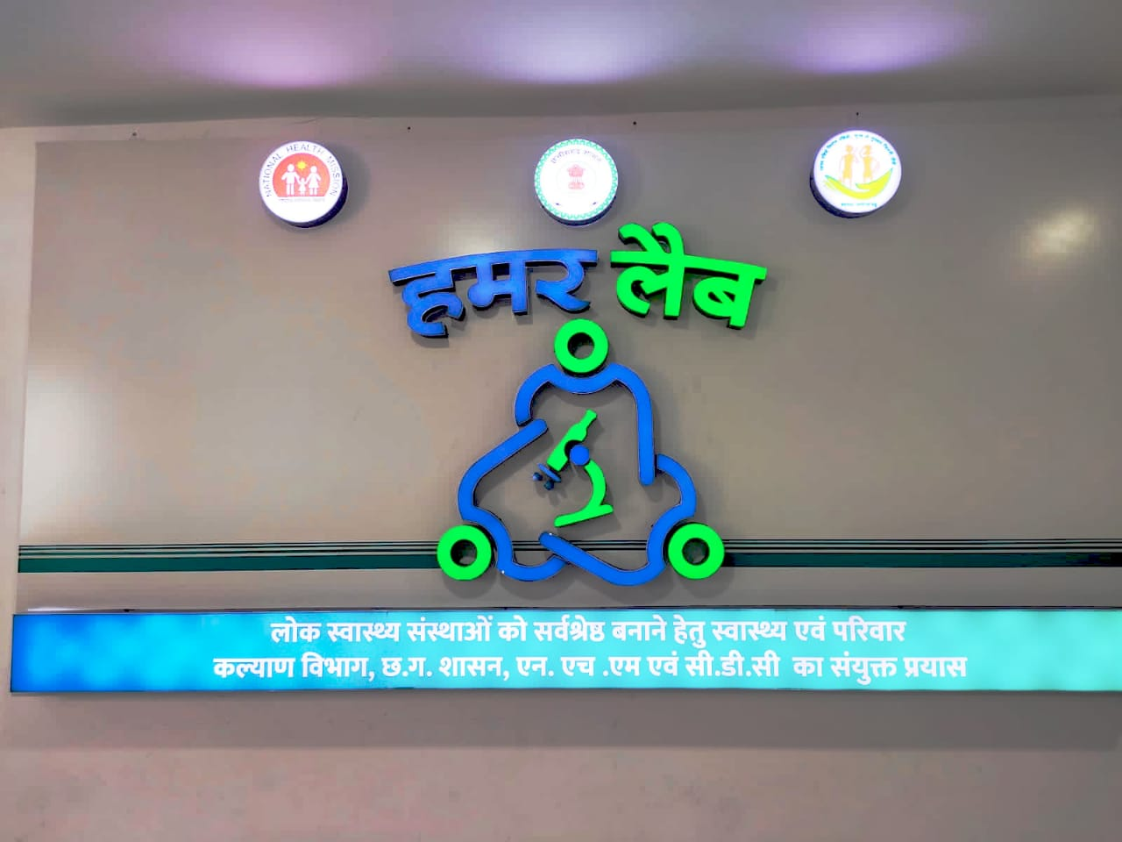
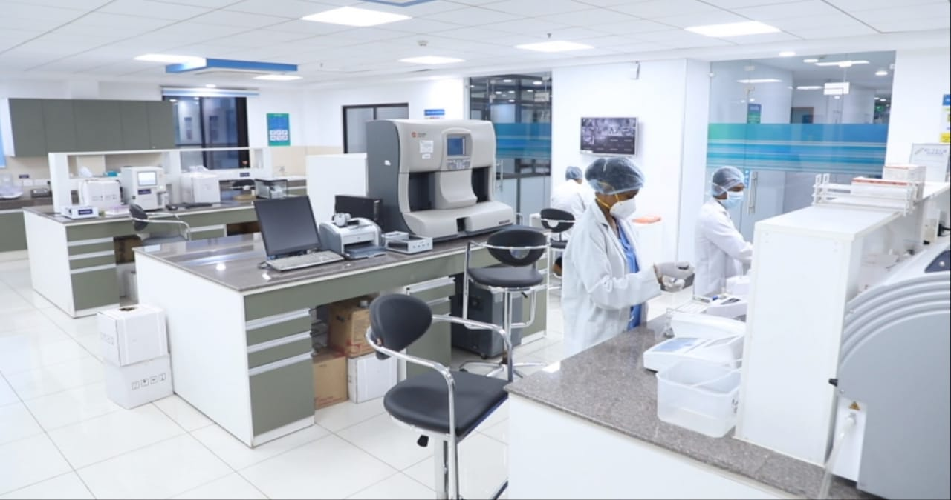
Main Central Laboratory
“ जांच मितान”
“ जांच मितान”

Slide 24
120 + Tests

Slide 25
MADHYA PRADESH GOVT’S
DEPARTMENT OF HEALTH SERVICES
REFERENCE
LABS
District & Civil Hospitals: Special tests along with the routine ones
An integrated diagnostics project with:
Collection Centres (Spokes) at PHCs
Hub Labs at CHCs
Reference Labs at District & Civil Hospitals
State adopted Wet Lease basis Reagent Rental Model so as to have high quality pathology services with a large array of tests made available to patients with ease, closer to their homes
HUBS LABS
CHCs: Samples for machine tests from spokes along with routine and hormone tests
SPOKES
PHCs: Sample Collection will be done at spokes and Rapid / POC tests performed

Slide 26
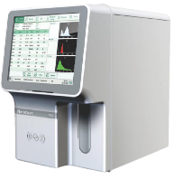
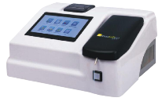
MADHYA PRADESH GOVT’S
DEPARTMENT OF HEALTH SERVICES
MACHINE NAME | INSTALLATION AT
Automatic Hematology Analyzer (Sysmex, Japan) | 50 District and 35 Civil Hospitals
Automatic Biochemistry Analyzer (Biosystems, Spain) | 50 District and 35 Civil Hospitals
Automatic Urine Analyzer (YD Diagnostic, South Korea) | 50 District and 35 Civil Hospitals
Automatic Hormone (Immunoassay) Analyzer (Siemens, USA) | 50 District Hospitals
Automatic Coagulation Analyzer (Stago, France) | 50 District Hospitals
Automatic HPLC Analyzer (Biorad, USA) | 50 District Hospitals
22,000+ Investigations Daily
410+ Equipment
85
Hospitals

Slide 27
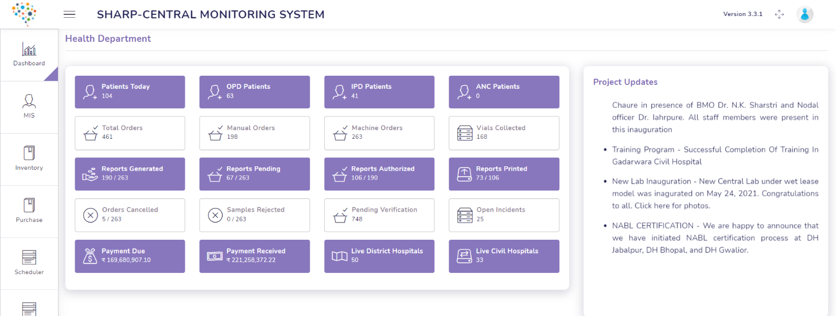
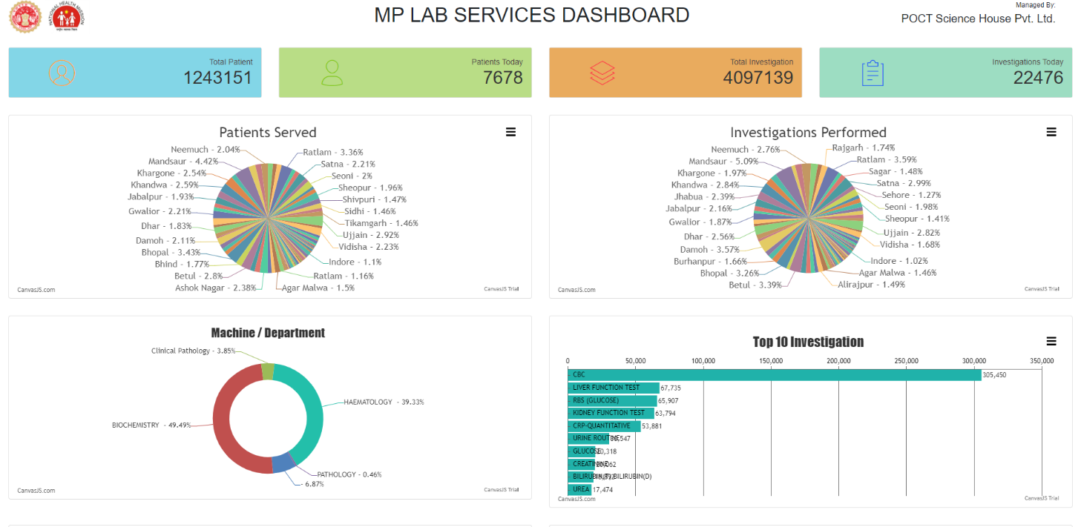
MADHYA PRADESH GOVT’S
DEPARTMENT OF HEALTH SERVICES
S.NO | TOP 10 TEST NAME
1 | CBC
2 | RBS
3 | LIVER FUNCTION TEST
4 | KIDNEY FUNCTION TEST
4 | CRP-QUANTITATIVE
6 | URINE ROUTINE
7 | T3 T4 TSH
8 | SERUM SODIUM
9 | SERUM POTASSIUM
10 | GLUCOSE

Slide 28
Thank You

