Slide 1
Integration of Lab services under IDSP with IPHL

Slide 2
Integrated Disease Surveillance Program (IDSP)
Objectives:
To detect the early warning signals of impending outbreaks of selected communicable diseases
Initiation of timely and effective public health actions
Creation of trained cadre of responders at the District, State & National levels (Rapid Response Teams)
Reducing mortality and morbidity due to communicable disease outbreaks
Three levels of data collection – Syndromic (S form) by ANMs, Presumptive (P form) by doctors at health facilities and Laboratory (L form) by laboratories

Slide 3
Integrated Health Information Platform
IHIP is a health information system that is used for
Real time, case-based information
Integrated analytics
AI tools integration capability
Advanced visualization capability
Use of GIS
Auto generated reports
Integrates information from multiple sources
Compliant to prescribed GoI standards to ensure interoperability
HMIS, IDSP and NMEP have already been placed on IHIP
Long term vision – All National Health Programmes to be placed on IHIP in line with the National Digital Health Mission

Slide 4
Key differences between IDSP & IDSP-IHIP
IDSP | IDSP-IHIP
Captures aggregated data only | Captures disaggregated data (Case based surveillance)
No linkage of data from S, P and L forms | Links data from S, P, L, EWS form
Paper based data collection | Electronic collection & transmission of surveillance data
Weekly Surveillance reporting | Realtime or daily surveillance reporting
Monitor 18 health conditions | Monitor 33+ health conditions
Data not geocoded | Has all data geocoded for geographic reference
Additional Features of IDSP-IHIP: Provides analyzed reports on mobile or other electronic devices Outbreak investigation activities can be initiated and monitored electronically Integrates data from other ongoing disease surveillance programs Special surveillance modules added e.g. COVID-19, INSACOG (WGS), Post disaster, Mass gatherings (Used successfully during Kumbh Mela 2019) etc.

Slide 5
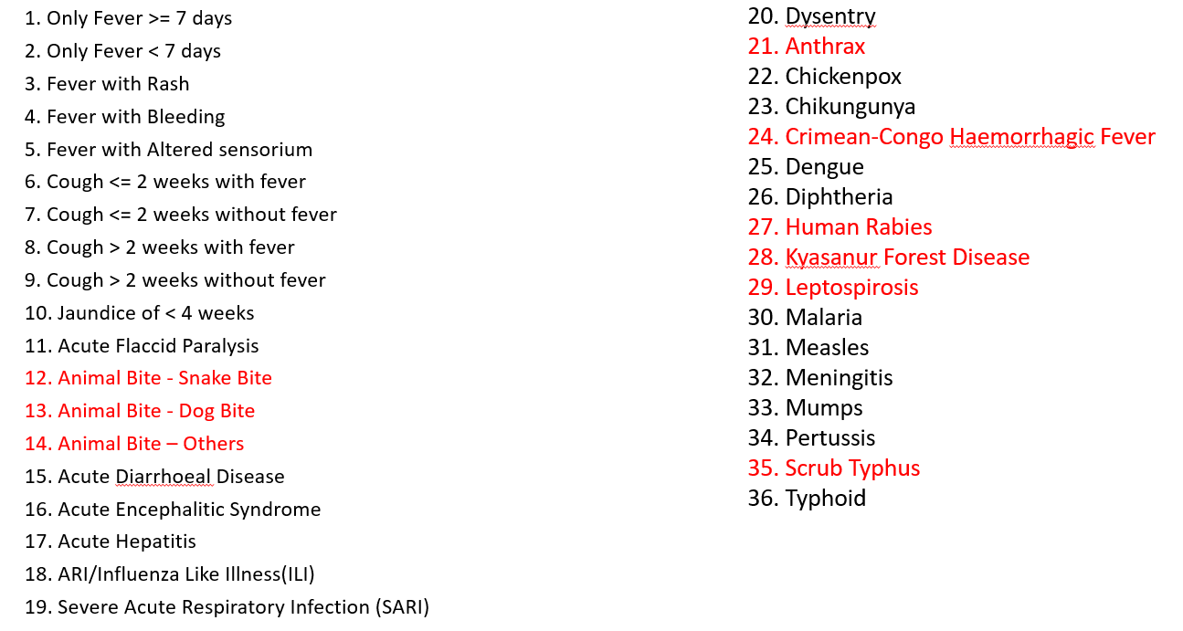
Disease under IDSP-IHIP
IDSP | IDSP-IHIP
Captures aggregated data only | Captures disaggregated data (Case based surveillance)
No linkage of data from S, P and L forms | Links data from S, P, L, EWS form
Paper based data collection | Electronic collection & transmission of surveillance data
Weekly Surveillance reporting | Realtime or daily surveillance reporting
Monitor 18 health conditions | Monitor 33+ health conditions
Data not geocoded | Has all data geocoded for geographic reference
Additional Features of IDSP-IHIP: Provides analyzed reports on mobile or other electronic devices Outbreak investigation activities can be initiated and monitored electronically Integrates data from other ongoing disease surveillance programs

Slide 6
Integrated Disease Surveillance Programme(IDSP) – Major components
Decentralization of Surveillance activities
Human Resource Development - Training of SSO, DSO, RRT, other medical and paramedical staff
Laboratory Strengthening
Use of Information Technology for collection, compilation, analysis & dissemination of data
Inter sectoral Coordination with Animal Health

Slide 7
IDSP Lab structure
CSU
NPO IDSP
AD Microbiology & Consultant Microbiologists
SSU
SSO
State Microbiologist at SSU
DSU
DSO
DPHLs at District Hospital - District Microbiologists, Lab Technician & Lab attendant/assistant (Health systems approach)
State referral Labs – Government medical colleges; linkages with Districts

Slide 8
Current strategy of IDSP for Lab strengthening
Two pronged approach
Referral Labs Network (State Referral Labs):
Existing State Government medical colleges lab - diagnostic facilities for epidemic prone diseases during outbreaks
Provision of only annual funds & reimbursement cost based on number of tests performed.
DPHLs: Strengthening of existing District Hospital labs in the country
Diagnostic services for epidemic prone diseases to cater to the health care needs of the community and generate a quality lab based surveillance data.
Provision of equipment (non-recurring cost based on gap analysis submitted), Manpower & recurring cost (based on performance)
State Referral labs & DPHLs are sacnctioned through PIP process based on proposals made by State.

Slide 9
Key Expectations from IDSP- DPHL Network
Diagnostic services of epidemic prone diseases on a routine basis
Support outbreak investigations in the District – establish system of specimen collection & transport
Report weekly data in L form on IDSP-IHIP platform
Participate in EQAS
Implement Biomedical waste management policy
Monitor for any clustering of cases & inform DSU
Notes:
Integrated within the existing District Hospital to cater to the health care needs of the community /be functional at all times
Must have an established system of receiving routine clinical specimens (from the CHCs/PHCs and field)
Undertake lab confirmation of epidemic prone diseases on a routine basis along with locally endemic diseases also (eg scrub typhus, leptospirosis, etc
Report weekly surveillance data on L form of IDSP/ Real time reporting in L form on IHIP ( mandatory for States which have migrated to IHIP )
Support outbreak investigations in the district
DSO is responsible for the DPHLs within the district

Slide 10
Testing Modalities at DPHLs
MICROSCOPY
BACTERIAL CULTURE
SEROLOGY
WIDAL (Slide/Tube)-Enteric fever
Rapid Latex Agglutination Meningococcal Meningitis
ELISA: Hepatitis A & E, Dengue Chikungunya, Measles
Rapid Ag Test: Leptospirosis, Scrub Typhus
Throat culture -Diphtheria
Direct wet mount smear – Stool- Hanging drop -Cholera
Stool culture: Cholera (Vibrio cholera), Other common Enteropathogens
Gram stain and special stain smear examination
Blood Culture:
Enteric Fever
Urine Culture:
UTI, Enteric Fever.
Bacteriological tests for water quality and potability
Tests for other outbreak prone diseases prevalent - locally are also being performed

Slide 11
Budgetary provisions for DPHLs
Non recurring budget for each DPHL (based on gap analysis) – One time grant of Rs 17.9 Lakhs
Annual Recurring Budget for each DPHL: Maximum Rs 4 lakhs /DPHL based on performance

Slide 12
Current budget (non-recurring & recurring expenditure) towards establishment of DPHL under IDSP
Non recurring Budget for each DPHL (based on gap analysis) – One time grant of Rs 17.9 Lakhs
Annual Recurring Budget for each DPHL: Maximum Rs 4 lakhs /DPHL based on performance

Slide 13
L- Form Reporting Diseases under IDSP & IDSP-IHIP
IDSP | LAB CONFIRMED DISEASES | IDSP-IHIP
1. Dengue / DHF / DSS | A. Bacterial | 1. Anthrax 2. Cholera 3. Dysentery 4. Diphtheria 5. Leptospirosis 6. Meningitis 7. Pertussis 8. Scrub Typhus 9. Typhoid
2. Chikungunya
3. JE
4. Meningococcal Meningitis
5. Enteric Fever
6. Diphtheria
7. Cholera
8. Shigella Dysentery
9. Viral Hepatitis A & E | B. Viral | 10.Hepatitis A & E 11.CCHF 12.Chickenpox 13. Chikungunya 14. Dengue 15.Kyasanur Forest Disease 16. Measles 17. Mumps
11. Leptospirosis
12. Malaria (PV,PF)
13. state specific diseases- Scrub typhus, Zika
 | C. Parasitic | 18. Malaria
Presently 18 Disease conditions pertaining to lab confirmation/L-form reporting are being captured under IDSP-IHIP
Notes:
18 diseases under IDSP plus 2 animal bite conditions plus 2 state specific / unusual syndromes
33 conditions under IDSP-IHIP plus 3 animal bite conditions

Slide 14
Financial Year wise Expansion of DPHL
Financial Year/PIP | DPHL sanctioned(No.) | Year Wise Cumulative
Up to 2010 | 48 | 48
2011-12 | 32 | 80
2012-13 | 36 | 116
2013-14 | 26 | 142
2014-15 | 56 | 198
2015-16 | 23 | 221
2016-17 | 30 | 251
2017-18 | 17 | 268
2018-19 | 23 | 291
2019-20 | 35 | 326
2020-21 | 45 | 371
2021-22 | 26 | 397
2022 - 24 | 23 | 413*
Total DPHL sanctioned:
413*
(as of August’2022)
*7 DPHLs surrendered by MP

Slide 15
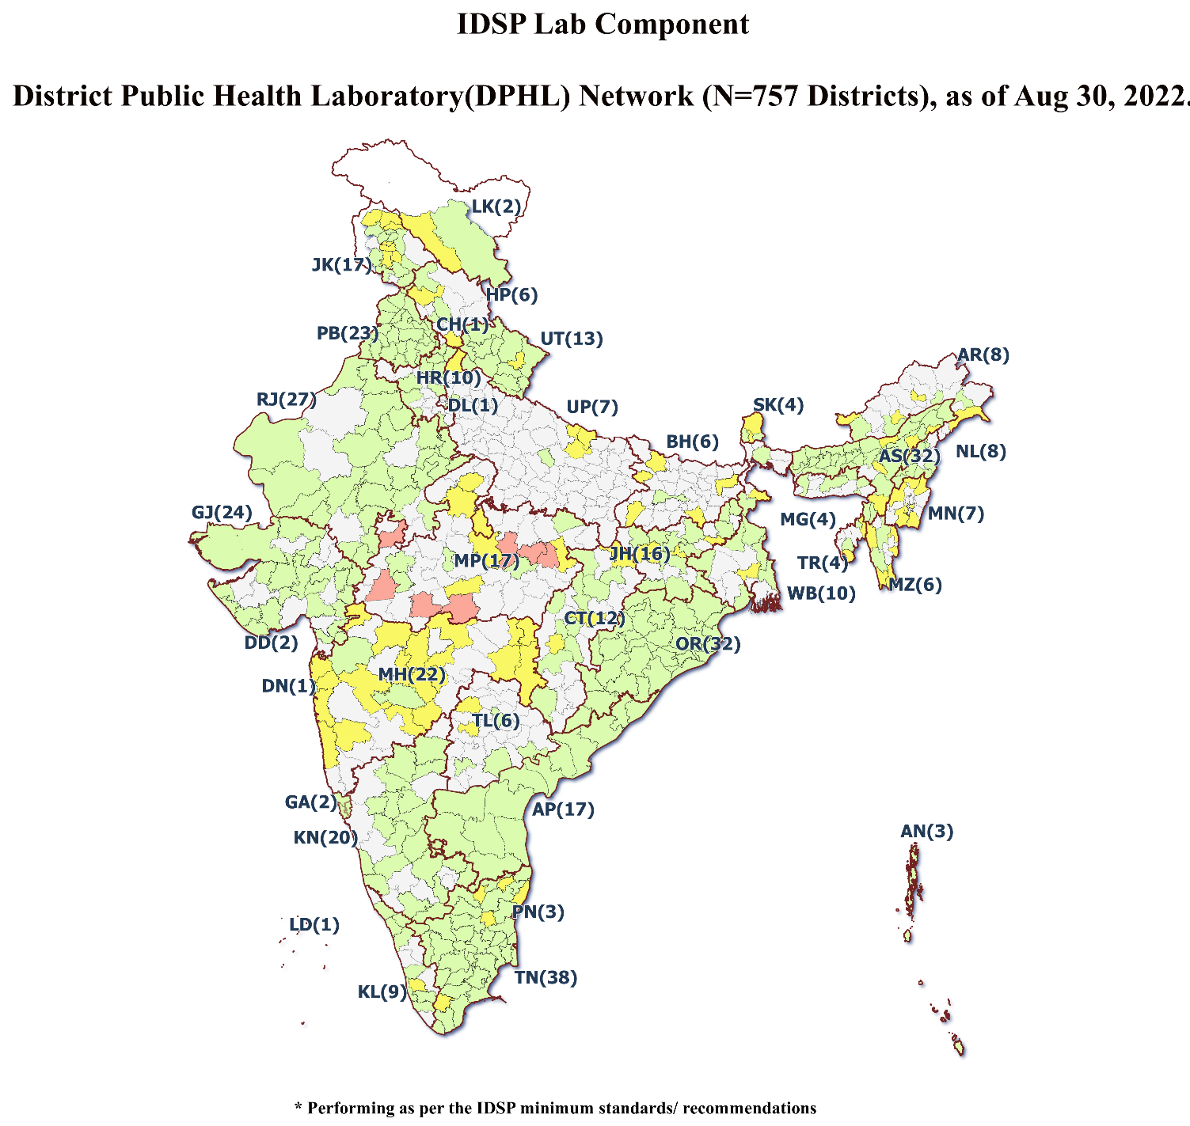
District Public Health Laboratory(DPHL)Network across 757 Districts, as of aug 2022
Sanctioned: 413 (excluding 7 surrendered)
Strengthened & performing: 316

Slide 16
IDSP-DPHL Network Performance-Current Status
DPHLs sanctioned 413
DPHLs sanctioned in FY 2022 – 2024: 24
Microscopy/Rapid tests/Widal tests - 262
Serology (ELISA) - 260
Culture - 191
DPHLs performing - 316
* Performance based on DPHLs report of July 2022. 23 DPHLs didn’t share DPHL monthly report.

Slide 17
Status of UP DPHLs
Number of Districts: 75
Number of DPHLs sanctioned: 7
District | Year of sanction
Lucknow Regional Lab Swasthya Bhawan | 2010-2011 | Performing Microscopy, serological tests & Culture
Ghaziabad MMG Hospital | 2010-2011 | Performing Microscopy, serological tests & Culture
Gonda | 2016-2017 | Equipment procurement under process at the Level of UPMSCL
Lalitpur | 2016-2017 | Equipment procurement under process at the Level of UPMSCL
Balrampur | 2016-2017 | Equipment procurement under process at the Level of UPMSCL
Saharanpur | 2016-2017 | Equipment procurement under process at the Level of UPMSCL
Shravasti | 2016-2017 | Equipment procurement under process at the Level of UPMSCL

Slide 18
Status of Bihar DPHLs
Number of Districts: 38
Number of DPHLs sanctioned: 6
District | Year of sanction
Patna (PMCH) | 2009 | Performing Microscopy, serological tests & Culture
Siwan | 2012-2013 | Equipment procurement under process
East Champaran | 2012-2013 | Equipment procurement under process
Jamui | 2012-2013 | Equipment procurement under process
Rohtas | 2012-2013 | Equipment procurement under process
Purnia | 2012-2013 | Equipment procurement under process

Slide 19
Status of Chhattisgarh DPHLs
Number of Districts: 27
Number of DPHLs sanctioned: 9
District | Year of sanction
Bemetara/ Raipur | 2019-2020 | Strengthened
Durg | 2013-2014 | Strengthened
Bilaspur | 2014-2015 | Strengthened
Dhamtari | 2014-2015 | Strengthened
Bijapur | 2020-2021 | Strengthened
Kanker/Dantewada | 2021-2022 | Strengthened
Kawardha/Bastar | 2014-2015 | Strengthened
Koriya | 2014-2015 | Strengthened
Surguja/Korba | 2019-2020 | Strengthened

Slide 20
Status of Jharkhand DPHLs
Number of Districts: 24
Number of DPHLs sanctioned: 12
District | Year of sanction
Dumka | 2014-2015 | Strengthened
West Singhbhum | 2014-2015 | Strengthened
Palamu (Daltonganj) | 2015-2016 | Strengthened
Hazaribagh | 2015-2016 | Strengthened
Godda | 2017-2018 | Strengthened
Simdega | 2017-2018 | Strengthened
Sahibganj | 2017-2018 | Strengthened
East Singhbhum | 2017-2018 | Strengthened
Giridih | 2019-2020 | equipment purchased, to be installed
Ranchi | 2019-2020 | equipment purchased, to be installed
Bokaro | 2019-2020 | equipment purchased, to be installed
Chatra | 2019-2020 | equipment purchased, to be installed

Slide 21
Status of Madhya Pradesh DPHLs
Number of Districts: 51
Number of DPHLs sanctioned: 10
District | Year of sanction
Bhopal | upto 2010 | Strengthened
Shivpuri | 2013-2014 | equipment purchased, to be installed
Indore | 2021-2022 | Strengthened
Rewa | 2021-2022 | Strengthened
Jabalpur | 2021-2022 | Strengthened
Ujjain | 2021-2022 | Strengthened
Sagar | 2021-2022 | equipment purchased, to be installed
Shahdol | 2021-2022 | equipment purchased, to be installed
Hoshangabad | 2021-2022 | equipment purchased, to be installed
Gwalior | 2021-2022 | equipment purchased, to be installed

Slide 22
Status of Uttarakhand DPHLs
Number of Districts: 13 Number of DPHLs sanctioned: 13
District | Year of sanction
District Hospital, Almora | 2008-2009 | Strengthened
District Hospital, Bageshwar | 2020-2021 | Equipment procurement under process
District Hospital, Chamoli | 2019-2020 | Strengthened
District Hospital, Champawat | 2020-2021 | Strengthened
District Hospital, Nainital | 2020-2021 | Strengthened
District Hospital, Pauri Garhwal | 2008-2009 | Strengthened
District Hospital, Pithoragarh | 2019-2020 | Strengthened
District Hospital, Rudraprayag | 2019-2020 | Strengthened
District Hospital, Tehri Garhwal | 2020-2021 | Strengthened
District Hospital, Uttarkashi | 2020-2021 | Strengthened
Doon Hospital, Dehradun | 2014-2015 | Strengthened
JLN Hospital, U.S Nagar | 2014-2015 | Strengthened
Mela Hospital, Haridwar | 2017-2018 | Strengthened

Slide 23
Distribution of Districts w.r.t. presence of DPHL and Outbreak reported in 2021
Outbreaks reporting under IDSP in 2021 | Districts distribution as per the presence of sanctioned DPHLs |  | Total
 | Districts with DPHLs Sanctioned (N= 397) | Districts without DPHLs (N=337)
Outbreaks reported No.(%) | 479(65.79) | 249(34.20) | 728
Of the total Outbreaks reported during the year 2021, districts with DPHLs (397) have reported remarkably higher proportion of Outbreaks (479/728, 65.79%) as compared to the one which do not have DPHLs.
Hence, It is observed that the presence of DPHLs in districts
may improve the outbreak reporting from the district(s).
Notes:
Colour of the slides to be modified- not red- and mild / less bright ones-Classification of districts –title of the slide-
Districts having DPHLs
Districts not having DPHLs
Presence of DPHLs in districts improves outbreak reporting

Slide 24
SWOT ANALYSIS
Distribution of Districts w.r.t. presence of DPHL and Outbreak reported in 2021
Strengths
Provision of basic minimum infrastructure for diagnosis of epidemic prone diseases.
Weakness
Limited awareness.
Threats
Outsourcing of labs
Opportunities
Establish IPHL under PM-ABHIM – new vigor to DPHL strengthening
Confusion with PWD - Public Health Labs and IDSP-DPHLs.
DH upgrading to MC (difference in mandate)
Not all strengthened DPHLs are performing, many performing basic minimum tests.
Poor sample referrals
Fund allocation – priorities at State/District
QC – QMS services
Prolonged Procurement process.
Lab based Community surveillance
Improved early warning/ Outbreak reporting

Slide 25
Key issues
Coordination between multiple National Health Programs at the State and Central levels
LMIS for IPHLs and data sharing with all NHPs through it
Mapping of stakeholders and clearly defined roles and responsibilities
Clarity on roles and responsibilities of existing staff after integration
Ensuring adequate HR / Need for additional HR
Mapping of equipment with programme mandate
Space / Infra requirements
District Hospitals that have ben converted to Medical Colleges

Slide 26
Thank you

Slide 27
IDSP-DPHL Network Performance-Current Status
(As of Mar’2022)

Slide 28
Dedicated HR under IDSP Lab Component (DPHL)
Approved/ Sanctioned HR positions in DPHL (DSU)
HR Positions under DSU (DPHL) | Qualification | Number of Positions/ DPHL
*Microbiologist | MBBS, MD/MSc Medical Microbiology/MSc Microbiology with 2 years lab experience in diagnostic services for epidemic prone diseases | 1
Lab Technicians | minimal qualification DMLT | 1/2 ( as per workload)
Laboratory Assistant cum DEO |  | 1
Laboratory Attendant |  | 1
Total |  | 5
*1 State Microbiologist position is also approved under SSU
Currently (Feb 2022) in 32 States/UTs Microbiologists are in position
State Microbiologist position vacant in 4 States/1UT (Haryana, HP, Jammu, Sikkim & Puducherry)

Slide 29
Key Challenges
Awareness among Leadership regarding DPHLs; Confusion with PWD - Public Health Labs performing water testing and IDSP-DPHLs performing microbiological tests.
Lack of State / District level ownership/initiative for public health lab strengthening:
Outsourcing of labs
Despite efforts, slow progress in expanding the network to all Districts
Many labs still doing only basic or rapid Tests (Widal/malaria etc.)
Nil/minimal testing for epidemic prone diseases
No sample referrals by clinicians/sample size too small to generate district level surveillance data/ no visibility or acceptance of DPHL in DH
Funds allocationed by the MS/CMHO
adhocism- gaps in provision of infrastructure/procurement of equipment
HR sanctioning/ recruitment- vacant positions
lack of facilities and training (basic and advanced) technicians & microbiologists

Slide 30
Strengthening of DPHL- Key Challenges
Challenge of QC & QMS services
Outsourcing of services due Free Diagnostic scheme of NHM
District hospitals getting converted to Medical colleges in few States
Currently guidance to States/ UTs to strengthen/ establish IPHL under PM-ABHIM: Key initiative but sustainability and State’s commitment to same needs to be monitored

Slide 32
Once these fields are filled in…

Slide 34
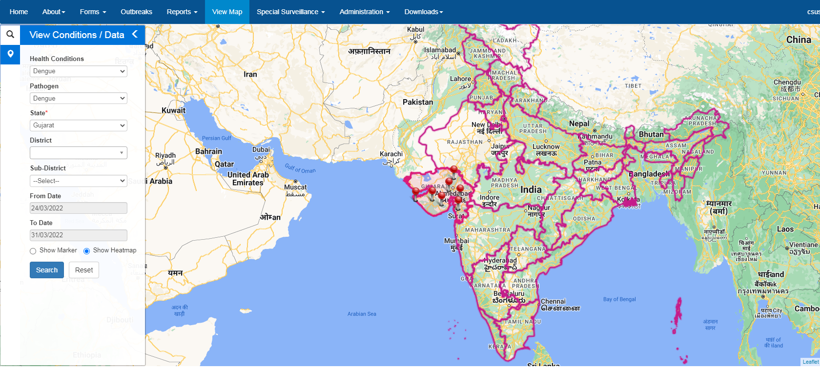
IHIP HEAT MAP
IHIP Heat Map showing Dengue cases in Gujarat from 24.03.22 to 31.03.22 (1 week)

Slide 35
State Referral Lab Network
Existing functional laboratories at medical colleges, linked to adjoining districts for referral of clinical specimens during suspected outbreaks
Annual fund (Rs 2 lakhs) for procuring reagents and testing kits, etc, subsequent reimbursements for tests done for field samples (upto Rs 3 lakhs)
District
District
District
District
District
District
State Reference Lab
State Reference Lab
SSU/DSU/ State Lab Consultant/ State Lab Coordinator
State Reference Lab
State Reference Lab
District
District
District
District
District
District

Slide 36
Selection Criteria for the State Referral Labs
Willingness to participate
Well-functioning microbiology laboratory - infrastructure and human resources
Agree to sign an MoU with State Surveillance Unit
Designate a nodal officer(microbiologist) who would be responsible for IDSP related activities
Agree to comply with the State Biomedical Waste Management Guidelines
Agree to participate in the External Quality Assessment Scheme

Slide 37
Commitment of SRL under IDSP network
Testing of samples referred from districts for confirmation of suspected outbreaks.
Provide logistic support for transport of microbiological samples (e.g. provide stool transport media etc to linked districts)
Mentoring of microbiologist/lab technicians towards adequate sample collection and transport
Report routine laboratory surveillance data weekly on IDSP L form and quarterly report of field samples tested
Ensure performance standards for lab to be functional at all times for outbreak investigation under IDSP, maintain adequate:
infrastructure,
equipment and
consumables

Slide 38
Tests expected to be carried out at the State Referral Labs
Cholera and other common enteropathogens : biochemical identification, culture and sensitivity and serotyping
Typhoid: Blood Culture & antimicrobial sensitivity (including isolate confirmation with specific antisera)
Bacterial meningitis-rapid latex agglutination test, CSF examination-wet mount, gram stain and culture & antimicrobial sensitivity
Hepatitis A & E- IgM ELISA
Measles- IgM ELISA
Dengue- IgM ELISA, NS1 Antigen ELISA
Leptospirosis-ELISA/Rapid test
Diphtheria-Smear examination, culture and toxigenecity testing
Any other tests for locally prevalent epidemic prone disease (to be identified by the state)

Slide 39
Format for quarterly reporting of the SRLs

Slide 40
Role of State Referral Labs beyond 2020
Agree to participate in the EQAS
Handholding of District/Taluka/Block level labs
Monitoring of linked labs
Provide support to the Rapid Response Teams of the linked districts (such as providing the transport media )
Report the lab results of outbreak related samples to the DSO and SSO expeditiously and maintaining confidentiality
Timely submission of quarterly report to SSU and CSU

Slide 41
State Referral Laboratory(SRL) Network Strengthening
MOU with SRL every year and State to monitor progress. If not functioning optimally can terminate MOU.
State can recommend new SRL as per requirement. The states are to identify functional labs existing
in government institutes (preferably in the Medical Colleges and various other large institutions) and
link the adjoining districts to them for providing the lab services during suspected outbreak
situations.
The role of referral labs to be expanded in Medical College beyond supporting outbreak
Investigations-
o Supervision and Training
o Mentors for establishing QMS in district labs: IQC EQAS
o More handholding and onsite support - can augment strengthening of the laboratories.
o Provide control strains

Slide 43
District Public Health Laboratory(DPHL) Strengthening
States to make all District Public Health Labs (DPHLs) sanctioned under IDSP functional, at the earliest for lab confirmed diagnosis of epidemic & outbreak prone diseases. DPHLs need to be integrated with the District Hospitals.
State should ensure that nomenclature from DPL changed to DPHL for all functional purpose.
Culture facility to be made available in all functioning DPHLs.
Districts where DH is converted to Medical College, the decision to shift the DPHL is to be left to respective States.
Regarding expansion of DPHLs, States/UTs to prepare a report based on catchment population, OPD load, sample load etc. Gap analysis done in this regard may be used for proposing additional DPHLs in next year PIPs.
States to review existing funding approved for all the functional DPHLs and justify additional funding request.
DPHLs should initiate/test for Scrub typhus and Leptospirosis as per the guidelines provided by NCDC.
DPHL Microbiologist to sensitize the clinicians for sample referral to the DPHL (the State Microbiologist also on visit to DPHL could meet the clinicians and emphasize on IDSP mandate).

