Slide 1
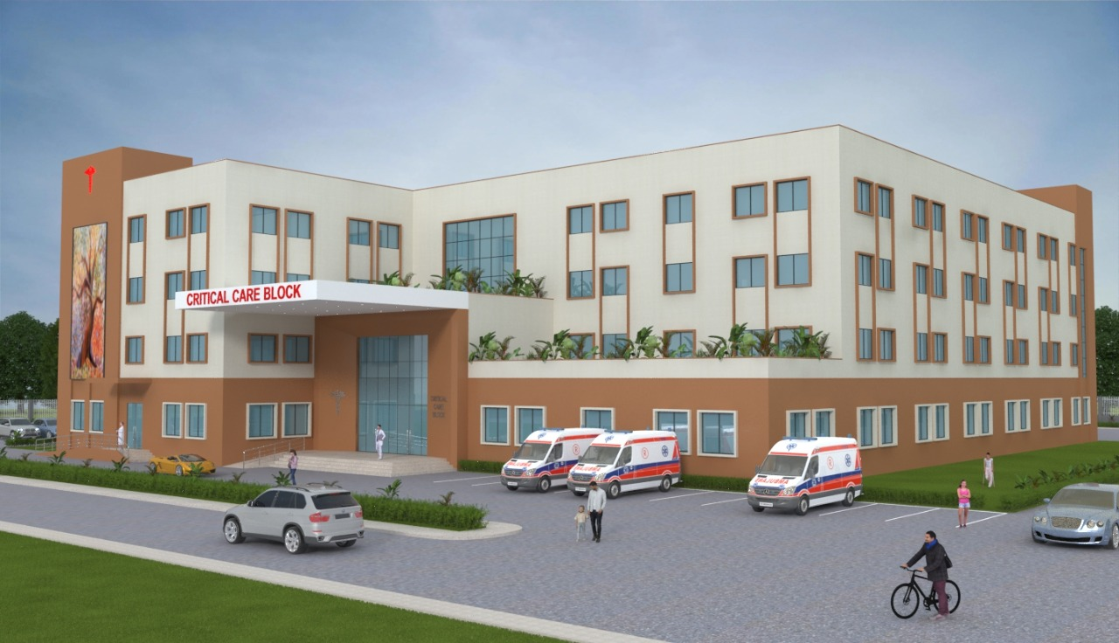
Pradhan Mantri Ayushman Bharat Health Infrastructure Mission
Critical Care Block
100 bedded Critical Care Block (Prospective Plan)

Slide 2
Critical Care Block
Apart from the critical care beds identified and recommended under IPHS 2022, every district in the country have also been sanctioned Critical Care Blocks (CCB) under PM-ABHIM.
Critical care wing or block will be an integral part of the existing District Hospital (DH) or Medical College Hospital (MCH) to ensure optimum utilization of resources.
The purpose of establishing these blocks is to augment the capacity of the district for assured treatment and management of patients with infectious diseases and managing outbreaks.
However, it must be ensured that there are separate entry and exit for the critical care block and that it should be constructed in such a manner that it can be isolated and used as a dedicated facility for management of infectious diseases.
The separate entry/exit will help in isolating it from the main hospital building so that, the routine patient care does not suffer. However, in normal situations the hospital will utilize this wing for managing all types of critical patients.

Slide 3
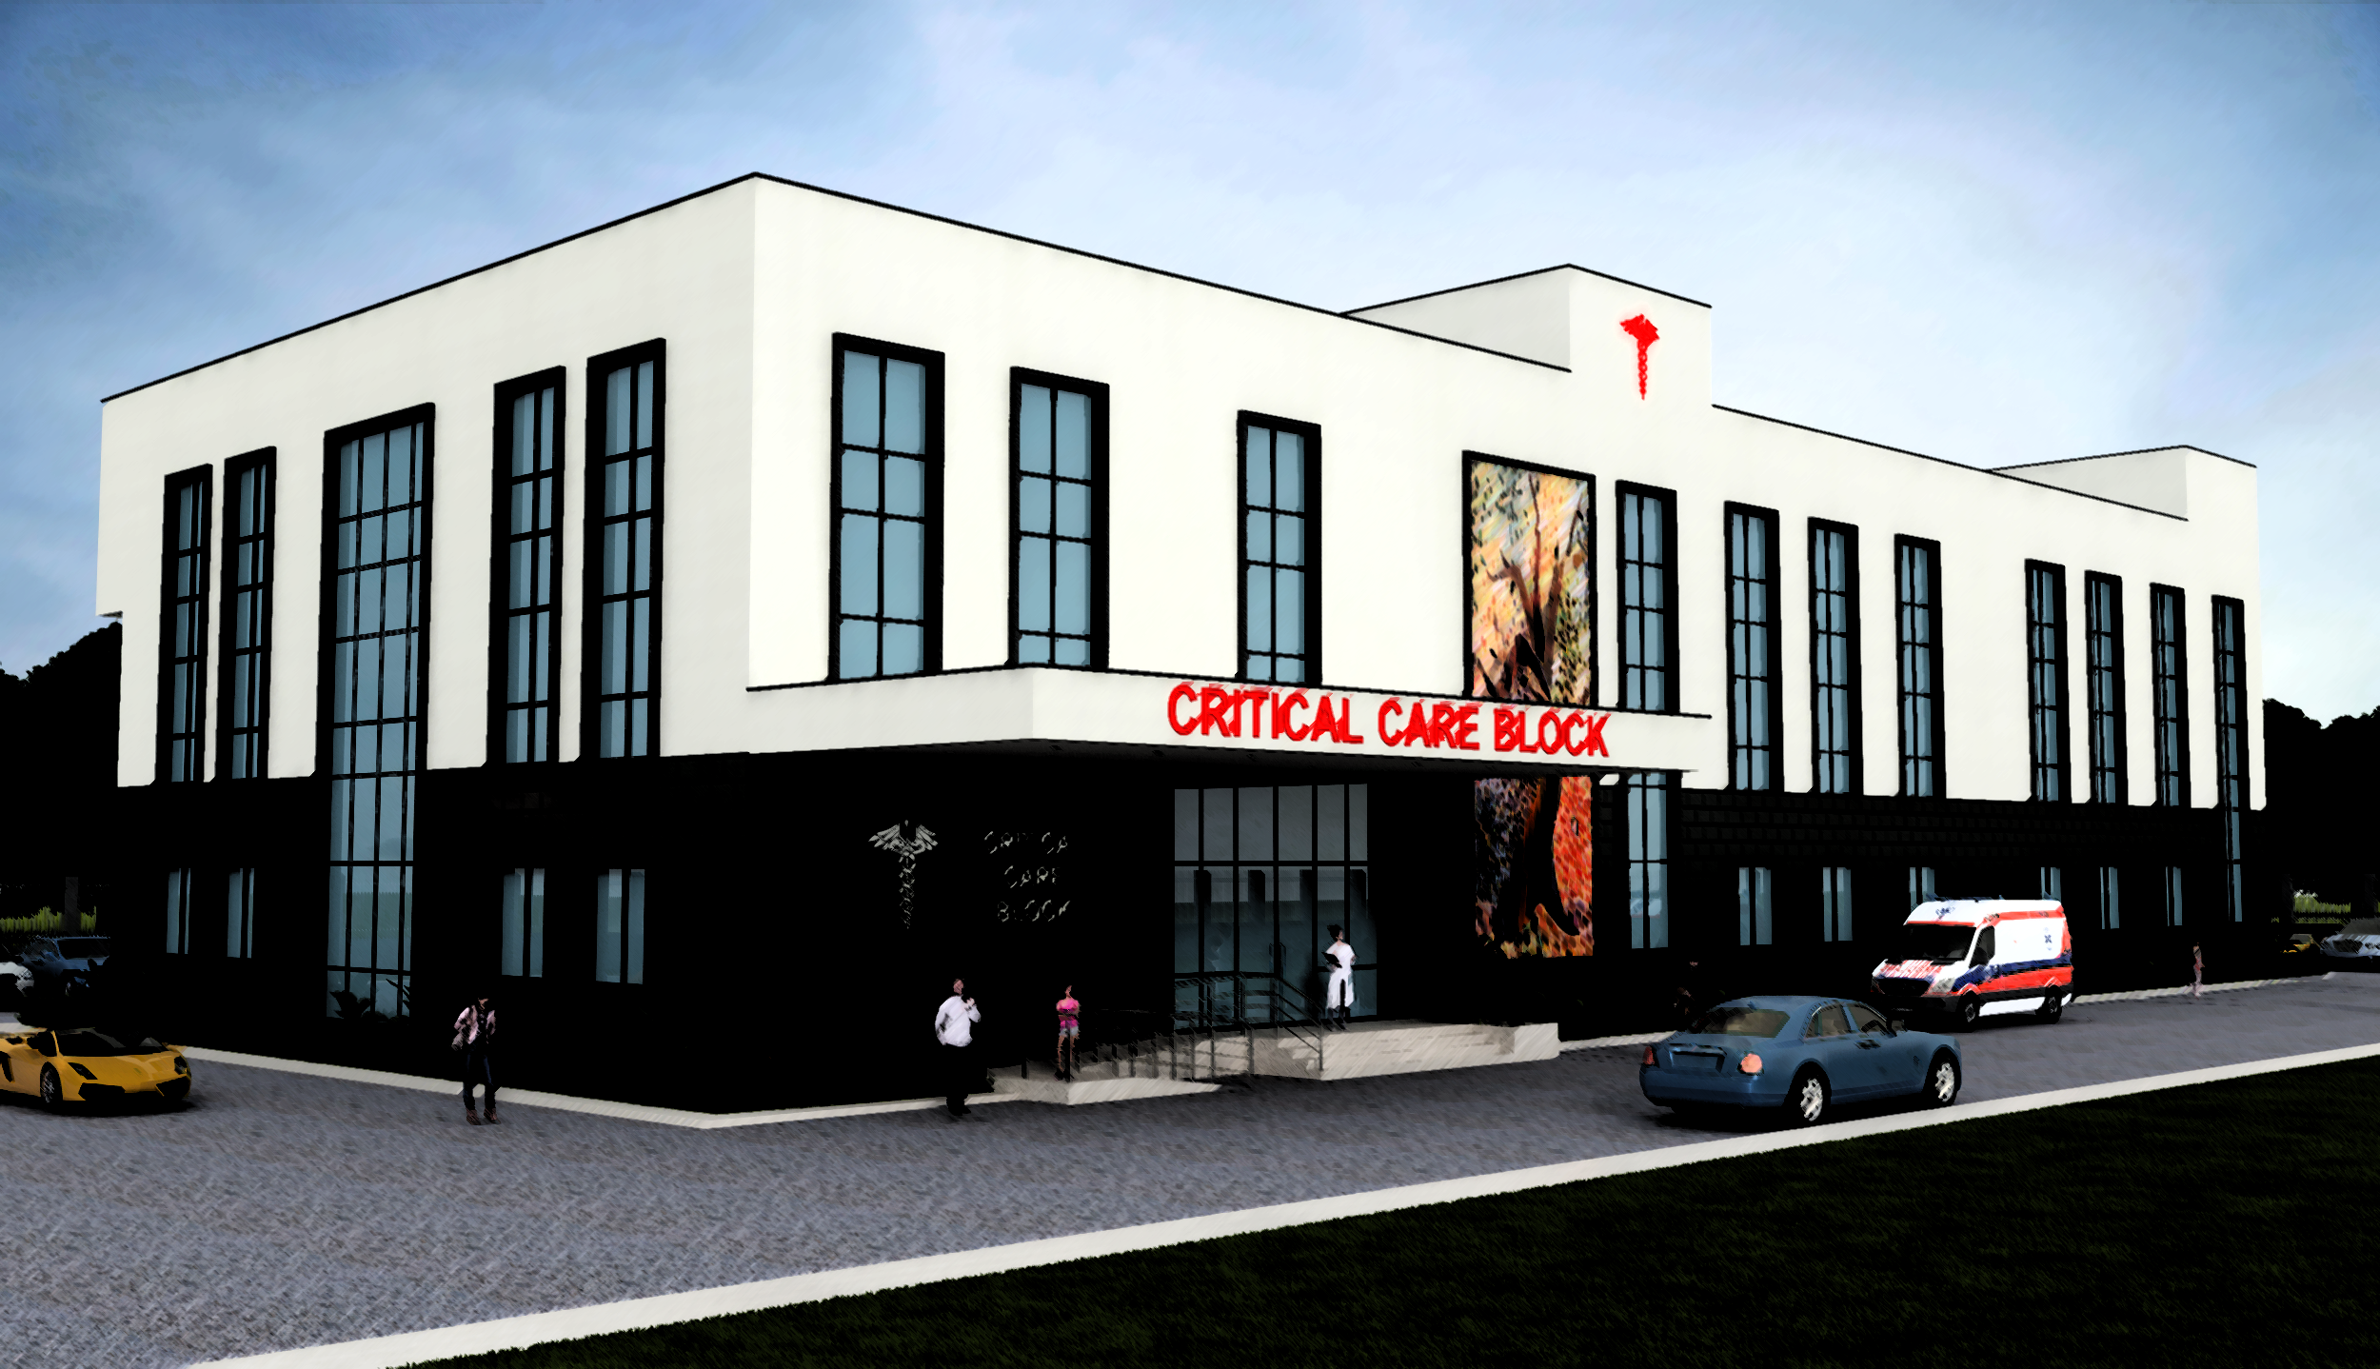
602 Districts across all states/ UTs.
5-20 lakh population
(274 districts)
50 Bedded CCB/Wing
More than 20 lakh population
(102 districts )
Less than 200 =50 bedded CCB
200-300 =75 Bedded CCB
More than 300=100 bedded CCB
226 districts with Medical college
50 Bedded CCB

Slide 4
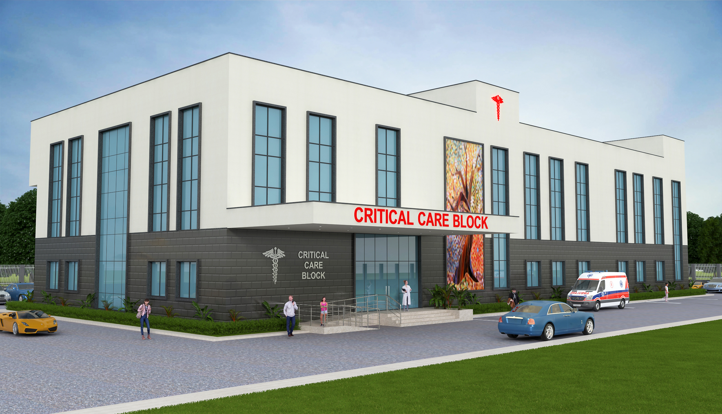
Considerations in the Guidelines
Location: to be part of existing DH/MC. Provision of isolation during outbreak.
Area Covered: 85 sq. m. per bed (as per IPHS).
Layout: Layout plans prepared depicting suggestive flow of services.
Design Principles: As per IPHS, NBC norms and state by-laws.
Human Resource Support: up to 2025-26. HR norms defined as per IPHS.
50 bedded Critical Care Block (Prospective Plan)

Slide 5
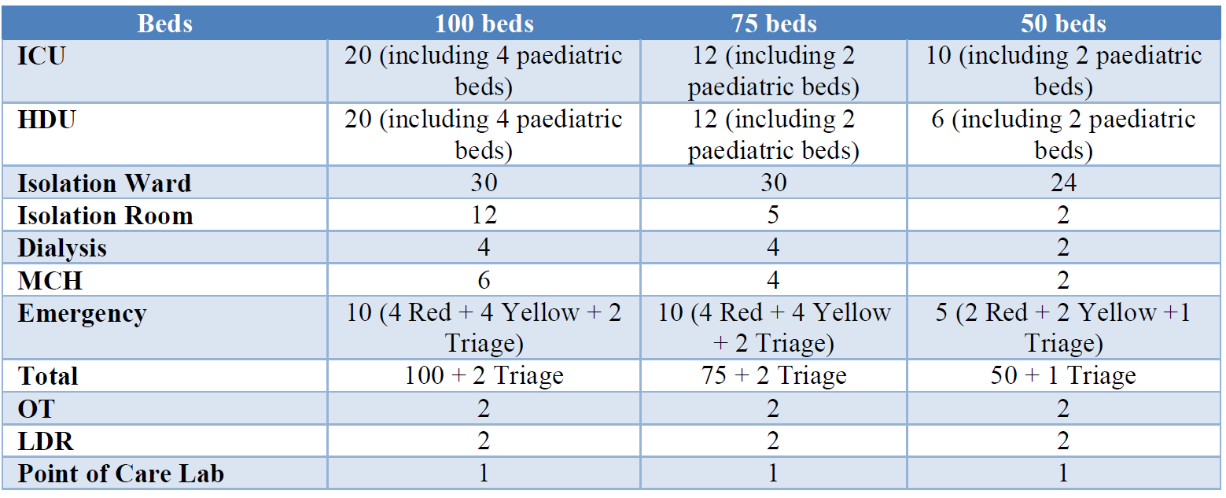
Components of CCB

Slide 6
HR Norms
HR Norms | Specialists - round the clock for OT, ICU, Emergency, delivery unit and other areas as per IPHS.
 | GDMO - 1 for 10 beds - critical care area and 1 for 20 beds non critical area
 | Nurses - 1:1 ICU; 1:2 Step Down Unit; 1:6 wards and other areas; OT - 2 per OT per shift; 1 nurse round the clock for delivery unit
 | Support staff- as per IPHS/GoI guidelines

Slide 7
Implementation Mechanism
MoU to be signed between state and MoHFW
Selection of site as per criteria mentioned in the guidelines
Site survey
Preparation of DPR & Layout plans
DPR Finalization including preliminary estimated cost as per state process
Tender
Initiation of work

Slide 8
Monitoring
District Health Society will be monitoring the implementation against the approvals on a periodic basis.
Additional Chief Secretary/Principal Secretary/Secretary (Health) in the States/UTs as the chairperson of EC of the State Health Society, will be responsible for monitoring the progress and implementation status.
At the national Level, the Ministry, under the NHM Framework, will monitor the progress of implementation of various components across the country. Overall, oversight will be provided by the Mission Steering Group (MSG).
The States must prepare the proposals as per the format given in the Operational Guidelines on PMABHIM and send along with the required annexures.
Monthly progress must be updated in the Progress Monitoring System

Slide 9
Cost
Type of critical care units | 100 bedded | 50 bedded | 50 bedded in Medical Colleges
Capital Cost (in Rs.) | 44.50 Cr | 23.75 Cr | 23.75 Cr
Recurring Cost (in Rs.) | 7.912 Cr | 4.592 Cr | -

Slide 10
Layout Plan
50 Bedded CCB – ground floor
50 Bedded CCB – first floor
50 Bedded CCB – second floor

Slide 11
Thank You

