Slide 1
Strengthening SHSRC and IMPLEMENTATION research
Dr Neha Dumka
Knowledge Management Division, nhsrc

Slide 2
SHSRC as technical arm to state nhm
NHM framework specifies NHSRC (its state counterpart SHSRCs) role to serve as an apex body for technical support to Centre and states
Reflecting on NHSRC’s functioning as the “think tank” for NHM at national level, SHSRCs also need to align their mandate accordingly, with focus on national and state health priorities.
SHSRCs are envisioned as state’s think tank providing support with focus on problem identification, analysis and problem solving in the process of implementation.
SHSRC identified as a potential platform for providing technical support to respective states for implementation of NHM

Slide 3
SHSRC as technical arm to state nhm
SHSRCs could play a critical role in identifying Health system gaps and supporting states to address such gaps
SHSRC could document the best practices within the state itself
Underline role of SHSRCs in research and studies
National Knowledge Partner agencies could also be requested to involve SHSRCs in studies
Complimenting the efforts with Enhanced resource allocation !!!
Review study: Revision of ToR and mandates to reflect on changing health needs and health priorities

Slide 4
Research In Health systems
Systematic uptake of evidence-based practices into routine practice – to improve the quality and effectiveness of health care
Innovation
Adoption
Diffusion
Yields scalable solutions and improvements in health policies, systems, products, technologies, services, and delivery methods, in order to improve service delivery, quality of care, diagnosis and treatment, education, outreach, prevention and promotive care and access to healthcare

Slide 5
Health systems Research
Health systems Research has been identified as an important contributor to improve overall performance of health systems.
It has played an important role in guiding reforms and monitoring progress in NHM
Several studies have linked research on program and policy implementation with public accountability
Over the years there has been a growth in published research covering NHM and associated reforms – which is a positive development.

Slide 6
Research supporting hss
Enabling health systems for building resilience:
A well-designed, evidence-based research – essential to future capacity building and achieving the overarching goals of NHM towards attaining UHC
A robust foundation to understand key limitations, challenges, and develop effective strategies – to repurpose and strengthen the health system
Health systems aware through up-to-date information; analysis shedding light on the health system assets and weaknesses
REFLECTIONS AND EVIDENCE FROM FIELD

Slide 7
NHM: FRAMEWORK OF IMPLEMENTATION

Slide 8
NATIONAL HEALTH POLICY 2017 - recognizes the key role that health research plays in the development of a nation’s health.
In knowledge based sector like health, where advances happen daily, it is important to increase investment in health research.

Slide 9
Need of research.. REFLECTIONS FROM PANDEMIC
Recently, COVID-19 presented us with a set of complex challenges. The pandemic moved with rapidity across the country: required that policy decisions, strategy design, and prompt response to the evolving situation and in a manner that would facilitate rapid scaling up of the responses.
Lack of research related activities in HSS – was identified as a concern

Slide 10
Research identified as a key component
Partnership established: internationally and domestically for research
Task force created to support research related activities (pandemic)
Increased investments in research – GoI initiative
Both under NHM & other relevant areas : Support through NHM
NHSRC’s role as knowledge hub : supporting evidence generation for HSS
Newer initiatives like PM ABHIM – included research related activities as objectives

Slide 11
NHM: moving towards evidence based policy making…
MoHFW established ‘National Knowledge Platform’ in 2016-17
- to promote Health Policy and Systems Research
- to address the challenges faced in strengthening health systems
NKP →IR-HSS (KMD)
Identifying state specific priorities
- state level consultations to identify emerging programme priorities for research, so that health systems research targeted towards the state’s needs.
RESEARCH: NHSRC with technical experts formulates implementation research questions aligned with identified research priorities by the states.
KNOWLEDGE HUB: Repository of experts and evidences – Innovations and best practices ; Collaborations and partnership encouraged for research

Slide 12
Implementation research
Properly conducted Implementation research – with context specific approach – can help implementation foresee and anticipate problems !!!

Slide 13
Implementation research
Implementation research is vital to:
Understanding context,
assessing performance,
informing implementation; and
facilitating health systems strengthening.
IR : important in supporting the scale-up of interventions and integrating them into health systems at the national level.
IR : to help organizations develop the capacity to learn.

Slide 14
IR HSS Platform
IR HSS Platform
To provide support to States through implementation research
NHM IR Committee
JS (Policy)
JS (RCH)
JS (Urban Health)
ED-NHSRC
Chaired by – AS&MD, NHM
Final research topics reviewed and approved
Research Topics
EoI floated on NHSRC website
Proposals received – screened
“SAC” constituted and meeting held – scoring done – Research work initiated.
Priority setting workshop
Regional workshops on ‘Priority setting for IR HSS’
Priority Research Questions framed

Slide 15
RESEARCH TOPICS under IR HSS platform
Human Resources
Urban Primary
Health Care
Community Processes
Service Delivery
Health Care Technology

Slide 16
IR HSS Platform: Research Topics
Service delivery:
What are the reasons for ambulatory care patients at secondary and tertiary hospitals bypassing primary health centres?
Why do patients bypass government primary care facilities and seek care from private providers?
Does access to telemedicine reduce forgone care in communities? What are patient perspectives related to telemedicine.
Correlates of neonatal and infant mortality?

Slide 17
IR HSS Platform: Research Topics
Human Resources:
What are health worker perceptions of virtual (or distance) training programs using mHealth technologies? OR Do health workers trained through distance or virtual training programs learn more compared to those who receive in-person training?
What is the ability or quality of care among CHOs for managing common health conditions seen at primary care settings? -- 2
What are the differences in teaching/learning outcomes by various methods of trainings for Health Care workforce such as contact learning, e-Learning etc.?

Slide 18
IR HSS Platform: Research Topics
Community Processes:
Undertake a comparative assessment of VHSNC and MAS functioning in selected states to understand facilitators and barriers
Undertake an assessment of current workload of ASHA in different context of the country to understand issues related to task allocation and capacity building
How do task allocation and capacity building needs of the ASHA vary in relation to current workload in different contexts of the country?
What types of pilot models can potentially improve efficiency of ASHA’s time and functioning?

Slide 19
IR HSS Platform: Research Topics
Urban Primary Health Care :
Undertake a landscape analysis of effective working models for delivering primary health care in urban areas
Defining the roles and understanding the relationship between CHW and HCWs. How can we improve the interlinkages between CHWs and HCWs?

Slide 20
IR HSS Platform: Research Topics
Health Care Technology
Undertake an assessment of effectiveness of Free Diagnostics Initiative (FDI) in reducing Out of Pocket Expenditure
What are the social, economic, organizational and ethical issues in implementation and use of various technologies in Healthcare at various levels for : diagnostic services / treatment of NCDs / Vaccines especially adult vaccines including the vaccines for COVID-19
How to estimate outcomes regarding treatment/management and patient satisfaction among those screened for NCDs

Slide 21
IR HSS Platform: Research Topics
Others:
What are the factors effecting treatment adherence for Hypertension and Diabetes in different contexts?
Across income quintile assess perception of quality of care provided in public health facility.
Governance
How has improved cadre management, incentives affected/ impacted the healthcare delivery indicators?

Slide 22
IR HSS Platform: Research Topics
COVID-19
Understanding Community engagement for COVID-19 prevention and control. Roles undertaken by Community Based platforms in addressing the COVID 19 crisis.
Understanding the role of intersectoral convergence in COVID 19, and its feasibility in Epidemic Preparedness and Response at community levels; and using the evidence to develop guidance for future pandemics/ outbreaks?

Slide 23
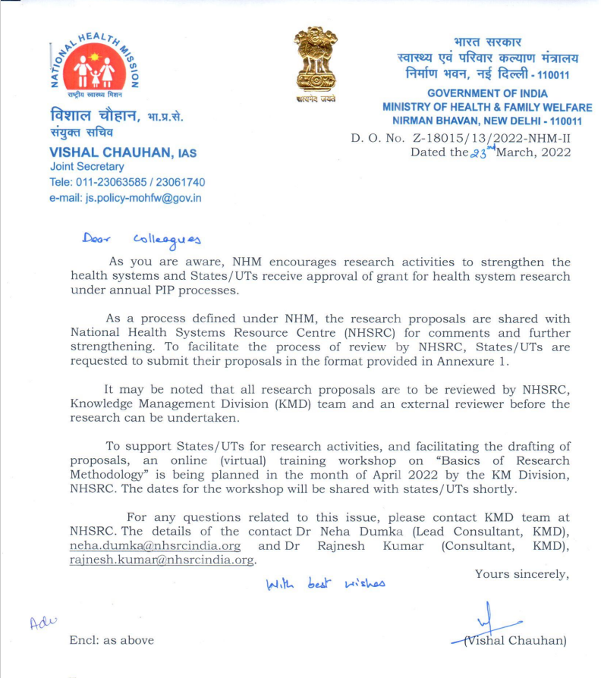
HEALTH SYSTEMS RESEARCH
REVIEW
WORKING IN
COLLABORATION
HSR
INPUTS
ROP APPROVAL
SUBMITTED IN PIP
RESEARCH
PRIORITIES
IN HOUSE
CONSULTATION
RESEARCH
PROPOSAL

Slide 24
NHSRC & Health Systems Research
Research priority areas
HSR and IR HSS
SHSRC to anchor !!!
Knowledge network – national, state and district level
Reflections and Evidence from field – Field visits as part of programme/domain
Building capacities of SHSRC (12/15), PRC(18) and other relevant stakeholders
Collaborations and partnerships

Slide 25
Challenges & Way forward
Research with focus on neglected health systems domains.
Strengthened Research capacity : States, institutions of national importance, Colleges, Other research / public health organizations, etc
Enhanced funding for health systems research
Prioritization: deficient health systems domains, geographical areas, institutions.
Building partnerships and strengthening collaboration – promoting synergy

Slide 26
Way forward – towards multisectoral/collaborative efforts
Multisectoral collaborative efforts : crucial in designing pathway to progress towards improving overall health outcomes and health systems efficiency
Effective Collaboration : ‘Quality of collaboration’
Factors influencing collaborations : context, support, interaction processes, defined task/deliverables, teams, individuals involved, ownership, other overarching factors
Optimize collaborative efforts : Develop mechanisms for stakeholders to integrate their needs and perspectives - Users

