Slide 1
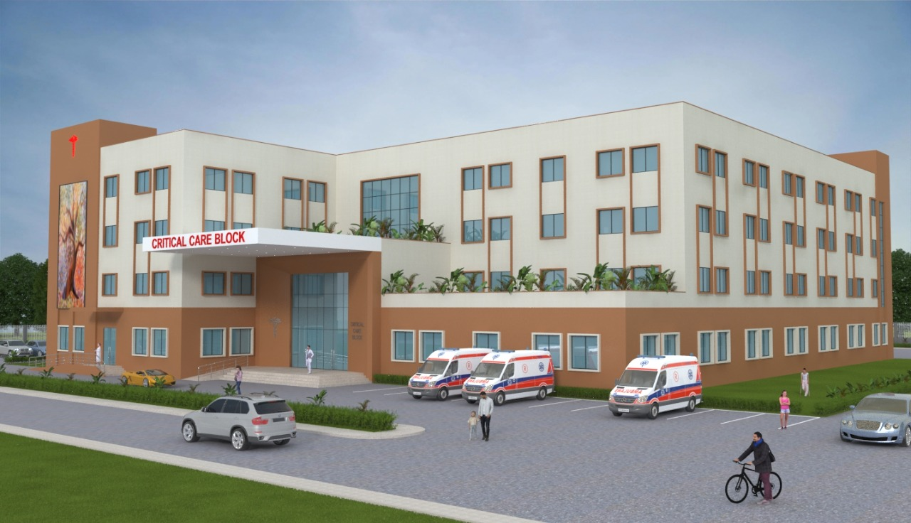
Assuring Critical Care Services
Critical Care Block

Slide 2
Background
Every district in the country have also been sanctioned Critical Care Blocks (CCB) under PM-ABHIM.
CCB : An integral part of the existing District Hospital (DH) or Medical College
Separate entry and exit must be ensured
In normal situations the hospital will utilize this wing for managing all types of critical patients.

Slide 3
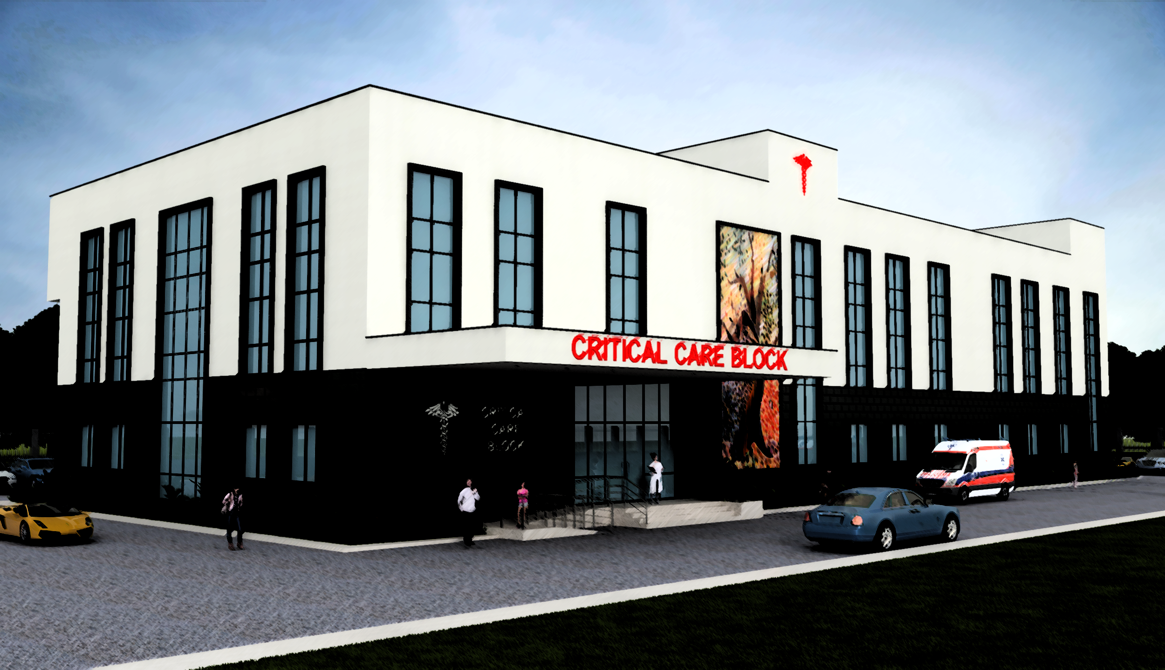
602 Districts across all states/ UTs
5-20 lakh population
(274 districts)
50 Bedded CCB/Wing
More than 20 lakh population
(102 districts )
Less than 200 =50 bedded CCB
200-300 =75 Bedded CCB
More than 300=100 bedded CCB
226 districts with Medical college
50 Bedded CCB

Slide 4
Statewise breakup of physical deliverable
State | 2021-22 to 2025-26
Karnataka | 30
Andaman & Nicobar Islands | 1
Maharashtra | 36
Puducherry | 3
Tamil Nadu | 37
Kerala | 14

Slide 5
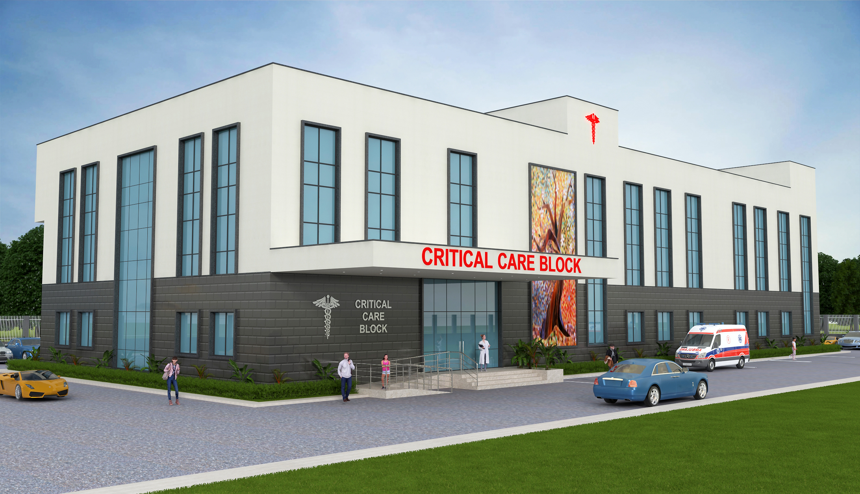
Considerations
Location: to be part of existing DH/MC. Provision of isolation during outbreak.
Area Covered: 85 sq. m. per bed (as per IPHS).
Layout: Layout plans prepared depicting suggestive flow of services.
Design Principles: As per IPHS, NBC norms and state by-laws.
Human Resource Support: up to 2025-26. HR norms defined as per IPHS.
50 bedded Critical Care Block (Prospective Plan)

Slide 6
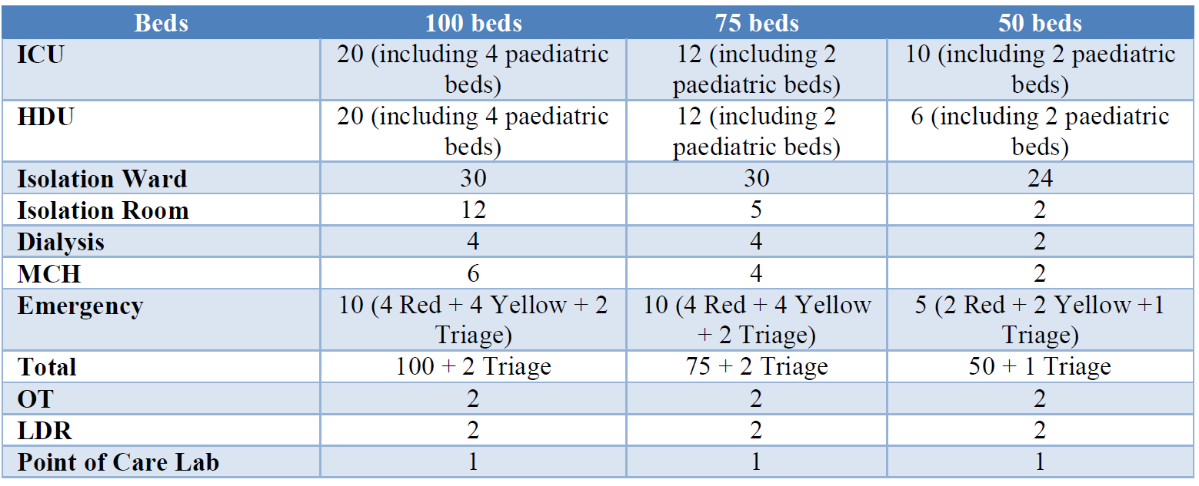
Components of CCB

Slide 7
HR Norms
HR Norms | Specialists - round the clock for OT, ICU, Emergency, delivery unit and other areas as per IPHS.
 | GDMO - 1 for 10 beds - critical care area and 1 for 20 beds non critical area
 | Nurses - 1:1 ICU; 1:2 Step Down Unit; 1:6 wards and other areas; OT - 2 per OT per shift; 1 nurse round the clock for delivery unit
 | Support staff- as per IPHS/GoI guidelines

Slide 8
Implementation Mechanism
MoU to be signed between state and MoHFW
Selection of site as per criteria mentioned in the guidelines
Site survey
Preparation of DPR & Layout plans
DPR Finalization including preliminary estimated cost as per state process
Tender
Initiation of work

Slide 9
Cost
Type of critical care units | 100 bedded | 50 bedded | 50 bedded in Medical Colleges
Capital Cost (in Rs.) | 44.50 Cr | 23.75 Cr | 23.75 Cr
Recurring Cost (in Rs.) | 7.912 Cr | 4.592 Cr | -

Slide 10
Layout Plan
50 Bedded CCB – ground floor
50 Bedded CCB – first floor
50 Bedded CCB – second floor

