Slide 1
Integration of lab services under IDSP with IPHL
Regional Consultation Workshop on PM-ABHIM and
XV-FC Health Grants, 13-14 Sept. 2022, Goa
Dr. Dhara B. Shah,
M.D.(Medical Microbiology), CIC(USA),DipRCPath(London),
Integrated Disease Surveillance Programme (IDSP),
Central Surveillance Unit(CSU),
National Centre for Disease Control (NCDC),
22-Shamnath Marg, New Delhi,
Delhi-110054, India.

Slide 2
Historical Background
IDSP become part of NRHM
Reporting surveillance data through portal started
2010 – 11
IDSP supported peripheral labs and microscopy centers
2012 - 13
2014 - 15
1990 – 96
Restructuring of IDSP project
Review of the IDSP, by the World Bank with technical support from WHO
Block level data entry in phased manner
Cholera & plague outbreaks
2003 - 04
2006 - 07
Restructuring of IT network (MOU with NIC)
Simplification of IDSP formats
Portal enabled Data reporting and management
2008 - 09
CSU established at Nirman Bhawan
Review Committees formed to focus on outbreak prone diseases
Importance of Disease surveillance
1997-98
Additional Technical manpower at CSU, SSU, DSU
NRHM supported-50 DPHLs
5th April 2021 - IHIlP launched
12 States (3rd phase) undergoing migration to IHIP
Weekly reporting of disease alerts/ outbreaks through IDSP by States/UTs initiated
Expanded to support state, regional and national along with DPHL
Plan for Referral Lab Network (Medical College, apex public & private labs)
Inclusion of 19 Regional Director offices & eight NCDC branches under IDSP
World Bank fund used for CSU and nine States (TN,KK, GUJ, PB, WB, MH,UK, AP, RJ)
Referral Laboratory Network initiated in the World Bank funded States
Competency Assessment Tool for monitoring introduced
Since Jan 2011, only Portal data monitored
Feb 2011 restructuring of IDSP and extension for 2010-11 & 2011-12
Continuation of the IDS Project as IDSP as a central scheme NRHM
CSU shifted (Nirman Bhawan to NCDC)
IDSP merged with NCDC
Continuation of IDSP approved by Mission Steering Group of NRHM and HFM
2016 -21
Monitoring of disease trend and respond to outbreaks in early rising phase through trained Rapid Response Teams
Strategic Health Operations Centre (SHOC) established under IDSP
Offline data entry at IDSP portal in phased manner
Milestones revision and addition
Disease surveillance project initiated.
IDSP launched (up to March 2010)
24 states migrated (11& 13 in two phases by 30th Sep 21 and 31st Dec,21) to real time reporting on IHIP
Domestic funds used for remaining States/UTs
Concept of district IPHL launched as part of PM-ABHIM
To review status of laboratory strengthening under IDSP, TAG and TWG were created with recommendation of integration and strengthening of comprehensive diagnosis and role of IPHL in surveillance and early detection

Slide 3
Integrated Disease Surveillance Programme(IDSP)
Major Components under IDSP
  Decentralization of Surveillance activities
  Human Resource Development - Training of SSO, DSO, RRT, other medical and paramedical staff
  Laboratory Strengthening
  Use of Information Technology for collection, compilation, analysis & dissemination of data
  Inter sectoral Coordination with Animal Health

Slide 4
IDSP Lab structure
CSU
NPO IDSP
AD Microbiology & Consultant Microbiologists
SSU
SSO
State Microbiologist at SSU
DSU
DSO
DPHLs at District Hospital - District Microbiologists, Lab Technician & Lab attendant/assistant (Health systems approach)
State referral Labs – Government medical colleges; linkages with Districts

Slide 5
Current strategy of IDSP for Lab strengthening
Two pronged approach
  Referral Labs Network (State Referral Labs):
    Existing State Government medical colleges lab - diagnostic facilities for epidemic prone diseases during outbreaks
    Provision of only annual funds & reimbursement cost based on number of tests performed.
  DPHLs: Strengthening of existing District Hospital labs in the country
    Diagnostic services for epidemic prone diseases to cater to the health care needs of the community and generate a quality lab based surveillance data.
    Provision of equipment (non-recurring cost based on gap analysis submitted), Manpower & recurring cost (based on performance)
State Referral labs & DPHLs are sacnctioned through PIP process based on proposals made by State.

Slide 6
KEY EXPECTATIONS from IDSP- DPHL Network
Diagnostic services of epidemic prone diseases on a routine basis
Support outbreak investigations in the District – establish system of specimen collection & transport
Report weekly data in L form on IDSP-IHIP platform
Participate in EQAS
Implement Biomedical waste management policy
Monitor for any clustering of cases & inform DSU
Notes:
Integrated within the existing District Hospital to cater to the health care needs of the community /be functional at all times
Must have an established system of receiving routine clinical specimens (from the CHCs/PHCs and field)
Undertake lab confirmation of epidemic prone diseases on a routine basis along with locally endemic diseases also (eg scrub typhus, leptospirosis, etc
Report weekly surveillance data on L form of IDSP/ Real time reporting in L form on IHIP ( mandatory for States which have migrated to IHIP )
Support outbreak investigations in the district
DSO is responsible for the DPHLs within the district

Slide 7
Testing Modalities at DPHLs
MICROSCOPY
Clinical specimens -throat swab, sputum, CSF etc
BACTERIAL CULTURE
Blood Culture:
Enteric Fever
Urine Culture:
UTI, Enteric Fever,
Stool culture
Gram stain and special stain smear examination
SEROLOGY
WIDAL (Slide/Tube)-Enteric fever
Rapid Ag Test: Leptospirosis, Scrub Typhus
Cholera (Vibrio cholera)
Other common Enteropathogens
Peripheral blood smear- Malaria
Rapid Latex Agglutination test-suspected outbreaks of Meningococcal Meningitis
ELISA : Viral Hepatitis A & E, Dengue (+NS1 Ag, IgM Ab), Chickungunya, Measles
Throat culture -Diphtheria
Direct wet mount smear – Stool- Hanging drop -Cholera
Blood Culture:
Enteric Fever
Urine Culture:
UTI, Enteric Fever,
Stool culture
Bacteriological tests for water quality and potability
Tests for other outbreak prone diseases prevalent -
locally are also being performed

Slide 8
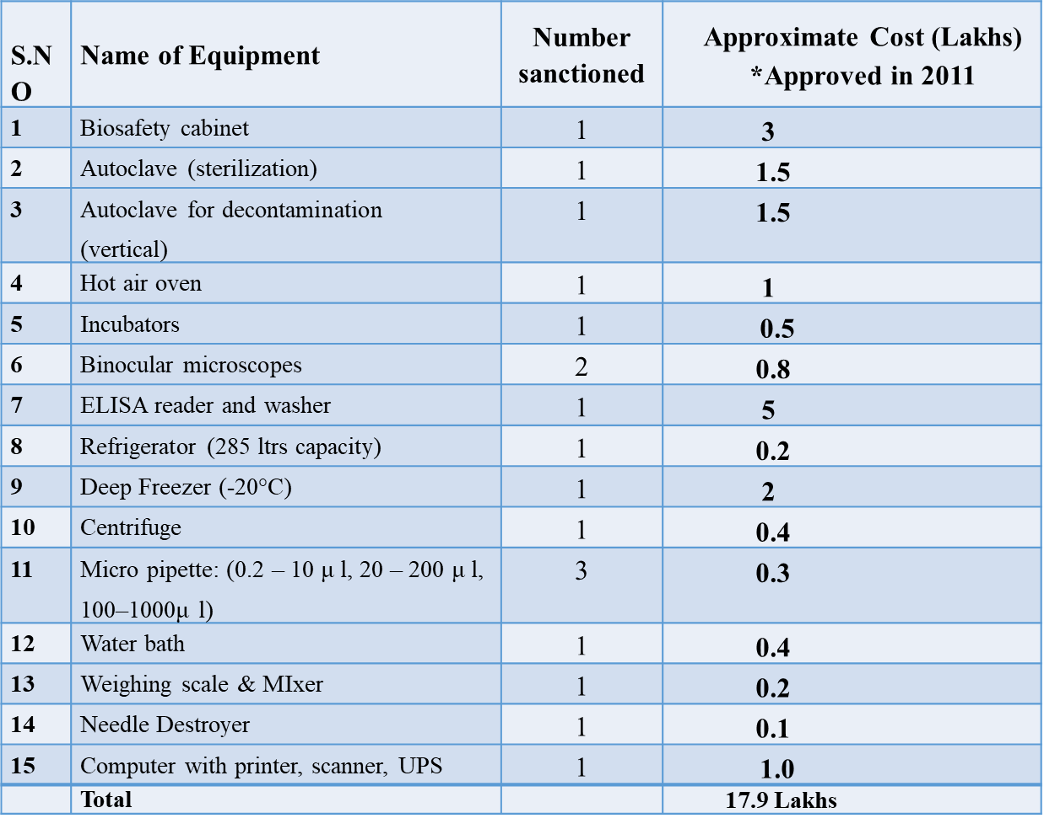
Current budget (non-recurring & recurring expenditure) towards establishment of DPHL under IDSP
Non recurring Budget for each DPHL (based on gap analysis) – One time grant of Rs 17.9 Lakhs
Annual Recurring Budget for each DPHL: Maximum Rs 4 lakhs /DPHL based on performance

Slide 9
L- Form Reporting Diseases under IDSP & IDSP-IHIP
IDSP | LAB CONFIRMED DISEASES | IDSP-IHIP
1. Dengue / DHF / DSS | A. Bacterial | 1. Anthrax 2. Cholera 3. Dysentery 4. Diphtheria 5. Leptospirosis 6. Meningitis 7. Pertussis 8. Scrub Typhus 9. Typhoid
2. Chikungunya
3. JE
4. Meningococcal Meningitis
5. Enteric Fever
6. Diphtheria
7. Cholera
8. Shigella Dysentery
9. Viral Hepatitis A & E | B. Viral | 10.Hepatitis A & E 11.CCHF 12.Chickenpox 13. Chikungunya 14. Dengue 15.Kyasanur Forest Disease 16. Measles 17. Mumps
11. Leptospirosis
12. Malaria (PV,PF)
13. state specific diseases- Scrub typhus, Zika
 | C. Parasitic | 18. Malaria
Presently 18 Disease conditions pertaining to lab confirmation/L-form reporting are being captured under IDSP-IHIP
Notes:
18 diseases under IDSP plus 2 animal bite conditions plus 2 state specific / unusual syndromes
33 conditions under IDSP-IHIP plus 3 animal bite conditions

Slide 10
Laboratory Strengthening – Financial Year wise Expansion of DPHL
Financial Year/PIP | DPHL sanctioned(No.) | Year Wise Cumulative
Up to 2010 | 48 | 48
2011-12 | 32 | 80
2012-13 | 36 | 116
2013-14 | 26 | 142
2014-15 | 56 | 198
2015-16 | 23 | 221
2016-17 | 30 | 251
2017-18 | 17 | 268
2018-19 | 23 | 291
2019-20 | 35 | 326
2020-21 | 45 | 371
2021-22 | 26 | 397
2022 - 24 | 23 | 413*
Total DPHL sanctioned:
413*
(as of August’2022)
*7 DPHLs surrendered by MP

Slide 11
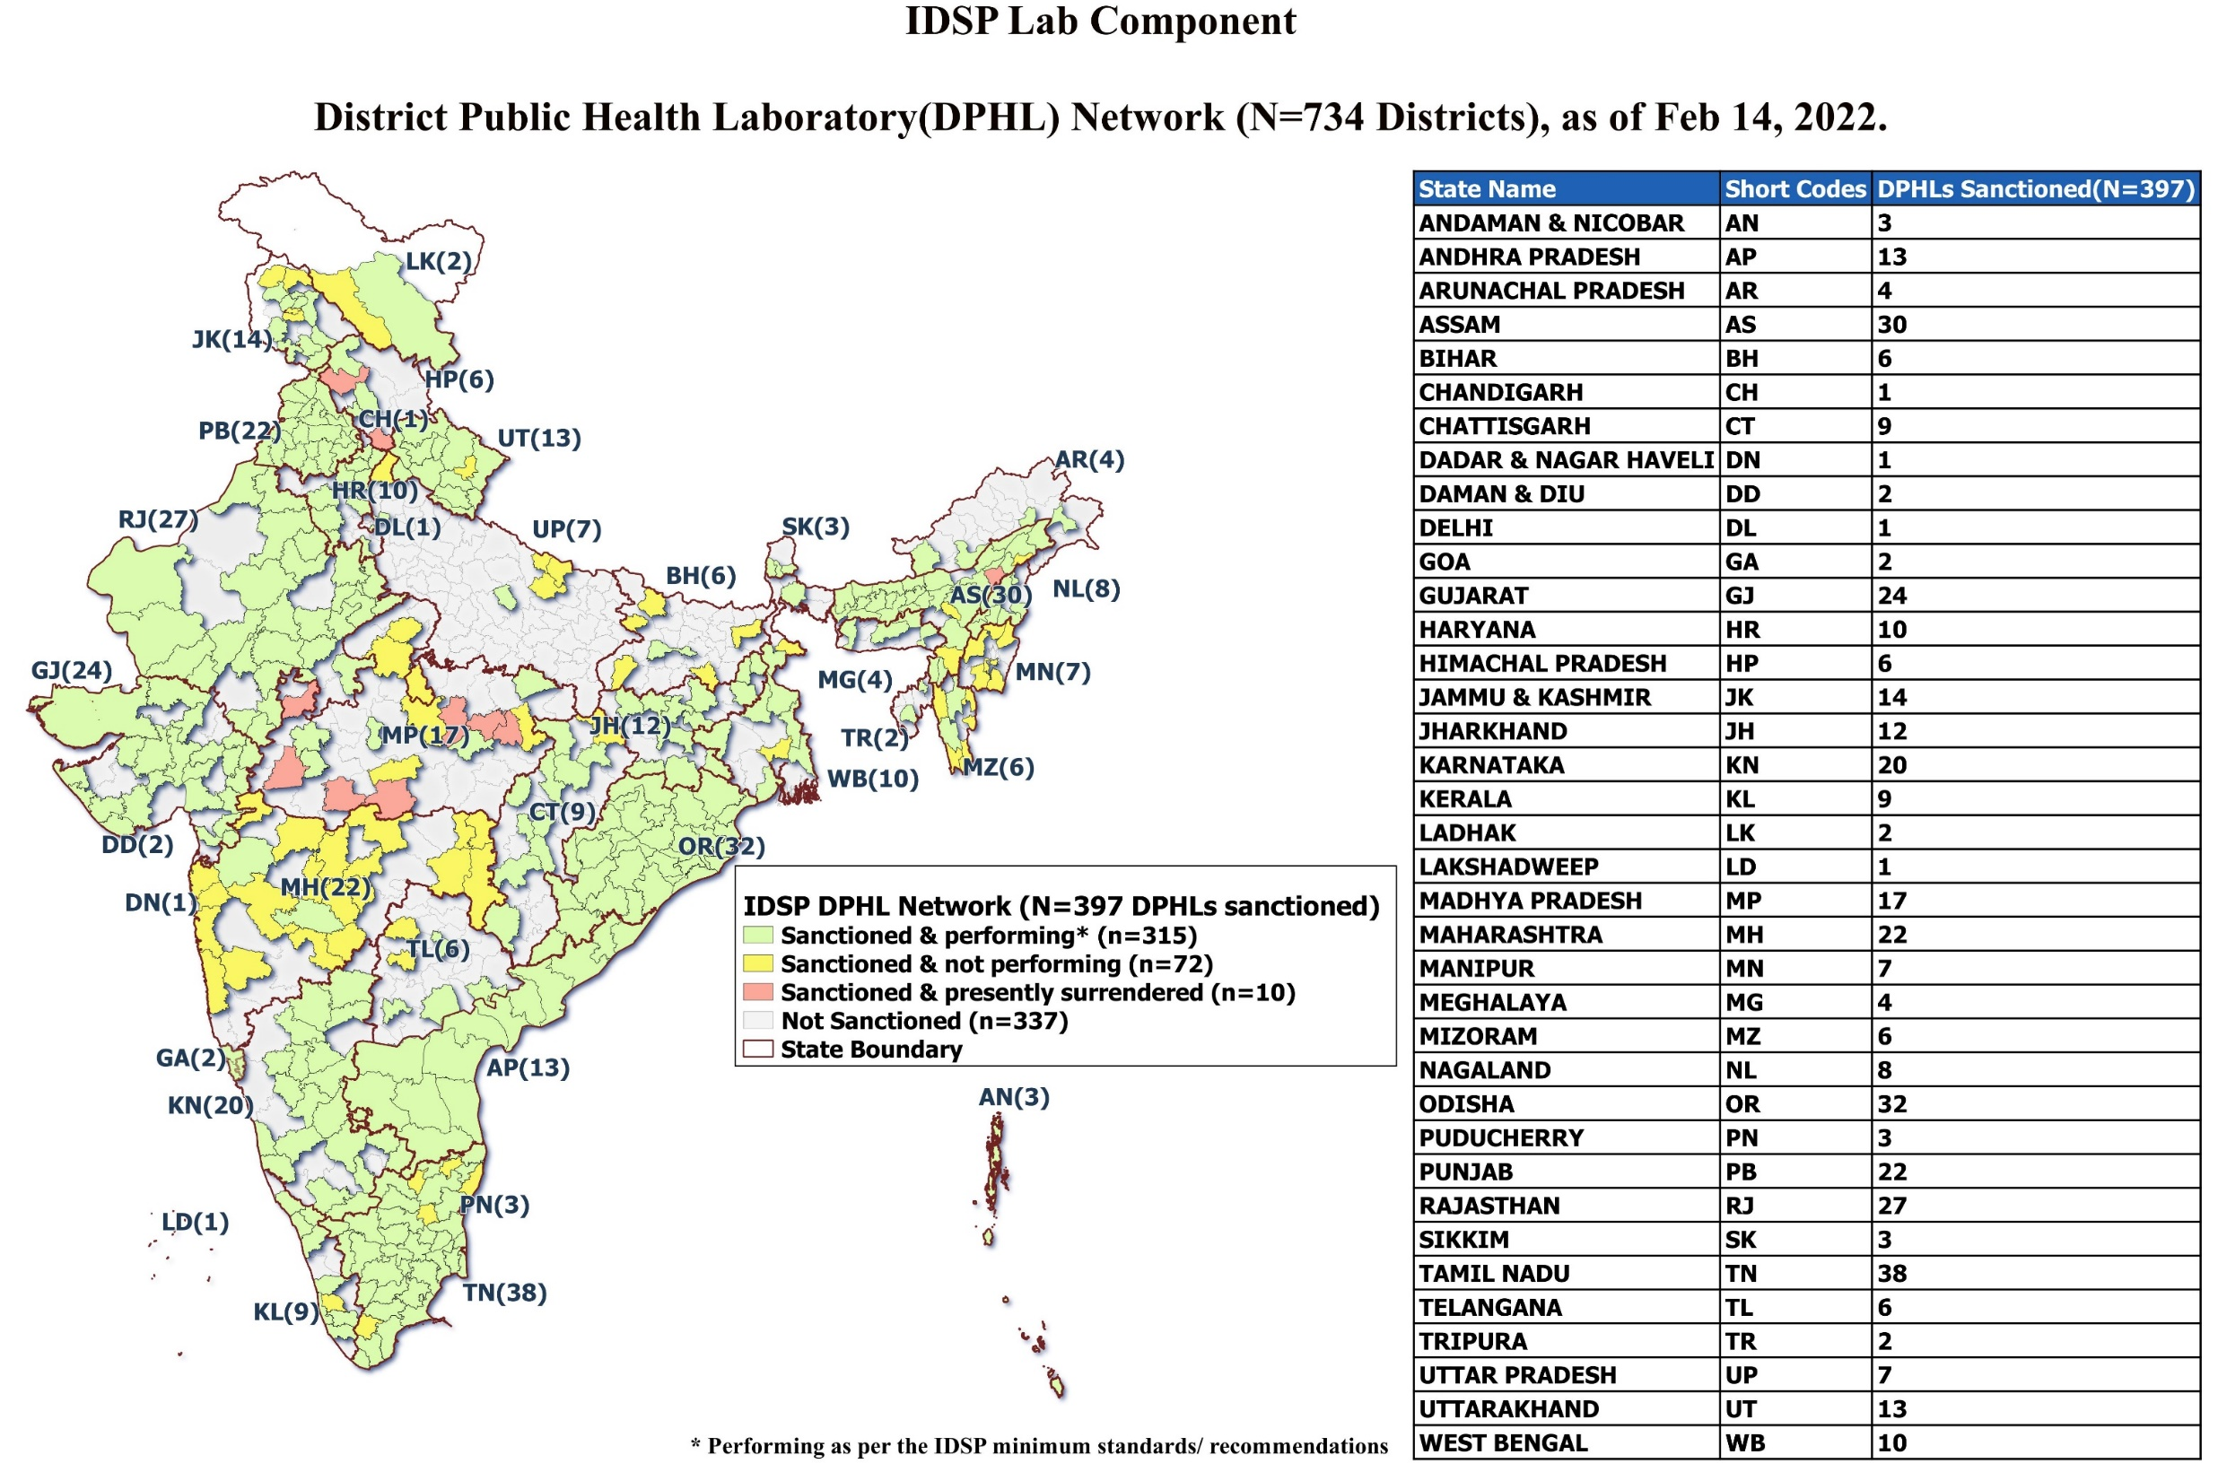
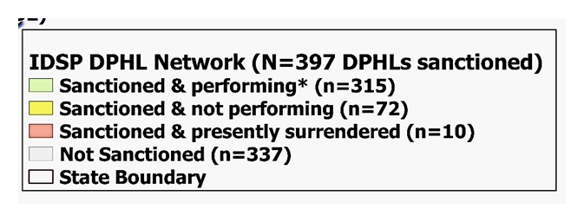
IDSP LAB COMPONENT
District Public Health Laboratory(DPHL)Network across 735 Districts, as of Feb 2022
State/UT | District (No.) | DPHLs Sanctioned(N=397)(%)
ANDAMAN & NICOBAR | 03 | 03(100)
ANDHRA PRADESH | 13 | 13(100)
ARUNACHAL PRADESH | 26 | 04(15.4)
ASSAM | 33 | 30(9.1)
BIHAR | 38 | 06(15.8)
CHANDIGARH | 01 | 01(100)
CHATTISGARH | 27 | 09(33.3)
DADARA & NAGAR HAVELI | 01 | 01(100)
DAMAN & DIU | 02 | 02(100)
DELHI | 11 | 01(9.1)
GOA | 02 | 02(100)
GUJARAT | 33 | 24(72.7)
HARYANA | 22 | 10(45.5)
HIMACHAL PRADESH | 12 | 06(50)
JAMMU & KASHMIR | 20 | 14(70)
JHARKHAND | 24 | 12(50)
KARNATAKA | 30 | 20(66.7)
KERALA | 14 | 09(64.3)
LADAKH | 02 | 02(100)
LAKSHADWEEP | 01 | 01(100)
MADHYA PRADESH | 52 | 17(32.7)
MAHARASHTRA | 36 | 22(61.1)
MANIPUR | 16 | 07(43.8)
MEGHALAYA | 11 | 04(36.4)
MIZORAM | 11 | 06(54.5)
NAGALAND | 11 | 08(72.7)
ODISHA** | 30 | 32**(100)
PUDUCHERRY | 04 | 03(75)
PUNJAB | 22 | 22(100)
RAJASTHAN | 33 | 27(81.8)
SIKKIM | 04 | 03(75)
TAMIL NADU | 38 | 38(100)
TELANGANA | 33 | 06(18.2)
TRIPURA | 08 | 02(25)
UTTAR PRADESH | 75 | 07(9.3)
UTTARAKHAND | 13 | 13(100)
WEST BENGAL | 23 | 10(43.5)

Slide 12
IDSP-DPHL Network Performance-Current Status
DPHLs sanctioned 413
DPHLs sanctioned in FY 2022 – 2024: 24
Microscopy/Rapid tests/Widal tests - 262
Serology (ELISA) - 260
Culture - 191
DPHLs performing - 316
* Performance based on DPHLs report of July 2022. 23 DPHLs didn’t share DPHL monthly report.

Slide 13
Distribution of Districts w.r.t. presence of DPHL and Outbreak reported in 2021
Outbreaks reporting under IDSP in 2021 | Districts distribution as per the presence of sanctioned DPHLs |  | Total
 | Districts with DPHLs Sanctioned (N= 397) | Districts without DPHLs (N=337)
Outbreaks reported No.(%) | 479(65.79) | 249(34.20) | 728
  Of the total Outbreaks reported during the year 2021, districts with DPHLs (397) have reported remarkably higher proportion of Outbreaks (479/728, 65.79%) as compared to the one which do not have DPHLs.
  Hence, It is observed that the presence of DPHLs in districts
  may improve the outbreak reporting from the district(s).
Notes:
Colour of the slides to be modified- not red- and mild / less bright ones-Classification of districts –title of the slide-
Districts having DPHLs
Districts not having DPHLs
Presence of DPHLs in districts improves outbreak reporting

Slide 14
IDSP-DPHL Network Performance-Current Status
S. No. | State / UT (No. of Districts) | Number of DPHLs Sanctioned till March 2022 | Number of DPHLs Functional | Reasons for Non- Performing
1. | Andaman & Nicobar(3) | 3 | 3 | ---
2. | Andhra Pradesh (26) | 13 | 13 | ---
3. | Arunachal Pradesh (25) | 4 | 3 | Bomdila DPHL under construction, Microbiologist is appointed, working at TRIHMS, Naharlagun
4. | Assam (33) | 30 | 28 | Funds shifted to South Salmara (Newly proposed DPHL), Instruments under procurement - Revised Budget
5. | Bihar(38) | 6 | 1 | 5 NF -Instruments under procurement – Budget is Revised
6. | Chandigarh (1) | 1 | 1 | ---
7. | Chhattisgarh (28) | 9 | 9 | ---
8. | Dadra & Nagar Haveli (1) | 1 | 1 | ---
9. | Daman & Diu (2) | 2 | 2 | ---
10. | Delhi (11) | 1 | 1 | ---
11 | Goa (2) | 2 | 2 | ---
12 | Gujarat (33) | 24 | 24 | ---

Slide 15
IDSP-DPHL Network Performance-Current Status
S. No. | State / UT(No. of Districts) | Number of DPHLs Sanctioned | Number of DPHLs Performing tests as per IDSP mandate | Reasons for Non- Performing (NP)
13. | Haryana (22) | 10 | 8 | 2 NP- No HR – No Microbiologist & Lab Technician
14. | Himachal Pradesh (12) | 6 | 3 | 2 Upgraded to MC; 1 NP as MC present
15. | Jammu (10) | 5 | 5 | -
16. | Kashmir (10) | 9 | 7 | 2 NP- Space not identified
17. | Jharkhand (24) | 12 | 8 | 4 NP-Equipment are purchased, Need to be installed
18. | Karnataka (30) | 20 | 20 | -
19. | Kerala (14) | 9 | 8 | 1 NP- Construction of the building is ongoing
20. | Ladakh (2) | 2 | 1 | 1- Funds to be released
21. | Lakshadweep (1) | 1 | 0 | -
22. | Madhya Pradesh (52) | 10 | 5 | 5 NP- 2 DPHL Infrastructure available but no HR; 3- No infrastructure & HR
23 | Maharashtra (36) | 22 | 3 | 19 NP-Equipment procurement is under process; HR recruitment under process
24 | Manipur (16) | 7 | 0 | 1-HR issue 6- Lab equipment purchase under process
25 | Meghalaya (11) | 4 | 2 | 2 NP- Space constraint in the DPHL for installation of all equipment
26 | Mizoram(8) | 6 | 2 | Microbiologists N/A, Funds which are approved in ROP for the procurement of the lab materials are not released
27 | Nagaland(11) | 8 | 7 | 1NP- Equipment not purchased

Slide 16
IDSP-DPHL Network Performance-Current Status
S. No. | State/ UT (No. of Districts) | Number of DPHLs Sanctioned | Number of DPHLs Performing tests as per IDSP mandate | Reasons for Non- Performing (NP)
28. | Odisha (30) | 32 | 32 | --
29. | Puducherry (4) | 3 | 3 | -
30. | Punjab (23) | 22 | 22 | --
31. | Rajasthan (33) | 27 | 27 | --
32. | Sikkim (4) | 3 | 1 | 2 NP- Infrastructure& Equipment procurement o be initiated
33. | Tamil Nadu (38) | 32 | 32 | 6 NP Equipment procurement under process
34. | Telangana (31) | 6 | 4 | 2 NP
35. | Tripura (8) | 2 | 2 | --
36. | Uttar Pradesh ( 75) | 7 | 2 | 5 NP sanctioned funds have not be been utilized
37. | Uttarakhand (13) | 13 | 12 | 1 NP Equipment procurement under process
38. | West Bengal (23) | 10 | 9 | 1 NP- renovation & equipment procurement processes have been initiated

Slide 17
Total TARGET: 730 IPHLs
(FY 2021-22 to 2025-26)

Slide 18
Integration of Lab services under IDSP with IPHL
Joint Ownership by multiple National Health Programs: Hand in Hand approach
Road map & Timeline for IPHL including DPHL in every District- State
Reduction in time taken for Procurement & fund transfers
Appropriate IEC – all stakeholders

Slide 19
Strengths
Provision of basic minimum infrastructure for diagnosis of epidemic prone diseases.
Weakness
Limited awareness among health Leadership.
Threats
Outsourcing of labs
Opportunities
Establish IPHL under PM-ABHIM – new vigor to DPHL strengthening
Confusion with PWD - Public Health Labs and IDSP-DPHLs.
DH upgrading to MC (difference in mandate)
Not all sanctioned DPHLs are performing, many performing basic minimum tests.
Poor sample referrals
Fund allocation – priorities at State/District
QC – QMS services
Prolonged Procurement process.
Lab based Community surveillance
Improved early warning/ Outbreak reporting

Slide 20
Key issues
Coordination between multiple National Health Programs at the State and Central levels
LMIS for IPHLs and data sharing with all NHPs through it
Mapping of stakeholders and clearly defined roles and responsibilities
Clarity on roles and responsibilities of existing staff after integration
Ensuring adequate HR / Need for additional HR
Mapping of equipment with programme mandate
Space / Infra requirements
District Hospitals that have ben converted to Medical Colleges

Slide 21
Thank you

Slide 22
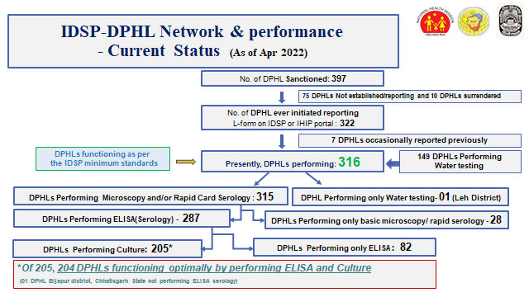
IDSP-DPHL Network Performance-Current Status
(As of Mar’2022)

Slide 23
Dedicated HR under IDSP Lab Component (DPHL)
Approved/ Sanctioned HR positions in DPHL (DSU)
HR Positions under DSU (DPHL) | Qualification | Number of Positions/ DPHL
*Microbiologist | MBBS, MD/MSc Medical Microbiology/MSc Microbiology with 2 years lab experience in diagnostic services for epidemic prone diseases | 1
Lab Technicians | minimal qualification DMLT | 1/2 ( as per workload)
Laboratory Assistant cum DEO |  | 1
Laboratory Attendant |  | 1
Total |  | 5
*1 State Microbiologist position is also approved under SSU
Currently (Feb 2022) in 32 States/UTs Microbiologists are in position
State Microbiologist position vacant in 4 States/1UT (Haryana, HP, Jammu, Sikkim & Puducherry)

Slide 24
Key Challenges
Awareness among Leadership regarding DPHLs; Confusion with PWD - Public Health Labs performing water testing and IDSP-DPHLs performing microbiological tests.
Lack of State / District level ownership/initiative for public health lab strengthening:
  Outsourcing of labs
Despite efforts, slow progress in expanding the network to all Districts
Many labs still doing only basic or rapid Tests (Widal/malaria etc.)
  Nil/minimal testing for epidemic prone diseases
    No sample referrals by clinicians/sample size too small to generate district level surveillance data/ no visibility or acceptance of DPHL in DH
    Funds allocationed by the MS/CMHO
    adhocism- gaps in provision of infrastructure/procurement of equipment
    HR sanctioning/ recruitment- vacant positions
    lack of facilities and training (basic and advanced) technicians & microbiologists

Slide 25
Strengthening of DPHL-
Key Challenges
Challenge of QC & QMS services
Outsourcing of services due Free Diagnostic scheme of NHM
District hospitals getting converted to Medical colleges in few States
Currently guidance to States/ UTs to strengthen/ establish IPHL under PM-ABHIM: Key initiative but sustainability and State’s commitment to same needs to be monitored

Slide 27
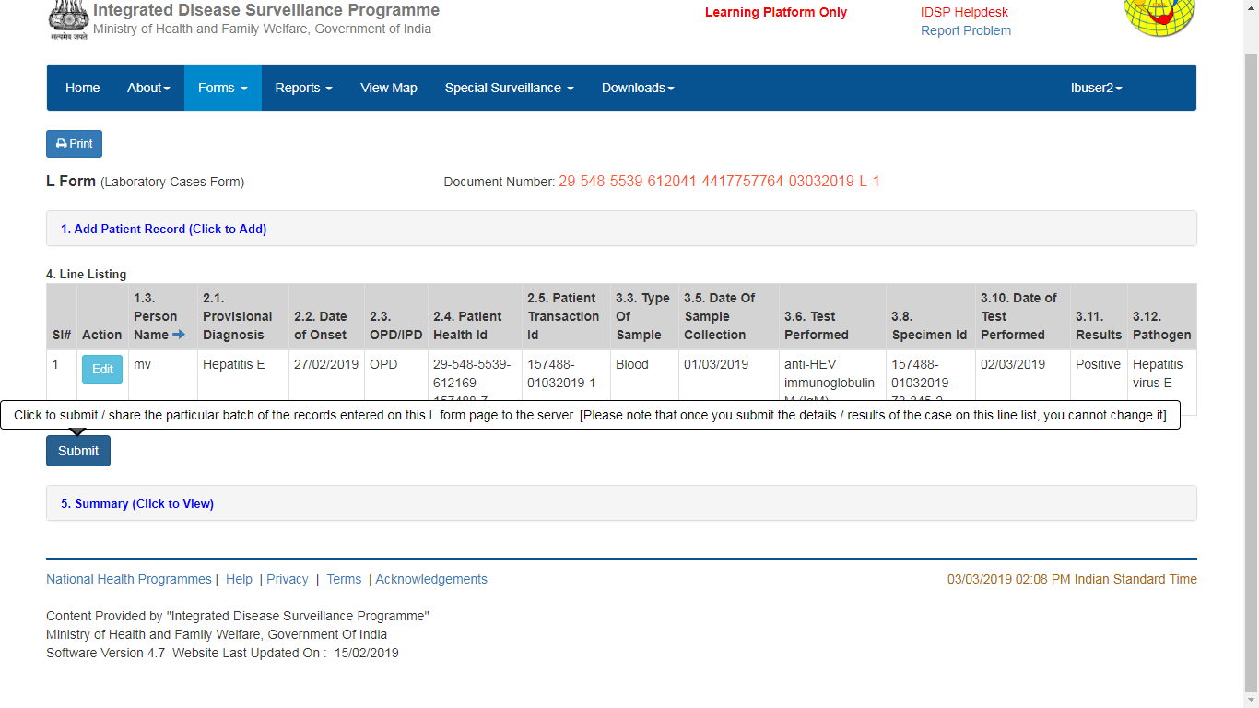
Once these fields are filled in…

Slide 28
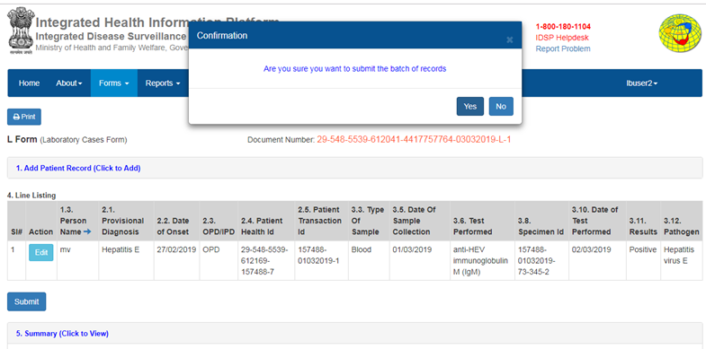

Slide 29
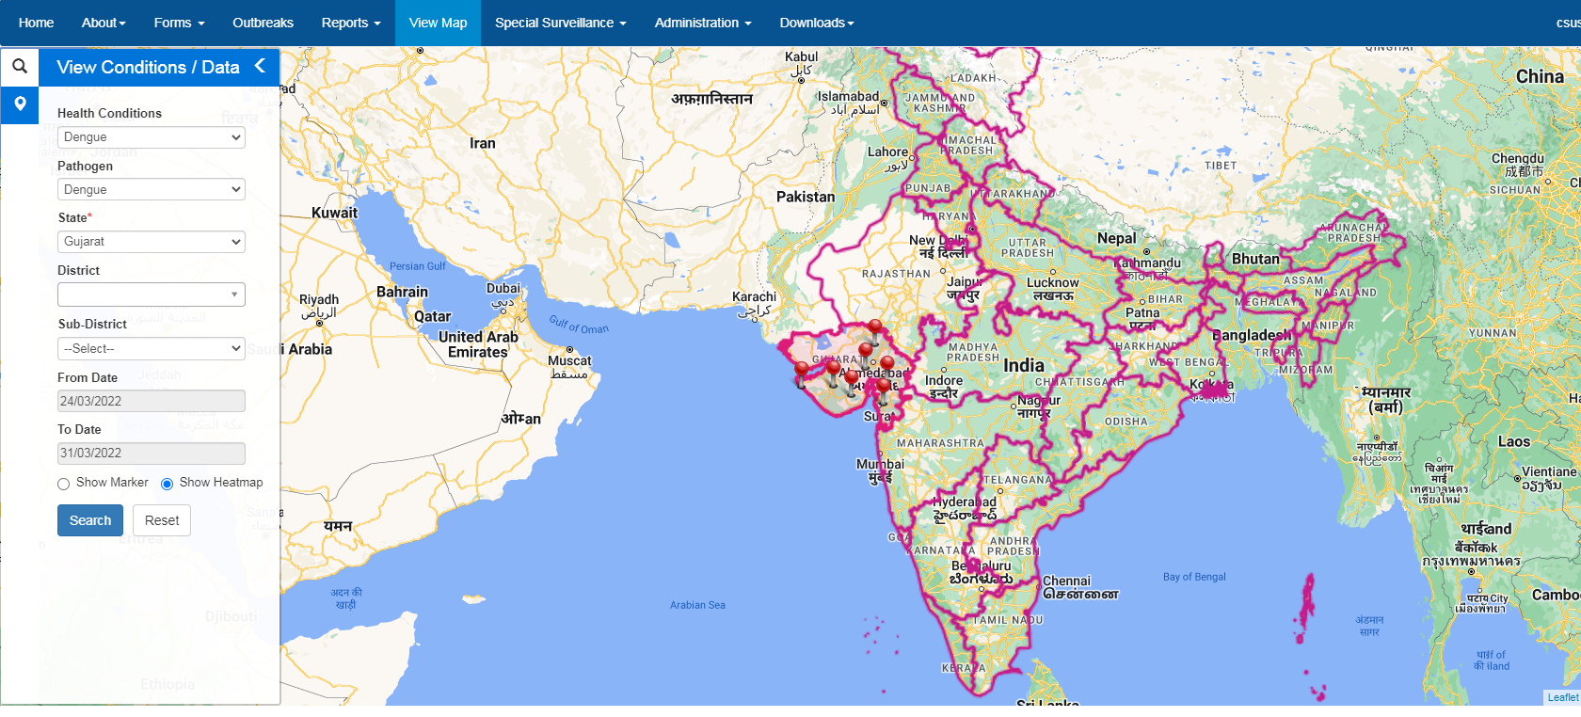
IHIP HEAT MAP
IHIP Heat Map showing Dengue cases in Gujarat from 24.03.22 to 31.03.22 (1 week)

Slide 30
State Referral Lab Network
Existing functional laboratories at medical colleges, linked to adjoining districts for referral of clinical specimens during suspected outbreaks
Annual fund (Rs 2 lakhs) for procuring reagents and testing kits, etc, subsequent reimbursements for tests done for field samples (upto Rs 3 lakhs)
District
District
District
District
District
District
State Reference Lab
State Reference Lab
SSU/DSU/ State Lab Consultant/ State Lab Coordinator
State Reference Lab
State Reference Lab
District
District
District
District
District
District

Slide 31
Selection Criteria for the State Referral Labs
Willingness to participate
Well-functioning microbiology laboratory - infrastructure and human resources
Agree to sign an MoU with State Surveillance Unit
Designate a nodal officer(microbiologist) who would be responsible for IDSP related activities
Agree to comply with the State Biomedical Waste Management Guidelines
Agree to participate in the External Quality Assessment Scheme

Slide 32
Commitment of SRL under IDSP network
Testing of samples referred from districts for confirmation of suspected outbreaks.
Provide logistic support for transport of microbiological samples (e.g. provide stool transport media etc to linked districts)
Mentoring of microbiologist/lab technicians towards adequate sample collection and transport
Report routine laboratory surveillance data weekly on IDSP L form and quarterly report of field samples tested
Ensure performance standards for lab to be functional at all times for outbreak investigation under IDSP, maintain adequate:
  infrastructure,
  equipment and
  consumables

Slide 33


Tests expected to be carried out at the State Referral Labs
  Cholera and other common enteropathogens : biochemical identification, culture and sensitivity and serotyping
  Typhoid: Blood Culture & antimicrobial sensitivity (including isolate confirmation with specific antisera)
  Bacterial meningitis-rapid latex agglutination test, CSF examination-wet mount, gram stain and culture & antimicrobial sensitivity
  Hepatitis A & E- IgM ELISA
  Measles- IgM ELISA
  Dengue- IgM ELISA, NS1 Antigen ELISA
  Leptospirosis-ELISA/Rapid test
  Diphtheria-Smear examination, culture and toxigenecity testing
  Any other tests for locally prevalent epidemic prone disease (to be identified by the state)

Slide 34
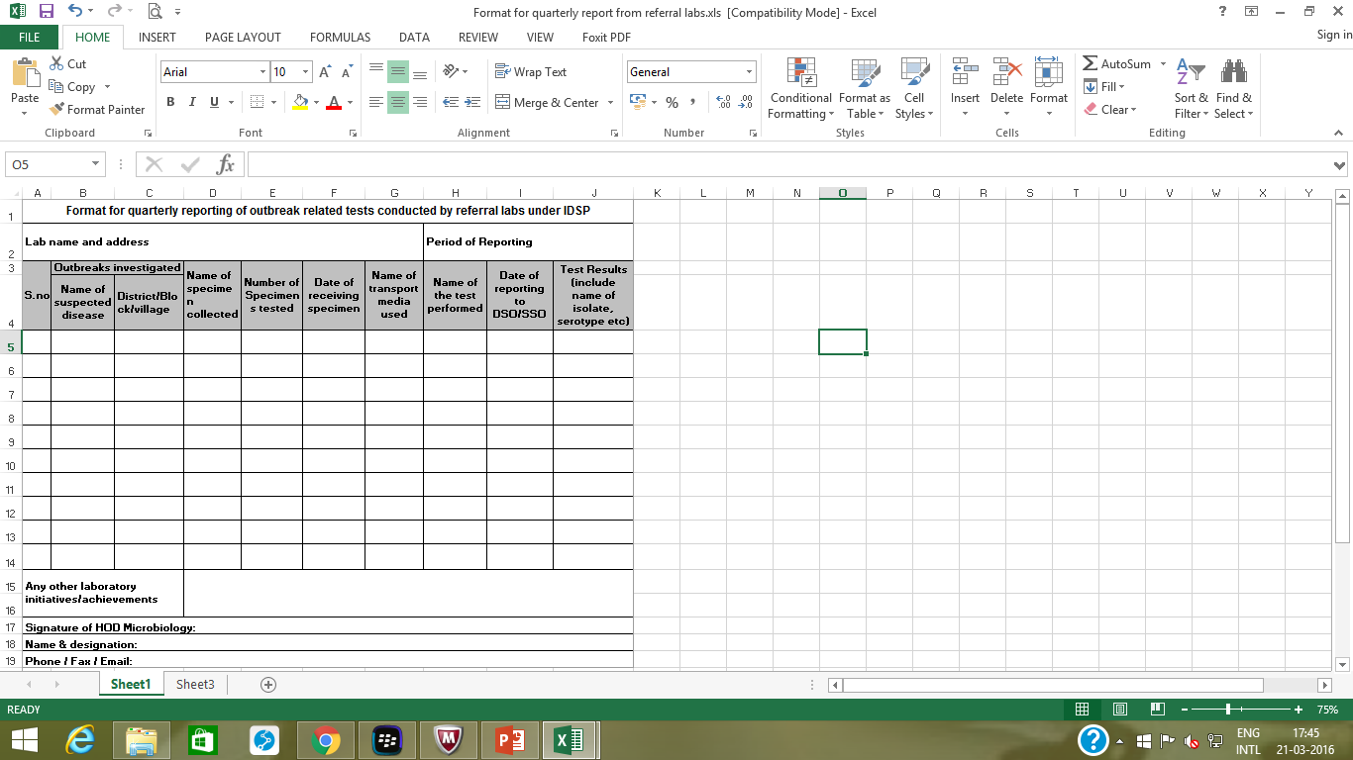
Format for quarterly reporting of the SRLs

Slide 35
Role of State Referral Labs beyond 2020
Agree to participate in the EQAS
Handholding of District/Taluka/Block level labs
Monitoring of linked labs
Provide support to the Rapid Response Teams of the linked districts (such as providing the transport media )
Report the lab results of outbreak related samples to the DSO and SSO expeditiously and maintaining confidentiality
Timely submission of quarterly report to SSU and CSU

Slide 36
State Referral Laboratory(SRL) Network Strengthening
MOU with SRL every year and State to monitor progress. If not functioning optimally can terminate MOU.
State can recommend new SRL as per requirement. The states are to identify functional labs existing
in government institutes (preferably in the Medical Colleges and various other large institutions) and
link the adjoining districts to them for providing the lab services during suspected outbreak
situations.
The role of referral labs to be expanded in Medical College beyond supporting outbreak
Investigations-
o Supervision and Training
o Mentors for establishing QMS in district labs: IQC EQAS
o More handholding and onsite support - can augment strengthening of the laboratories.
o Provide control strains

Slide 37
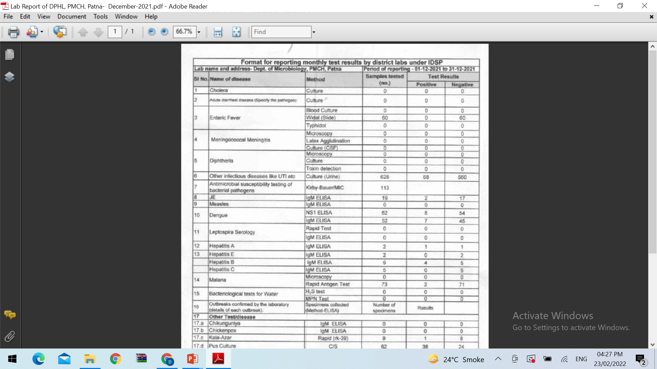
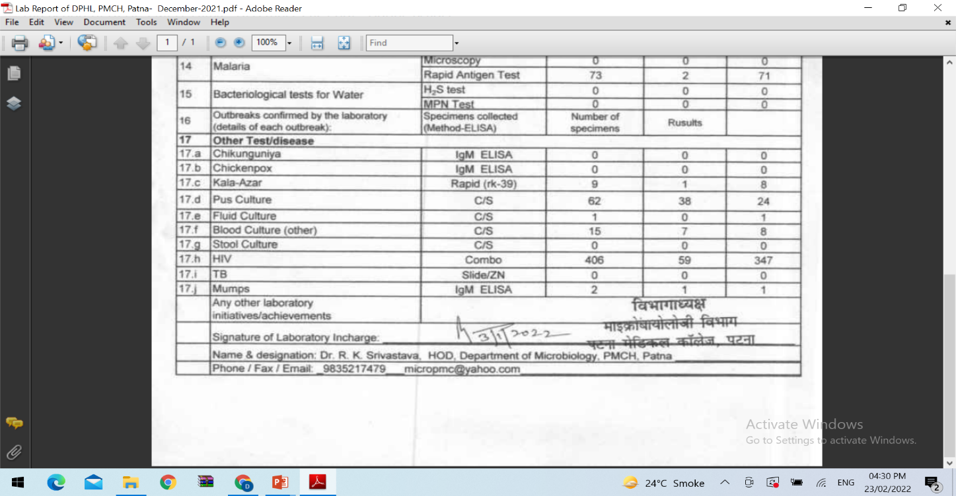

Slide 38
District Public Health Laboratory(DPHL) Strengthening
States to make all District Public Health Labs (DPHLs) sanctioned under IDSP functional, at the earliest for lab confirmed diagnosis of epidemic & outbreak prone diseases. DPHLs need to be integrated with the District Hospitals.
State should ensure that nomenclature from DPL changed to DPHL for all functional purpose.
Culture facility to be made available in all functioning DPHLs.
Districts where DH is converted to Medical College, the decision to shift the DPHL is to be left to respective States.
Regarding expansion of DPHLs, States/UTs to prepare a report based on catchment population, OPD load, sample load etc. Gap analysis done in this regard may be used for proposing additional DPHLs in next year PIPs.
States to review existing funding approved for all the functional DPHLs and justify additional funding request.
DPHLs should initiate/test for Scrub typhus and Leptospirosis as per the guidelines provided by NCDC.
DPHL Microbiologist to sensitize the clinicians for sample referral to the DPHL (the State Microbiologist also on visit to DPHL could meet the clinicians and emphasize on IDSP mandate).

