Slide 1
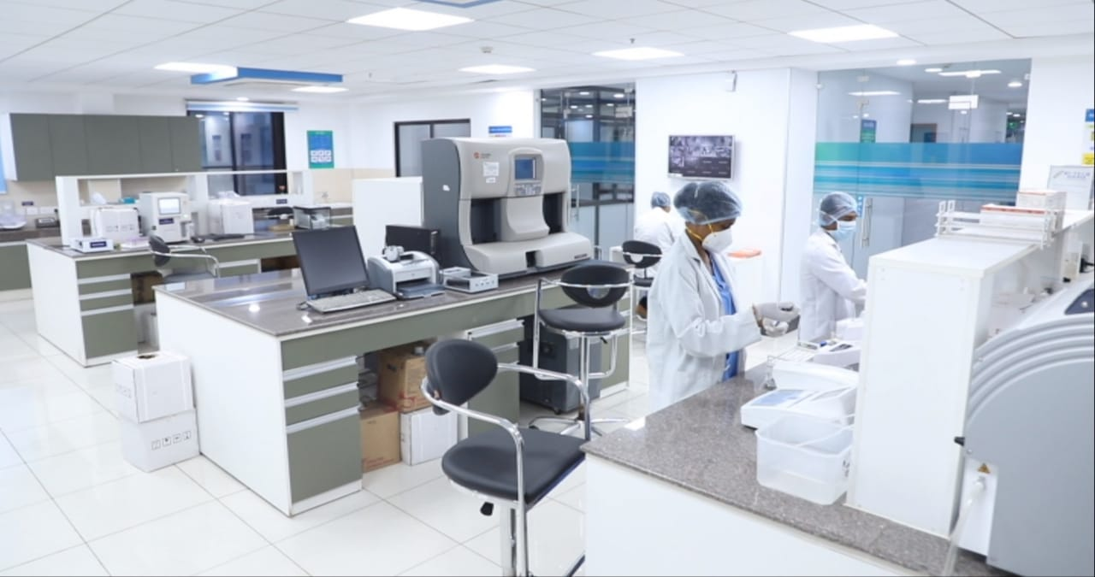

Integrated District Public Health Laboratory
Dr. Himanshu Bhushan
Advisor, Public Health Administration, NHSRC

Slide 2
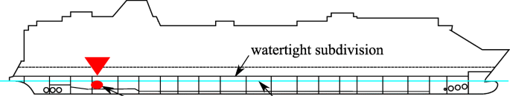
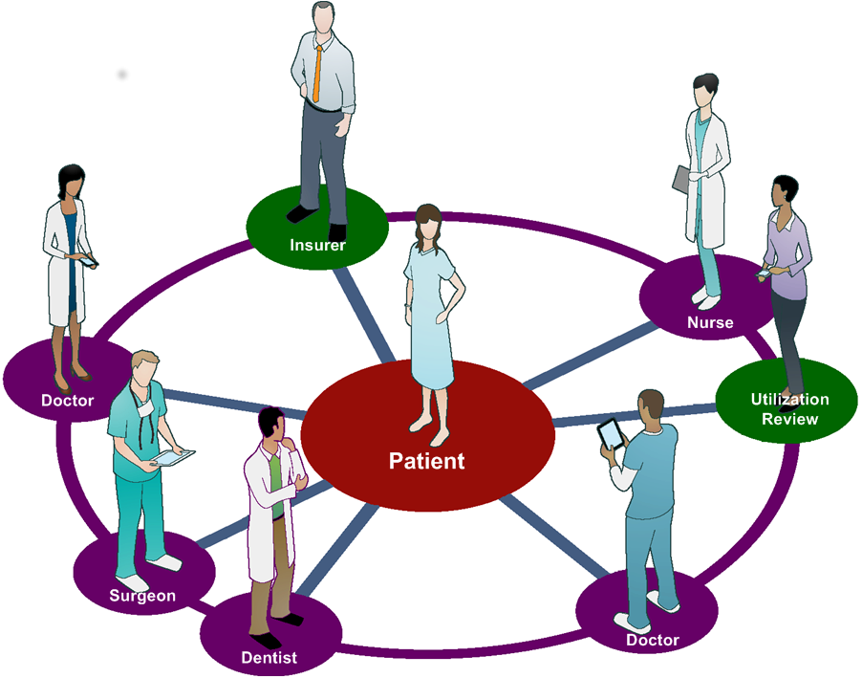

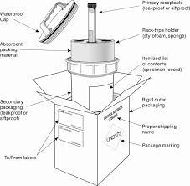
Major Gaps
Limited range of assured testing services
Laboratory services not patient-centric
Multiple program labs working in silos
Suboptimal utilization of resources
Lack of dedicated lab funding: leading to stock outs
Lack of a dedicated specimen referral network of laboratories
Healthcare workers untrained in handling infectious substances
Notes:
What were the major gaps that are frequently observed in district hospital laboratory:
The most significant gap was: Suboptimal utilization of resources because the major health programs were working in silos, were not sharing their resources or information,
The laboratory services were not patient-centric. As a result, the patient would have to go to different sections of the labs to submit samples for various tests.
And Because the lab was never a priority there was a Lack of Dedicated funding for labs: leading to frequent stockouts of reagents and kits
A dedicated specimen referral network of laboratories was lacking
Healthcare workers are untrained in handling infectious substances. In fact, the early samples of COVID-19 referred from different states were rejected by airlines because they did not conform to IATA regulations.

Slide 3
Out of Pocket Expenditure by Health Care Function, NHA 2017-18
*Expenditure on Medicines includes prescribed medicines and over-the-counter medicines.
**Others include specialized day curative care, home-based curative care, patient transportation, laboratory & imaging services, therapeutic appliances and other medical non-durable goods and other functions.

Slide 4
Situational analysis of Out Of Pocket Expenditure of various states
7 States have OOPE less than National’s average (48.8%)
Source: National Health Authority Report 2017-18

Slide 5
Integrated Public Health Laboratory (IPHL)
The term extends to a laboratory providing comprehensive services including Infectious disease diagnostics along with other diagnostic services like haematology and clinical chemistry all combined under one laboratory service.
Physical integration - establishment of a central sample collection facility in a patient friendly location.
Functional integration - merging the lab components of various vertical programs at the district public health lab, in the process sharing the space, manpower and equipment to avoiding duplication and disconnect.
Data
Integration
Functional Integration
Physical Integration

Slide 6
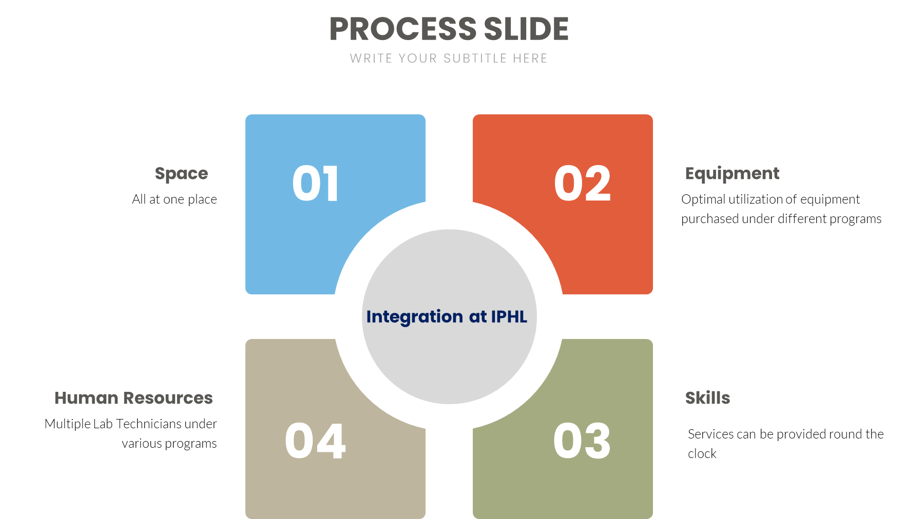
Functional Integration
Vertical Health Programs providing testing
TB clinics
DPHLs
ART centres
NCD clinics
Malaria labs
IPHL
Infrastructure
Workforce
Equipment
Space
Services
Notes:
The functional integration requires the various vertical program sections to operate in a coordinated way under one roof sharing the space, workforce and equipment, thus avoiding duplication and disconnect. Automation and interfacing of equipment with laboratory information systems is an essential component of IPHLs to improve the quality, and speed of testing and reporting.

Slide 7
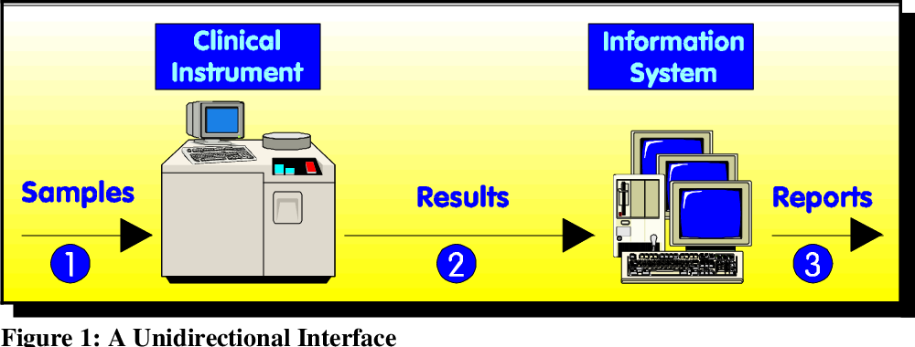
Data integration
Digital results through established laboratory information system linked to IHIP for an urgent action in real time by early identification of unusual trends in mortality and morbidity
IDSP (forms)
NTEP
LIMS
Peripheral facilities
NACP
Dashboard at National level
Integrated Health Information Platform

Slide 8
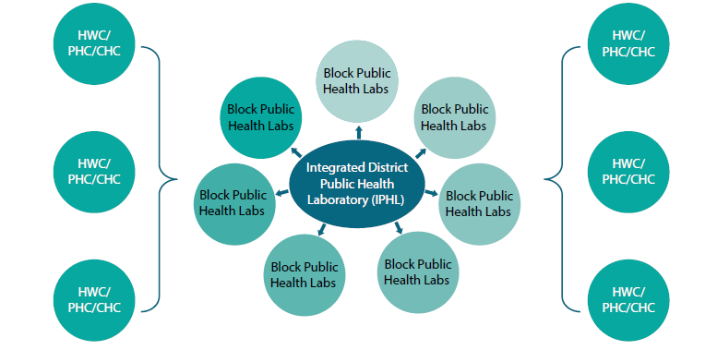
Strengthening Diagnostic services

Slide 9
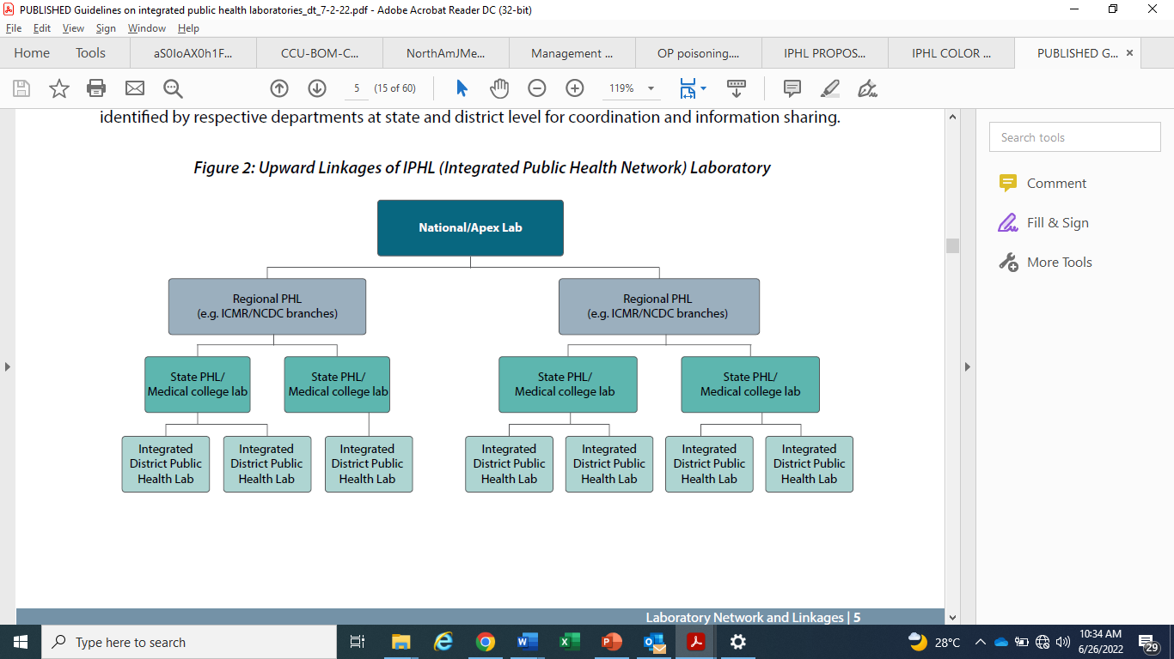
Defined Upward Linkages

Slide 10
Services
No. of tests-
DH- 134
SDH-111
(as per FDSI)
Test Area | Tests to be conducted | Major Equipment Required
Clinical Pathology | Urine microscopy, chemistry and pregnancy test, Stool microscopy for ova, cysts and parasites Stool occult blood Stool Hanging drop for cholera Rapid stool test for cholera Semen analysis | Binocular Microscope, Urine analyser Centrifuge Bunsen burner with gas supply
Haematology | Microscopy of peripheral blood smear for blood cells & haemoparasites (malaria/filaria) Complete haemogram & cell count Blood grouping, cross matching, Coombs and hemoglobinopathies Coagulation profile Bone marrow examination | Binocular Microscope Automated Cell Counter (3 part/5 part) with nucleated RBC flag Automated Coagulometer Automated ESR analyser Haemoglobin HPLC machine (variant analyser)
Cytology | Fine-Needle Aspiration Cytology (FNAC) PAP smear examination CSF & body fluid cytology | Binocular Microscope Centrifuge
Biochemistry | Quantitative analysis of routine biochemical parameters and special chemistry parameters (including hormones) | Automated Biochemistry analyser ISE based Electrolyte analyser Automated Hormone Immunoassay analyser (CLIA Based)
Sample receiving and reporting area | Sample acceptance and registration Report generation and delivery | Computer with scanner, printer, UPS
Routine sampling of air or surfaces for culture is not recommended. In special circumstances air culture using slit sampler can be performed in the operation theatres (OTs) instead of settle plate test.

Slide 11
Services
(contd.)
Test Area |  | Tests to be conducted | Major Equipment Required
Microbiology | Bacteriology | Microscopy, Bacterial Culture & Antimicrobial susceptibility testing for clinical samples Microbiological analysis of Water (H2S test for screening, Coliform presence-absence (PA) test for confirmation) | Binocular Microscope Incubator Automated blood culture Automated bacterial ID/AST system Biosafety Cabinet Class II A2 (model conforming to NSF standards) Bunsen burner with gas supply Computer with scanner, printer, UPS Culture media
 | Mycobacteriology (TB) | Microscopy for AFB CB-NAAT for mycobacteria | Binocular Microscope (LED) Fluorescent Microscope Biosafety Cabinet Class II A2 with thimble ducting NAAT machine Bunsen burner with gas supply Biosafety Centrifuge
 | Serology | ELISA, Rapid card tests | ELISA reader and washer VDRL rotator/shaker
 | Molecular biology/ Virology (BSL-2) | Real Time PCR & Rapid diagnostic platforms for Influenza, COVID-19 and others Viral load for Hepatitis B & C | Real Time PCR machine Biosafety Cabinet Class II A2 (model conforming to NSF standards) PCR Workstation, ELISA reader and ELISA washer Microcentrifuge PCR hood/PCR workstation
 | Media preparation room | Preparation of culture media | Electronic balance Hot plate Autoclave Bunsen burner with gas supply
 | Washing & Sterilization area | Washing & sterilization of glassware Sterilization of biomedical waste | Autoclave Hot air oven

Slide 12
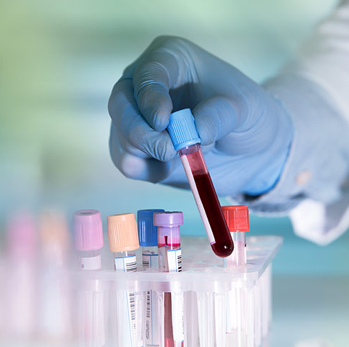
Haematology Tests
Complete blood count
Coagulation Profile
Blood Grouping
Hemoglobin electrophoresis (Sickle Cell Anemia/Thalassemia)
Malaria/Filaria

Slide 13
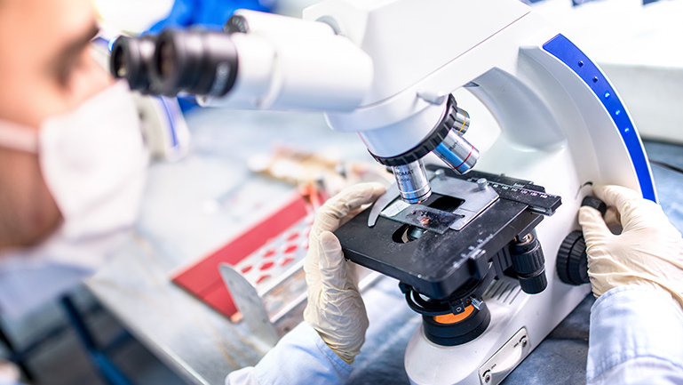
Clinical Pathology
Urine
  microscopy, chemistry and pregnancy test,
Stool
  microscopy for ova, cysts and parasites
  occult blood
  Hanging drop for cholera
  Rapid test for Cholera
Semen analysis

Slide 14

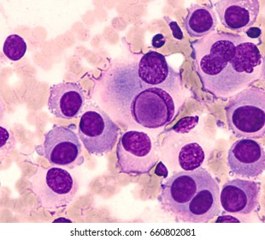
Cytology
Fine-Needle Aspiration Cytology
(FNAC)
PAP smear examination
CSF & body fluid cytology

Slide 15
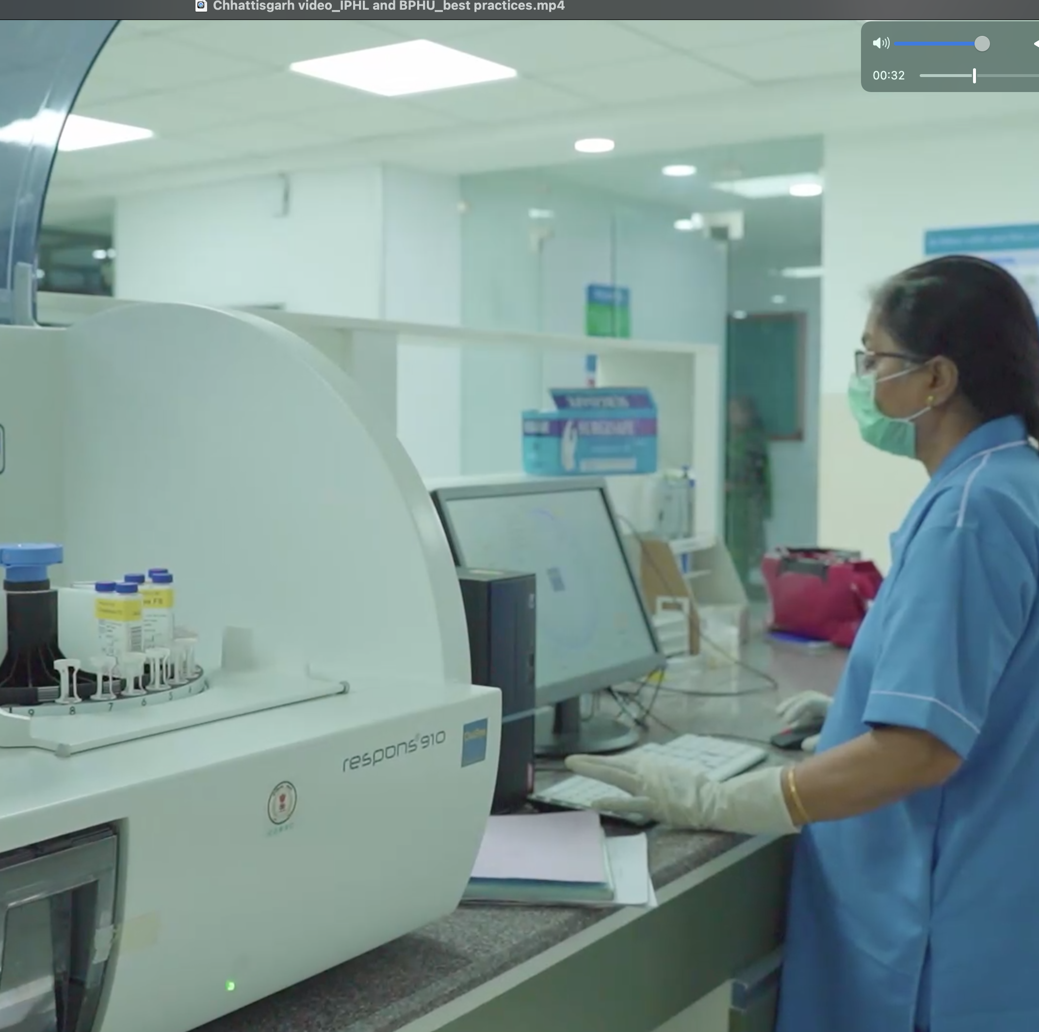
Biochemistry/ Clinical Chemistry
Quantitative analysis of:
Routine biochemical parameters and
Special chemistry parameters (including hormones)
Body fluid chemistry

Slide 16
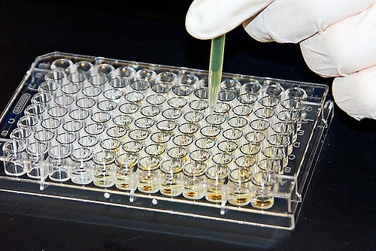
Serology
ELISA:
  Dengue
  Chikungunya
  Leptospirosis
  Scrub typhus
  Hepatitis A & E etc.
Rapid card tests
  Malaria
  Hepatitis B & C
  HIV etc.

Slide 17
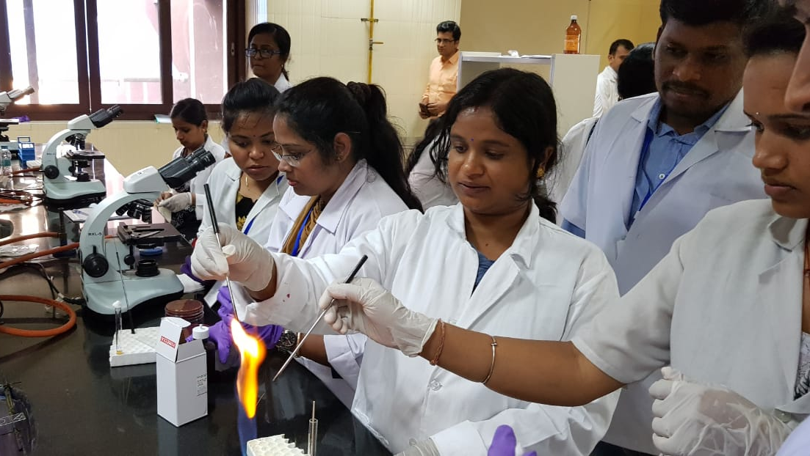
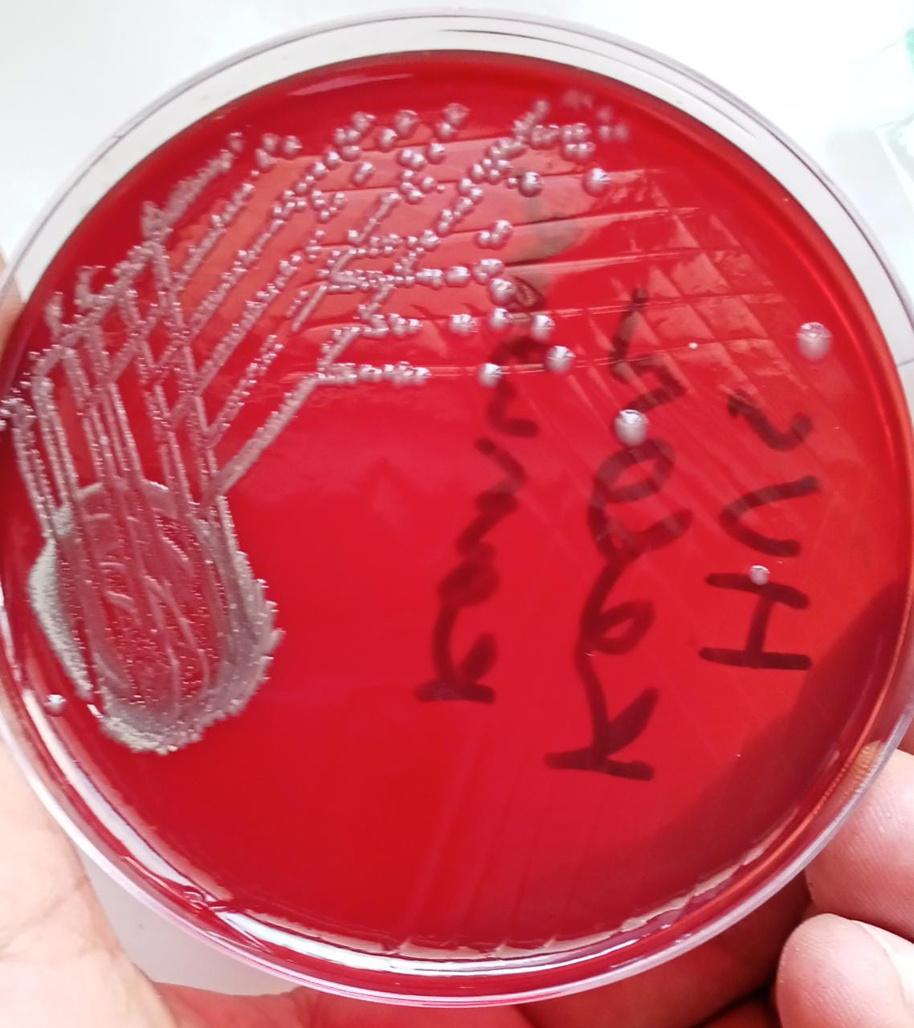
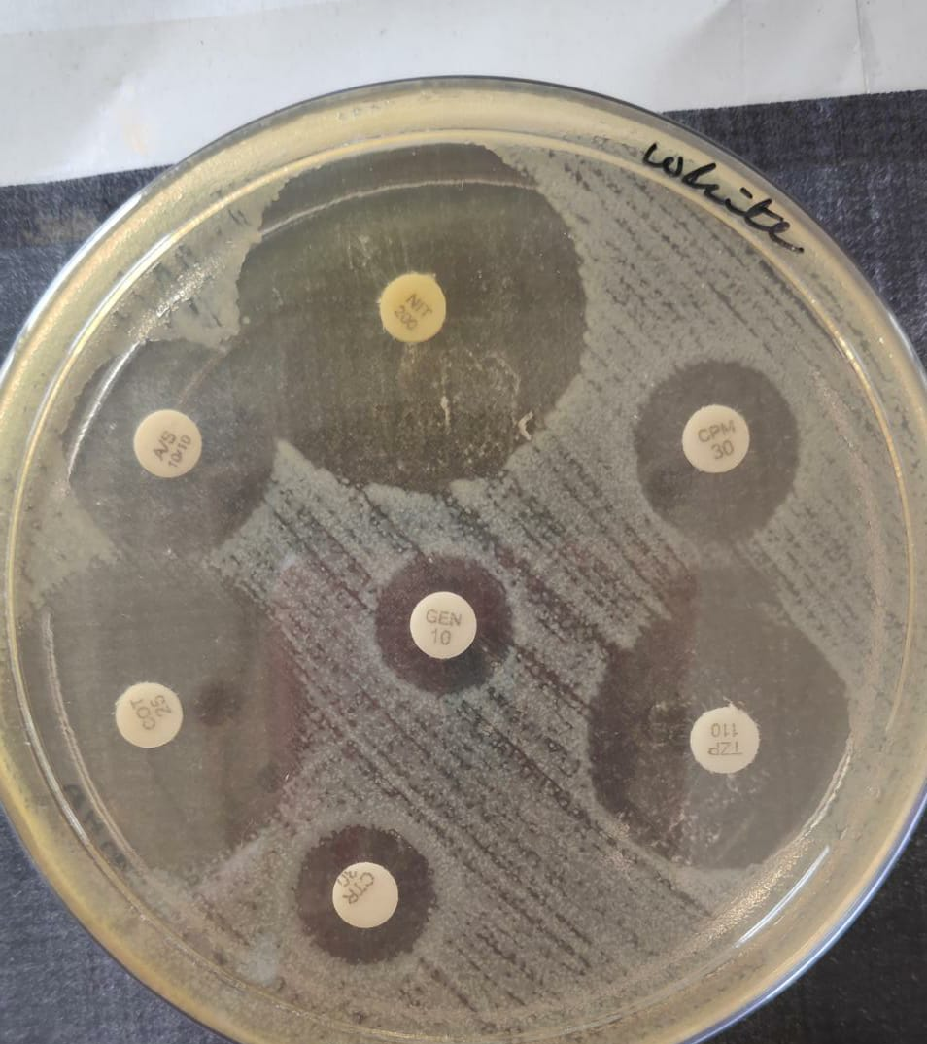
Bacteriology (including TB)
Microscopy
    Wet mount
    Gram stain, Albert stain (Diphtheria), AFB stain (Mycobacteria)
Bacterial Culture
    All clinical samples (including Urine, Blood, Stool, Pus and Sputum)
Antimicrobial susceptibility testing
    Preferably automated
CB-NAAT for mycobacteria
Microbiological analysis of Water:
  H₂S test for screening
  Coliform presence/absence (PA) test for confirmation

Slide 18
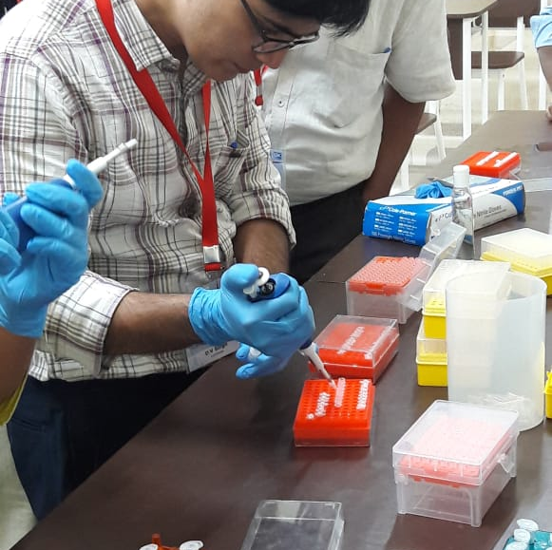
Molecular tests
Real Time PCR
Rapid diagnostic platforms for Influenza, COVID-19 and others
Viral load for Hepatitis B & C

Slide 19
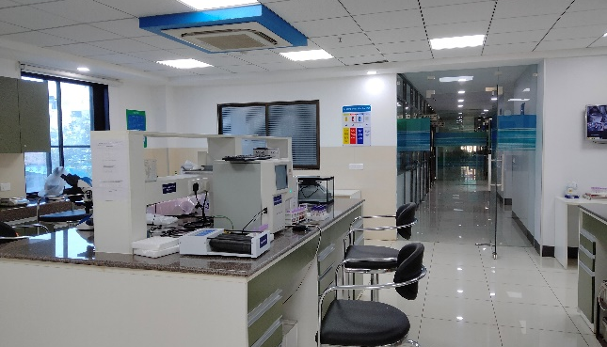
Set-up IPHL- Ideally at District Hospital
Scenario 03- Shifting of lab in newly constructed building
Scenario 01- Upgradation of Existing clinical lab
If adequate space not available within the premises of district hospital, then suitable co-located building/area which is newly constructed with scope of vertical/horizontal extension
Extension of existing clinical laboratory if necessary, adjoining room activities should be relocated to other areas
Scenario 02-Vertical extension of existing lab
Scenario 04- At Critical Care Block
If space is not available to construct the IPHL as an integrated unit, then can be constructed in two or three parts with separate collection facility on ground floor .
If the DH has approval for new Critical Care Block (CCB), then IPHL can be built on one floor of the CCB building

Slide 20
Structural Components of IPHL
There are two components of an ideal IPHL:
  i) Central sample collection facility: should be located near OPD preferably located at the ground floor and should have easy access to IPD and Emergency and MCH departments (wherever feasible)
  ii) Integrated Diagnostic Testing Facility: It will be a restricted access area which can be either placed adjacent to the collection facility or in a separate location.

Slide 21
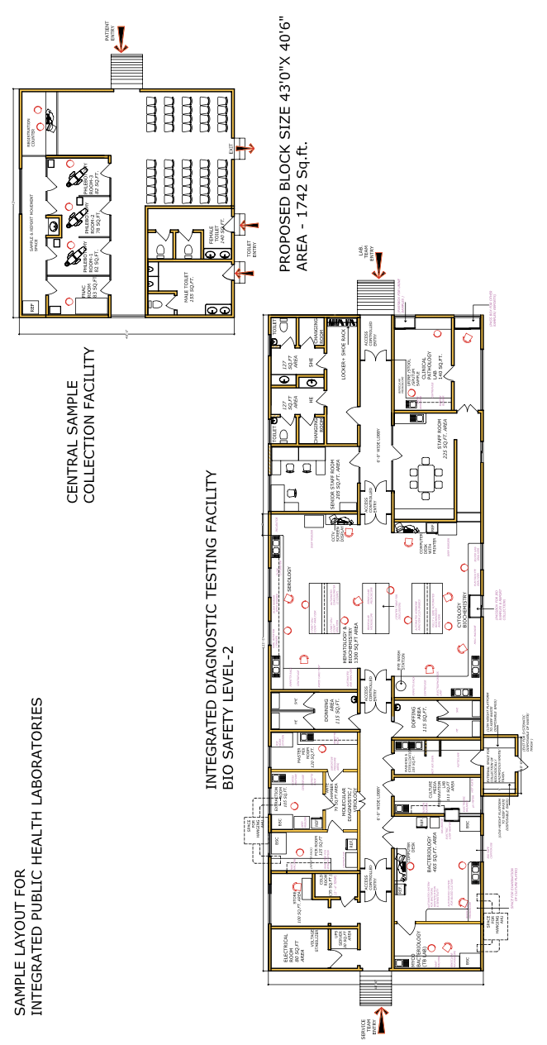
Sample Layout of IPHL
Model 2

Slide 22
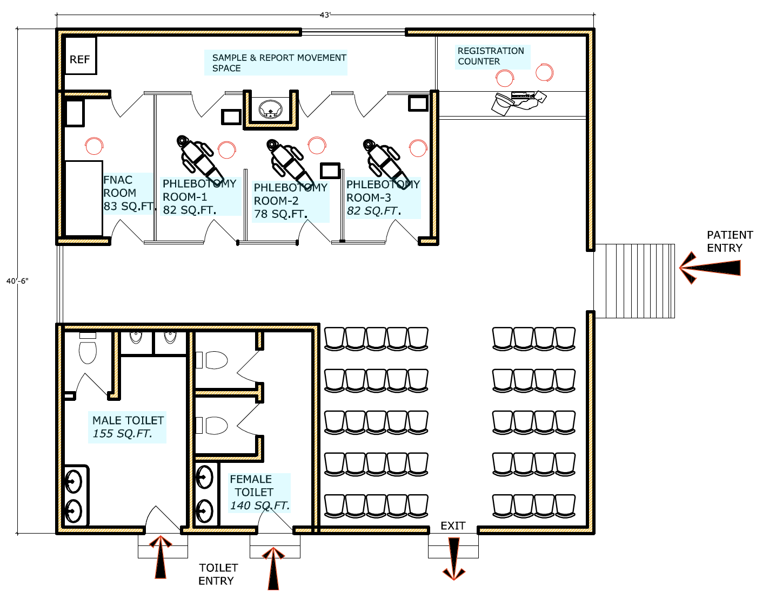
Common Sample Collection Area

Slide 23
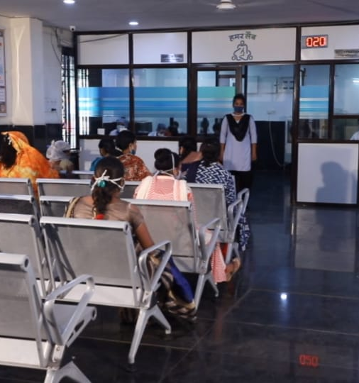
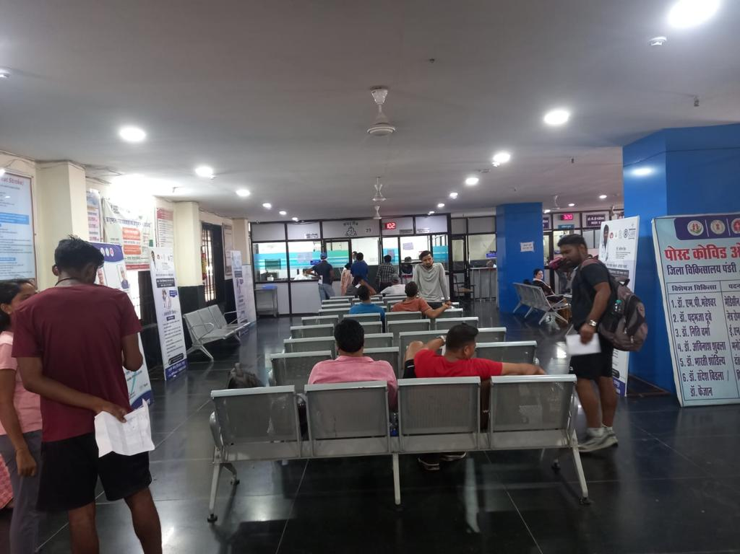
Raipur IPHL: Sample Collection Area

Slide 24
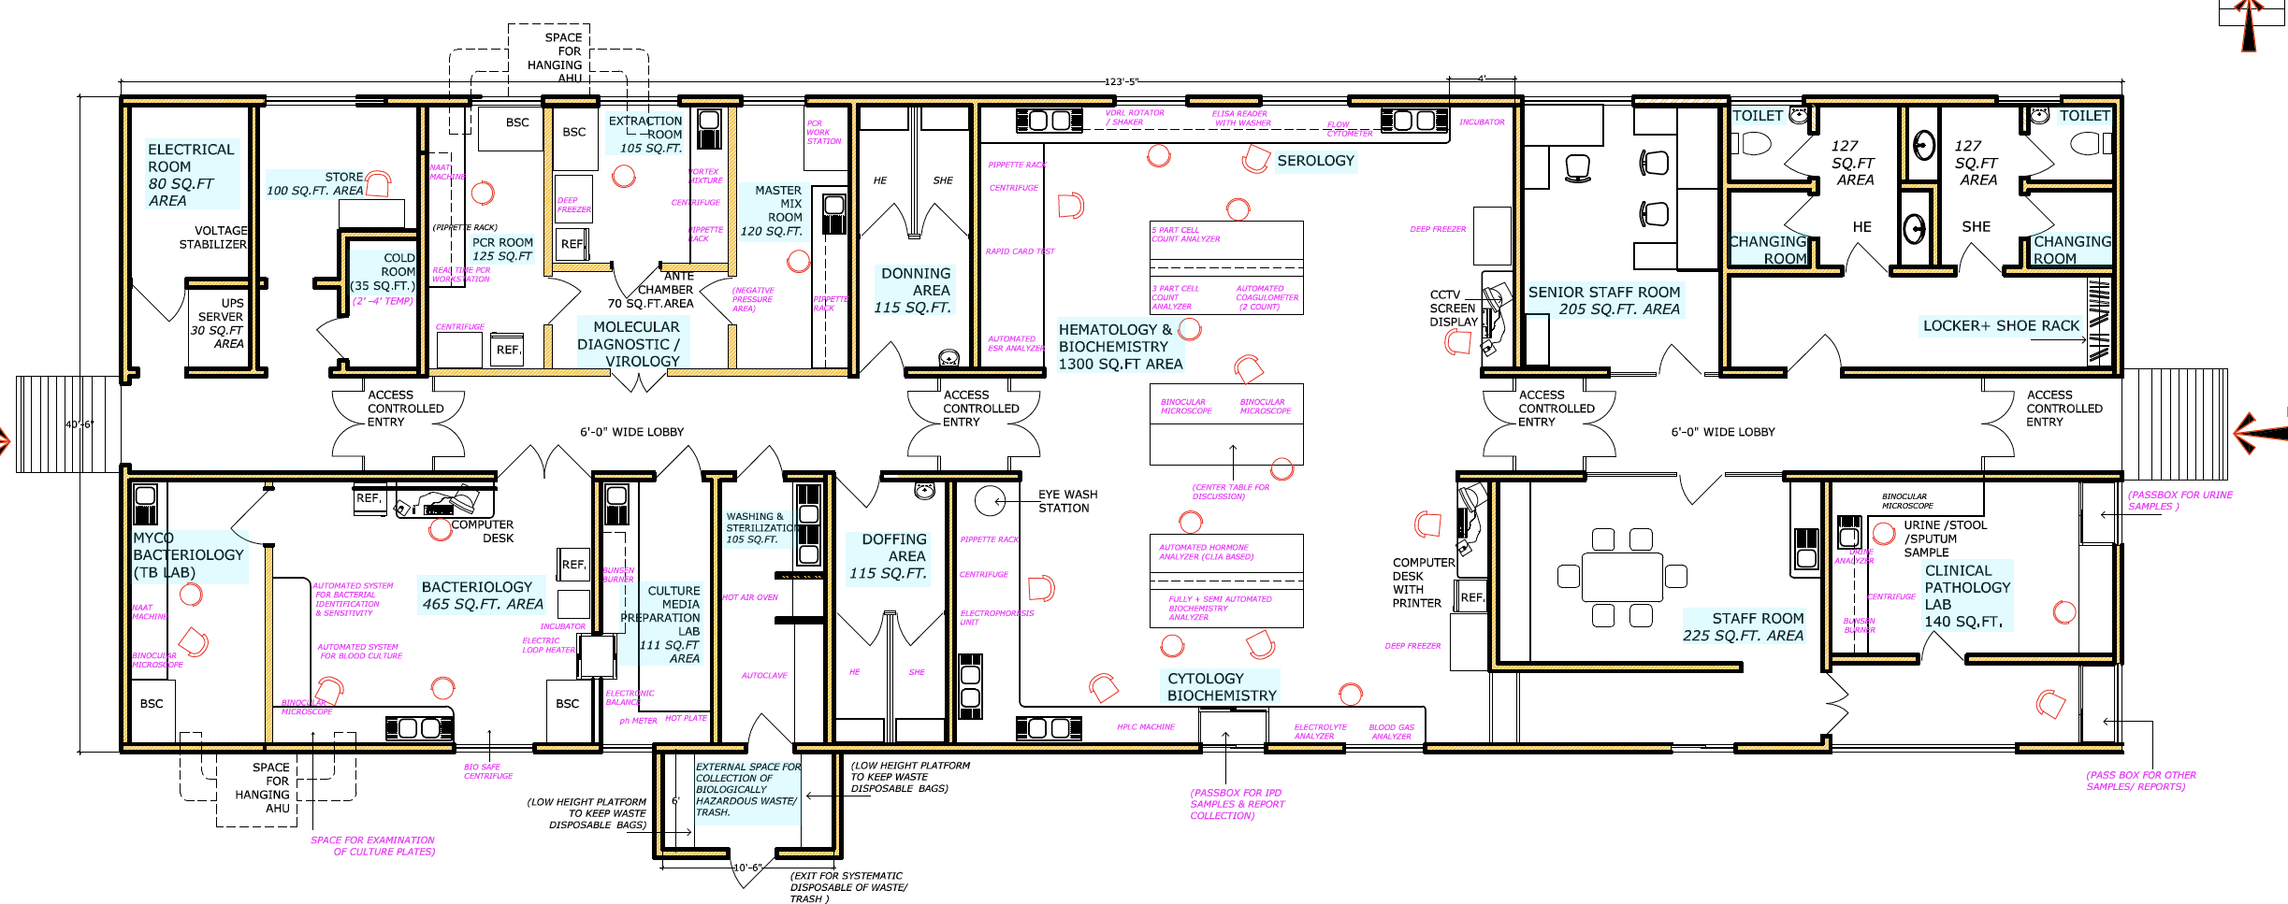
Integrated Testing Area
(No patient Entry)

Slide 25
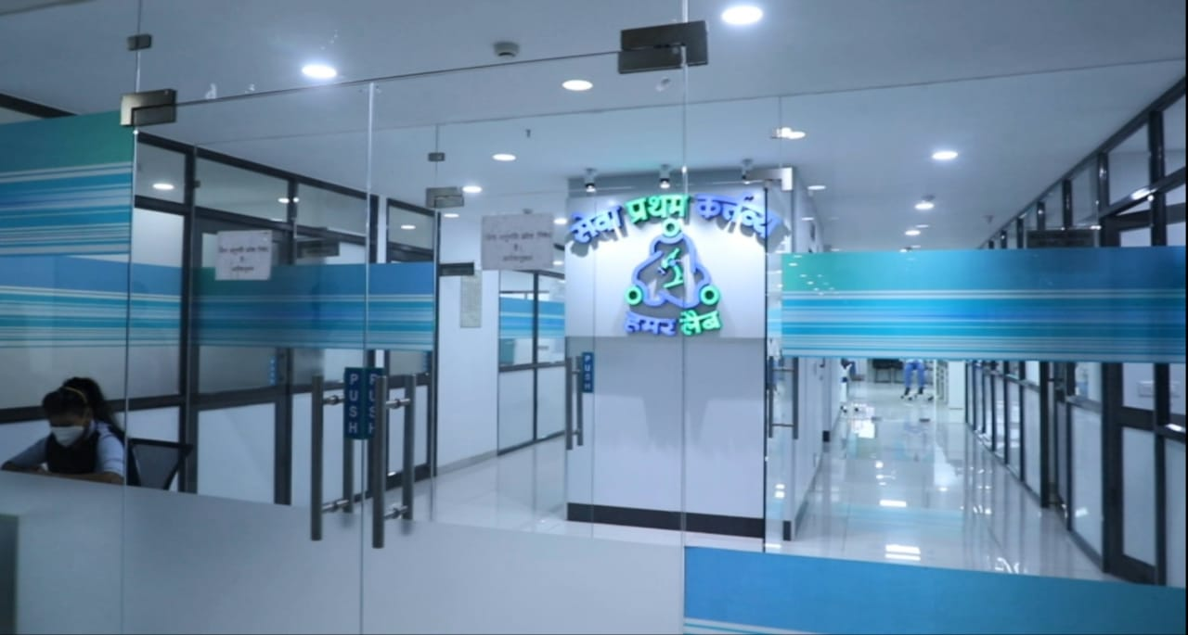
Raipur IPHL: Integrated Testing Area

Slide 26

Human Resource
Human Resource | Essential | Desirable (Additional)
Specialists
Pathologist | 1 | 1
Microbiologist | 1 | 1
Biochemist | 1
Lab Technicians (shift-wise*) | 11 (Morning: 08; Evening: 02; Night: 01) | 4
HR will be ensured as per IPHS 2022
*The shift-wise deployment of the HR is only indicative; the number will depend upon the case load of the facility.
**Minimum performance standard for LTs as 200 tests per day

Slide 27
Human Resource for Lab for SDH & DH (IPHS 2022)
HRH | SDH | 50 Bedded DH | 100 Bedded DH | 200 Bedded DH | 300 Bedded DH | 400 Bedded DH | 500 Bedded DH
Pathologist | 1E | 1E +1 Each Desirable | 1E | 1E+1D | 1E+1D | 1E+1D | 2E+1D
Microbiologist |  |  | 1E | 1E | 1E+1D | 1E+1D | 1E+1D
Biochemistry specialist |  |  | 1E | 1E | 1E | 1E | 1E
Medical lab technologists/ Laboratory Technician | 8E | 8E | 9E | 11E | 14E | 17E | 18E
DEO | 1E | 1E | 1E | 1E | 1E | 1E | 1E
Sanitation Staff | 2E | 1E | 2E | 2E | 2E | 4E | 4E

Slide 28
Financial Support
State specific physical targets | Total Units
Bihar | 38
Chhattisgarh | 28
Jharkhand | 24
Madhya Pradesh | 55
Uttar Pradesh | 75
Uttarakhand | 13
Support to establish District Integrated Public Health Labs in all the 730 districts is being provided as
  Capital Cost: Rs. 1.25 Crore per unit
  Recurring Cost: Rs. 49.05 lakhs per annum (from the second year of the scheme for the functional units till the end of the scheme period)

Slide 29
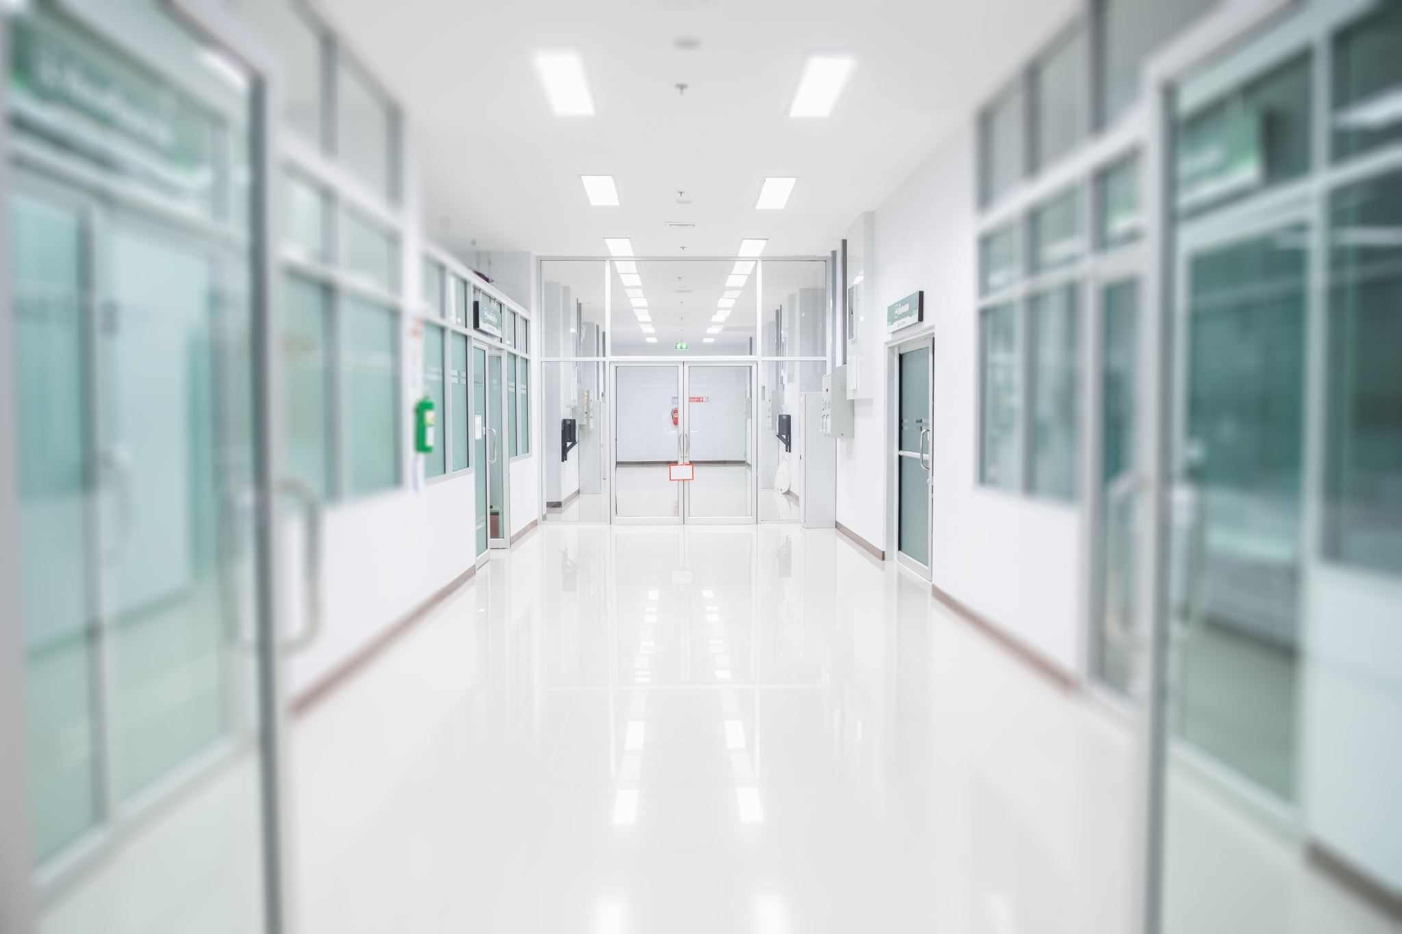
Roadmap for Implementation
Notification of the State, District level committees through Officer order for implementation
Orientation of the teams/committees on tools for baseline assessments of district laboratories identified for the establishment of IPHLs
Conduct baseline assessment of identified sites to review infrastructure, equipment, human resource, and laboratory diagnostic capacity.
Gap Assessment and preparation of action plan for implementation through district level committee
Develop a detailed implementation plan for:
Infrastructure development,
Procurement of equipment/reagent
Equipment maintenance and
Integrated Training of laboratory staff

Slide 30

Roadmap for Implementation (contd.)
Layout finalization- Frequent meetings with engineers, program officers, DPs
Design consideration-
Program requirements as per national guidelines
Access control for restricted entry
Installation of AHU for high containment areas (bacteriology, mycobacteriology, and virology) in the farthest corner of the facility
Institutionalization of integration through joint efforts including program officers at State and District levels.
Visits to the site by the program officers to ensure adherence to the program requirements
Capacity Building of the Laboratory staff
Reporting and Monitoring of data through IHIP
Quality certification of the lab under NQAS, NABL, EQAS and ILC.

Slide 31
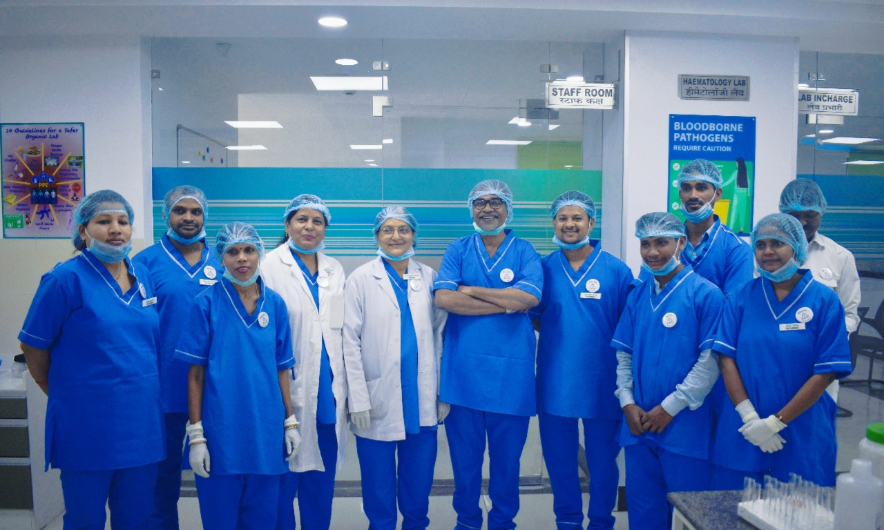

Slide 32
THANK YOU
Link for IPHL-https://nhsrcindia.org/sites/default/files/guidelines%20on%20integrated%20public%20health%20laboratories_dt%2007%20jan.pdf

Slide 33
List of Equipment available under Various Programs

