Slide 1
Regional Orientation Workshop Kerala 20-21st September, 2022

Slide 2
OVERVIEW
National Health Mission
PM - Ayushman Bharat Health Infrastructure Mission (PM-ABHIM)
XV-FC Health Grants
ECRP- II

Slide 3
National Health Mission

Slide 4
Pre-conditions for release of funds under CSS
Department of Expenditure(DOE) on 23.03.2021 and on 23.03.2022 prescribed procedure and conditions for release of GoI funds to States
Subsequently, Ministry on 6th April 2022 requested the States/UTs to ensure compliance of following conditions:
Central Share (CS) released till 31st March 2022 to be completely transferred to the Single Nodal Account (SNA)
Corresponding State share (SS) in full to be credited to SNA
Interest earned in the SNA to be deposited in the Consolidated Fund of India
Closure of all bank accounts (except SNA / zero balance accounts(ZBAs) of Implementing Agencies(IAs) & transfer of amount available to SNA
Achieve 75% expenditure
Funds available in bank account of SNA to be not more than 1st installment of CS likely to be released and matching SS

Slide 5
Status of Central Release under NHM
Particulars | State/UTs
States/UTs yet to comply with all conditions for 1st Tranche (Out of seven participating States) | Nil
Pendency in compliance of Conditions
Conditions | States/UTs yet to comply
States with pendency of State Share | Karnataka (115.24),Maharashtra (233.45),Puducherry (6.05),Tamil Nadu (206.65)
States with pendency of Central Share | Karnataka (282.30),Maharashtra (501.59),Puducherry (9.12),Tamil Nadu (343.32)
Andaman & Nicobar Islands and Kerala –Proposal under Consideration

Slide 6
Financial Status (As per NHM-PMS portal)
(As on 19th Sep 2022)
FY 2022-23
State | Approval (In Cr) | Physical Mapping against Approvals (%) | Expenditure against approval (in Cr.)
Andaman & Nicobar Islands | 58.31 | 0% | 0
Karnataka | 3530.98 | 57.76% | 0
Kerala | 1791.33 | 0% | 0
Maharashtra | Under updation process | _ | _
Puducherry | 76.05 | 0% | 0
Tamil Nadu | 3142.59 | 83.91% | 0

Slide 7
PM - Ayushman Bharat Health Infrastructure Mission (PM-ABHIM)

Slide 8
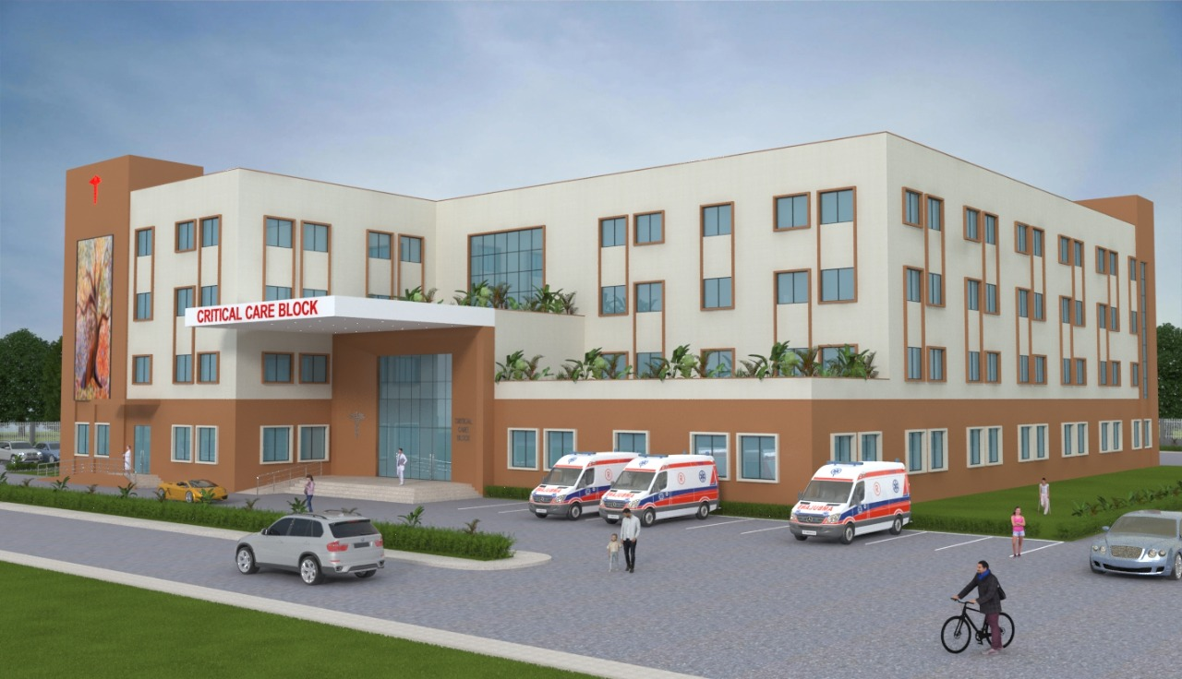
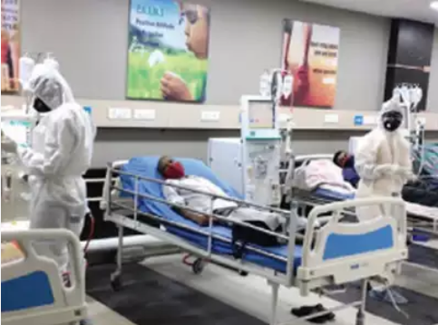
PM - Ayushman Bharat Health Infrastructure Mission- Salient Features
Largest Pan-India scheme since 2005 for creation & improvement of long-term Public Healthcare Infrastructure.
Support for Health Infrastructure in each district.
Financial Outlay-Rs. 64,180 cr from 2021-22 to 2025-26.
Saturation approach to operationalize surveillance, diagnostic, treatment and research facilities at Block, District, Regional and National level.
Critical gaps to be plugged for a holistic and Comprehensive Healthcare & Pandemic Response System
Convergence with other schemes and Programmes.
Notes:
https://health.economictimes.indiatimes.com/health-files/union-budget-2021-recognises-the-importance-of-health-in-india-s-growth-story/4793

Slide 9
The Component-wise physical deliverables during Scheme Period (2021-22 to 2025-26)
Component | Andaman & Nicobar Islands | Karnataka | Kerala | Maharashtra | Puducherry | Tamil Nadu
Infrastructure support to Building-less SHCs in rural areas | - | - | - | - | - | -
Urban - Health & Wellness Centres (Urban -HWCs) in Urban areas (Cumulative) | 4 | 736 | 0 | 0 | 32 | 436
Block Public Health Units | - | - | - | - | - | -
Integrated District Public Health Laboratory | 3 | 30 | 14 | 36 | 4 | 38
Critical Care Hospital Blocks in the districts | 1 | 30 | 14 | 36 | 3 | 37

Slide 10
Status of Approval and envisaged physical deliverable
FY 2021-22 and FY 2022-23
S.no. | States | Administrative Approvals (In Rs Crore) | Physical deliverable as approved
 |  |  | Rural HWCs | Urban HWCs | BPHU | IPHL (Tender) | CCB (Tender)
1 | Andaman & Nicobar Islands | - | - | - | - | - | -
2 | Karnataka | 281.26 | - | 114 | - | 9 (3) | 9 (0)
3 | Kerala | 100.49 | - | - | - | 4 (4) | 4 (0)
4 | Maharashtra | 116.30 | - | - | - | 4 (0) | 4 (0)
5 | Puducherry | 9.50 | - | 8 | - | 1 (0) | -
6 | Tamil Nadu | 332.60 | - | - | - | 12 (4) | 12 (4)
Andaman & Nicobar Islands - Proposal not received for FY 2021-22 & 2022-23
Maharashtra - Approval of FY 2022-23 is under process

Slide 11
Financial Status (As per NHM-PMS portal)
(As on 19th Sep 2022)
 | FY 2021-22 |  |  | FY 2022-23
State | Approval (In Cr) | Mapping against Approval (%) | Expenditure Against Approval (In Rs Cr) | Approval (In Cr) | Mapping against Approval (%) | Expenditure Against Approval (In Rs Cr)
Andaman & Nicobar Islands | 0 | _ | _ | _ | 100% | 0
Karnataka | 75.00 | 100% | 0 | 206.26 | 80.63% | 0
Kerala | 25.00 | 100% | 0 | 75.00 | 0% | 0
Maharashtra | 116.30 | 100% | 0 | Under Process | - | -
Puducherry | 2.25 | 100% | 0 | 7.25 | 0% | 0
Tamil Nadu | 116.30 | 100% | 25% | 216.30 | 100% | 0

Slide 12
XV-FC Health Grants

Slide 13
Introduction to XV Finance Commission
XV FC was constituted by the Hon. President in November 2017, and was mandated to recommend measures needed to augment the Consolidated Funds of the States for the period spanning FY 2020-25.
Key Recommendations of XV Finance Commission-
Health spending by States should be increased to more than 8 percent of their budget by 2022
Primary healthcare expenditure should be two-thirds of the total health expenditure by 2022 and,
Centrally Sponsored Schemes (CSS) in health should be flexible enough to allow states to adapt and innovate, with the focus shifting from inputs to outcomes.
The Union Government has accepted the grant of Rs. 70,051 crores for local governments. This grant is split into urban and rural components as follows :
Urban Health Grant | Rs. 26,123 Crores | 37% of total funds
Rural Health Grant | Rs. 43,928 Crores | 63% of total funds

Slide 14
XV FC - Urban components
Support for Diagnostic Infrastructure at primary healthcare facilities
Urban Health and Wellness Centres
Rs.2,095 Cr
Rs. 24,028 Cr
(2.9%)
(34.3%)
Fully equip the urban primary health care facilities so that they can provide some necessary diagnostic services
Enable decentralised delivery of primary health care to smaller populations, increasing the reach to cover the vulnerable and marginalised.

Slide 15
XV FC - Rural components
Buildingless SHCs, PHCs and CHCs
Block Public Health Units
Support for Diagnostic Infrastructure at primary healthcare facilities
Conversion of rural PHCs and SCs to HWCs
Rs.7,167 Cr
Rs.5,279 Cr
Rs.16,377 Cr
Rs. 15,105 Cr
(10.23%)
(7.54%)
(23.4%)
(21.56%)
To address infrastructure gaps in Rural areas
To integrate service delivery, public health action, strengthened laboratory services for disease surveillance, diagnosis and public health and serve as the hub for health-related reporting
Fully equip the rural primary health care facilities to provide some necessary diagnostic services
To convert existing primary health care facilities i.e. sub-centres and PHCs into HWCs

Slide 16
Status of Approval and envisaged physical deliverable
FY 2021-22 and FY 2022-23
 |  |  | Physical deliverables as approved
S.no. | States | Administrative Approvals (In Rs Crore) | Construction of Building-less SHCs, PHCs and CHCs | Urban HWCs | BPHU | Rural HWCs | Support for Diagnostic facility to Urban Centres | Support for Diagnostic facility to Rural Centres
1 | Karnataka | 1034.07 | 18 | 438 | 98 | 2906 | 365 | 11107
2 | Kerala | 521.43 | 2 | 623 | 75 | 6305 | 102 | 6295
3 | Maharashtra | 2530.03 | 175 | 2232 | 207 | 12512 | 658 | 10526
4 | Tamil Nadu | 1607.15 364 1388 178 8640 484 10755

Slide 17
Financial Status (As per NHM-PMS portal)
(As on 19th Sept 2022)
 | FY 2021-22
State | Approval (In Cr) | Mapping against Approval (%) | Expenditure Against Approval (In Rs Cr)
Karnataka | 551.53 | 67.45 | 115.60
Kerala | 521.43 | 95.02 | 50.88
Maharashtra | 1,323.60 | 41.66 | 173.02
Tamil Nadu | 805.93 | 100 | 545.04

Slide 18
Conditions for Release of Grants under FC XV Health Grants through Local Governments
Release of Grants (subsequent instalment) to State by MOF based on:
Submission of Grant Transfer Certificates by States as per Annexure IX of the guidelines
Recommendation of MOHFW based on NHM PMS progress
Recommendation of MOHFW subject to the following conditions:
For release of Grants for the FY 2022-23 : 50% physical and financial progress as per the NHM PMS portal against the approval of 2021-22
For release of Grants for the FY 2023-24 ; 75% physical and financial progress as per the NHM PMS portal against the approval of 2021-22 and 50% physical and financial progress as per the NHM PMS portal against the approval of 2022-23

Slide 19
ECRP-II

Slide 20
Andaman & Nicobar Islands : ECRP-II Physical & Financial progress
(As per NHM PMS Portal on 19th Sept 2022)
Total Expenditure - 47.71 %
100 % mapped against approvals
Gap of Approval against Resource Envelope – NIL
Total ICU/HDU Beds |  |  |  | Total O₂ Supported Beds |  |  |  | Pediatric ICU/HDU*
Approved | Completed | Under Progress |  | Approved | Completed | Under Progress |  | Approved | Completed | Under Progress
41 | 19 | 33 |  | 40 | 32 | 40 |  | 24 | 8 | 16
Tele-Consultation Hubs |  |  |  | Tele-Consultation Spokes
Approved | Completed | Under Progress |  | Approved | Completed | Under Progress
0 | 0 | 0 |  | 48 | 0 | 48
Total LMO Storage Tanks |  |  |  | Total MGPS |  |  |  | Lab Strengthening for RT-PCR
Approved | Completed | Under Progress |  | Approved | Completed | Under Progress |  | Approved | Completed | Under Progress
0 | 0 | 0 |  | 1 | 0 | 0 |  | 2 | 2 | 0
* These beds are a subset of Total ICU/HDU Beds

Slide 21
Maharashtra: ECRP-II Physical & Financial progress
(As per NHM PMS Portal on 19th Sept 2022)
Total Expenditure – 45.81%
98.25% mapped against approvals
Gap of Approval against Resource Envelope – NIL
Total ICU/HDU Beds |  |  |  | Total O₂ Supported Beds |  |  |  | Pediatric ICU/HDU*
Approved | Completed | Under Progress |  | Approved | Completed | Under Progress |  | Approved | Completed | Under Progress
3780 | 284 | 3036 |  | 4886 | 270 | 1147 |  | 1332 | 0 | 1114
Tele-Consultation Hubs |  |  |  | Tele-Consultation Spokes
Approved | Completed | Under Progress |  | Approved | Completed | Under Progress
5 | 4 | 1 |  | 170 | 46 | 45
Total LMO Storage Tanks |  |  |  | Total MGPS |  |  |  | Lab Strengthening for RT-PCR
Approved | Completed | Under Progress |  | Approved | Completed | Under Progress |  | Approved | Completed | Under Progress
142 | 98 | 25 |  | 0 | 0 | 0 |  | 9 | 9 | 0
* These beds are a subset of Total ICU/HDU Beds

Slide 22
Tamil Nadu: ECRP-II Physical & Financial progress
(As per NHM PMS Portal on 19th Sept 2022)
Total Expenditure - 87.71%
99.61% mapped against approvals
Gap of Approval against Resource Envelope – Rs.3.38 Cr
Total ICU/HDU Beds |  |  |  | Total O₂ Supported Beds |  |  |  | Pediatric ICU/HDU*
Approved | Completed | Under Progress |  | Approved | Completed | Under Progress |  | Approved | Completed | Under Progress
2249 | 2246 | 3 |  | 1050 | 1050 | 0 |  | 983 | 983 | 0
Tele-Consultation Hubs |  |  |  | Tele-Consultation Spokes
Approved | Completed | Under Progress |  | Approved | Completed | Under Progress
0 | 0 | 0 |  | 0 | 0 | 0
Total LMO Storage Tanks |  |  |  | Total MGPS |  |  |  | Lab Strengthening for RT-PCR
Approved | Completed | Under Progress |  | Approved | Completed | Under Progress |  | Approved | Completed | Under Progress
42 | 31 | 11 |  | 57 | 31 | 12 |  | 17 | 11 | 6
* These beds are a subset of Total ICU/HDU Beds

Slide 23
Karnataka: ECRP-II Physical & Financial progress
(As per NHM PMS Portal on 19th Sept 2022)
Total Expenditure – 47.24%
97.2% mapped against approvals
Gap of Approval against Resource Envelope – Rs.8.27 Cr
Total ICU/HDU Beds |  |  |  | Total O₂ Supported Beds |  |  |  | Pediatric ICU/HDU*
Approved | Completed | Under Progress |  | Approved | Completed | Under Progress |  | Approved | Completed | Under Progress
4180 | 56 | 3905 |  | 670 | 100 | 0 |  | 988 | 18 | 926
Tele-Consultation Hubs |  |  |  | Tele-Consultation Spokes
Approved | Completed | Under Progress |  | Approved | Completed | Under Progress
36 | 0 | 0 |  | 146 | 0 | 0
Total LMO Storage Tanks |  |  |  | Total MGPS |  |  |  | Lab Strengthening for RT-PCR
Approved | Completed | Under Progress |  | Approved | Completed | Under Progress |  | Approved | Completed | Under Progress
162 | 0 | 162 |  | 0 | 0 | 0 |  | 0 | 0 | 0
* These beds are a subset of Total ICU/HDU Beds

Slide 24
Kerala: ECRP-II Physical & Financial progress
(As per NHM PMS Portal on 19th Sept 2022)
Total Expenditure – 55.12%
100% mapped against approvals
Gap of Approval against Resource Envelope – Rs.5.16 Cr
Total ICU/HDU Beds |  |  |  | Total O₂ Supported Beds |  |  |  | Pediatric ICU/HDU*
Approved | Completed | Under Progress |  | Approved | Completed | Under Progress |  | Approved | Completed | Under Progress
424 | 305 | 42 |  | 490 | 430 | 30 |  | 198 | 152 | 22
Tele-Consultation Hubs |  |  |  | Tele-Consultation Spokes
Approved | Completed | Under Progress |  | Approved | Completed | Under Progress
14 | 13 | 0 |  | 104 | 85 | 0
Total LMO Storage Tanks |  |  |  | Total MGPS |  |  |  | Lab Strengthening for RT-PCR
Approved | Completed | Under Progress |  | Approved | Completed | Under Progress |  | Approved | Completed | Under Progress
14 | 10 | 4 |  | 14 | 10 | 4 |  | 5 | 0 | 0
* These beds are a subset of Total ICU/HDU Beds

Slide 25
Puducherry: ECRP-II Physical & Financial progress
(As per NHM PMS Portal on 19th Sept 2022)
Total Expenditure - 30.62%
100% mapped against approvals
Gap of Approval against Resource Envelope – NIL / Rs.1.81 Cr Pendency of State Share to SHS
Total ICU/HDU Beds |  |  |  | Total O₂ Supported Beds |  |  |  | Pediatric ICU/HDU*
Approved | Completed | Under Progress |  | Approved | Completed | Under Progress |  | Approved | Completed | Under Progress
18 | 0 | 0 |  | 60 | 0 | 30 |  | 12 | 0 | 0
Tele-Consultation Hubs |  |  |  | Tele-Consultation Spokes
Approved | Completed | Under Progress |  | Approved | Completed | Under Progress
0 | 0 | 0 |  | 0 | 0 | 0
Total LMO Storage Tanks |  |  |  | Total MGPS |  |  |  | Lab Strengthening for RT-PCR
Approved | Completed | Under Progress |  | Approved | Completed | Under Progress |  | Approved | Completed | Under Progress
5 | 0 | 3 |  | 0 | 0 | 0 |  | 3 | 3 | 0
* These beds are a subset of Total ICU/HDU Beds

Slide 26
Status of ABHA ID
Data As on 19/September/2022
STATE/UT | ABHA Generated | HPR Health Professionals Registry | HFR Health Facility Registry | Health Records linked with ABHA
A&I | 4,22,695 | 361 | 221 | 11,236
Maharashtra | 1,49,39,481 | 3,790 | 12,848 | 861
Tamil Nadu | 32,07,318 | 73 | 0 | 1,284
Karnataka | 85,24,718 | 20,321 | 19,316 | 1,09,671
Kerala | 1,30,78,814 | 11 | 0 | 94
Puducherry | 8,78,281 | 1,797 | 373 | 0

Slide 27
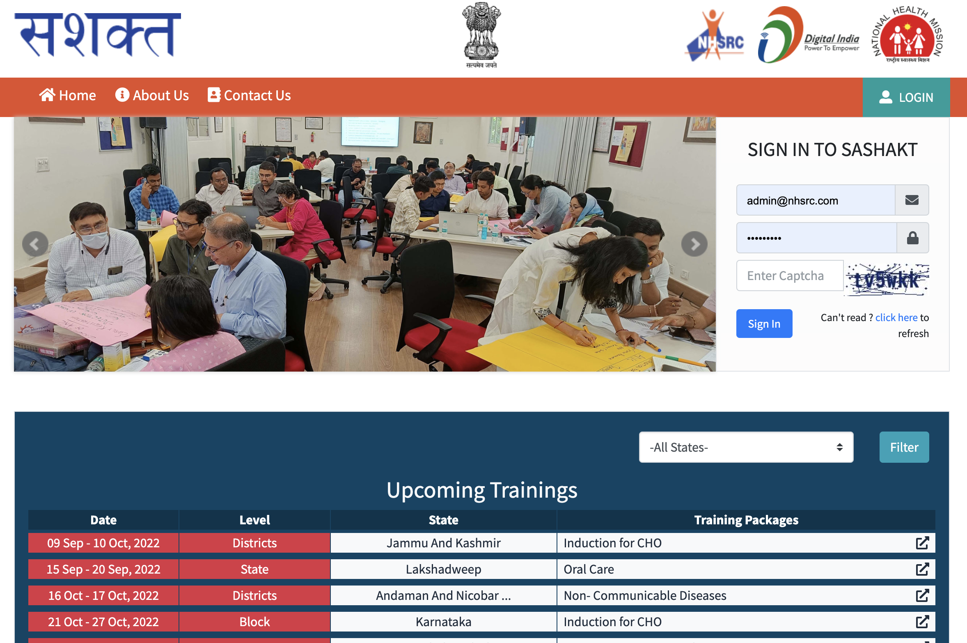
‘SYSTEMATIC ASSESSMENT OF HEALTH CARE PROVIDER’S KNOWLEDGE AND TRAINING’ SASHAKT

Slide 28
PURPOSE
A tool to plan, execute, document, report and monitor the trainings of healthcare functionaries

Slide 29
Key Features
Users: Users are at National, State and District level (with variable access rights)
Participant Profile: Updated details of participants
Participants feedback - captures participants' feedback
Training Calendar : Visualisation of training plan
Manage Trainers: Updated details of trainers
Ranking: State wise ranking based on training status
Certificate: Generate and provide certificates in the designated format
Dashboard to provide progress of the trainings
Participants App login:
Participants self-verification.
Download training certificate
Can view training details or scheduled time.
Download training resource materials of each training.

Slide 30
Integration with AB-HWC portal and state specific portal
SASHAKT is being integrated with AB-HWC Portal and hence separate user login is not required for HWC Portal users.
Open API to be provided so that integration can be done by the states with the state specific portals/software.
Users of the HWC Portal will need to create separate user credentials to grant access to SASHAKT to users of other portals.

Slide 31
Teleconsultation services at AB-HWCs

Slide 32
Preparation & Monitoring of Teleconsultation Services
Preparation
Identify Nodal Officer for monitoring implementation at Sate & District level
Conducting Gap Analysis at AB-HWCs and Hubs for assessing the available infrastructure
Finalization of location/space in the shortlisted AB-HWCs and Hubs for housing equipment and providing furniture
Ensuring required internet bandwidth at HUB and Spokes (HWCs)
Training of Human Resources for teleconsultation services
IEC activities for maximum participation
Monitoring
Identify less or non-performing SHC-HWCs and PHCs under tele-consultation and handholding the concerned CHOs and Medical Officers to ensure service provision
For continuous monitoring of the project, a Dashboard will be developed for various levels (District/State/Centre) and integrated with AB-HWC Portal
Weekly review in terms of quantity and quality of Tele-Medicine services rendered at facility level

Slide 33
Current Status-Telemedicine Implementation through e-Sanjeevani-HWC
Coverage
Consultations
Infrastructure
34 States/UTs except West Bengal and Nagaland; these states are using state specific application/portal for teleconsultation
95% + Population
5.07+ Crore Consultation
Highest 3.31 lakhs Consultation/day (on 16 April 22)
11,897 HUBs
1,01,715 (85%) HWCs rolled out teleconsultation services
Average >=25 per month
Average <=9 per month

Slide 34
Kerala
 | Required | Sanctioned (Reg + Cont) | In-place (Reg + Cont) | Vacancy% (Sanctioned-Inplace) | Gap% (Required – Inplace)
MPW (M+F) | 7253 | 9826 | 5025 | 49% | 31%
Nurses | 14023 | 9451 | 9661 | 0% | 31%
Lab Technicians | 2999 | 1955 | 1563 | 20% | 48%
Pharmacists | 2275 | 2145 | 1927 | 10% | 15%
Medical Officers | 4121 | 4609 | 4101 | 11% | 0%
Specialists | 3222 | 2350 | 1918 | 18% | 40%
Karnataka
 | Required | Sanctioned (Reg + Cont) | In-place (Reg + Cont) | Vacancy% (Sanctioned-Inplace) | Gap% (Required – Inplace)
MPW (M+F) | 20530 | 18718 | 13116 | 30% | 36%
Nurses | 25775 | 17074 | 15548 | 9% | 40%
Lab Technicians | 7422 | 4352 | 1596 | 63% | 78%
Pharmacists | 4299 | 3290 | 2298 | 30% | 47%
Medical Officers | 7359 | 4824 | 3631 | 25% | 51%
Specialists | 5662 | 3859 | 2827 | 27% | 50%

Slide 35
Tamil Nadu
 | Required | Sanctioned (Reg + Cont) | In-place (Reg + Cont) | Vacancy% (Sanctioned-Inplace) | Gap% (Required – Inplace)
MPW (M+F) | 22654 | 22349 | 15220 | 32% | 33%
Nurses | 35778 | 20267 | 19311 | 5% | 46%
Lab Technicians | 8763 | 4490 | 4255 | 5% | 51%
Pharmacists | 4504 | 3781 | 3039 | 20% | 33%
Medical Officers | 8364 | 6329 | 5215 | 18% | 38%
Specialists | 9099 | 5284 | 4964 | 6% | 45%
Maharashtra
 | Required | Sanctioned (Reg + Cont) | In-place (Reg + Cont) | Vacancy% (Sanctioned-Inplace) | Gap% (Required – Inplace)
MPW (M+F) | 36671 | 41232 | 20115 | 51% | 45%
Nurses | 28499 | 17296 | 12459 | 28% | 56%
Lab Technicians | 8069 | 3997 | 2381 | 40% | 70%
Pharmacists | 6718 | 4307 | 3492 | 19% | 48%
Medical Officers | 10605 | 6604 | 5803 | 12% | 45%
Specialists | 6052 | 4936 | 3494 | 29% | 42%

Slide 36
Andaman & Nicobar Islands
 | Required | Sanctioned (Reg + Cont) | In-place (Reg + Cont) | Vacancy% (Sanctioned-Inplace) | Gap% (Required – Inplace)
MPW (M+F) | 295 | 262 | 248 | 5% | 16%
Nurses | 533 | 406 | 406 | 0% | 24%
Lab Technicians | 91 | 55 | 49 | 11% | 46%
Pharmacists | 65 | 63 | 46 | 27% | 29%
Medical Officers | 107 | 101 | 97 | 4% | 9%
Specialists | 116 | 35 | 13 | 63% | 89%
Puducherry
 | Required | Sanctioned (Reg + Cont) | In-place (Reg + Cont) | Vacancy% (Sanctioned-Inplace) | Gap% (Required – Inplace)
MPW (M+F) | 333 | 338 | 323 | 4% | 3%
Nurses | 1273 | 1199 | 1331 | 0% | 0%
Lab Technicians | 177 | 161 | 145 | 10% | 18%
Pharmacists | 105 | 171 | 136 | 20% | 0%
Medical Officers | 277 | 480 | 452 | 6% | 0%
Specialists | 230 | 156 | 82 | 47% | 64%

Slide 37
Components of Revised IPHS
Service Provision
Infra-structure
Human Resource
Drugs
Diagnostics
Equipment
Quality*
Monitoring & Certification*
Accountability & Operationalizing IPHS*
Clinical Governance*
*Added in IPHS 2022

Slide 38
IPHS Targets
 | Andaman & Nicobar Islands | Karnataka | Kerala | Maharashtra | Puducherry | Tamil Nadu
Facilities as per RHS 20-21 (SC+PHC+CHC+SDH+DH) | 158 | 12356 | 6701 | 13680 | 132 | 11301
Compliance target by 2025-26 (50%) | 79 | 6178 | 3350 | 6840 | 66 | 5650
Compliance target for 2022-23 & 2023-24 (as per RoP) | 16 (20%) 32 (40%) | 1236 (20%) 2471 (40%) | 670 (20%) 1340 (40%) | 1368 (20%) 2736 (40%) | 33 (50%) 33 (50%) | 5650 (100%) in two years

Slide 39
NQAS Certification: Key Activities
Regular Assessment of Health Facilities against NQAS
Review of NQAS score in State & District Meetings
Allocation of targets to CMHOs/Civil Surgeon
Capacity Building – TOT Model
Utilisation of trained resource
Support for Regulatory Compliances – BMW Authorisation, Fire safety, Blood Bank Licence, etc.
Audits – Prescription Audits, Death Audits, etc.
Linking with Mera-Aspataal & Analysis of patient feedback
Strengthening State NQAS certification mechanism
Sustenance

Slide 40
Certification Status of Health Facilities
STATES | TAMIL NADU |  | KARNATAKA |  | PUDUCHERRY |  | ANDAMAN & NICOBAR
Type of Facilities | Target* | Achievement # | Target* | Achievement # | Target* | Achievement # | Target* | Achievement #
DH | 16 | Achieved | 13 | 8 | 3 | 0 | 2 | 0
SDH | 70 | 31 | 38 | 0 | 1 | 0 | 0 | NA
CHC | 100 | 59 | 52 | 4 | 1 | 0 | 1 | 0
PHC | 471 | 60 | 634 | 27 | 10 | 0 | 7 | 0
UPHC | 116 | 5 | 90 | 9 | 4 | 0 | 1 | 0
HWC-SCs | 521 | 0 | 610 | 0 | 8 | 0 | 10 | 0
* Target as per FY 2022-23 & # Achievement till Aug 2022

Slide 41
STATES | KERALA |  | MAHARASHTRA
Type of Facilities | Target* | Achievement # | Target* | Achievement #
DH | 24 | 7 | 25 | 1
SDH | 22 | 7 | 25 | 1
CHC | 57 | 10 | 107 | 1
PHC | 233 | 117 | 669 | 53
UPHC | 37 | Achieved | 212 | 0
HWC-SCs | 155 | 0 | 816 | 0

Slide 42
Thanks

