Slide 1
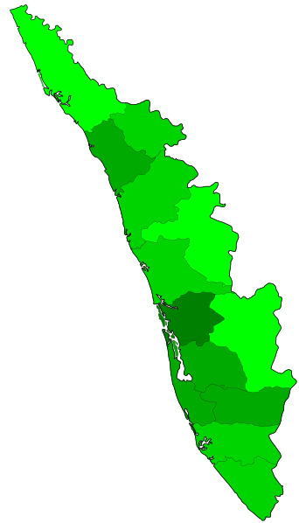
Regional Orientation workshop on NHM, PM-ABHIM, ECRP-II & FC-XV
KERALA

Slide 2
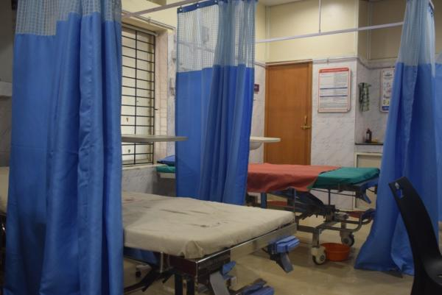
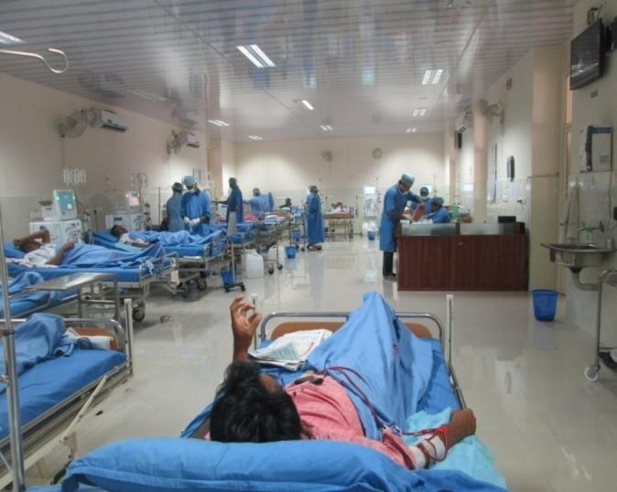
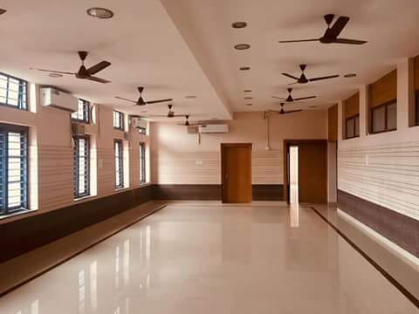
OVERVIEW
Health Infrastructure Status
Free Diagnostic Service Initiative (FDSI)
Status of NHM
Status of PM-ABHIM
Status of XV-FC Health Grants
Status of ECRP- II

Slide 3
Health Infrastructure Status
Facility details | Required (Nos) as per IPHS | Operational (Nos) | Shortfall (%) against IPHS | IPHS compliant (Nos) | NQAS certified (Nos)
District Hospital | At least 14 | 36 | Nil |  | 2
Sub district Hospital | At least 33 | 87 | Nil |  | 4
Community health Centre | At least 162 | 227 | Nil |  | 8
Primary Health Centre | At Least 648 | 849 | Nil |  | 93
Urban Primary Health Centre |  | 98 | Nil |  | 38
Sub Centre (Rural) | At least 4021 | 5412 | Nil
No. of PHCs converted to HWC | 849 | 849 | N.A. |  | 93
No. of U-PHCs converted to HWC | 102 | 98 |  |  | 38
No. of SCs converted to HWC | 5409 | 1541 |  |  | 0
No. of District Public health laboratories |  | 9 |  |  | 0

Slide 4
Free Diagnostic Service Initiative
SL | Type of Facility | % of facilities providing full range of services* | Mode(In house/PPP)
1 | SC | Not Planned
2 | PHC | State is is planning to provide 10 higher level test out of 63 test at a nominal rate to all the patients coming at all 886 PHCs & UPHCs through Hub & Spoke model. | Inhouse mode
3 | UPHC
4 | CHC | Not Planned
5 | SDH | Not Planned
6 | DH | Not Planned
Number of Hub Laboratories in the state/district | 103
*Full range of essential diagnostic tests as per FDSI guidelines-SC:14/PHC:63/ CHC:97/SDH:111/ DH:134

Slide 5
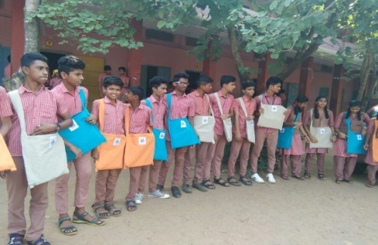
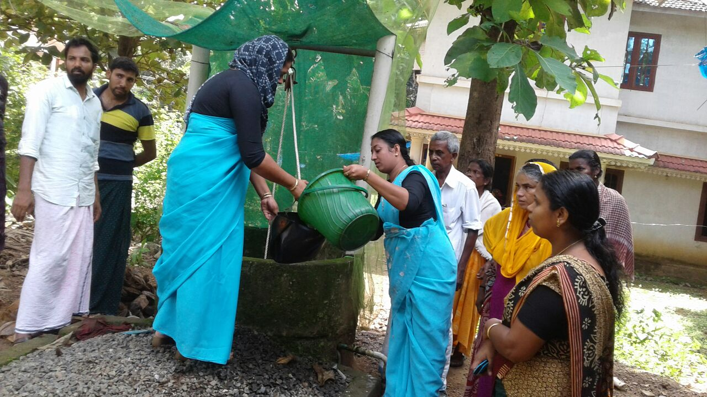
National Health Mission (NHM)

Slide 6
Financial Progress – NHM
(Rs. in crore)
Schemes | Funds Released during FY 2022-23 | Total Cash GIA Released (Excl. IM and Kind Grants) | Central Share transferred from State Treasury to SNA | Pending Central Share | State share due (Opening) | Proportionate State Share due (on current year release) | State Share credited | Pending State Share | % of Expenditure (against Total Fund Receivable)
1 | 2 | 3 | 4 | 5=(3-4) | 6 | 7 | 8 | 9=([6+7]-8) | 10
NHM | 279.71 | 167.99 | 167.99 | Nil | 152.72 | 186.47 | 339.19 | Nil | 83%
Note:
1. The format to be filled by States of Tamil Nadu, Karnataka, Andaman and Nicobar Islands, Kerala.

Slide 7
Status of Seeding ABHA IDs in different portals in the States/UTs
Different portal | Number of ABHA ID created
NCD | Not available with NCD division
Nikshay | Currently this data not available in the Ni-kshay portal
RCH | 7
HWC Portal | 522
E-Sanjeevani | eSanjeevani OPD - 357 & e-Sanjeevani HWC - 3

Slide 8
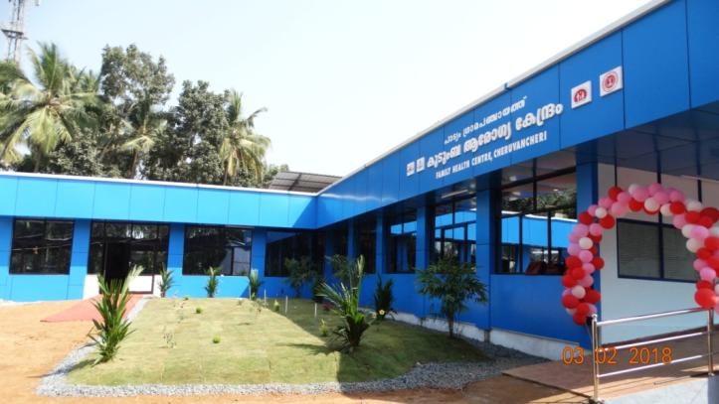
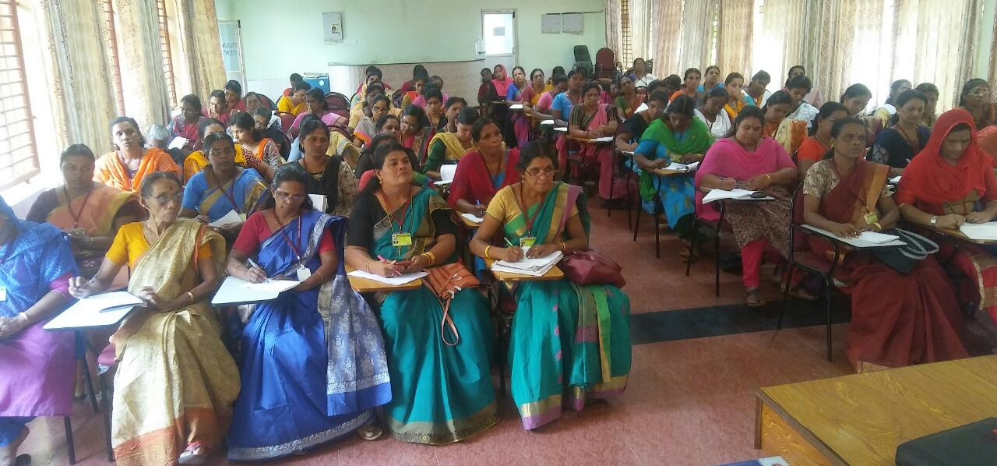
PM-Ayushman Bharat Health Infrastructure Mission (PM-ABHIM)

Slide 9
Implementation Status
Component Name | Physical Target |  | Work Initiated (in No.) | Implementation Challenges
 | 2021-22 | 2022-23
Infrastructure Support for Building- less Sub Health Centers | 0 | 0 |  | 1. 2. 3. . . .
Block Public Health Units | 0 | 0
Integrated Public Health Labs (IPHLs) | 1 | 3 | Civil Works allotted to PMC & DPR under preparation Gap analysis for Equipment conducted & AS will be issued to KMSCL for procurement
CCB- 50 bedded in DH | 0 | 1 | Civil Works allotted to PMC & DPR under preparation
CCB- (50 bedded in Med Col) | 1 | 2 | Civil Works allotted to PMC & DPR under preparation
CCB -75 Bedded | 0 | 0
CCB - 100 Bedded | 0 | 0
Urban Health &Wellness Centre | 0 | 0

Slide 10
Financial Progress – PM-ABHIM
(Amount in Rs. Crores)
(Rs. in crore)
Financial Year | Funds Released during FY 2022-23 | Total Cash GIA Released (Excl. IM and Kind Grants) | Central Share transferred from State Treasury to SNA | Pending Central Share | State share due (Opening) | Proportionate State Share due (on current year release) | State Share credited | Pending State Share | % of Expenditure (against Total Fund Receivable)
1 | 2 | 3 | 4 | 5=(3-4) | 6 | 7 | 8 | 9=([6+7]-8) | 10
2021-22 | 3.75 | 3.75 | 3.75 | Nil | Nil | 2.50 | 2.50 | Nil | Nil
2022-23 | Nil | Nil | Nil | Nil | Nil | Nil | Nil | Nil | Nil
Note: 1. The format to be filled by States of Andaman & Nicobar Islands, Karnataka, Kerala and Puducherry. 2. Above releases are updated upto 16.09.2022.

Slide 11
Financial Progress – PM-ABHIM
Financial Year | Cash GIA Released | IM Releases | Kind Grant Releases | Total Cash GIA Released (Excl. IM and Kind Grants) | 1st Tranche Possible Release | Remarks
1 | 2 | 3 | 4 | 5=(2+3+4) | 6 | 7
2021-22 | 3.75 | 0 | 0 | 3.75 | 3.75
2022-23 | Nil | Nil | Nil | Nil | Nil
Note: 1.The format to be filled by State of Kerala. 2. Above releases are updated upto 16.09.2022.

Slide 12
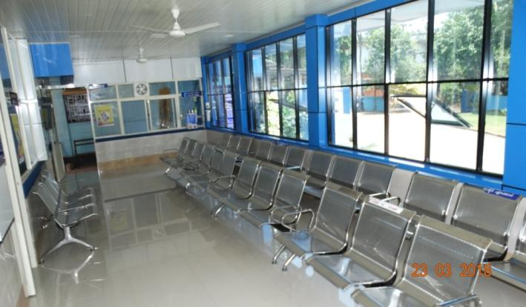
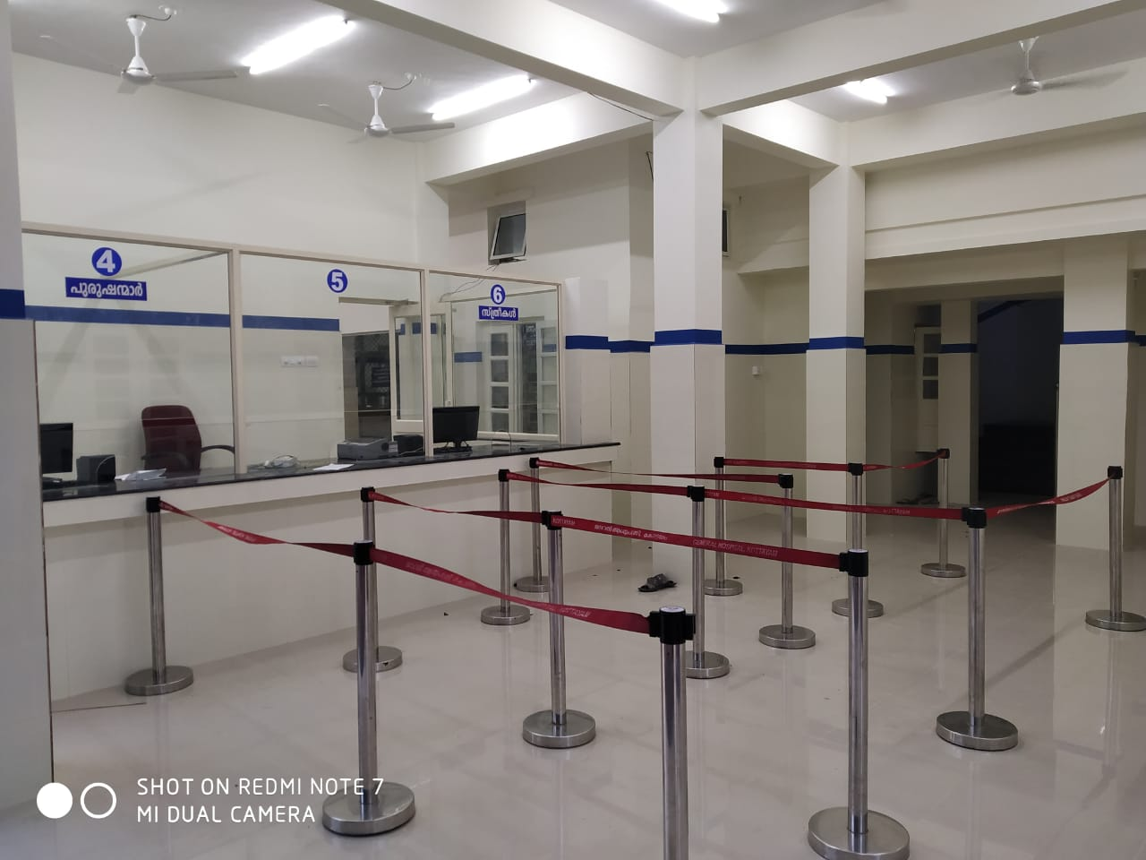
XV - Finance Commission Health Grants

Slide 13
Implementation Status
(Amount in Rs. Crores)
Component | 2021-22 |  |  | 2022-23 |  |  | Total (2021-2026)
 | Nos | Fund allotted | Funds utilized (As per NHM PMS) | Nos | Fund allotted | Funds utilized (As per NHM PMS) | Nos | Fund allotted
Building-less Sub-Centres, PHCs, CHCs | 2 | 0.50 | 0 |  |  |  |  | 2.65
Urban HWCs | 380 | 322.22 | 0 |  |  |  |  | 1711.04
Conversion of Rural PHCs and SCs into HWCs | 5409 | 105.43 | 50.89 |  |  |  |  | 559.83
Block Public Health Units | 75 | 30.59 | AS issued to M/s KMSCL for procurement & supply |  |  |  |  | 162.43
Diagnostic infrastructure for SHCs | 5409 | 39.61 |  |  |  |  |  | 210.36
Diagnostic infrastructure for PHCs | 886 | 49.58 |  |  |  |  |  | 263.27
Diagnostic infrastructure for UPHCs | 102 | 11.05 | 0 |  |  |  |  | 58.70

Slide 14
Implementation Status
(Amount in Rs. Crores)
Component Name | Physical Target |  | Work Initiated (in No.) | Implementation Challenges
 | 2021-22 | 2022-23
Building-less Sub-Centres, PHCs, CHCs | 2 |  |  | Order for implementation of program issued vide Govt order. G.O.(Rt).No..2132/2022/LSGD Dated 31.08.2022 & G.O.(Rt).No..2156/2022/LSGD dated 01.09.2022. State level TOT for implementation of scheme for 21-22 as well as preparation of scheme for 22-23 conducted on 17.09.22. Trainings for LSG members and officials will be held on 20,22 & 23 Sept 2022. LSGs directed to submit proposal for 22-23 by 30th Sept 2022. Proposed to submit PIP 22-23 by 15th Oct 2022.
Urban HWCs | 380
Conversion of Rural PHCs and SCs into HWCs | 5409
Block Public Health Units | 75 |  | AS issued to M/s KMSCL for procurement & supply
Diagnostic infrastructure for SHCs | 5409
Diagnostic infrastructure for PHCs | 886
Diagnostic infrastructure for UPHCs | 102

Slide 15
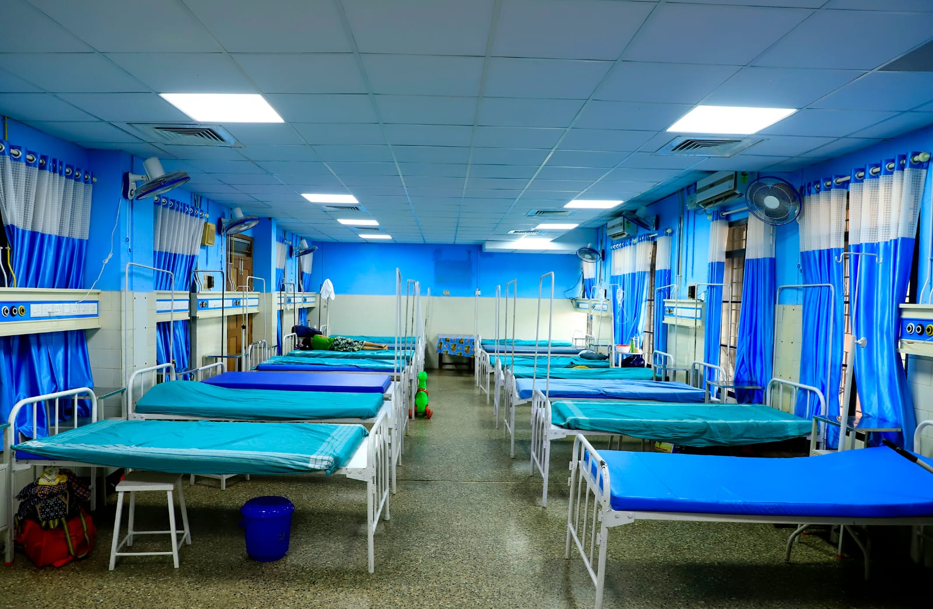
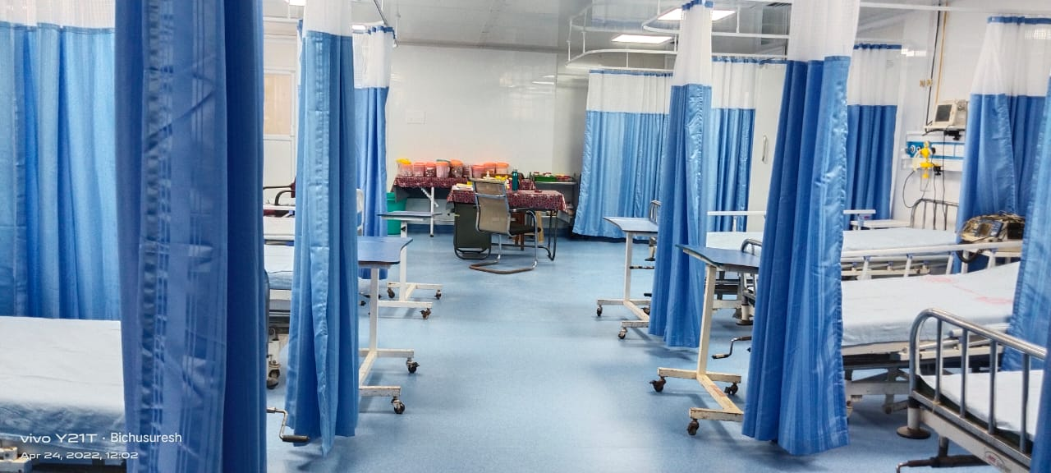
Emergency COVID Response Package PHASE- II

Slide 16
Financial Progress
S. No. | Items | Amount (Rs. In Crore)
1 | Total Resource Envelope | 289.82
2 | Total Amount Approved (MoHFW + GB) | 289.82
3 | Amount Credited from Treasury to SHS | 289.82
4 | Expenditure (Till date: 19.09.2022) | 176.68
5 | Expenditure (%) | 61
6 | Pendency of State Share to SHS | Nil
8 | Gap of Approval against Resource Envelope | Nil

Slide 17
Physical Progress
S. No. | Items | Approved | Completed | In-progress
1 | Augmented Adult ICU Beds | 464 | 464
2 | Total Pediatric ICU/HDU Beds | 556 | 507 | 49
2.1 | Dedicated Pediatric ICU beds | 350 | 220 | 130(bed procured,not installed as civil work ongoing)
2.2 | Dedicated Pediatric HDU beds | 206 | 172 | 34(bed procured,not installed as civil work ongoing)
2.3 | Reserved Pediatric ICU beds
3 | Pediatric Centre of Excellence (CoE) | 2 | 1 | 1
As per NHM-PMS Portal

Slide 18
Physical Progress
S. No. | Items | Approved | Completed | In-progress
4 | Total Oxygen Supported Beds | 590 | 215 | 375(civil work ongoing and hence bed purchase of 90 nos holded, sufficient beds available at remaining institutions)
4.1 | O₂ Supported Beds at dedicated Pediatric Units | 560 | 435 | 125
4.2 | Pre-fab Units
4.3 | Field Hospitals – 50/100 Bedded (Establishment) | 315 | 315
As per NHM-PMS Portal

Slide 19
Physical Progress (Contd…)
S. No. | Items | Approved | Completed | In-progress
5 | Lab Strengthening for RT-PCR
6 | LMO Storage Tank | 14 | 12 | 2
7 | MGPS | 14 | 12 | 2
8 | Tele-consultation Hubs (Establishment & Strengthening) | 14 | 4 | 10
9 | Tele-consultation Spokes (Establishment & Strengthening) | 104 | 25 | 79
10 | Hospital MIS (HMIS) | 25 | 0 | 25
11 | Critical Care Blocks (CCB) – if any
Implementation Challenges:
1.
2.
3.
As per NHM-PMS Portal

Slide 20
