Slide 1


STRENGTHENING OF DIAGNOSTIC NETWORK IN A DISTRICT
THROUGH XV-FC AND PM-ABHIM GIA & ANTICIPATED KEY CHALLENGES

Slide 2
Solutions - Out of the Box
AVAILABILITY OF DIAGNOSTICS AT PUBLIC HEALTH FACILITIES
INTEGRATED PUBLIC HEALTH LABORATORY
GAP ASSESSMENT
BLOCK PUBLIC HEALTH UNIT
DIAGNOSTIC INFRASTRUCTURE, PHYSICAL LAYOUT, IPC
EQUIPMENT MAINTENANCE, AMC/CAMC
SAMPLE COLLECTION, STORAGE, TRANSPORT, TURN AROUND TIME, QUALITY
QUALITY OF SERVICE, QUALITY OF REPORTS, EQUAS, IQAS, ILC
HUMAN RESOURCE OPTIMAL UTILIZATION, SKILLING, MOTIVATION
PRE-ANALYTICAL, ANALYTICAL & POST-ANALYTICAL VARIABLES
IT PLATFORM INTEGRATION (LIMS)

Slide 3
RESOURCES AVAILABLE XV FC AND PM-ABHIM (FY-2021-22 TO 2025-26)
XV-FC
Rural Component
Building-less SC, PHCs, CHCs (Rs. 7167 Cr)
Support for diagnostic infrastructure to the primary healthcare facilities (Rs. 16377 Cr)
HWCs in Rural (Rs. 15105 Cr)
For all other BPHUs (Rs. 5279 Cr)
Urban Component
Support for diagnostic infrastructure to the primary healthcare facilities (Rs. 2095 Cr)
HWCs in Urban (Rs. 24028 Cr)
PM-ABHIM
Centrally Sponsored Scheme (CSS) Components
AB-HWCs in Rural
17788 SHCs in 7 High Focus States + 3 NE States
(Rs. 9872.66 Cr)
AB-HWCs in Urban
11044 UHWCs in 11 HFS
(Rs. 19955 Cr)
IPHL in 730 Districts
(Rs. 1482.6 Cr)
3382 BPHUs in 11 High Focus States
(Rs. 3829.52 Cr)
Critical Care Hospital Blocks Population > 5 L
(Rs. 19064.8 Cr)
Central Sector (CS) Components
Critical Care Hospital Blocks in 12 Central Institutions
20 Metro Surveillance Units, 5 Regional NCDCs and implementation of IHIP
Strengthening surveillance capacities at 17 Points of Entry
Strengthening Disaster and Epidemic Preparedness 15 EOC & 2 Container based mobile hospitals
Bio-security preparedness & strengthening Pandemic Research, National Institution for One Health
The Units/Blocks under two different funding sources are required to be kept distant and separate for the support provided under each scheme

Slide 4
UNIT COSTS
 | INR (IN LAKHS)
New/greenfield diagnostic infrastructure for SHC | 3.91
New/greenfield diagnostic infrastructure for PHC | 25.86
New/greenfield diagnostic infrastructure for UPHC in urban areas | 25.86
Composite Unit Cost for BPHU diagnostic infrastructure | CAPEX 80.96 OPEX 20.14
Integrated Public Health Lab | CAPEX 1250 OPEX 49.05

Slide 5
OBJECTIVES OF DIAGNOSTICS SUPPORT
XV-FC
1)Availability of min. set of diagnostics.
2)Availability & Training of HR
3) Early detection, prevention & containment of infectious disease.
4) Strengthening disease surveillance
5)Leverage technology for use of POC diagnostics
6)Universal health coverage
7) Reduce OOPE
BPHU
1) Strengthening disease surveillance
2)Act as hub in case of disaster & public health emergency
3) Integration and strengthening of comprehensive diagnostic facilities
IPHL
1) Build & expand IT enable disease surveillance system
2) Integration and strengthening of comprehensive diagnostic facilities at public health laboratories at district and sub-district level

Slide 6
Common Objectives
Achieve Universal Health Coverage
Availability of minimum set of diagnostics as per EDL
Improved public health data reporting & follow-up action for clinical & public health functions
Reduce high Out of Pocket Expenditure (OOPE)
Continuum of care approach
leverage technology for expeditious use of Point of Care diagnostics.
strengthening the public health surveillance

Slide 7
KEY FUNCTIONS OF IPHL
Comprehensive Lab services
Carryout laboratory-based surveillance for infectious and non-infectious diseases
Water culture for coliforms and rapid diagnostic tests (RDTs)
Hub to provide technical support to BPHL and other peripheral laboratories
Support the block and district surveillance units
Conduct training for peripheral laboratory staff
Implementation of Quality Management System
District Labs for various public health programs- NACP,NTEP,NVHCP,NVBDCP,IDSP.
Data management- Analysis, Reporting
Notes:
Change color tone

Slide 8
INTEGRATION OF DIFFERENT SECTIONS OF THE DISTRICT HOSPITAL LABORATORY
Physical
Establishing a central sample collection facility in a patient friendly location
Data
Establish Laboratory Information management system
Functional
Merging the lab components of various vertical programs

Slide 9
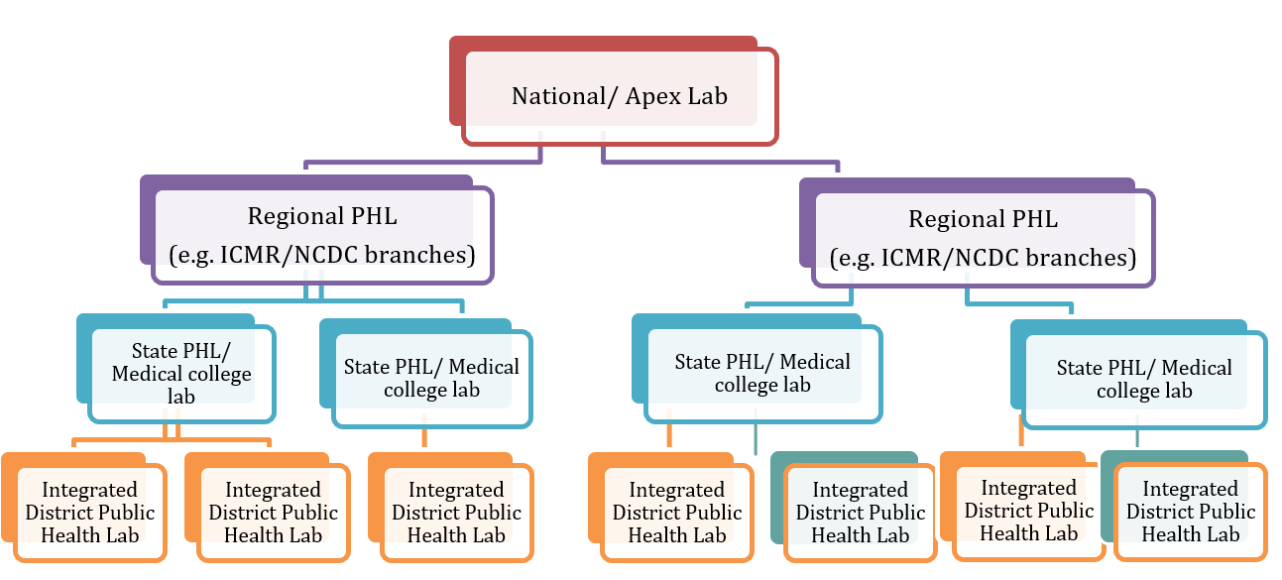
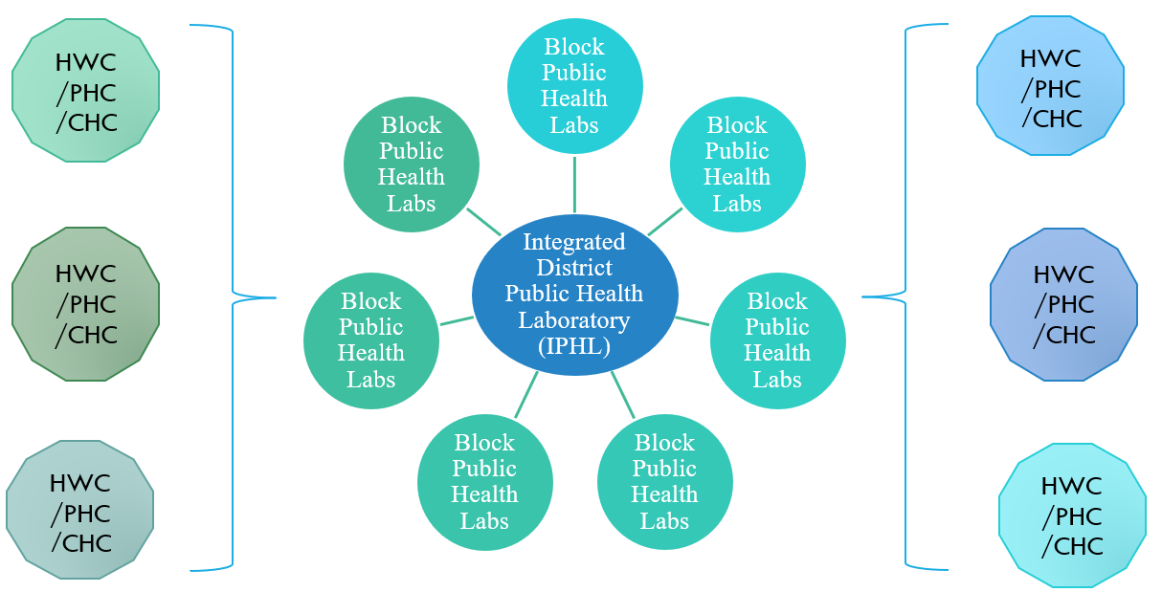
LABORATORY NETWORK AND LINKAGES
1)Downward linkage of 2) Upward linkages of IPHL
IPHL (Hub and Spoke model)

Slide 10
PHED
VET LAB
CPCB
FSSAI
INTEGRATED DISTRICT PUBLIC HEALTH LABORATORY (IPHL)
&
BLOCK PUBLIC HEALTH UNIT (BPHU)
WATER BOARD
WASH
ICDS
NDMA
NDRF
WCD

Slide 11

GAP ANALYSIS
Identifying & Mapping High Caseload Health Facilities
Availability of Infrastructure for providing diagnostic services as per IPHS
Availability of Human Resource for providing services as per IPHS
Diagnostic and Laboratory Equipment including storage
Reagents & Consumables Inventory Management
Supply Chain management
Equipment maintenance mechanism
Sample Transportation (Cost and Mode of sample transportation to hub – reducing the Turn Around Time)
IT Infrastructure (LIMS) Report generation

Slide 12
SERVICE DELIVERY OPTIONS
INHOUSE
PPP-HYBRID
PPP-Contract In
HUB & SPOKE (IN)
HUB & SPOKE (PPP)
RENTAL REAGENT

Slide 13
FINANCIAL MODELS
RECURRING-INHOUSE
PER PATIENT MODEL
PER TEST MODEL
DISCOUNT ON CGHS
RENTAL REAGENT
REVENUE SHARING

Slide 14
RECOMMENDED SERVICE DELIVERY MODEL
High volume and low-cost tests not requiring highly skilled manpower, should preferably be done within the public health facilities (IN-HOUSE) and not be outsourced
HUB
SPOKE
SPOKE
SPOKE
SPOKE
High-cost and low volume tests requiring expensive equipment and technologically complicated processes, could be outsourced with adequate checks and balances as safeguards

Slide 15
SAMPLE COLLECTION AND TRANSPORT
Sample vials and Virus Transport Medium (VTM)
Routine samples can be packed safely to avoid spillage. For Labelling, barcode labels should be utilized
WHO recommends basic triple packaging system for safe transportation of infectious substances and diagnostic specimen.
A suitable outer container (e.g., thermocol box, ice-box, hard-board box) for transportation by road, courier or State transport corporation
Hard-frozen Gel Packs

Slide 16
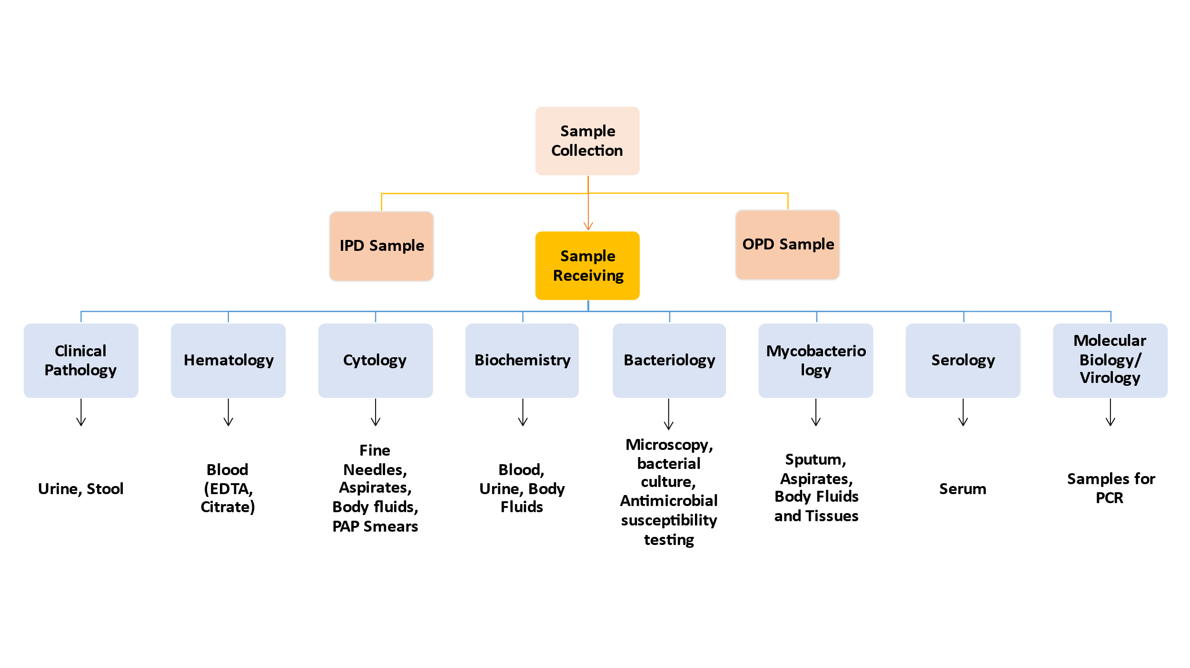

Slide 17
Sample Collection
The "turnaround time“ (TAT) is defined as the reporting interval. - The time from receipt of the specimen in the laboratory to the time the result is reported. Turnaround times are set by the need for timeliness of reporting for clinical decision-making.
A "critical value" is a test result that conveys life or death information and is defined for "out of reference range" test results that must be acted upon as soon as possible. A critical value has life-threatening, time-dependent implications and must be directly reported to the health care provider for immediate action.
A "stat" test is defined as a quick turnaround time, generally an hour or less from specimen receipt until test result reporting.
"Routine" test turnaround applies to specimens for patients without immediate need for results.

Slide 18
Sample Transportation
Sample integrity is dependent on accurate pre-analytical processes
Right sample at the right time, properly collected, stored and transported is the key to a good laboratory practice.
The samples collected should be picked up from the health facilities on the same day and transported to the hub laboratory/mother laboratory for testing.
The time is a crucial factor in sample handling and choosing the right transportation mode remains an important challenge.
Sample identification (Using barcode or QR code) at the facility prior to transportation must be ensured.
The three basic tenets of sample transportation are Time, Temperature & Stability.
Needs good working relationship and communication amongst the sender at the spoke lab, the carrier and the receiver at the Hub lab

Slide 19
Sample Packaging
WHO recommends basic triple packaging system for safe transportation of infectious substances and diagnostic specimen.
Primary receptacle – A well labelled primary water-tight, leak-proof receptacle containing the specimen and wrapped with adequate absorbent material to absorb all fluid in case of breakages.
Secondary receptacle – A second durable, water-tight, leak-proof receptacle with enough absorbent material to enclose and protect the primary receptacle.
Outer shipping package – The secondary receptacle is placed in an outer shipping package which protects it and its content from outside such as physical damages and water while transit.

Slide 20
SPECIMEN TYPE | COLLECTION MATERIALS | STORAGE TILL TESTING
Nasopharyngeal & Oropharyngeal Swab | Dacron or polyester flocked swabs | ≤5 days: 4 °C >5 days: -70 °C
Sputum | Sterile Container | ≤48 hours: 4 °C >48 hours: –70 ° C
Serum | Serum separator tubes | ≤5 days: 4 °C >5 days: –70 °C
Blood | Adult blood culture bottle Paediatric blood culture bottle | Blood culture hold at room temperature until processed for a maximum of 4hrs. Do not refrigerate
Urine | Sterile Urine Culture Container | Cultured within 2 hours Delay of maximum 24 hours, refrigerated at 2°C-8°C
Stool | Sterile disposable Container | Cultured within 2 hours Delay of maximum 24 hours, refrigerated at 2°C-8°C
CSF & Body Fluids | Sterile disposable Container | CSF and body fluids for culture can be kept at 37 degree centigrade
Precautions
Sample should be kept at 2-8 degree centigrade during storage and transport
Ideally sample is required to be transported within 30 minutes to 2 hrs of collection
Specimen for bacterial culture should not be stored for more than 24hrs.
Stool swab, rectal swab, liquid stool to be transported within 4h. Fresh stool in 8h
Serum sample can be stored upto 1 week in refrigerator 2-8 degree centigrade and when transported should be with ice pack boxes/cold chain boxes.

Slide 21
Common Errors Encountered in Pathological Laboratories
Error in identification of samples
Incorrect storage of kits/reagents/chemicals/consumables
Inappropriate use of reagents/chemicals
Equipment failure
Unsuitable environment
Untrained staff
Technical failure in preparing sample testing protocol
Inaccuracies in documentation
Misinterpretation of results

Slide 22
Objectives of EQAS
Improve standards of performance in Laboratories/Blood Banks
Raising awareness of the need for improvement
Demonstrating the benefits of GLP
Capacity building for improvement

Slide 23
EQAS Process
EQAS organizer
Laboratory
Analyze
Coded samples
Report
results
Evaluation
Receive
report
performance report
ANALYSIS
Notes:
Specific to the NEQAS

Slide 24
EQAS Organizers
ABROAD | INDIA
Clinical Microbiology Proficiency Testing (CMPT), Canada | CMC, Vellore
National Reference Laboratory (NRL), Australia | BEQAS, Jaipur
Bureau of Laboratory Quality Standards, Thailand | AIIMS New Delhi
State should identify one Apex Referral lab in the state for State EQAS programme

Slide 25
QUALITY INDICATORS
Pre-analytic Indicators:
% of unacceptable samples (samples rejected)
% of contaminated blood cultures
Analytic indicators:
EQAS score*/Inter laboratory comparisons (ILC)
No. of IQC failures
Results of competency assessment of the staff
Average downtime for hematology analyzer and biochemistry analyzer
Post-analytic indicators:
Turnaround times compliance (Percentage of results meeting turn-around-time)*
No. of missed critical alerts
Indicators for Public Health Functions:
No. of IPHS recommended parameters included in the scope of testing
No. of Tests being done by Labs
% of outbreaks detected by IPHL through routine lab-based surveillance
% of outbreaks investigated by IPHL in the district

Slide 26
LABORATORY INFORMATION MANAGEMENT SYSTEM (LIMS)
All the laboratory information data need to be digitalized to support surveillance and managing outbreaks
The system for digitalization of the laboratory information data ideally be a part of Integrated Health Information Platform (IHIP).
LIMS plays a key role in laboratories meeting Quality standards, decreasing transcription errors, reducing turnaround time from specimen receipt to reporting of results, and improving patient outcomes.
There are two common types of LIMS:
A module within a hospital information system (HIS)- A LIMS within HIS serves mostly as a means to capture results and a few key elements of data.
A stand-alone LIMS- A dedicated LIMS shares most of the components listed above and can support all the laboratory functions.
As a backup, laboratories may choose to keep paper-based records (in case computerized information system not available) to manage workflow, quality and audit trail for the samples processed in the laboratory.

Slide 27
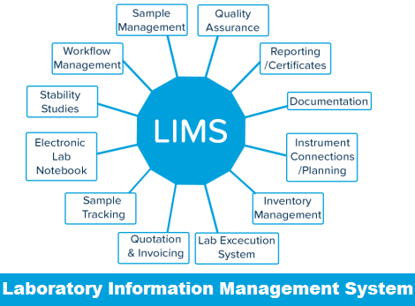
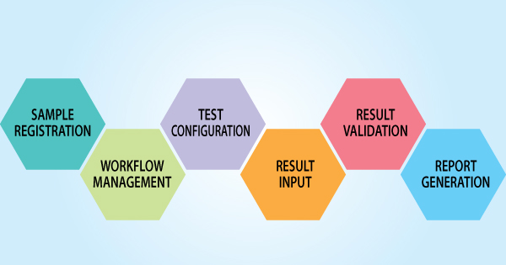
LABORATORY INFORMATION MANAGEMENT SYSTEM (LIMS)

Slide 28
STRENGTHNING OF DIAGNOSTIC NETWORK
Enhance Inhouse Capability
Human Resource Training, Motivation, Conducting Workshops
Equipment Procurement And Maintenance
Robust Sample Transportation System
A Good Supply Chain Method for getting the Reagents & Consumables
Good LIMS for Reporting
Good upward, downward and lateral linkages

Slide 29
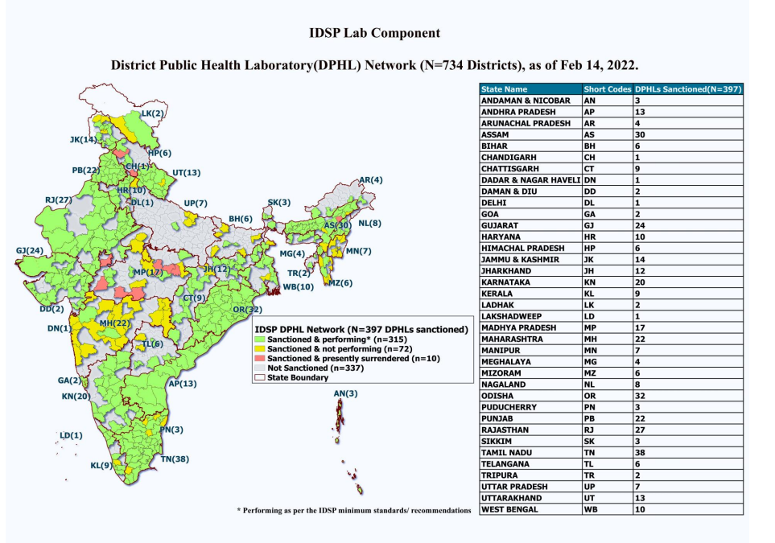

Slide 30
Re-Visiting Integrated Disease Surveillance Programme
Linkages with National Centre for Disease Control, DGHS – Integrated Disease Surveillance Programme
Surveillance units have been established at all States and District Headquarters (SSUs, DSUs).
Central surveillance Unit (CSU) is established and integrated in the National Centre for Disease Control, New Delhi
State Rapid Response Teams (RRT) and District RRT established across the States
Integrated IT network established by connecting 776 sites at all States /Districts HQ and premier institutes in the country ( www.idsp.nic.in)
A 24×7 call center & a toll free telephone number (1075) is available to receive disease alerts all across the country

Slide 31
NETWORKING FOR INTEGRATION
A referral lab network is already established by NCDC in the States/UTs for providing diagnostic support during outbreaks
States to hold consultative meetings with District Public Health Labs and leverage the opportunity of using the District RRTs in Disease Surveillance and epidemics and outbreaks in the State
Integrate District Labs with the IDSP Labs through extension of their IT platform. Necessary approvals to be taken from NCDC for extension of IDSP IT Portal to all DH Labs
Integrate the Food Labs, Vet Labs, Public Health Engineering Department, Central Pollution Control Board by forming a state level IPHL committee to hold monthly consultative/ review meetings
Establish linkages with Defence Food Research Lab (DFRL) and DRDE, Gwalior for on spot test kits like Water poison detection kit, Food borne pathogen/toxin test kit, pesticide detection test kit, Milk adulteration Kit, Rapid test kit for E. Coli detection etc

Slide 32
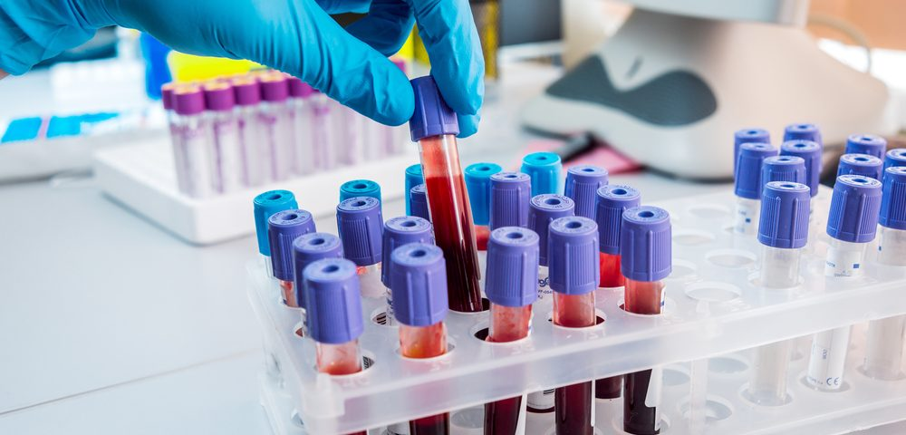
WAY FORWARD
Identify & Map existing DPHLs. Hold consultative meetings.
Adopt SOPs for water & food sample collection, storage and transport
IT integration with the DHs (IPHL) for standardization of reporting formats & data collection and analysis
Capacity building for the Lab Technicians in DPHL functioning

Slide 33


Telangana Diagnostics
Hub & Spoke Model where a Central Laboratory (Hub) caters to all Health Facilities (DH/ SDH/ CHC/ PHC/ Basti Davakhana) (Spokes) that are in the vicinity of below 60 KMs.
Each district have at least 1 Diagnostic Hub based on OPD volume of connected spokes.
Distance between Hub and Connected Spokes is between 30-60 KMs. This prevents sample damage due to longer transportation time.
Telangana State Medical Services & Infrastructure Development Corporation (TSMSIDC) is the nodal agency for procurements
Supply Chain Management is through eAushadhi workflow
Started with 800 Samples collected from respective Spokes at Hyderabad Hub. Currently 17,000 samples are tested daily with Turn-Around-Time (TAT) of 24 Hours across the state

Slide 34
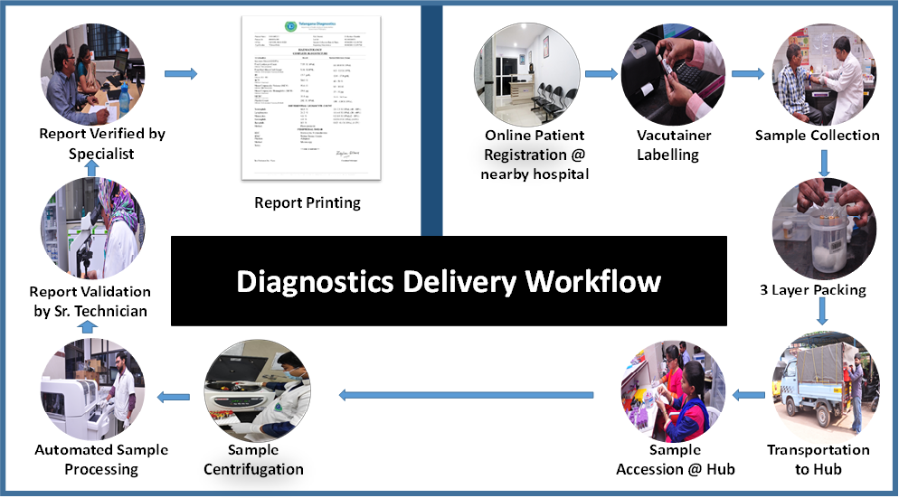
LIMS – SHARP (Science House Application for Remote Pathology)

Slide 35
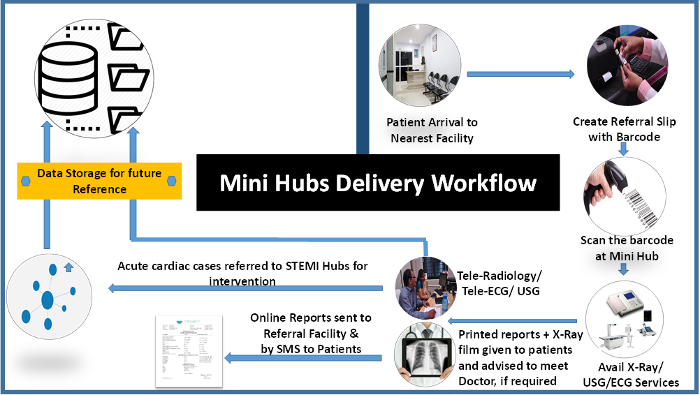
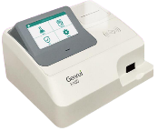

Slide 36


  Currently 10 Hamar Labs functional (7 DHs & 3 CHCs)
  Block Public Health Unit (BPHU) functional at CHC Patan Durg.
  Number of tests performed : 120 tests in DH and 36 tests in CHCs.
  Haematology (18 tests), Biochemistry (59 tests), Clinical Pathology (15 tests) , Serology & Immunology (16 tests) , Microbiology (12 Tests)
  Sample collection and transportation is done through TB Runner (“ जांच मितान”)
सेवा प्रथम कर्तव्य

Slide 37
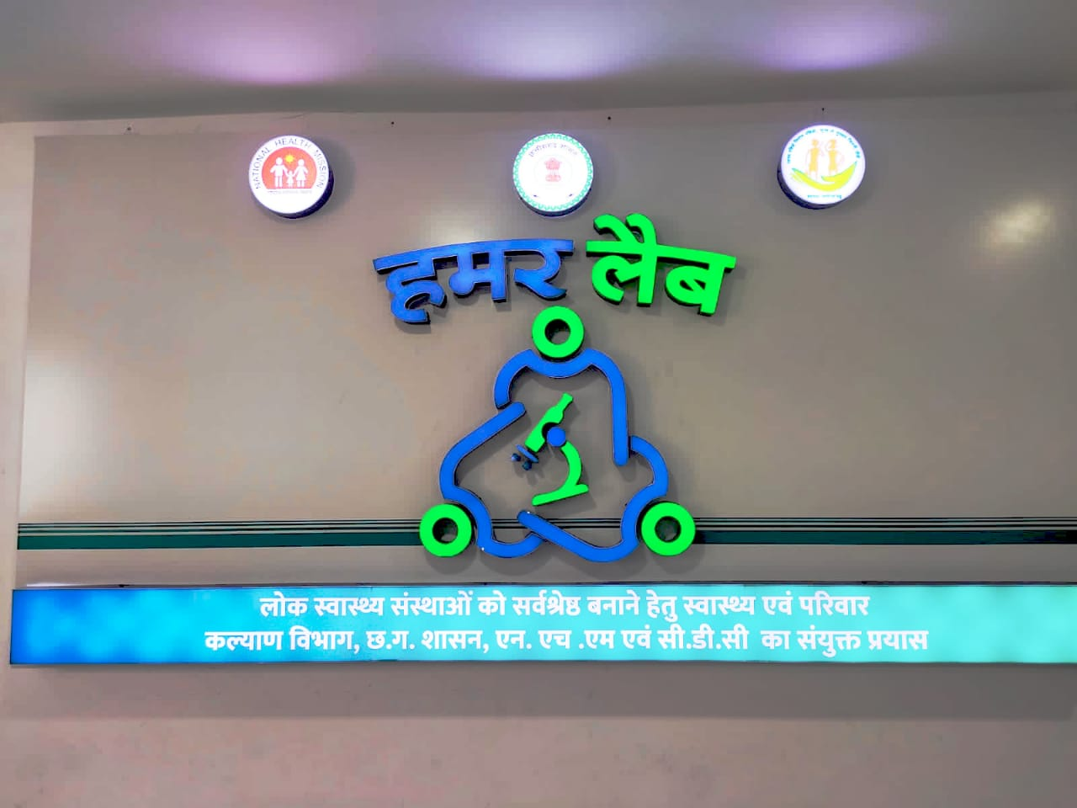
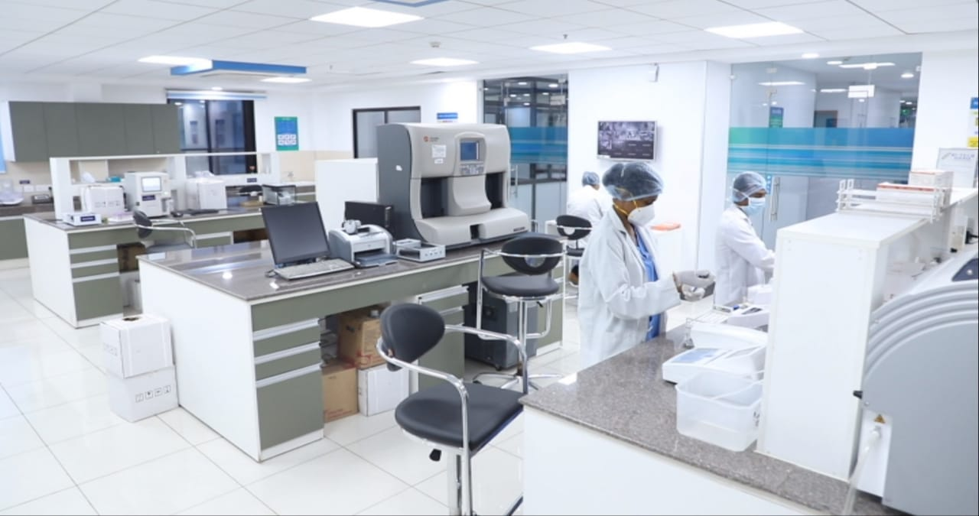
Main Central Laboratory
“ जांच मितान”
“ जांच मितान”

Slide 38
MADHYA PRADESH GOVT’S
DEPARTMENT OF HEALTH SERVICES
REFERENCE
LABS
District & Civil Hospitals: Special tests along with the routine ones
An integrated diagnostics project with:
Collection Centres (Spokes) at PHCs
Hub Labs at CHCs
Reference Labs at District & Civil Hospitals
State adopted Wet Lease basis Reagent Rental Model so as to have high quality pathology services with a large array of tests made available to patients with ease, closer to their homes
HUBS LABS
CHCs: Samples for machine tests from spokes along with routine and hormone tests
SPOKES
PHCs: Sample Collection will be done at spokes and Rapid / POC tests performed

Slide 39
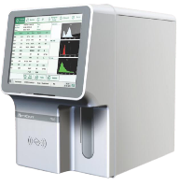
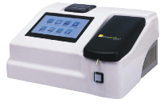
MADHYA PRADESH GOVT’S
DEPARTMENT OF HEALTH SERVICES
MACHINE NAME | INSTALLATION AT
Automatic Hematology Analyzer (Sysmex, Japan) | 50 District and 35 Civil Hospitals
Automatic Biochemistry Analyzer (Biosystems, Spain) | 50 District and 35 Civil Hospitals
Automatic Urine Analyzer (YD Diagnostic, South Korea) | 50 District and 35 Civil Hospitals
Automatic Hormone (Immunoassay) Analyzer (Siemens, USA) | 50 District Hospitals
Automatic Coagulation Analyzer (Stago, France) | 50 District Hospitals
Automatic HPLC Analyzer (Biorad, USA) | 50 District Hospitals
22,000+ Investigations Daily
410+ Equipment
85
Hospitals

Slide 40
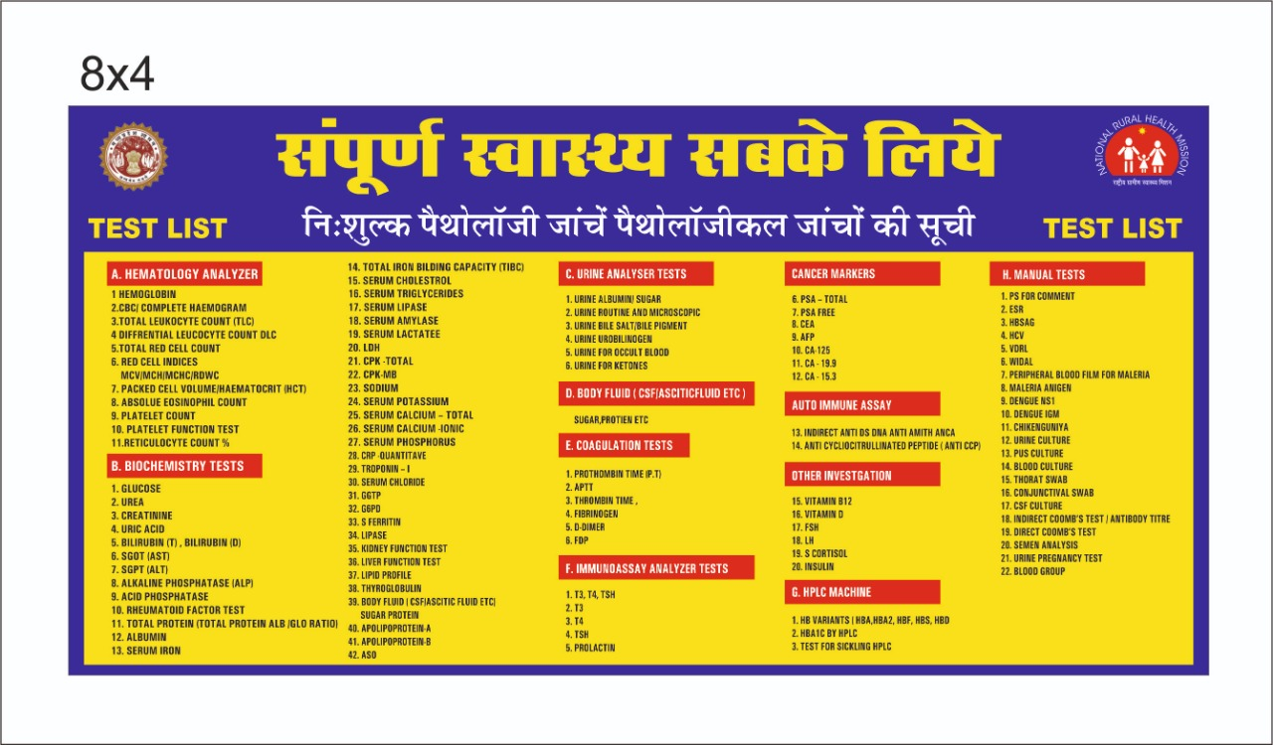
120 + Tests

Slide 41
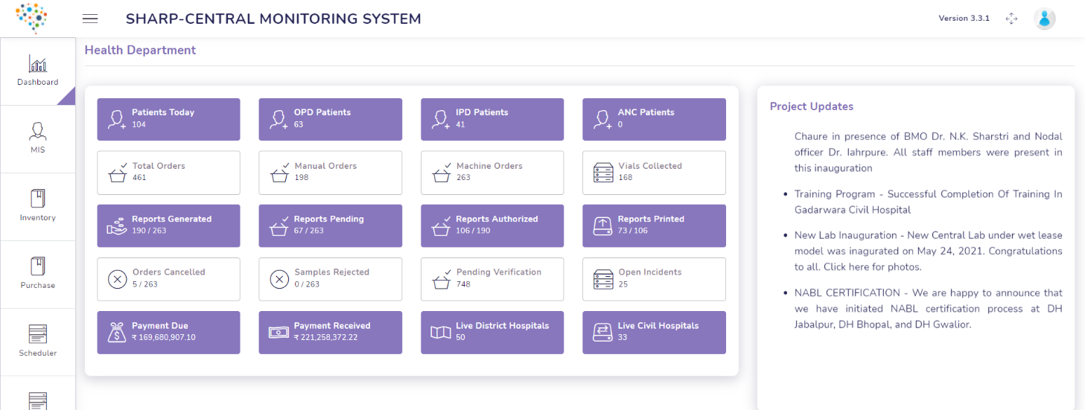
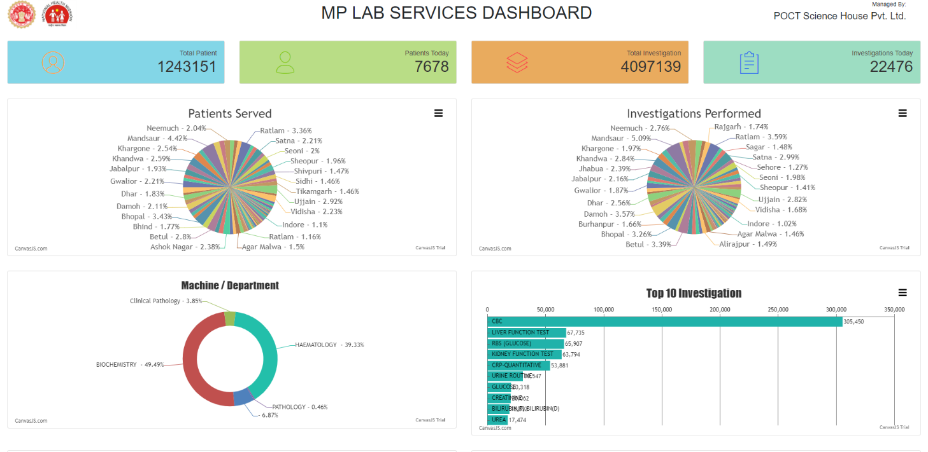
MADHYA PRADESH GOVT’S
DEPARTMENT OF HEALTH SERVICES
S.NO | TOP 10 TEST NAME
1 | CBC
2 | RBS
3 | LIVER FUNCTION TEST
4 | KIDNEY FUNCTION TEST
4 | CRP-QUANTITATIVE
6 | URINE ROUTINE
7 | T3 T4 TSH
8 | SERUM SODIUM
9 | SERUM POTASSIUM
10 | GLUCOSE

Slide 42

Thank You

Slide 43
Sample Transportation - Precautions
Ideally sample is required to be transported within 30 minutes to 2 hrs of collection
Sample should be kept at 2-8 degree centigrade during storage and transport
Specimen for bacterial culture should not be stored for more than 24hrs.
Urine, stool, viral specimen, sputum, swabs, etc need to be stored at 4 degree centigrade.
CSF and body fluids for culture can be kept at 37 degree centigrade.
Blood culture hold at room temperature until processed for a maximum of 4hrs. Do not refrigerate.
Stool swab, rectal swab, liquid stool to be transported within 4h. Fresh stool in 8h.
Serum sample can be stored upto 1 week in refrigerator 2-8 degree centigrade and when transported should be with ice pack boxes/cold chain boxes.

Slide 44
Why WET LEASE MODEL is best suited?
Wet Lease is a radical model under PPP that has transformed the delivery of diagnostic services by remedying the inefficiencies of the existing model.
DRAWBACKS OF THE LEGACY MODEL | ADVANTAGES OF WET LEASE
Lack of reagents – non-availability and misappropriation | The service provider arranges for and manages the supply of reagents at their cost, thus relieving the government of the burden of monitoring and losses pertaining to misuse
Tests not being performed | The service provider is paid only for the tests performed, thus they run all ordered tests
Equipment maintenance and downtime | Brand new, most modern equipment installed by private partner at their cost, thus saving the government any capital expenditure. In case of breakdowns, private partner is liable to replace the equipment
Lack of proper Data and Insights | Centralization of data and the various analyses on it offer rich insights into community health

