Slide 1



INTEGRATION OF LAB SERVICES UNDER NTEP WITH IPHL

Slide 2


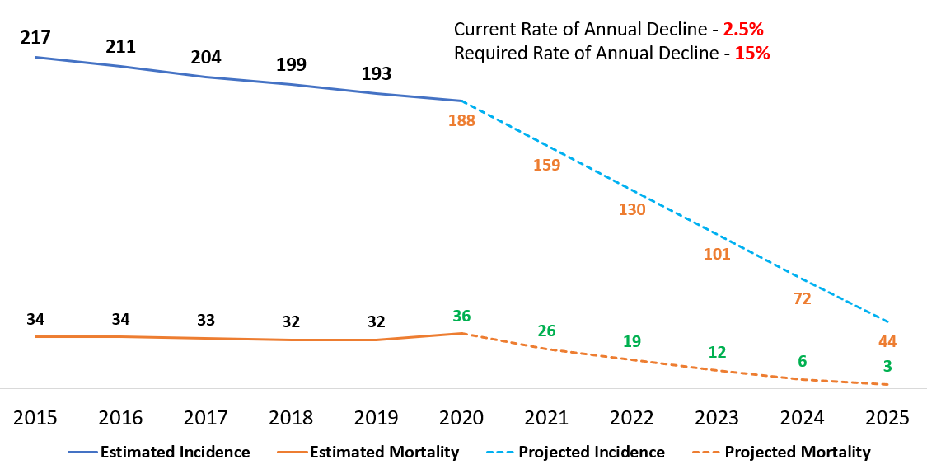


TB ELIMINATION – THE VISION
National TB Elimination Mission 2025 has taken up key priorities along with reduction in incidence rate
80%
TB INCIDENCE RATE
Reduction in TB incidence rate [as compared to 2015 levels]
90%
TB MORTALITY RATE
Reduction in TB Mortality rate
[as compared to 2015 levels]
INR 0
CATASTROPHIC EXPENDITURE Due to TB

Slide 3
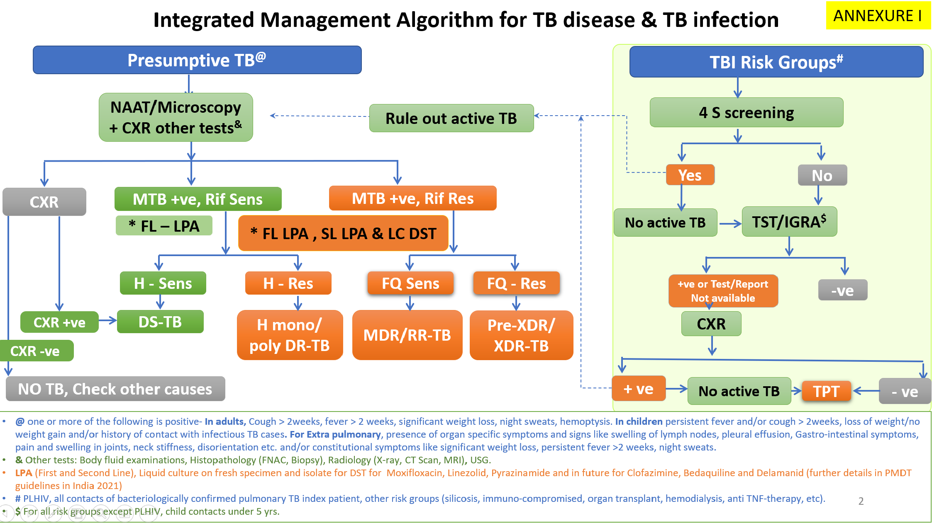
DIAGNOSTIC ALGORITHM UNDER NTEP

Slide 4
EXISTING NETWORK OF LABORATORIES UNDER NTEP

Slide 5
LEVEL OF FACILITY IN THE HEALTH SYSTEM
TESTING MODALITIES AVAILABLE
Microscopy, NAAT, LPA, Liquid Culture, LCDST
Training, Quality Assurance of all testing modalities
National reference laboratory
6
Intermediate reference laboratory (State Level)
34
C&DST laboratory
(In Medical colleges & Private sector)
Microscopy, NAAT, LPA, Liquid Culture, LCDST
61
Microscopy,
NAAT – CBNAAT & Truenat
District & sub- district level
3760 NAAT
NAAT
Peripheral level
Microscopy
22284- DMCs
DMCs
AB HWC – For Sample Collection and Transportation

Slide 6
Expansion of diagnostics under NTEP
SM- Smear microscopy; CB- CBNAAT; Tru- Truenat; FL- FL LPA; SL-SL LPA; LC- Liquid culture; LCDST- Liquid culture DST

Slide 7
EXTERNAL QUALITY ASSURANCE (EQA)
EQA
EQA is a specialized form of assessment focused on assuring the accuracy and reliability of examination methods
EQA /Proficiency Testing is an effective tool to promote continual improvement which can identify occurrences/nonconforming events and offers an assessment of process output.

Slide 8
EQA- SMEAR MICROSCOPY
Onsite Supervision
Tuberculosis unit
DMC
Panel Testing
NRL
DMC
Random Blinded Crosschecking
NRL
DMC
IRL
District
NRL
IRL (Microbiologist & LTs of IRL)
District (All STLS)
IRL
District
Tuberculosis Unit
By NRL team once in a year
No Blind checking at IRL
Under supervision of NRL team during annual visit
By IRL team once in a year
Review of Random blind checking records and results by IRL team during annual visit
Under supervision of IRL team during annual visit
By DTO once at least once in every month
By IRL team during annual visit
Blinded cross checking at the district level by STLS of the randomly sampled slides monthly collected from DMCs
By STLS once at least once in every month
By DTO & MO TC team at least once a Qtr
By IRL team during annual visit
No Panel Testing as routine
Monthly random collection of routine slides from DMCs. Slides transported to District

Slide 9
EQA FOR NAAT
Why?
1
Quality assured CBNAAT test results are essential to ensure patients are correctly diagnosed early and initiated on an appropriate treatment regimen.
What?
CBNAAT EQA is conducted additionally (apart from internal quality checks present inside the test kit) to assess the proficiency of the LT and also the performance of the machine.
2
How?
3
CBNAAT EQA has been extended to cover 750 Truenat sites in the first phase.
Where?
Both NAAT EQAs are coordinated by NTI, Bengaluru.
4

Slide 10
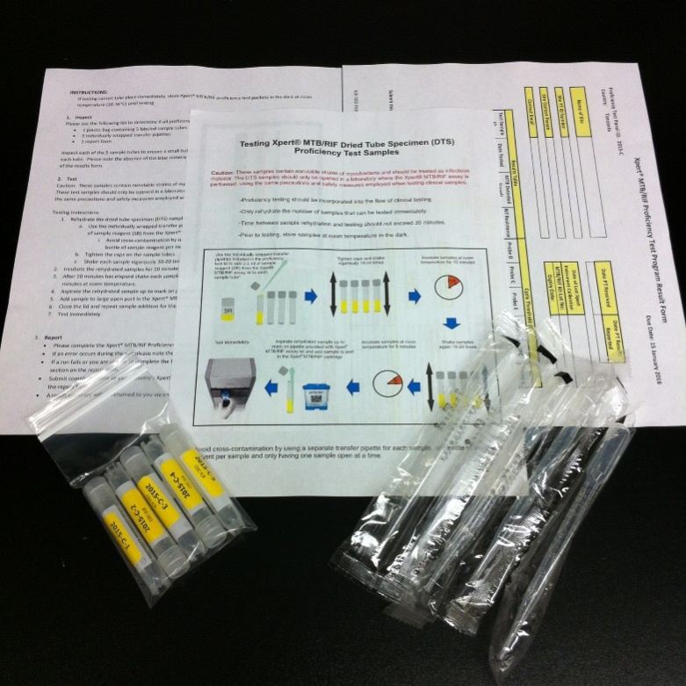
EQA for CBNAAT using
Dried Tube Specimen (DTS)
PT panel kits
  5 coded Dried Tube Specimen (DTS) samples
    well-characterized M.tb complex and NTM
  5 transfer pipettes
  Instructions for testing
  Result report form
Notes:
Dried tube specimens (DTS) PT panels are used for testing the efficiency of laboratories. Panel consists of inactivated non-infectious dried culture of M.tb with RIF sensitive and resistant and negative / NTM. Procedure are safe and compatible with testing protocol.
PT panel of 5 DTS samples are provided for testing to the laboratories to check pre-analytical, analytical and post-analytical processes, and the results of all laboratories are analyzed, compared, and reported to the laboratories.
To enable prompt initiation of corrective actions, feedback regarding PT results is provided in a timely manner to the testing sites and to supervisory staff.

Slide 11
HR REQUIREMENTS
DMC
NAAT
C&DST
1- Lab Technician
1- Lab Technician
2- Microbiologists
5- Senior LTs
1- Lab Attendant & 1 DEO – Provided under NHM PIP
HR cadre (for state/ district level), educational qualifications and experience – guided by NTEP

Slide 12
TRAINING SCHEDULE
Name of the training Program | Duration (days) | Category of personnel trained | Curriculum | Coordinated with
Comprehensive Training Course for lab personnel (LPA, LC DST, NAAT & Ni-kshay) | 12 | Microbiologist Technical Officer/Sr LTs/ LTs | Module reading, presentation, Demonstration, Hands on training | NRL/ IRL
LPA First line & second line | 5 |  | Presentation, Demonstration & Hands-on training | NRL/ IRL
Liquid culture and DST (First line and Second line) | 5 |  | Presentation, Demonstration & Hands on training | NRL/ IRL
LT Modular and NIKSHAY training | 10 | LT of DMC/STLS | Module reading, slide preparation, observation, grading, recording and reporting Hand on training | State/ District
NIKSHAY | 1 | STLS | Presentation | State
CBNAAT and NIKSHAY Training | 2 | CBNAAT LT, STLS | Presentation, Demonstration of sample processing | State

Slide 13
NTEP SERVICES UNDER IPHL AT THE DISTRICT LEVEL
Services
Clinical Pathology
Hematology
Cytology
Sample collection from OPD/IPD/spokes and Reporting area
Biochemistry
Microbiology
Ensure Molecular Diagnostics at IPHL at District level under PM ABHIM- NAAT
Procurement of TrueNat (Chip based Real time micro-PCR) 15th Finance Commission - Block level Public Health Units
Establishment of DMC, Procurement of Microscopes, Lab Consumables for DMCs under NHM/ 15th Finance Commission under Support for diagnostic infrastructure to the primary healthcare/UPHCs facilities grant
PTE & follow up test (Hematology, *cytology, biochemistry, and microbiological tests available at BPHL & IPHL) for PTB, EPTB.
Collection and transportation of PTB and EPTB samples

Slide 14
NTEP Services in Block Public Health Unit
A total of 87 tests encompassing hematology, serology, biochemistry, clinical pathology, microbiology, and any other test for improved public health surveillance/clinical condition will be done at BPHU
For diagnosis of TB, smear microscopy and NAAT will be offered

Slide 15
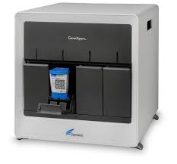
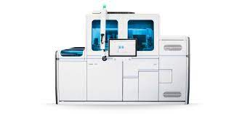
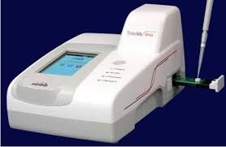
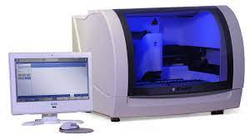
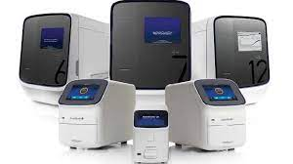
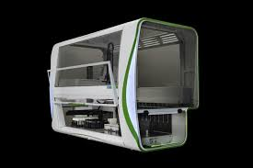
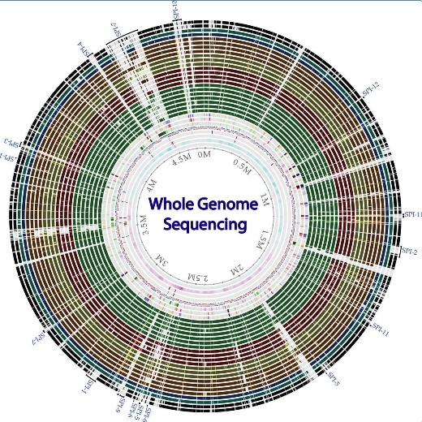

PLATFORM TECHNOLOGY
Gene Xpert
Truenat
Roche/Cobas 6800
BD Max
ID NOW, Abbott
RT PCR system,
Applied biosystems
Perkin Elmer
Whole Genome Sequencing

Slide 16
Additionally,
The process of QA of IPHL will be in accordance with QA programme and with other specific requirements of the GoI (NQAS) in align with Diagnostic algorithm used for diagnosis of TB

Slide 17
Key Actionable for the Programme Officers
Integration of services under one lab at district and block level in terms of equipment
Establishment of microscopy lab at the district hospital and SDH/CHC (if not already existing). This could mean procurement of additional logistics for the lab
Establishment of CBNAAT/TRUNAAT lab at the DH and TrueNAT lab at the SDH/CHC. This could mean the procurement of additional NAAT machines.
Integration of services under one lab at district and block level in terms of infrastructure
Find a spot in the DH/SDH/CHC premises to set up or integrate the NTEP lab services
Provide linkages for timely collection of samples and transportation to the labs from OPD/IPD/spokes
Integration of services under one lab at district and block level in terms of Human Resources
Utilization of already existing lab HR to ensure continued services under NTEP
Capacity building of the HR on diagnostic techniques, Ni-Kshay, sample packaging etc
Involvement of HR especially Medical Officers in -monitoring and regular reviews.
Storage and dispensation of Anti TB drugs and drugs for TB preventive therapy from DH/SDH/CHC pharmacist
Integration of laboratory services under IPHL will increase the preparedness for future epidemics, and also facilitate the achievement of our end TB strategy

Slide 18
Thank You

